Slide 1
Project: Smart Policy Data System

Slide 2
Brief Summary-Deepak Goyal
15 yrs + experienced IT Professional
Microsoft Certified Trainer / Certified Cloud Solution Architect
One of the most popular Azure Instructor across world
Taught Azure to 50k+ working professional across platform.

Slide 3
Project: Smart Policy Data System
VInsure is an insurance company who sells insurance policy to retail customers.
In this project, trainees will develop an end-to-end data engineering pipeline for an insurance company to analyze claims data and perform customer segmentation.
This will help the company to better understand their customers' needs and tailor their offerings accordingly.

Slide 4
Project: Smart Policy Data System- High Level Detail
These are the source system:
Rest API (To fetch demographic info)
CSV Files
JSON Files
SQL Server DB
Plan is to build the 3 layered (Bronze/Silver/Gold) architecture.
Data contains lot of inconsistency and needs some cleaning.
Once cleanup done, multiple transformation is required.
Final layer i.e. the gold layer will be stored as Data lakehouse in Databricks.
Later on this gold layer data will be accessed by PowerBI for visualization and reporting purpose.

Slide 5
Project Flow Diagram

Slide 6
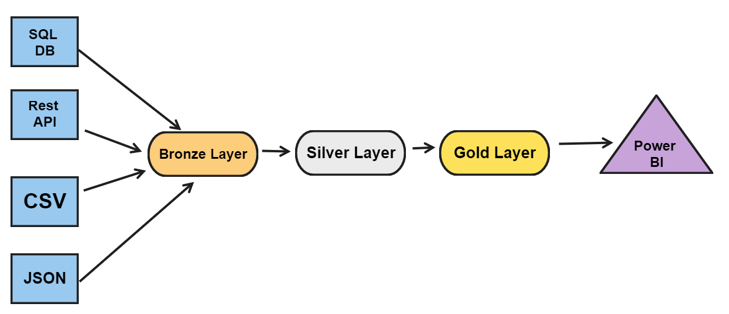
Project: Flow Diagram

Slide 7
Project Additional Information

Slide 8
Project: Additional Information
Few points to consider:
Branch data, Claim data, Agent data we get from Azure SQL DB.
Policy Data is send once every day by upstream system in ADLS container in JSON format.
Customer Information is send once every day by upstream system in ADLS container in CSV format.
Weather data is fetch from Rest API every day.
Plan is to create 3 layered Data lake house architecture.
Final data will be used by PowerBI
Keeping best practice included while designing solution.
All the sample data included in the course resource section.

Slide 9
Your Task Think and Create Architecture

Slide 10
Project Architecture Diagram

Slide 11
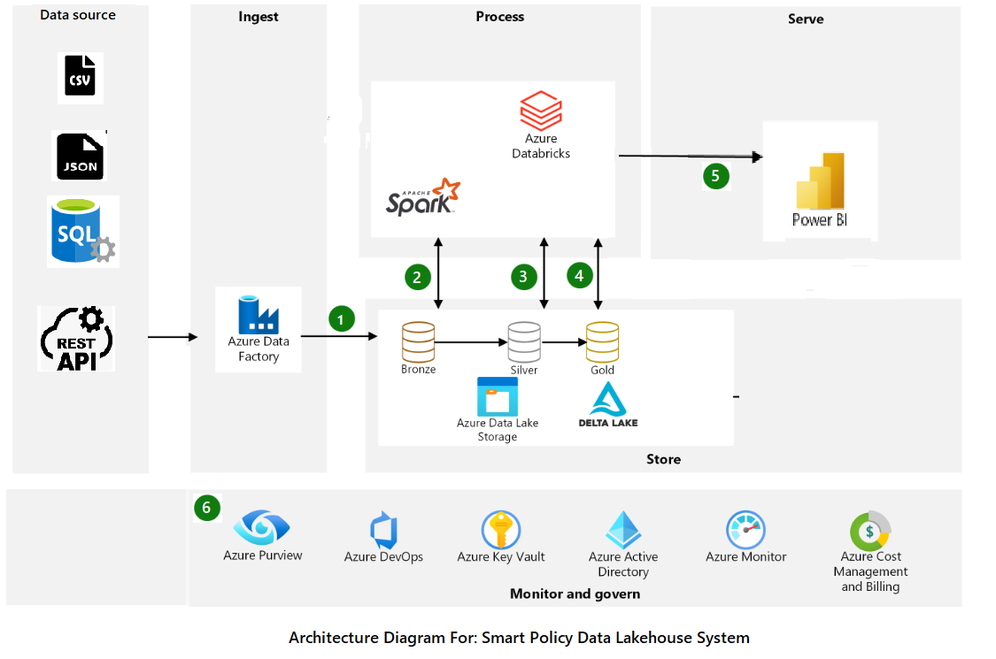
Project: Architecture Diagram

Slide 12
Project Components Needed

Slide 13
Project: Service Components Needed
ADLS Account to hold input CSV, JSON, SQL, Rest data
ADF account to create the pipeline
Azue SQLDB to use as input data source
Databricks account to create notebook and data lakehouse
Key Vault to store secrets
Azure devops GIT for CI/CD
Power BI is optional

Slide 14
Project: Cleanup & Transformation
ADF account to create the pipeline
Azue SQLDB to use as input data source
Databricks account to create notebook and datalakehouse
Key Vault to store scerets
Azure devops GIT for CI/CD
Power BI is optional

Slide 15
Bronze Layer- Create Agent Table
Agent data is available in landing/AgentData in ADLS
Load the data as the Agent table (delta table) in Databricks.
Location of delta table is bronzelayer/Agent in ADLS
Once the data get loaded in table, move the file in into processed/AgentData folder in ADLS.

Slide 16
Silver Layer- Load Branch Data
Create the delta table silverlayer.Branch in path silverlayer/Branch in ADLS
Add the merged_timestamp column in silver layer branch table
Load the data from the bronzelayer.Branch table.
While loading pull only the data where merged_flag is false.
Do the cleanup/transformation and then merge the data in silverlayer/Branch table.
Update the merge_flag = true for within the bronzelayer.Branch table.

Slide 17
Resume Write Up For this Project-1
Developed an end-to-end data engineering pipeline for a top insurance company, enhancing claims analysis and customer segmentation. Key achievements include:
Ingested and stored multi-source data into Azure Data Lake Storage (ADLS) Gen2, improving data accessibility by 30%.
Processed and transformed raw data with Azure Synapse Analytics, resulting in a 25% reduction in data processing time.
Conducted advanced analytics using Azure Databricks, identifying 5 distinct customer segments for targeted marketing.
Automated the data pipeline with Azure Data Factory (ADF), increasing operational efficiency by 20%.
The project led to a 15% increase in targeted marketing effectiveness and reduced customer churn by 10%.

Slide 18
Resume Write Up For this Project-2
Architected and implemented an end-to-end data engineering pipeline for a top insurance company, handling 5 TB of claims data to enhance analysis and customer segmentation. Key achievements include:
Ingested and stored multi-source data into Azure Data Lake Storage (ADLS) Gen2, streamlining access to over 5 TB of insurance data and improving data accessibility by 30%.
Processed and transformed raw data with Azure Synapse Analytics, achieving a 25% reduction in data processing time and optimizing the handling of 1.0 million daily claims records.
Conducted advanced analytics using Azure Databricks, uncovering insights from vast datasets and identifying 5 distinct customer segments for targeted marketing.
Automated the data pipeline with Azure Data Factory (ADF), increasing operational efficiency by 20% and reducing manual intervention.
The project led to a 15% increase in targeted marketing effectiveness and reduced customer churn by 10%, demonstrating the impact of data-driven decision-making.

