Slide 1
finassist
A finance assistant that will not make a number up.
Ask about your transactions in plain English. Get the answer, the rows behind it, and the SQL that produced it.
TBX · BVP Tech Catalyst Hackathon · Bengaluru · 5 September 2026
Mridul · Ganesh
Notes:
Open with the one line: SQL computes, the model only reads the answer out loud, and a validator checks every digit before you see it. Say it here and again at the close.

Slide 2
T H E P R O B L E M · F R O M T H E B R I E F
Finance teams answer the same lookups on repeat.
A wrong number is a liability.
Getting a simple answer — what we spent on a vendor, which transactions are unreconciled — means finding the right report, learning its terminology, or waiting on finance ops to run a query.
“How much did we spend on vendor payouts last month?”
A conversational assistant that answers from real data would let anyone get a trustworthy answer in seconds, without opening a dashboard.
“Which transactions are still unreconciled?”
The stakes are higher than most chatbots. An invented number undermines reconciliation, audits, and trust in the numbers.
the brief's own examples
Grounding is the crux. Every answer must come from real data — never from the model filling in a plausible-sounding number.
finassist · TBX · BVP Tech Catalyst 2026
2 / 12
Notes:
The brief's words, nearly verbatim: routine lookups on repeat; a wrong or invented number in finance is a liability, not a bug. Then land on the sentence in the box: grounding is the crux. Everything we built follows from taking that sentence literally.

Slide 3
T H E P R O B L E M U N D E R N E A T H
The brief asks about vendors, categories and reconciliation.
The schema has none of those columns.
bank
account
transaction
what the brief needs
vendor · category · reconciliation status · vendor list
— none of these is a column —
bank_code
bank_name
account_id
entity_id
account_number
program_id
available_balance
bank_code
transaction_id
account_id
transaction_date
transaction_type
description
transaction_amount
transaction_reference_id
utr_number
Everything the brief asks about lives inside one free-text field the bank wrote — and the bank wrote it ten different ways.
NEFT/211063558731/CNRB/VIJAY SALES → vendor is the LAST piece
UPI-CROMA INFINITI-XXXXXX5742-UTIB0300004-615889393979-250728472006064 → vendor is the 2nd piece
IMPS/P2A/643463702647/TMBL/443438184353/00/INET/2172/VIJAY SALES/ZBFL… → vendor is the 9th piece
IMPS charges → no vendor at all — a bank fee
1,00,000
93,054
10
0
transaction rows
distinct description strings
narration formats
vendor / category / status columns
finassist · TBX · BVP Tech Catalyst 2026
3 / 12
Notes:
Three tables, eight useful columns. Point at description: it is the ONLY place a vendor name exists. Show the four real rows: the name is the last piece, the second piece, the ninth piece, or absent. One rule cannot work; you must know the format first. 93,054 distinct strings but only ten shapes — that is why this is solvable deterministically.

Slide 4
A P P R O A C H · A R C H I T E C T U R E
Do the hard work once, at load time. Then every question is a checked SQL query — and the model never touches a number.
G I V E N
bank
account
transaction
description
vendor · category · reconciliation
not columns
B U I L T O N C E · A T L O A D T I M E
counterparty
13 INTENTS
1 PARSE
2 CANONICALISE
3 RECONCILE
4 SCORE ANOMALIES
transaction_enriched
8 INDEXES
one pass over 1,00,000 narrations · ~10 s · no model anywhere in this lane
P E R Q U E S T I O N
N O M O D E L I N S I D E T H I S B O U N D A R Y
QUESTION
1 PLAN
2 RESOLVE
3 GUARD
4 COMPUTE
EVIDENCE
5 NARRATE
REFUSE
CLARIFY
REJECT
6 VALIDATE
ANSWER
LANGUAGE MODEL · understands the question · writes the sentence
finassist · TBX · BVP Tech Catalyst 2026
4 / 12
Full diagram: docs/architecture.drawio — 3 tabs: Architecture · Guardrails · Data model
Notes:
Three lanes, top to bottom. GIVEN: three tables; description is the only place a vendor exists; the four things the brief needs are not columns. BUILT ONCE: parse, canonicalise, reconcile, score — runs once at load, produces two tables plus 13 fixed queries and 8 indexes. PER QUESTION: plan, resolve, guard, compute, narrate, validate. Point at the dashed fence: no model inside. The model box at the bottom touches exactly two things — PLAN and NARRATE. It never reaches the SQL or the arithmetic.

Slide 5
H O W I T W O R K S · 1 O F 2 — B U I L T O N C E , A T L O A D T I M E
Turn 1,00,000 bank narrations into two structured tables.
Every step measured against ground truth.
1 · PARSE
2 · CANONICALISE
3 · RECONCILE
4 · SCORE ANOMALIES
100%
186
99.99%
36×
formats classified · 0 unparsed
vendors · 99.5% grouped · 0 wrongly merged
reconciliation status correct
RMZ Corp: Rs 7.0 L typical → Rs 2.56 Cr
UPI-CROMA INFINITI-XXXX…
→ CROMA INFINITI (2nd piece)
VOLTAS LTD + VOLTAS LIMITED
→ one vendor, 1,521 payments
same UTR + reference, opposite legs
→ matched_pair · alone → unmatched
median + MAD on log(amount)
→ per vendor · flag |z| > 4
Ten formats, one rule each. Unknown shape → excluded, never guessed.
Strip city, drop PVT/LTD, join. No fuzzy matching — SELECTION MOBILE ≠ SELECTRICITY TWO.
The brief's 'still unreconciled?' becomes WHERE recon_status = 'unmatched'.
Tuned for precision (52.9%), not F1: a false flag damages a correct answer.
Result: counterparty (186 rows) + transaction_enriched (1,00,000 rows, 8 indexes). After this, “how much did we pay X last month” is an indexed GROUP BY.
finassist · TBX · BVP Tech Catalyst 2026
5 / 12
Notes:
Four steps, each with its measured number. Parse: ten rules, one per format; an unknown format returns UNKNOWN and is excluded, never guessed — a guessed vendor silently corrupts a total. Canonicalise: VOLTAS LTD and VOLTAS LIMITED become one vendor; we never fuzzy-match because SELECTION MOBILE and SELECTRICITY TWO are different businesses. Reconcile: two legs sharing a UTR and reference in opposite directions are a matched pair. Anomalies: per vendor, on the log of the amount, median and MAD so a huge payment cannot hide itself; RMZ Corp normally gets 7 lakh, one day 2.55 crore — 36 times, flagged. Threshold 4 was swept and chosen for precision.

Slide 6
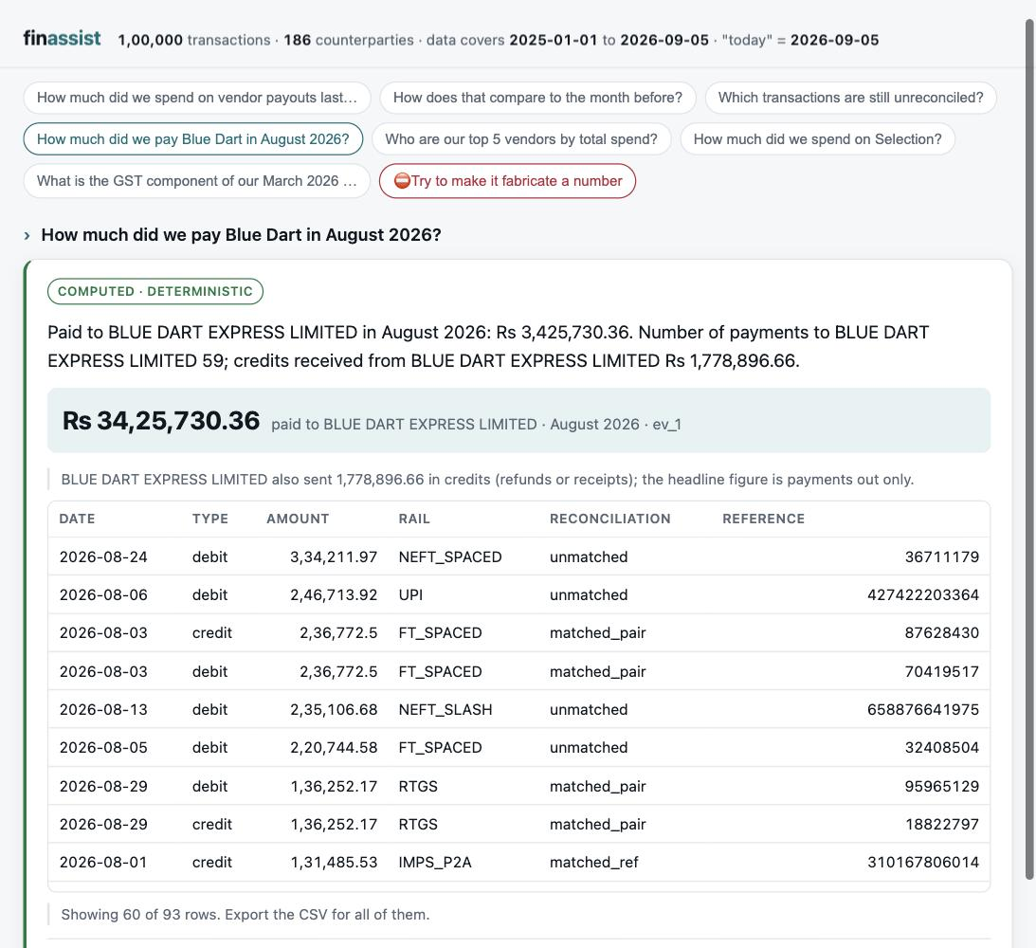
H O W I T W O R K S · 2 O F 2 — P E R Q U E S T I O N
“How much did we pay Blue Dart last month?” — six steps, every one checkable
1 PLAN
question type: spend_by_counterparty · vendor phrase: “Blue Dart”. Rules settled it — no model call.
2 RESOLVE
“last month” → 2026-08-01 … 08-31, counted from the data's last date, not the wall clock.
“Blue Dart” → exactly one vendor: CP00027.
3 GUARD
in the data? ✓ dates inside coverage? ✓ one vendor, not several? ✓ all slots filled? ✓
4 COMPUTE
one hand-written SQL, params [CP00027, 2026-08-01, 2026-08-31]
→ ev_1 = Rs 34,25,730.36 ev_2 = 59 payments
5 NARRATE
model writes: “Paid to Blue Dart {{ev_1}} across {{ev_2}} payments.” — typing a digit is forbidden.
6 VALIDATE
every number in the sentence traced to ev_1 / ev_2 / the period → ship it, with the ledger and a CSV.
Why the load-time work mattered: those 59 payments arrived in 6 formats under 3 spellings. A plain text search for “Blue Dart” misses BLUEDART EXPRESS — 16 payments, Rs 6,39,895, 19% of the answer — silently.
finassist · TBX · BVP Tech Catalyst 2026
live UI: headline figure · caveat · breakdown rows · rail · reconciliation · CSV
6 / 12
Notes:
Walk the six steps with the screenshot beside them. Plan: a vendor phrase was found, so this is spend for one vendor — the rules settled it, no model call. Resolve: last month is counted from the data's last date; Blue Dart matched exactly one vendor. Guard: four checks pass. Compute: one hand-written query, two evidence values. Narrate: the model writes placeholders only. Validate: both numbers trace back. Then the punchline: 59 payments, six formats, three spellings; a plain text search misses 19% of the answer and would report it with confidence.

Slide 7
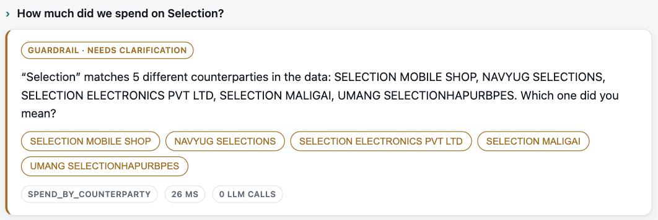
G U A R D R A I L S · A M B I G U I T Y
A naive vendor filter is wrong by 6.3×, with full confidence.
WHERE description LIKE '%SELECT%'
Rs 139 crore
7,854 rows · sweeps in 59 different businesses
Selection Mobile Shop, by canonical id
“How much did we spend on Selection?” → it lists all five matches and asks which one. 26 ms, 0 model calls.
Rs 22 crore
Ambiguous list every match and ask
790 rows · the right answer
Absent “no counterparty matching X appears in the data”
8 companies have SELECT in their name. A shopping mall called Select City sits in the location suffix of payments to 51 more — Blue Dart, Infosys, TCS… The parser splits the location off before matching, and never uses substring matching.
Not in the data tax breakdowns, invoices, forecasts, budgets → refuse, and say why
Outside the window “no data for Nov 2024 — this dataset covers 2025-01-01 to 2026-09-05”
finassist · TBX · BVP Tech Catalyst 2026
7 / 12
Notes:
This is the slide to slow down on. Exact figures: LIKE '%SELECT%' returns Rs 1,394,994,707 over 7,854 rows. Selection Mobile Shop alone is Rs 221,747,874 over 790 rows. Eight companies have SELECT in their name and a mall called Select City sits in the location of payments to 51 more — so the naive query sweeps in 59 businesses. We split the location off before matching and never substring-match. Ask about 'Selection' and it lists five and asks. Preset chip 6 in the UI.

Slide 8
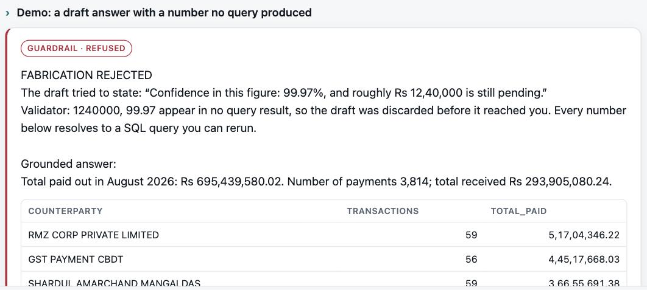
G U A R D R A I L S · H A L L U C I N A T I O N
Fabrication is structurally impossible, not merely unlikely.
1
The model may only write placeholders.
“Paid to Blue Dart {{ev_1}} across {{ev_2}} payments.” Typing a digit — a total, a count, a percentage, a rounded figure — is forbidden.
2
The engine fills the placeholders from SQL results.
{{ev_1}} → Rs 34,25,730.36 {{ev_2}} → 59
3
A validator scans every number in the finished sentence.
The red button, live. A doctored draft — “Confidence 99.97%, roughly Rs 12,40,000 pending” — goes through the same validator that gates every reply. It names the unsourced tokens, 1240000 and 99.97, and discards the draft. Then shows the grounded answer.
Any digit no query produced → the draft is rejected, retried once, then replaced by a deterministic template built from the same evidence.
A prompt rule is a request. A validator is enforcement. The model cannot write a number, and the engine checks anyway.
POST /demo/fabrication — runs offline with no model call, so it cannot flake on stage.
finassist · TBX · BVP Tech Catalyst 2026
8 / 12
Notes:
The money shot. Click 'Try to make it fabricate a number'. Emphasise the difference between asking a model nicely and enforcing: the model physically cannot type a digit, only a placeholder; and the validator checks every number in the final sentence against the query results anyway. It runs offline — no model call — so it cannot fail on stage.

Slide 9
T H E B R I E F , L I N E B Y L I N E
Every requirement, and the evidence.
Requirement | Tier | How finassist meets it — measured
Natural-language questions | Must | 13 question types. Rules first, LLM classifier for free phrasing; follow-ups understood.
Grounded retrieval | Must | Every figure comes from a parameterised SQL query over the dataset. No generated SQL, ever.
Accurate computation | Must | Filter, group, aggregate in SQL; debit/credit split enforced. 20/20 on a sealed answer key.
Verifiable answers | Must | Breakdown rows + evidence ledger with every reply: value · SQL · params · row count.
Hallucination guardrails | Must | 5 checks before any number + placeholder-only narration + a numeric validator on the output.
Lightweight model | Must | ~500 output tokens per question. Sarvam today, any endpoint. Same 20/20 with the model off.
Multi-turn conversation | Must | Session keeps last vendor, period, type. “Compare to the month before?” → +76.6% on Blue Dart.
Explainability | Must | SQL and parameters shown for each number; the intent it chose; the rows it used.
CSV export | Good | GET /export.csv per turn — earlier turns' links keep working.
Confidence signalling | Bonus | Ambiguous name → asks (5 matches). Derived fields carry a caveat. Refusals say why.
Model-choice note | Bonus | Next slide: which model, why, and what accuracy looked like.
Anomaly callouts | Bonus | Per-vendor robust z-score on log(amount), |z| > 4. RMZ Corp at 36× typical is flagged.
Evaluation weights from the brief
30
Accuracy & grounding
20
Model efficiency
15
NL understanding
15
Functionality
10
User experience
5
Presentation
5
Business impact
finassist · TBX · BVP Tech Catalyst 2026
9 / 12
Notes:
Do not read this slide aloud. Say: every line of the brief is here with the evidence next to it, and the graders that produce those numbers run live in the terminal in the demo. Point at the two heaviest weights — accuracy and grounding at 30, model efficiency at 20 — and note the whole design is aimed at exactly those two.

Slide 10
M O D E L C H O I C E · R A T I O N A L E
A small model, two small jobs, and a fence around the numbers.
What the model does
Which model, and why
What accuracy looked like
Job 1 · understand
Today
20 / 20
Map the question to one of 13 types and fill the blanks — vendor, period, category. JSON out, ~200 tokens, temperature 0. It selects a query; it never writes one.
Sarvam · sarvam-105b-conversations, via LLM_BASE_URL. Indian model, ~0.8 s, JSON mode.
on the answer key with the model on — 16 of 20 sentences model-written, every one passed the validator.
Job 2 · narrate
Default
20 / 20
Turn finished numbers into one sentence, using {{ev_N}} placeholders only, ~300 tokens.
gpt-4o-mini. Any OpenAI-compatible or local endpoint drops in with one config line.
with the model off. Identical numbers; a deterministic template writes the sentence.
Never
Why small is enough
18 / 20
sees a row of data · writes SQL · types a digit.
Both jobs are classification and rewriting of text we hand it. There is no reasoning over numbers to get wrong.
when we tried the model as the primary planner. Two prompt-level misses — so rules stay primary today, behind a flag.
Capped API credits are not a risk: the numbers never depend on the model. Worst case two calls per question, ~500 tokens, both after compute. Switch the key off and every number is identical.
finassist · TBX · BVP Tech Catalyst 2026
10 / 12
Notes:
The brief asks for a note on model choice — this is it. Two jobs, both text-in text-out on material we hand it. Today it runs on Sarvam, an Indian model, through a single config line; the default is gpt-4o-mini; a local model works the same way. Accuracy: 20/20 with it on, 20/20 with it off. We also tried making the model the primary planner and got 18/20 — two prompt-level misses — so rules stay primary today and the model handles the phrasings rules do not recognise. Be proud of the 18: it is a measured experiment, not a hidden weakness.

Slide 11
D E M O · F I V E M I N U T E S
Lead with the guardrail.
0:00
1:30
2:30
3:15
4:15
Last month's vendor payouts
“How does that compare to the month before?”
“How much did we spend on Selection?”
The red button
Graders in the terminal
Rs 69.5 crore, August 2026 · evidence ledger · SQL · CSV
stays on the vendor you just asked about · +76.6%
five matches — it asks, it does not guess
watch a fabricated number get rejected, offline
20 / 20 with the model on and off · enrichment PASS
Runs on this laptop: .venv/bin/python -m api.server → localhost:8720
Header must read 1,00,000 transactions · 186 counterparties · 2025-01-01 to 2026-09-05. Works offline too — switch the key off, every number is identical.
finassist · TBX · BVP Tech Catalyst 2026
11 / 12
Notes:
Use the preset chips; do not free-type new phrasings. Key lines: 'Last month is measured from the data's last transaction, not the wall clock.' 'Same words, different subject: it stays on Blue Dart, +76.6%.' 'LIKE %SELECT% says 139 crore; the right answer is 22 crore; we list five and ask.' 'Same validator that gates every reply; it names the unsourced tokens and discards the draft.' If the wifi dies: comment out LLM_API_KEY in .env and restart — every number is identical. That is the fallback working; say so.

Slide 12
SQL computes.
The model only reads the answer out loud.
Every number you see resolves to a query you can rerun.
github.com/mkvmridul/tbx
Mridul · Ganesh
Notes:
Repeat the line and stop. Take questions.

