Slide 1
GroupConvolution on GNA
Some notes by Mike Deisher
November 2022

Slide 2
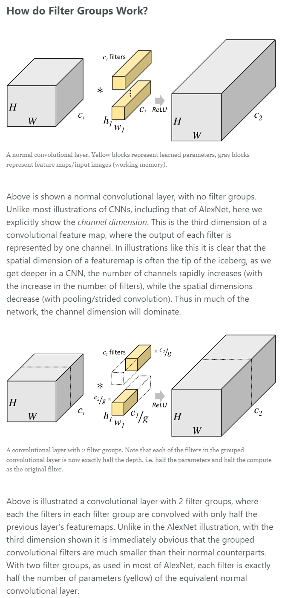
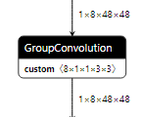
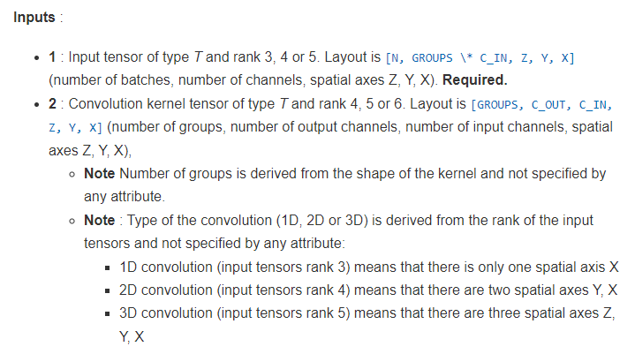
OpenVINO Definition
Dimensions
Input: N,C,H,W
Kernel: G,Co,Ci,H,W
In the example, 1,8,48,48 * 8,1,1,3,3
G=8 means split input channels into 8 equal groups of 1 each
G==Ci is DWSC
Notes:
https://blog.yani.ai/filter-group-tutorial/

Slide 3
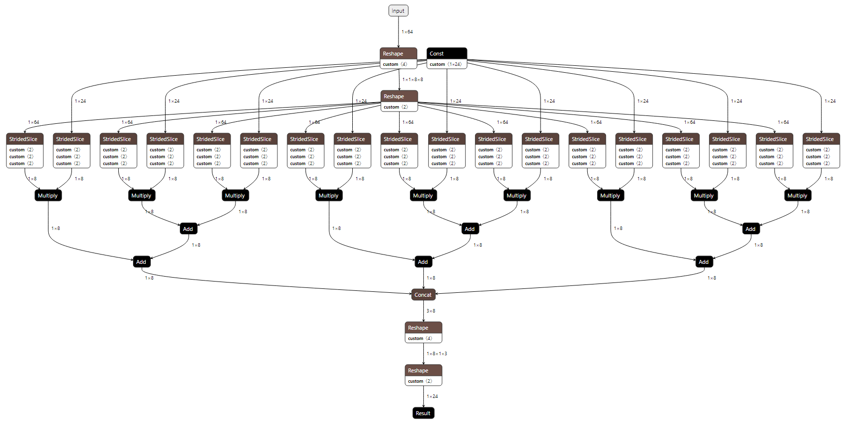
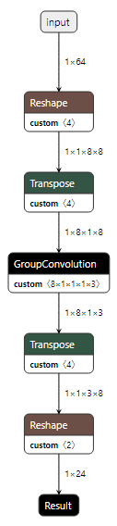
Piotr Rozen’s 1D DWSC
Elementwise
Multiply per
Kernel element
No padding,
stride 2
Σ
C=8
G=8
H=8
H=3
Σ
C=8
K=1x3
Σ

Slide 4
Naïve Solution
The main problem: GNA convolution has no strided memory access
Secondary problem: GNA has no strided copy
Even if it did this solution requires G times more memory bandwidth
Claim: the best we can do to solve the general problem is:
Large transpose
Requires >2*2*N*H*W*C additional memory bandwidth
May not work for all problem sizes
G individual convolutions
Concat
May be VERY costly if parts are not 64B aligned
Number of layers can be quite large
If input tensor is not too big and dimensions are “nice” this approach is feasible

Slide 5
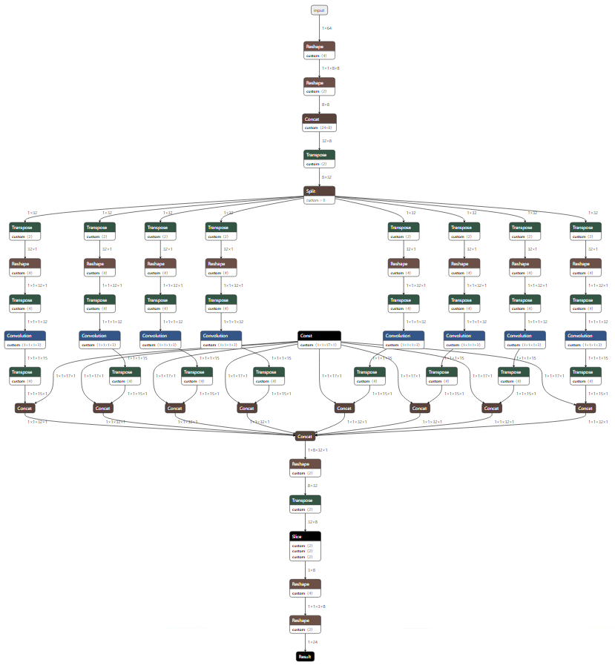
Naïve 1D DWSC
No padding,
stride 2
Transpose,
Split, &
Convolve
Pad,
Transpose,
Split
C=8
G=8
H=8
H=3
C=8
K=1x3

Slide 6
Naïve Method vs Piotr Rozen’s 1D DWSC
For 1D problems Piotr’s solution is better
Inefficient but in-place so no extra memory movement
Does not require unaligned memory operations on convolution output
66% faster on customer DWSC model on MTL
Drawbacks
For some problems, it results in many more layers
Does not work for 2D
Does not generalize to Group Convolution

Slide 7
Source Code
https://github.com/intel-sandbox/gna_tools/tree/main/run_ngraph
See groupconv_decomposition.cpp
run_ngraph is a command line tool to perform a sequence of transformations on an IR graph producing a new IR graph
https://github.com/intel-sandbox/gna_tools/tree/main/make_ngraph
make_ngraph is a command line tool to construct simple networks for testing

Slide 8
Questions?

