Slide 1
TransposeConvolution on GNA
Some notes by Mike Deisher
November 2022

Slide 2
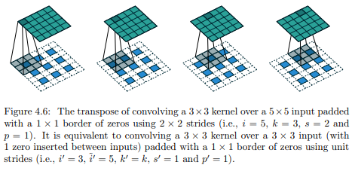
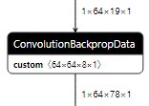
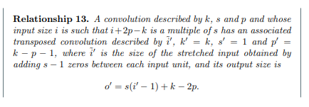
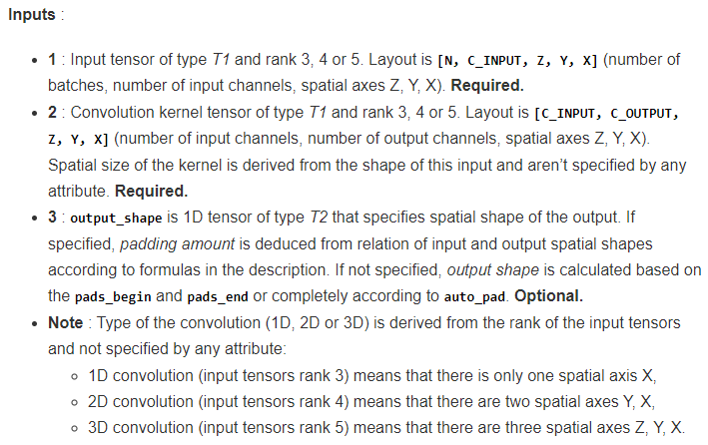
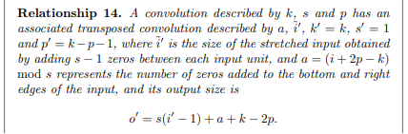
OpenVINO Definition
ConvolutionBackPropData (really?)
Expands the input tensor via weighted interpolation according to “stride” param
Equivalent to zero insertion, padding, and regular convolution
Kernel tensors in inverse order
Notes:
https://arxiv.org/pdf/1603.07285.pdf
<number>

Slide 3
One Possible Solution
Direct zero insertion is very costly to perform and resulting convolution is very inefficient (lots of multiplication by zero)
Customer models only have stride > 1 in one direction
For expansion in one direction, a solution exists
Identify repeating (partial) kernel patterns
Split input tensor
Perform convolution of tensor sections with reduced kernels
For “nice” problem sizes it is near optimal
For “not nice” problem sizes, degenerates into MANY convolutions with unaligned slice/concat
Can still reduce to at most 3 convolutions but the tradeoff is extra computation due to zero padding the partial kernels

Slide 4
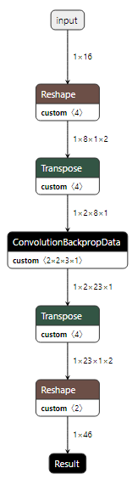
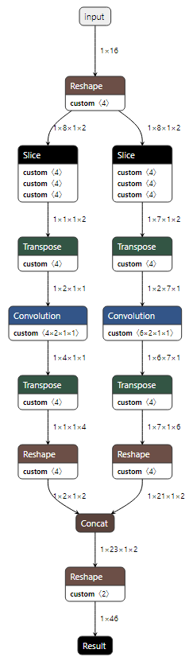
GNA Transpose Convolution in One Direction
Reconfigure
kernel as 1x1
w/ extra outputs,
apply to sliced Input
tensor, reshape,
and concat
Virtual
Padded
Convolution
Pad 1,
Outer Pad 1,
Stride 3
C=2
First two
steps are
unique
Regular
pattern
starting
from
2nd output
H=8
kernels
C=2
K=3x1

Slide 5
Naïve Method
Works for stride >1 in one direction only
When stride == kernel length
Very efficient since there is one large convolution with possibly tiny pre- and post-convolutions
When stride < kernel length
Oscillating kernel patterns prevent direct combination since alternating sizes are different
Can result in large number of layers but can be mitigated
Zero pad to make partial kernel lengths length match
Fold into extra “output channels” and reshape later
Results in a most 3 convolutions total but wastes some computation due to multiply by 0
But this may not matter because…
When sizes are “not nice” there will be unaligned split at beginning and unaligned concat at end ➔ degraded performance

Slide 6
Source Code
https://github.com/intel-sandbox/gna_tools/tree/main/run_ngraph
See transconv_decomposition.cpp
run_ngraph is a command line tool to perform a sequence of transformations on an IR graph producing a new IR graph
https://github.com/intel-sandbox/gna_tools/tree/main/make_ngraph
make_ngraph is a command line tool to construct simple networks for testing

Slide 7
Questions?

