Slide 1
Minimum Spanning Trees
Group 3
Baris Senzeybek, Ellis Chang, Michael Kwok

Slide 2
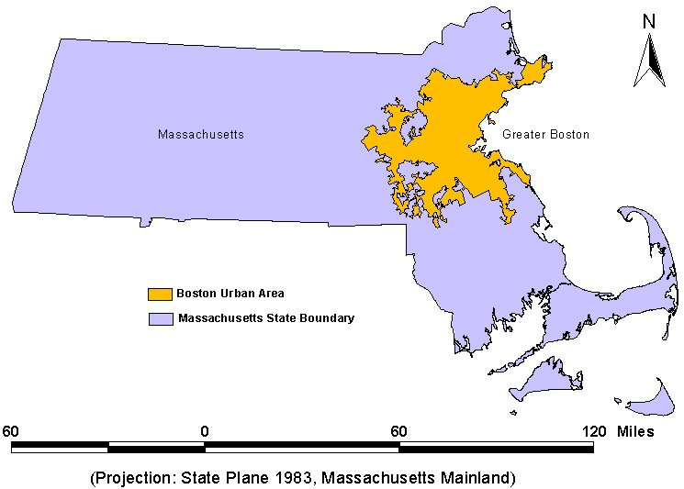

Slide 3
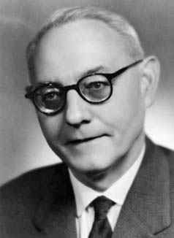
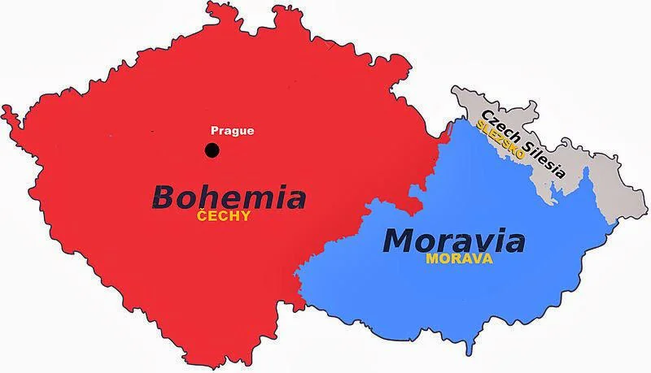

Slide 5





Slide 6
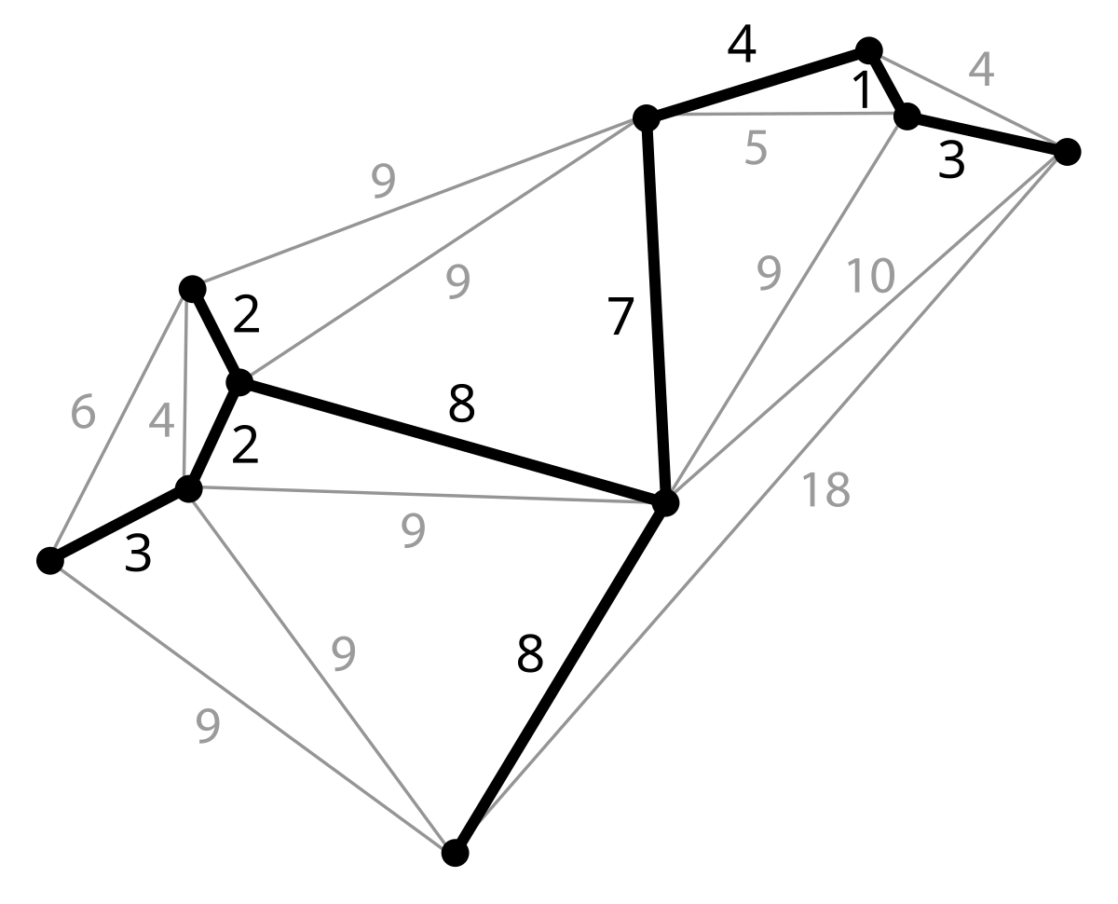
Minimum Spanning Tree

Slide 7
Prim’s Algorithm
1
42
Greedy approach
Start with any edge.
Add the smallest edge that connects a vertex in the MST to a vertex outside it.
Repeat this process until all vertices are included.
2
15
24
21
3
6
7
36
27
18
38
4
5
33

Slide 8
Prim’s Algorithm: Example
1
42
1
2
15
2
21
24
15
21
24
3
6
7
3
6
7
36
27
18
38
18
4
38
5
4
5
33
33
Total Cost = 15 + 38 + 33 + 18 + 24 + 21
= 149

Slide 9
Prim’s Algorithm: Example
1
42
1
2
15
2
21
24
15
21
24
3
6
7
3
6
7
36
27
18
38
18
4
38
5
4
5
33
33
Total Cost = 15 + 38 + 33 + 18 + 24 + 21
= 149

Slide 10
Kruskal’s Algorithm
1
42
Greedy approach
Sort all edges by weight.
Add the smallest edge that does not form a cycle with the already selected edges.
Repeat this process until all vertices are included.
2
15
24
21
3
6
7
36
27
18
38
4
5
33

Slide 11
Kruskal’s Algorithm: Example
1
42
1
2
2
15
24
15
21
21
24
3
3
6
7
6
7
36
27
18
36
27
18
38
38
4
4
5
5
33
33
Total Cost = 15 + 38 + 33 + 18 + 24 + 21
= 149

Slide 12
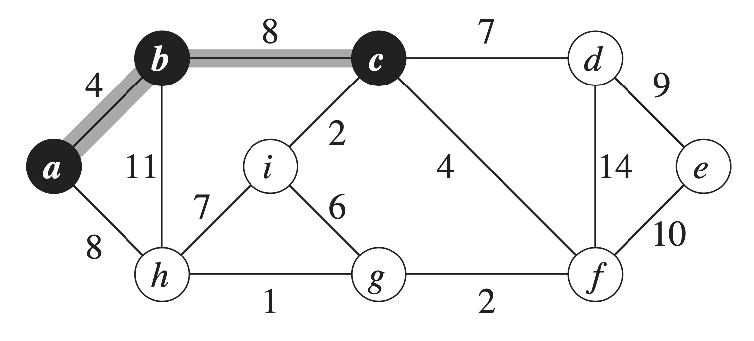
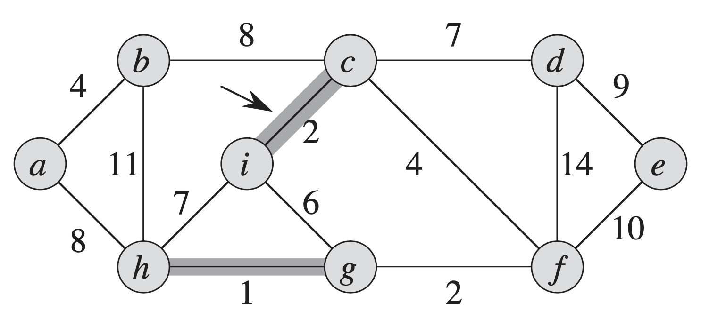
Differences
Prim__________________________
Start: anywhere
Order: a -> b -> c -> …
Kruskal_______________________
Start: smallest edge
Order: 1, 2, 2, 4…
Notes:
To compare the algorithms side-by-side: for Prim, you start at any vertex, for example “a.” Then you choose the smallest edge to continue the tree: in this case, we compare a->b vs a->h. Since 4 is less than 8, then we go to b. And repeat the process, 8 is smaller than 11, so next we would go to c. Keep going until all vertices are visited. This is similar to Dijkstra algorithm that we previously learned.
As for Kruskal, you start with the vertex with the lowest weight edge, which in this case is 1. Then you look for the next lowest weight, which is 2. There are two of them, we can choose any as long as it doesn’t form a cycle. So here we choose i->c. Next we choose g->f. And so on until all vertices are visited.

Slide 13
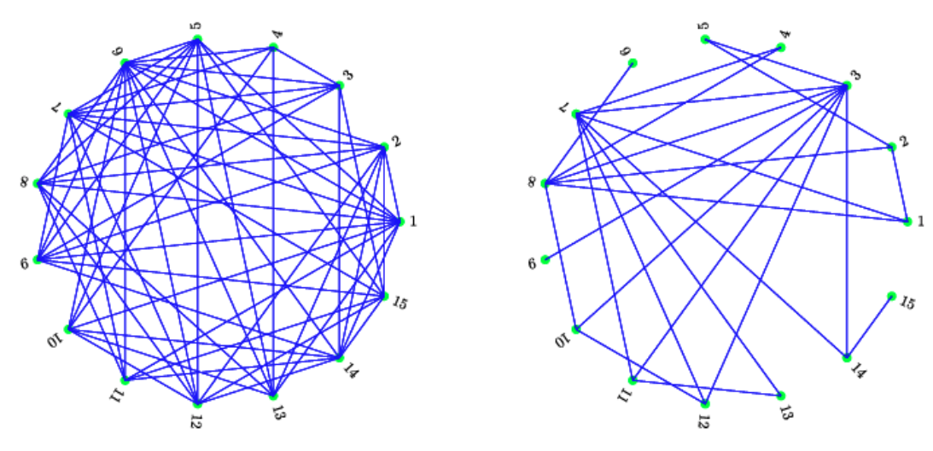
Advantages
Prim__________________________
Better for dense
Kruskal_______________________
Need to sort edges = better for sparse
Notes:
Based on this mechanism, Prim is more suited for dense graphs whereas Kruskal is better for sparse graphs. Compared to a sparse graph, a dense graph has the same number of vertices but more edges, as shown in these pictures. This is because Kruskal needs to sort all edges by weight, so if the graph is dense, then that takes more complexity. Whereas for Prim, at each step you just choose the optimal solution, then you never have to revisit those edges again, much more efficient.

Slide 14
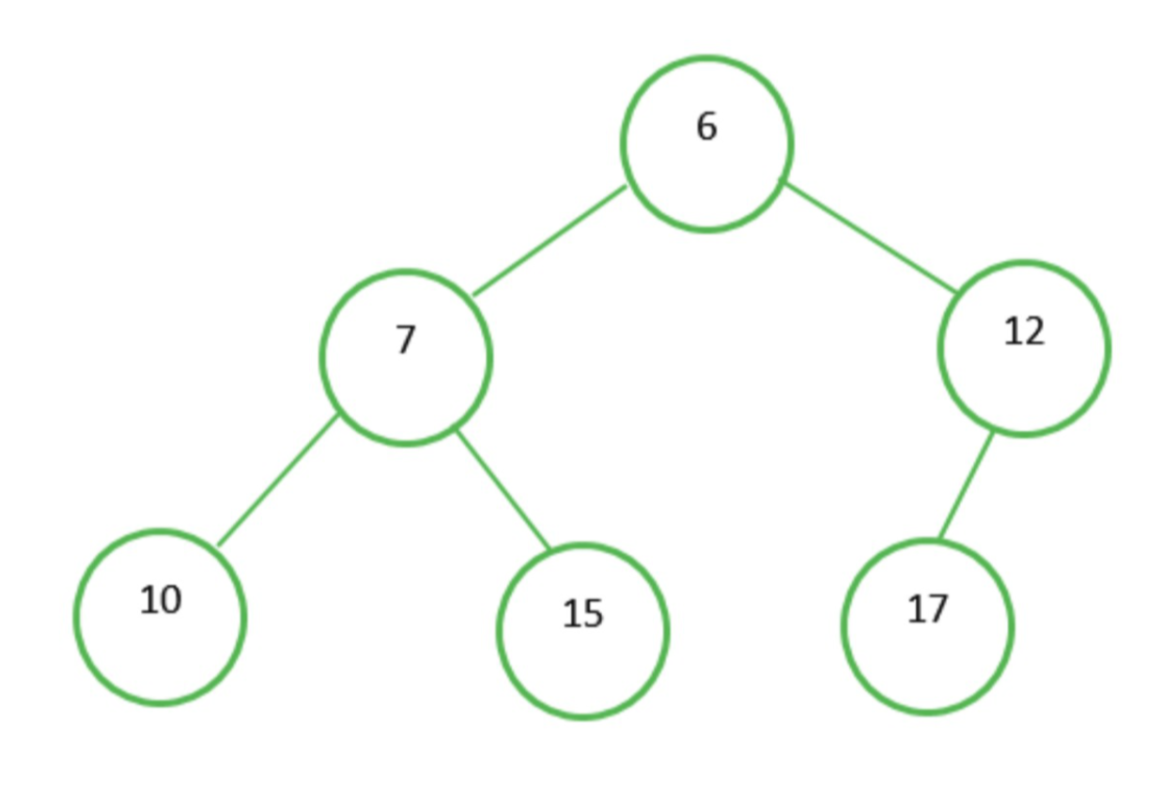
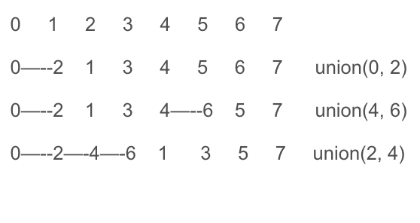
Comparisons
Prim__________________________
Priority queue (min-heap)
O(ElogV)
Kruskal_______________________
0 1 2 3 4 5 6 7
0—--2 1 3 4 5 6 7 union(0, 2)
0—--2 1 3 4—--6 5 7 union(4, 6)
0—--2—-4—-6 1 3 5 7 union(2, 4)
Union-find (disjoint-set union), detects cycles
O(ElogV)
Notes:
Prim uses priority queue min-heap which we all know about — represented by a tree where each parent is smaller than its children — while kruskal uses union-find, which tracks which vertices are in the same connected component so that we can detect and avoid cycles. Runtime depends a lot on what data structure is used, for example can also use a fibonacci-heap for Prim. But to keep things simple, it is about the same on average.

Slide 15
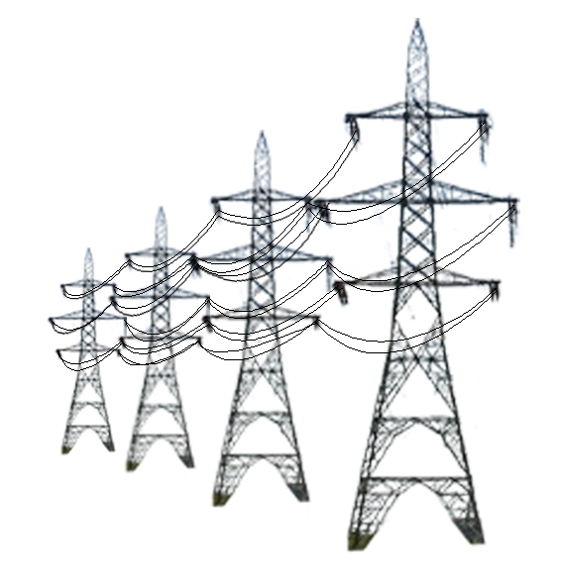
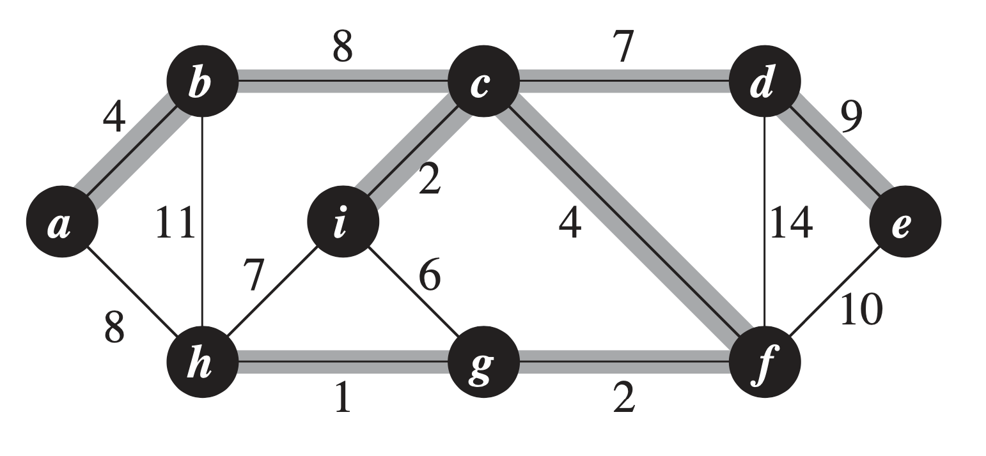
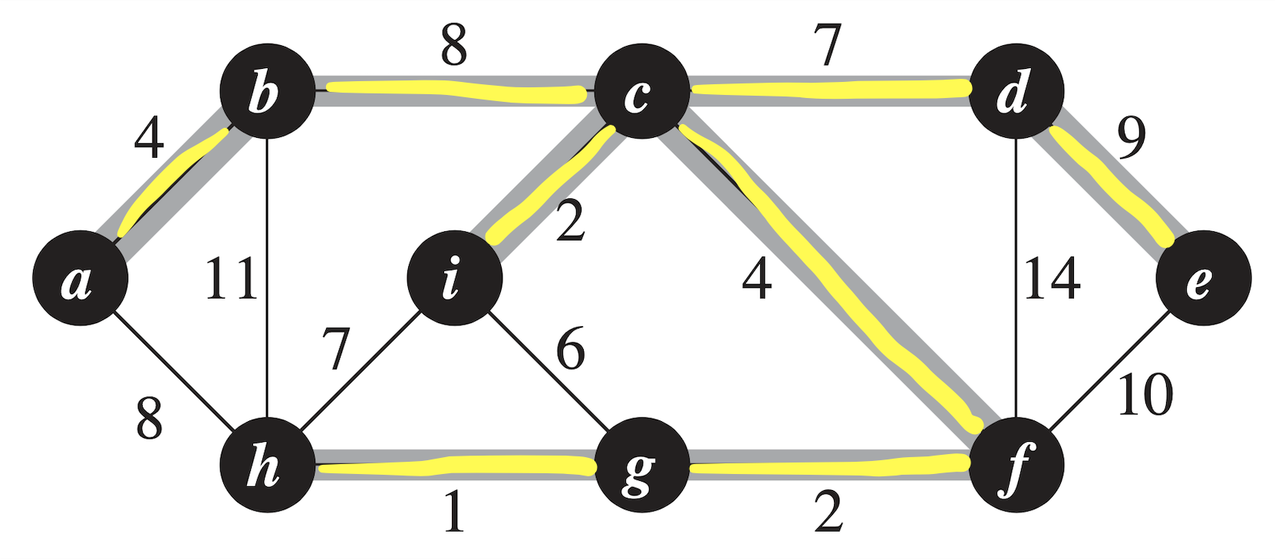
Conclusions of Minimum Spanning Tree
Tree connecting all vertices using minimum cost
Various algorithms, Prim and Kruskal
Greedy. Local solution = global solution
Notes:
To summarize the main idea, the minimum spanning tree has a literal name describing what it is. It’s a tree connecting all vertices using the minimum cost. There are several algorithms to find this tree given an undirected weighted graph. They are greedy algorithm in that obtaining the local solution at each step becomes part of the overall global solution.

Slide 16
Questions

Slide 17
References
Wikipedia contributors. (2024, October 12). Borůvka’s algorithm. In Wikipedia, The Free Encyclopedia. Retrieved from
https://en.wikipedia.org/wiki/Bor%C5%AFvka%27s_algorithm
Applications of Minimum Spanning Trees in Network Design. (n.d.). UT Dallas. Retrieved from
https://personal.utdallas.edu/~besp/teaching/mst-applications.pdf
Wikipedia contributors. (2024, October 9). Minimum Spanning Tree. In Wikipedia, The Free Encyclopedia. Retrieved from
https://en.wikipedia.org/wiki/Minimum_spanning_tree
Nesetril, J., Milkova, E. & Nesetrilova, H. (2001). Otakar Boruvka on minimum spanning tree problem Translation of both the 1926
papers, comments, history. Discrete Mathematics. Retrieved from
https://www.cs.mun.ca/~kol/courses/6901-f16/boruvka-nmn.pdf
Narayan, Darren, (2007). Modern applications of graph theory. Congressus Numerantium. Retrieved from
https://www.researchgate.net/publication/264916066_Modern_applications_of_graph_theory
Cormen, T. H., Leiserson, C. E., Rivest, R. L., & Stein, C. (2009). Ch.23: Minimum Spanning Trees. In Introduction to algorithms (pp. 624–642). essay, MIT Press.
GeeksforGeeks, argha_c14. (2024, July 17). Difference between Prim’s and Kruskal’s algorithm for MST. https://www.geeksforgeeks.org/difference-between-prims-and-kruskals-algorithm-for-mst/
Optimal disease outbreak detection in a community using network observability - Scientific Figure on ResearchGate. Available from:
https://www.researchgate.net/figure/Two-different-graph-topologies-of-a-network-of-15-nodes-a-dense-and-b-sparse_fig1_305869701 [accessed 1 Dec 2024]

