Slide 1
3. Requirements
3.1. Functional Requirements

Slide 2
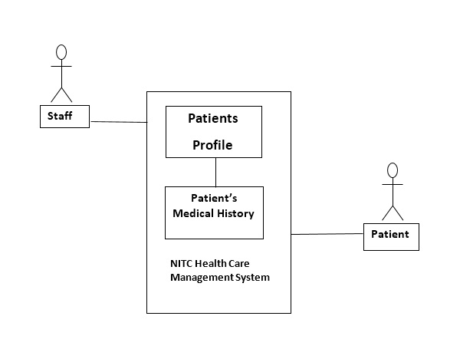
Overall Description
The NITC Health Centre Managment System has 2 types of users,
namely Staff & Patient. There are 4 kinds of Patients namely Students, Faculties, NITC Staff & Outside Patients. Each patient details is maintained by the HC Staff & the Patient can only view his details.

Slide 3
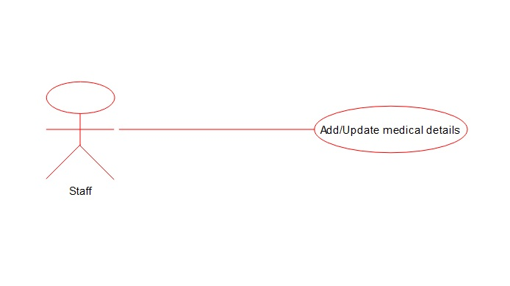
3.1.1. Add/Update Medical Details
Brief Description:
  The HC Staff has the priveledge of Adding & Updating Medicine details & Test report
Step by Step Description:
The Staff has already logged into his profile using his ID & password
  The HC Staff Selects to ADD MEDICINE
    Medicine Prescribed Details
    Test Prescribed
    Date of NEXT VISIT
    Additional Comments

Slide 4
The HC Staff Selects to ADD LAB TEST REPORT
  Tests Taken
  Result of Tests
  Additional Information

Slide 5
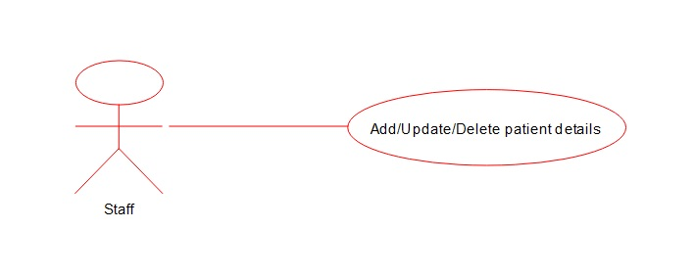
3.1.2 Add/Update/Delete Patient Details
Brief Description
  The HC Staff can Add a new patient by filling in the details in the form, later he can Update this information & finally when the Patient is no longer a part of NITC the profile of the pateint can be Deleted
Step By Step Description
  The Staff has already logged into his profile using his ID & password
  The HC Staff can select ADD PATIENT
    Add ID no.
    Add type

Slide 6
3.1.2 Add/Update/Delete Patient Details
Brief Description
  The HC Staff can Add a new patient by filling in the details in the form, later he can Update this information & finally when the Patient is no longer a part of NITC the profile of the pateint can be Deleted
Step By Step Description
  The Staff has already logged into his profile using his ID & password
  The HC Staff can select ADD PATIENT
    Add ID no.
    Add type

Slide 7
      Student
      NITC Staff
      Faculty
      Outside Patient
    Add Name [optional]
    Add Contact Details [optional]
      Phine no.
      Email Id
    Blood Group [optional]
    Gender [optional]
  The HC Staff Can select UPDATE PATIENT DETAILS
  THE HC Staff can select DELETE PATIENT PROFILE

Slide 8
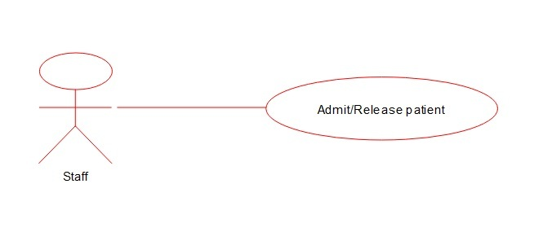
3.1.3 Admit / Release Patient
Brief Description
  The HC Staff can Admit a patient incase of Chicken Pox & later after Recovery of the patient , he can Release the patient.
Step By Step Description
  The Staff has already logged into his profile using his ID & password
  The HC Staff can select ADMIT PATIENT
    Add ID no.
    Entry Date
    Docter in Charge
  The HC Staff can select RELEASE PATIENT

Slide 9
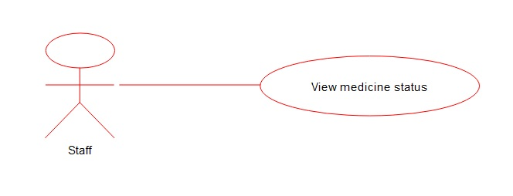
3.1.3 View Medical Status
Brief Description
  The HC Staff can View The Medicine Status of all the Medicines that have been prescibed to the patients on a monthly basis
Step By Step Description
  The Staff has already logged into his profile using his ID & password
  The HC Staff can select VIEW MEDICINE STATUS by :
    Monthly Analysis
    Yearly Analysis

Slide 10
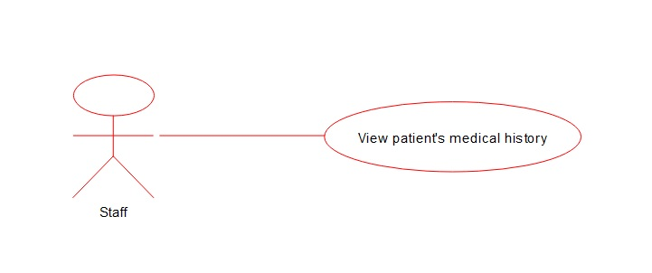
3.1.4 View Patients Medical History
Brief Description
  The HC Staff can View The Medical Details of the Patients by just typing in the ID no. Of the Patient
Step By Step Description
  The Staff has already logged into his profile using his ID & password
  The HC Staff can SelectVIEW PATIENT MEDICAL DETIALS :
    Entering Type
    Entering ID no.

Slide 11
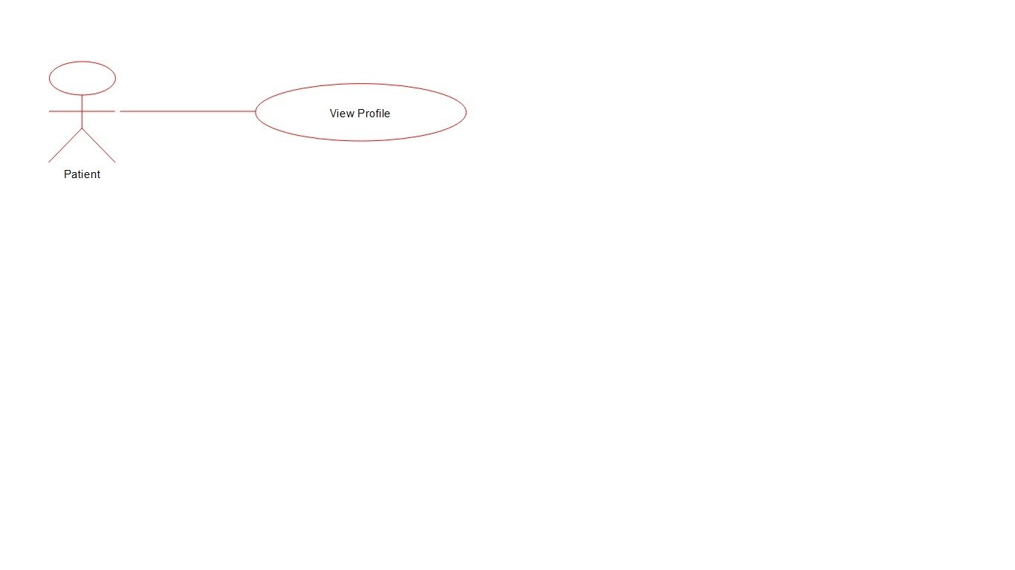
3.2.1 View Profile
Brief Description
  The Patient can View their own Profile and if there are any changes to be made then he can approach the HC Staff
Step By Step Description
  The Patient has already logged into his profile using his ID & password
  The Patient can Select VIEW PROFILE

Slide 12
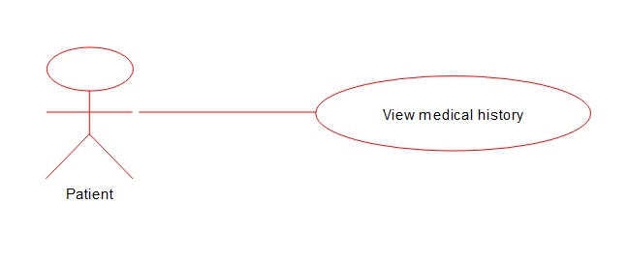
3.2.2 View Medical History
Brief Description
  The Patient can View their own Medical History
Step By Step Description
  The Patient has already logged into his profile using his ID & password
  The Patient can Select VIEW MEDICAL HISTORY

Slide 13
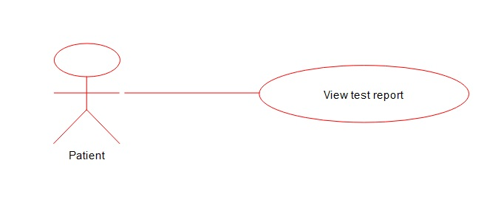
3.2.3 View Test Report
Brief Description
  The Patient can View their own Test Reports
Step By Step Description
  The Patient has already logged into his profile using his ID & password
  The Patient can Select VIEW Test Reports

Slide 14
3.3 Functional Requirements at a glance:
3.3.1 The software must request username and password for accessing the system by staff and Doctor, only after authentication they will be allowed.
3.3.2 The System will display Monthly Medicine Status to the HC staff, i.e. The Medicines that have been Prescribed to the patients
3.3.3 The software must allow browsing by the physician or staff of historical
medical information of the patients by entering their unique id (Roll no. or
NITC ID card no.)
3.3.4 The software must allow patient to view their own medical record on the
system and they have privilege to Read only.
3.3.5 The system must only allow deletions by the staff and only after archiving data in flat file format.
3.3.6 The software to be developed must display the correct patient name and
details.
3.3.7 The software to be developed must operate without interruption twenty-
four hours a day

Slide 15
3.3.8 The system also allows access and entry to limited bloodwork, medication,and allergen information by lab Technician and display results in order specified by operator.
3.3.9 The software must retrieve and sort medical record information and allow
for screen and print output of said information.
Note. Print output will include name, roll no and requested diagnostic
information only.
3.3.10 The Staff will be able to upload the Health Details of the patient of to the
system after they have been diagnosed by the doctor. All the details
including:
• Medicines Prescribed
• Tests Prescribed
• Symptom observed
• Preventions to be taken
• Results of any Tests done

Slide 16
3.2 Non-Functional Requirements

Slide 17
3.2.1 The software interface must follow design conventions which allow for easy search of details by the stuents and other patients. The name and dosage of medicine should properly be mentioned and shown to the patient for their proper intake.
3.2.2 The software must require high levels of error correction and input
validation.
Note. Message box prompts the User when they will be entering any wrong or invalid data.
3.2.3 More than five attempts at login and failure will produce a red flag to
system administrator.
3.2.4. Details of the Staff present at the health center including the Doctors
timing, lab technicians timing etc. will be displayed on the system for easy
reference by the patients
3.2.5 Emergency contact no’s of nearby Blood banks, Ambulance ,Hospitals and other required technicians will be provided.
3.2.6. The Patients can view other essential Details Like
      Doctor Timings
      Contact Details of Health Centre
      The List of Staff working at the Health Centre

Slide 18
3.2.7 Maintainability
System can be maintained by the Staff easily, as he can make required changes to the system. He can maintain the details regarding the Patient and also the authorized students , faculty , NITC Staff Can view their Medical Details
3.2.8 Portability
The entire system can be implemented in either a Linux based server(Ex:Andromeda) or a Windows based Server. While the system can be used on any machine
irrespective of the underlined operating system.
3.2.9 User Interfaces:
Authorized User: user can enter the Login details in the space provided in the Home page. Then the system will redirect them to their respective profile pages, where they
can performe their designated tasks, like updating details, Viewing Medical Details etc.
Patient: user can go through the Details Health Centre Staff: Can Update Detials of Medical History,Test results etc.
3.2.10 Hardware Interfaces:
The web portal on which the HCMS will be accessed from, doesn't have any designated hardware, thus it does not have any direct hardware interfaces.
3.2.11 Design constraints
The system will be developed usingJAVA Swing and a MYSQL database.

Slide 19
3.2.12 Reliability
The Entire System is Read Only for the Patients and the Changes can only be made by Authorized staff. The Details can't be changed or tampered upon without the permission of the designated Doctor. The data will be available whenever required by the Patient, Doctor 7 HC Staff.
3.2.13 Availability
The system will be available 9 am to 5 pm ( NITC Health Centre Timing), but the Updation of the system can only be done by the HC staff in the end of every working day.
3.2.14 Security
The entire Security of the system depends on the Authenticity of the authorization provided by the Patients and the HC staff while creating
user accounts & Updating Detials. As this Health Centre management System is to be implemented on a stand alone System the Security of the system depends on the Person accesing the System.

Slide 20
4. Work Done
Did Literature Surveying
  Interviewed NITC Health Centre Staff for the present functioning of the health centre
  Went through different Previous SRS documents of Health Centres [1]
Created Software Requirements Specifications Using the Literature Survey done.
Created a GIT HUB account for the present project:
https://github.com/subhodip-codesmith/NITCHealthCentre.git
Members went through a small workshop in using JAVA, which will be the Programming language to be used for implementation.

Slide 21
