Slide 1
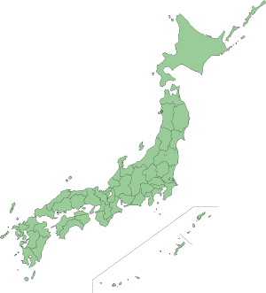
How Japan's capital moved
Tokyo
1869
Kyoto
794
Nara
710

