Slide 1
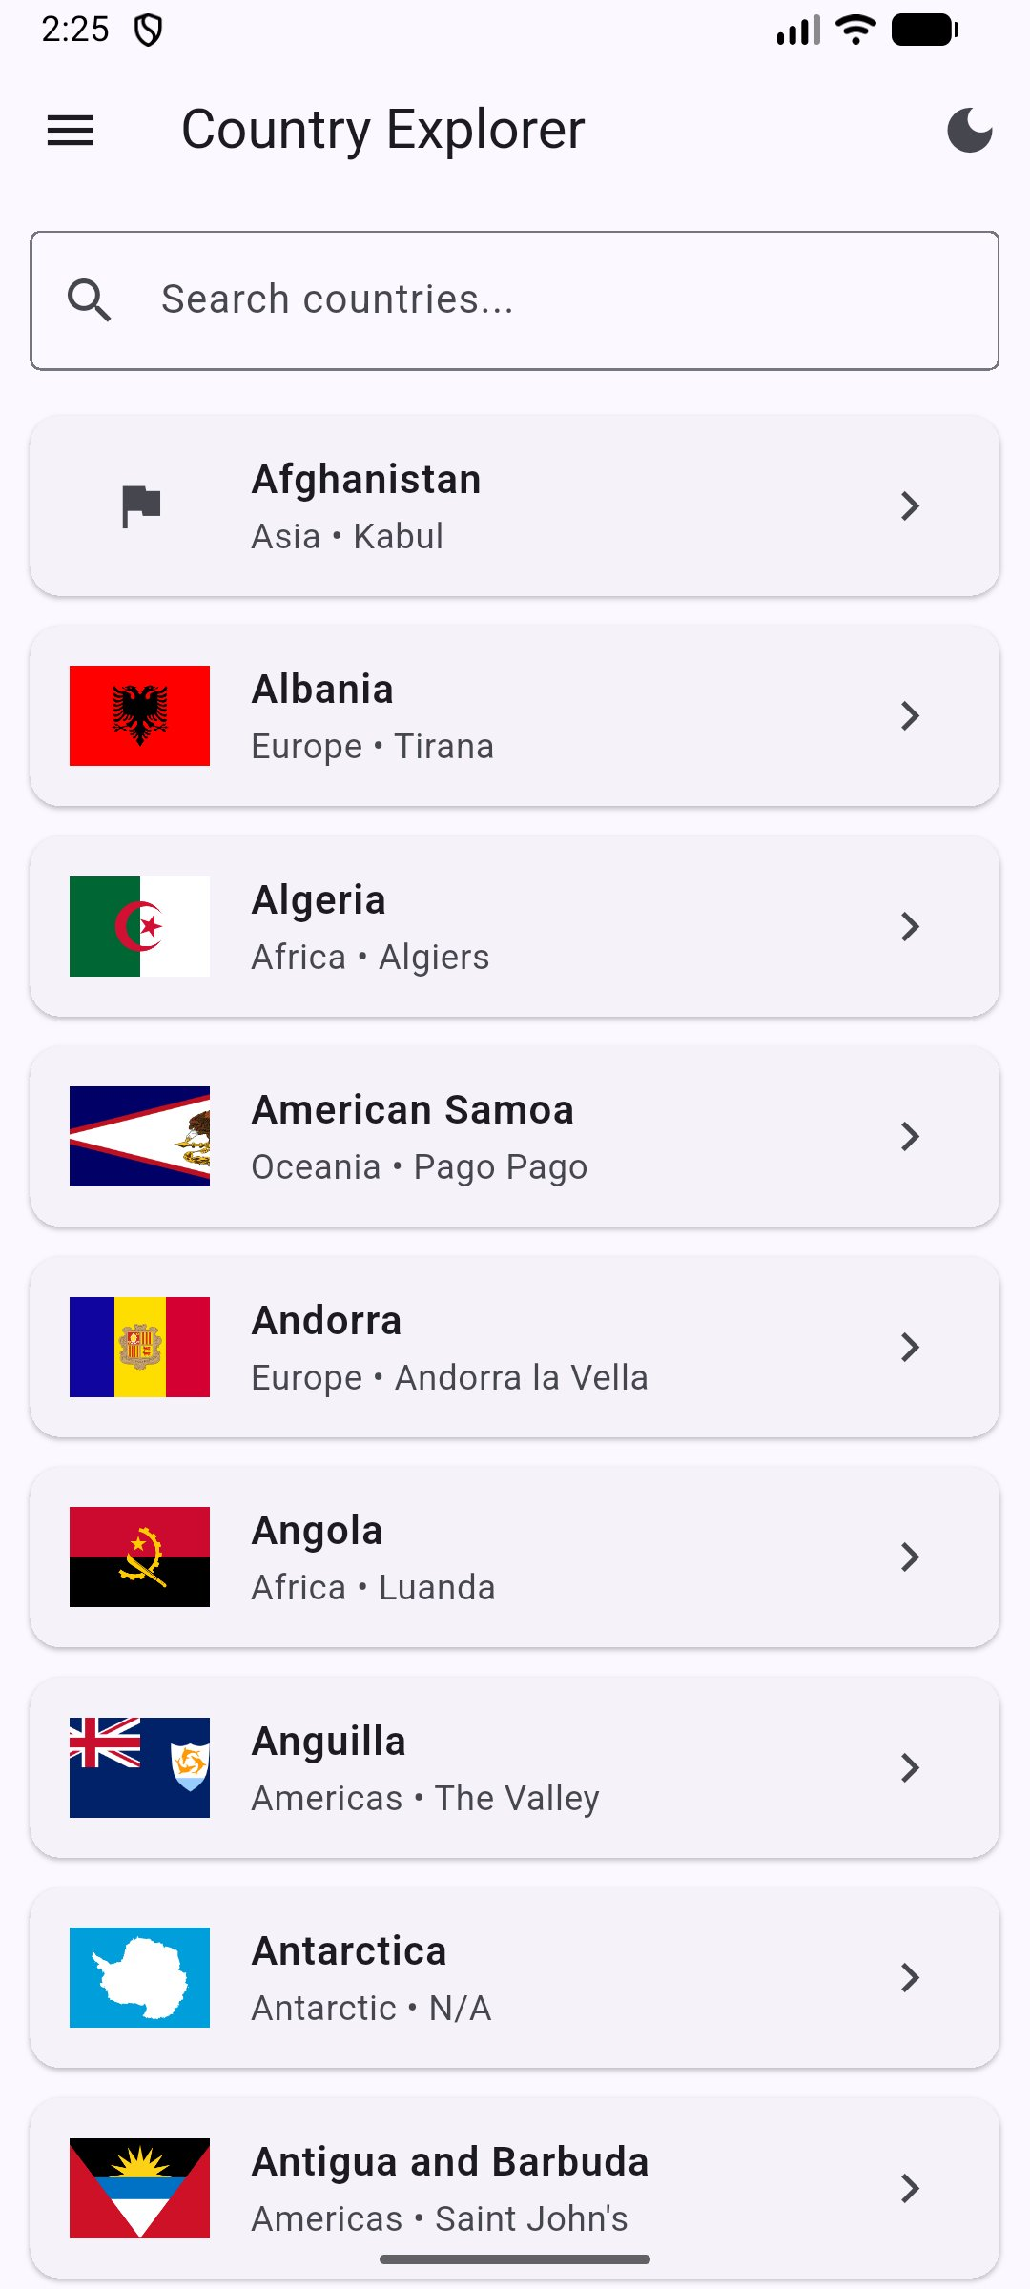
TAMK · MOBILE APPLICATIONS · 2026
Mobile Dev Final Presentation
Country Explorer
A Flutter mobile application for exploring countries around the world
PRESENTED BY
Min Zaw · Oliver Chandler · May Khine

Slide 2
Introduction
Meet the team building Country Explorer
MZ
OC
MK
Min Zaw
Oliver Chandler
May Khine
Developer
Developer
Developer
About the project
Country Explorer is a Flutter-based mobile application that lets users browse 250+ countries, search by name, view detailed information including flags, capitals, populations, languages, and currencies.

Slide 3
App Overview
What Country Explorer does and the stack behind it
WHAT IT DOES
DATA SOURCE
Browse, search, and view detailed info on 250+ countries
REST Countries API — free, public, no auth required
PLATFORM
TECH STACK
Android (also runs on iOS — Flutter cross-platform)
Flutter · Riverpod · go_router · shared_preferences

Slide 4
Key Features
All technical requirements implemented — plus bonus features
Drawer menu navigation
Scrollable list with custom tiles
✓
✓
Search bar with input validation
Detail screen with full country info
✓
✓
Light / dark theme toggle
Settings persisted with shared_preferences
✓
✓
Loading, error & empty states
Retry button on network failure
✓
✓
Infinite scroll pagination ⭐
Layered architecture (7 folders)
✓
✓

Slide 5
Architecture
Layered architecture with strict separation of concerns
lib/
models/ > Country class
services/ > API + JSON
providers/ > Riverpod state
screens/ > 4 screens
widgets/ > Reusable UI
utils/ > Validators
router/ > go_router
test/
4 test files > flutter test
Data Layer
Models + service classes — fetch and parse JSON
Logic Layer
Riverpod providers — state management, no UI dependencies
UI Layer
Screens and widgets — never touch HTTP directly

Slide 6
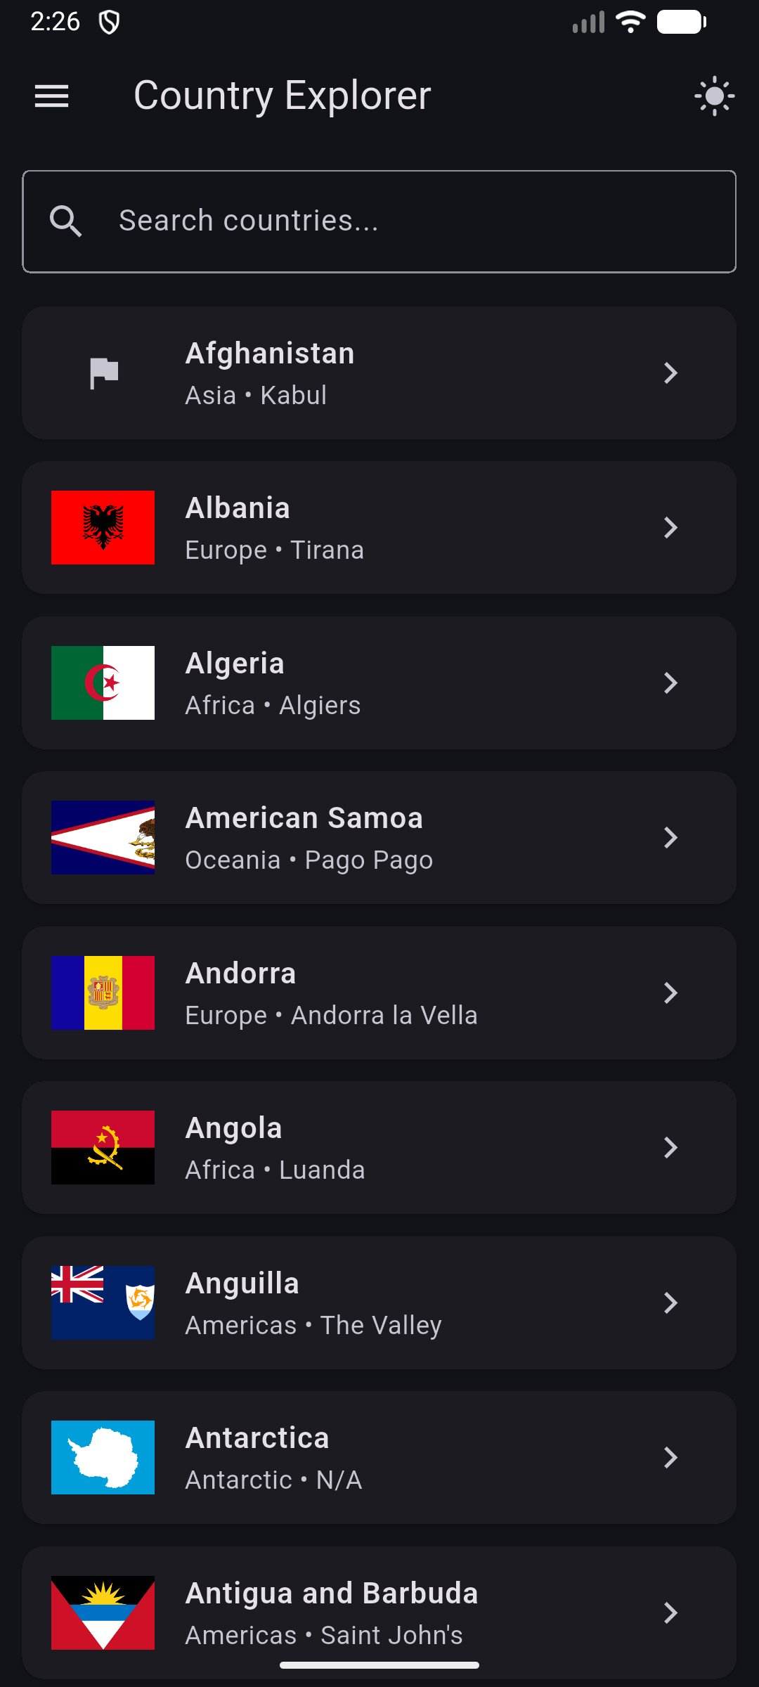
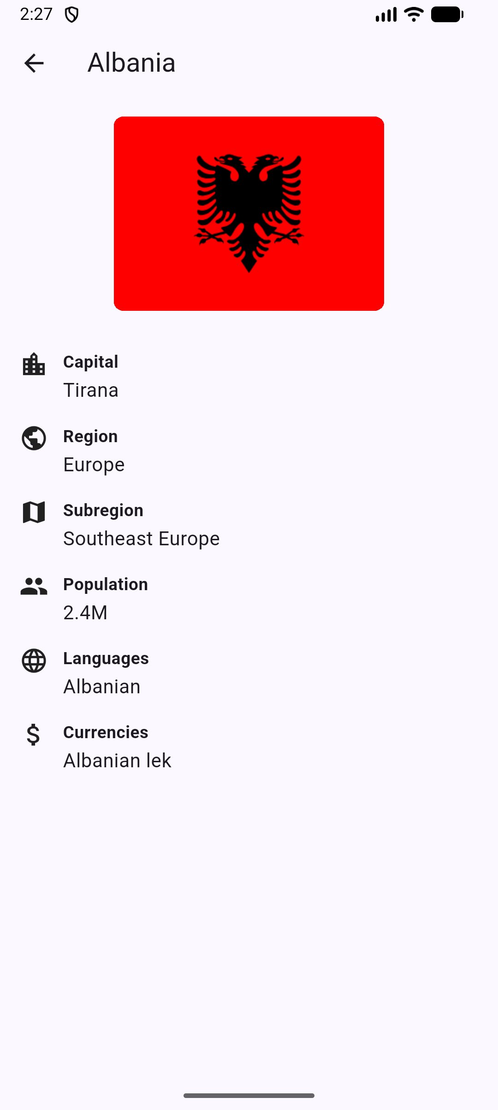
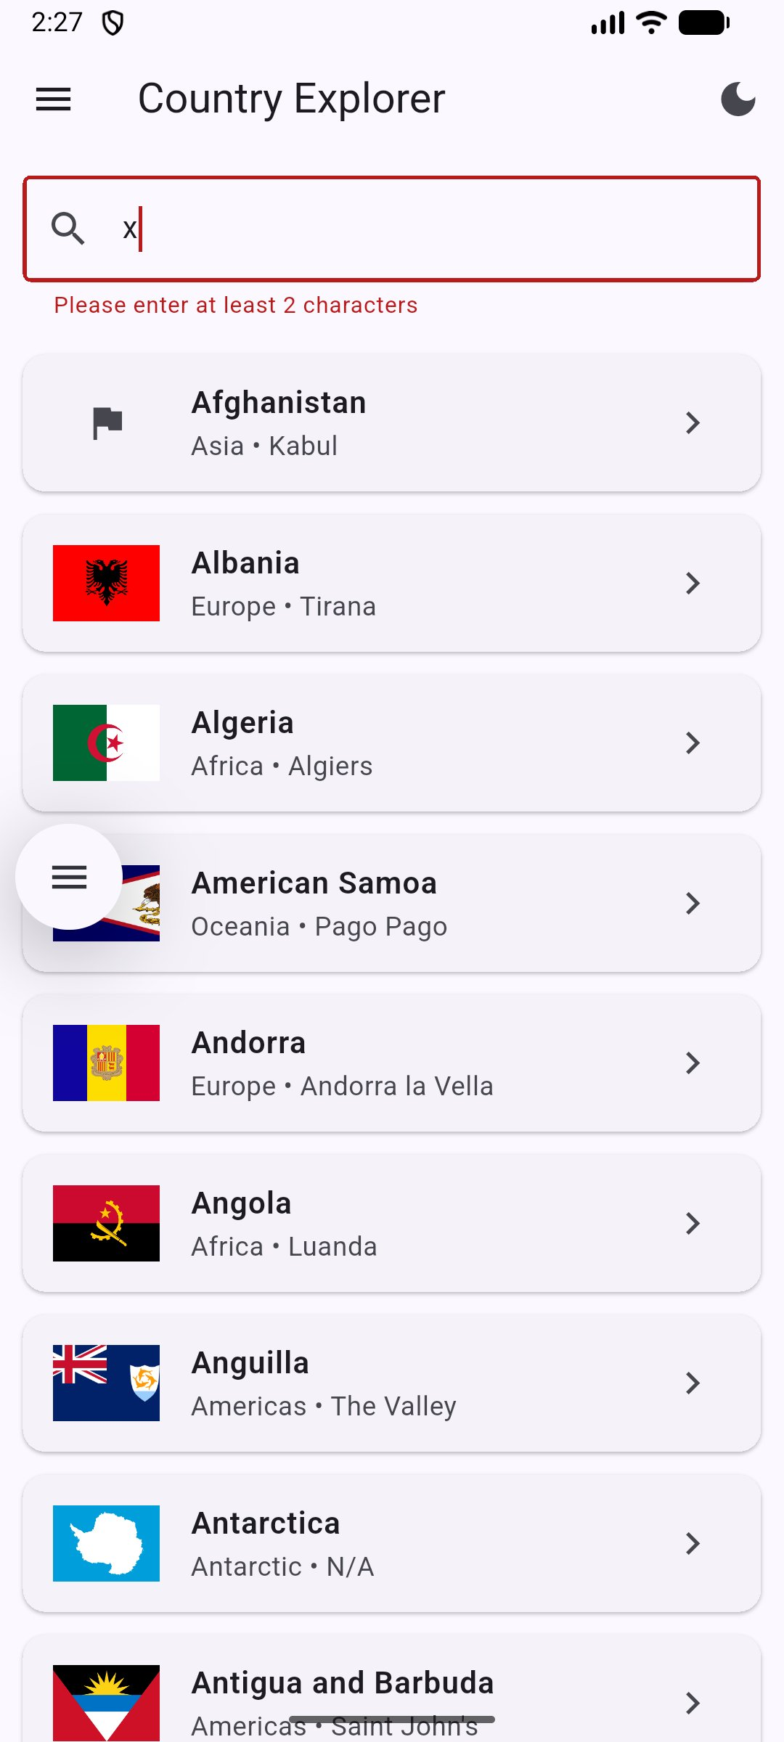
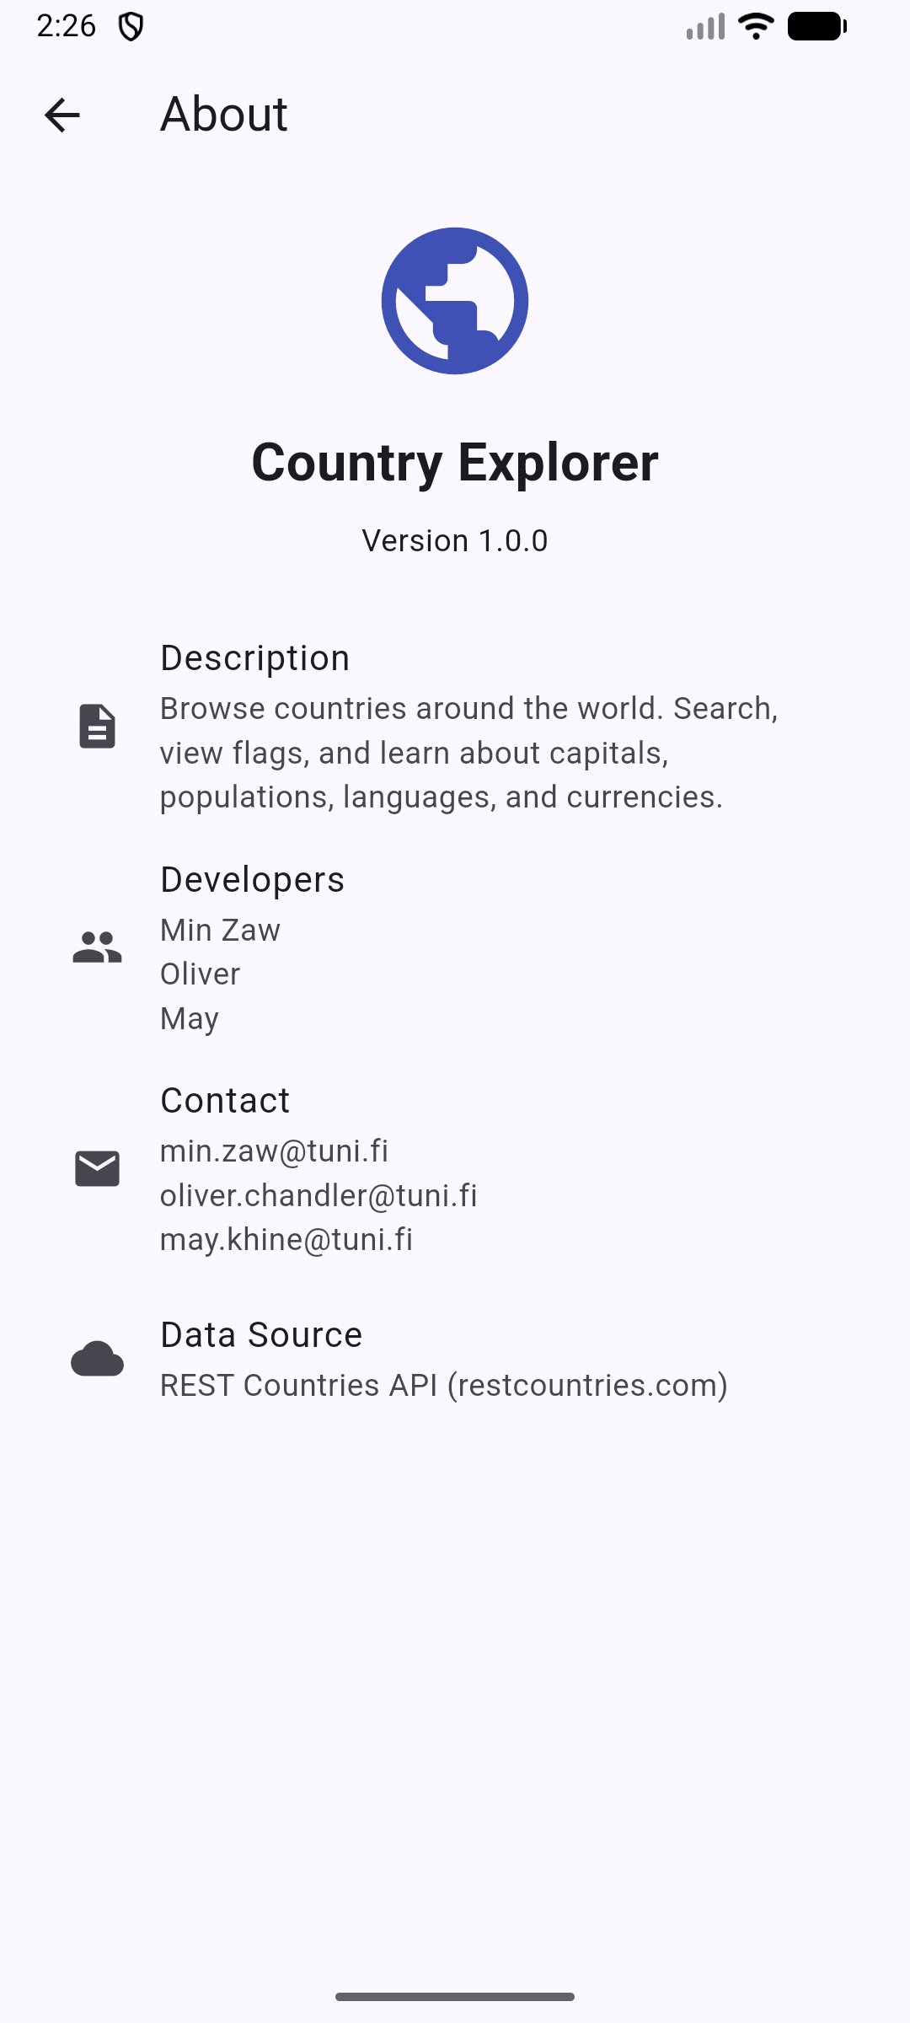
App Screens
Light mode, dark mode, detail screen, search validation, and about
Home (Light)
Home (Dark)
Detail Screen
Input Validation
About

Slide 7
PART 2
Live Demo
Country Explorer in action — running on Android emulator

Slide 8
Code Highlights
Four files that showcase the architecture
country.dart
Pure data class with safe fromJson factory using null-coalescing
validators.dart
Pure validation function outside the widget — testable in isolation
country_provider.dart
Five composed Riverpod providers: service > list > search > filtered > paginated
home_screen.dart
AsyncValue.when() handles loading/error/data + scroll listener for pagination

Slide 9
Testing
All tests passing on flutter test
✓
Model
13+
Country fromJson/toJson roundtrip
✓
Validators
All branches of search validator
TESTS PASSING
✓
Service
HTTP fetch with MockClient
flutter test
✓
UI
CountryTile renders and handles tap

Slide 10
Thank You!
Questions & Discussion
Min Zaw · Oliver Chandler · May Khine
TAMK · Mobile Applications · 2026

