Slide 1

Employee Turnover Research Study
Michael Zoucha

Slide 2
Introduction
Studies show that the total cost of losing an employee can range from tens of thousands of dollars to 1.5-2X annual salary (Bersin, 2013)
Recruitment / Hiring Costs
Training and Onboarding
Loss of productivity
Entire company culture can suffer
Call center turnover rates at 25%-35% on average
Maintaining quality customer service can be challenging
Spending more money on employees than they make the company back

Slide 3
Employee Data
Simulated dataset created by IBM for employee turnover modeling research
Testing viability for actual company data
1,470 records (only 237 of which have left the company)
35 features
22 categorical, 13 numerical
HR, performance review, and personal survey data
Also included daily login / logout information for the employees, but it wasn’t used

Slide 4
Predictive Modeling
Classification problem
Logistic Regression
Random Forest
K-nearest Neighbors
Grid Search with cross validation
Test multiple different models with multiple different hyperparameters
Cross validates and selects the best model / hyperparameter combo for the dataset

Slide 5
Risks / Contingencies
Simulated dataset may not translate well to ‘real’ company data
US protected classes are included
Age, gender, etc. will be removed
Removes potential for discrimination from the model(s)
Some data points are survey questions
Subjective nature of scores would best be left out of the data

Slide 6
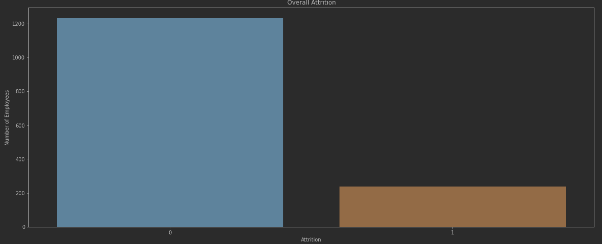
Exploratory Data Analysis
Overall Attrition Rate – 16.1%

Slide 7
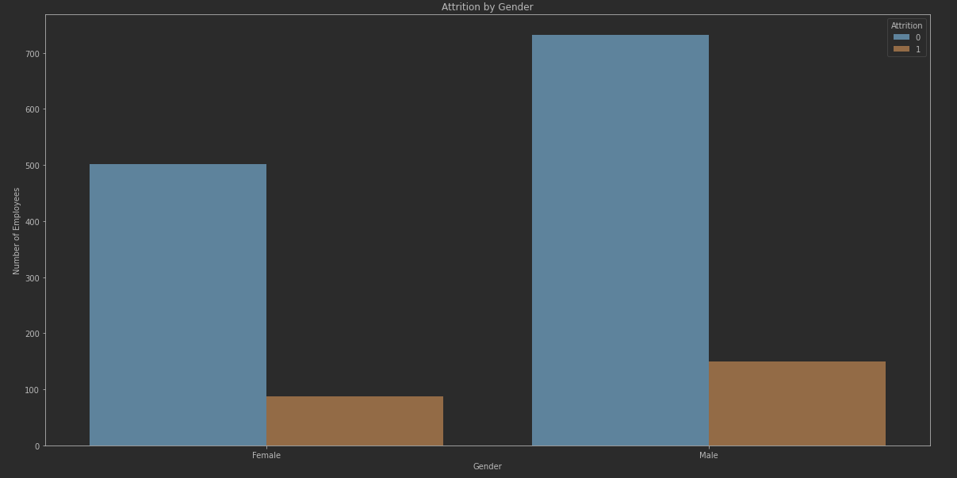
Exploratory Data Analysis
Attrition Rate:
Male - 18.0%
Female - 14.8%

Slide 8
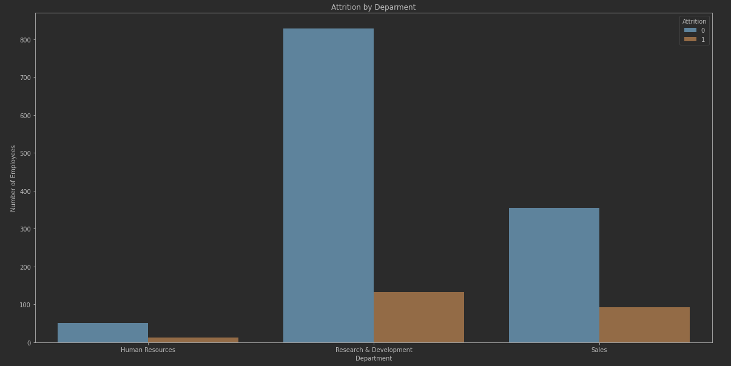
Exploratory Data Analysis
Attrition Rate:
Human Resources - 19.0%
Research & Development - 13.8%
Sales - 20.6%

Slide 9
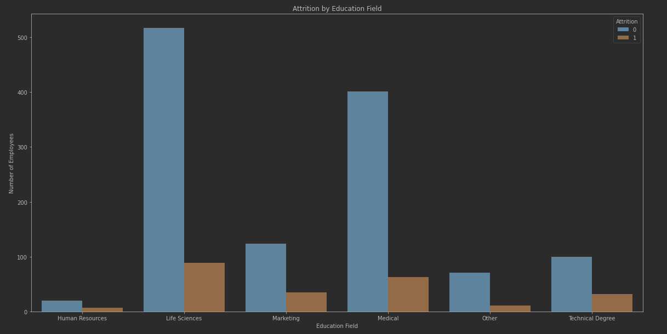
Exploratory Data Analysis
Attrition Rate:
Human Resources - 25.9%
Life Sciences - 14.2%
Marketing - 22.0%
Medical - 13.6%
Other - 13.4%
Technical Degree - 24.2%

Slide 10
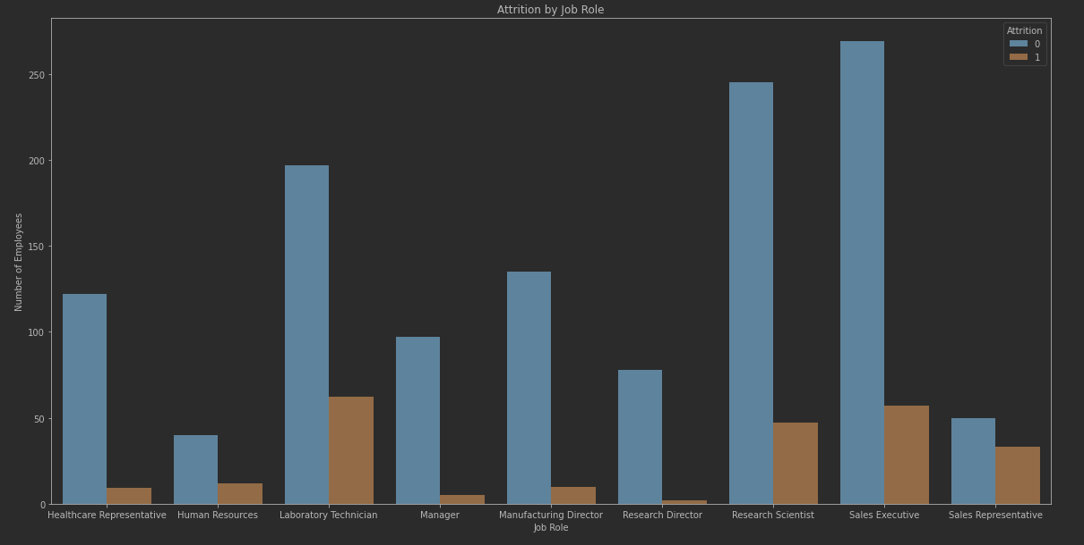
Exploratory Data Analysis
Attrition Rate:
Research Director - 2.5%
Research Scientist - 16.1%
Sales Executive - 17.5%
Sales Representative - 39.8%
Attrition Rate:
Healthcare Representative - 6.9%
Human Resources - 23.1%
Laboratory Technician - 23.9%
Manager - 4.9%
Manufacturing Director - 6.9%

Slide 11
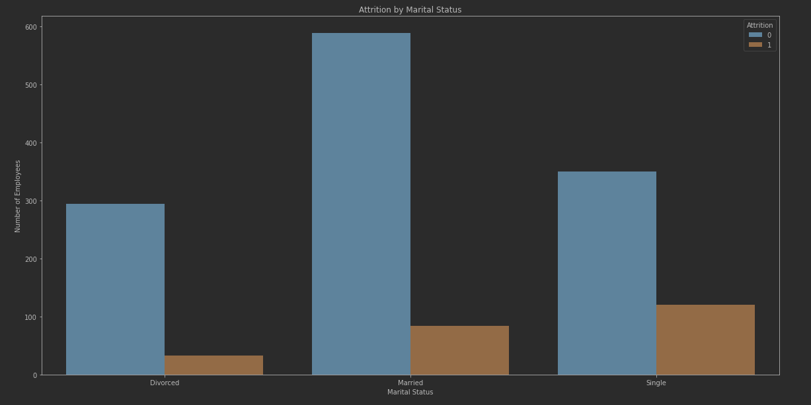
Exploratory Data Analysis
Attrition Rate:
Divorced - 10.1%
Married - 12.5%
Single - 25.5%

Slide 12
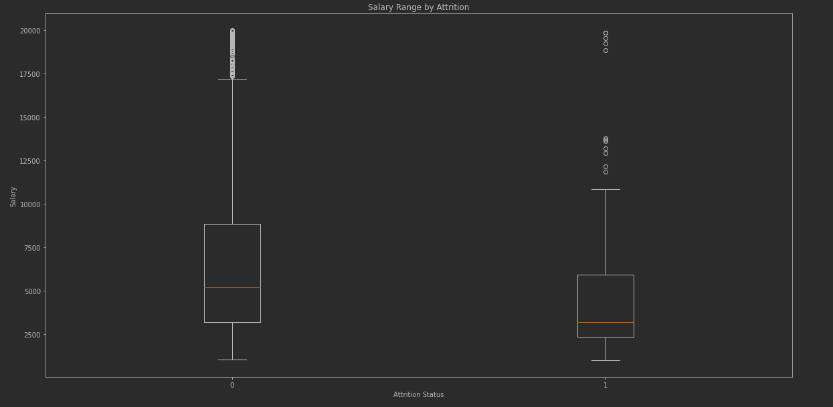
Exploratory Data Analysis
The general salary range is the same regardless of attrition status, however, those who stay in their positions longer have a higher average monthly salary.

Slide 13
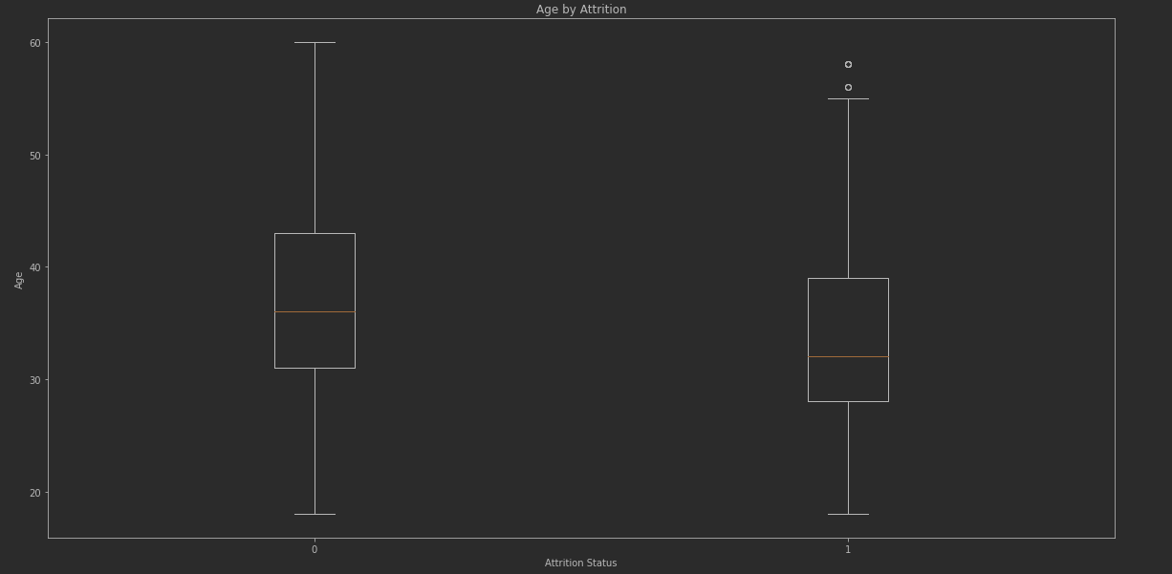
Exploratory Data Analysis
The average age of those who leave the company is slightly lower than that of those who are still employed.

Slide 14
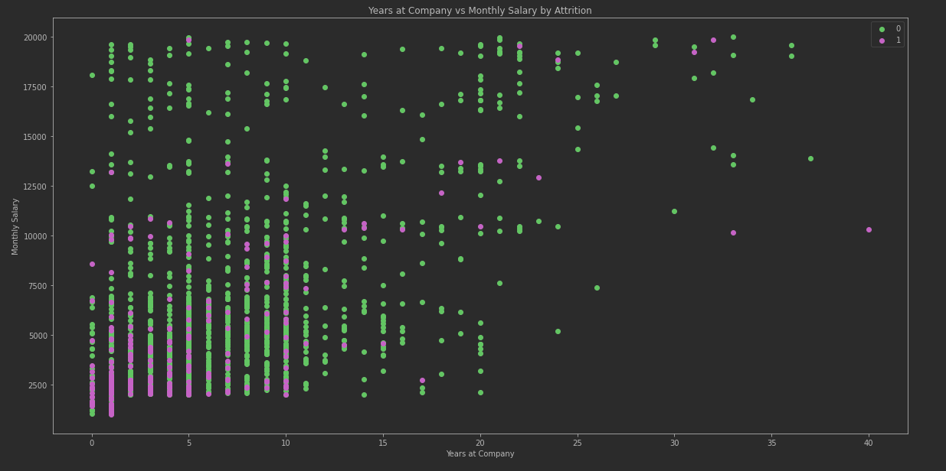
Exploratory Data Analysis
The majority of employees who left the company did so within the first 10 years of employment, but generally make less money.

Slide 15
Data Preparation
No missing values
No major outliers
Drop employee ID for modeling
Converted all categorical variables to ‘dummy’ columns
Creates a binary (1 or 0) column out of each possible category for each variable

Slide 16
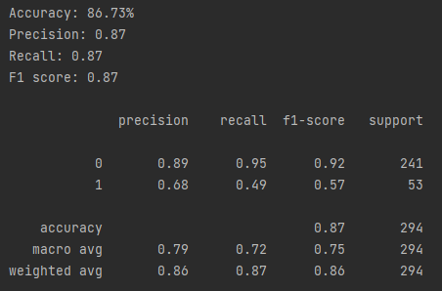

Base Model
All data was included, no class balancing
Pipeline included 5 different models (random forest, logistic regression, multinomial Naïve Bayes, linear support vector, and K-nearest neighbors)
200 total fits (or attempts) with all hyperparameters
Logistic regression had the highest accuracy (88% in training)

Slide 17
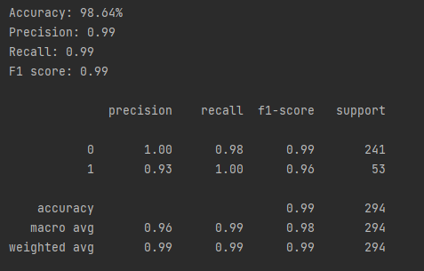
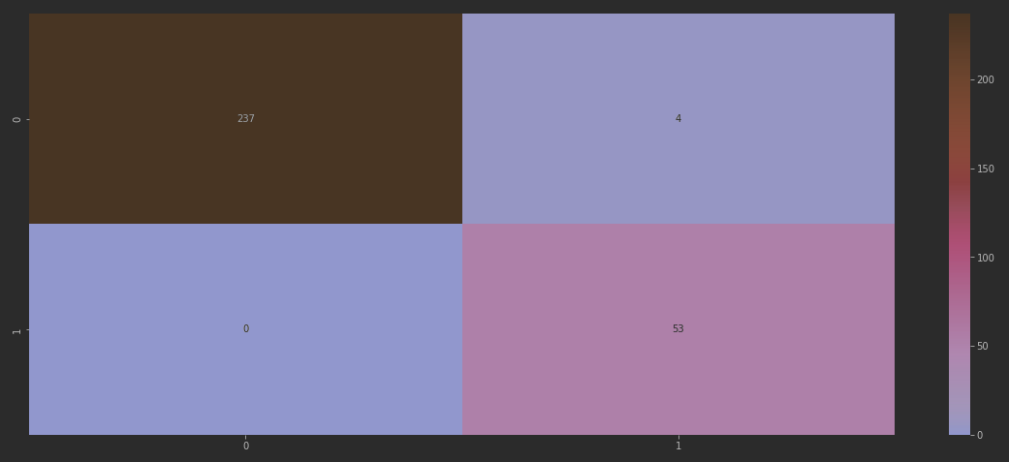
Balanced Classes
All data was included and over-/under-sampled to create balanced target classes
Same pipeline as the previous model
Random forest had the highest accuracy (96.6% in training)
10,000 estimators, ‘gini’ classifier
Model was then tested on ‘real’ imbalanced data (98.64%)

Slide 18

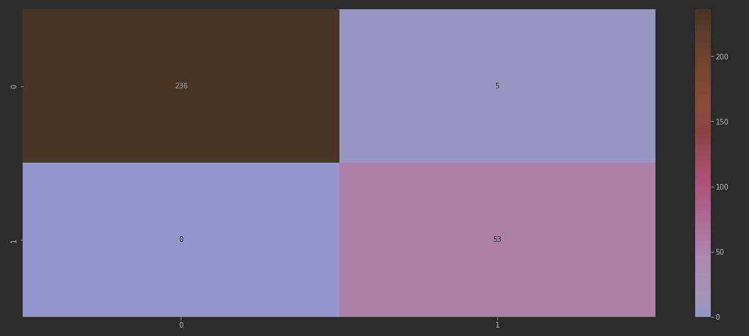
Automated Feature Reduction
All data was included with balanced classes
39 was the ‘optimal’ feature number
Same pipeline as the previous model
Random forest had the highest accuracy (96.5% in training)
10,000 estimators, ‘gini’ classifier
Model was then tested on ‘real’ imbalanced data (98.3%)

Slide 19
Manual Feature Reduction
All data was included with balanced classes
Features were removed in chunks, then tested for accuracy
Job role, education field, gender, age, department, and business travel were removed in waves
Same pipelines as the previous model
Random forest had the highest accuracy for all attempts
10,000 estimators, ‘gini’ classifier
Model was then tested on ‘real’ imbalanced data

Slide 20

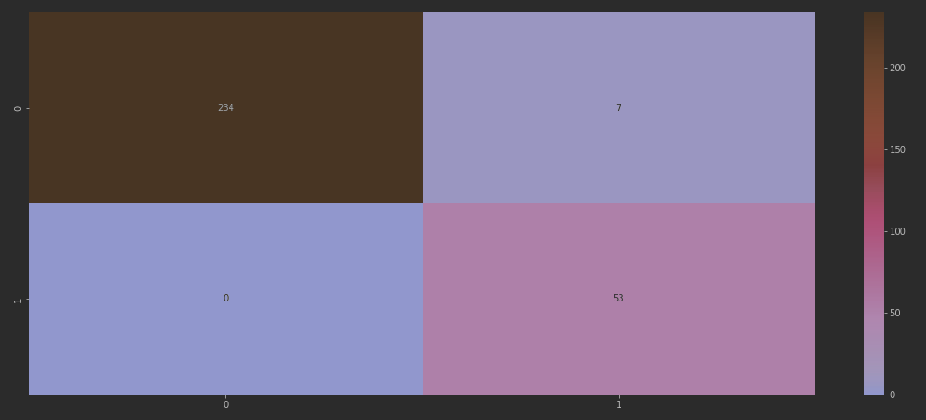
Manual Feature Reduction
Final run reduced 55 total features to 21
No protected classes were used
No subjective survey question scores
No department, job role, or education to make the model more portable

Slide 21
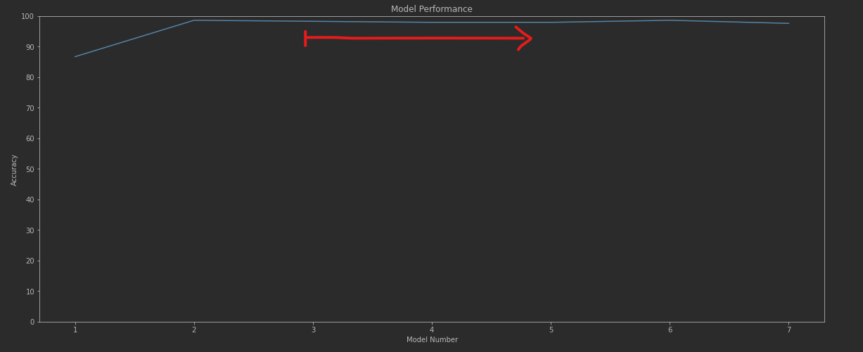
Overall Model Performance
From the start of the manual reduction process, the change in accuracy is negligible, but the model becomes much more simplistic with each attempt.

Slide 22
Conclusion
Overall accuracy averaged between 97% and 99%
Feature reduction makes the model much more viable for our company data
No chance for discrimination
Random forest removes some ability to gain actionable insights from the data
Features are weighted differently than a simple regression
Less features increases probability of generalization
Occam’s razer – the simplest model is usually the best model

