Slide 2
Limits of neural Networks
Neural neworks can be susceptible to image manipulation
Intriguing properties of neural networks, 2014
There are pixels that can be manipulated to manipulate NN regardless of trainig sets.
We didnt thave the means to write an algorythm to do that.
But what happens if ther is random corruption without malice?

Slide 3
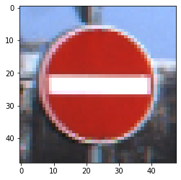

What happens if images get „corrupted“?
„Do not enter“ sign
„Do not enter“ sign with a black pixel

Slide 4
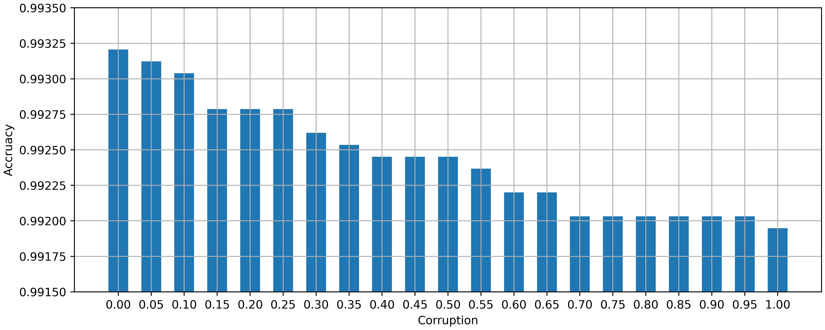
Does this throw of the CNN?
-Accruacy decreased from
0.99320 to 0.99194
-That means 18,5% more wrong predictions

Slide 5
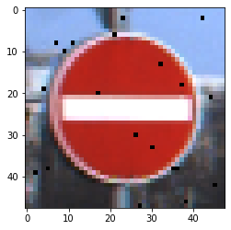
Why stop at 1 pixel?
„Do not enter“ sign
„Do not enter“ sign with twenty black pixels

Slide 6
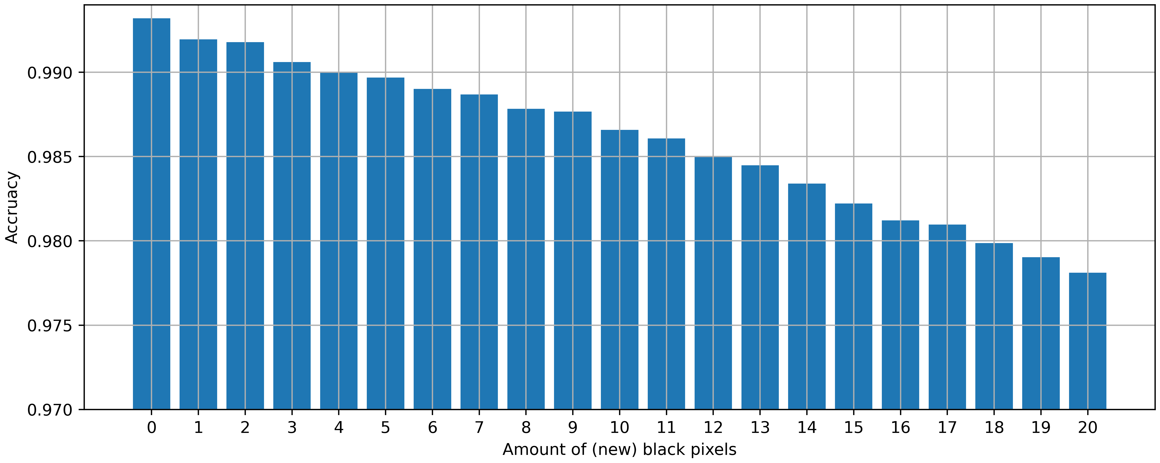
-Accruacy decreased from
0.99320 to 0.97810
-That means 43,8% more wrong predictions

Slide 7
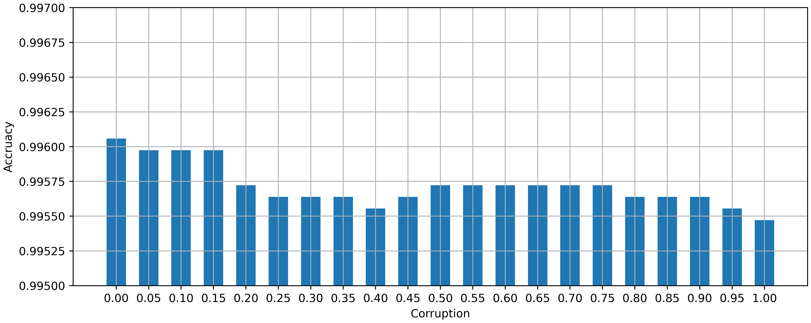
And with te extra Data preprocessing?
-Accruacy decreased from
0.99605 to 0.99547
-That means 14,7% more wrong predictions

Slide 8
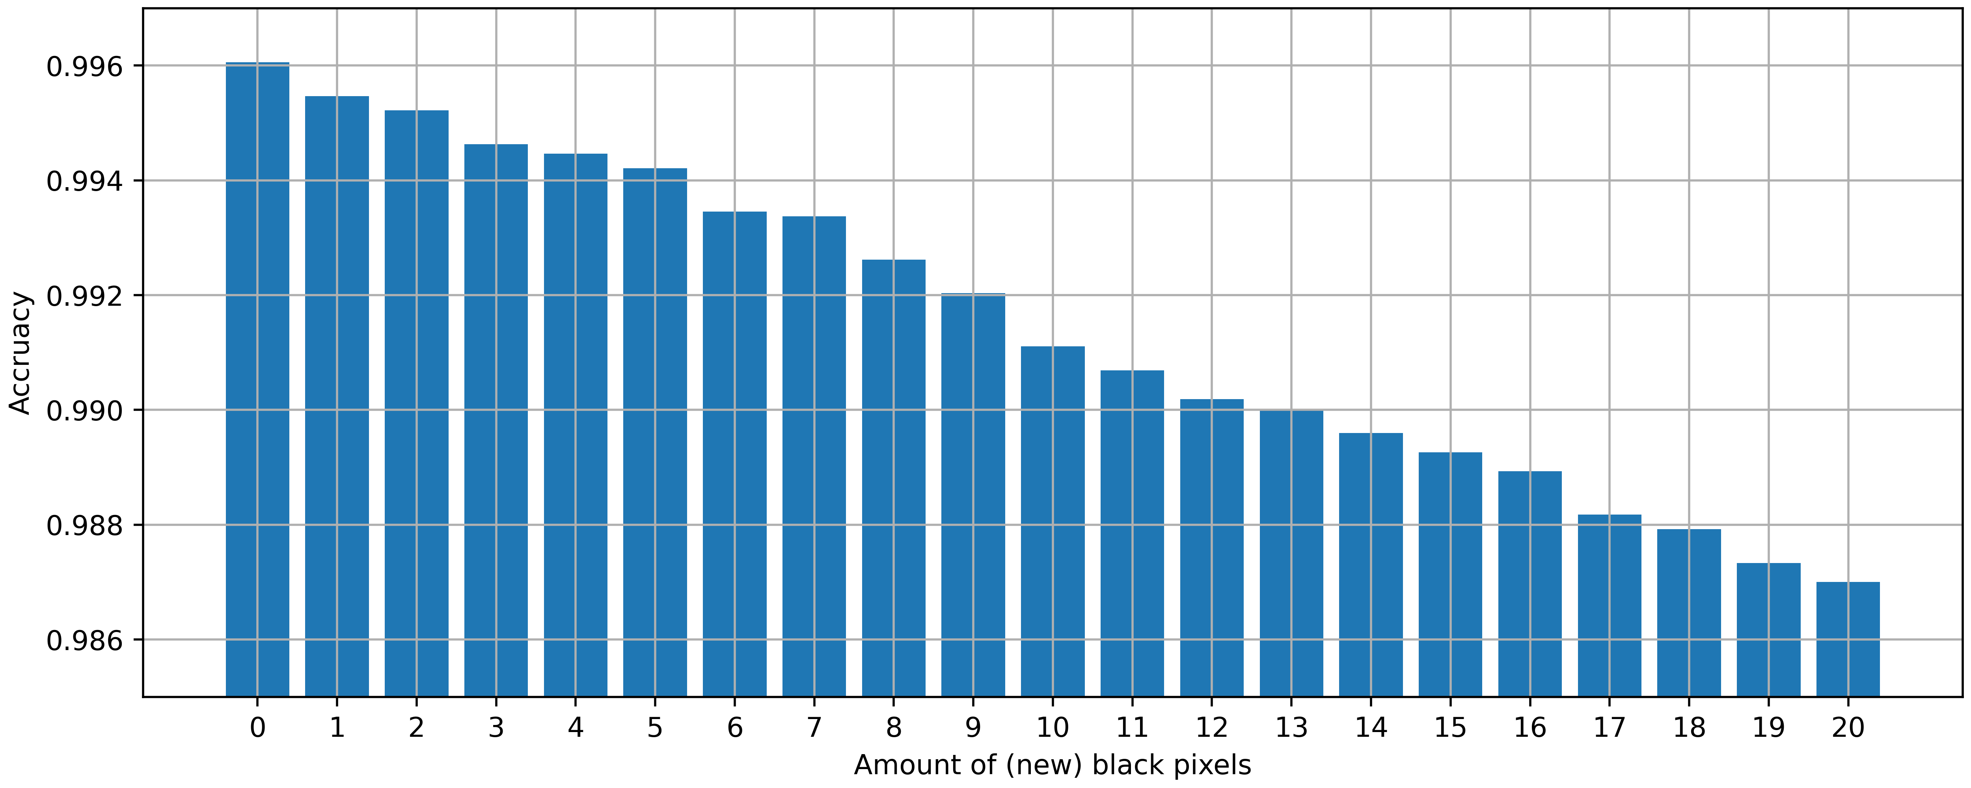
-Accruacy decreased from
0.99605 to 0.98700
-That means 229,1% more wrong predictions

Slide 9
What else coud happen to the image?
Blur
Sharp

Slide 10

Blur with 1x1 Kernel

Slide 11

Blur with 3x3 Kernel

Slide 12

Blur with 5x5 Kernel

Slide 13
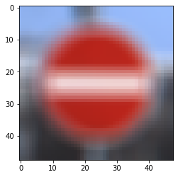
Blur with 7x7 Kernel

Slide 14

Blur with 9x9 Kernel

Slide 15
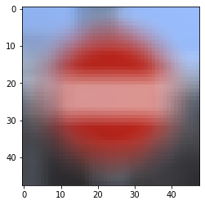
Blur with 11x11 Kernel

Slide 16
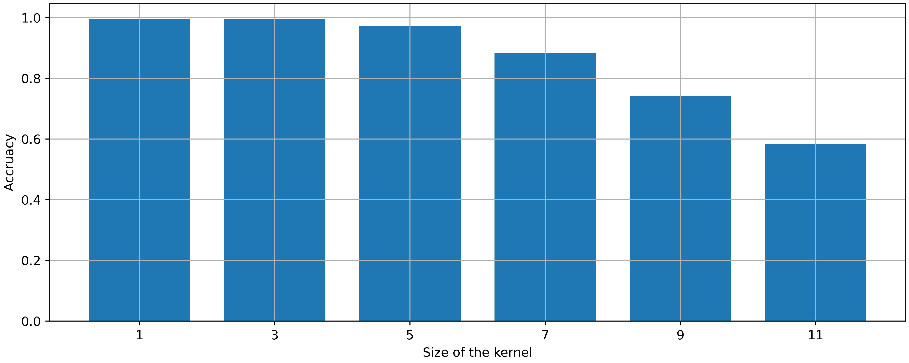
Whats the overall performance with blur?

Slide 17
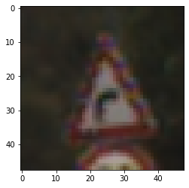
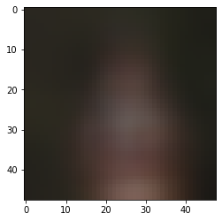
Many images are worse…
Original
9x9 kernel

Slide 18
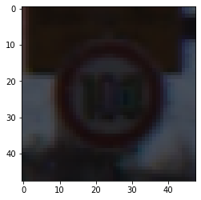
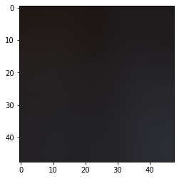
Many images are worse…
Original
9x9 kernel

Slide 19
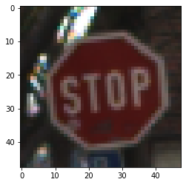
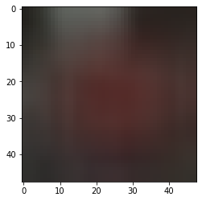
Many images are worse…
Original
9x9 kernel

Slide 20
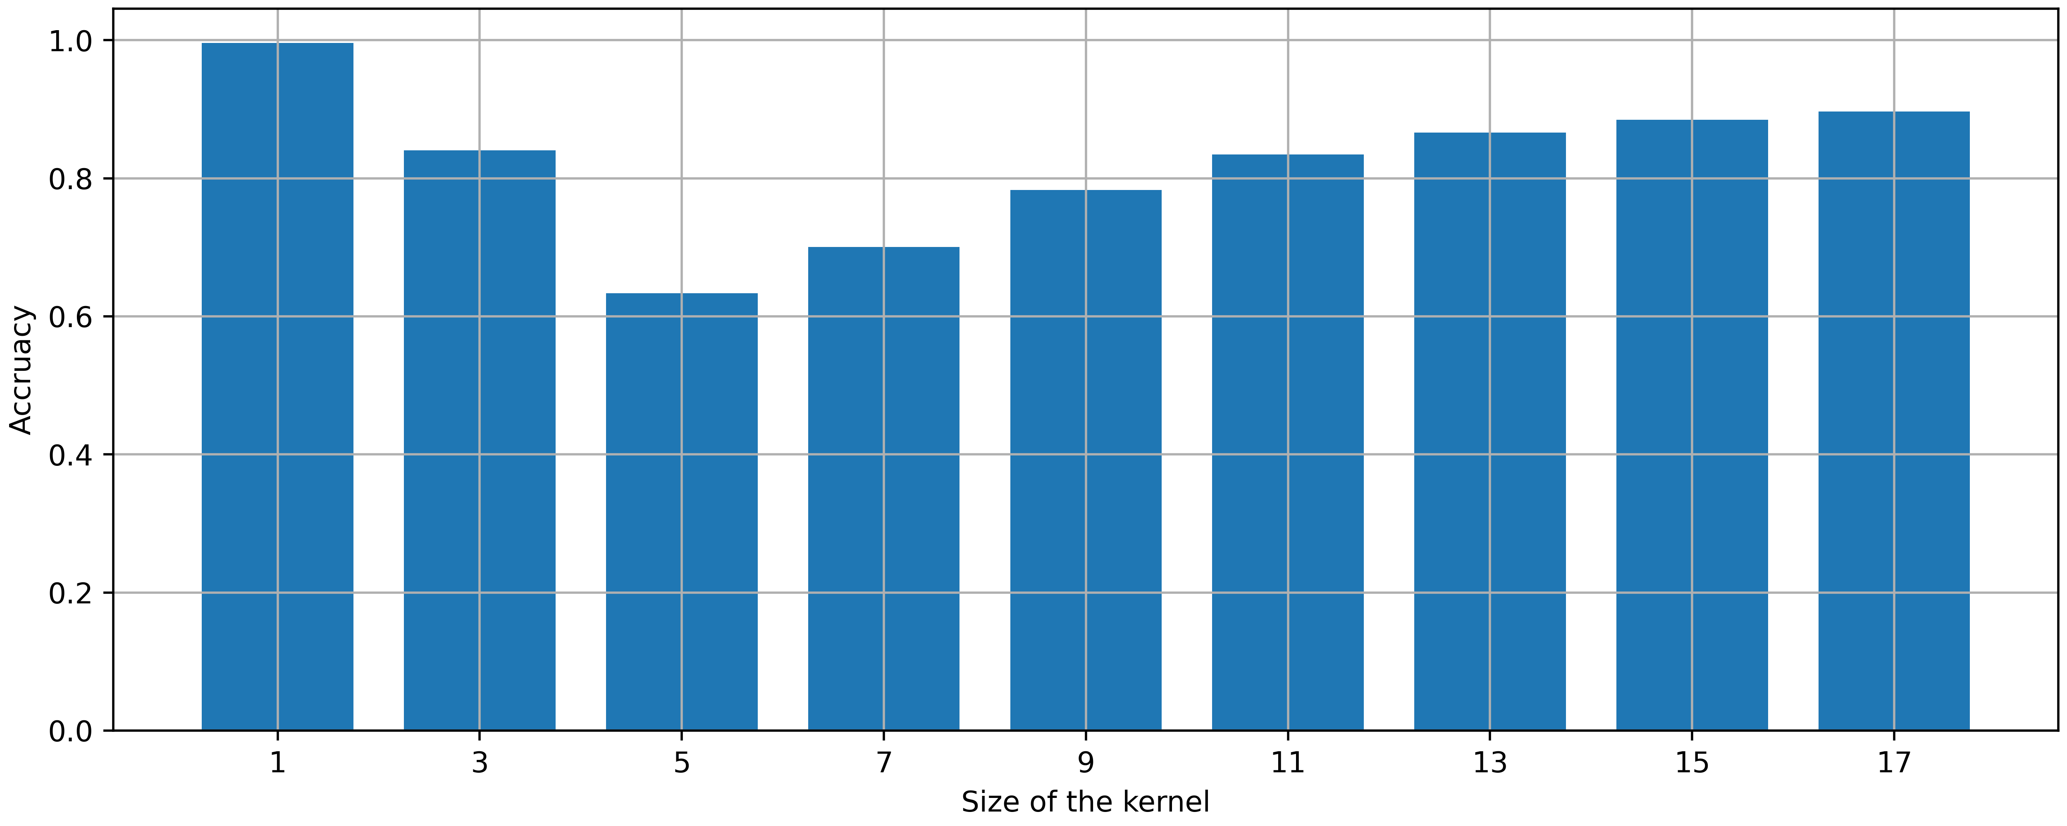
Sharpening has an interensting trend

Slide 21
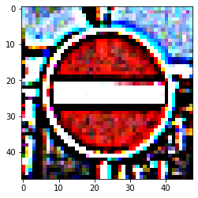
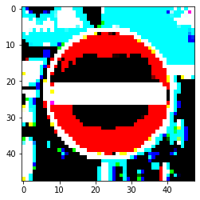
While the colours look wierd
5x5 Kernel
17x17 Kernel

Slide 22
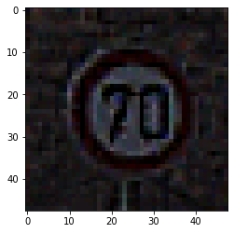
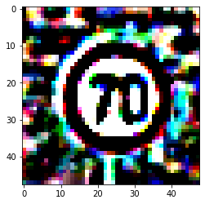
While the colours look wierd
5x5 Kernel
17x17 Kernel

Slide 23
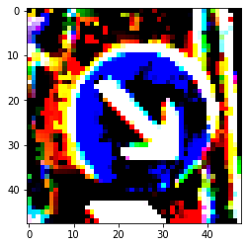
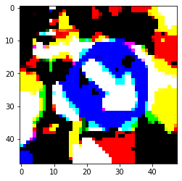
While the colours look wierd
5x5 Kernel
17x17 Kernel

Slide 24
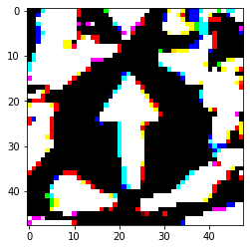
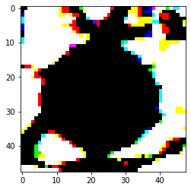
But sometimes …
5x5 Kernel
17x17 Kernel

