Slide 1
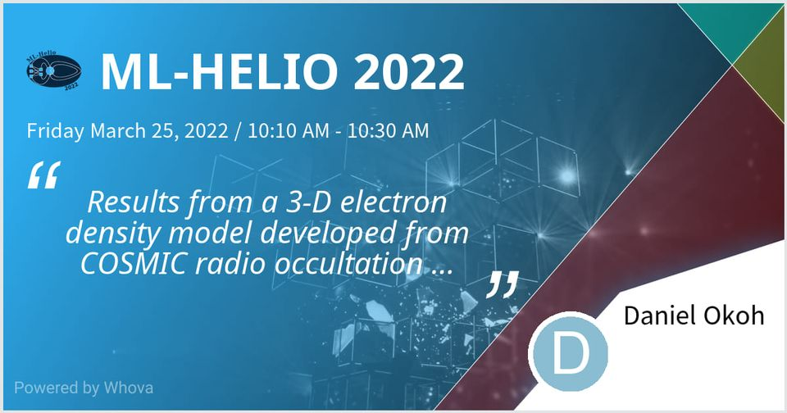

Slide 2


Results from a 3-D electron density model developed from COSMIC radio occultation data using artificial neural networks
Daniel Okoh, John Bosco Habarulema, Rabiu Babatunde
Machine Learning in Heliophysics (ML-Helio)
25 March 2022

Slide 3
Outline
Intro: What & Why 3-D?
Data & Methods
Results

Slide 4
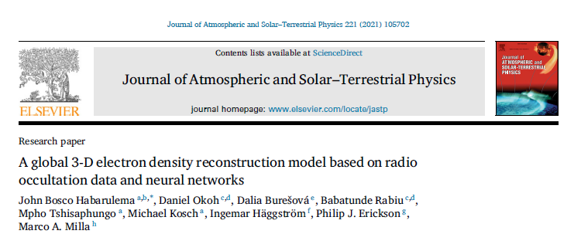
Reference paper for model development

Slide 5
Intro: What and Why 3-D?
In our context, the 3-D ionospheric model involves representation of the ionosphere (electron densities) in 3 space dimensions of Longitude, Latitude, and Altitude.

Slide 6
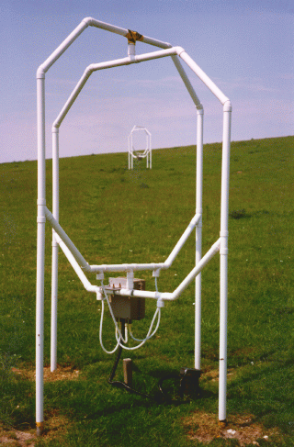
Intro: What and Why 3-D?
Ionosondes and Incoherent Scatter Radars (ISRs) provide altitude-varying profiles of electron density.
Profiles are limited to locations of the equipment
We may not get good spatial (longitude-by-latitude) coverage unless the equipment are installed in dense populations.
Practically, we are limited by costs and logistics of installation/maintenance, especially across oceans and deserts.

Slide 7
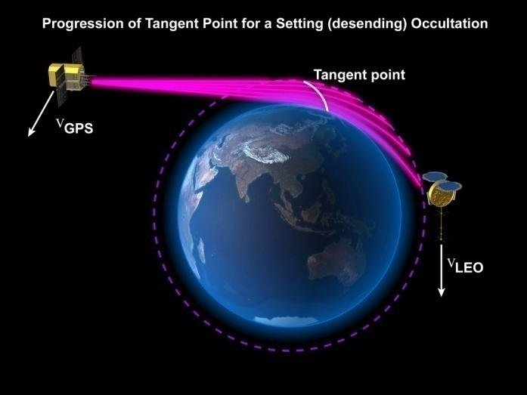
Intro: What and Why 3-D?
On the other hand, the technique of radio occultation (RO) applied on low Earth orbit satellite constellations (such as COSMIC: Constellation Observing System for Meteorology, Ionosphere, and Climate) is providing avenue to record altitude-varying electron density profiles across the globe.
The limitation is that we do not get continuous measurements of the profiles over time at individual Earth locations. The system however provides enormous amount of data, with good global coverage, to develop 3-D electron density model as done in this study.
Such model offers opportunity to represent continuous altitude-varying electron density profiles over any given Earth location.

Slide 8

Intro: What and Why 3-D?
Given the big size of data available, machine learning techniques are usually most suitable, so as to optimally harness information from the big data.
A number of research (e.g. Tulasi Ram et al., Gowtam et al., 2019) have demonstrated that artificial neural networks (ANNs) are good candidates for such modelling). Earlier studies (e.g. Habarulema et al., 2010; Okoh et al., 2019) have also shown that ANNs are generally good candidates for ionospheric modelling, as ANNs have been shown to posses capacity to learn ionospheric variation patterns from emperical data, and to predict events for which they are not trained, with good accuracy.

Slide 9
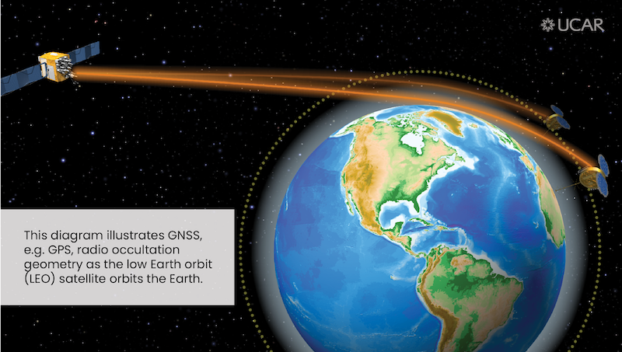
Data and methods
Global radio Occultation electron density profiles from COSMIC mission during the period 2006-2019 were accessed from http://cosmicio.cosmic.ucar.edu/cdaac/index.html.
Second level (ionPrf) data files were used.

Slide 10

Data and methods
Data cleaning
For the purpose of quality control of the data, we did the following:
removed negative electron density measurements
removed the entire profiles if they have negative electron densities at altitudes greater than or equal to 100 km,
eliminated entire profiles in which the heights of peak electron densities (hmF2) are outside the range 200-450 km

Slide 11
Data and methods
The global dataset is too large (about 2 billion data points)
We therefore split the globe into 864 cells.
The size of each cell is 5◦ × 15◦ degrees (Latitude and Longitude)

Slide 12

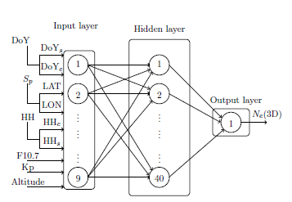
Data and methods
Inputs for the neural network training:
Hour of the Day in UT (HH)
HHc
HHs
Day of the Year (DOY)
DOYc
DOYs
Spatial components
LATITUDE
LONGITUDE
ALTITUDE
Solar and magnetic activity indicators
F10.7
Kp

Slide 13
Results
Model Validation with GIM
3D-NN
GIM
3D-NN
GIM

Slide 14
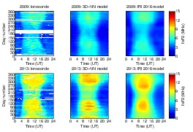
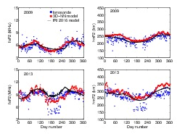
Results
Model Validation with Ionosonde data and IRI model
Ionosonde
3D-NN
IRI
Grahamstown (33.3 ºS, 26.5º E), South Africa

Slide 15
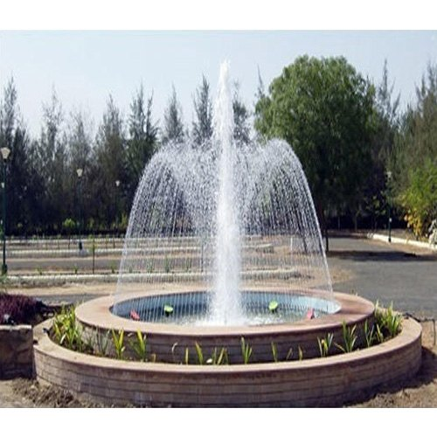
Results
The EIA idea in this work: distance between anomaly crests at various altitudes
The distance between the crests increases as the altitude decreases
We shall refer to the altitude in which the anomaly disappears as the anomaly apex (apx).

Slide 16
Results
Equatorial ionization Anomaly descriptions
Altitudes:
~ 200 – 500 km
3 Longitude sectors:
American (-60º)
African (15º)
Asian (105º)
Hour of Day:
12:00 Local Time of each sector
Year:
2012 (moderate solar activity)
High and Low solar activity years are also considered for the detailed report
Days:
20 March (March equinox)
21 June (June solstice)
22 Sept. (Sept. equinox)
21 Dec. (Dec. solstice)

Slide 17
Results
Equatorial ionization Anomaly descriptions (Position of crests)
Sample American Sector (Longitude -60º) December solstice (21 Dec. 2012)
Local midday (16:00 UT) 300 km

Slide 18
Results
Equatorial ionization Anomaly descriptions (Position of crests)
Sample African Sector (Longitude 15º) March equinox (20 March 2012)
Local midday (11:00 UT) 300 km

Slide 19
Results
Equatorial ionization Anomaly descriptions (Position of crests)
Sample Asian Sector (Longitude 105º) September equinox (22 September 2012)
Local midday (05:00 UT) 300 km

Slide 20
Results
American Sector (Longitude -60º) Local midday (16:00 UT) Year 2012
apx is typically around 350 – 500 km in this sector
apx is highest in March, lowest in June
Locations of the anomaly crests define the shape of the fountain

Slide 21
Results
African Sector (Longitude 15º) Local midday (11:00 UT) Year 2012
Anomaly crests are more southwards during the Dec. solstice (southern summer), and more northern during the June solstice (northern summer)

Slide 22
Results
Asian Sector (Longitude 105º) Local midday (05:00 UT) Year 2012
apx is highest in Sept., lowest in Dec.
At 200 km altitude, distance between the crests can reach 80 degrees.

Slide 23
Results
March Equinox (20 March 2012) Local midday
apx is consistently higher in the Asian sector, followed by the African sector and then American sector

Slide 24
Results
June Solstice (21 June 2012) Local midday
apx is consistently higher in the Asian sector, followed by the African sector and then American sector

Slide 25
Results
September Equinox (22 September 2012) Local midday
apx is consistently higher in the Asian sector, followed by the African sector and then American sector

Slide 26
Results
December Solstice (21 December 2012) Local midday
apx is consistently higher in the Asian sector, followed by the African sector and then American sector

Slide 27
Results
December Solstice (21 December 2012) Local midday
Using the geomagnetic scale (as in previous figures) may suggest that the distance between the anomaly crests is consistently lower in the American sector. This is not correct as illustrated here using the geographic scale
Geographic/Linear scale

Slide 28
Thanks for Listening

