Slide 1



Reinforcement learning
Episode 2
Value-based methods,
Temporal Difference

Slide 2
Reinforcement learning
Episode 2
Oh gosh,
we have 101 slides!

Slide 3

Recap: reinforcement learning
Agent
Can do anything
observation
action
Can't even see
(worst case)
Environment

Slide 4
Recap: reinforcement learning
Agent
Can do anything
observation
action
Can't even see
(worst case)
Q: How did we solve it?
Environment

Slide 5
Black box methods
Genetic algorithms
Evolution strategies
Crossentropy method
…

Slide 6

Black box drawbacks
Both need a full session to start learning
Requires a lot of interaction
  A lot of crashed robots / simulations

Slide 7
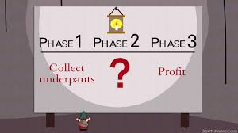
Today: value-based methods
Core idea:
  1. You are at state s
  2. Compute expected reward for session if you take
    each possible action (a1,a2,a3,...)
  Then what? (e.g. chess)
    You can compute expected win rate for each move.
    What do you do?

Slide 8
Today: value-based methods
Core idea:
  1. You are at state s
  2. Compute expected reward for session if you take
    each possible action (a1,a2,a3,...)
  3. Take action with highest expected reward!

Slide 9

MDP formalism: reward on each tick
Classic MDP(Markov Decision Process)
Agent interacts with environment
  Environment states:
  Agent actions:
  State transition:
  Reward:

Slide 10
Model-based setup
What we know
State transitions
or
Rewards

Slide 11
Model-based setup
What we know
State transitions
or
Rewards
Weaker version: we can only
sample from P(s'|s,a)

Slide 12

Discounted reward MDP
Objective:
  Discounted return G
γ ~ patience
Cake tomorrow is γ as good as now

Slide 13
Discounted reward MDP
Objective:
  Discounted return G
γ ~ patience
Cake tomorrow is γ as good as now
Q1: which γ corresponds to
“only current reward matters”?
Q2: with which γ G is just a sum of rewards?

Slide 14
Discounted reward MDP
Objective:
  Discounted return G
Reinforcement learning:
  Find policy that maximizes
    the expected reward

Slide 15
Discounted reward MDP
Objective:
  Discounted return G
Reinforcement learning:
  Find policy that maximizes
    the expected reward
Does not maximize sum of rewards
Unless γ = 1

Slide 16

Dealing with G
=
We rewrite G with sheer power of math!

Slide 17
Dealing with G
=
=
=
We rewrite G with sheer power of math!

Slide 18
Dealing with G
=
=
=
=
We rewrite G with sheer power of math!

Slide 19

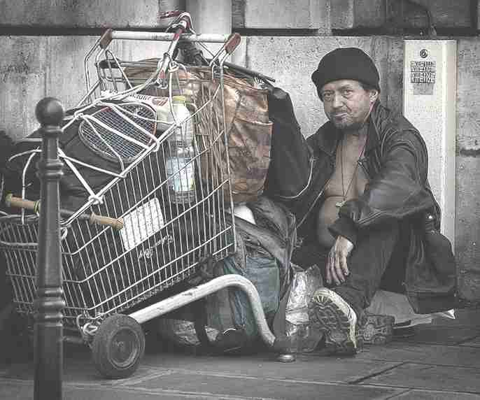
More new letters!
  Definition: Vπ(s) – expected total reward G that can be obtained starting from state s and following policy π.
large potential rewards
small potential rewards
vs

Slide 20
More new letters!
  Definition: Vπ(s) – expected total reward G that can be obtained starting from state s and following policy π.
…

Slide 21
State value
  Definition: Vπ(s) – expected total reward G that can be obtained starting from state s and following policy π.
…

Slide 22
State value
  Definition: Vπ(s) – expected total reward G that can be obtained starting from state s and following policy π.
…

Slide 23
State value
  Definition: Vπ(s) – expected total reward G that can be obtained starting from state s and following policy π.

Slide 24
State value
  Definition: Vπ(s) – expected total reward G that can be obtained starting from state s and following policy π.
trajectory τ = (s,a,r,s',a',r',...)

Slide 25
Bellman equation
  Definition: Vπ(s) – expected total reward R that can be obtained starting from state s and following policy π.

Slide 26
Bellman equation
  Definition: Vπ(s) – expected total reward R that can be obtained starting from state s and following policy π.
how I like s = what r I can get right now + γ * how I like s'

Slide 27
Optimal policy
Imagine we know exact value of any Vπ(s).
(also P(s',r|s,a))
Q: how do we pick optimal action?
s1
V(s1) = 4.5
r=+1
s0
a1
s2
a2
r=+2
V(s2) = 3.9
a3
r=+3
s3
V(s2) = 2.2

Slide 28
Optimal policy
Imagine we know exact value of any Vπ(s).
(also P(s',r|s,a))
Q: how do we pick optimal action?
s1
V(s1) = 4.5
r=+1
s0
a1
s2
a2
r=+2
V(s2) = 3.9
If gamma=1
a3
r=+3
s3
V(s2) = 2.2

Slide 29
π*(a|s) and V*(s)

Slide 30
Value iteration (TD)
Idea:
  Iterative updates

Slide 31

Value iteration (TD)
Idea:
  Iterative updates
0
0
0
0
0
0
0
0
0
0

Slide 32
Value iteration (TD)
Idea:
  Iterative updates
0
0
γ
0
0
0
0
0
0
1

Slide 33
Value iteration (TD)
Idea:
  Iterative updates
0
γ²
γ
0
γ²
0
0
0
0
2

Slide 34
Value iteration (TD)
Idea:
  Iterative updates
γ³
γ²
γ
0
γ²
0
0
γ³
0
3

Slide 35
Value iteration (TD)
Idea:
  Iterative updates
γ³
γ²
γ
γ⁴
γ²
γ⁵
γ⁴
γ³
γ⁴
5

Slide 36

Value iteration (TD)
Idea:
  Iterative updates

Slide 37
Decision process in the wild
Agent
Can do anything
observation
action
Can't even see
(worst case)
Environment

Slide 38



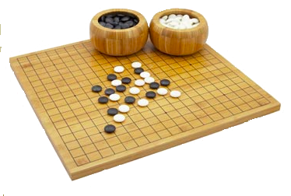
Decision process in the wild
Agent
Can do anything
observation
action
Can't even see
(worst case)
Environment

Slide 39
Model-free setting:
We don't know actual
P(s',r|s,a)
Whachagonnado?

Slide 40
Model-free setting:
We don't know actual
P(s',r|s,a)
Learn it?
Get rid of it?

Slide 41
More new letters
Vπ(s) – expected G from state s if you follow π
V*(s) – expected G from state s if you follow π*

Slide 42
More new letters
Vπ(s) – expected G from state s if you follow π
V*(s) – expected G from state s if you follow π*
Qπ(s,a) – expected G from state s
  if you start by taking action a
  and follow π from next state on
Q*(s,a) – guess what it is :)

Slide 43
More new letters
Vπ(s) – expected G from state s if you follow π
V*(s) – expected G from state s if you follow π*
Qπ(s,a) – expected G from state s
  if you start by taking action a
  and follow π from next state on
Q*(s,a) – same as Qπ(s,a) where π = π*

Slide 44
Any ideas?
Assuming you know Q*(s,a),
  how do you compute π*
  how do you compute V*(s)?
Assuming you know V(s)
  how do you compute Q(s,a)?

Slide 45
To sum up
Image: cs188x
Action value Qπ(s,a) is the expected total reward G agent gets from state s by taking action a and following policy π from next state.

Slide 46
Learning from trajectories
Model-based: you know P(s'|s,a)
- can apply dynamic programming
- can plan ahead
Model-free: you can sample trajectories
- can try stuff out
- insurance not included
  r
prev s
s'
s
a'
a
s''
prev a
a''
  r'

Slide 47
MDP trajectory
  r
prev s
s'
s
a'
a
s''
prev a
a''
  r'
Trajectory is a sequence of
  states (s)
  actions (a)
  rewards (r)
We can only sample trajectories

Slide 48
MDP trajectory
  r
prev s
s'
s
a'
a
s''
prev a
a''
  r'
Trajectory is a sequence of
  states (s)
  actions (a)
  rewards (r)
We can only sample trajectories
Q: What to learn?
V(s) or Q(s,a)

Slide 49
MDP trajectory
  r
prev s
s'
s
a'
a
s''
prev a
a''
  r'
Trajectory is a sequence of
  states (s)
  actions (a)
  rewards (r)
We can only sample trajectories
Q: What to learn?
V(s) or Q(s,a)
V(s) is useless
without P(s'|s,a)

Slide 50
More temporal difference
Remember we can improve Q(s,a) iteratively!

Slide 51
More temporal difference
Remember we can improve Q(s,a) iteratively!
That's Q*(s,a)
That's value for π*
aka optimal policy

Slide 52
More temporal difference
Remember we can improve Q(s,a) iteratively!
That's Q*(s,a)
That's value for π*
aka optimal policy
That's something
we don't have
What do we do?

Slide 53
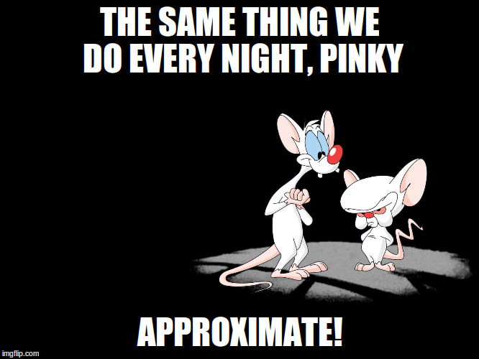
More temporal difference

Slide 54
More temporal difference
Replace expectation with sampling

Slide 55
More temporal difference
Replace expectation with sampling
Use moving average with just one sample!

Slide 56
Q-learning
  r
prev s
s'
s
a'
a
s''
prev a
a''
  r'
Works on a sequence of
  states (s)
  actions (a)
  rewards (r)

Slide 57
Q-learning
  r
prev s
s'
s
a'
a
s''
prev a
a''
  r'
Initialize Q(s,a) with zeros
Loop:
  Sample <s,a,r,s'> from env

Slide 58
Q-learning
  r
possible
actions
prev s
s'
s
a'
a
s''
prev a
a''
  r'
Initialize Q(s,a) with zeros
Loop:
  Sample <s,a,r,s'> from env
  Compute

Slide 59
Q-learning
  r
possible
actions
prev s
s'
s
a'
a
s''
prev a
a''
  r'
Initialize Q(s,a) with zeros
Loop:
  Sample <s,a,r,s'> from env
  Compute
  Update

Slide 60

What could possibly go wrong?
Our mobile robot learns to walk.
Initial Q(s,a) are zeros
robot uses argmax Q(s,a)
He has just learned to crawl with positive reward!

Slide 61
What could possibly go wrong?
Our mobile robot learns to walk.
Initial Q(s,a) are zeros
robot uses argmax Q(s,a)
Too bad, now he will never learn to walk upright =(

Slide 62
What could possibly go wrong?
New problem:
If our agent always takes “best” actions
from his current point of view,
How will he ever learn that other actions
may be better than his current best one?
Ideas?

Slide 63

Exploration Vs Exploitation
Balance between using what you learned and trying to find something even better

Slide 64
Exploration Vs Exploitation
Strategies:
    ε-greedy
        With probability ε take random action; otherwise take optimal action.

Slide 65
Exploration Vs Exploitation
Strategies:
    ε-greedy
        With probability ε take random action; otherwise take optimal action.
    Softmax
        Pick action proportional to softmax of shifted normalized Q-values.
    More cool stuff coming later

Slide 66
Exploration over time
Idea:
If you want to converge to optimal policy,
you need to gradually reduce exploration
Example:
Initialize ε-greedy ε = 0.5, then gradually reduce it
    If ε → 0, it's greedy in the limit
    Be careful with non-stationary environments

Slide 67
A popular vote
More lecture Vs some seminar?

Slide 68
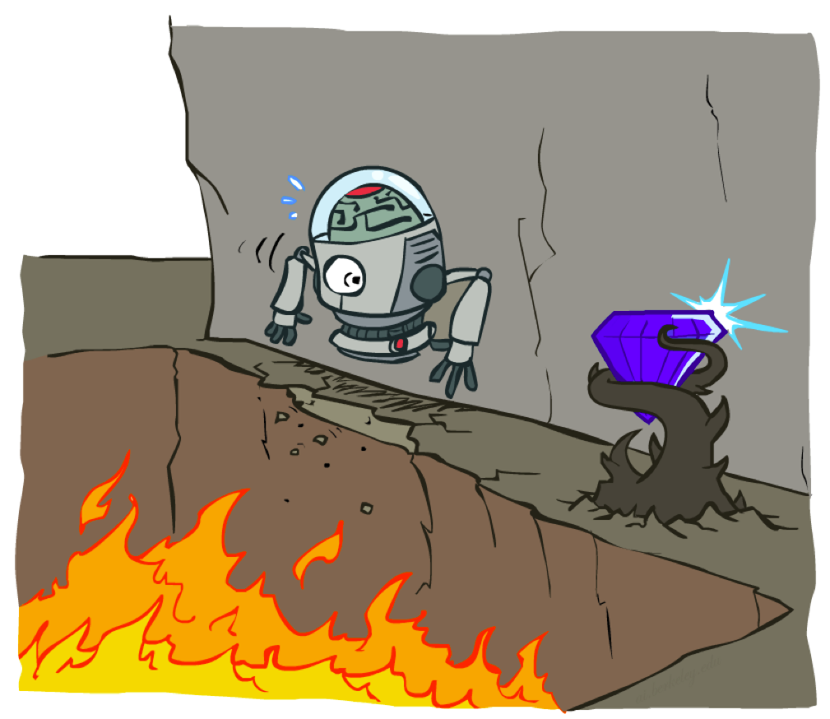
Cliff world
Picture from Berkeley CS188x

Slide 69
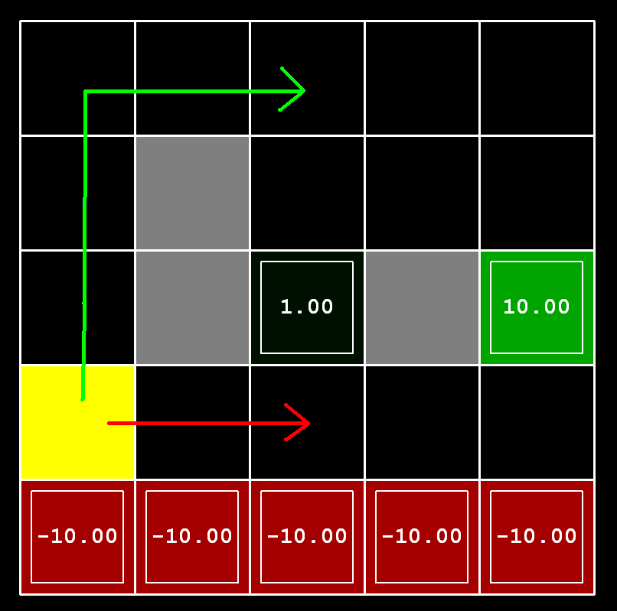
Cliff world
Conditions
      Q-learning
      no slipping
Trivia:
What will q-learning learn?

Slide 70
Cliff world
Conditions
      Q-learning
      no slipping
Trivia:
What will q-learning learn?
Will it maximize reward?
follow the short path

Slide 71
Cliff world
Conditions
      Q-learning
      no slipping
Trivia:
What will q-learning learn?
Will it maximize reward?
follow the short path
no, robot will fall due to
epsilon-greedy “exploration”

Slide 72
Cliff world
Conditions
      Q-learning
      no slipping
Decisions must account
for actual policy!
e.g. ε-greedy policy

Slide 73
Generalized update rule
Update rule (from Bellman eq.)
“better Q(s,a)”

Slide 74
Q-learning VS SARSA
Update rule (from Bellman eq.)
Q-learning
“better Q(s,a)”

Slide 75
Q-learning VS SARSA
Update rule (from Bellman eq.)
Q-learning
SARSA
“better Q(s,a)”

Slide 76
Recap: Q-learning
  r
possible
actions
prev s
s'
s
a'
a
s''
prev a
a''
  r'
Loop:
  Sample <s,a,r,s'> from env
  Compute
  Update

Slide 77
SARSA
  r
prev s
s'
s
a'
a
s''
prev a
a''
  r'
Loop:
  Sample <s,a,r,s',a'> from env
  Compute
  Update

Slide 78
SARSA
  r
prev s
s'
s
a'
a
s''
prev a
a''
  r'
Loop:
  Sample <s,a,r,s',a'> from env
  Compute
  Update
hence “SARSA”
next action
(not max)

Slide 79
Expected value SARSA
  r
possible
actions
prev s
s'
s
a'
a
s''
prev a
a''
  r'
Loop:
  Sample <s,a,r,s'> from env
  Compute
  Update

Slide 80
Expected value SARSA
  r
possible
actions
prev s
s'
s
a'
a
s''
prev a
a''
  r'
Loop:
  Sample <s,a,r,s'> from env
  Compute
  Update
Expected value

Slide 81
Difference
SARSA gets optimal
rewards under current
policy
Q-learning policy
would be optimal
under
Q-learning
SARSA

Slide 82
On-policy vs Off-policy
Two problem setups
on-policy
Agent can pick actions
  Most obvious setup :)
  Agent always follows his
  own policy
off-policy
Agent can't pick actions
  Learning with exploration,
  playing without exploration
  Learning from expert
    (expert is imperfect)
  Learning from sessions
    (recorded data)

Slide 83
On-policy vs Off-policy
Two problem setups
on-policy
Agent can pick actions
  On-policy algorithms can't learn off-policy
off-policy
Agent can't pick actions
  Off-policy algorithms can
  learn on-policy
  learn optimal policy even if agent takes random actions
Q: which of Q-learning, SARSA and exp. val. SARSA
will only work on-policy?

Slide 84
On-policy vs Off-policy
Two problem setups
on-policy
Agent can pick actions
  On-policy algorithms can't learn off-policy
  SARSA
  more later
off-policy
Agent can't pick actions
  Off-policy algorithms can
  learn on-policy
  Q-learning
  Expected Value SARSA

Slide 85
On-policy vs Off-policy
Two problem setups
on-policy
Agent can pick actions
  On-policy algorithms can't learn off-policy
  SARSA
  more coming soon
off-policy
Agent can't pick actions
  Off-policy algorithms can
  learn on-policy
  Q-learning
  Expected Value SARSA

Slide 86
On-policy vs Off-policy
Two problem setups
on-policy
Agent can pick actions
  On-policy algorithms can't learn off-policy
  SARSA
  more coming soon
off-policy
Agent can't pick actions
  Off-policy algorithms can
  learn on-policy
  Q-learning
  Expected Value SARSA

Slide 87
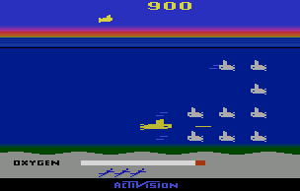
Experience replay
Interaction
Idea: store several past interactions
<s,a,r,s'>
Train on random subsamples
Agent
training
<s,a,r,s'>
<s,a,r,s'>
<s,a,r,s'>
<s,a,r,s'>
<s,a,r,s'>
<s,a,r,s'>
<s,a,r,s'>
~
training
batches
Replay
buffer

Slide 88
Experience replay
Interaction
Idea: store several past interactions
<s,a,r,s'>
Train on random subsamples
Training curriculum:
- play 1 step and record it
- pick N random transitions to train
Profit: you don't need to re-visit same (s,a) many times to learn it.
Only works with
off-policy algorithms!
Agent
training
<s,a,r,s'>
<s,a,r,s'>
<s,a,r,s'>
<s,a,r,s'>
<s,a,r,s'>
<s,a,r,s'>
<s,a,r,s'>
~
training
batches
Btw, why
only them?
Replay
buffer

Slide 89
Experience replay
Interaction
Idea: store several past interactions
<s,a,r,s'>
Train on random subsamples
Training curriculum:
- play 1 step and record it
- pick N random transitions to train
Profit: you don't need to re-visit same (s,a) many times to learn it.
Only works with
off-policy algorithms!
Agent
training
<s,a,r,s'>
<s,a,r,s'>
<s,a,r,s'>
<s,a,r,s'>
<s,a,r,s'>
<s,a,r,s'>
<s,a,r,s'>
~
training
batches
Old (s,a,r,s) are
from older/weaker
version of policy!
Replay
buffer

Slide 90
New stuff we learned
Anything?

Slide 91
New stuff we learned
V(s), V*(s), Q(s,a), Q*(s,a)
Value iteration (model-based)
Q-learning, SARSA (model-free)
Exploration vs exploitation (basics)
Learning On-policy vs Off-policy
  Using experience replay

Slide 92

Coming next...
What if state space is large/continuous
Deep reinforcement learning

Slide 93
Remember discounted rewards?

Slide 94
Discounted reward fails #1
s0
Trivial example:
r=1
s1
s2
terminal state
s3
...
What path will agent choose?
    γ=0.9
    arrows = actions
    game ends at s1 or s100
r=10
s100
terminal state

Slide 95
Discounted reward fails #1
s0
Trivial example:
r=1
s1
s2
terminal state
s3
...
What path will agent choose?
    γ=0.9
    arrows = actions
    game ends at s1 or s100
    left action has higher R!
r=10
s100
terminal state

Slide 96

Discounted reward fails #2
Deephack'17 qualification round, Atari Skiing
You steer the red guy
Session lasts ~5k steps
You get -3~-7 reward each tick
(faster game = better score)
At the end of session, you get up to r=-30k
(based on passing gates, etc.)
Q-learning with gamma=0.99 fails
it doesn't learn to pass gates
What's the problem?
http://rl.deephack.me/

Slide 97
Discounted reward fails #2
Deephack'17 qualification round, Atari Skiing
You steer the red guy
Session lasts ~5k steps
You get -3~-7 reward each tick
(faster game = better score)
At the end of session, you get up to r=-30k
(based on passing gates, etc.)
  Q-learning with gamma=0.99 fails
http://rl.deephack.me/

Slide 98

Discounted reward fails #3
CoastRunner7 experiment (openAI)
You control the boat
Rewards for getting to checkpoints
Rewards for collecting bonuses
What could possibly go wrong?
“Optimal” policy video:
https://www.youtube.com/watch?v=tlOIHko8ySg
https://openai.com/blog/faulty-reward-functions/

Slide 99

Nuts and bolts: MC vs TD
Monte-carlo
Ignores intermediate rewards
  doesn't need γ (discount)
Needs full episode to learn
Infinite MDP are a problem
Doesn't use Markov property
  Works with non-markov envs
Temporal Difference
Uses intermediate rewards
  trains faster under right γ
Learns from incomplete episode
  Works with infinite MDP
Requires markov property
  Non-markov env is a problem

Slide 100
Nuts and bolts: discount
Effective horizon
Heuristic: your agent stops giving a damn in this many turns.
Typical values:
  γ=0.9, 10 turns
  γ=0.95, 20 turns
  γ=0.99, 100 turns
  γ=1, infinitely long
Higher γ = less stable algorithm.
γ=1 only works for episodic MDP (finite amount of turns).

Slide 101
Nuts and bolts: discount
Effective horizon
Heuristic: your agent stops giving a damn in this many turns.
Atari Skiing, reward was
delayed by in 5k steps
γ=0.99 is not enough
γ=1 and a few hacks
works better
Or use a better
reward function

Slide 102
#ShamelessSelfPromotion
More stuff
  https://github.com/yandexdataschool/practical_rl/tree/fall17
  Videos lectures, more theory, more coding
    Model-based – week2
    Mode-free – week3

Slide 103
Let's write some code!

