Slide 1

NSP Alarms GenAI RCA Agent v8+ Using Google Gemini
July 2025

Slide 2
Key Components
Python
NSP client
Kafka client
RCA Agent
NSP
24.11
Kafka alarms (Topic= NSP-FAULT-YANG)
LLM
Google Gemini
2.5 Flash

Slide 3
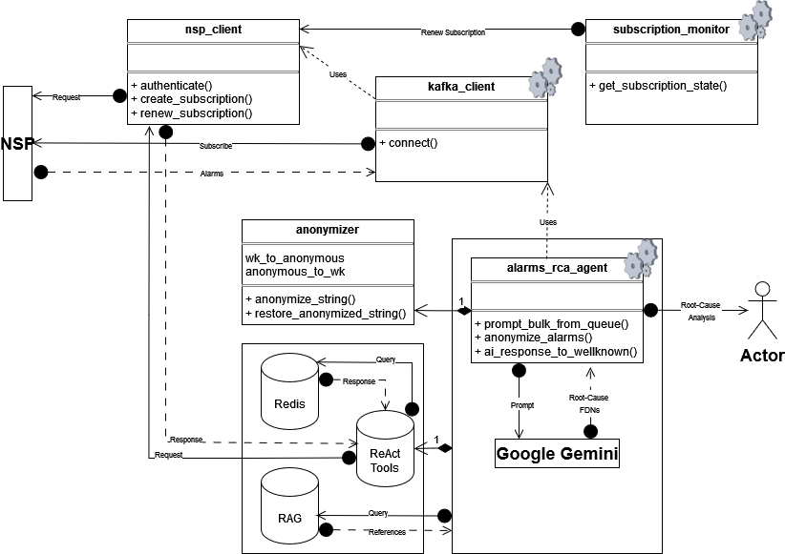
UML

Slide 4
Anonymized Data
The RCA Agent maintains a dictionary (well-known <-> anonymized) that it builds in real-time.
Identifiers sent to the LLM are garbled; subsequently the anonymized root-cause FDNs that the LLM returns are translated back to their actual well-known values to send to the Actor (the network administrator).
Actual | Sent to LLM
2025-05-12T18:32:02.760893587Z | sim234_225 | fdn:app:mdm-ami-cmodel:2001::225:service:Site:/service[service-id='411'] | Interface toCE is not operational | 2025-05-12T18:32:02.760893587Z | jfr9fge1 | fdn:app:mdm-ami-cmodel:3pifkb1q:service:Site:/service[yo4xz9f0] | avlb8xpc is not operational
2025-05-20T19:49:34.586318210Z | sim234_225 | fdn:app:mdm-ami-cmodel:2001::225:equipment:Equipment:/port[port-id='1/1/c3/1'] | Interface 1/1/c3/1 is not operational | 2025-05-20T19:49:34.586318210Z | jfr9fge1 | fdn:app:mdm-ami-cmodel:3pifkb1q:equipment:Equipment:/port[m0zwciib] | pg8q5tv4 is not operational
2025-05-12T18:32:01.672731026Z | sim234_236 | fdn:app:mdm-ami-cmodel:100.2.3.4:/openconfig-network-instance:network-instances/network-instance/protocols/protocol/bgp/neighbors/neighbor/state:/router[router-name='Base']/bgp/neighbor[ip-address='FFC0:1::1'] | (ASN 200) VR 1: Group iBGP: Peer FFC0:1::1: received notification: code CEASE subcode CONN_REJECT | 2025-05-12T18:32:01.672731026Z | 6cc1vpht | fdn:app:mdm-ami-cmodel:20fwv1o7:/openconfig-network-instance:network-instances/network-instance/protocols/protocol/bgp/neighbors/neighbor/state:/router[router-name='Base']/bgp/neighbor[ip-address='d4by4wp8'] | (zke8kw2c) VR 1: Group iBGP: Peer d4by4wp8: received notification: code CEASE subcode CONN_REJECT
Further anonymization can be achieved by programming the Agent to reset the dictionary periodically (e.g. every 5 minutes) to roll new patterns for the same identifiers.

Slide 5
RCA Agent Prompt and Output
A few-shot prompt is used
The following information is sent to LLM:
If there is a single root-cause for the failure: LLM will return a single root-cause FDN
If there are multiple possible root-causes for the failure, LLM will return multiple root-cause FDNs
If there isn’t enough information to make an inference e.g. logical failure in the absence of equipment failure, LLM will return ‘indeterminate’
The next slides show stdout of the Agent working on real-time alarm feeds …
“You are the network alarms RCA agent” | Format of alarms feed (very abbreviated NSP Kafka output in tabular form) |  | How to determine the root-cause failure or failures + expected response format
Two examples of alarm-feeds + expected responses |  | “Explain your reasoning”

Slide 6
RCA Agent ReAct Tools + LangGraph
On-the-fly interactions between the LLM and NSP to clarify per-alarm object identity/association
Goal: Improve the quality of data sent to the LLM to improve RCA
Clarify relationships between alarmed objects
Parent port for L3VPN interface:
2025-05-20T19:20:18.400111080Z | sim234_225 | fdn:app:mdm-ami-cmodel:2001::225:service:Site:/service[service-id='411'] | Interface toCE is not operational
IGP NH interface for iBGP peer:
2025-05-27T17:34:59.819541798Z | sim234_236 | fdn:app:mdm-ami-cmodel:2001::236:/openconfig-network-instance:network-instances/network-instance/protocols/protocol/bgp/neighbors/neighbor/state:/router[router-name='Base']/bgp/neighbor[ip-address='38.120.234.226'] | (ASN 200) VR 1: Group iBGP: Peer 38.120.234.226: received notification: code CEASE subcode CONN_REJECT
Parent port for PE-CE eBGP peer:
2025-05-27T17:35:01.972907588Z | sim234_225 | fdn:app:mdm-ami-cmodel:2001::225:/openconfig-network-instance:network-instances/network-instance/protocols/protocol/bgp/neighbors/neighbor/state:/service[service-id='411']/bgp/neighbor[ip-address='10.41.1.2'] | (ASN 200) VR 7: Group toCE: Peer 10.41.1.2: being disabled because the interface is operationally disabled
Future: Inter-NE correlation (see Future Enhancements section)

Slide 7
RCA Agent Demo

Slide 8
RCA Agent Real Output #1
2025-06-16T19:47:43.456347478Z | sim234_225 | 2001::225 | fdn:app:mdm-ami-cmodel:2001::225:equipment:Equipment:/port[port-id='1/1/c2/1'] | Interface 1/1/c2/1 is not operational
2025-06-16T19:47:43.466153190Z | sim234_225 | 2001::225 | fdn:app:mdm-ami-cmodel:2001::225:/openconfig-network-instance:network-instances/network-instance/interfaces/interface:/router[router-name='Base']/interface[interface-name='toVMX226'] | Interface toVMX226 is not operational
2025-06-16T19:47:43.491736666Z | sim234_225 | 2001::225 | fdn:app:mdm-ami-cmodel:2001::225:service:Site:/service[service-id='411'] | Interface toCE is not operational
2025-06-16T19:47:43.492112491Z | sim234_225 | 2001::225 | fdn:app:mdm-ami-cmodel:2001::225:/openconfig-network-instance:network-instances/network-instance/interfaces/interface:/router[router-name='Base']/interface[interface-name='toVMX226_ExplicitNull'] | Interface toVMX226_ExplicitNull is not operational
2025-06-16T19:47:43.493167491Z | sim234_225 | 2001::225 | fdn:app:mdm-ami-cmodel:2001::225:mpls:Mpls:/router[router-name='Base']/mpls | Interface toVMX226 is in administrative state: inService, operational state: outOfService
2025-06-16T19:47:43.500690340Z | sim234_225 | 2001::225 | fdn:app:mdm-ami-cmodel:2001::225:/openconfig-network-instance:network-instances/network-instance/protocols/protocol/bgp/neighbors/neighbor/state:/service[service-id='411']/bgp/neighbor[ip-address='10.41.1.2'] | (ASN 200) VR 7: Group toCE: Peer 10.41.1.2: being disabled because the interface is operationally disabled
2025-06-16T19:47:46.433886263Z | sim234_236 | 2001::236 | fdn:app:mdm-ami-cmodel:2001::236:/openconfig-network-instance:network-instances/network-instance/protocols/protocol/bgp/neighbors/neighbor/state:/router[router-name='Base']/bgp/neighbor[ip-address='38.120.234.226'] | (ASN 200) VR 1: Group iBGP: Peer 38.120.234.226: received notification: code CEASE subcode CONN_REJECT
🚨root_cause_fdns=["fdn:app:mdm-ami-cmodel:2001::225:equipment:Equipment:/port[port-id='1/1/c2/1']"]🚨
💡reasoning=The port 'port-id='1/1/c2/1'' is not operational, resulting in dependent interface 'interface-name='toVMX226'' also being not operational. This then causes the L3VPN service 'service-id='411'' to fail and the BGP peer '10.41.1.2' associated with that service to be disabled. The MPLS service also fails.
The failure of the BGP peer '38.120.234.226' on NE '2001::236' is unrelated, so is not the root cause.💡

Slide 9
RCA Agent Real Output #2
2025-05-20T19:19:00.673005095Z | sim234_236 | fdn:app:mdm-ami-cmodel:2001::236:/openconfig-network-instance:network-instances/network-instance/protocols/protocol/bgp/neighbors/neighbor/state:/router[router-name='Base']/bgp/neighbor[ip-address='38.120.234.226'] | (ASN 200) VR 1: Group iBGP: Peer 38.120.234.226: received notification: code CEASE subcode CONN_REJECT
2025-05-20T19:19:30.674575549Z | sim234_236 | fdn:app:mdm-ami-cmodel:2001::236:/openconfig-network-instance:network-instances/network-instance/protocols/protocol/bgp/neighbors/neighbor/state:/router[router-name='Base']/bgp/neighbor[ip-address='38.120.234.226'] | (ASN 200) VR 1: Group iBGP: Peer 38.120.234.226: received notification: code CEASE subcode CONN_REJECT
🚨root_cause_fdns=['indeterminate']🚨
💡reasoning=The BGP peer received a connection reject notification. This may be due to misconfiguration or an issue with the peer itself. Since there is no indication of a local equipment failure, the root cause is indeterminate.💡

Slide 10
RCA Agent Real Output #3
2025-05-20T19:49:34.586033743Z | sim234_225 | fdn:app:mdm-ami-cmodel:2001::225:/openconfig-network-instance:network-instances/network-instance/interfaces/interface:/router[router-name='Base']/interface[interface-name='toSR236'] | Interface toSR236 is not operational
2025-05-20T19:49:34.586318210Z | sim234_225 | fdn:app:mdm-ami-cmodel:2001::225:equipment:Equipment:/port[port-id='1/1/c3/1'] | Interface 1/1/c3/1 is not operational
2025-05-20T19:49:34.603975148Z | sim234_225 | fdn:app:mdm-ami-cmodel:2001::225:/openconfig-network-instance:network-instances/network-instance/interfaces/interface:/router[router-name='Base']/interface[interface-name='toSR236'] | BFD: Local Discriminator 49224 BFD session on node 10.225.236.2 is down due to pathDown
2025-05-20T19:49:34.681534008Z | sim234_225 | fdn:app:mdm-ami-cmodel:2001::225:mpls:Mpls:/router[router-name='Base']/mpls | Interface toSR236 is in administrative state: inService, operational state: outOfService
2025-05-20T19:49:34.713502330Z | sim234_225 | fdn:app:mdm-ami-cmodel:2001::225:rsvp:Rsvp:/router[router-name='Base']/rsvp/interface[interface-name='toSR236']/neighbor[ip-address='10.225.236.2'] | Neighbor 10.225.236.2 on interface toSR236 changed to inactive state because linkDown
🚨root_cause_fdns=["fdn:app:mdm-ami-cmodel:2001::225:equipment:Equipment:/port[port-id='1/1/c3/1']"]🚨
💡reasoning=The alarm indicating that interface 1/1/c3/1 is not operational is likely the root cause. This is an equipment failure, and the other alarms related to toSR236 not being operational can be triggered by this.💡

Slide 11

Target Actor
Which application shall consume the RCA output?
NSP?
Enhance NSP FM application
New API for Agent to set relationship between alarms:
ReSTConf (patch/post) API to specify that the root-cause of Alarm X is Alarm Y
OSS?
Enhance NBI Kafka for OSS consumption
New Kafka topic = NSP-FAULT-RCA-YANG
An Alarms OSS would subscribe to NSP-FAULT-YANG and NSP-FAULT-RCA-YANG
RCA results will not be available in NSP

Slide 12

Continuous Improvement Slide 1 of 3
v1 -> v2
Added subscription-monitor daemon
auto renew-subscription()
Because NSP subscriptions last for a maximum of 1 hour
v2 -> v3
Added ReAct tools
Added logging
Added MV support (ongoing)
v3 -> v4
Added support for orphan alarms
Laying groundwork for joining sliding-windows (see Future Enhancements section)
Hide Gemini API key

Slide 13
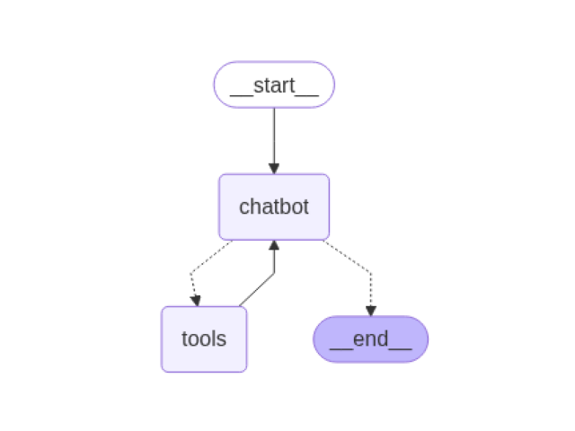
Continuous Improvement Slide 2 of 3
v4 -> v5
Added RAG to store vendor/OS/chassis alarms documentation
v5 -> v6 -> v7
Added LangGraph to support multi-turn ReAct loops
Added multi-model
Two Agents
One Agent uses tools to research the alarms
Another Agent to do the RCA
v7 -> v8
Added Redis
Store tools outputs
To improve LangChain performance

Slide 14
Continuous Improvement Slide 3 of 3
Multi-Process
Refactor to solve Windows Pickle issues
Added Redis message-bus
Memory
Utilize recall/memory that Gemini and other advanced LLMs possess
Simulation
Added alarm-feed simulation for controlled/repeatable testing

Slide 15
Future Enhancements Slide 1 of 3
Current implementation analyzes alarms raised within a sliding 5s window.
Issue: If a ‘card-down’ failure was reported at the end of the penultimate 5s window, and consequent ‘port-down’ alarms were reported in the next 5s window, the RCA-Agent will correctly identify the ‘card-down’ as the root-cause, but also incorrectly identify the ‘port-down’ alarms as root-causes because the ‘port-down’ alarms are the highest-level alarms in the current window
Solutions:
Concatenate alarms from current window with alarms from prior window; perform RCA on the combination
Assumes that 2 x 5s = 10s window is big enough (it likely is; this will be an improvement over the current single 5s window)
Additional enhancement: Adjustable window size
OR
Utilize recall/memory that Gemini and other advanced LLMs possess

Slide 16
Future Enhancements Slide 2 of 3
Inter-NE alarm correlation e.g.
2025-05-20T19:49:34.586318210Z | sim234_225 | fdn:app:mdm-ami-cmodel:2001::225:equipment:Equipment:/port[port-id='1/1/c3/1'] | Interface 1/1/c3/1 is administratively shutdown
2025-05-20T19:49:34.586412210Z | sim234_225 | fdn:app:mdm-ami-cmodel:2001::225:equipment:Equipment:/port[port-id='1/1/c3/1'] | Interface 1/1/c3/1 is not operational
2025-05-20T19:49:34.606318810Z | sim234_236 | fdn:app:mdm-ami-cmodel:2001::225:equipment:Equipment:/port[port-id='1/1/c3/1'] | Interface 1/1/c3/1 is not operational
🚨root_cause_fdns=["fdn:app:mdm-ami-cmodel:2001::225:equipment:Equipment:/port[port-id='1/1/c3/1']"]🚨
💡reasoning=interface 1/1/c3/1 on sim234_225 is down because it is shutdown. Interface 1/1/c3/1 on sim234_225 is physically connected to interface 1/1/c3/1 sim234_236. Shutting down the interface on sim234_225 likely caused the connected interface on toSR236 to become inoperable.💡

Slide 17
Future Enhancements Slide 3 of 3
RCA of all active alarms
On-demand or periodic
Network object troubleshooting flow/use-case
Enhance LangGraph: Handle parallel NE chains
Integrate with Model Context Protocol (MCP)

