Slide 1

Ubuntu
BIO727P – Software Development Group Project for MSc. Bioinformatics
Camila Ballenghien, Haotian Zheng, Shathavi Krishnan, Aiza Safdar

Slide 2
INTRODUCTION
The Ubuntu Analysis Tool (UAT) is a platform tailored to facilitate the analysis of genetic data sourced from diverse human populations.
This tool allows users to explore the genetic landscape of these populations, getting insightful information into population structure and genetic diversity.

Slide 3
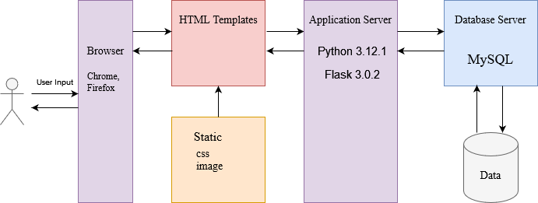
SOFTWARE SCHEMATIC

Slide 4
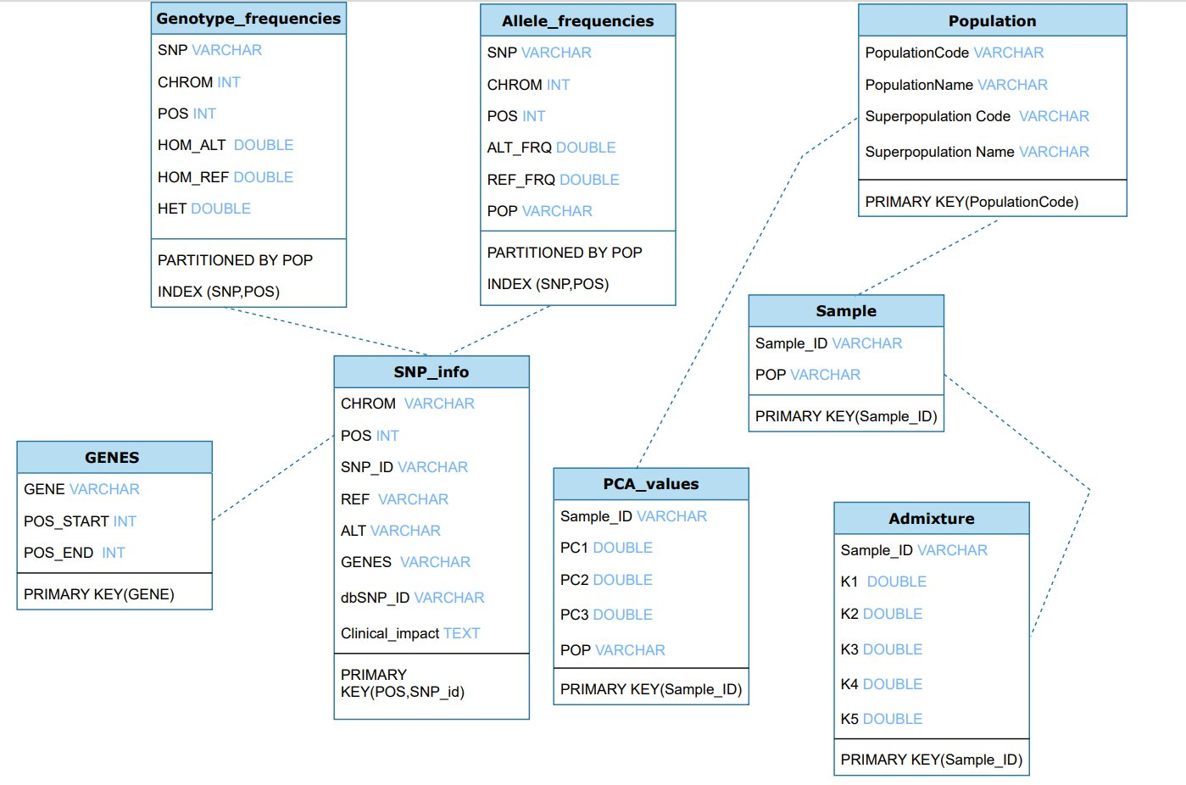
DATABASE SCHEMA

Slide 5
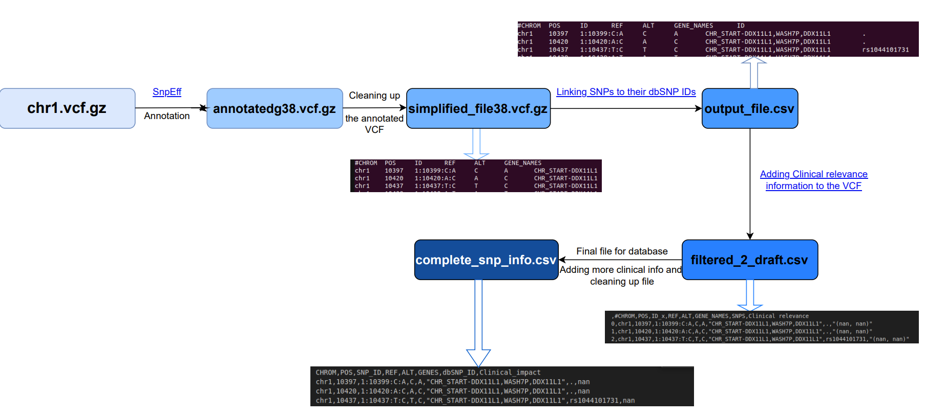
STEPS FOR SNP_INFO TABLE
Notes:
SnpEff: Open-source bioinformatics tool for variant annotation and prediction of genetic variant effects, such as SNPs (Cingolani, 2023)Prerequisites include Unix-based OS and Java Runtime Environment. Utilized GRCh38.p7.RefSeq database for functional annotations and gene impact analysis in the Ubuntu project.

Slide 6
ALLELE AND GENOTYPE FREQUENCIES TABLES
ALLELE
GENOTYPE
Plink v.1.9 was used to do basic allele report per population group.
Python script which calculated alternate and reference allele frequency based on the basic allele reports
Hardy-Weinberg equation
Ran a python script on the resulting allele frequencies
CHR | SNP | A1 | A2 | MAF
Chromosome number | SNP ID | Usually minor allele | Usually major allele | Allele 1 Frequency
Notes:
CHR
Chromosome code
SNP
Variant identifier
A1
Allele 1 (usually minor)
A2
Allele 2 (usually major)
MAF
Allele 1 frequency
NCHROBS
Number of allele observations

Slide 7
WHY HARDY-WEINBERG EQUATION
Baseline for genetic predictions
Simplified genotype frequency calculation
Natural populations rarely meet these conditions
We wanted to calculate observed genotype frequencies but ran out of time

Slide 8
Linking the database to Flask
Only for requirement 3 : Getting allele and genotype frequencies and clinical relevance when applicable when selection gene names, SNP IDs or coordinates
Get SNP information based on gene names, position and SNP IDs
MySQL connector package was used
For SNP_ID and chromosome coordinates : joined allele and genotype frequencies on snp_info
For the gene names: - create a table with all the SNPs relevant to the gene names - join allele and genotype frequencies to that table - drop that table

Slide 9
Principle Component Analysis:
PCA used to explore population structure
PCA can reveal patterns in the data, that can correspond to the population structure
Similar PC scores can suggest population are genetically similar

Slide 10
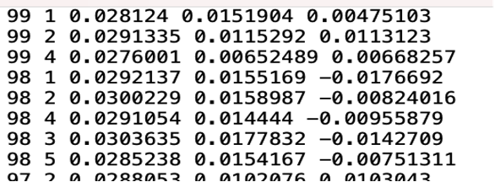
Plink v1.9
Plink used to make bed files
3 Principle components calculated, eigenvec file produced

Slide 11
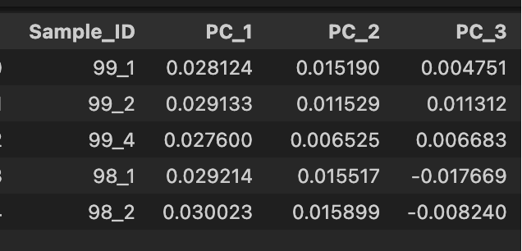
Manipulation of Eigenvec
Eigenvec file was converted into a table suitable for the database
Pandas was used

Slide 12
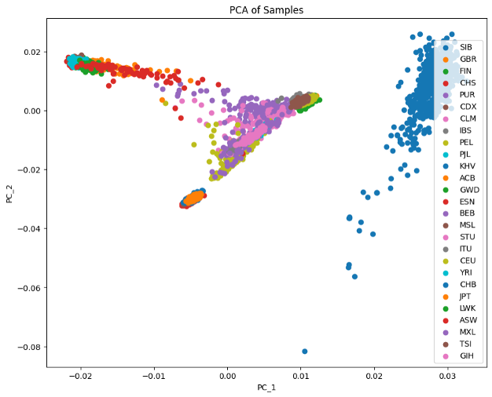
PCA plot

Slide 13
Admixture analysis
Admixture analysis can be used to determine the proportions of ancestral population in groups of individuals.
Admixture software used

Slide 14
ADMIXTURE
Create
Use Plink1.9v to create bed file
admixture in apocrita
Run
Run admixture for K3-5
USE

Slide 15
K5
Choose to use K5
Had lowest cross validation and therefore had the best predictive accuracy

Slide 16
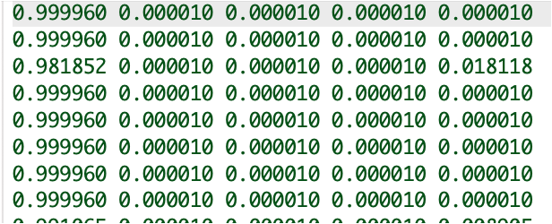
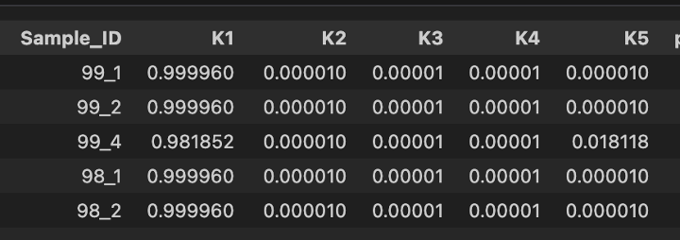
Q-file manipulation
Pandas python used to manipulate Q-file into a suitable file for the database

Slide 17
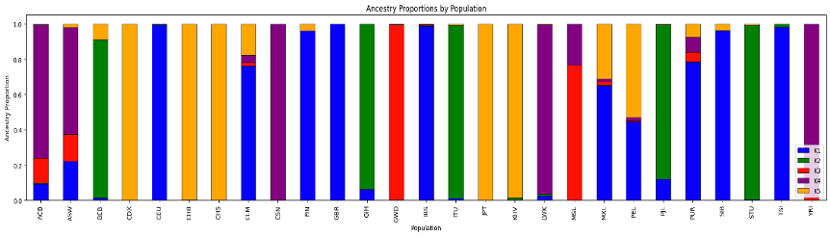
Admixture plot

Slide 18
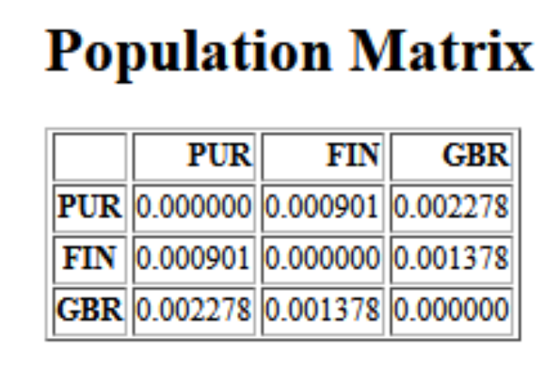
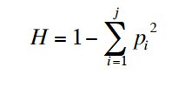

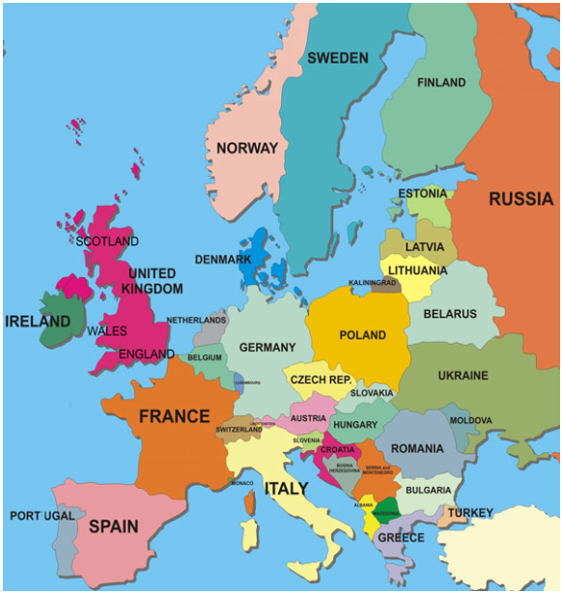
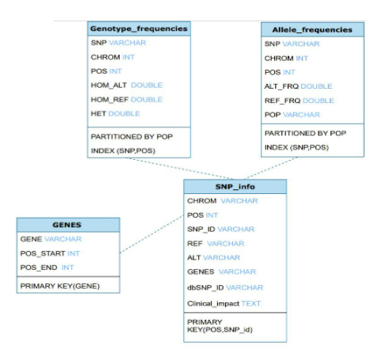
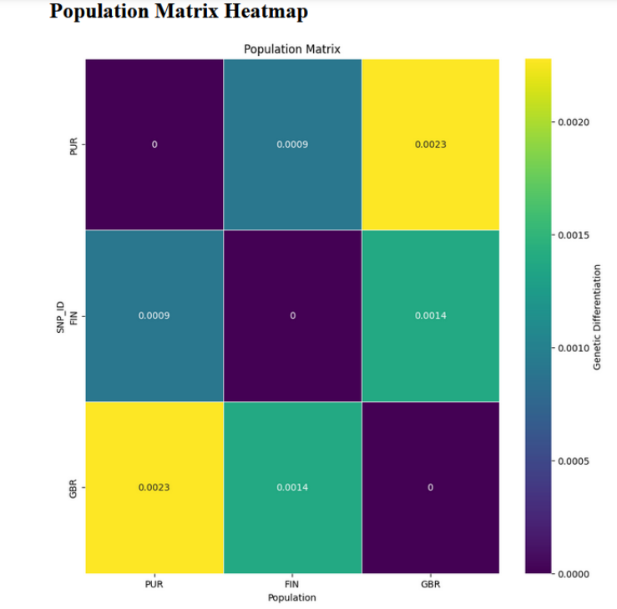
Pair-wise Fixation index (Fst)

Slide 19



Front end
Flask
Python
Web
css
Html

Slide 20
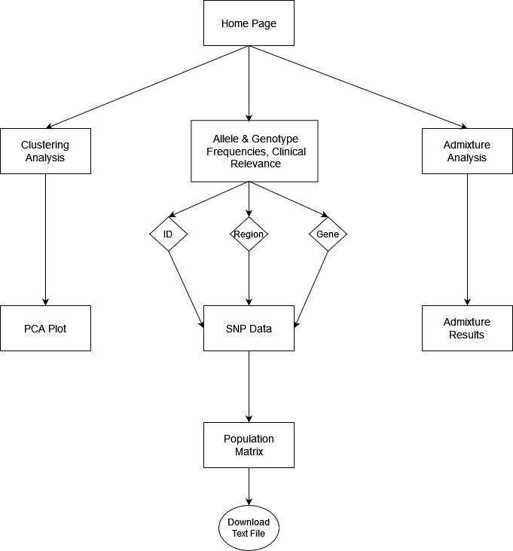
Web Structure

Slide 21
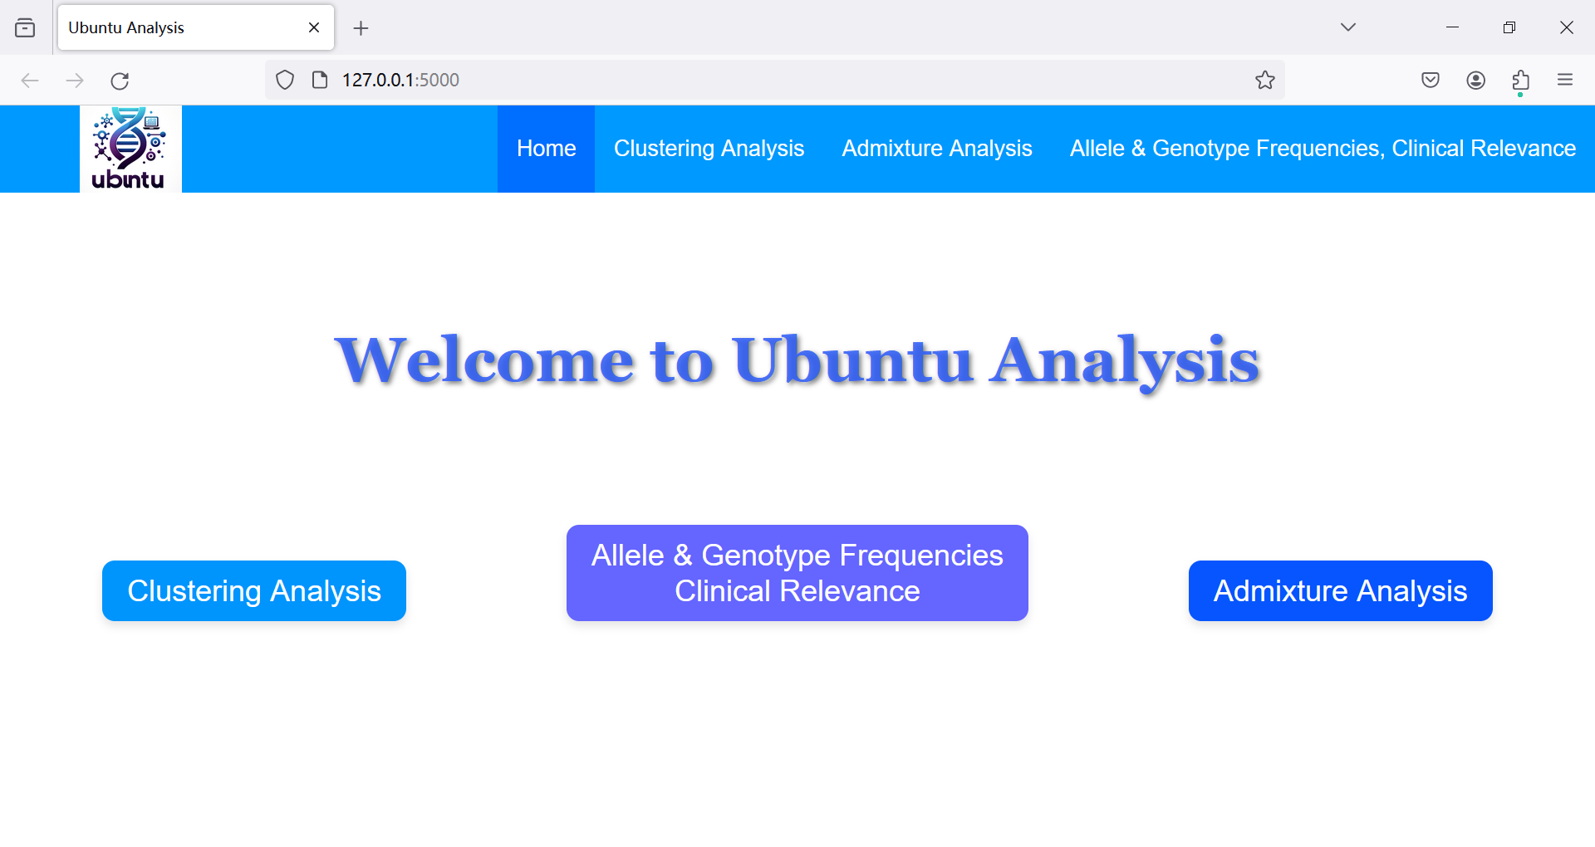
Demo

Slide 22

Questions?
Thank You

