Slide 1
Weather ETL System
A real-time weather data pipeline with dashboarding & automated alerts
Apache Airflow
PostgreSQL
FastAPI
Docker
Nginx
Open-Meteo API
Marvin Lorff
neuefische · Data Engineering Bootcamp · Capstone Project
March 2026

Slide 2
OVERVIEW
What is Weather ETL?
An end-to-end data engineering project that automatically fetches, processes, and stores weather forecasts — and notifies users when their custom alert conditions are met.
Weather forecast data visualisation
🌍
⏱️
📊
🔔
~75 Cities
Hourly Runs
7-Day Forecast
Custom Email Alerts
Germany, Austria & Switzerland
Automated pipeline schedule
Daily + hourly data
Triggered by weather conditions

Slide 3
OVERVIEW
Why is Weather ETL useful ?
dashboard - weather data: clean and scientific hourly weather forecast ( my preference )
weather warnings - examples
danger of flooding from excessive rainfall
-> notifications if rainfall exceeds a critical threshold
planting seeds in the garten
-> notifications if there is freezing soil temperatures in spring
planning a weekend adventure (cycling, climbing, outdoor activities)
-> notification if weather is warm and sunny on weekends

Slide 4

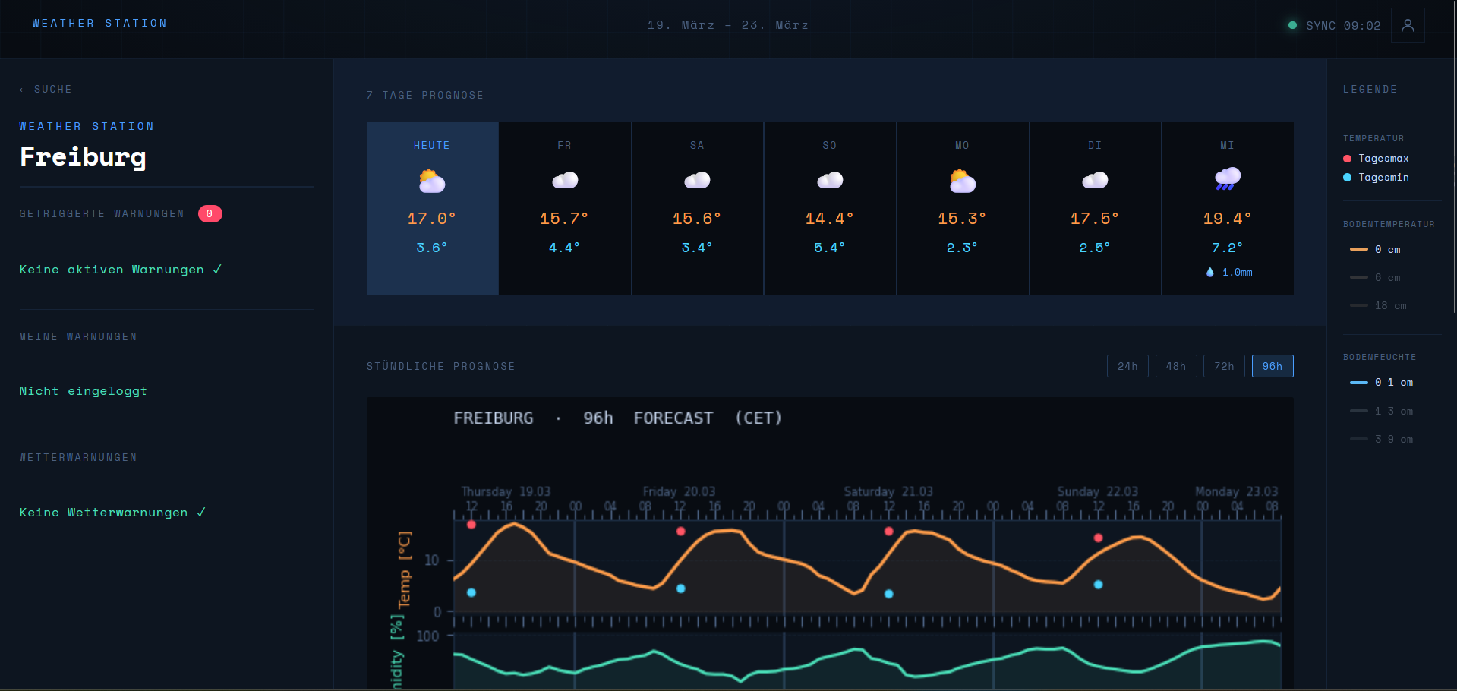
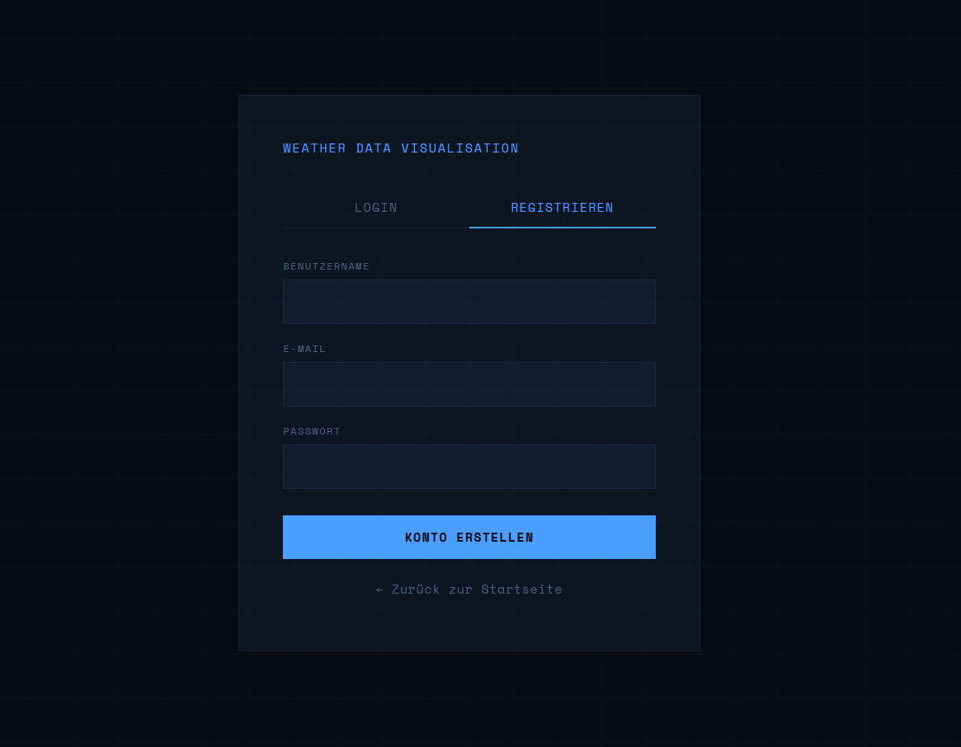
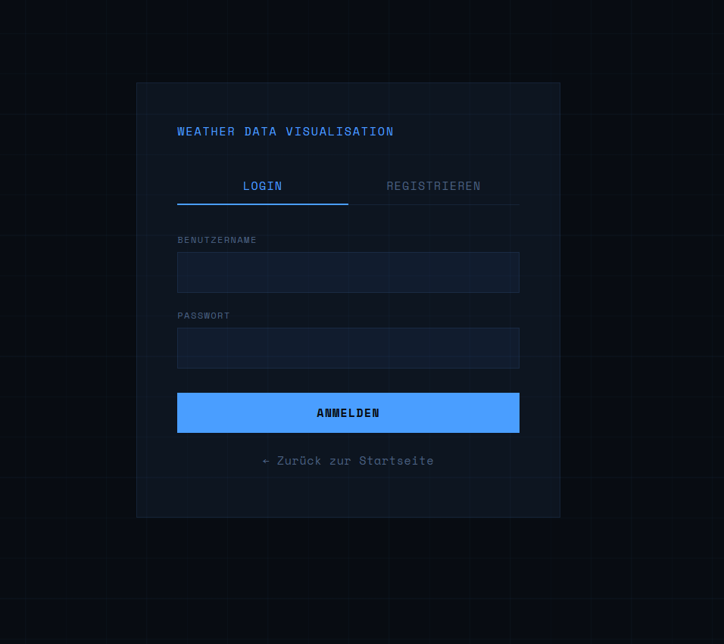
DEMO
How does it look like ? Dashboard & Features
Station Search
Weather Dashboard
user registration and login
Warning Builder
Active Warnings

Slide 5
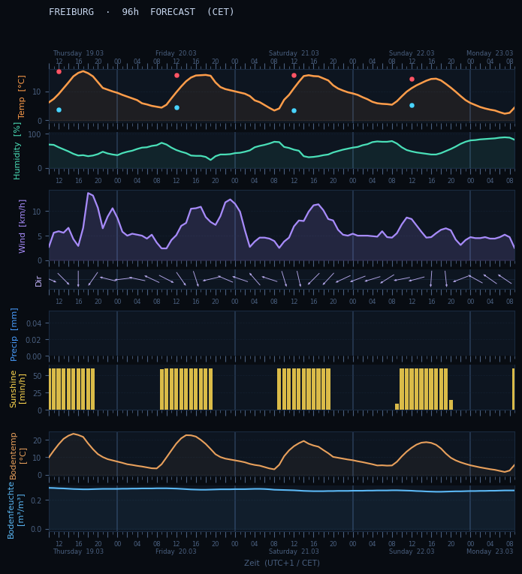
DEMO
weather forecast diagramm
scientific weather diagramm
hourly data diagramm
lines and barplots
includes 4 days (96 h) of weather forecast
also includes soil-moisture and soil-temperature
Warning Builder
Active Warnings

Slide 6
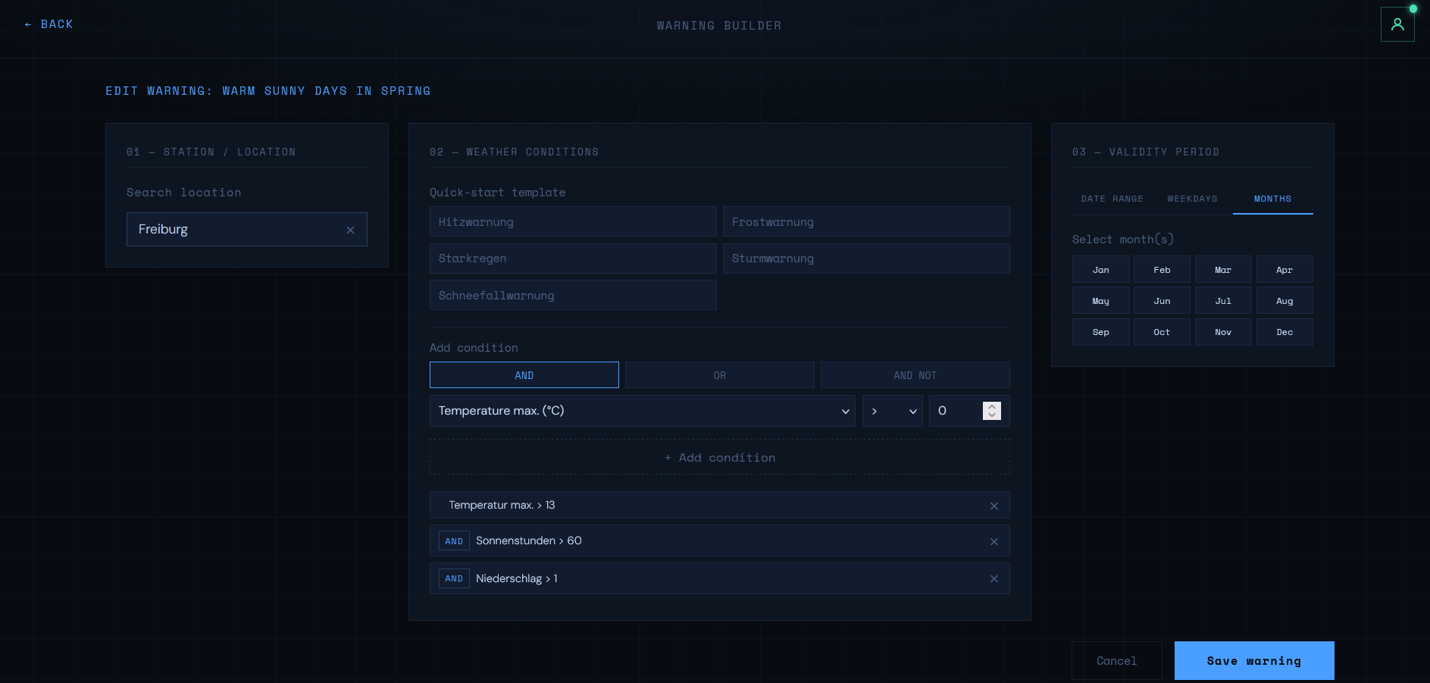
FEATURE
Weather Warning Configurator

Slide 7
STACK
Technology Stack
⚙️ Apache Airflow
🗄️ PostgreSQL 15
🚀 FastAPI
Pipeline orchestration · DAG scheduling · XCom data passing · Retry logic
Primary datastore · 6 tables · JSONB conditions · UPSERT pattern
REST API · JWT auth · 18 endpoints · SQLAlchemy ORM
🌐 Nginx + JS
🐳 Docker Compose
🌤️ Open-Meteo API
Static frontend · Station search · Chart.js dashboard
6 services · Isolated containers · Single-command deployment
Free · No API key required · 7-day forecast · Daily + hourly

Slide 8
INFRASTRUCTURE
Docker Network Architecture
All 6 services run in a single Docker Compose stack — one command to deploy everything.
🌐
Nginx Frontend
🚀
FastAPI Backend
🗄️
PostgreSQL 15
:80
:8000
:5432
Static HTML/JS · Station search · Dashboard
REST API · JWT Auth · SQLAlchemy ORM
Primary datastore · Persistent volume
⚙️
Airflow Webserver
🕐
Airflow Scheduler
📬
Mailhog / SMTP
:8080
internal
:1025 / :8025
DAG monitoring · Run history
DAG execution · Retry policy
SMTP catch-all · Email preview UI
All services share one internal Docker network · Secrets via .env · Backend runs as non-root user · Data persisted in named volumes

Slide 9
INFRASTRUCTURE
Airflow Dags

Slide 10
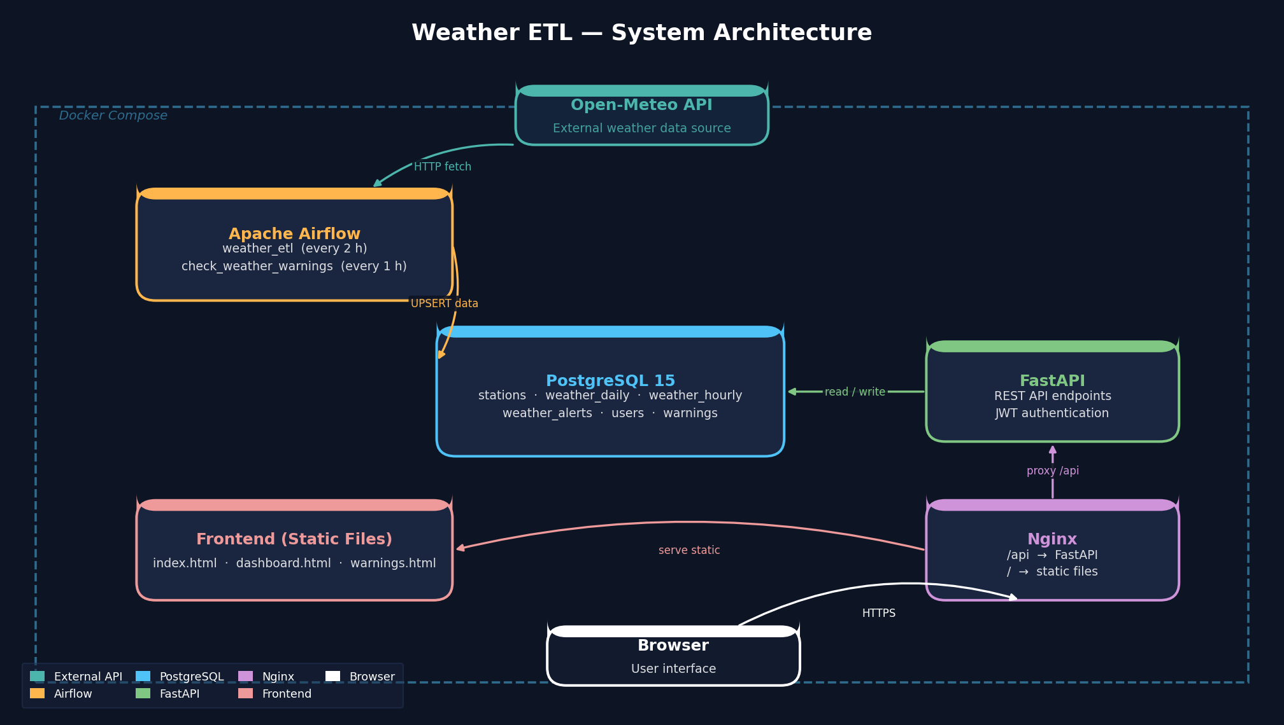
INFRASTRUCTURE
Docker Network Architecture

Slide 11
ETL PIPELINE
The ETL Pipeline
DAG 1 — weather_etl (every 2h)
DAG 2 — check_warnings (every 1h)
📡
→
🔄
→
💾
🗄️
→
⚖️
→
📧
Extract
Transform
Load
Read DB
Evaluate
Notify
E
Extract
T
Transform
L
Load
GET api.open-meteo.com with lat/lon. Returns 7-day daily (10 vars) + 168h hourly (17 vars incl. soil data). Raw JSON pushed to Airflow XCom.
API arrays unpacked into flat row dicts. WMO codes mapped to descriptions. Alert rules from YAML evaluated with AND logic against daily records.
ON CONFLICT DO UPDATE — no duplicate rows. Previous alerts deactivated; fresh alerts inserted per run. Fully idempotent across all pipeline runs.

Slide 12
ETL — TRANSFORM
Transforming the Raw Data
1
Unpack API Arrays → Flat Row Dicts
Open-Meteo returns columnar arrays (e.g. temperature_2m_max: [12.1, 15.3, …]). Transform zips all arrays by index into individual row dicts — one dict per calendar day or hour.
2
WMO Code Enrichment
Each row's numeric WMO weather code (e.g. 63) is translated to a human-readable string ("Moderate Rain") using a built-in lookup table covering all 30 WMO codes.
3
Alert Rule Evaluation (YAML Config)
Alert thresholds loaded from alerts_config.yaml — not hardcoded in Python. Each rule defines: name, severity, conditions (AND logic), message text. Triggered alerts are included in the XCom payload alongside daily/hourly records.
Example rules: temperature_max > 35 → danger | precipitation_sum > 20 → warning | wind_speed_max > 60 → danger | snowfall_sum > 10 → info

Slide 13
ETL — LOAD
Loading Data into PostgreSQL
UPSERT Pattern
Alert Lifecycle
• Unique constraint: (city, forecast_date) for daily
Before insert: all previous alerts for city
• Unique constraint: (city, forecast_time) for hourly
set is_active = false
• On conflict → update all columns in-place
Fresh alerts from current run inserted as
is_active = true
• No duplicate rows accumulate across runs
Dashboard always shows current forecast only
What gets written per pipeline run:
7 rows
168 rows
n rows (if triggered)
weather_daily
weather_hourly
weather_alerts

Slide 14
DATABASE
PostgreSQL Schema — 6 Tables
📅
weather_daily
🕐
weather_hourly
🔔
weather_alerts
13 columns
21 columns
10 columns
Daily forecast per city · UPSERT on (city, date)
Hourly forecast + soil data · UPSERT on (city, time)
System-generated alerts · JSONB trigger snapshot
📍
stations
👤
users
⚠️
warnings
6 columns
6 columns
10 columns
~75 cities pre-seeded · lat/lon for API calls
bcrypt-hashed passwords · email for notifications
User rules · JSONB conditions + validity · active flag
ETL tables | Application tables

Slide 15
DATABASE — SCHEMA DETAIL
Core ETL Tables
weather_daily
weather_hourly (key columns)
Column
Type
Unit
Column
Type
Unit
id (PK)
INTEGER
—
temperature
DECIMAL(5,2)
°C
city
VARCHAR(100)
—
feels_like
DECIMAL(5,2)
°C
forecast_date
DATE
—
precipitation
DECIMAL(5,2)
mm
temperature_max
DECIMAL(5,2)
°C
wind_speed
DECIMAL(6,2)
km/h
temperature_min
DECIMAL(5,2)
°C
wind_direction
INTEGER
degrees
precipitation_sum
DECIMAL(6,2)
mm
humidity
INTEGER
%
snowfall_sum
DECIMAL(6,2)
cm
sunshine_duration
DECIMAL(6,2)
sec
wind_speed_max
DECIMAL(6,2)
km/h
soil_temperature_0cm
DECIMAL(5,2)
°C
wind_gusts_max
DECIMAL(6,2)
km/h
soil_temperature_6cm
DECIMAL(5,2)
°C
uv_index_max
DECIMAL(4,2)
—
soil_temperature_18cm
DECIMAL(5,2)
°C
weather_code
INTEGER
WMO
soil_moisture_0_1cm
DECIMAL(8,6)
m³/m³
sunrise / sunset
TIMESTAMPTZ
UTC
soil_moisture_1_3cm
DECIMAL(8,6)
m³/m³
created_at
TIMESTAMPTZ
UTC
soil_moisture_3_9cm
DECIMAL(8,6)
m³/m³

Slide 16
DATABASE — SCHEMA DETAIL
Application Tables
users
warnings (user-defined)
Column
Type / Notes
Column
Notes
id (PK)
INTEGER
user_id (FK)
→ users.id CASCADE DELETE
email
VARCHAR(255) UNIQUE
station_id (FK)
→ stations.id SET NULL
username
VARCHAR(100) UNIQUE
city
Target city name
hashed_password
VARCHAR(255) — bcrypt
name
User-chosen label
is_active
BOOLEAN
conditions
JSONB array of rules
created_at
TIMESTAMPTZ
validity
JSONB — date_range / weekdays / months
active
Enable / disable toggle
weather_alerts
• alert_name:
From YAML config
• severity:
info / warning / danger
• message:
Human-readable description
• condition_met:
JSONB — value + threshold snapshot
• is_active:
Only latest pipeline run = true

Slide 17
FEATURE
User Warning Pipeline
Users configure custom alert rules — the second Airflow DAG checks them hourly and sends email notifications.
🖱️
🗄️
⚙️
⚖️
📧
→
→
→
→
User creates warning in UI
Stored as JSONB in warnings table
Airflow DAG runs every hour
Conditions checked vs. weather_daily
Email sent via SMTP
Condition Types
Pre-built Templates
Parameters: temp max/min, precipitation, snowfall, wind, gusts, UV index
🌡️ Heatwave: temperature_max > 32°C
Comparators: > >= < <= ==
Logic: AND across all conditions in a rule
❄️ Frost: temperature_min < 0°C
🌧️ Heavy Rain: precipitation_sum > 20 mm
Validity Modes:
date_range — from / to specific dates
💨 Storm: wind_speed_max > 60 km/h
weekdays — e.g. Saturday & Sunday only
months — e.g. January & February only
🌨️ Snowfall: snowfall_sum > 10 cm

Slide 18
SUMMARY
By the Numbers
~75
6
175
2
18
6
Pre-seeded stations
PostgreSQL tables
Rows per pipeline run
Airflow DAGs
API endpoints
Docker services
✅ OWASP security hardening — JWT, bcrypt, non-root container, XSS prevention
✅ UPSERT pattern — fully idempotent pipeline runs
✅ JSONB conditions — flexible warning rules without schema migrations
✅ YAML alert config — threshold changes without code redeploy

Slide 19
Thank You
Weather ETL — Capstone Project
💻 GitHub
📚 Stack
github.com/ml271/weather_etl
Airflow · PostgreSQL · FastAPI · Docker · Nginx
Marvin Lorff
neuefische · Data Engineering Bootcamp · Capstone Project · March 2026
Questions?

