Slide 1
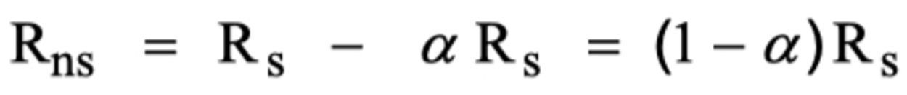


Cropped Image
Transcribed Image
Decoded equation from transcribed image
Decoded equation from cropped image

Slide 2
Cropped Image
Decoded equation from transcribed image

Slide 3




(a)
Transcribed Imagex
(b)
Transcribed Image
Decoded equation from transcribed image
Decoded equation from transcribed image

Slide 4
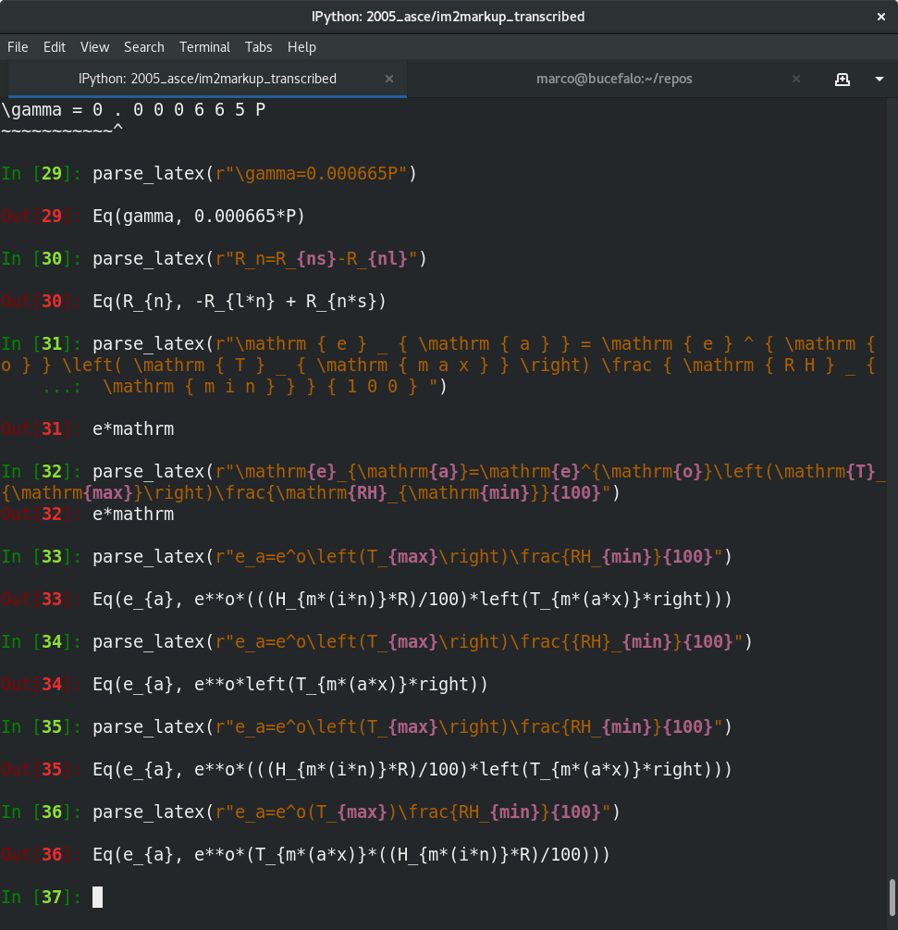

Slide 5
(a)
SymPy created from direct output of model (spaces removed) using latex2sympy
(b)
After removing font typesetting
(c)
After removing specialized grouping symbols

Slide 6

Decoded equation from transcribed image

Slide 7
In [2]: parse_latex(r"\gamma = 0 . 0 0 0 6 6 5 P ”) )
---------------------------------------------------------------------------
LexerNoViableAltException Traceback (most recent call last)
~/miniconda3/lib/python3.6/site-packages/antlr4/Lexer.py in nextToken(self)
127 try:
--> 128 ttype = self._interp.match(self._input, self._mode)
129 except LexerNoViableAltException as e:
(...stack trace elided...)
~/miniconda3/lib/python3.6/site-packages/sympy/parsing/latex/_parse_latex_antlr.py in syntaxError(self, recog, symbol, line, col, msg, e)
57 else:
58 err = fmt % ("I don't understand this", self.src, marker)
---> 59 raise LaTeXParsingError(err)
60
61
LaTeXParsingError: I don't understand this
\gamma = 0 . 0 0 0 6 6 5 P
~~~~~~~~~~~^

