Slide 1
Busy Bee ideas (6/1)
Loren Rieffer-Champlin

Slide 2


Likelihood of path
From Kaminka, Vered, and Agmon (2018),

Slide 3
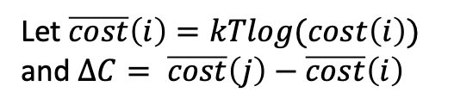

Likelihood of path
From Kaminka, Vered, and Agmon (2018),
This slide is just for context!
$${=e}^{log⁡(\frac{cost({\hat{π}}_{g})}{cost(π)})}=e^{\log\left(cost\left({\hat{π}}_{g}\right)\right)−log⁡(cost\left(π\right))}$$
$$=e^{\frac{−kT\log\left(cost\left({\hat{π}}_{g}\right)\right)+kTlog⁡(cost\left(π\right))}{kT}}$$
$$=e^{−\frac{∆C}{kT}}$$
Let $\overline{cost}\left(i\right)=kTlog(cost\left(i\right))$ and $ΔC= \overline{cost}\left(j\right)−\overline{cost}\left(i\right)$
A Boltzmann distribution!
Notes:
e

Slide 4
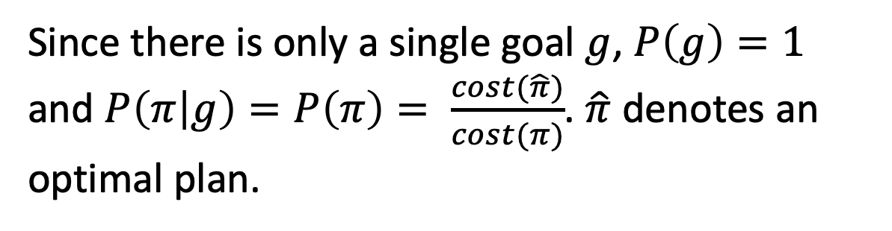
Likelihood of path
From Kaminka, Vered, and Agmon (2018),
Since there is only a single goal $g$, $P\left(g\right)=1$ and $P\left(π | g\right)=P\left(π\right)= \frac{cost(\hat{π})}{cost(π)}$. $\hat{π}$ denotes an optimal plan.

Slide 5

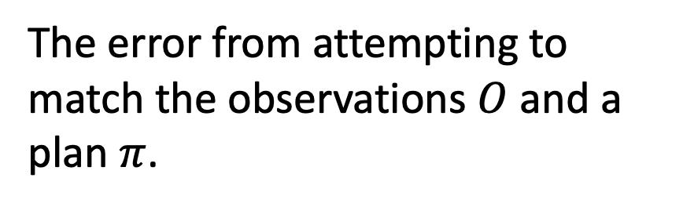
Likelihood of path
From Kaminka, Vered, and Agmon (2018),
The error from attempting to match the observations $O$ and a plan $π$.

Slide 6
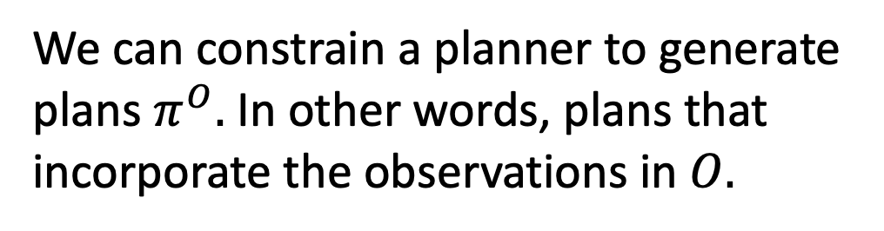
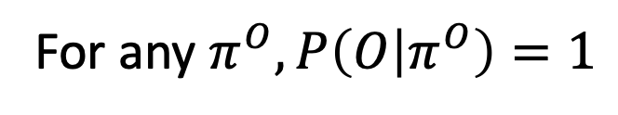
Likelihood of path
From Kaminka, Vered, and Agmon (2018),
We can constrain a planner to generate plans $π^{O}.$ In other words, plans that incorporate the observations in $O.$
For any $π^{O}, P\left(O | π^{O}\right)=1$

Slide 7

Likelihood of path
Thus, $P\left(π^{O} | O\right)=β\frac{cost(\hat{π})}{cost(π^{O})}$ for any $π^{O}$.

Slide 8
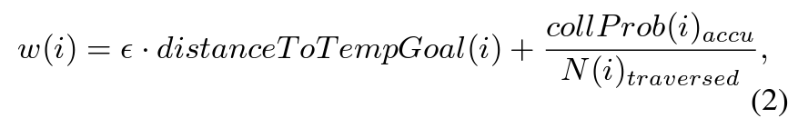
SES cost function
This is computed for each path
SES/RRT picks the path that minimizes w.

Slide 9
SES cost function
This is computed for each path
SES/RRT picks the path that minimizes w.
They call it “greed”, but it can also be somewhat re-interpreted as risk tolerance. The greater it is, the more willing I am to risk collision to reduce my distance from the goal.

Slide 10

SES cost function
Thus, $P\left(π^{O} | O\right)=β\frac{w(\hat{π,}ε)}{w(π^{O},ε)}$ for any $π^{O}$.

Slide 11

SES cost function
Thus, $P\left(π^{O} | O\right)=β\frac{w(\hat{π,}ε)}{w(π^{O},ε)}$ for any $π^{O}$.
The most likely plan for the agent would be ${\hat{π}}^{O}$ (i.e., the most optimal plan that adheres to the observations). But since $ε$ is unknown, we will assume it is a random variable and thus ${\hat{π}}^{O}$ itself is a random variable.

Slide 12

SES cost function
$$P\left(ε | {\hat{π}}^{O},O\right)∝P\left({\hat{π}}^{O} | O,ε\right)P\left(ε\right)$$

Slide 13
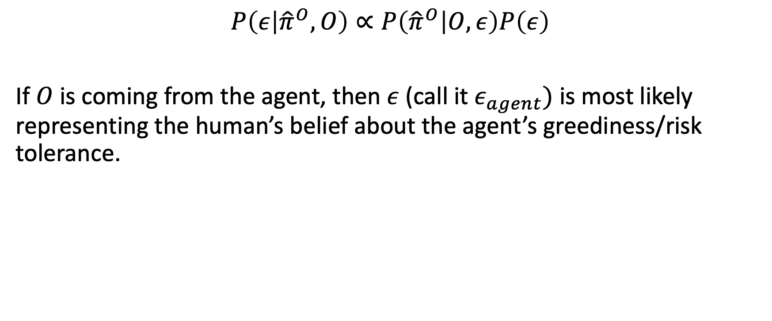
SES cost function
$$P\left(ε | {\hat{π}}^{O},O\right)∝P\left({\hat{π}}^{O} | O,ε\right)P\left(ε\right)$$
If $O$ is coming from the agent, then $ε$ (call it $ε_{agent})$ is most likely representing the human’s belief about the agent’s greediness/risk tolerance.

Slide 14
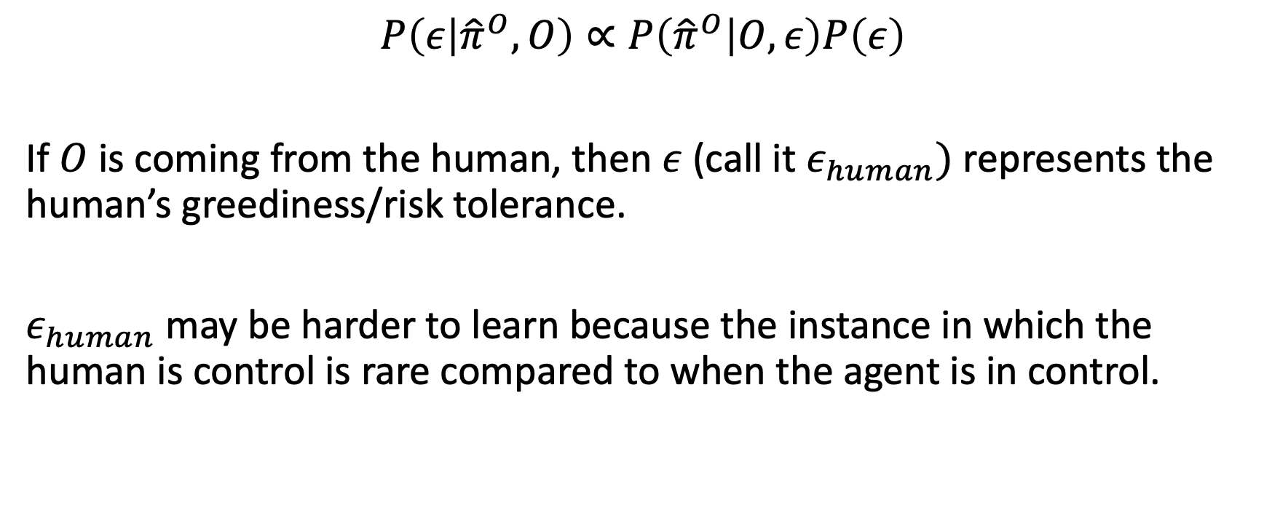
SES cost function
$$P\left(ε | {\hat{π}}^{O},O\right)∝P\left({\hat{π}}^{O} | O,ε\right)P\left(ε\right)$$
If $O$ is coming from the human, then $ε$ (call it $ε_{human})$ represents the human’s greediness/risk tolerance.
$ε_{human}$ may be harder to learn because the instance in which the human is control is rare compared to when the agent is in control.

Slide 15

Takeover Process
Compute ${\hat{π}}_{agent}^{O}=\underset{π^{O}}{argmax}{P(π^{O}|O,ε_{agent}(Σ))}$

Slide 16

Takeover Process
Compute ${\hat{π}}_{agent}^{O}=\underset{π^{O}}{argmax}{P(π^{O}|O,ε_{agent}(Σ))}$
Compute ${\hat{π}}_{human}^{O}=\underset{π^{O}}{argmax}{P(π^{O}|O,ε_{human}(Θ))}$

Slide 17
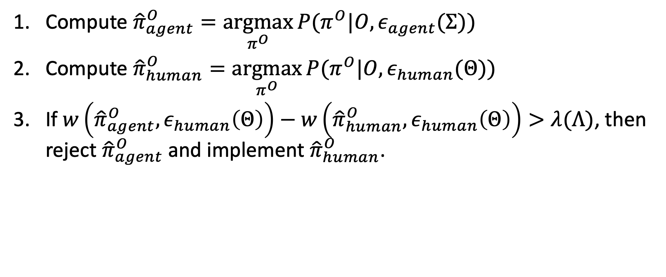
Takeover Process
Compute ${\hat{π}}_{agent}^{O}=\underset{π^{O}}{argmax}{P(π^{O}|O,ε_{agent}(Σ))}$
Compute ${\hat{π}}_{human}^{O}=\underset{π^{O}}{argmax}{P(π^{O}|O,ε_{human}(Θ))}$
If $w\left({\hat{π}}_{agent}^{O},ε_{human}\left(Θ\right)\right)−w\left({\hat{π}}_{human}^{O},ε_{human}\left(Θ\right)\right)>λ(Λ)$, then reject ${\hat{π}}_{agent}^{O}$and implement ${\hat{π}}_{human}^{O}$.

Slide 18
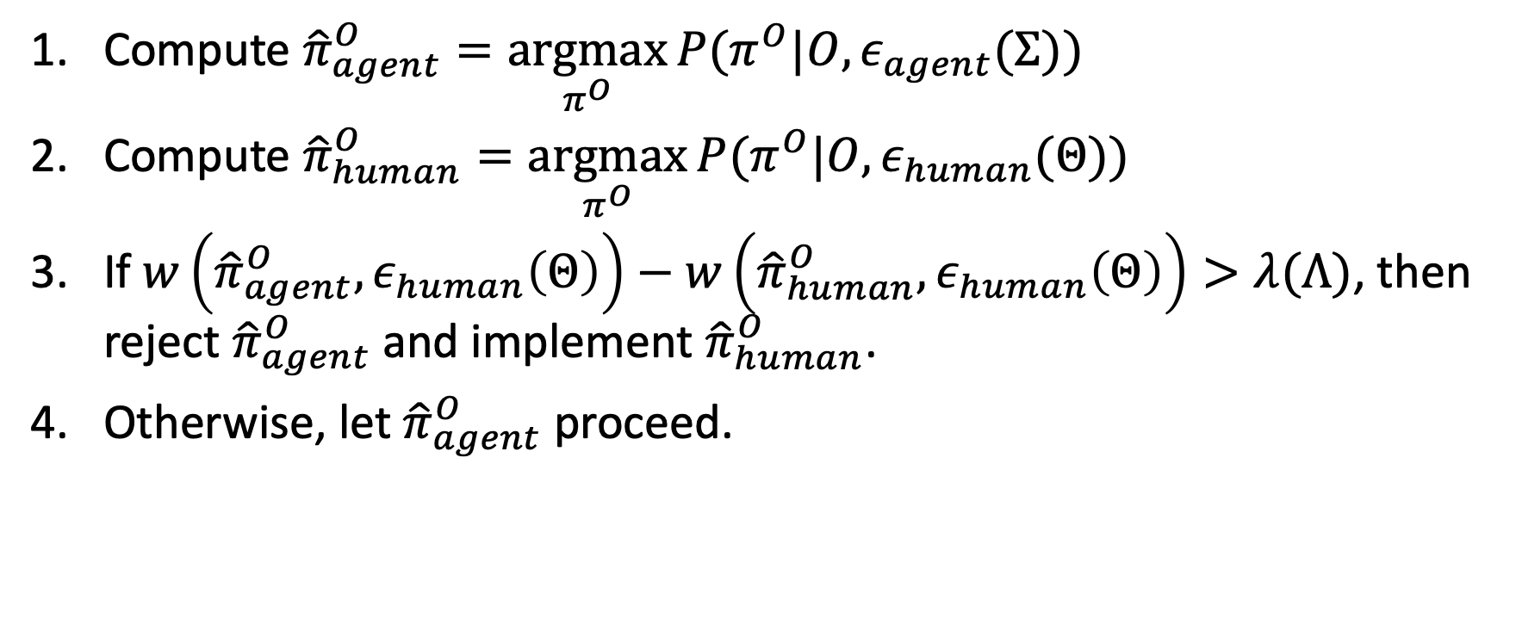
Takeover Process
Compute ${\hat{π}}_{agent}^{O}=\underset{π^{O}}{argmax}{P(π^{O}|O,ε_{agent}(Σ))}$
Compute ${\hat{π}}_{human}^{O}=\underset{π^{O}}{argmax}{P(π^{O}|O,ε_{human}(Θ))}$
If $w\left({\hat{π}}_{agent}^{O},ε_{human}\left(Θ\right)\right)−w\left({\hat{π}}_{human}^{O},ε_{human}\left(Θ\right)\right)>λ(Λ)$, then reject ${\hat{π}}_{agent}^{O}$and implement ${\hat{π}}_{human}^{O}$.
Otherwise, let ${\hat{π}}_{agent}^{O}$proceed.

Slide 19

Takeover Process Remarks
Each $ε$ variable just represent some kind of preference parameter and $w$ is just a cost function. They don’t have to be defined how they are in the SES paper.

Slide 20

Takeover Process Remarks
Each $ε$ variable just represent some kind of preference parameter and $w$ is just a cost function. They don’t have to be defined how they are in the SES paper.
Step 1 can be replaced with any type of prediction algorithm based on the human’s beliefs about the agent.

Slide 21
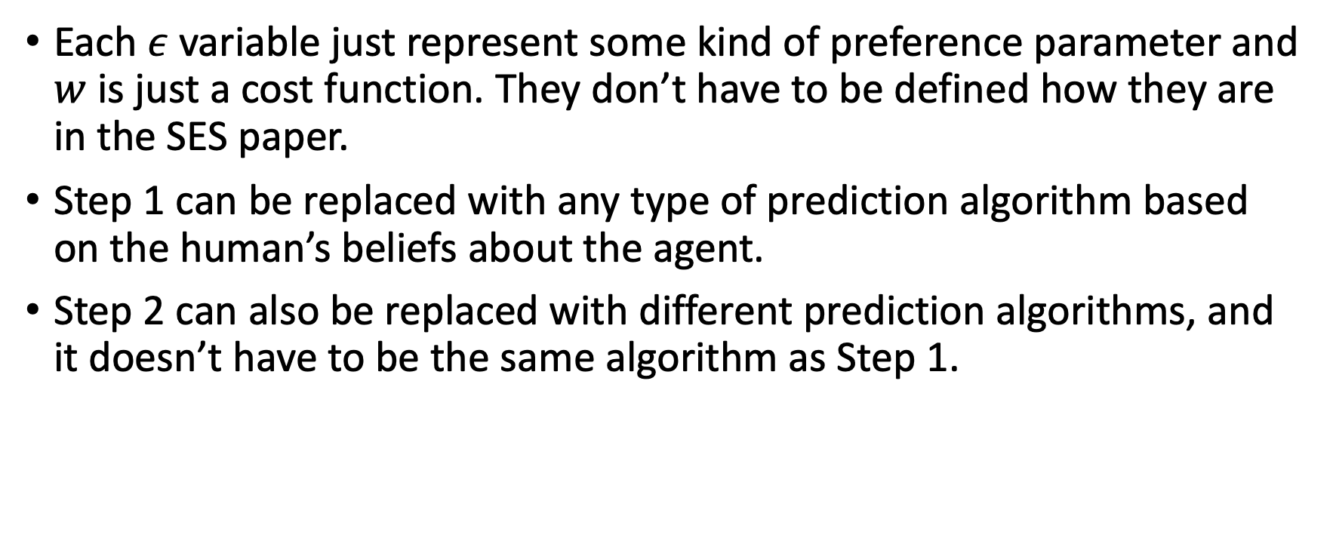
Takeover Process Remarks
Each $ε$ variable just represent some kind of preference parameter and $w$ is just a cost function. They don’t have to be defined how they are in the SES paper.
Step 1 can be replaced with any type of prediction algorithm based on the human’s beliefs about the agent.
Step 2 can also be replaced with different prediction algorithms, and it doesn’t have to be the same algorithm as Step 1.

Slide 22

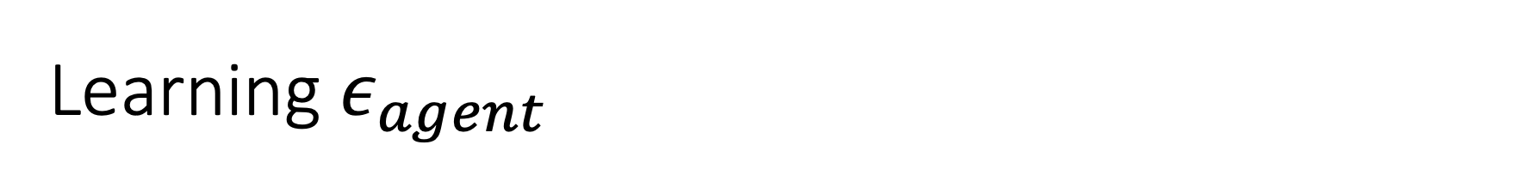
Learning $ε_{agent}$
$$P\left(ε_{agent} | O,Σ\right)∝P\left(O | ε_{agent}\right)P\left(ε_{agent}|Σ\right)$$

Slide 23
Learning $ε_{agent}$
We could have a prior over some or all of these hyper-parameters too.
$$P\left(ε_{agent} | O,Σ\right)∝P\left(O | ε_{agent}\right)P\left(ε_{agent}|Σ\right)$$

Slide 24
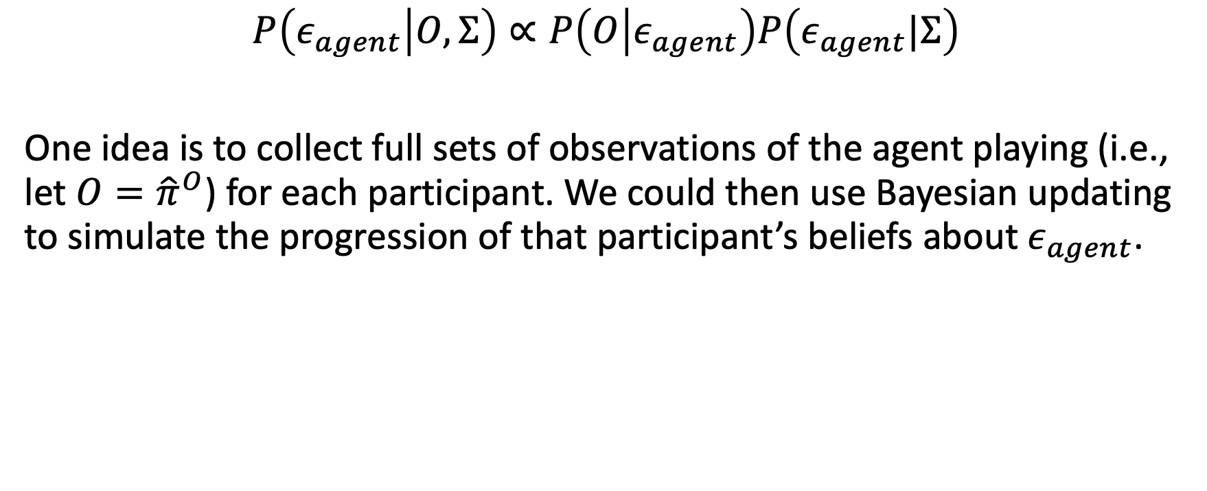
Learning $ε_{agent}$
We could have a prior over some or all of these hyper-parameters too.
$$P\left(ε_{agent} | O,Σ\right)∝P\left(O | ε_{agent}\right)P\left(ε_{agent}|Σ\right)$$
One idea is to collect full sets of observations of the agent playing (i.e., let $O={\hat{π}}^{O}$) for each participant. We could then use Bayesian updating to simulate the progression of that participant’s beliefs about $ε_{agent}$.

Slide 25
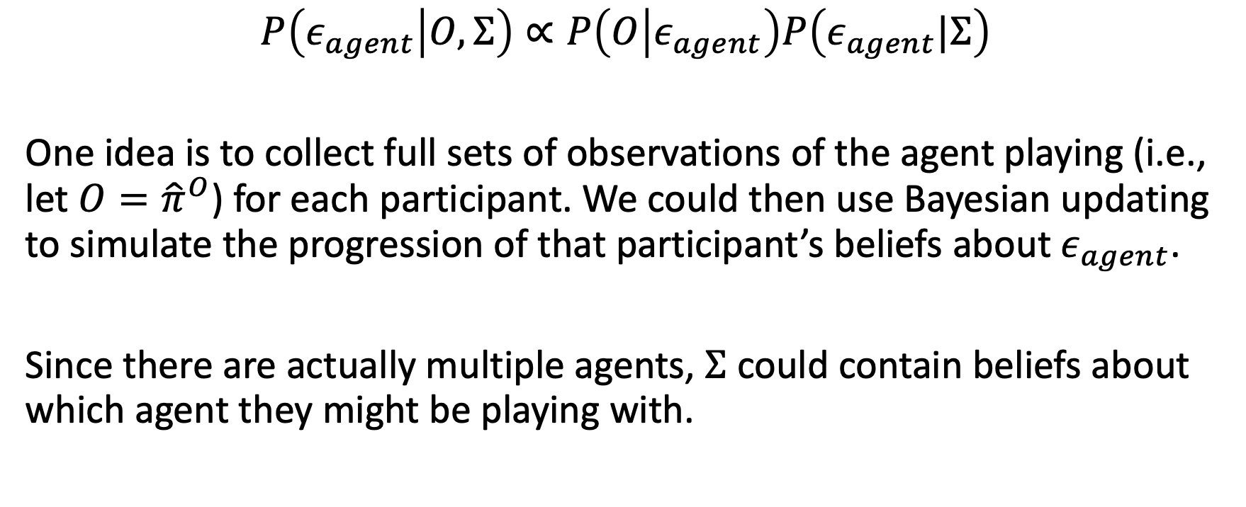
Learning $ε_{agent}$
We could have a prior over some or all of these hyper-parameters too.
$$P\left(ε_{agent} | O,Σ\right)∝P\left(O | ε_{agent}\right)P\left(ε_{agent}|Σ\right)$$
One idea is to collect full sets of observations of the agent playing (i.e., let $O={\hat{π}}^{O}$) for each participant. We could then use Bayesian updating to simulate the progression of that participant’s beliefs about $ε_{agent}$.
Since there are actually multiple agents, $Σ$ could contain beliefs about which agent they might be playing with.

Slide 26
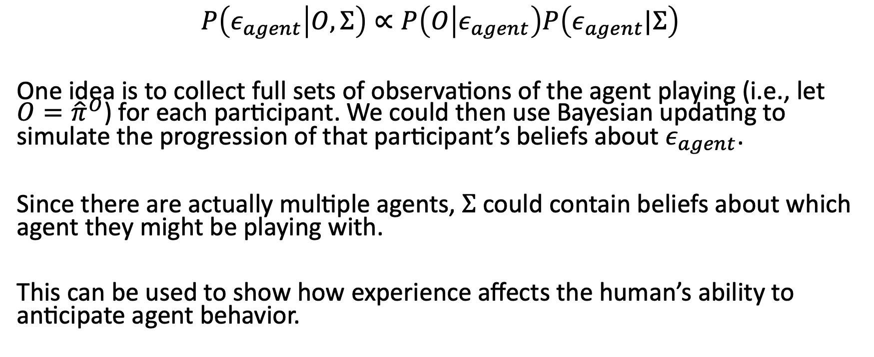
Learning $ε_{agent}$
We could have a prior over some or all of these hyper-parameters too.
$$P\left(ε_{agent} | O,Σ\right)∝P\left(O | ε_{agent}\right)P\left(ε_{agent}|Σ\right)$$
One idea is to collect full sets of observations of the agent playing (i.e., let $O={\hat{π}}^{O}$) for each participant. We could then use Bayesian updating to simulate the progression of that participant’s beliefs about $ε_{agent}$.
Since there are actually multiple agents, $Σ$ could contain beliefs about which agent they might be playing with.
This can be used to show how experience affects the human’s ability to anticipate agent behavior.

Slide 27

Bayesian Updating
$$P(θ|O_{a})∝P\left(O_{a} | θ\right)P(θ)$$

Slide 28
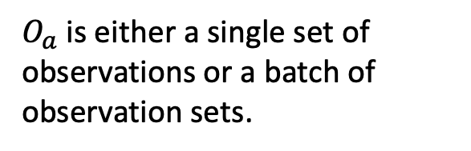
Bayesian Updating
$$P(θ|O_{a})∝P\left(O_{a} | θ\right)P(θ)$$
$O_{a}$ is either a single set of observations or a batch of observation sets.

Slide 29

Bayesian Updating
$$P(θ|O_{a})∝P\left(O_{a} | θ\right)P(θ)$$
$$P(θ|O_{b})∝P\left(O_{b} | θ\right)P(θ|O_{a})$$
$O_{a}$ is either a single set of observations or a batch of observation sets.

Slide 30
Bayesian Updating
$$P(θ|O_{a})∝P\left(O_{a} | θ\right)P(θ)$$
$$P(θ|O_{b})∝P\left(O_{b} | θ\right)P(θ|O_{a})$$
$O_{a}$ is either a single set of observations or a batch of observation sets.
And so and so forth.

Slide 31

TODO: Finding a prior
$$P\left(ε_{agent} | O,Σ\right)∝P\left(O | ε_{agent}\right)P\left(ε_{agent}|Σ\right)$$
$$P\left(O | ε_{agent}\right)=β\frac{w(\hat{π},ε_{agent})}{w(O,ε_{agent})}$$

Slide 32
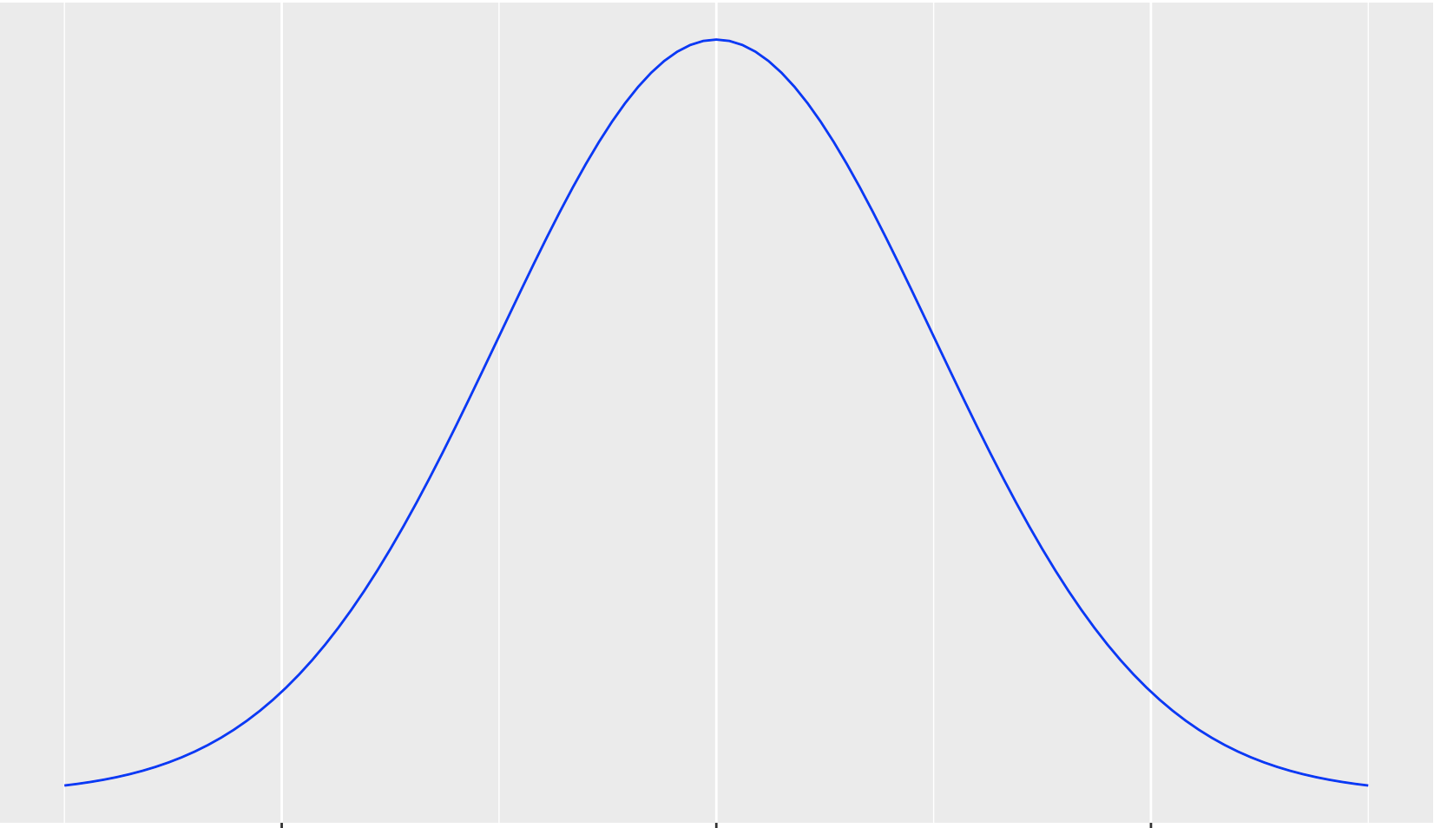

Collision probabilities
Occupancy Distribution
$$μ$$
The mean distance traveled per some time step t.

Slide 33
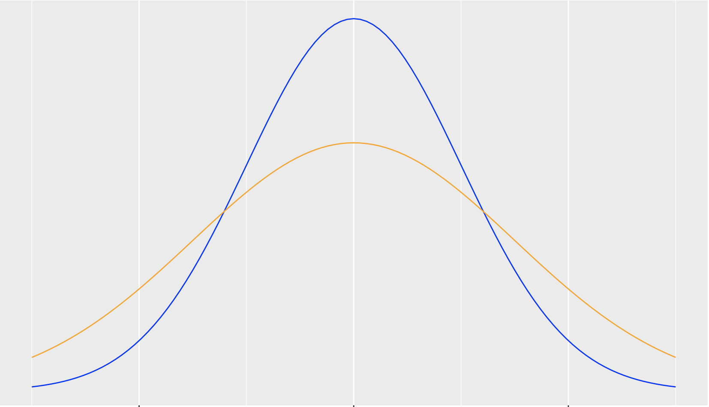

Human perception of collision probabilities
True Occupancy Distribution
Perceived Occupancy Distribution
$$μ$$

Slide 34

Human perception of collision probabilities
Let $X$ be the distance that an obstacle moves along its direction of travel for some time step $t$.

Slide 35

Human perception of collision probabilities
Let $X$ be the distance that an obstacle moves along its direction of travel for some time step $t$.
$X\sim N\left(μ,σ^{2}\right)$ is the true distribution*.
*It’s technically a truncated normal bound between the min and max distances the obstacle can travel

Slide 36
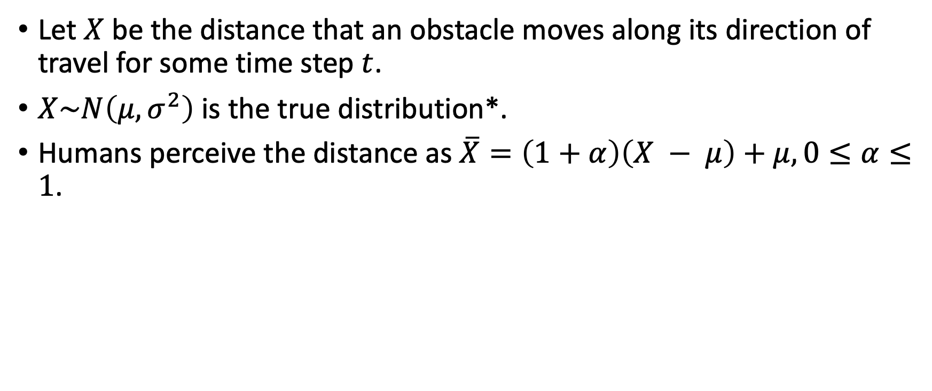
Human perception of collision probabilities
Let $X$ be the distance that an obstacle moves along its direction of travel for some time step $t$.
$X\sim N\left(μ,σ^{2}\right)$ is the true distribution*.
Humans perceive the distance as $\overline{X}=\left(1+α\right)\left(X − μ\right)+μ, 0≤α≤1$.
*It’s technically a truncated normal bound between the min and max distances the obstacle can travel

Slide 37
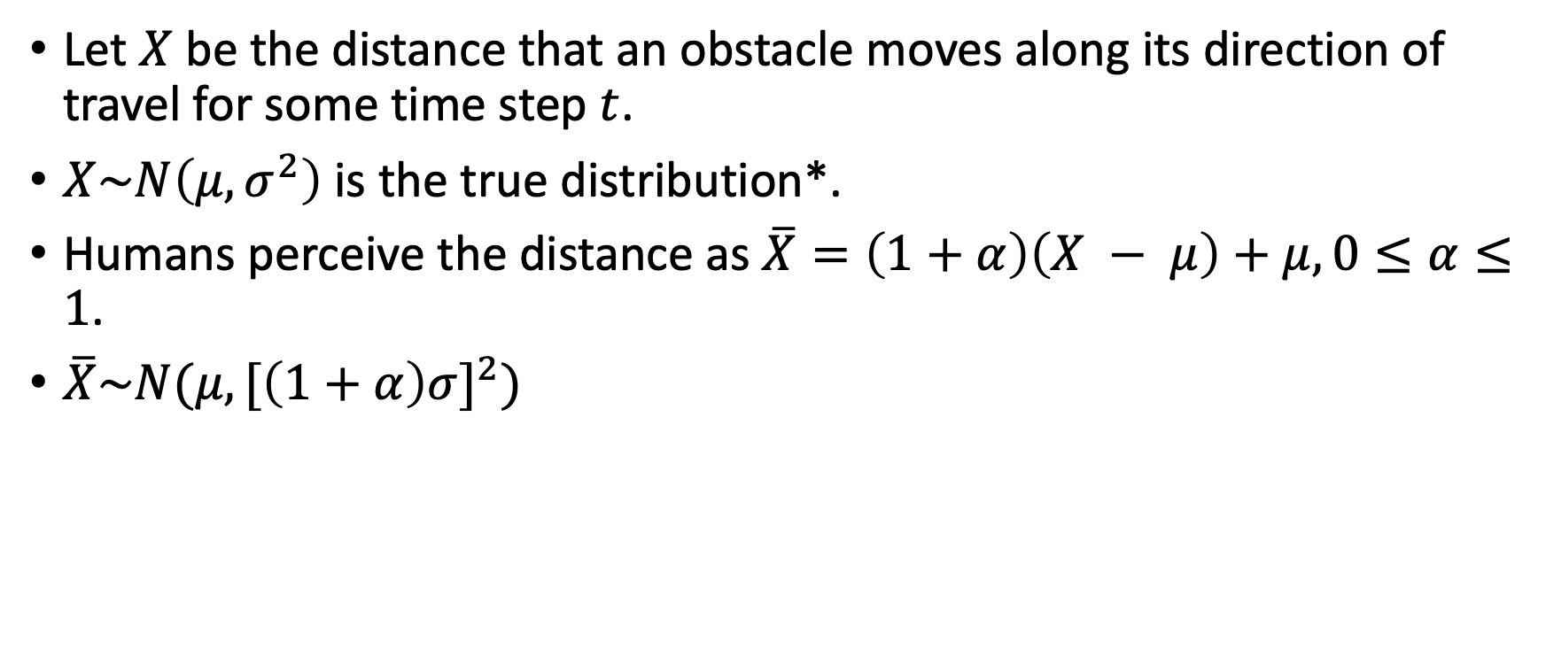
Human perception of collision probabilities
Let $X$ be the distance that an obstacle moves along its direction of travel for some time step $t$.
$X\sim N\left(μ,σ^{2}\right)$ is the true distribution*.
Humans perceive the distance as $\overline{X}=\left(1+α\right)\left(X − μ\right)+μ, 0≤α≤1$.
$\overline{X}\sim N(μ,{[\left(1+α\right)σ]}^{2})$
*It’s technically a truncated normal bound between the min and max distances the obstacle can travel

Slide 38
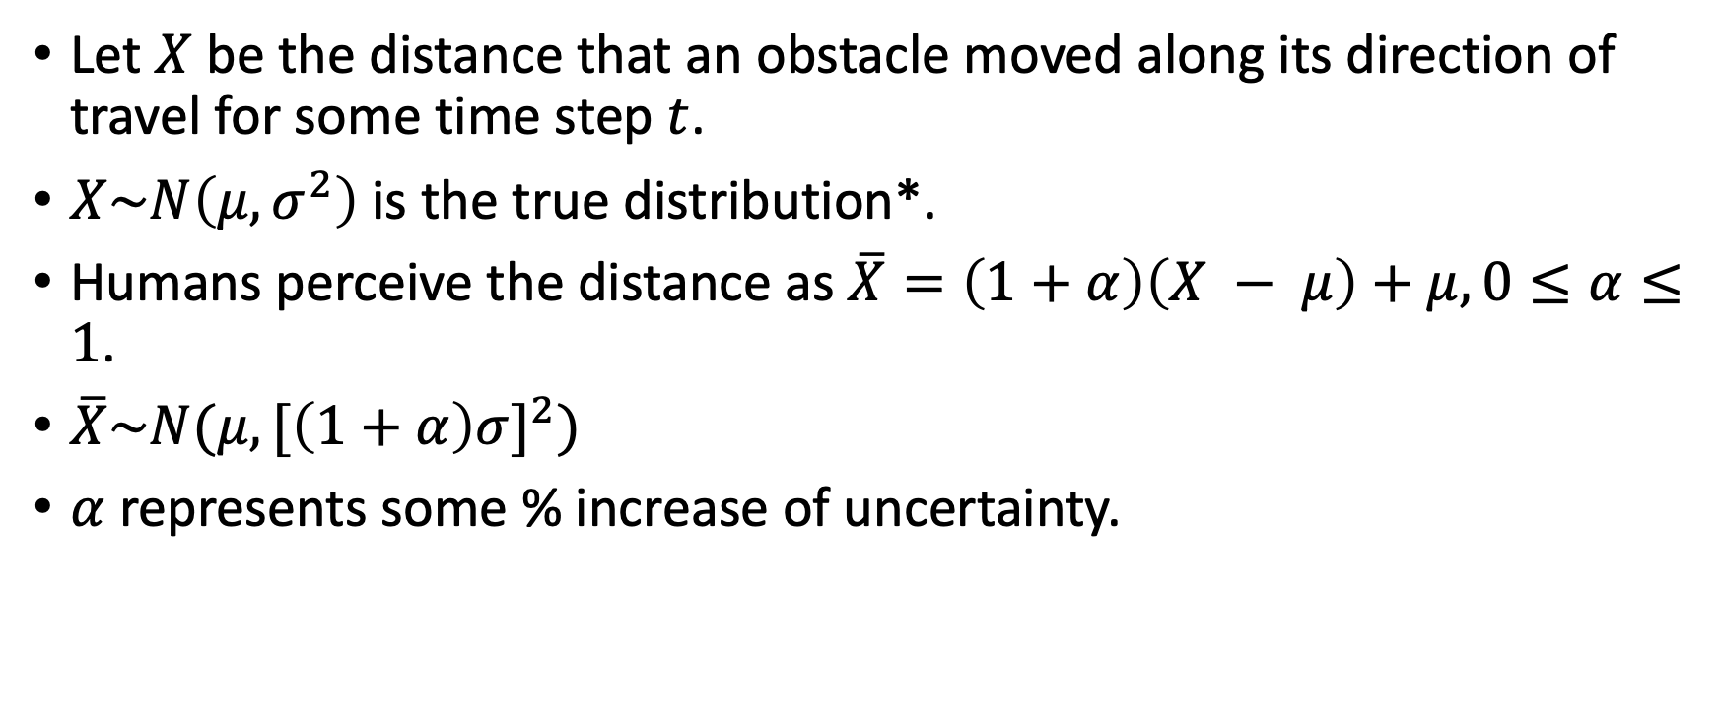
Human perception of collision probabilities
Let $X$ be the distance that an obstacle moved along its direction of travel for some time step $t$.
$X\sim N\left(μ,σ^{2}\right)$ is the true distribution*.
Humans perceive the distance as $\overline{X}=\left(1+α\right)\left(X − μ\right)+μ, 0≤α≤1$.
$\overline{X}\sim N(μ,{[\left(1+α\right)σ]}^{2})$
$α$ represents some % increase of uncertainty.
*It’s technically a truncated normal bound between the min and max distances the obstacle can travel

