Slide 1
When observing behavior with good resolution, we’re seeing a combination of control acting at different scales, often characterized as “deliberative” vs. “automatic” decision-making or control (“thinking fast and slow”).
For example, if we measure driving based on the movement of a vehicle, we see fine-grained adjustments related to lane keeping, etc., and broader adjustments related to route planning.
This is an IRL/plan recognition approach to simultaneously model multiple scales of control.
Relevant to Busy Beeway because movements are recorded at an extremely fine resolution relative to human decision making. Specifically, the production of a human trajectories on the order of 5 frames/<200ms.
The lowest level is meant to represent a kind of reactive/reflexive action control. Something like APF. The next level up is planning-based: It works on a larger scale/finer resolution and involves lookahead.
Human movement wouldn’t look like a pure planner for this task.
If the agent is controlled by a combo planner and APF, then the trajectory will go around the wall (planning) but produce reactive movements to the moving obstacle.
Notes:
This framing may not make total sense unless I have a reward function that specifically relates to the details of the trajectories. Right now I just grab similar trajectories and simulate those, but I could have a human trajectory controller and do inference on those params, too.

Slide 2
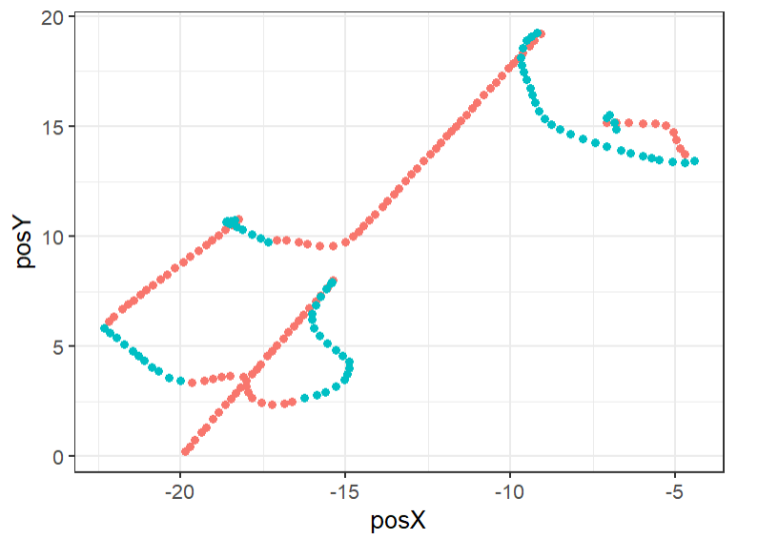

Discrete planning space
Observed plan includes 4 transitions/steps. Note that states are in both space and time
0 1 2 3 4 5 6 7 8
0 1 2 3 4 5 6 7 8
In a given session, we need to explain both agent and human control trajectories.
The resolution of human decision making isn’t clear, but it’s definitely not the same as the agent (30 hz).
Abstract up to a “planning space” that is a more realistic resolution for human decision making.
We also need to break a full trajectory into multiple plans, since a human doesn’t plan the entire session at once. They likely move through a series of plans and replan as needed.
To do that, the full trajectory becomes a series of plans, where each plan is a series of “planning steps.” Each planning step is a move through planning space.
NOTE: Planning space has 4 dimensions: x, y, time, and agent vs. human control.

Slide 3
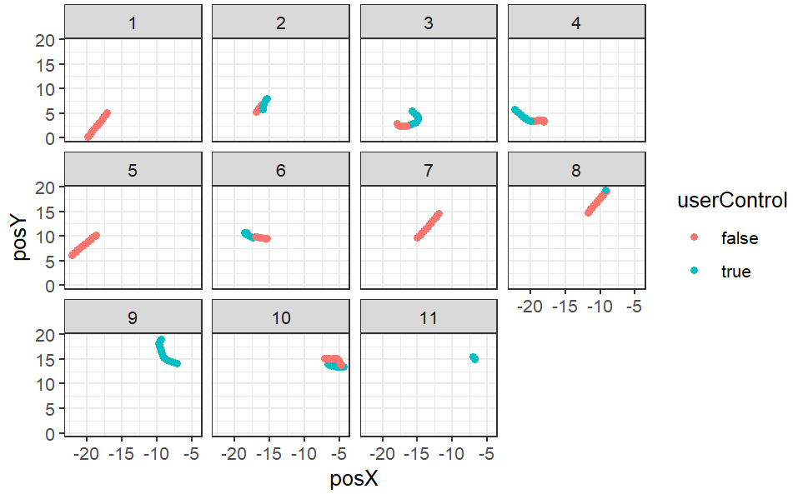
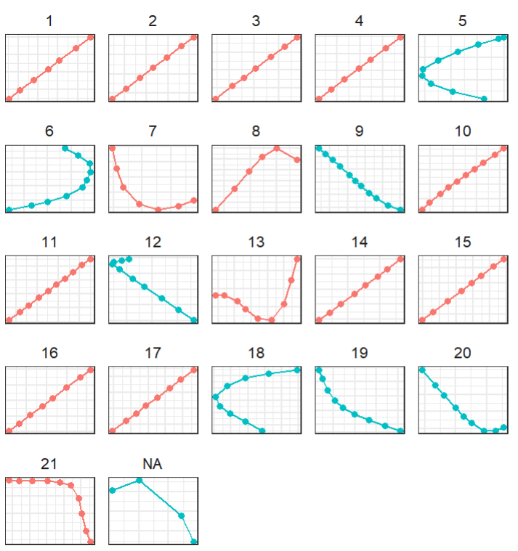
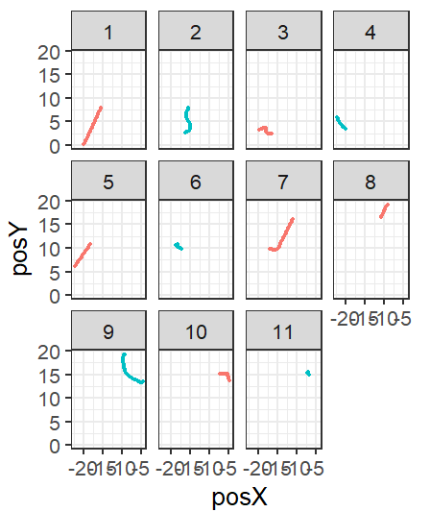
Break up full session into even units. Mixes human and agent control.
Break up session by control. Some segments are very long
Break up session by control and then tailor the number of steps with some minimum

Slide 4
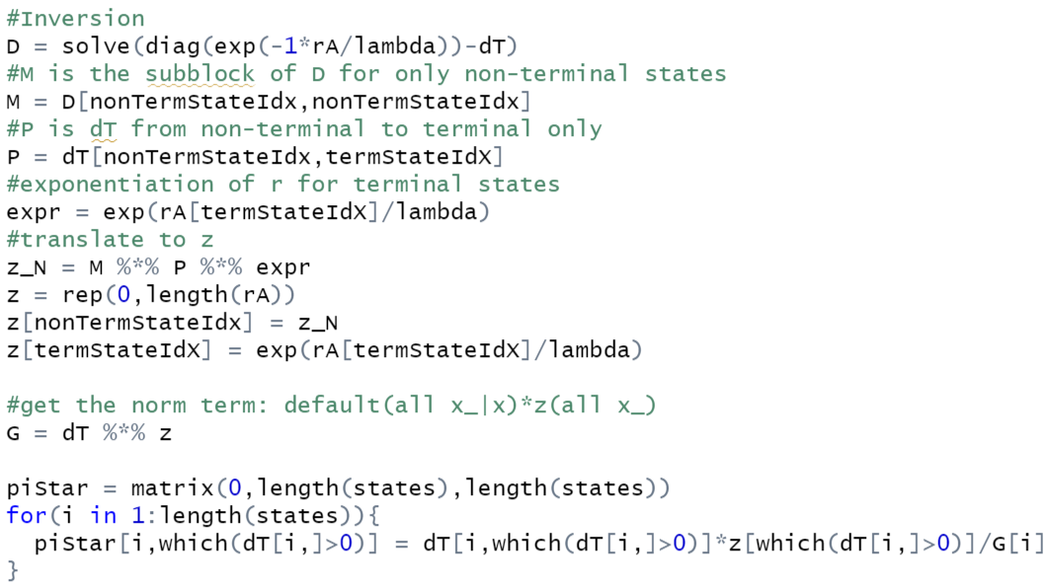
To do plan inference/IRL, we need an optimal policy, piStar, with which to evaluate the probability of observed data
rA = reward for all states (linear combination of features)
lambda = 1
dT = transition matrix, where element (i, j) is the probability of transitioning from state i to state j under the default policy
Terminal states are any state at the final step in a plan, non-terminal are all others

Slide 5
Input is a trajectory with high frequency sampling in a continuous space. Define a planning time frame and plan length and overlay a discrete planning space onto the continuous space. Walk through the transitions in the planning space that track the observed trajectory, sampling all next states at each planning time point and adding them to a log of transition frequencies and a log of features. Output is the two logs.
Note that planning space/states is given in x, y, and time dimensions.
Continuous game space
Continuous game space
Discrete planning space
Discrete planning space
x | x’ | c
4,4,1 | 3,5,2 | 10
4,4,1 | 4,5,2 | 10
4,4,1 | 5,5,2 | 10
4,4,1 | 3,4,2 | 15
4,4,1 | 5,4,2 | 15
… | … | …
x’ | f1
3,5,2 | .2
4,5,2 | 1.1
5,5,2 | .09
3,4,2 | .25
5,4,2 | .8
… | …
0 1 2 3 4 5 6 7 8
0 1 2 3 4 5 6 7 8
0 1 2 3 4 5 6 7 8
0 1 2 3 4 5 6 7 8
Transitions sampled
Continuous game space
Discrete planning space
x | x’ | c
4,4,1 | 3,5,2 | 10
4,4,1 | 4,5,2 | 10
… | … | …
3,2,4 | 2,1,5 | 4
3,2,4 | 3,1,5 | 20
3,2,4 | 4,1,5 | 20
x’ | f1
3,5,2 | .2
4,5,2 | 1.1
… | …
2,1,5 | 2
3,1,5 | .04
4,1,5 | .7
 | 4,4,1 | 3,5,2 | … | 3,1,5 | 4,1,5
4,4,1 | 0 | 10 | … | 0 | 0
3,5,2 | 0 | 0 | … | 0 | 0
… | … | … | … | … | …
3,2,4 | 0 | 0 | … | 20 | 20
… | … | … | … | … | 0
0 1 2 3 4 5 6 7 8
Transition counts from which we can get the transition probability matrix
0 1 2 3 4 5 6 7 8
Transitions sampled

Slide 6
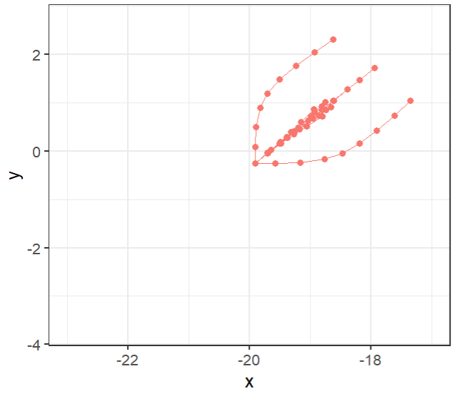
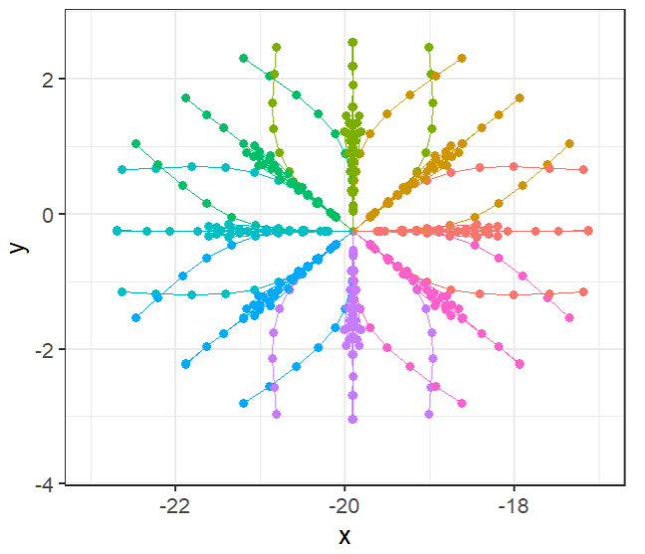
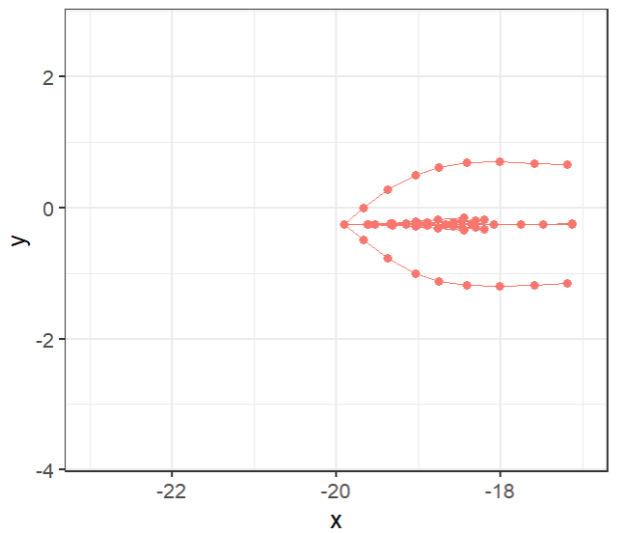
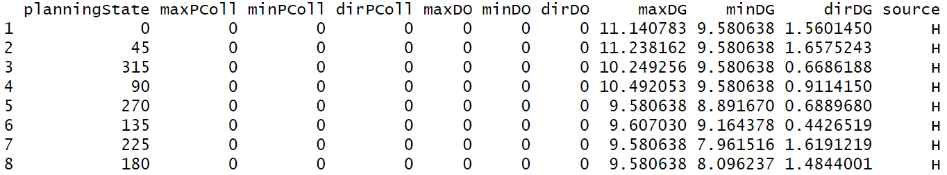
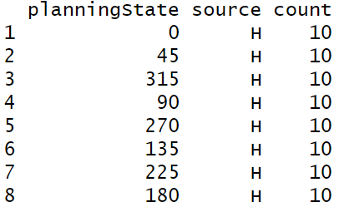
Continuous game space
Something is weird here with the transitions. Why are there symmetrical reflections for some theta but not others when plotting by theta instead of planning state? Does it matter? What was the point of theta in this case?
Planning space
Discrete planning space
0 1 2 3 4 5 6 7 8
0 1 2 3 4 5 6 7 8
Transitions sampled
Transition counts from which we can get the transition probability matrix

Slide 7
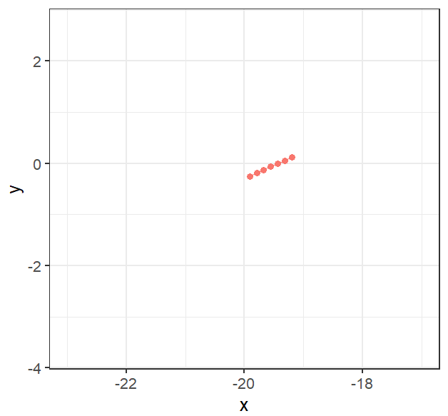
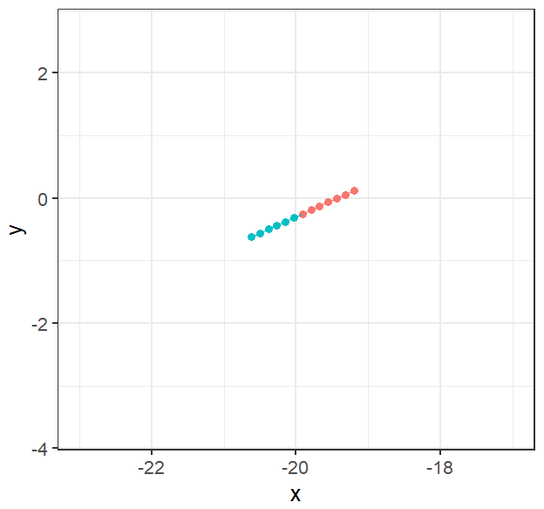
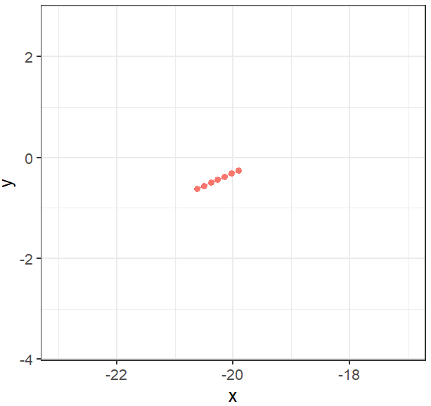
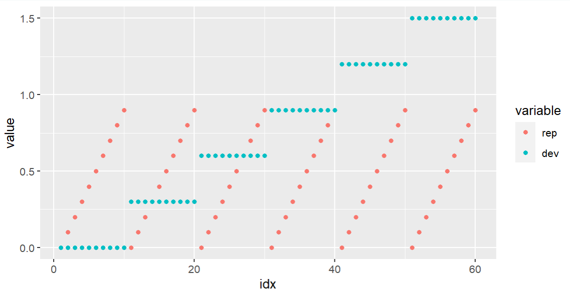
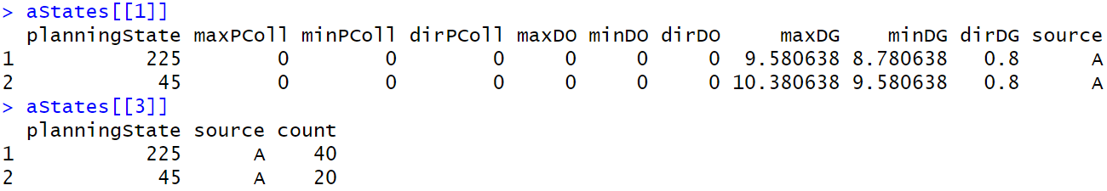
Continuous game space
Planning space
Discrete planning space
0 1 2 3 4 5 6 7 8
0 1 2 3 4 5 6 7 8
Transitions sampled
Transition counts from which we can get the transition probability matrix

Slide 8
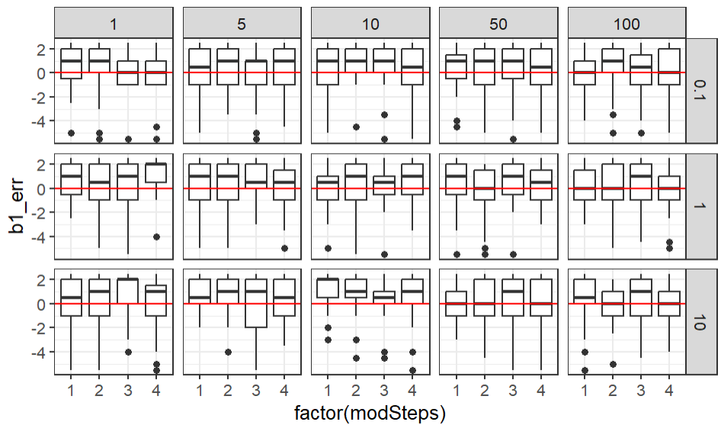
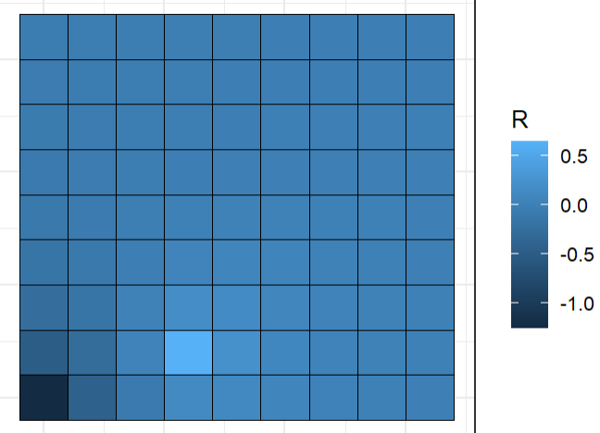
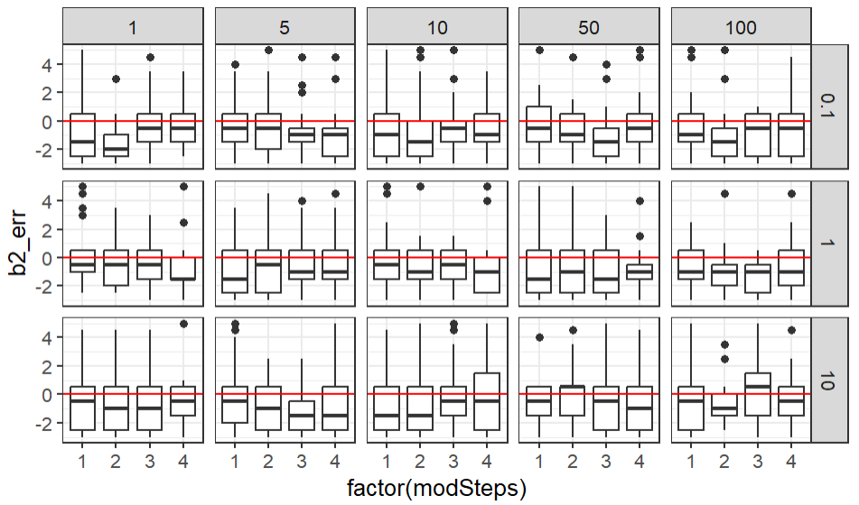


Create an observed trajectory based on a ground truth. Just minimize cost/reward at each step. Black is observed player trajectory, yellow is goal, red is anti-goal. White is comparison trajectory (just the opposite of the observed). The true reward is some function of distance to goal and distance to anti-goal: $R= b_{1}{dist}_{goal}+ b_{2 }{dist}_{anti−goal}$
Experimental parameters are
modSteps = {1,2,3,4}
nSim = {1,5,10,50,100}
Sigma = {.1,1,10}
Each unique combo of experimental parameters is sampled 25 times.
modSteps are the number of steps, starting from the last, that are modified from the original observed and opposite trajectories. They are selected randomly.
nSim is the number of modified trajectories that are used, in addition to the observed and opposite trajectories, to sample the environment.
Sigma is the error in feature sampling (i.e., distance to the goal + N(0,sigma).
$$b_{1}=−1.5,{ b}_{2}=1$$
0 1 2 3 4 5 6 7 8
0 1 2 3 4 5 6 7 8
$$b_{1}=−1.5,{ b}_{2}=1$$
0 1 2 3 4 5 6 7 8
0 1 2 3 4 5 6 7 8
modSteps = 2

Slide 9
NOTES

Slide 10
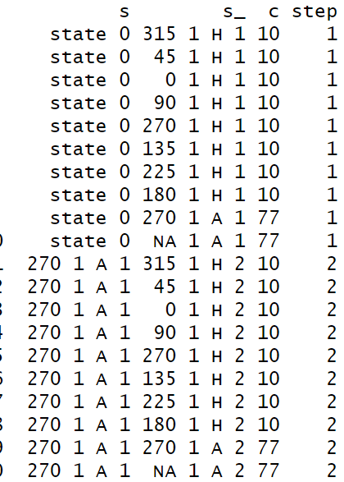
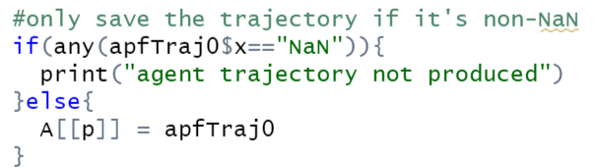

Continuous game space
What is m (or mc) doing for predicted movements for humans and agents?
Discrete planning space
0 1 2 3 4 5 6 7 8
Why are there NAs again? Should they be removed? When params don’t produce a valid trajectory. It shouldn’t be counted in tL
0 1 2 3 4 5 6 7 8
Continuous game space
Discrete planning space
0 1 2 3 4 5 6 7 8
0 1 2 3 4 5 6 7 8
Notes:
Look into Options framework for RL

Slide 11
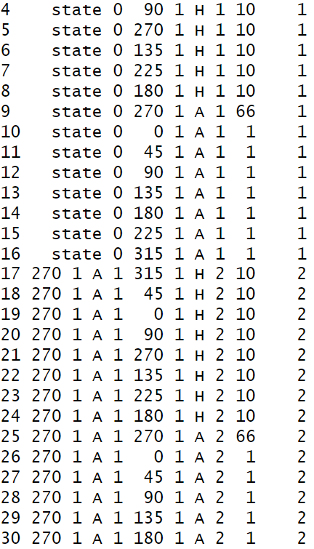
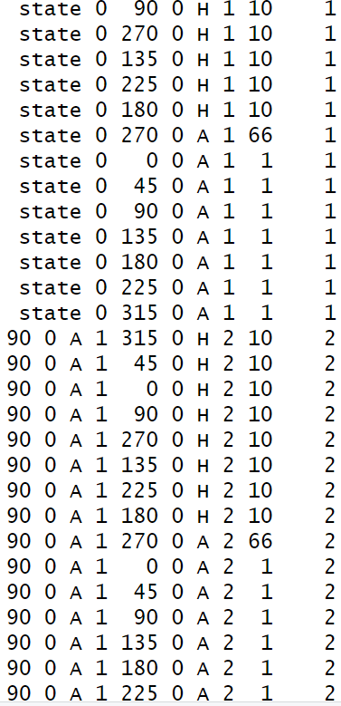
What happens if s at step t+1 isn’t in s_ at step t? This can happen if the simulated human has misspecified something like the APF prior or the obstacle movement. Return 0 likelihood, right? I could add every state not observed (i.e., all c == 0) and add a tiny amount so that the trajectory is considered technically possible but extremely unlikely. Only needed for agent movement, since human movement is already the full 360
s at t+1 isn’t in s_ at t for rotated flipped. I think this is because the choice of s at t+1 is based on the rotating and flipping of observed, not what the agent would actually do. Adding c = 1 for all possible agent movements would make s at t+1 possible but extremely unlikely, which is accurate, since rotated/flipped is supposed to represent that

Slide 12
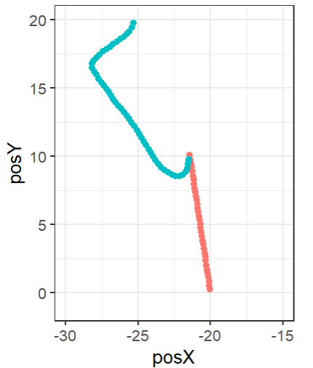
Now that I can run coreLRL(), I have piStar. I can assess the likelihood of any trajectory through planning space.
Things to validate: Get the states into a planning coordinate system where the first position is (0,0). This will make checking things easier

Slide 13
Is there a way to learn the reward with gradient descent? Or somehow imbed the math into a neural net? Advantages would be totally flexible feature representation and maybe meta learning?
Interesting as a sequential mc because particles can represent different default representations/simulations.
Is there a general theoretical advantage to this approach? Something about combining theory-based/task-specific models with IRL? Look into the options framework more
What would this look like with a team of multiple agents?
What's a toy test case that this would be uniquely good at? What is it about BB that led me to this?
Whats the request for an extension going to look like? What results will I want to have?
Maybe simplify features and plot reward functions to see if they're sensible like?
When do reward values crash it? What's happening with the math when I get that error?
Can easily sample two steps out from an observed state. Does that help? What does help even look like?
Does too much sampling ever hurt performance?
Can I also do inference at the level of the human trajectories? It would be the same as the priors over APF params. The number of states sampled would be way fewer, probably, since it wouldn’t sample in all directions. This might work better, since it would allow the default policy to appropriately call some human trajectories very improbable. It would also mean I’d actually be doing multi-scale IRL

