Slide 1
Busy Bee ideas (6/1)
Loren Rieffer-Champlin

Slide 2


Likelihood of path
From Kaminka, Vered, and Agmon (2018),

Slide 3
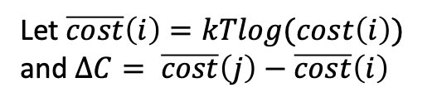

Likelihood of path
From Kaminka, Vered, and Agmon (2018),
This slide is just for context!
$${=e}^{log⁡(\frac{cost({\hat{π}}_{g})}{cost(π)})}=e^{\log\left(cost\left({\hat{π}}_{g}\right)\right)−log⁡(cost\left(π\right))}$$
$$=e^{\frac{−kT\log\left(cost\left({\hat{π}}_{g}\right)\right)+kTlog⁡(cost\left(π\right))}{kT}}$$
$$=e^{−\frac{∆C}{kT}}$$
Let $\overline{cost}\left(i\right)=kTlog(cost\left(i\right))$ and $ΔC= \overline{cost}\left(j\right)−\overline{cost}\left(i\right)$
A Boltzmann distribution!
Notes:
e

Slide 4
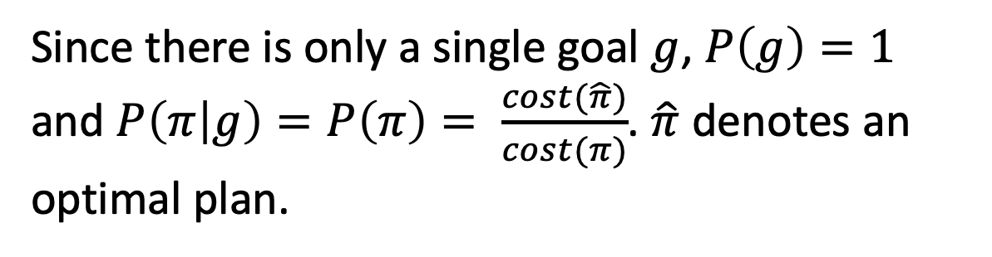
Likelihood of path
From Kaminka, Vered, and Agmon (2018),
Since there is only a single goal $g$, $P\left(g\right)=1$ and $P\left(π | g\right)=P\left(π\right)= \frac{cost(\hat{π})}{cost(π)}$. $\hat{π}$ denotes an optimal plan.

Slide 5

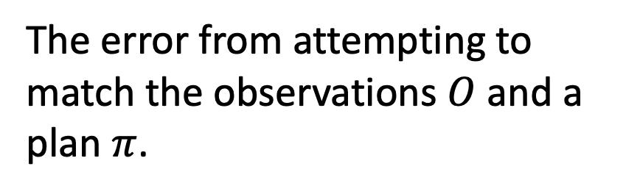
Likelihood of path
From Kaminka, Vered, and Agmon (2018),
The error from attempting to match the observations $O$ and a plan $π$.

Slide 6
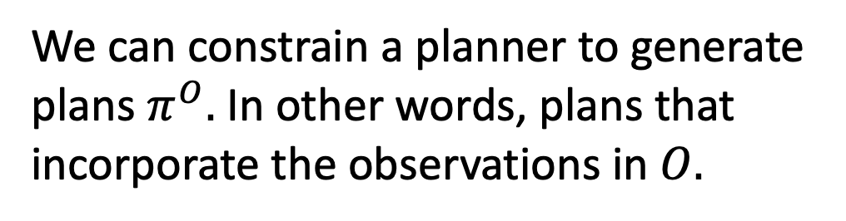
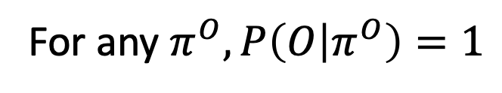
Likelihood of path
From Kaminka, Vered, and Agmon (2018),
We can constrain a planner to generate plans $π^{O}.$ In other words, plans that incorporate the observations in $O.$
For any $π^{O}, P\left(O | π^{O}\right)=1$

Slide 7

Likelihood of path
Thus, $P\left(π^{O} | O\right)=β\frac{cost(\hat{π})}{cost(π^{O})}$ for any $π^{O}$.

Slide 8
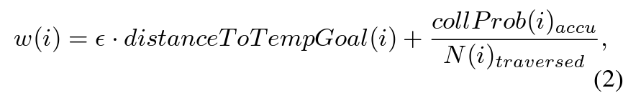
SES cost function
This is computed for each path
SES/RRT picks the path that minimizes w.

Slide 9
SES cost function
This is computed for each path
SES/RRT picks the path that minimizes w.
They call it “greed”, but it can also be somewhat re-interpreted as risk tolerance. The greater it is, the more willing I am to risk collision to reduce my distance from the goal.

Slide 10

SES cost function
Thus, $P\left(π^{O} | O\right)=β\frac{w(\hat{π,}ε)}{w(π^{O},ε)}$ for any $π^{O}$.

Slide 11

SES cost function
Thus, $P\left(π^{O} | O\right)=β\frac{w(\hat{π,}ε)}{w(π^{O},ε)}$ for any $π^{O}$.
The most likely plan for the agent would be ${\hat{π}}^{O}$ (i.e., the most optimal plan that adheres to the observations). But since $ε$ is unknown, we will assume it is a random variable and thus ${\hat{π}}^{O}$ itself is a random variable.

Slide 12

SES cost function
$$P\left(ε | {\hat{π}}^{O},O\right)∝P\left({\hat{π}}^{O} | O,ε\right)P\left(ε\right)$$

Slide 13
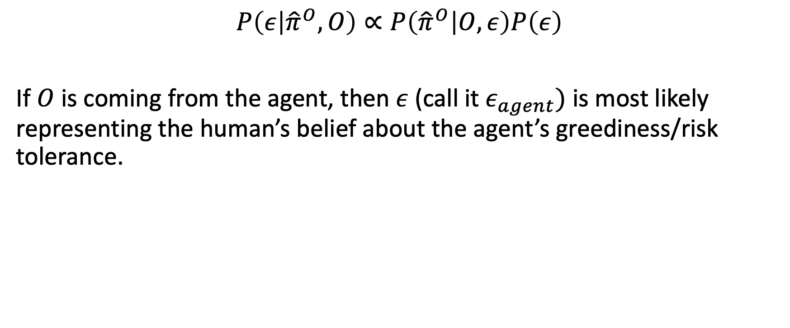
SES cost function
$$P\left(ε | {\hat{π}}^{O},O\right)∝P\left({\hat{π}}^{O} | O,ε\right)P\left(ε\right)$$
If $O$ is coming from the agent, then $ε$ (call it $ε_{agent})$ is most likely representing the human’s belief about the agent’s greediness/risk tolerance.

Slide 14
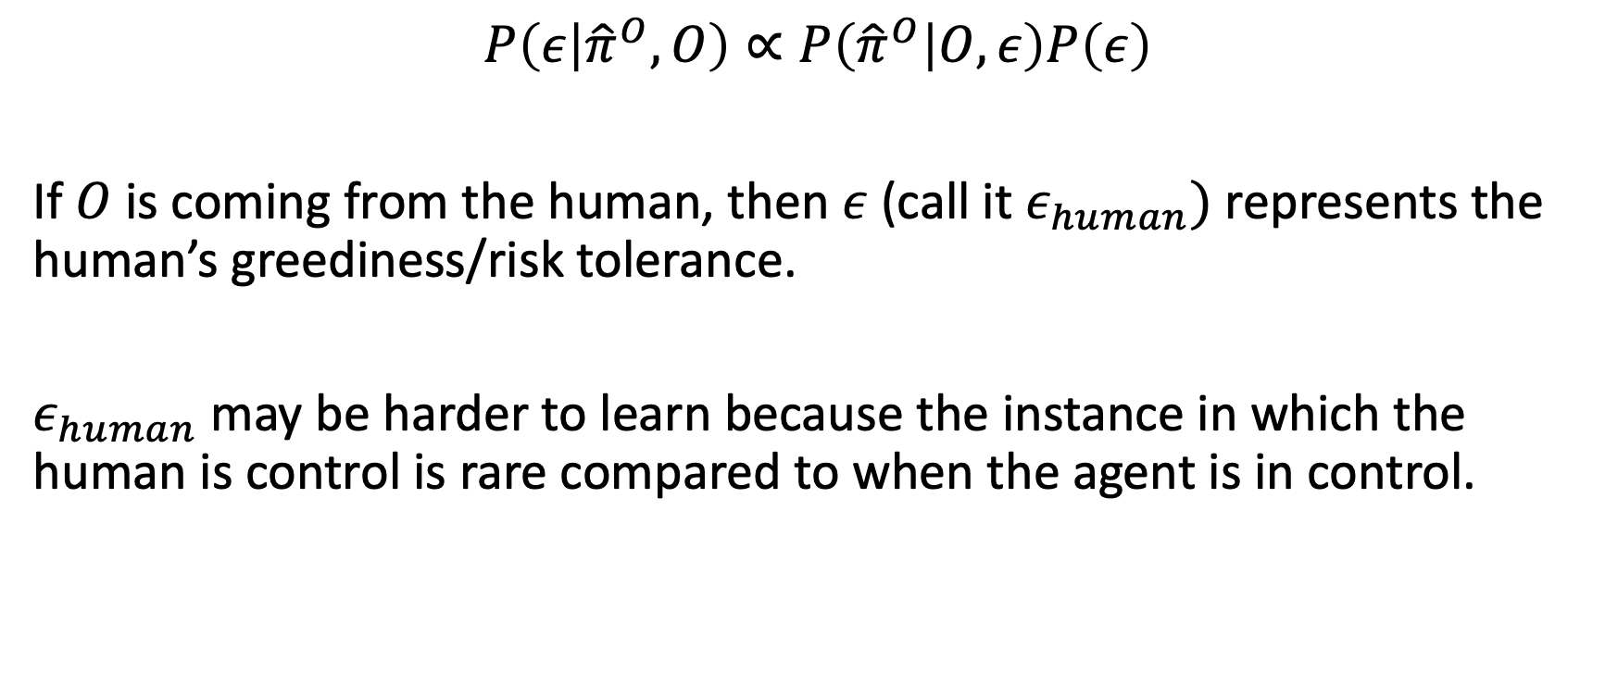
SES cost function
$$P\left(ε | {\hat{π}}^{O},O\right)∝P\left({\hat{π}}^{O} | O,ε\right)P\left(ε\right)$$
If $O$ is coming from the human, then $ε$ (call it $ε_{human})$ represents the human’s greediness/risk tolerance.
$ε_{human}$ may be harder to learn because the instance in which the human is control is rare compared to when the agent is in control.

Slide 15

Takeover Process
Compute ${\hat{π}}_{agent}^{O}=\underset{π^{O}}{argmax}{P(π^{O}|O,ε_{agent}(Σ))}$

Slide 16

Takeover Process
Compute ${\hat{π}}_{agent}^{O}=\underset{π^{O}}{argmax}{P(π^{O}|O,ε_{agent}(Σ))}$
Compute ${\hat{π}}_{human}^{O}=\underset{π^{O}}{argmax}{P(π^{O}|O,ε_{human}(Θ))}$

Slide 17
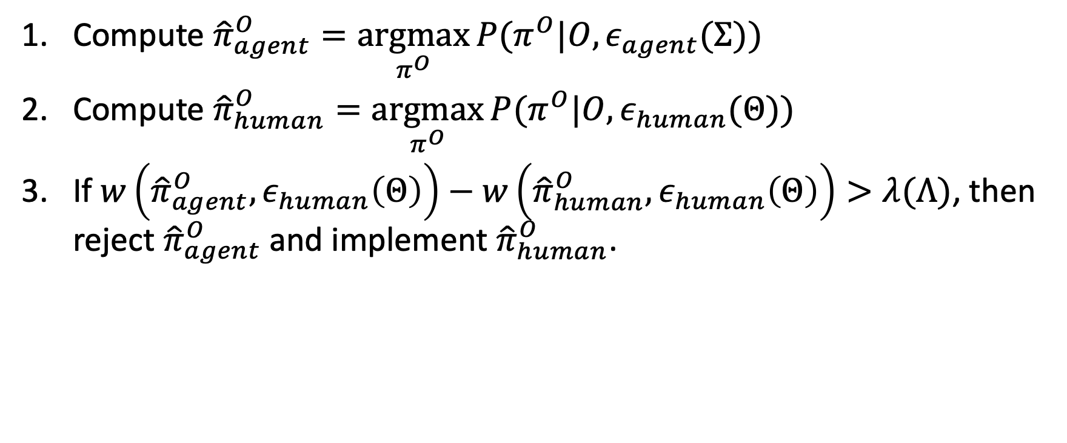
Takeover Process
Compute ${\hat{π}}_{agent}^{O}=\underset{π^{O}}{argmax}{P(π^{O}|O,ε_{agent}(Σ))}$
Compute ${\hat{π}}_{human}^{O}=\underset{π^{O}}{argmax}{P(π^{O}|O,ε_{human}(Θ))}$
If $w\left({\hat{π}}_{agent}^{O},ε_{human}\left(Θ\right)\right)−w\left({\hat{π}}_{human}^{O},ε_{human}\left(Θ\right)\right)>λ(Λ)$, then reject ${\hat{π}}_{agent}^{O}$and implement ${\hat{π}}_{human}^{O}$.

Slide 18
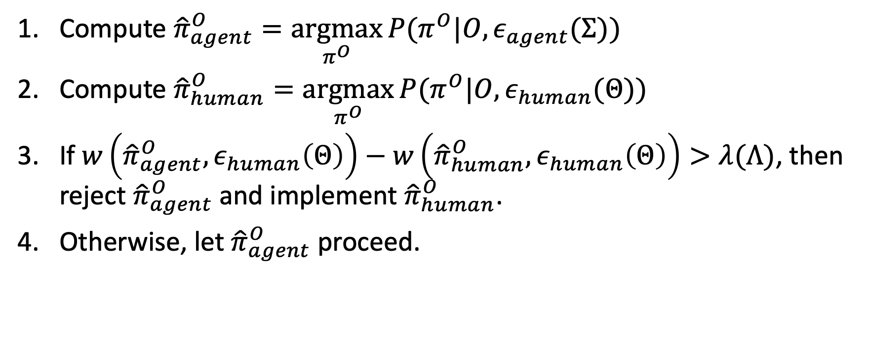
Takeover Process
Compute ${\hat{π}}_{agent}^{O}=\underset{π^{O}}{argmax}{P(π^{O}|O,ε_{agent}(Σ))}$
Compute ${\hat{π}}_{human}^{O}=\underset{π^{O}}{argmax}{P(π^{O}|O,ε_{human}(Θ))}$
If $w\left({\hat{π}}_{agent}^{O},ε_{human}\left(Θ\right)\right)−w\left({\hat{π}}_{human}^{O},ε_{human}\left(Θ\right)\right)>λ(Λ)$, then reject ${\hat{π}}_{agent}^{O}$and implement ${\hat{π}}_{human}^{O}$.
Otherwise, let ${\hat{π}}_{agent}^{O}$proceed.

Slide 19

Takeover Process Remarks
Each $ε$ variable just represent some kind of preference parameter and $w$ is just a cost function. They don’t have to be defined how they are in the SES paper.

Slide 20

Takeover Process Remarks
Each $ε$ variable just represent some kind of preference parameter and $w$ is just a cost function. They don’t have to be defined how they are in the SES paper.
Step 1 can be replaced with any type of prediction algorithm based on the human’s beliefs about the agent.

Slide 21
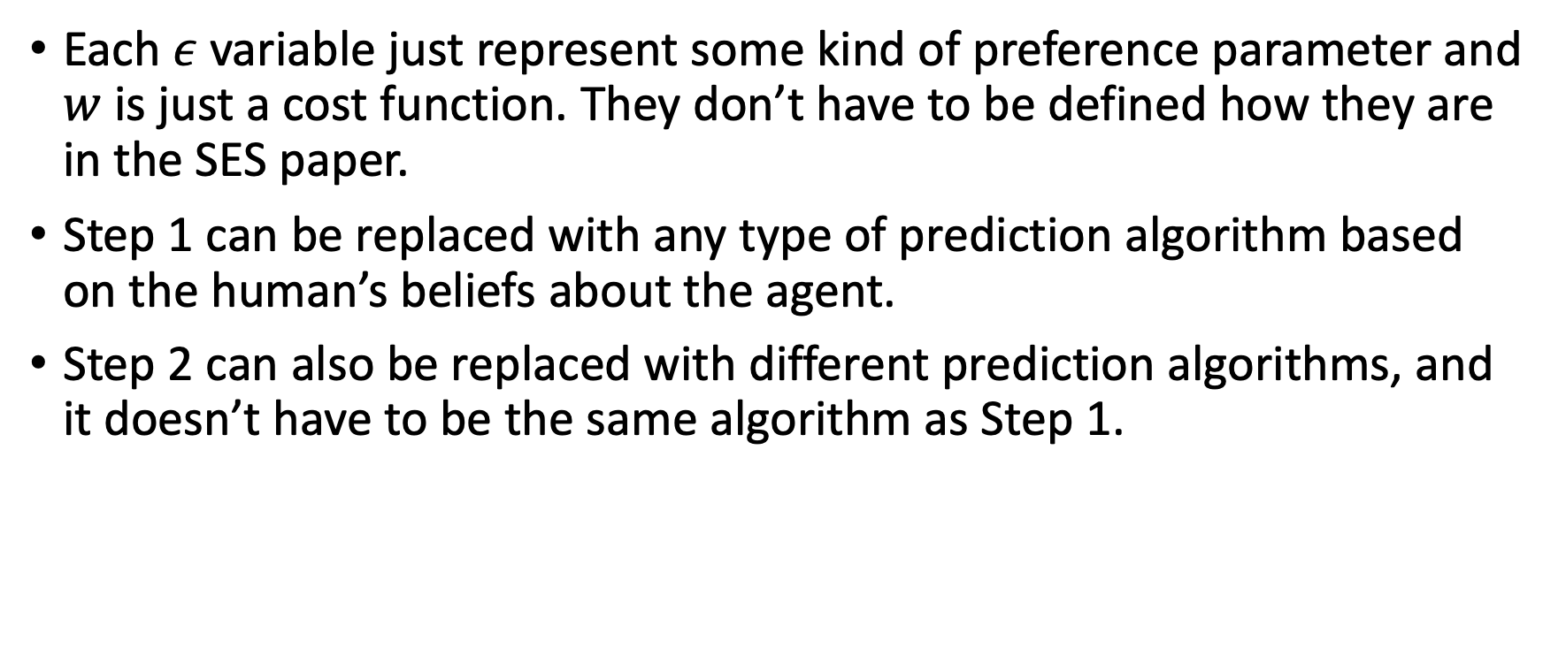
Takeover Process Remarks
Each $ε$ variable just represent some kind of preference parameter and $w$ is just a cost function. They don’t have to be defined how they are in the SES paper.
Step 1 can be replaced with any type of prediction algorithm based on the human’s beliefs about the agent.
Step 2 can also be replaced with different prediction algorithms, and it doesn’t have to be the same algorithm as Step 1.

Slide 22

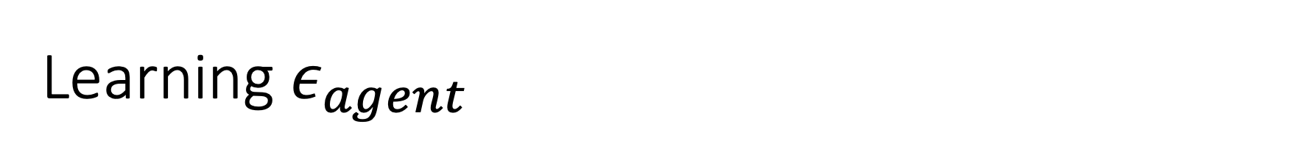
Learning $ε_{agent}$
$$P\left(ε_{agent} | O,Σ\right)∝P\left(O | ε_{agent}\right)P\left(ε_{agent}|Σ\right)$$

Slide 23
Learning $ε_{agent}$
We could have a prior over some or all of these hyper-parameters too.
$$P\left(ε_{agent} | O,Σ\right)∝P\left(O | ε_{agent}\right)P\left(ε_{agent}|Σ\right)$$

Slide 24
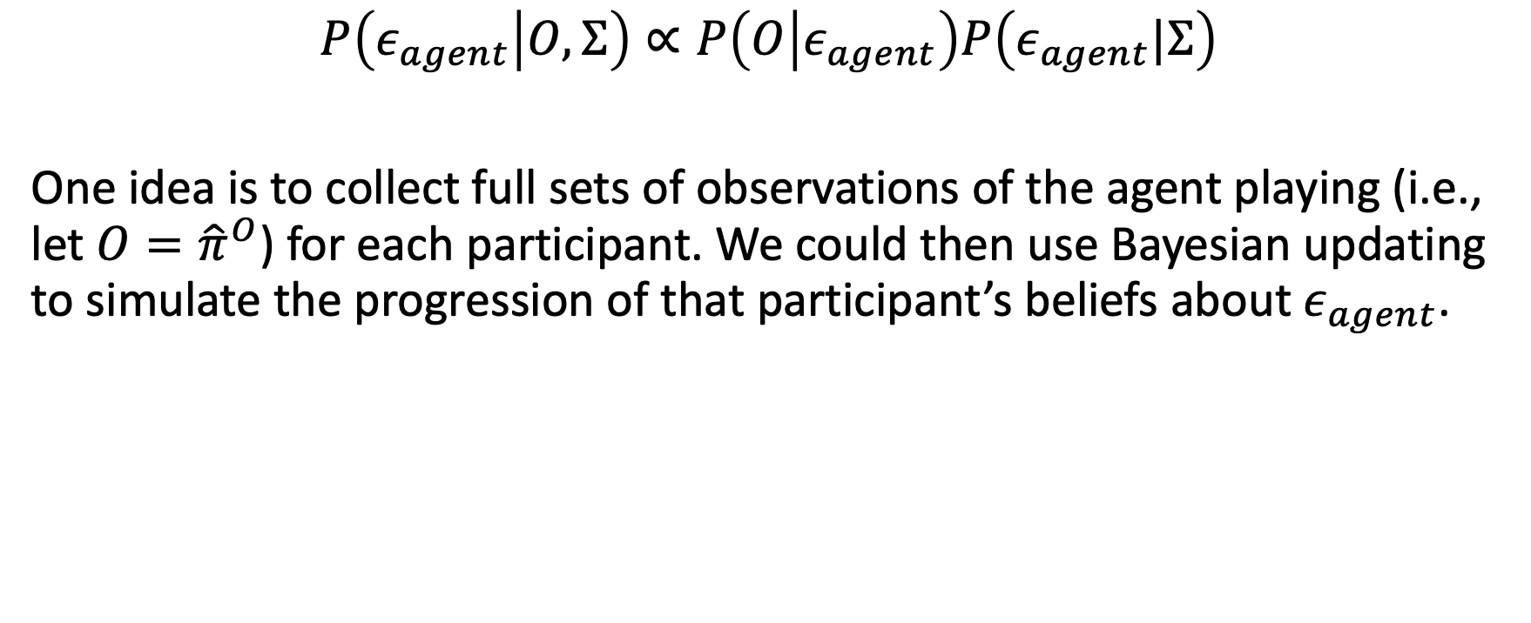
Learning $ε_{agent}$
We could have a prior over some or all of these hyper-parameters too.
$$P\left(ε_{agent} | O,Σ\right)∝P\left(O | ε_{agent}\right)P\left(ε_{agent}|Σ\right)$$
One idea is to collect full sets of observations of the agent playing (i.e., let $O={\hat{π}}^{O}$) for each participant. We could then use Bayesian updating to simulate the progression of that participant’s beliefs about $ε_{agent}$.

Slide 25
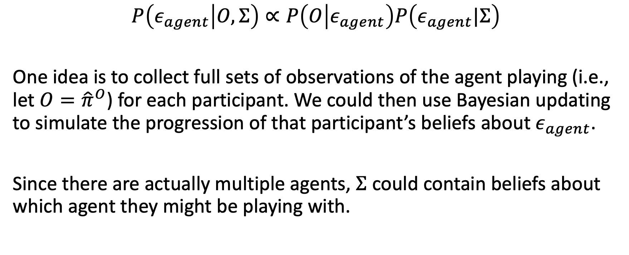
Learning $ε_{agent}$
We could have a prior over some or all of these hyper-parameters too.
$$P\left(ε_{agent} | O,Σ\right)∝P\left(O | ε_{agent}\right)P\left(ε_{agent}|Σ\right)$$
One idea is to collect full sets of observations of the agent playing (i.e., let $O={\hat{π}}^{O}$) for each participant. We could then use Bayesian updating to simulate the progression of that participant’s beliefs about $ε_{agent}$.
Since there are actually multiple agents, $Σ$ could contain beliefs about which agent they might be playing with.

Slide 26
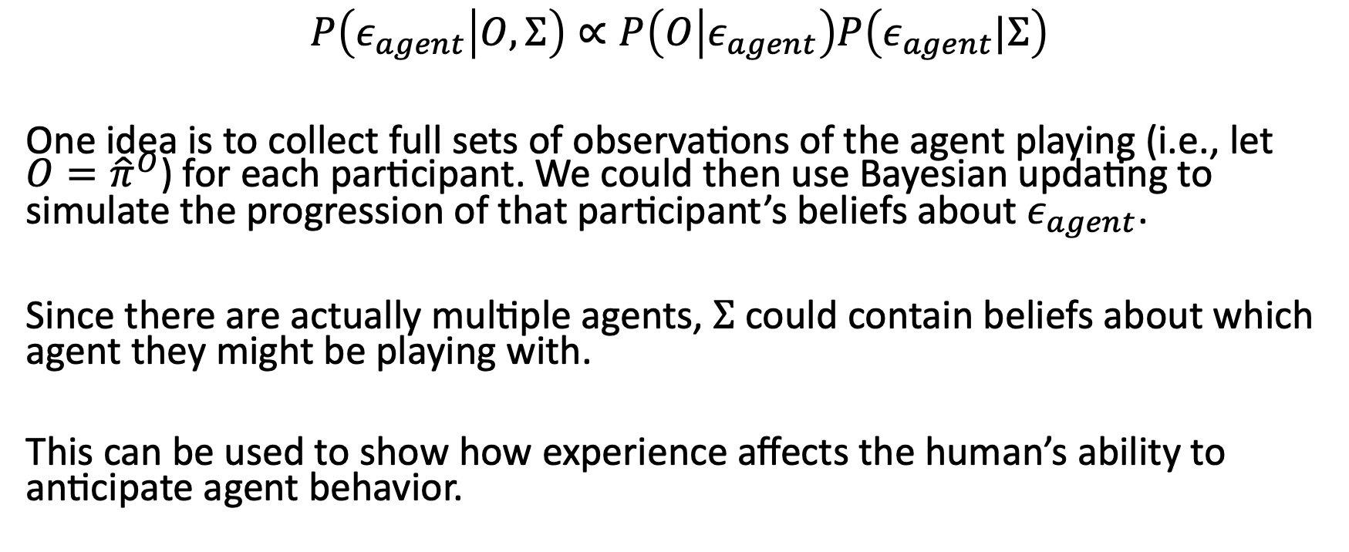
Learning $ε_{agent}$
We could have a prior over some or all of these hyper-parameters too.
$$P\left(ε_{agent} | O,Σ\right)∝P\left(O | ε_{agent}\right)P\left(ε_{agent}|Σ\right)$$
One idea is to collect full sets of observations of the agent playing (i.e., let $O={\hat{π}}^{O}$) for each participant. We could then use Bayesian updating to simulate the progression of that participant’s beliefs about $ε_{agent}$.
Since there are actually multiple agents, $Σ$ could contain beliefs about which agent they might be playing with.
This can be used to show how experience affects the human’s ability to anticipate agent behavior.

Slide 27

Bayesian Updating
$$P(θ|O_{a})∝P\left(O_{a} | θ\right)P(θ)$$

Slide 28
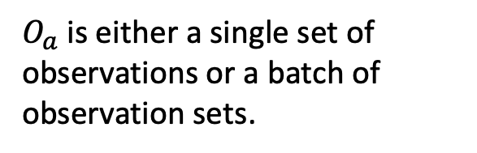
Bayesian Updating
$$P(θ|O_{a})∝P\left(O_{a} | θ\right)P(θ)$$
$O_{a}$ is either a single set of observations or a batch of observation sets.

Slide 29

Bayesian Updating
$$P(θ|O_{a})∝P\left(O_{a} | θ\right)P(θ)$$
$$P(θ|O_{b})∝P\left(O_{b} | θ\right)P(θ|O_{a})$$
$O_{a}$ is either a single set of observations or a batch of observation sets.

Slide 30
Bayesian Updating
$$P(θ|O_{a})∝P\left(O_{a} | θ\right)P(θ)$$
$$P(θ|O_{b})∝P\left(O_{b} | θ\right)P(θ|O_{a})$$
$O_{a}$ is either a single set of observations or a batch of observation sets.
And so and so forth.

Slide 31
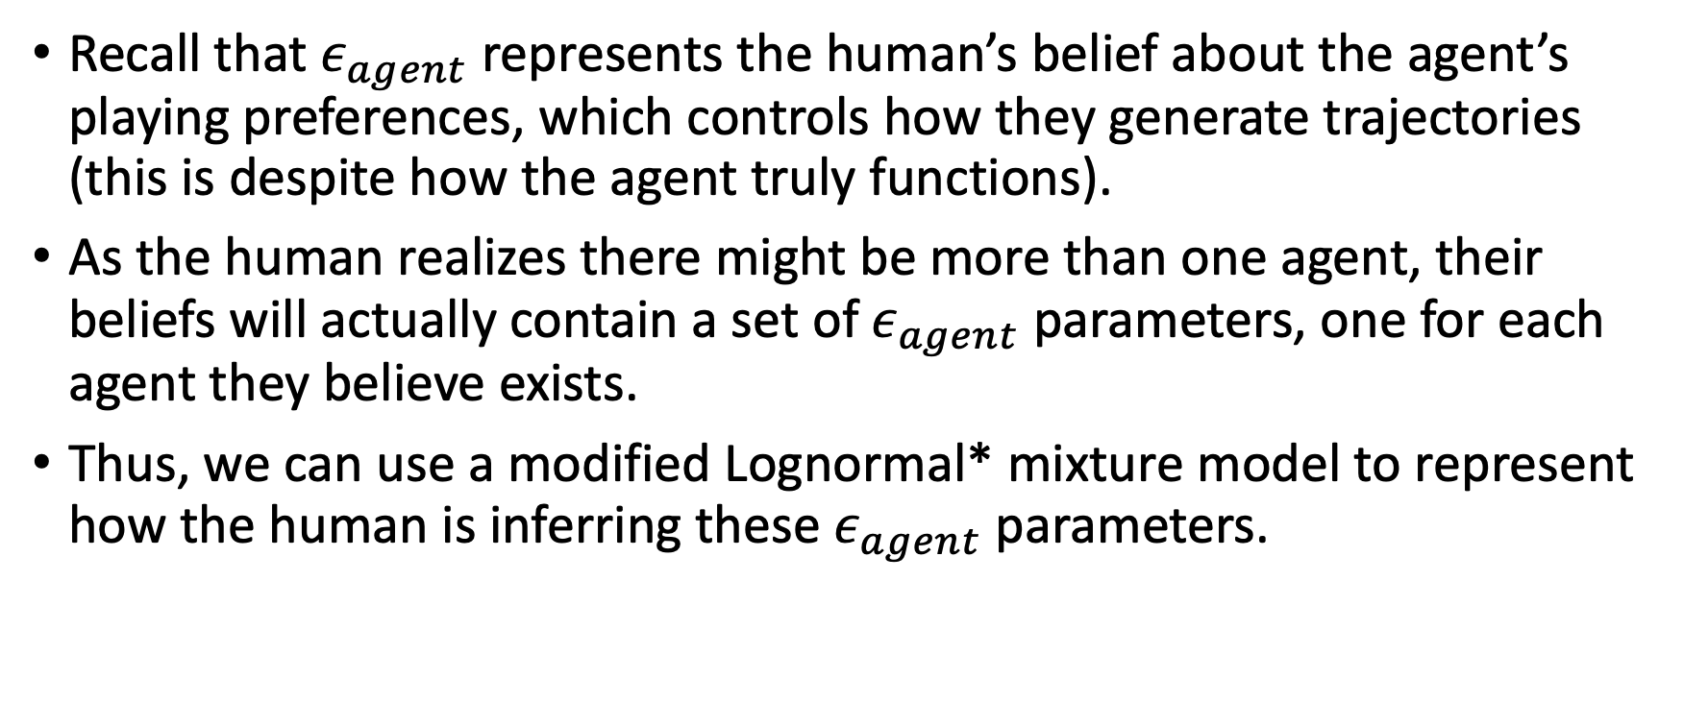
Generating agent observations
Recall that $ε_{agent}$ represents the human’s belief about the agent’s playing preferences, which controls how they generate trajectories (this is despite how the agent truly functions).
As the human realizes there might be more than one agent, their beliefs will actually contain a set of $ε_{agent}$ parameters, one for each agent they believe exists.
Thus, we can use a modified Lognormal* mixture model to represent how the human is inferring these $ε_{agent}$ parameters.
*The Lognormal distribution has a support of (0,INF) and has the same conjugate priors as a normal distribution.

Slide 32
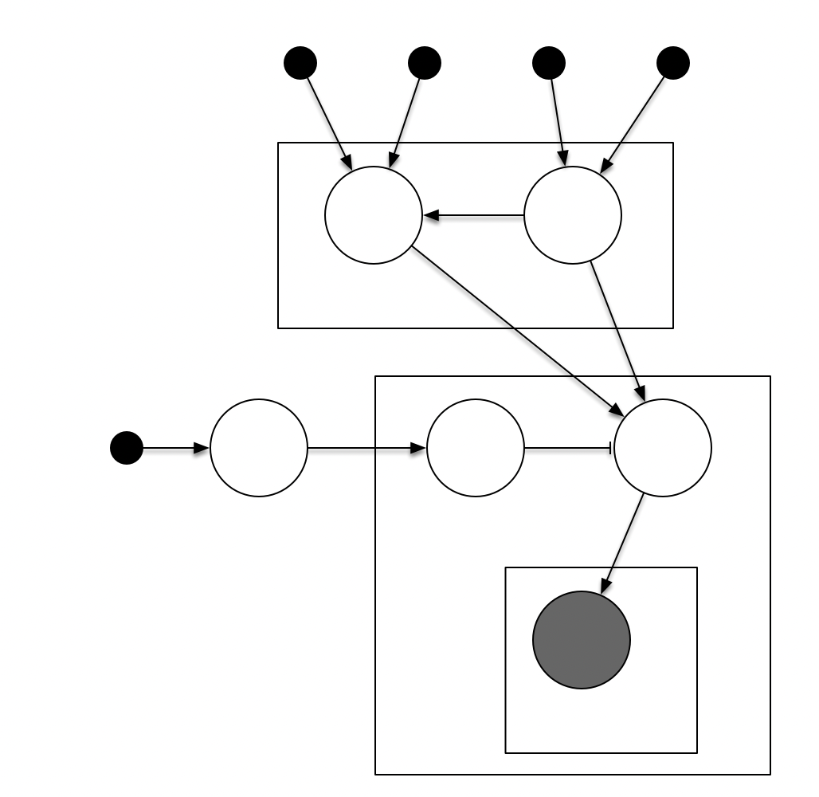





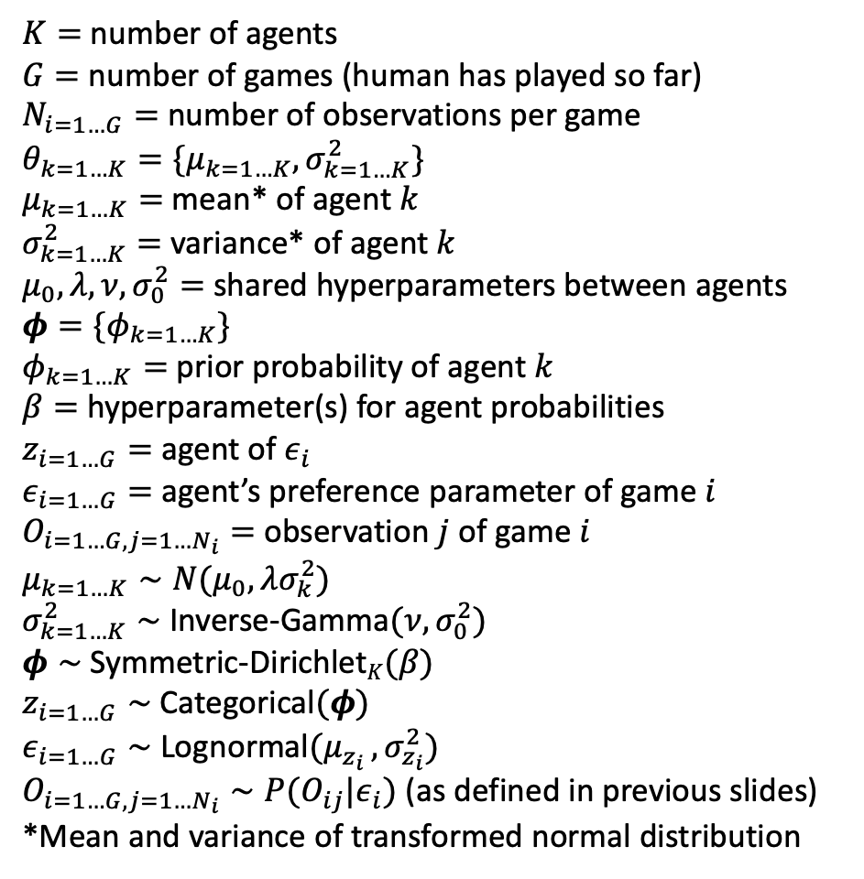









Generating agent observations
$$μ_{0}$$
$$λ$$
$$ν$$
$$σ_{0}^{2}$$
$K=$ number of agents
$G=$ number of games (human has played so far)
$N_{i=1…G}=$ number of observations per game
$θ_{k=1…K}=\{μ_{k=1…K},σ_{k=1…K}^{2}\}$
$μ_{k=1…K}=$ mean* of agent $k$
$σ_{k=1…K}^{2}=$ variance* of agent $k$
$μ_{0},λ,ν,σ_{0}^{2}=$ shared hyperparameters between agents
$φ=\{φ_{k=1…K}\}$
$φ_{k=1…K}=$ prior probability of agent $k$
$β=$ hyperparameter(s) for agent probabilities
$z_{i=1…G}=$ agent of $ε_{i}$
$ε_{i=1…G}=$ agent’s preference parameter of game $i$
$O_{i=1…G,j=1…N_{i}}=$ observation $j$ of game $i$
$μ_{k=1…K}∼N(μ_{0},λσ_{k}^{2})$
$σ_{k=1…K}^{2}∼$Inverse-Gamma$(ν,σ_{0}^{2})$
$φ∼$ Symmetric-Dirichlet$K(β)$
$z_{i=1…G}∼$ Categorical$(φ)$
$ε_{i=1…G}∼$ Lognormal$(μ_{z_{i} },σ_{z_{i}}^{2})$
$O_{i=1…G,j=1…N_{i}}∼P(O_{ij}|ε_{i})$ (as defined in previous slides)
*Mean and variance of transformed normal distribution
$$μ_{k}$$
$$σ_{k}^{2}$$
$$K$$
$$β$$
$$φ$$
$$z_{i}$$
$$ε_{i}$$
$$O_{ij}$$
$$N_{i}$$
$$G$$

Slide 33


$$K→∞$$
The current graph depicts a finite mixture model, but ideally it should be modified into an infinite mixture model to represent the human’s uncertainty on how many agents there.
This involves replacing the Dirichlet prior with a Dirichlet process prior and letting $K→∞$.

Slide 34

TODOS
Modified current $ε_{agent}$ model into infinite mixture model.
Construct inference algorithm (e.g., gibbs sampling, EM, etc.)

Slide 35
Resources
My graphical model is a modification of the Bayesian Gaussian mixture model seen in https://en.wikipedia.org/wiki/Mixture_model
This has a good explanation on how to formulate an infinite mixture model and how to do inference. https://www.ncbi.nlm.nih.gov/pmc/articles/PMC6583910/pdf/nihms-1528335.pdf
This is just a good resource on conjugate priors (in particular pg 34-35, which shows the formulas for Lognormal conjugate priors). https://courses.physics.ucsd.edu/2018/Fall/physics210b/REFERENCES/conjugate_priors.pdf

Slide 36
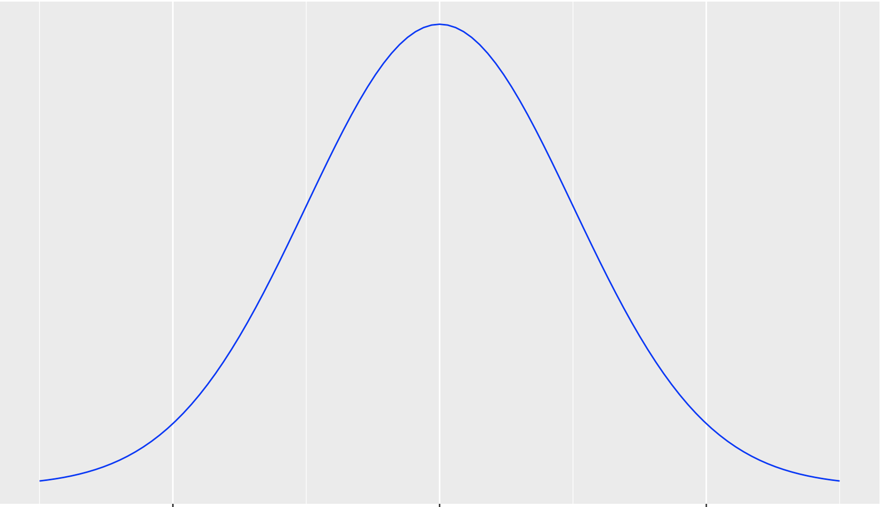
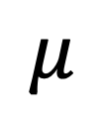
Collision probabilities
Occupancy Distribution
$$μ$$
The mean distance traveled per some time step t.

Slide 37
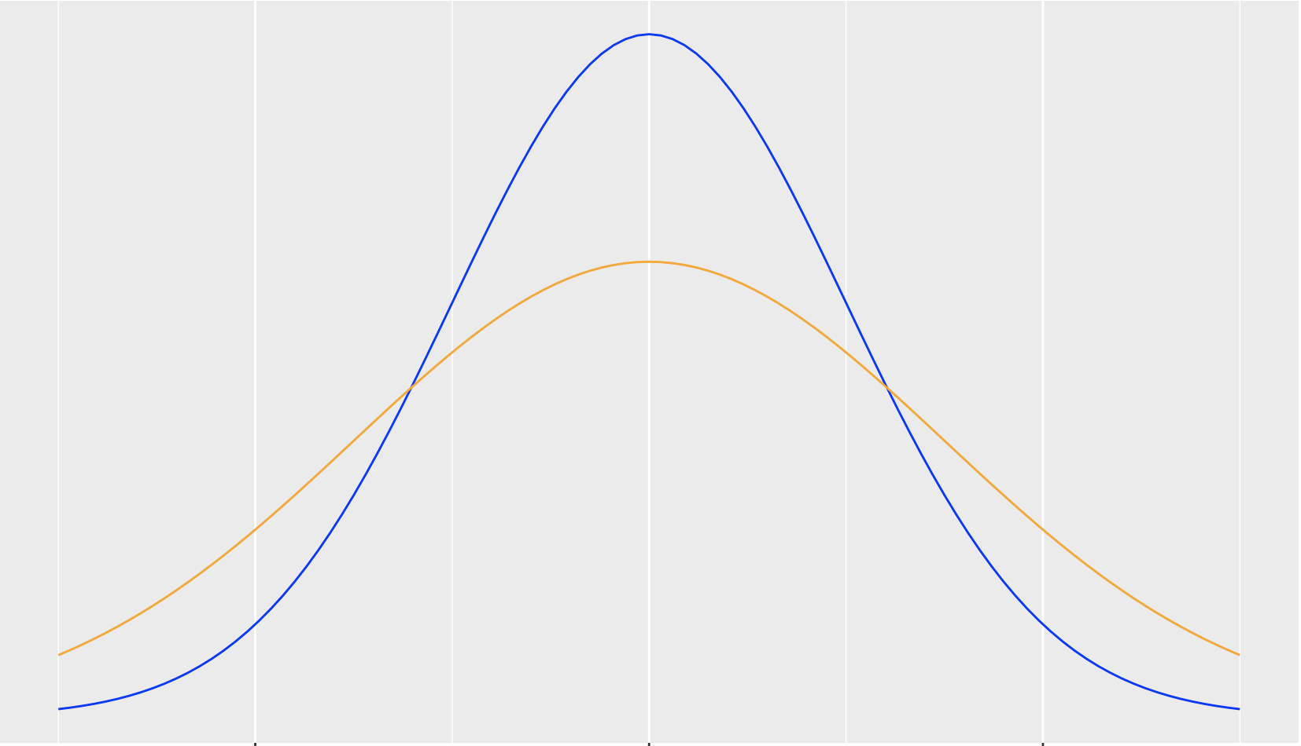
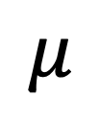
Human perception of collision probabilities
True Occupancy Distribution
Perceived Occupancy Distribution
$$μ$$

Slide 38

Human perception of collision probabilities
Let $X$ be the distance that an obstacle moves along its direction of travel for some time step $t$.

Slide 39

Human perception of collision probabilities
Let $X$ be the distance that an obstacle moves along its direction of travel for some time step $t$.
$X\sim N\left(μ,σ^{2}\right)$ is the true distribution*.
*It’s technically a truncated normal bound between the min and max distances the obstacle can travel

Slide 40
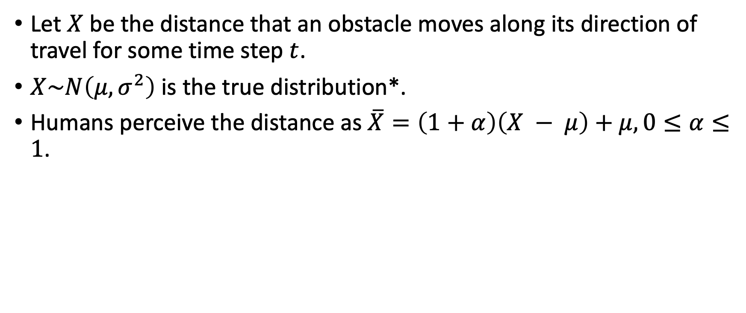
Human perception of collision probabilities
Let $X$ be the distance that an obstacle moves along its direction of travel for some time step $t$.
$X\sim N\left(μ,σ^{2}\right)$ is the true distribution*.
Humans perceive the distance as $\overline{X}=\left(1+α\right)\left(X − μ\right)+μ, 0≤α≤1$.
*It’s technically a truncated normal bound between the min and max distances the obstacle can travel

Slide 41
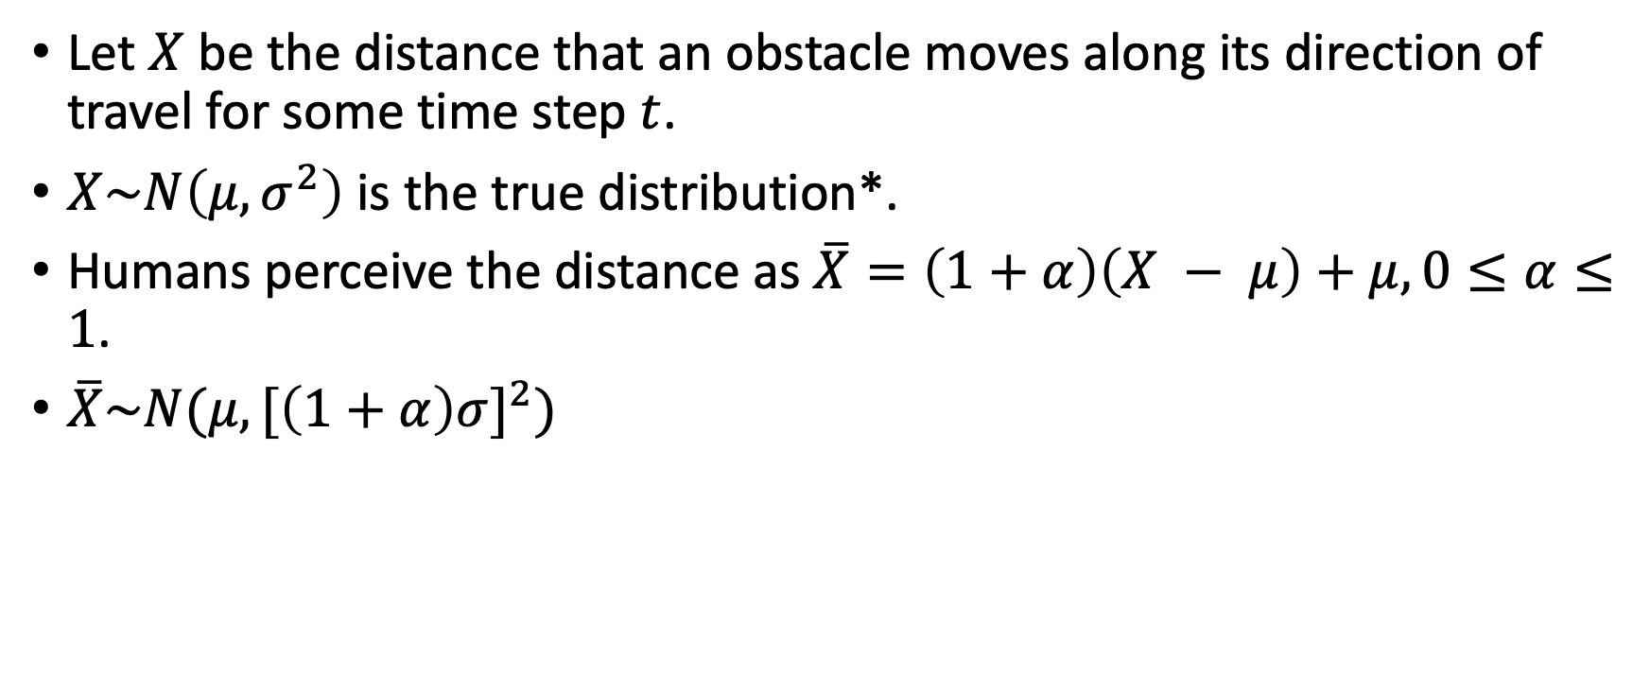
Human perception of collision probabilities
Let $X$ be the distance that an obstacle moves along its direction of travel for some time step $t$.
$X\sim N\left(μ,σ^{2}\right)$ is the true distribution*.
Humans perceive the distance as $\overline{X}=\left(1+α\right)\left(X − μ\right)+μ, 0≤α≤1$.
$\overline{X}\sim N(μ,{[\left(1+α\right)σ]}^{2})$
*It’s technically a truncated normal bound between the min and max distances the obstacle can travel

Slide 42
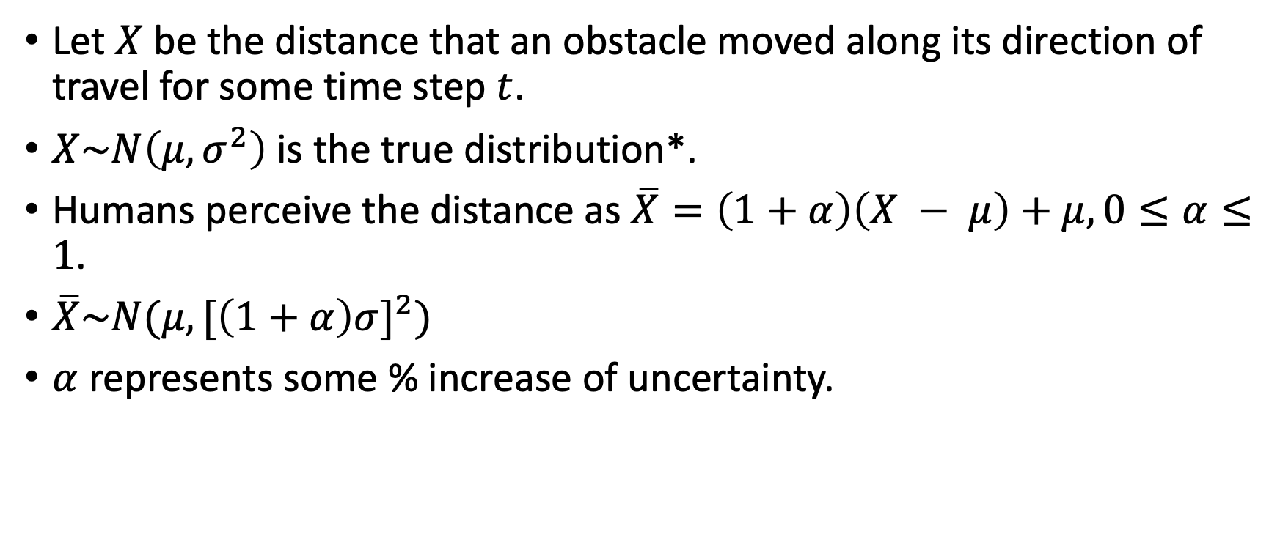
Human perception of collision probabilities
Let $X$ be the distance that an obstacle moved along its direction of travel for some time step $t$.
$X\sim N\left(μ,σ^{2}\right)$ is the true distribution*.
Humans perceive the distance as $\overline{X}=\left(1+α\right)\left(X − μ\right)+μ, 0≤α≤1$.
$\overline{X}\sim N(μ,{[\left(1+α\right)σ]}^{2})$
$α$ represents some % increase of uncertainty.
*It’s technically a truncated normal bound between the min and max distances the obstacle can travel

Slide 43
Two-level decision making
Global policy and short-term planning
Global policy:
Anticipatory policies (Strategies)
More developed and utilized by experienced players
Emergency policies (Improvising)
More seen with less experienced players
Policy supersedes planning (i.e., I’ll terminate planning if I reach a state that dictates a different policy).

Slide 44
Strategies
Player might employ different strategies for different AI.
This means there is likely a discovery period for the player to either learn a new AI’s behavior or recognize an old AI.

Slide 45
Example of strategy.
One strategy is to let AI handle moving to the goal but take over when wasps are nearby.
A: Player takes over to more safely avoid wasps.
B: Player takes over to more efficiently reach goal.

Slide 46
Policies for example strategy
If not in control and not threatened (no wasps within radius X), allow AI to proceed toward the goal.
If not in control and threatened, take over, create and execute short-term plan for (a) avoiding threats or (b) weaving through threats.
If in control and threatened, create and execute short-term plan for (a) avoiding threats or (b) weaving through threats.
If in control and not threatened, release control to AI.

Slide 47
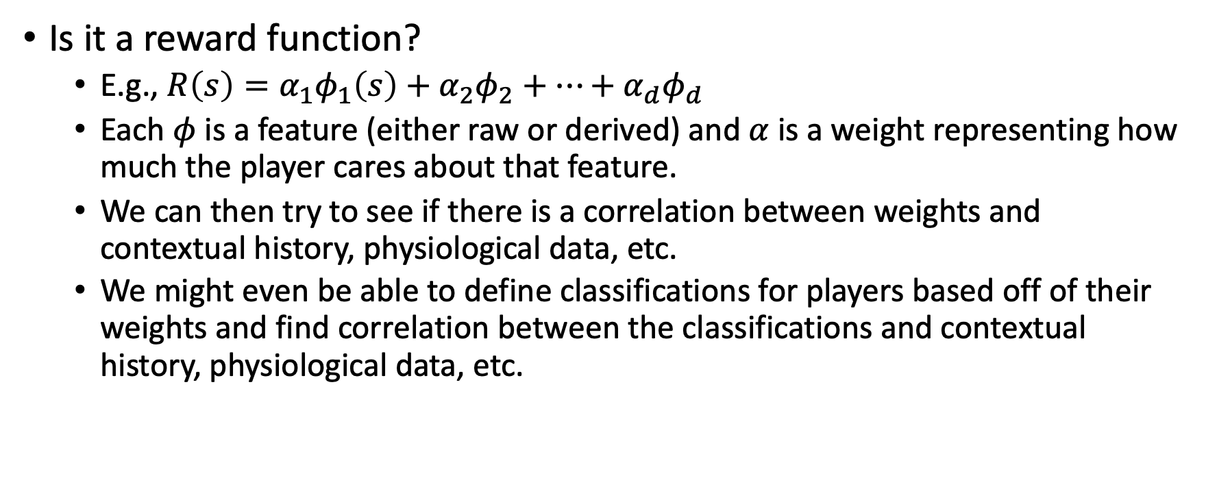
What does our output look like?
Is it a reward function?
E.g., $R\left(s\right)=α_{1}φ_{1}\left(s\right)+α_{2}φ_{2}+…+α_{d}φ_{d}$
Each $φ$ is a feature (either raw or derived) and $α$ is a weight representing how much the player cares about that feature.
We can then try to see if there is a correlation between weights and contextual history, physiological data, etc.
We might even be able to define classifications for players based off of their weights and find correlation between the classifications and contextual history, physiological data, etc.

Slide 48
What does our output look like?
Is it a policy/symbolic description?
Some description of what we expect the player to do when faced with particular states.
E.g., when wasps are X radius away, the player will do Y…etc.
Decision trees or graphs are suitable for modeling these.
This is along the lines of identifying strategies.
The strategies themselves can be used as classifications of players or may help us define classifications.
Again, we can try correlating output with contextual history, physiological data, etc.
Note: In IRL or related fields, we estimate a reward function and then an “optimal” policy based on that reward function.

Slide 49
What does our output look like?
Is it a set of estimated parameters/posterior distributions of parameters?
Some parameters could help describe the player's values (like a reward function), while others might imply some of the player’s policies.
E.g., a risk threshold parameter that describes at what proximity wasps threaten them.
Same as other outputs (correlations and classifications).

Slide 50
Linearly-Solvable MDP
There are uncontrolled state transitions (passive dynamics or default policy) and controlled state transitions under some control (their version of an “action”).
A control is a real-valued vector that modifies the probability of state transitions.
E.g., without any control, P(A -> B) = 0.5. With a control X, P(A -> B) = 1. X represents an action that causes the system to transition from A to B with certainty.
The goal is a policy that selects the controls for each state that optimizes the return (i.e., an optimal policy).

Slide 51
Linearly-Solvable MDP
Some problems likely don’t have passive dynamics, so “default policy” is probably a suitable moniker for uncontrolled state transitions.
What should the default policy be in these cases?

Slide 52
Inverse Optimal Control (IRL for linearly-solvable MDP)

Slide 53
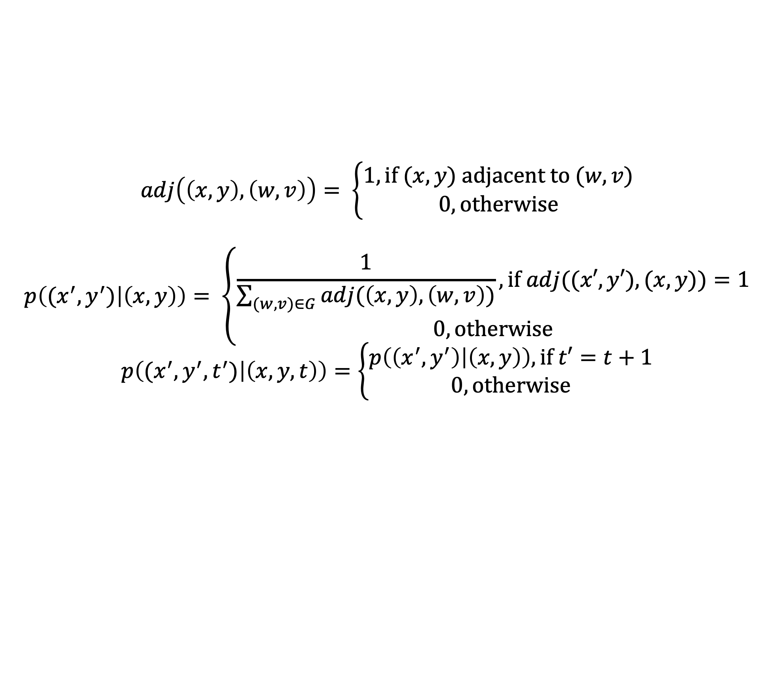
$$adj\left(\left(x,y\right),\left(w,v\right)\right)= \left\{\begin{aligned}1, \text{if} (x,y) \text{adjacent} \text{to} (w,v) \\ 0, \text{otherwise}\end{aligned}\right.$$
$$p\left((x^{′},y^{′}) | \left(x,y\right)\right)= \left\{\begin{aligned}\frac{1}{\sum_{(w,v)∈G}{adj(\left(x,y\right),\left(w,v\right))}}, \text{if} adj((x′,y′),(x,y))=1 \\ 0, \text{otherwise}\end{aligned}\right.$$
$$p\left((x^{′},y^{′},t^{′}) | \left(x,y,t\right)\right)=\left\{\begin{aligned}p\left(\left(x^{′},y^{′}\right) | \left(x,y\right)\right), \text{if} t′=t+1 \\ 0, \text{otherwise}\end{aligned}\right.$$

Slide 54
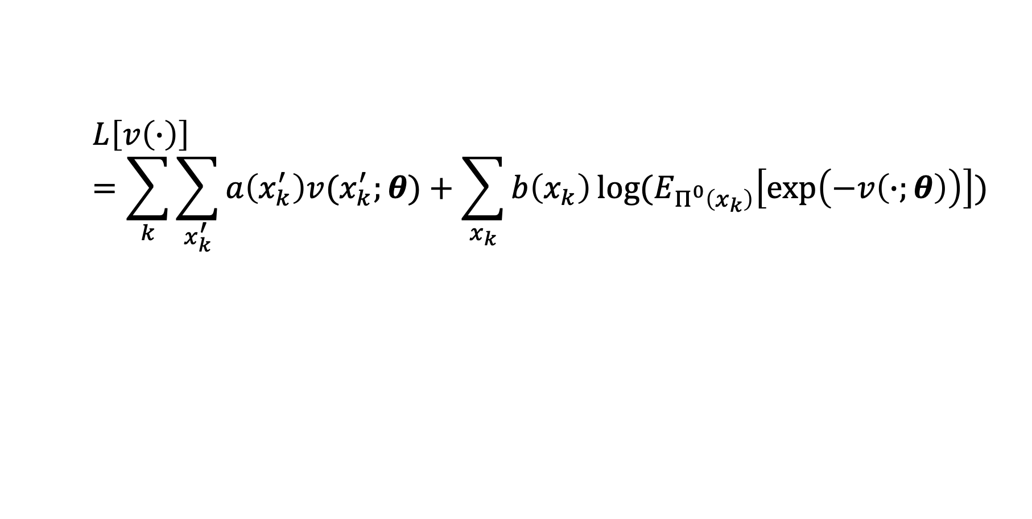
MLE Equation for OptV
$$L\left[v\left(∙\right)\right]=\sum_{k}{\sum_{x_{k}^{′}}{a\left(x_{k}^{′}\right)v(x_{k}^{′};θ)}+\sum_{x_{k}}{b\left(x_{k}\right)\log{(E_{Π^{0}\left(x_{k}\right)}\left[\exp\left(−v\left(∙;θ\right)\right)\right])}}}$$

Slide 55
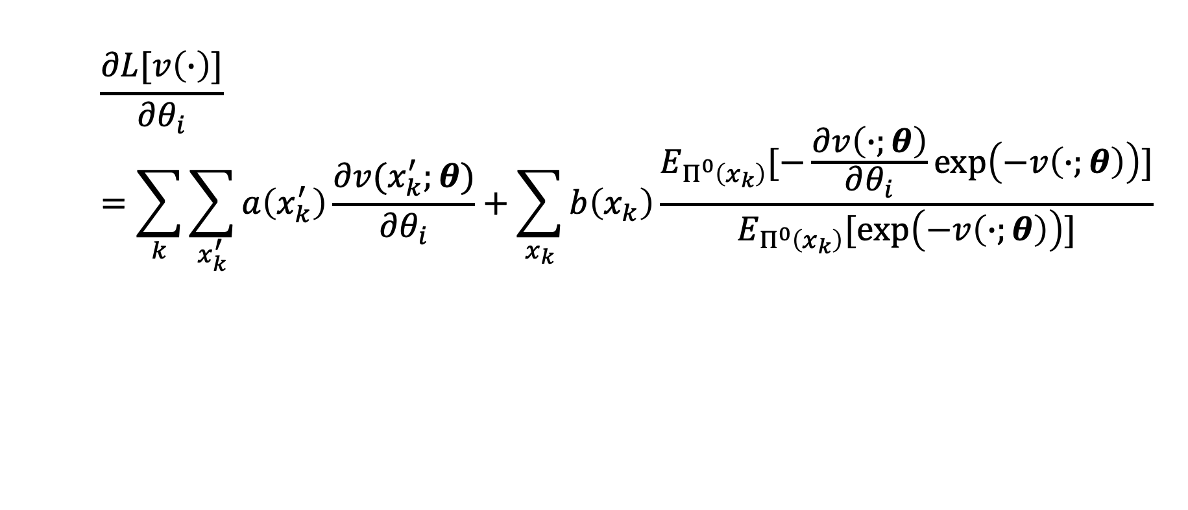
Gradient for OptV
$$\frac{∂L[v\left(∙\right)]}{∂θ_{i}}=\sum_{k}{\sum_{x_{k}^{′}}{a\left(x_{k}^{′}\right)\frac{∂v(x_{k}^{′};θ)}{∂θ_{i}}}+\sum_{x_{k}}{b\left(x_{k}\right)\frac{E_{Π^{0}\left(x_{k}\right)}[−\frac{∂v\left(∙;θ\right)}{∂θ_{i}}\exp\left(−v\left(∙;θ\right)\right)]}{E_{Π^{0}\left(x_{k}\right)}[\exp\left(−v\left(∙;θ\right)\right)]}}}$$

Slide 56

Hessian for OptV (diagonal)
$$\frac{∂L[v\left(∙\right)]}{∂θ_{i}^{2}}=\sum_{k}{\sum_{x_{k}^{′}}{a\left(x_{k}^{′}\right)\frac{∂v(x_{k}^{′};θ)}{∂θ_{i}^{2}}}+\sum_{x_{k}}{b\left(x_{k}\right)}}\frac{E_{Π^{0}\left(x_{k}\right)}\left[\left({\frac{∂v\left(∙;θ\right)}{∂θ_{i}}}^{2}−\frac{∂v\left(∙;θ\right)}{∂θ_{i}^{2}}\right)\exp\left(−v\left(∙;θ\right)\right)\right]E_{Π^{0}\left(x_{k}\right)}\left[\exp\left(−v\left(∙;θ\right)\right)\right]−{E_{Π^{0}\left(x_{k}\right)}[−\frac{∂v\left(∙;θ\right)}{∂θ_{i}}\exp\left(−v\left(∙;θ\right)\right)]}^{2}}{{E_{Π^{0}\left(x_{k}\right)}\left[\exp\left(−v\left(∙;θ\right)\right)\right]}^{2}}$$

Slide 57
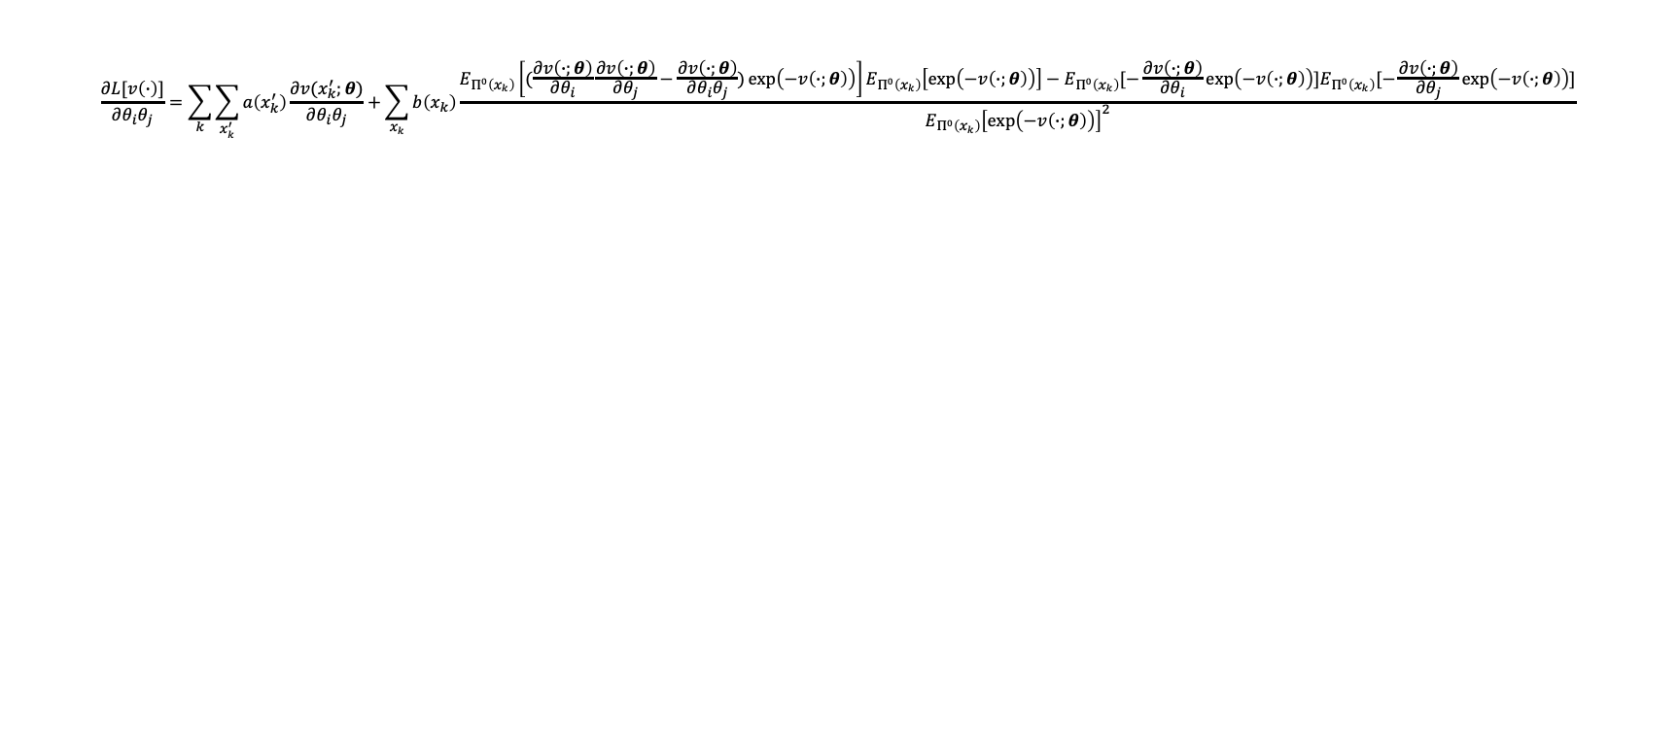
Hessian for OptV (off-diagonal)
$$\frac{∂L[v\left(∙\right)]}{∂θ_{i}θ_{j}}=\sum_{k}{\sum_{x_{k}^{′}}{a\left(x_{k}^{′}\right)\frac{∂v(x_{k}^{′};θ)}{∂θ_{i}θ_{j}}}+\sum_{x_{k}}{b\left(x_{k}\right)}}\frac{E_{Π^{0}\left(x_{k}\right)}\left[(\frac{∂v\left(∙;θ\right)}{∂θ_{i}}\frac{∂v\left(∙;θ\right)}{∂θ_{j}}−\frac{∂v\left(∙;θ\right)}{∂θ_{i}θ_{j}})\exp\left(−v\left(∙;θ\right)\right)\right]E_{Π^{0}\left(x_{k}\right)}\left[\exp\left(−v\left(∙;θ\right)\right)\right]−E_{Π^{0}\left(x_{k}\right)}[−\frac{∂v\left(∙;θ\right)}{∂θ_{i}}\exp\left(−v\left(∙;θ\right)\right)]E_{Π^{0}\left(x_{k}\right)}[−\frac{∂v\left(∙;θ\right)}{∂θ_{j}}\exp\left(−v\left(∙;θ\right)\right)]}{{E_{Π^{0}\left(x_{k}\right)}\left[\exp\left(−v\left(∙;θ\right)\right)\right]}^{2}}$$

Slide 58
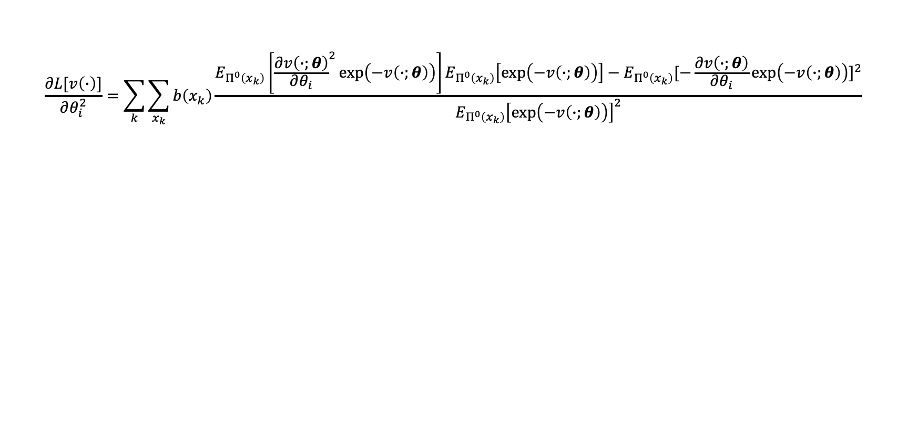
Hessian for Linear OptV (diagonal)
$$\frac{∂L[v\left(∙\right)]}{∂θ_{i}^{2}}=\sum_{k}{\sum_{x_{k}}{b\left(x_{k}\right)}}\frac{E_{Π^{0}\left(x_{k}\right)}\left[{\frac{∂v\left(∙;θ\right)}{∂θ_{i}}}^{2}\exp\left(−v\left(∙;θ\right)\right)\right]E_{Π^{0}\left(x_{k}\right)}\left[\exp\left(−v\left(∙;θ\right)\right)\right]−{E_{Π^{0}\left(x_{k}\right)}[−\frac{∂v\left(∙;θ\right)}{∂θ_{i}}\exp\left(−v\left(∙;θ\right)\right)]}^{2}}{{E_{Π^{0}\left(x_{k}\right)}\left[\exp\left(−v\left(∙;θ\right)\right)\right]}^{2}}$$

Slide 59

Hessian for Linear OptV (off-diagonal)
$$\frac{∂L[v\left(∙\right)]}{∂θ_{i}θ_{j}}=\sum_{k}{\sum_{x_{k}}{b\left(x_{k}\right)}}\frac{E_{Π^{0}\left(x_{k}\right)}\left[\frac{∂v\left(∙;θ\right)}{∂θ_{i}}\frac{∂v\left(∙;θ\right)}{∂θ_{j}}\exp\left(−v\left(∙;θ\right)\right)\right]E_{Π^{0}\left(x_{k}\right)}\left[\exp\left(−v\left(∙;θ\right)\right)\right]−E_{Π^{0}\left(x_{k}\right)}[−\frac{∂v\left(∙;θ\right)}{∂θ_{i}}\exp\left(−v\left(∙;θ\right)\right)]E_{Π^{0}\left(x_{k}\right)}[−\frac{∂v\left(∙;θ\right)}{∂θ_{j}}\exp\left(−v\left(∙;θ\right)\right)]}{{E_{Π^{0}\left(x_{k}\right)}\left[\exp\left(−v\left(∙;θ\right)\right)\right]}^{2}}$$

