Slide 1
Relevant equations part 1

Slide 2
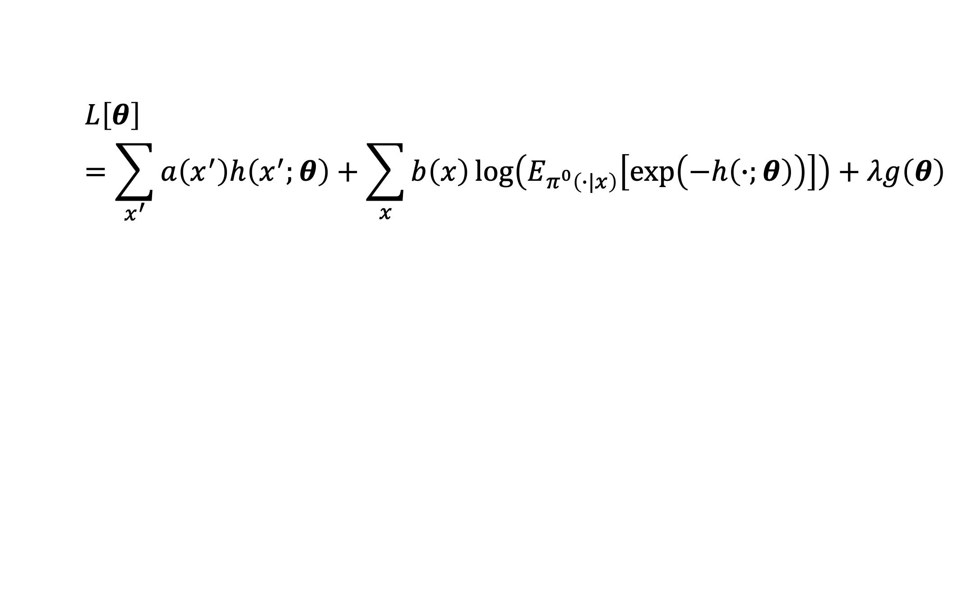
$$L\left[θ\right]=\sum_{x^{′}}{a\left(x^{′}\right)h\left(x^{′};θ\right)}+\sum_{x}{b\left(x\right)\log\left(E_{π^{0}\left(∙|x\right)}\left[\exp\left(−h\left(∙;θ\right)\right)\right]\right)}+λg\left(θ\right)$$

Slide 3
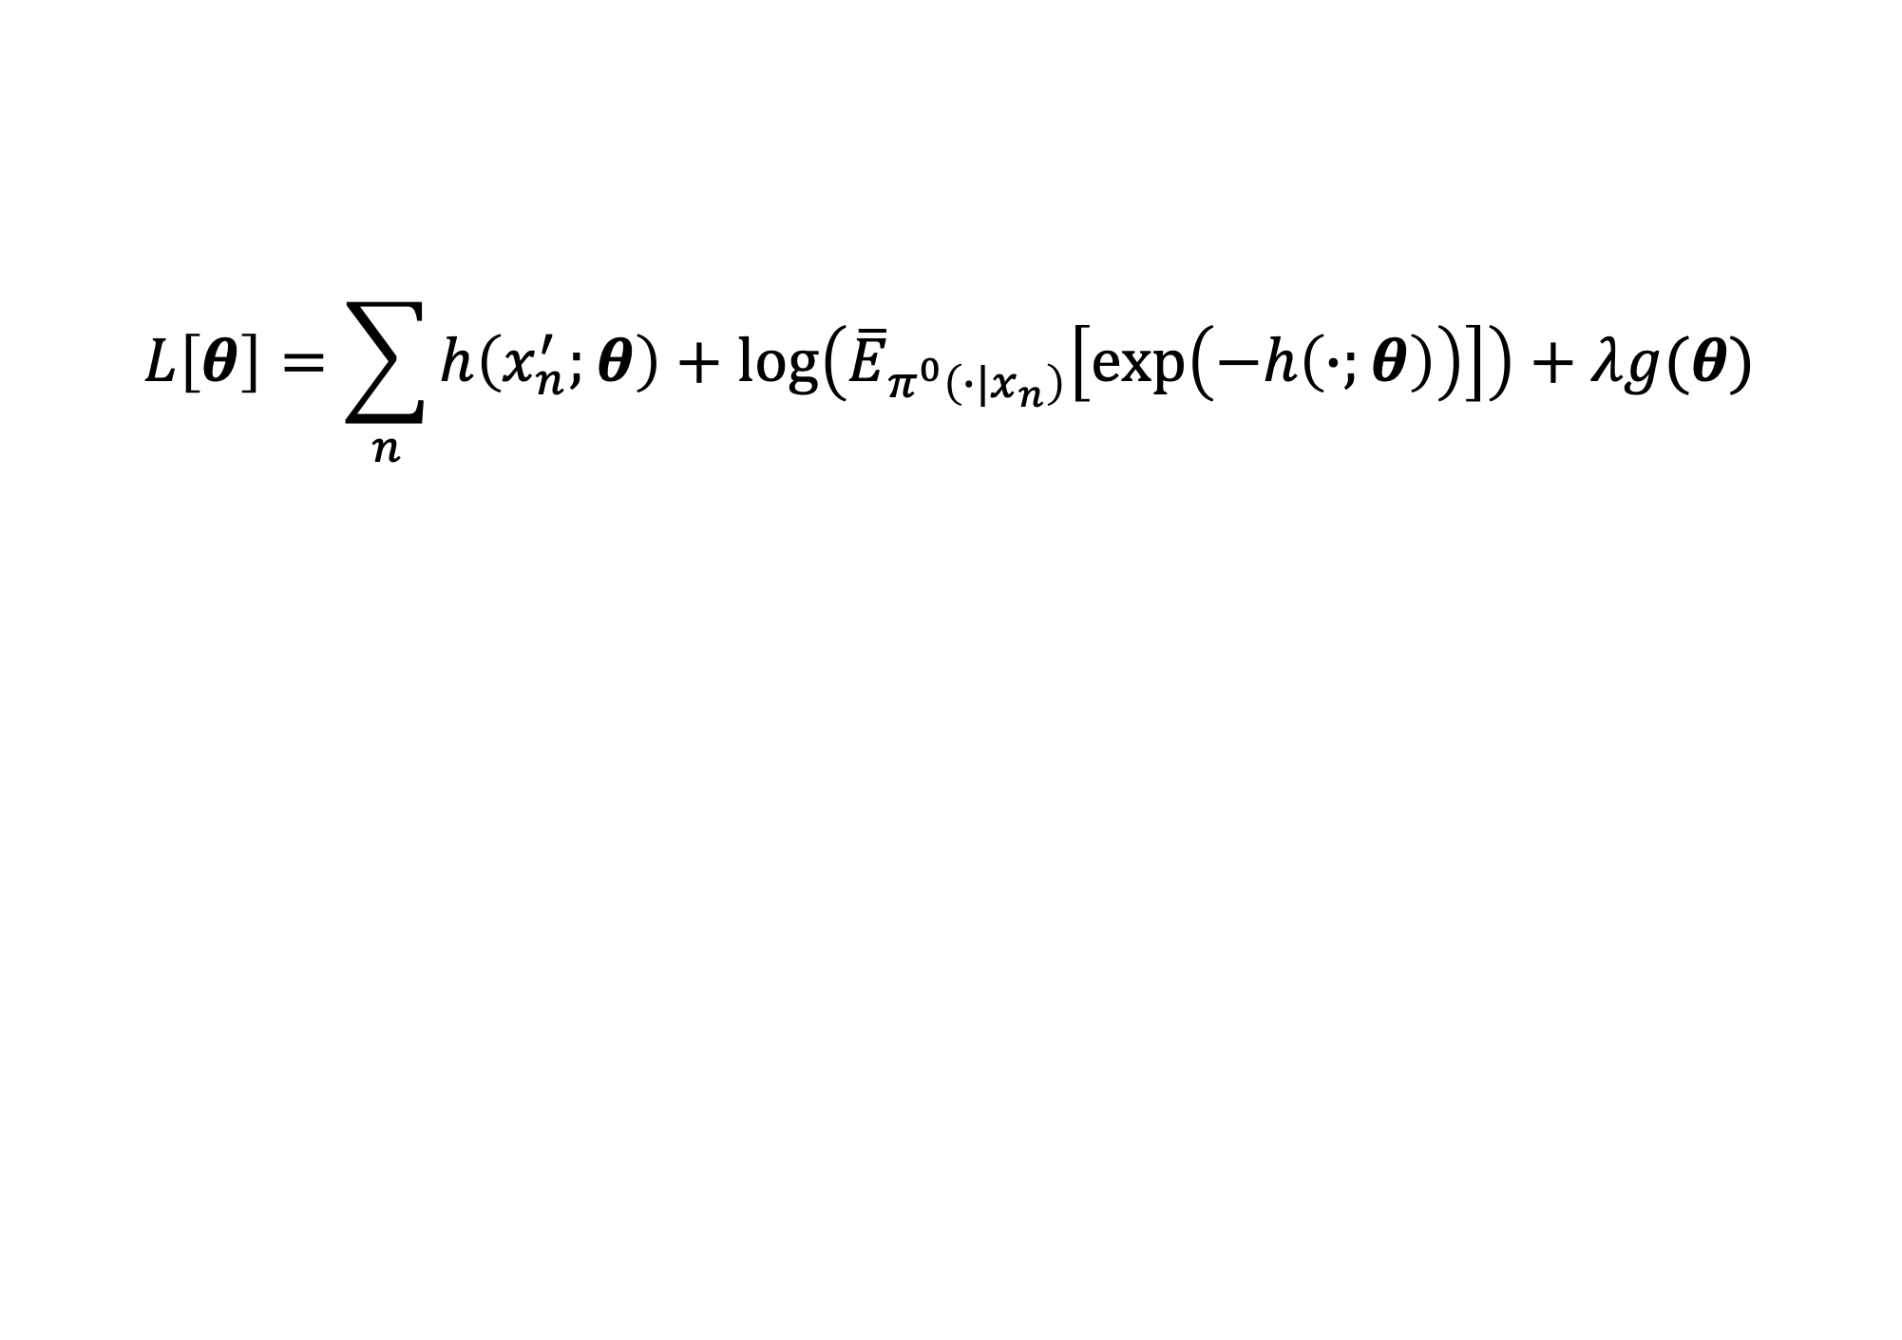
$$L\left[θ\right]=\sum_{n}{h\left(x_{n}^{′};θ\right)+\log\left({\overline{E}}_{π^{0}\left(∙|x_{n}\right)}\left[\exp\left(−h\left(∙;θ\right)\right)\right]\right)}+λg(θ)$$

Slide 4
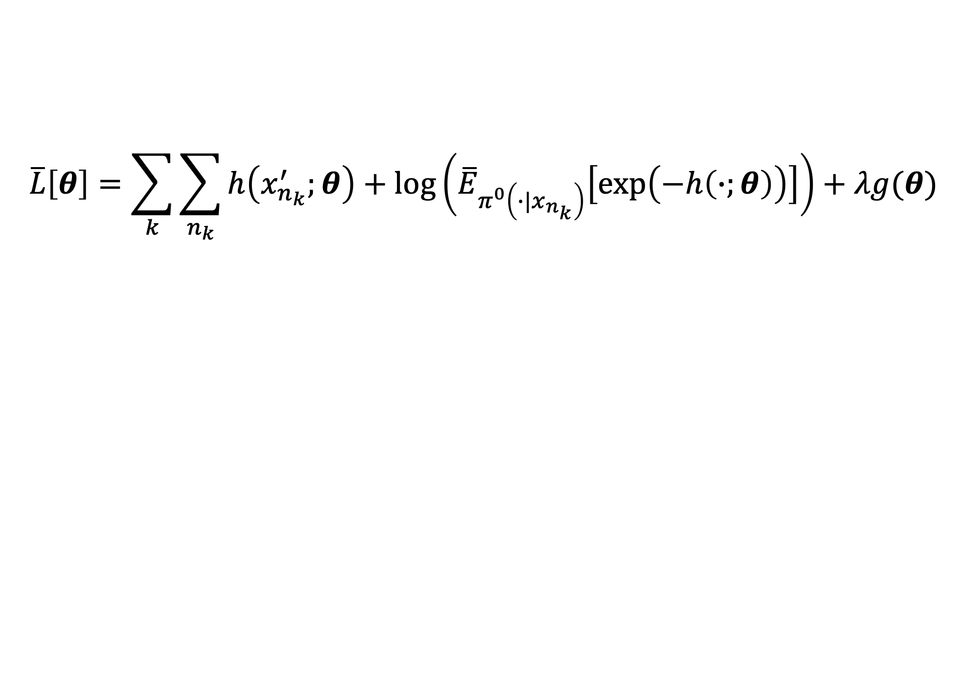
$$\overline{L}\left[θ\right]=\sum_{k}{\sum_{n_{k}}{h\left(x_{n_{k}}^{′};θ\right)+\log\left({\overline{E}}_{π^{0}\left(∙|x_{n_{k}}\right)}\left[\exp\left(−h\left(∙;θ\right)\right)\right]\right)}}+λg(θ)$$

Slide 5
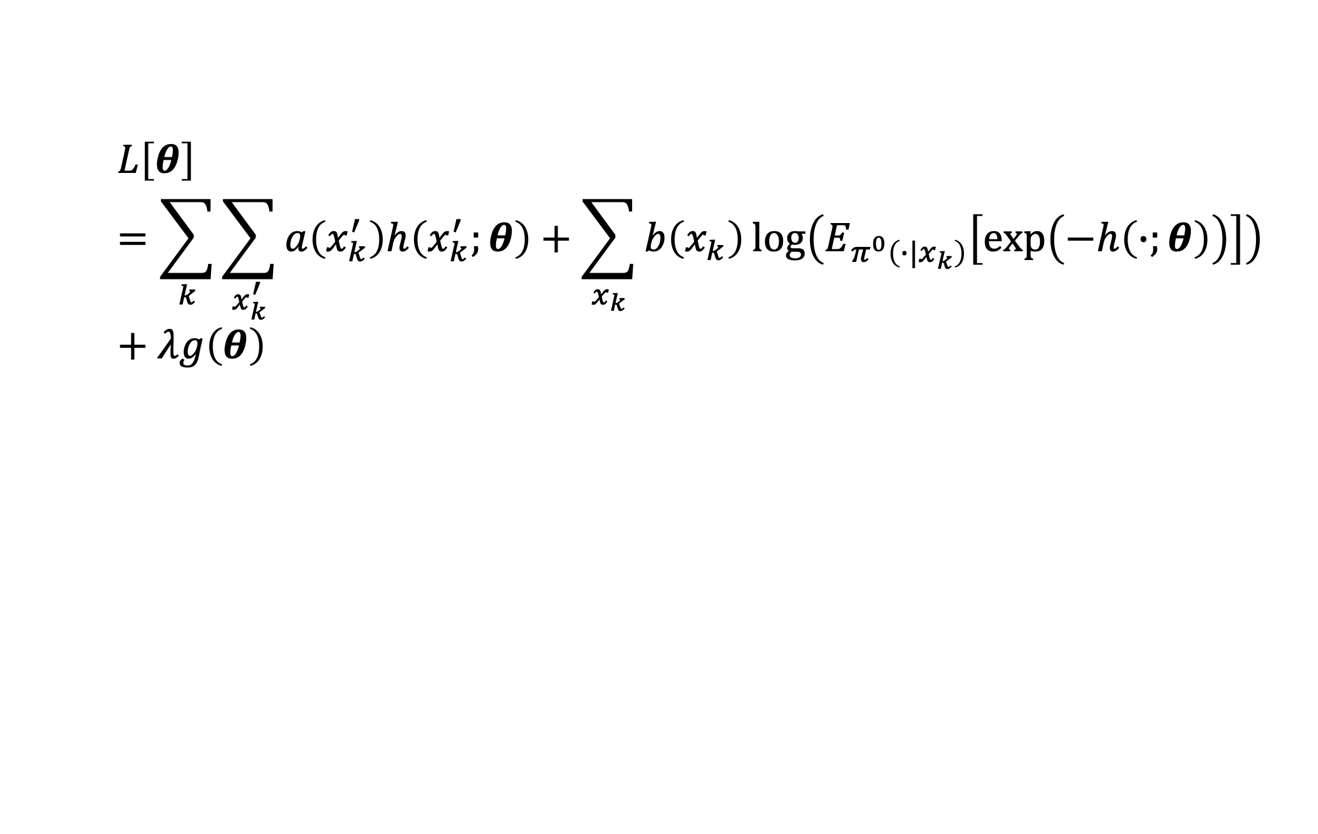
$$L\left[θ\right]=\sum_{k}{\sum_{x_{k}^{′}}{a\left(x_{k}^{′}\right)h\left(x_{k}^{′};θ\right)}+\sum_{x_{k}}{b\left(x_{k}\right)\log\left(E_{π^{0}\left(∙|x_{k}\right)}\left[\exp\left(−h\left(∙;θ\right)\right)\right]\right)}}+λg\left(θ\right)$$

Slide 6
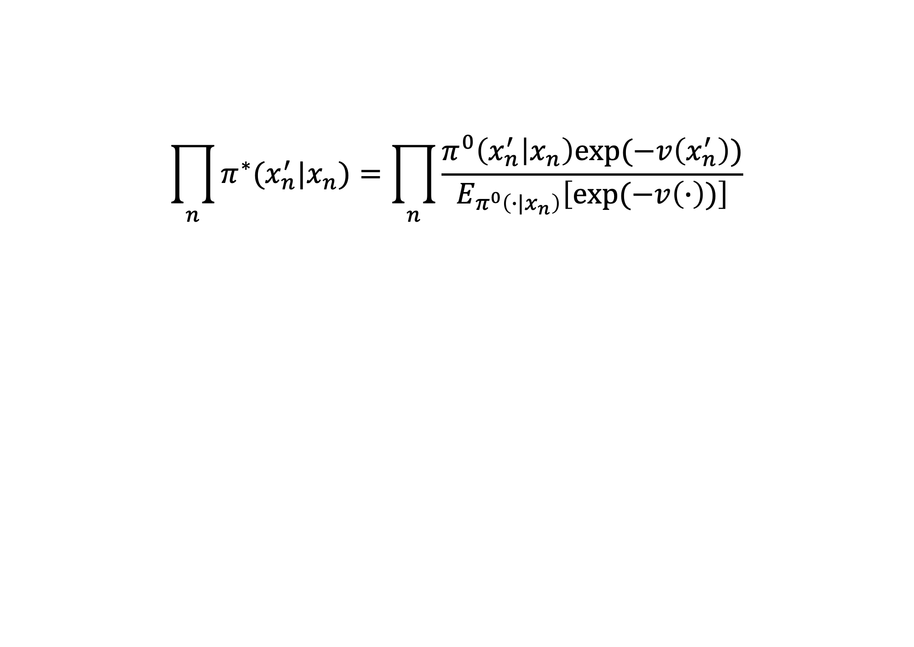
$$\prod_{n}{π^{∗}(x_{n}^{′}|x_{n})}=\prod_{n}{\frac{π^{0}\left(x_{n}^{′} | x_{n}\right)exp⁡(−v\left(x_{n}^{′}\right))}{E_{π^{0}\left(∙|x_{n}\right)}\left[exp⁡(−v\left(∙\right))\right]}}$$

Slide 7
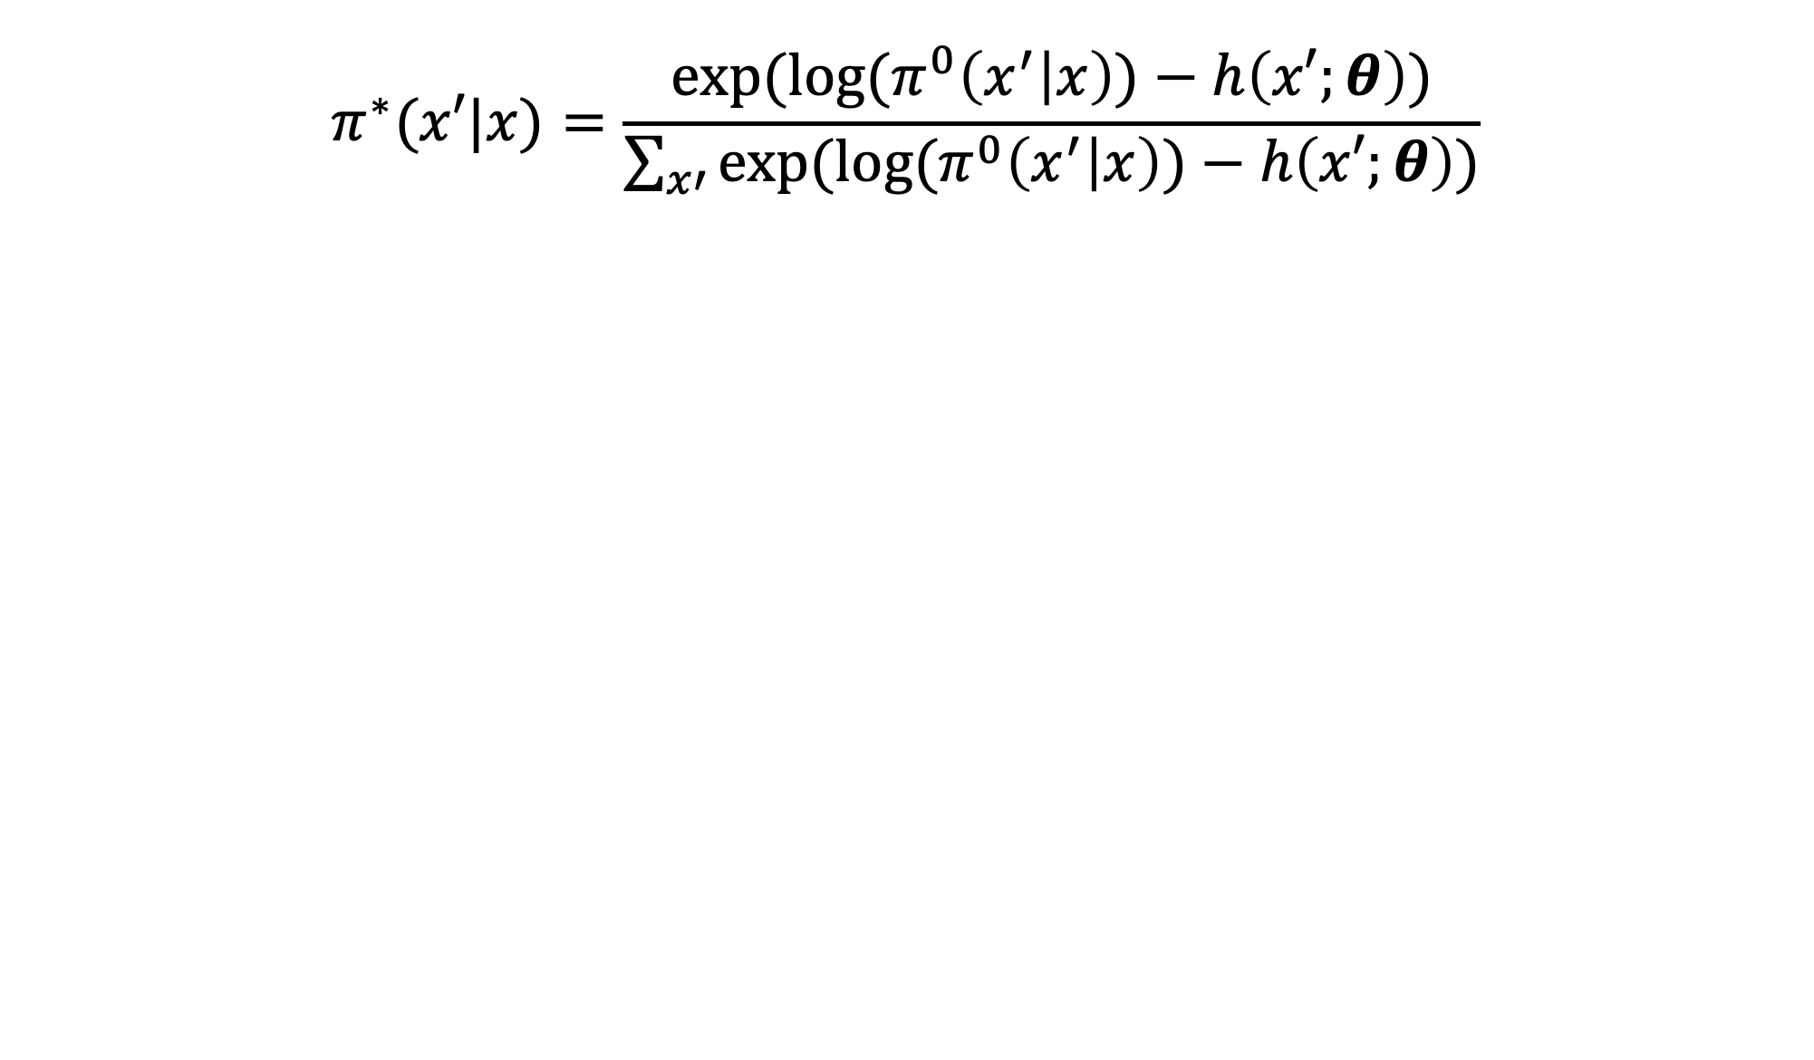
$$π^{∗}(x′|x)=\frac{exp⁡(log⁡(π^{0}\left(x^{′} | x\right))−h\left(x′;θ\right))}{\sum_{x′}{exp⁡(log⁡(π^{0}\left(x^{′} | x\right))−h\left(x′;θ\right))}}$$

Slide 8

$$π^{∗}(x′|x)=softmax(log⁡(π^{0}\left(x^{′} | x\right))−h\left(x^{′};θ\right))$$

Slide 9
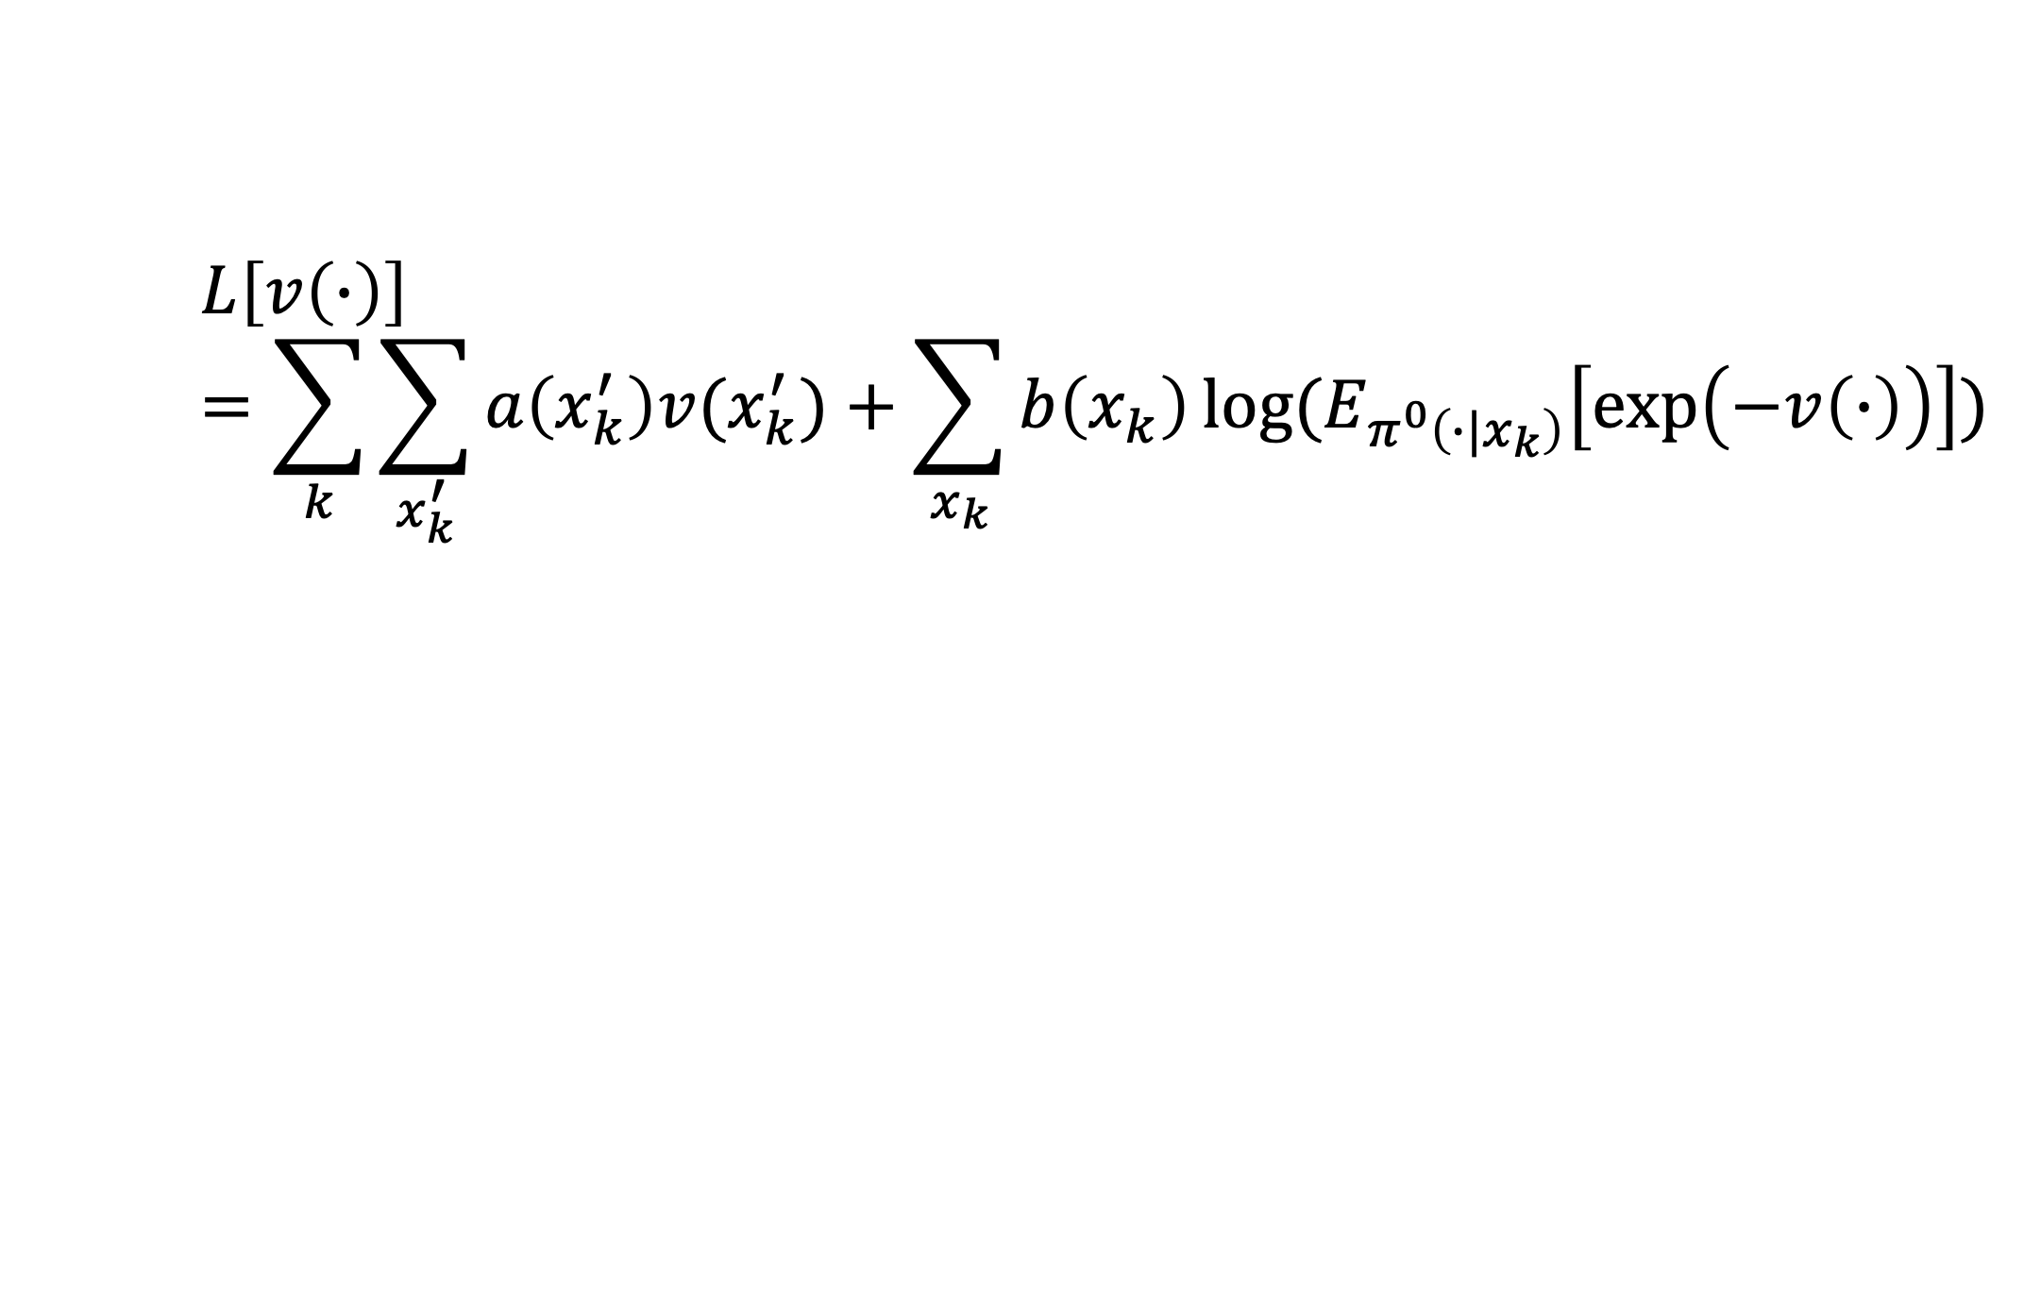
$$L\left[v\left(∙\right)\right]=\sum_{k}{\sum_{x_{k}^{′}}{a\left(x_{k}^{′}\right)v(x_{k}^{′})}+\sum_{x_{k}}{b\left(x_{k}\right)\log{(E_{π^{0}\left({∙|x}_{k}\right)}\left[\exp\left(−v\left(∙\right)\right)\right])}}}$$

Slide 10
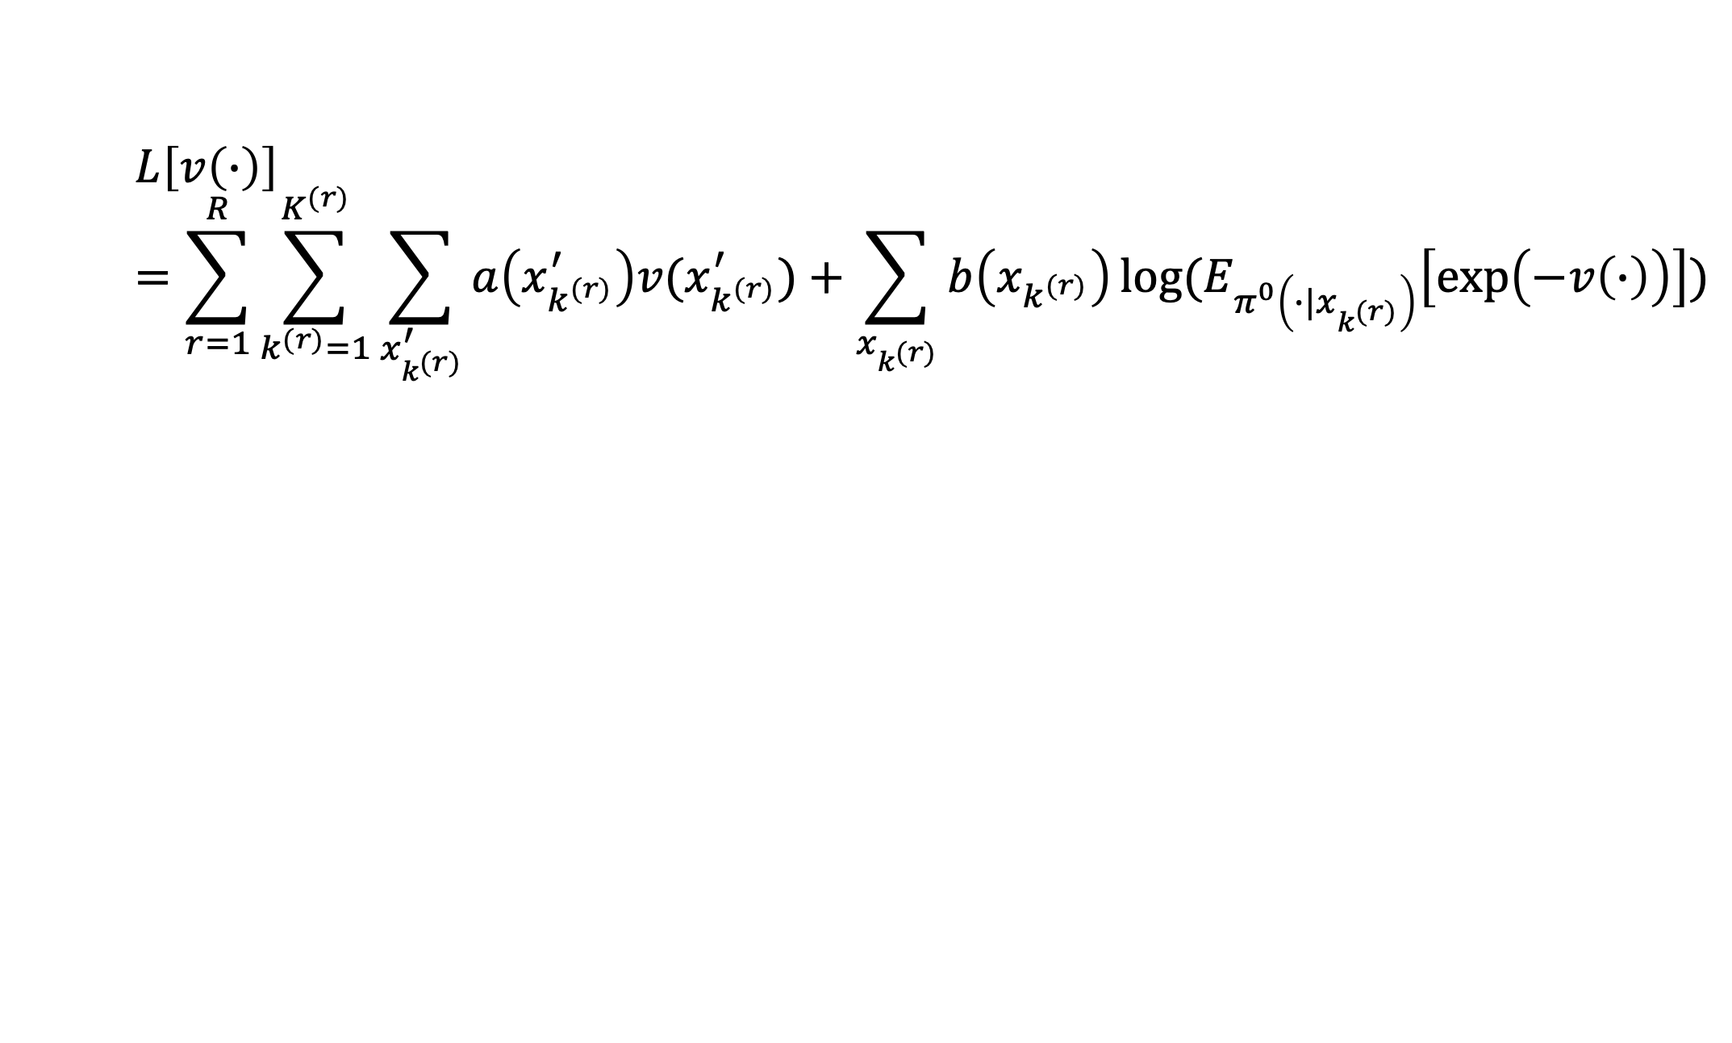
$$L\left[v\left(∙\right)\right]=\sum_{r=1}^{R}{\sum_{k^{(r)}=1}^{K^{(r)}}{\sum_{x_{k^{(r)}}^{′}}{a\left(x_{k^{(r)}}^{′}\right)v(x_{k^{(r)}}^{′})}+\sum_{x_{k^{(r)}}}{b\left(x_{k^{(r)}}\right)\log{(E_{π^{0}\left(∙|x_{k^{(r)}}\right)}\left[\exp\left(−v\left(∙\right)\right)\right])}}}}$$

Slide 11
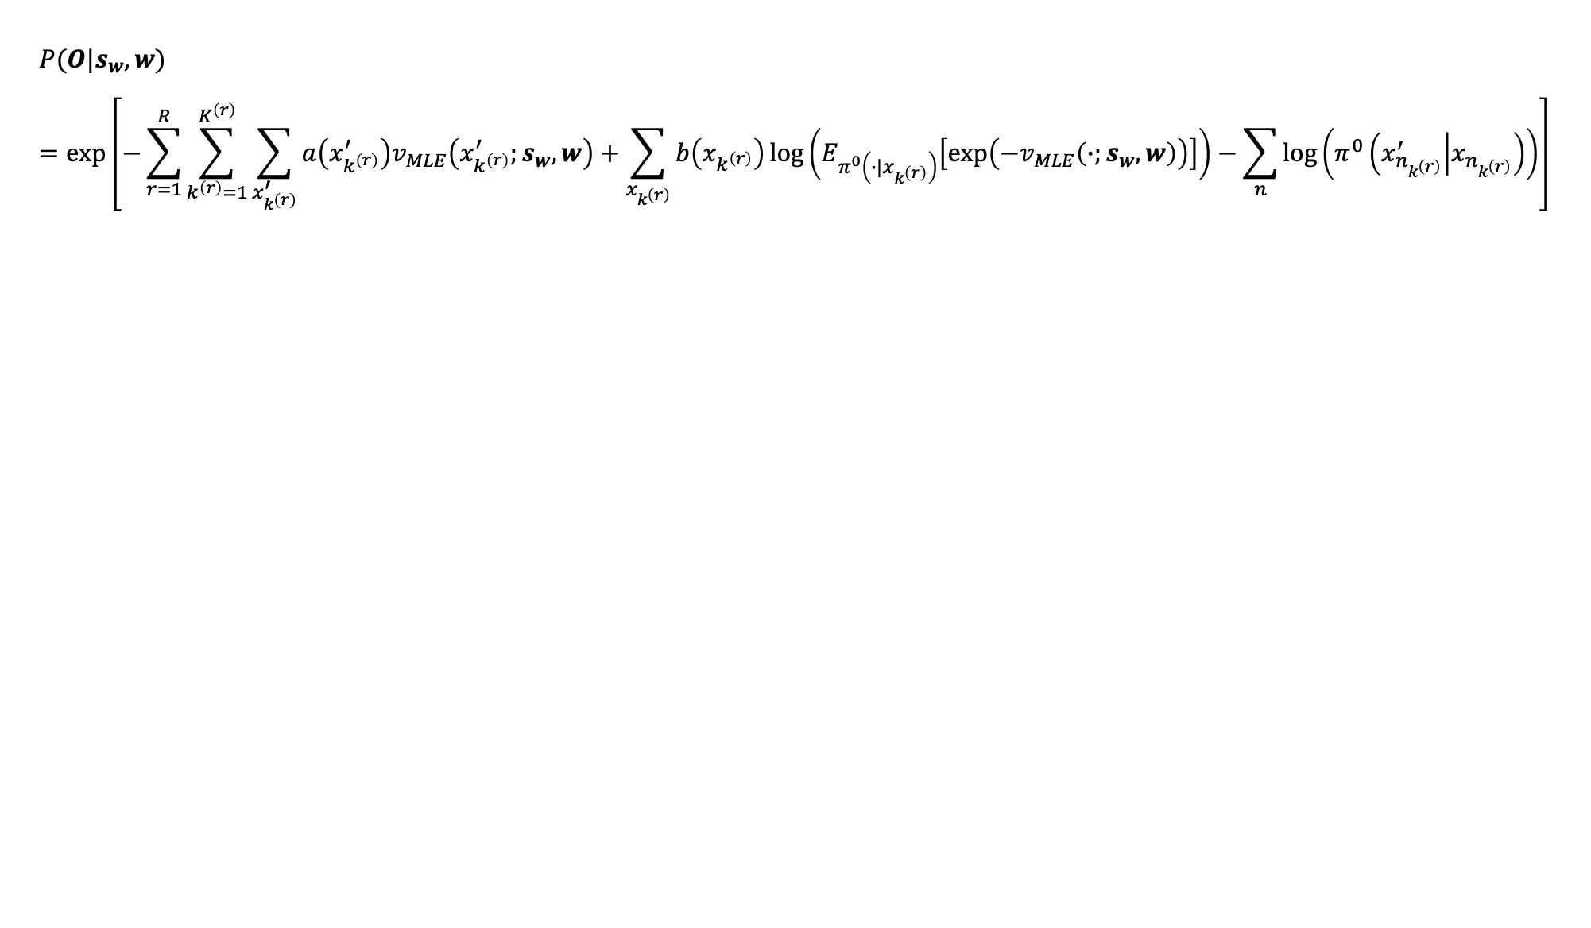
$$P(O|s_{w},w)=\text{exp}\left[−\sum_{r=1}^{R}{\sum_{k^{\left(r\right)}=1}^{K^{\left(r\right)}}{\sum_{x_{k^{\left(r\right)}}^{′}}{a\left(x_{k^{\left(r\right)}}^{′}\right)v_{MLE}\left(x_{k^{\left(r\right)}}^{′};s_{w},w\right)}+\sum_{x_{k^{\left(r\right)}}}{b\left(x_{k^{\left(r\right)}}\right)\log\left(E_{π^{0}\left(∙|x_{k^{\left(r\right)}}\right)}\left[\exp\left(−v_{MLE}\left(∙;s_{w},w\right)\right)\right]\right)}−\sum_{n}{\log\left(π^{0}\left(x_{n_{k^{\left(r\right)}}}^{′} | x_{n_{k^{\left(r\right)}}}\right)\right)}}}\right]$$

Slide 12

$$\frac{∂L\left[θ\right]}{∂θ_{i}}=\sum_{x^{′}}{a\left(x^{′}\right)\frac{∂h\left(x^{′};θ\right)}{∂θ_{i}}−\sum_{x}{b\left(x\right)[\sum_{x^{′}}{\frac{∂h\left(x^{′};θ\right)}{∂θ_{i}}π^{∗}(x^{′}|x)]+λ\frac{∂g(θ)}{∂θ_{i}}}} }$$

Slide 13
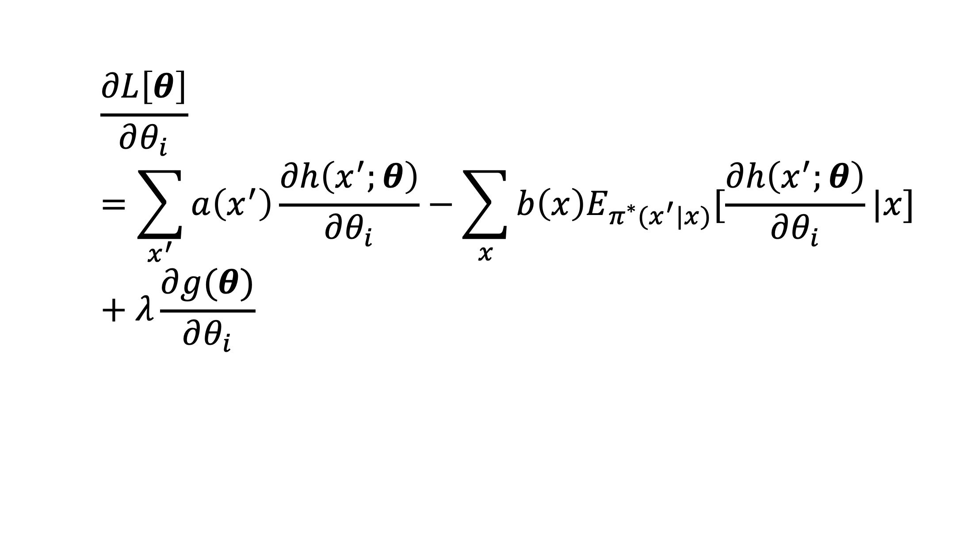
$$\frac{∂L\left[θ\right]}{∂θ_{i}}=\sum_{x^{′}}{a\left(x^{′}\right)\frac{∂h\left(x^{′};θ\right)}{∂θ_{i}}−\sum_{x}{b\left(x\right)E_{π^{∗}(x^{′}|x)}[\frac{∂h\left(x^{′};θ\right)}{∂θ_{i}}|x]} }+λ\frac{∂g(θ)}{∂θ_{i}}$$

Slide 14
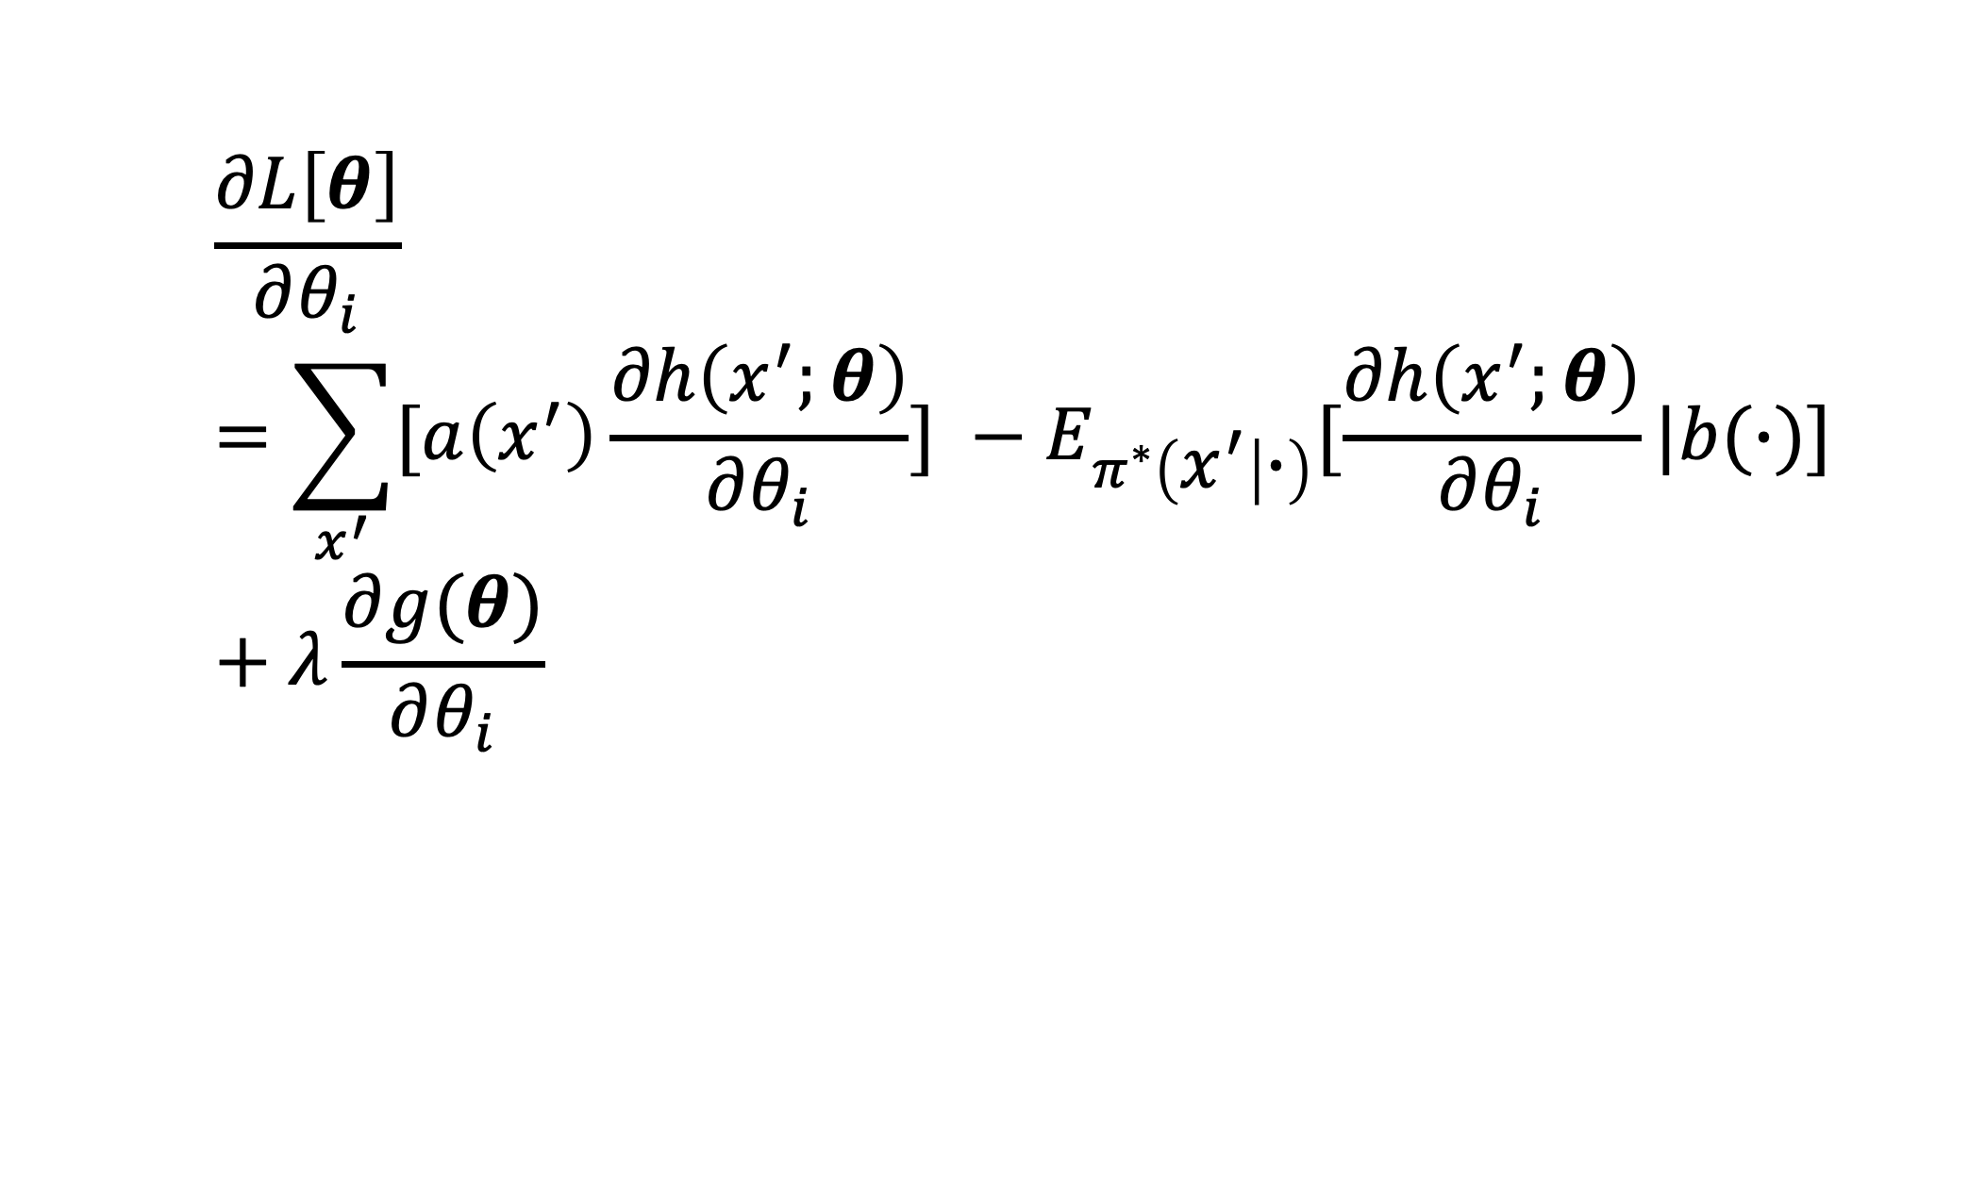
$$\frac{∂L\left[θ\right]}{∂θ_{i}}=\sum_{x^{′}}{[a\left(x^{′}\right)\frac{∂h\left(x^{′};θ\right)}{∂θ_{i}}] }−E_{π^{∗}\left(x^{′} | ∙\right)}[\frac{∂h\left(x^{′};θ\right)}{∂θ_{i}}|b(∙)]+λ\frac{∂g(θ)}{∂θ_{i}}$$

Slide 15
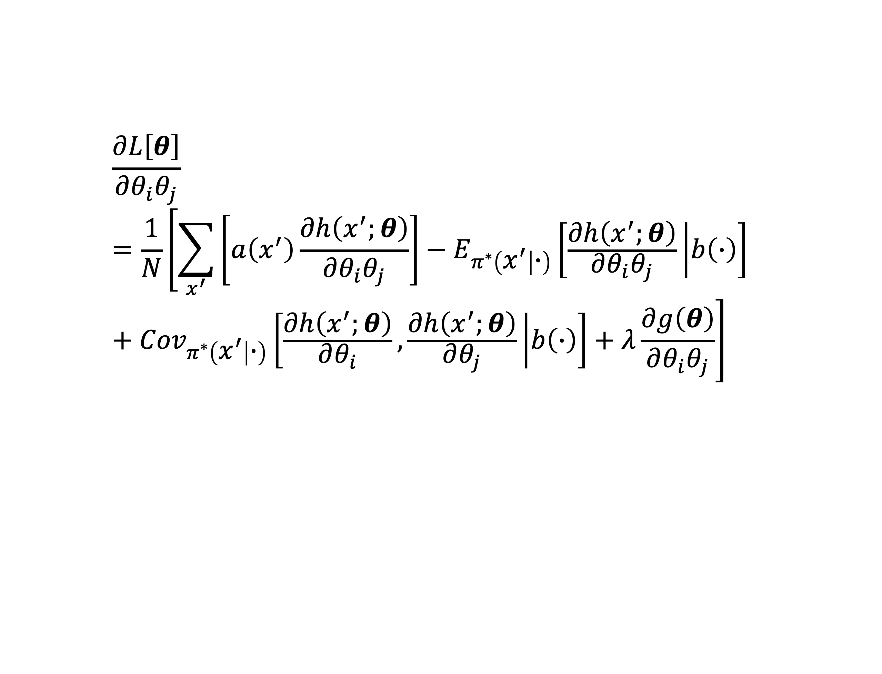
$$\frac{∂L\left[θ\right]}{∂θ_{i}θ_{j}}=\frac{1}{N}\left[\sum_{x^{′}}{\left[a\left(x^{′}\right)\frac{∂h\left(x^{′};θ\right)}{∂θ_{i}θ_{j}}\right]}−E_{π^{∗}\left(x^{′} | ∙\right)}\left[\frac{∂h\left(x^{′};θ\right)}{∂θ_{i}θ_{j}} | b\left(∙\right)\right]+{Cov}_{π^{∗}\left(x^{′} | ∙\right)}\left[\frac{∂h\left(x^{′};θ\right)}{∂θ_{i}},\frac{∂h\left(x^{′};θ\right)}{∂θ_{j}} | b\left(∙\right)\right]+λ\frac{∂g\left(θ\right)}{∂θ_{i}θ_{j}}\right]$$

Slide 16

$$\frac{∂L[v\left(∙\right)]}{∂v\left(y\right)v(w)}={Cov}_{[π^{∗}\left(y | ∙\right),π^{∗}\left(w | ∙\right)]}[∙|b\left(∙\right)]$$

Slide 17

$$P(s_{w},w|D)∝P\left(D | s_{w},w\right)P\left(s_{w} | w\right)P(w)$$

