Slide 1
Busy Bee ideas
Loren Rieffer-Champlin

Slide 2
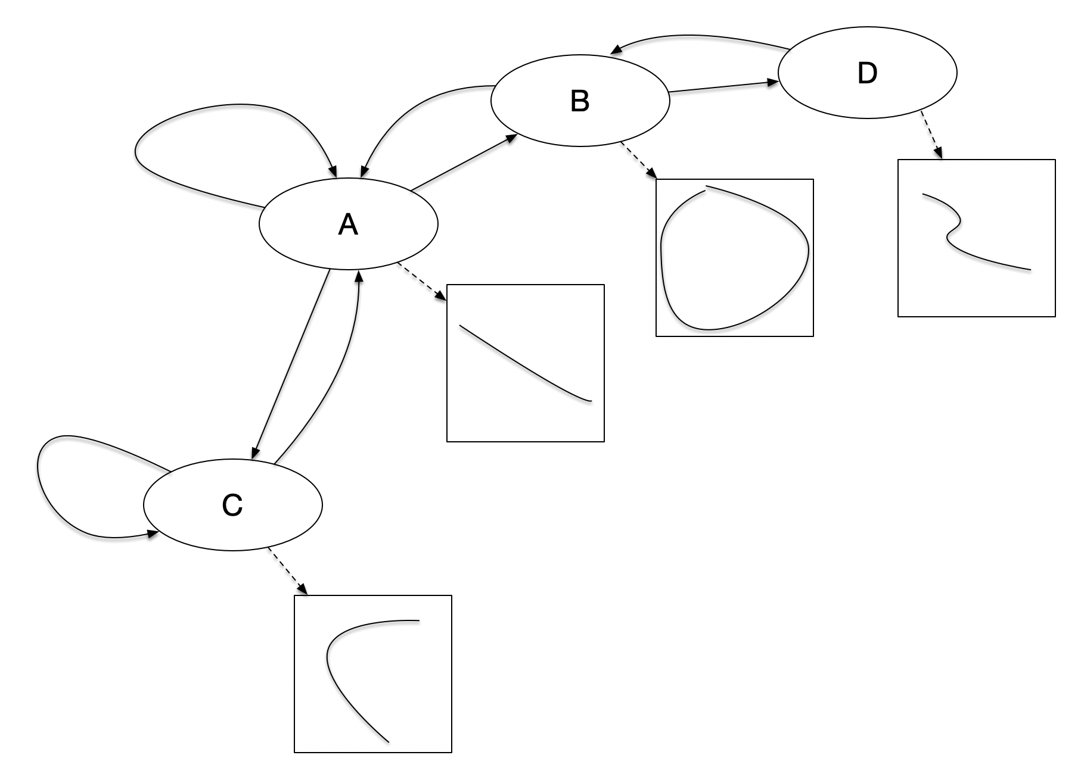
Finite-State Machine
x_7
x_5
x_6
x_4
x_3
x_1
x_0
x_2
Path Plan given state

Slide 3
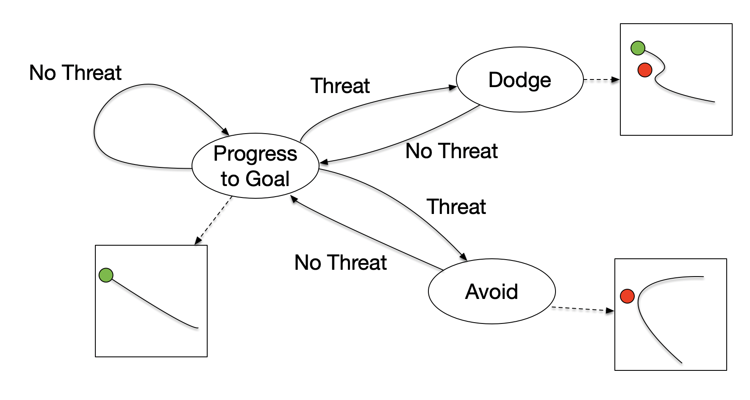
EXAMPLE

Slide 4
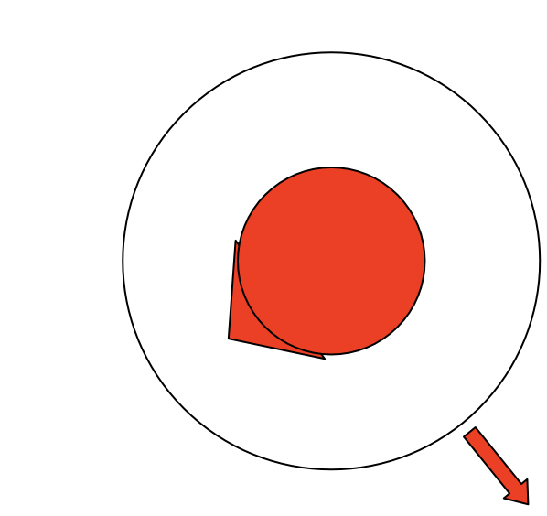
Repulsion Field
Wasp
We seem to assume,
Facing

Slide 5
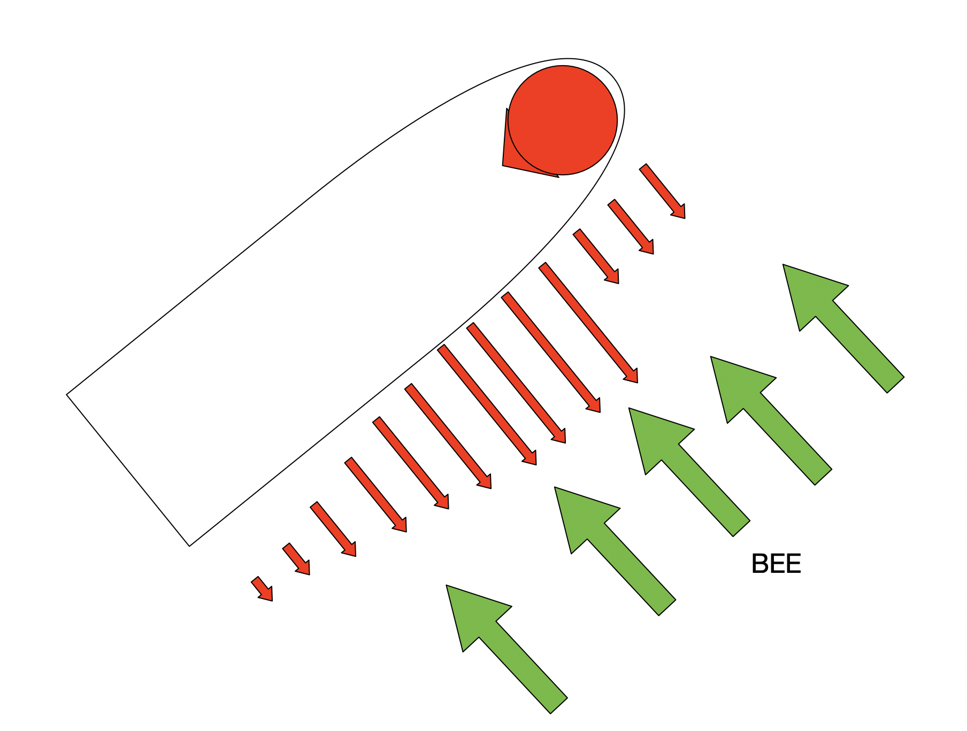
Repulsion Field
But maybe more like,

Slide 6
Research Questions
Can we build an accurate symbolic model of the human’s behavior?
Can we use the symbolic model to evaluate the discrepancy between the human’s behavior and the intended behavior of the AI?

Slide 7
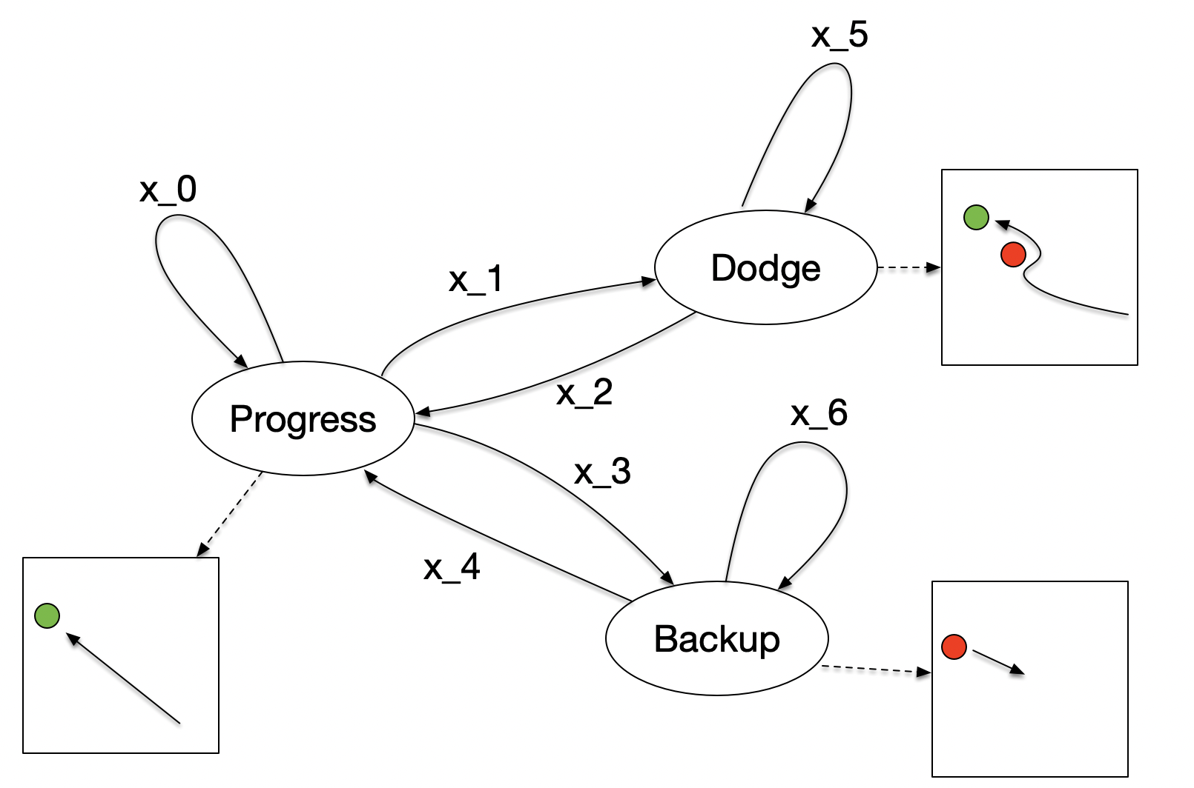
Symbolic model

Slide 8
Repulsion field
Consider the velocity of the obstacles in the repulsive field by creating virtual copies of the obstacles that simulate a human estimate of where an obstacle will be when the bee intersects its path.

Slide 9
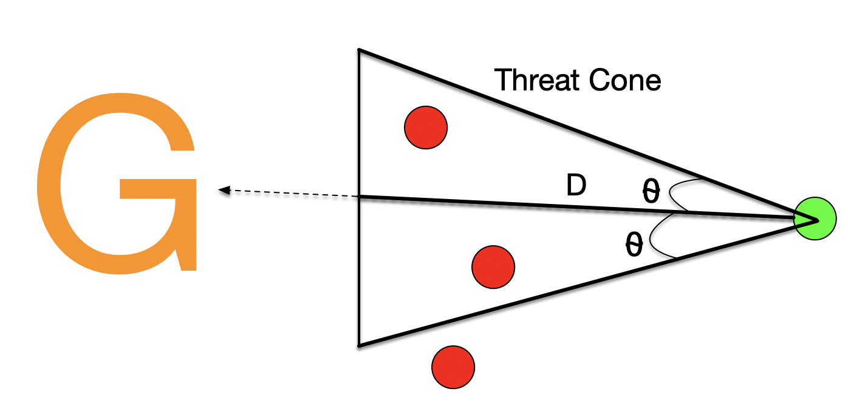
Triggers for state transitions.
Progress -> Dodge:

Slide 10
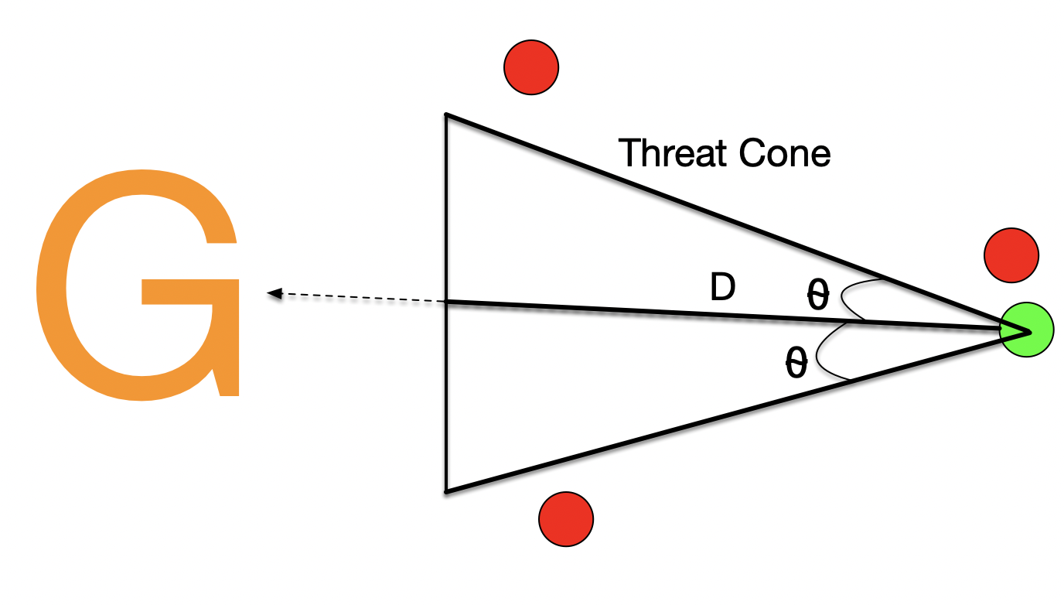
Triggers for state transitions.
Progress -> Progress:

Slide 11
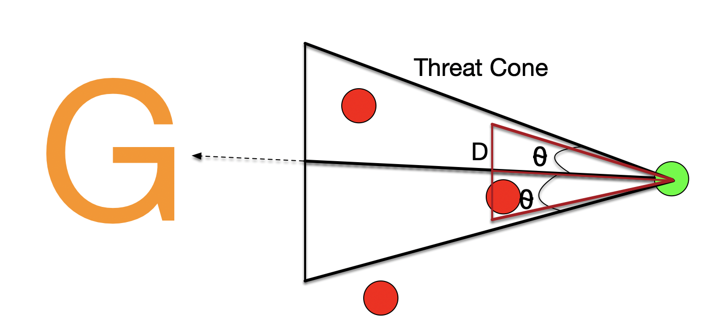
Triggers for state transitions.
Progress -> Backup:

Slide 12
Obstacle Trajectory Predictions
Research Question: How does experience affect obstacle trajectory predictions?

