Slide 1
MLE using OptV

Slide 2
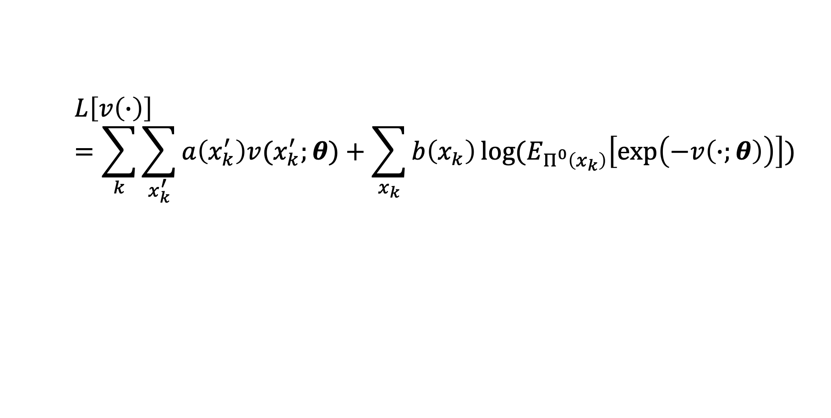
MLE Equation for OptV
$$L\left[v\left(∙\right)\right]=\sum_{k}{\sum_{x_{k}^{′}}{a\left(x_{k}^{′}\right)v(x_{k}^{′};θ)}+\sum_{x_{k}}{b\left(x_{k}\right)\log{(E_{Π^{0}\left(x_{k}\right)}\left[\exp\left(−v\left(∙;θ\right)\right)\right])}}}$$

Slide 3
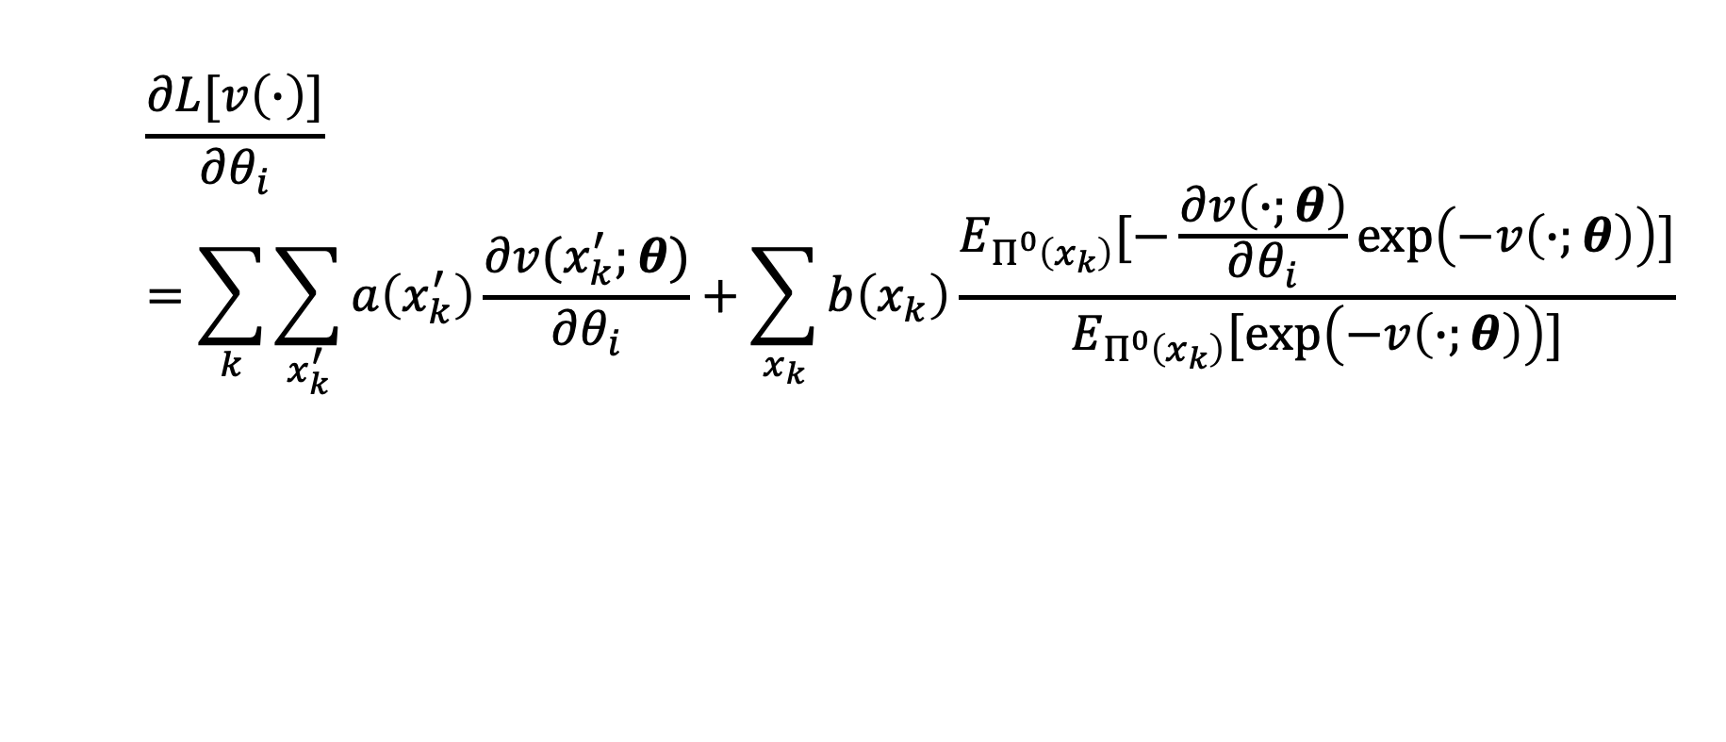
Gradient for OptV
$$\frac{∂L[v\left(∙\right)]}{∂θ_{i}}=\sum_{k}{\sum_{x_{k}^{′}}{a\left(x_{k}^{′}\right)\frac{∂v(x_{k}^{′};θ)}{∂θ_{i}}}+\sum_{x_{k}}{b\left(x_{k}\right)\frac{E_{Π^{0}\left(x_{k}\right)}[−\frac{∂v\left(∙;θ\right)}{∂θ_{i}}\exp\left(−v\left(∙;θ\right)\right)]}{E_{Π^{0}\left(x_{k}\right)}[\exp\left(−v\left(∙;θ\right)\right)]}}}$$

Slide 4

Hessian for OptV (diagonal)
$$\frac{∂L[v\left(∙\right)]}{∂θ_{i}^{2}}=\sum_{k}{\sum_{x_{k}^{′}}{a\left(x_{k}^{′}\right)\frac{∂v(x_{k}^{′};θ)}{∂θ_{i}^{2}}}+\sum_{x_{k}}{b\left(x_{k}\right)}}\frac{E_{Π^{0}\left(x_{k}\right)}\left[\left({\frac{∂v\left(∙;θ\right)}{∂θ_{i}}}^{2}−\frac{∂v\left(∙;θ\right)}{∂θ_{i}^{2}}\right)\exp\left(−v\left(∙;θ\right)\right)\right]E_{Π^{0}\left(x_{k}\right)}\left[\exp\left(−v\left(∙;θ\right)\right)\right]−{E_{Π^{0}\left(x_{k}\right)}[−\frac{∂v\left(∙;θ\right)}{∂θ_{i}}\exp\left(−v\left(∙;θ\right)\right)]}^{2}}{{E_{Π^{0}\left(x_{k}\right)}\left[\exp\left(−v\left(∙;θ\right)\right)\right]}^{2}}$$

Slide 5
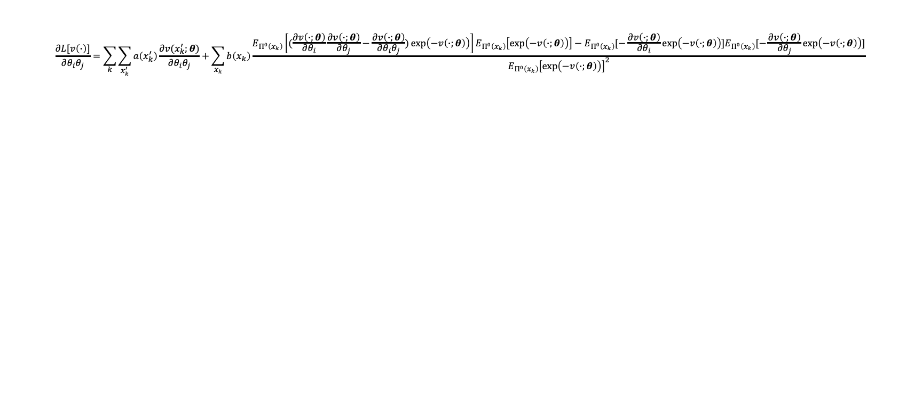
Hessian for OptV (off-diagonal)
$$\frac{∂L[v\left(∙\right)]}{∂θ_{i}θ_{j}}=\sum_{k}{\sum_{x_{k}^{′}}{a\left(x_{k}^{′}\right)\frac{∂v(x_{k}^{′};θ)}{∂θ_{i}θ_{j}}}+\sum_{x_{k}}{b\left(x_{k}\right)}}\frac{E_{Π^{0}\left(x_{k}\right)}\left[(\frac{∂v\left(∙;θ\right)}{∂θ_{i}}\frac{∂v\left(∙;θ\right)}{∂θ_{j}}−\frac{∂v\left(∙;θ\right)}{∂θ_{i}θ_{j}})\exp\left(−v\left(∙;θ\right)\right)\right]E_{Π^{0}\left(x_{k}\right)}\left[\exp\left(−v\left(∙;θ\right)\right)\right]−E_{Π^{0}\left(x_{k}\right)}[−\frac{∂v\left(∙;θ\right)}{∂θ_{i}}\exp\left(−v\left(∙;θ\right)\right)]E_{Π^{0}\left(x_{k}\right)}[−\frac{∂v\left(∙;θ\right)}{∂θ_{j}}\exp\left(−v\left(∙;θ\right)\right)]}{{E_{Π^{0}\left(x_{k}\right)}\left[\exp\left(−v\left(∙;θ\right)\right)\right]}^{2}}$$

Slide 6
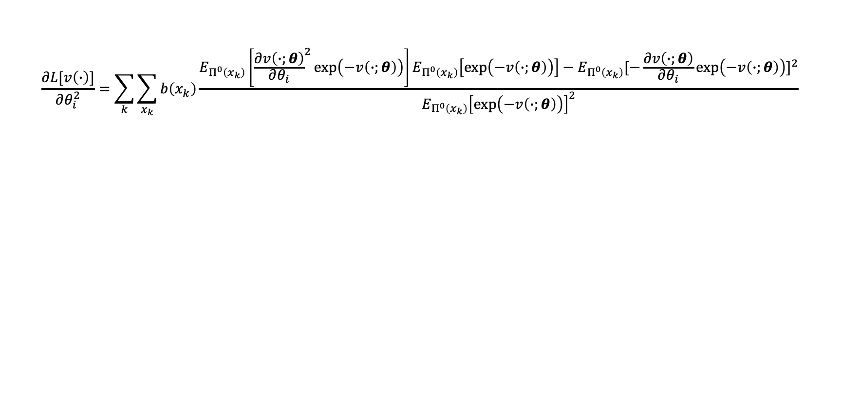
Hessian for Linear OptV (diagonal)
$$\frac{∂L[v\left(∙\right)]}{∂θ_{i}^{2}}=\sum_{k}{\sum_{x_{k}}{b\left(x_{k}\right)}}\frac{E_{Π^{0}\left(x_{k}\right)}\left[{\frac{∂v\left(∙;θ\right)}{∂θ_{i}}}^{2}\exp\left(−v\left(∙;θ\right)\right)\right]E_{Π^{0}\left(x_{k}\right)}\left[\exp\left(−v\left(∙;θ\right)\right)\right]−{E_{Π^{0}\left(x_{k}\right)}[−\frac{∂v\left(∙;θ\right)}{∂θ_{i}}\exp\left(−v\left(∙;θ\right)\right)]}^{2}}{{E_{Π^{0}\left(x_{k}\right)}\left[\exp\left(−v\left(∙;θ\right)\right)\right]}^{2}}$$

Slide 7

Hessian for Linear OptV (off-diagonal)
$$\frac{∂L[v\left(∙\right)]}{∂θ_{i}θ_{j}}=\sum_{k}{\sum_{x_{k}}{b\left(x_{k}\right)}}\frac{E_{Π^{0}\left(x_{k}\right)}\left[\frac{∂v\left(∙;θ\right)}{∂θ_{i}}\frac{∂v\left(∙;θ\right)}{∂θ_{j}}\exp\left(−v\left(∙;θ\right)\right)\right]E_{Π^{0}\left(x_{k}\right)}\left[\exp\left(−v\left(∙;θ\right)\right)\right]−E_{Π^{0}\left(x_{k}\right)}[−\frac{∂v\left(∙;θ\right)}{∂θ_{i}}\exp\left(−v\left(∙;θ\right)\right)]E_{Π^{0}\left(x_{k}\right)}[−\frac{∂v\left(∙;θ\right)}{∂θ_{j}}\exp\left(−v\left(∙;θ\right)\right)]}{{E_{Π^{0}\left(x_{k}\right)}\left[\exp\left(−v\left(∙;θ\right)\right)\right]}^{2}}$$

