Slide 1
Deriving L2 Norm Regularization

Slide 2

$$P\left(θ | D\right)=\frac{P\left(D | θ\right)P(θ)}{P(D)}$$

Slide 3
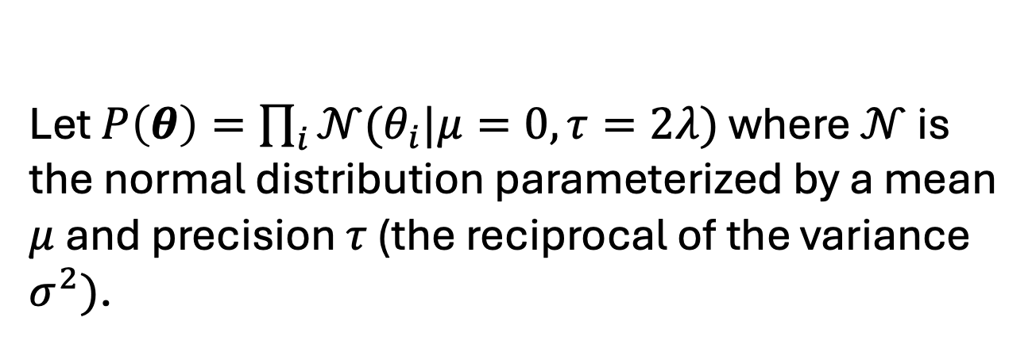
$$P\left(θ | D\right)=\frac{P\left(D | θ\right)P(θ)}{P(D)}$$
Let $P\left(θ\right)=\prod_{i}{𝒩(θ_{i}|μ=0,τ=2λ})$ where $𝒩$ is the normal distribution parameterized by a mean $μ$ and precision $τ$ (the reciprocal of the variance $σ^{2})$.

Slide 4
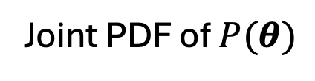
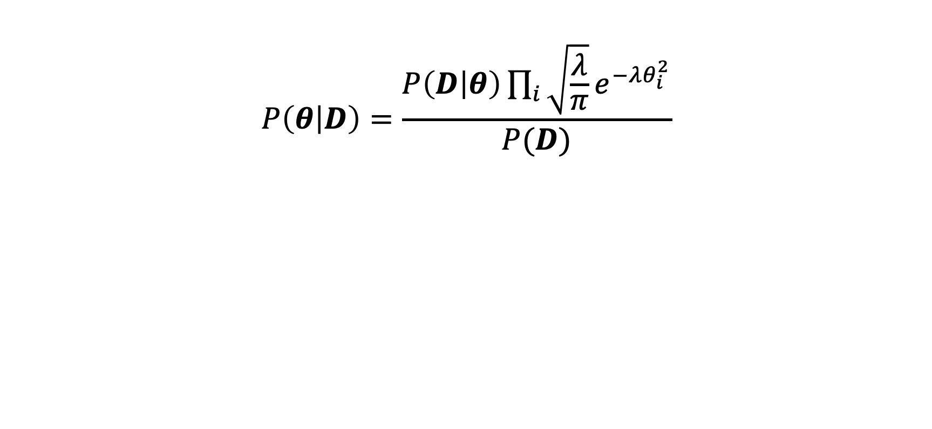
$$P\left(θ | D\right)=\frac{P\left(D | θ\right)\prod_{i}{\sqrt{\frac{λ}{π}}e^{−λθ_{i}^{2}}}}{P(D)}$$
Joint PDF of $P(θ)$

Slide 5
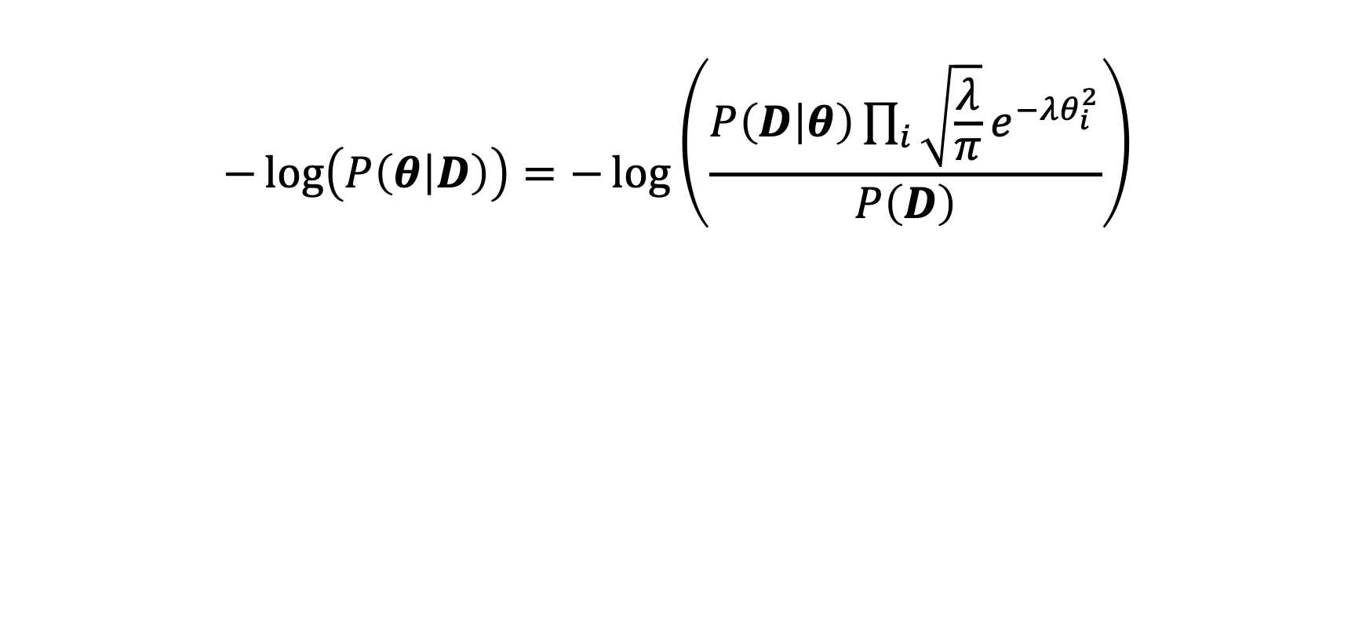
$$−\log\left(P\left(θ | D\right)\right)=−\log\left(\frac{P\left(D | θ\right)\prod_{i}{\sqrt{\frac{λ}{π}}e^{−λθ_{i}^{2}}}}{P\left(D\right)}\right)$$

Slide 6
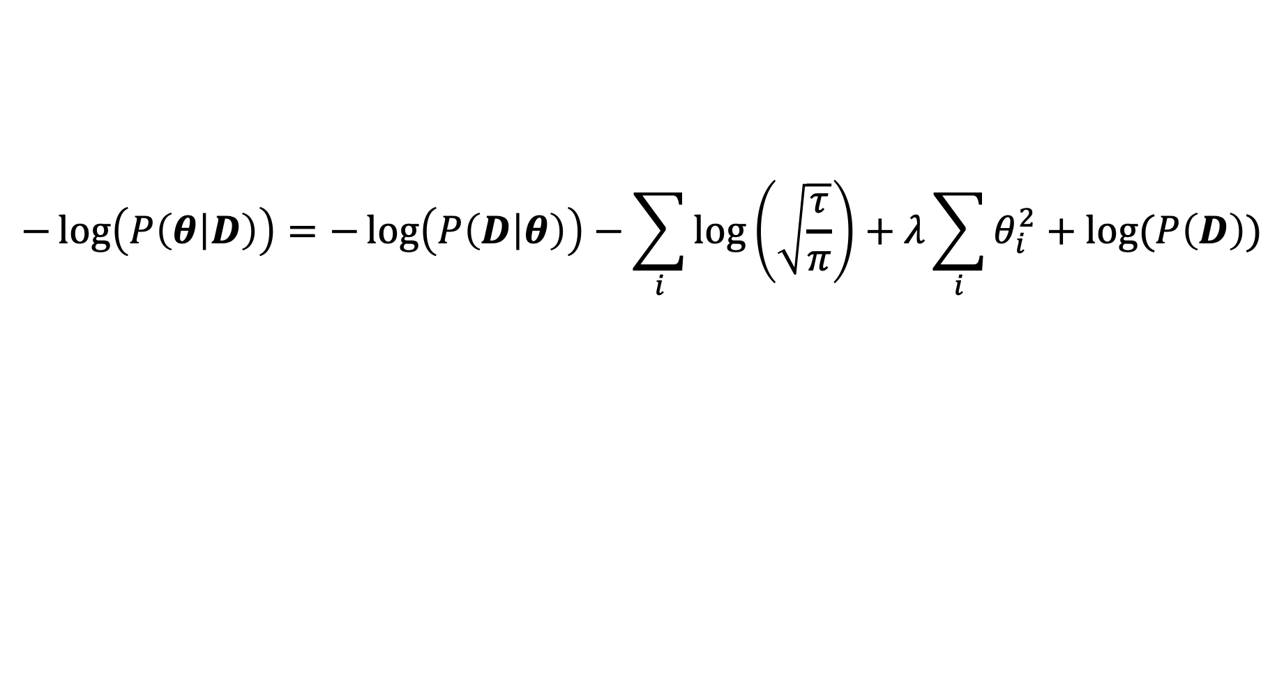
$$−\log\left(P\left(θ | D\right)\right)=−\log\left(P\left(D | θ\right)\right)−\sum_{i}{\log\left(\sqrt{\frac{τ}{π}}\right)}+λ\sum_{i}{θ_{i}^{2}}+log⁡(P\left(D\right))$$

Slide 7

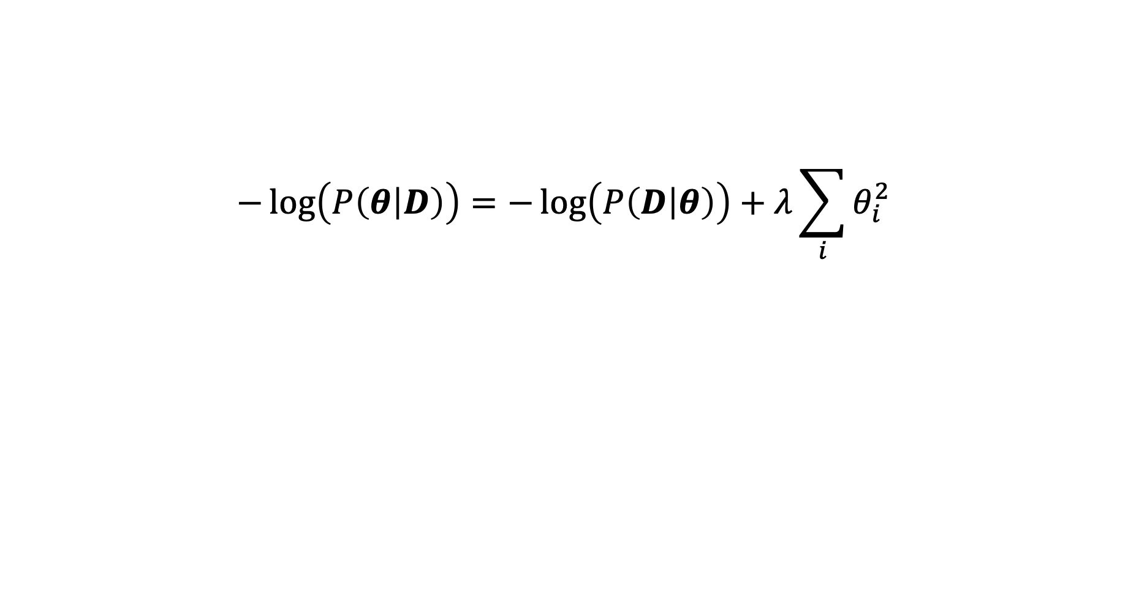
$$−\log\left(P\left(θ | D\right)\right)=−\log\left(P\left(D | θ\right)\right)+λ\sum_{i}{θ_{i}^{2}}$$
Removed all terms that don’t contain $θ$.

Slide 8
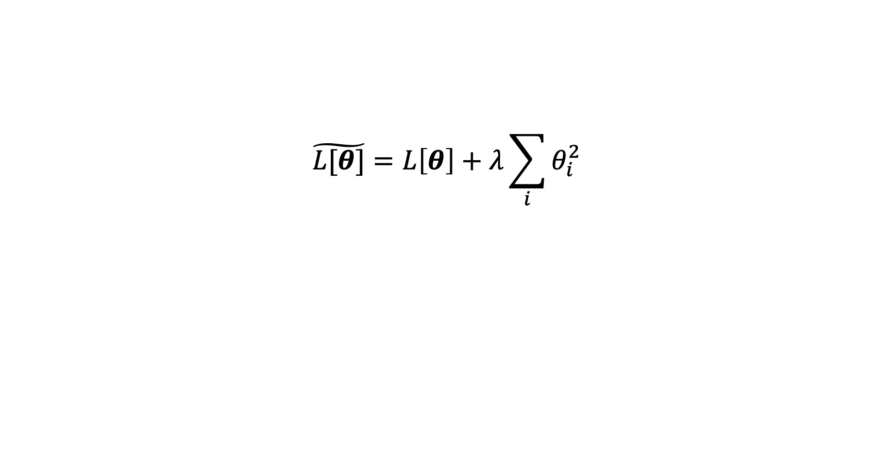
$$\tilde{L[θ]}=L\left[θ\right]+λ\sum_{i}{θ_{i}^{2}}$$
Regularized Loss Function
Loss Function
L2 Norm

Slide 9
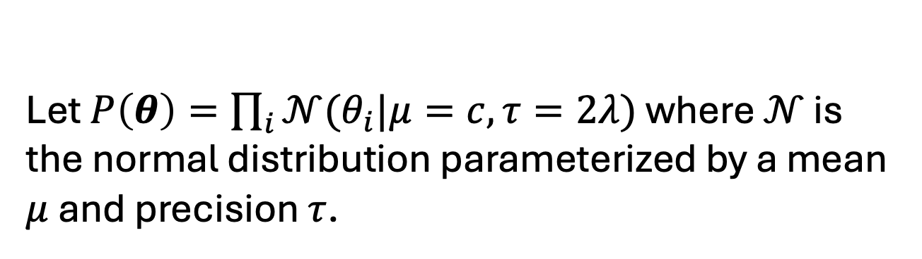
$$P\left(θ | D\right)=\frac{P\left(D | θ\right)P(θ)}{P(D)}$$
Let $P\left(θ\right)=\prod_{i}{𝒩(θ_{i}|μ=c,τ=2λ})$ where $𝒩$ is the normal distribution parameterized by a mean $μ$ and precision $τ$.

Slide 10
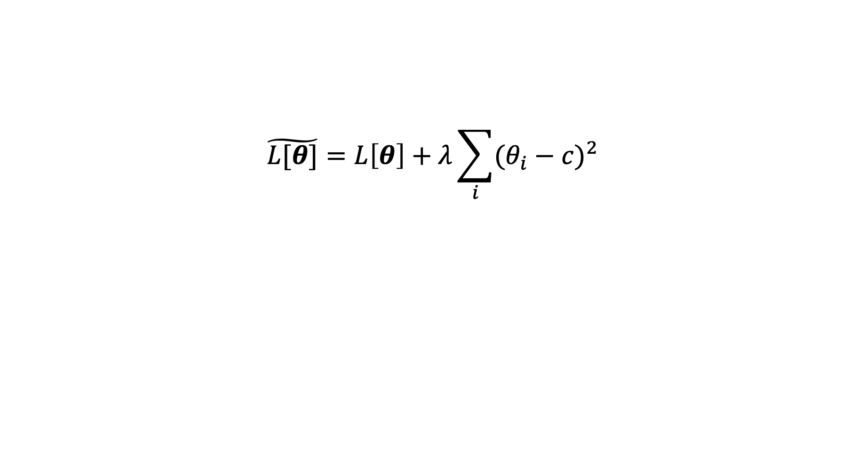
$$\tilde{L[θ]}=L\left[θ\right]+λ\sum_{i}{{(θ_{i}−c)}^{2}}$$
Regularized Loss Function
Loss Function
L2 Norm

