Slide 1
Inverse Reinforcement learning for a LMDP sequence Model

Slide 2
Busy Beeway
The human-AI team controls a bee avatar.
They have 3 lives to successfully guide the bee to each of the 7 goals (6 of them look like flowers, and the 7th looks like a portal) while avoiding moving wasps.
Only one goal is on the game map at any one time with a new goal appearing after the bee reaches the current goal.
Flower/ Final Goal Portal
Objective
Wasp
Bee
Wasp

Slide 3
Busy Beeway
The bee moves up to 8 units per second in any desired direction.
Wasps are randomly generated on the game map, with the amount depending on the difficulty level.
The wasps continuously move in a fixed randomly assigned direction at a non-fixed random speed.
There are four different speeds to sample from, and a new speed is sampled for each wasp every 1/30th of a second.
Flower/ Final Goal Portal
Objective
Wasp
Bee
Wasp

Slide 4
Busy Beeway
The AI teammate controls the bee whenever the human player is not touching their on-screen joystick.
The AI teammate follows an Artificial Potential Field (APF) path-planner
In each game session, the player is randomly assigned one of four AI teammates with varying APF parameters.
They are only identifiable to the player through their behavior.
Flower/ Final Goal Portal
Objective
Wasp
Bee
Wasp

Slide 5
Busy Beeway
We are still debating how to fit control-switching between the AI and human player. For now, we are treating them as a single controller.
Flower/ Final Goal Portal
Objective
Wasp
Bee
Wasp

Slide 6
Busy Beeway
The trajectory of the AI-human team is observed from the start of game play to the final goal or until a collision (known as an attempt).
Flower/ Final Goal Portal
Objective
Wasp
Bee
Wasp

Slide 7
Busy Beeway
In our model, we separate attempts into “runs”. A run is defined as from (1) the start of an attempt up to a goal or collision or (2) from a previous goal location to the next goal or collision.
The reason for this is discussed later on.
Flower/ Final Goal Portal
Objective
Wasp
Bee
Wasp

Slide 8

LMDP sequence model
4
In our model, we assume that the controller ”freezes” a small grid-like planning space around it.
3
2
1
0
-4
-3
-2
-1
-1
-2
-3
-4
0
1
2
3
4

Slide 9
LMDP sequence model
4
3
2
The controller/bee always starts at the origin of the planning space
1
0
-4
-3
-2
-1
-1
-2
-3
-4
0
1
2
3
4

Slide 10
LMDP sequence model
4
The closest grid space to the goal is marked (a pseudo-goal).
3
2
1
0
-4
-3
-2
-1
-1
-2
-3
-4
0
1
2
3
4

Slide 11
LMDP sequence model
4
3
2
1
0
-4
-3
The current positions of the wasps are frozen.
-2
-1
-1
-2
-3
-4
0
1
2
3
4

Slide 12
LMDP sequence model
4
3
However, their positional distribution is projected across the grid.
2
1
0
-4
-3
-2
-1
-1
-2
-3
-4
0
1
2
3
4

Slide 13
LMDP sequence model
4
The controller then “solves” this frozen planning space as an LMDP.
The objective of the controller is to minimize the distance from the pseudo-goal within a certain amount of time steps while avoiding spots with high collision probabilities.
3
2
1
0
-4
-3
-2
-1
-1
-2
-3
-4
0
1
2
3
4

Slide 14
LMDP sequence model
4
The controller then “solves” this frozen planning space as an LMDP.
The objective of the controller is to minimize the distance from the pseudo-goal within a certain amount of time steps while avoiding spots with high collision probabilities.
3
2
1
0
-4
-3
-2
-1
-1
-2
-3
-4
0
1
2
3
4

Slide 15
LMDP sequence model
4
Each time step represents some time length (e.g., 1/8th of a second) and the the number of time steps the controller takes determines the size of the planning space.
The grid on the left is sized for 4 time steps (or ½ of a second at 1/8th of a second per time step).
3
2
1
0
-4
-3
-2
-1
-1
-2
-3
-4
0
1
2
3
4

Slide 16
LMDP sequence model
4
3
The controller executes its planned trajectory and updates the positions of the wasps.
2
1
0
-4
-3
-2
-1
-1
-2
-3
-4
0
1
2
3
4

Slide 17
LMDP sequence model
4
3
As the graphic suggests, solving the LMDP produces a grid trajectory, but our controller would need a method for generating a smooth, continuous trajectory through this grid path.
However, for the purpose of doing IRL, we are not concerned with this secondary generation process.
2
1
0
-4
-3
-2
-1
-1
-2
-3
-4
0
1
2
3
4

Slide 18
LMDP sequence model
4
3
It then builds a new frozen planning space around its location and solves this new LMDP.
2
1
0
-4
-3
-2
-1
-1
-2
-3
-4
0
1
2
3
4

Slide 19
Linearly-Solvable Markov Decision Problem (LMDP) with static obstacles (example)
4
3
In an LMDP, we abstract away the concept of actions.
Only state transitions are considered (e.g., the bee transitions from coordinate (0,0) to coordinate (1,1)).
2
1
0
-4
-3
-2
-1
-1
-2
-3
-4
0
1
2
3
4

Slide 20
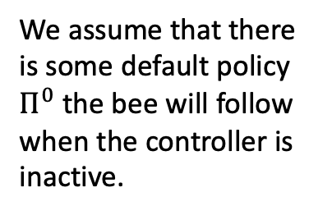
Linearly-Solvable Markov Decision Problem (LMDP) with static obstacles (example)
4
3
We assume that there is some default policy $Π^{0}$ the bee will follow when the controller is inactive.
2
1
0
-4
-3
-2
-1
-1
-2
-3
-4
0
1
2
3
4

Slide 21
Linearly-Solvable Markov Decision Problem (LMDP) with static obstacles (example)
4
3
Transition probabilities under
uniform default policy
We assume that there is some default policy $Π^{0}$ the bee will follow when the controller is inactive.
2
1
1/4
0
1/4
1/4
-4
1/4
-3
-2
-1
-1
-2
-3
-4
0
1
2
3
4

Slide 22
Linearly-Solvable Markov Decision Problem (LMDP) with static obstacles (example)
4
3
The controller can impose their policy on the bee at a cost of control.
The objective is to find a policy minimizing this control cost.
2
1
0
-4
-3
-2
-1
-1
-2
-3
-4
0
1
2
3
4

Slide 23
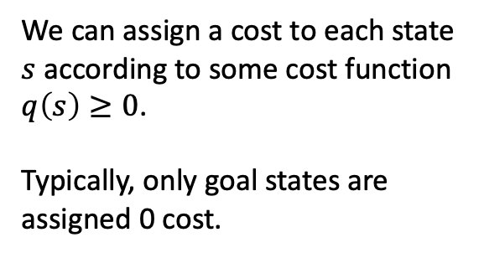
Linearly-Solvable Markov Decision Problem (LMDP) with static obstacles (example)
4
1
1
1
1
1
1
1
1
1
3
1
1
1
1
1
1
1
1
1
2
1
1
1
1
1
1
1
1
1
1
1
1
1
1
1
1
1
1
1
1
We can assign a cost to each state $s$ according to some cost function $q\left(s\right)≥0$.
Typically, only goal states are assigned 0 cost.
0
1
1
1
1
1
1
1
1
-4
5
1
1
1
1
1
1
1
1
-3
1
1
1
1
5
1
1
1
1
-2
1
1
1
1
1
1
1
1
1
-1
0
1
1
1
1
1
1
1
1
-1
-2
-3
-4
0
1
2
3
4

Slide 24
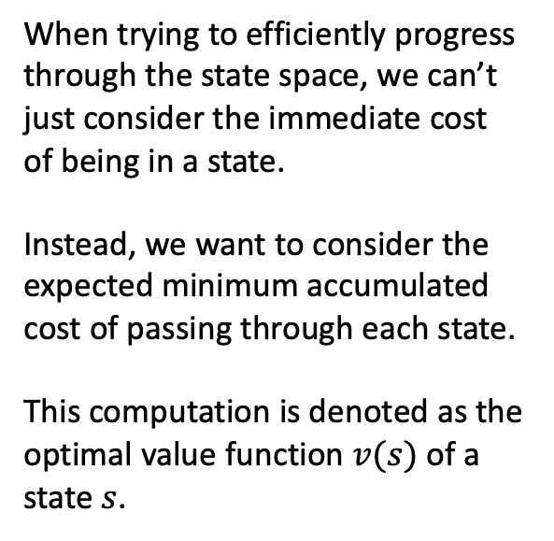
Linearly-Solvable Markov Decision Problem (LMDP) with static obstacles (example)
4
4
4
4
4
4
4
4
4
5
3
3
3
3
3
3
3
3
3
4
When trying to efficiently progress through the state space, we can’t just consider the immediate cost of being in a state.
Instead, we want to consider the expected minimum accumulated cost of passing through each state.
This computation is denoted as the optimal value function $v(s)$ of a state $s$.
2
2
2
2
2
2
2
2
3
4
1
1
1
1
1
1
1
2
3
4
0
4
3
1
1
1
2
2
3
4
-4
5
3
1
2
4
3
2
3
4
-3
2
2
.2
2
5
4
2
3
4
-2
.1
.1
.2
2
3
4
2
3
4
-1
0
.1
.2
.4
.5
1
2
3
4
-1
-2
-3
-4
0
1
2
3
4

Slide 25
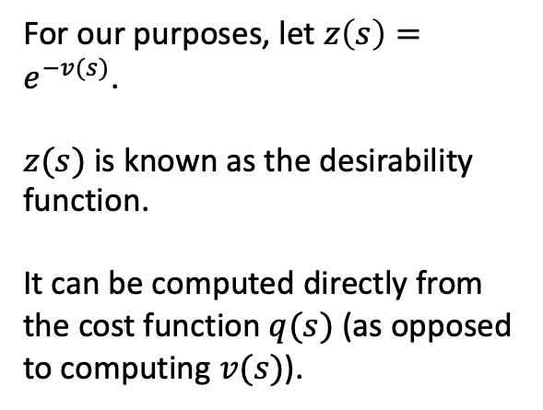
Linearly-Solvable Markov Decision Problem (LMDP) with static obstacles (example)
4
.018
.018
.018
.018
.018
.018
.018
.018
.007
3
.05
.05
.05
.05
.05
.05
.05
.05
.018
For our purposes, let $z\left(s\right)=e^{−v(s)}$.
$z(s)$ is known as the desirability function.
It can be computed directly from the cost function $q(s)$ (as opposed to computing $v(s)$).
2
.135
.135
.135
.135
.135
.135
.135
.05
.018
1
.368
.368
.368
.368
.368
.368
.135
.05
.018
0
.018
.05
.368
.368
.368
.135
.135
.05
.018
-4
.007
.05
.368
.135
.018
.05
.135
.05
.018
-3
.135
.135
.819
.135
.007
.018
.135
.05
.018
-2
.905
.905
.819
.135
.05
.018
.135
.05
.018
-1
1
.905
.819
.670
.607
.368
.135
.05
.018
-1
-2
-3
-4
0
1
2
3
4

Slide 26
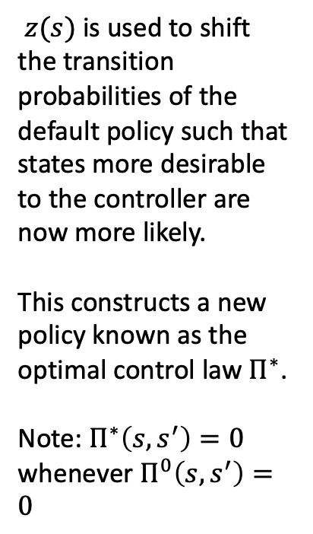
Linearly-Solvable Markov Decision Problem (LMDP) with static obstacles (example)
4
3
Transition probabilities under the optimal control law
$z(s)$ is used to shift the transition probabilities of the default policy such that states more desirable to the controller are now more likely.
This constructs a new policy known as the optimal control law $Π^{∗}$.
Note: $Π^{∗}\left(s,s^{′}\right)=0$ whenever $Π^{0}\left(s,s^{′}\right)=0$
2
1
1/3
0
1/3
1/4
-4
1/12
-3
-2
-1
-1
-2
-3
-4
0
1
2
3
4

Slide 27
Linearly-Solvable Markov Decision Problem (LMDP) with static obstacles (example)
4
3
Using an optimal state sequence algorithm like Viterbi on the optimal control law can generate optimal trajectories.
2
1
0
-4
-3
-2
-1
-1
-2
-3
-4
0
1
2
3
4

Slide 28

Feature-based optimal value function
$v(s)$ (or $z(s)$) can be expensive to compute since they involve multiple recursive computations over the entire state space.

Slide 29

Feature-based optimal value function
$v(s)$ (or $z(s)$) can be expensive to compute since they involve multiple recursive computations over the entire state space.
Instead, we define a feature-based approximation of the optimal value function $v\left(s;θ\right)$ where $θ$ is a set of feature weights.

Slide 30
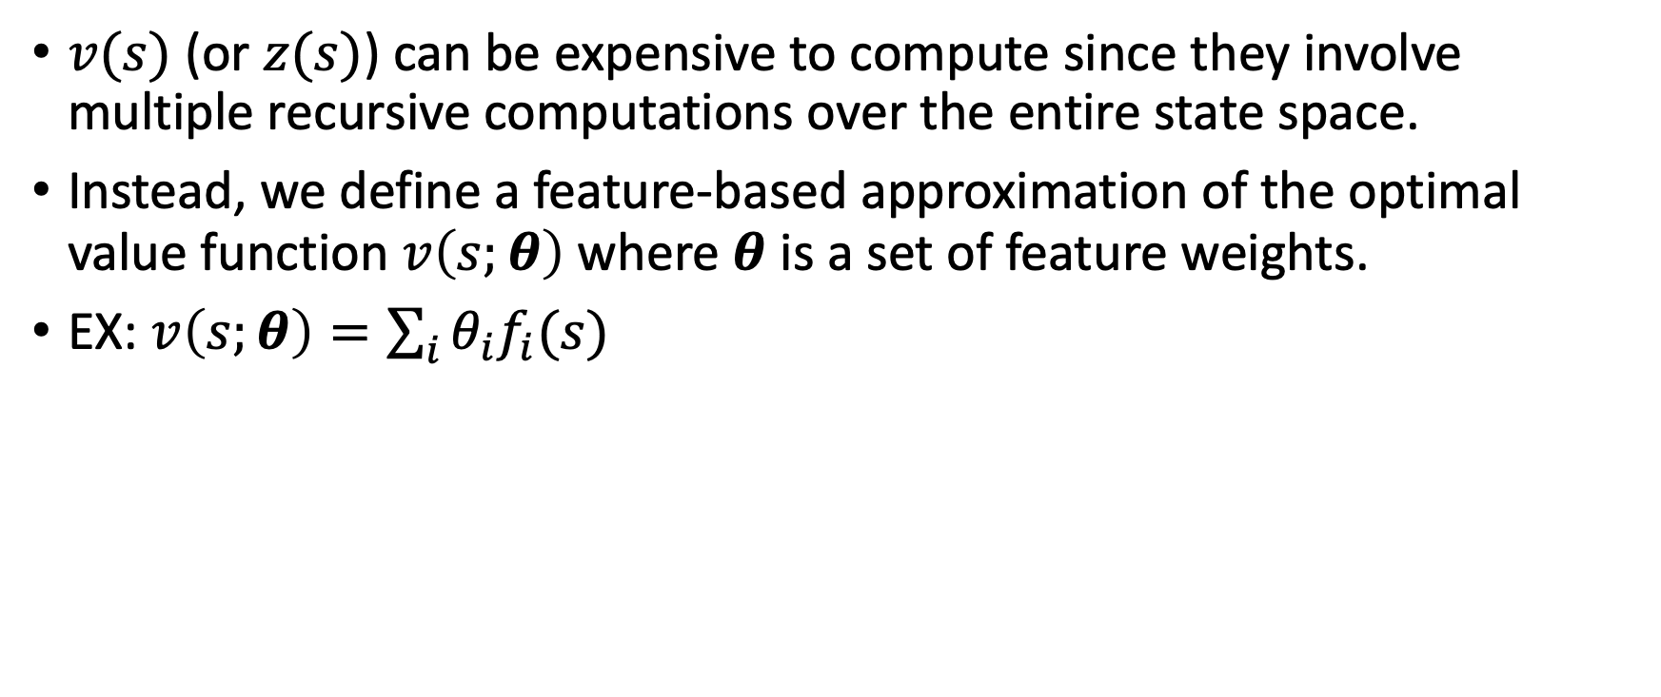
Feature-based optimal value function
$v(s)$ (or $z(s)$) can be expensive to compute since they involve multiple recursive computations over the entire state space.
Instead, we define a feature-based approximation of the optimal value function $v\left(s;θ\right)$ where $θ$ is a set of feature weights.
EX: $v\left(s;θ\right)=\sum_{i}{{θ_{i}f}_{i}(s)}$

Slide 31
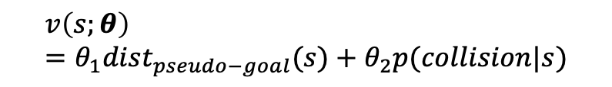
LMDP sequence model
4
3
2
1
0
-4
-3
-2
-1
-1
-2
-3
-4
0
1
2
3
4
$$v\left(s;θ\right)=θ_{1}{dist}_{pseudo−goal}(s)+θ_{2}p(collision|s)$$

Slide 32
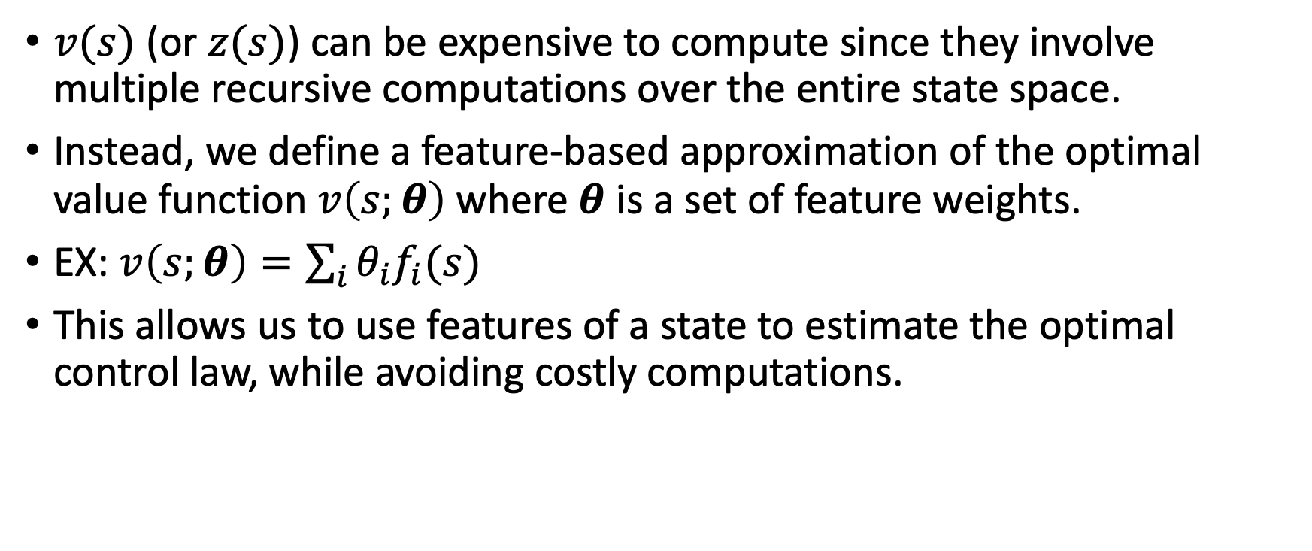
Feature-based optimal value function
$v(s)$ (or $z(s)$) can be expensive to compute since they involve multiple recursive computations over the entire state space.
Instead, we define a feature-based approximation of the optimal value function $v\left(s;θ\right)$ where $θ$ is a set of feature weights.
EX: $v\left(s;θ\right)=\sum_{i}{{θ_{i}f}_{i}(s)}$
This allows us to use features of a state to estimate the optimal control law, while avoiding costly computations.

Slide 33
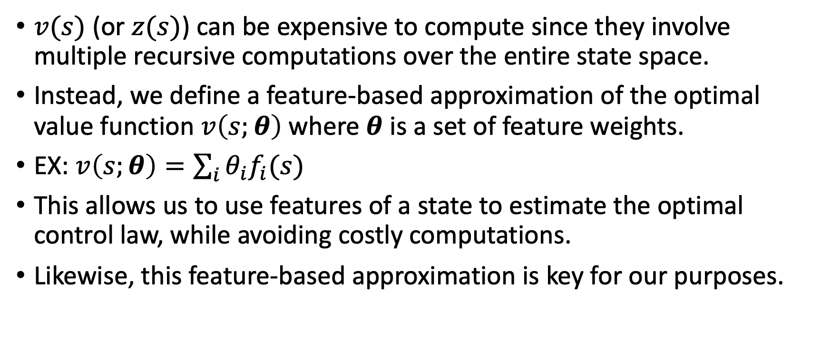
Feature-based optimal value function
$v(s)$ (or $z(s)$) can be expensive to compute since they involve multiple recursive computations over the entire state space.
Instead, we define a feature-based approximation of the optimal value function $v\left(s;θ\right)$ where $θ$ is a set of feature weights.
EX: $v\left(s;θ\right)=\sum_{i}{{θ_{i}f}_{i}(s)}$
This allows us to use features of a state to estimate the optimal control law, while avoiding costly computations.
Likewise, this feature-based approximation is key for our purposes.

Slide 34
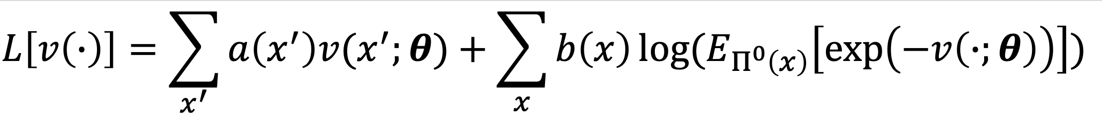
Negative Log-Likelihood (NLL) for a Linearly-Solvable MDP (LMDP) trajectory (or set of trajectories) in terms of the optimal value function

Slide 35
NLL for an LMDP trajectory (or set of trajectories) in terms of the optimal value function
${\{x_{n},x_{n}^{′}\}}_{n=1…N}$ is a set of observed state transitions (i.e., an observed trajectory or set of trajectories).

Slide 36
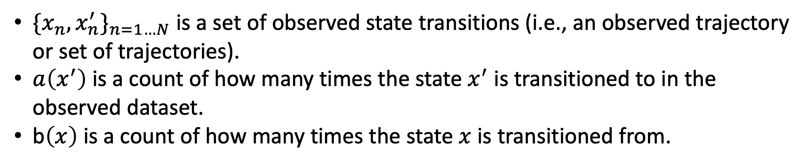
NLL for an LMDP trajectory (or set of trajectories) in terms of the optimal value function
${\{x_{n},x_{n}^{′}\}}_{n=1…N}$ is a set of observed state transitions (i.e., an observed trajectory or set of trajectories).
$a\left(x^{′}\right)$ is a count of how many times the state $x^{′}$ is transitioned to in the observed dataset.
b$\left(x\right)$ is a count of how many times the state $x$ is transitioned from.

Slide 37
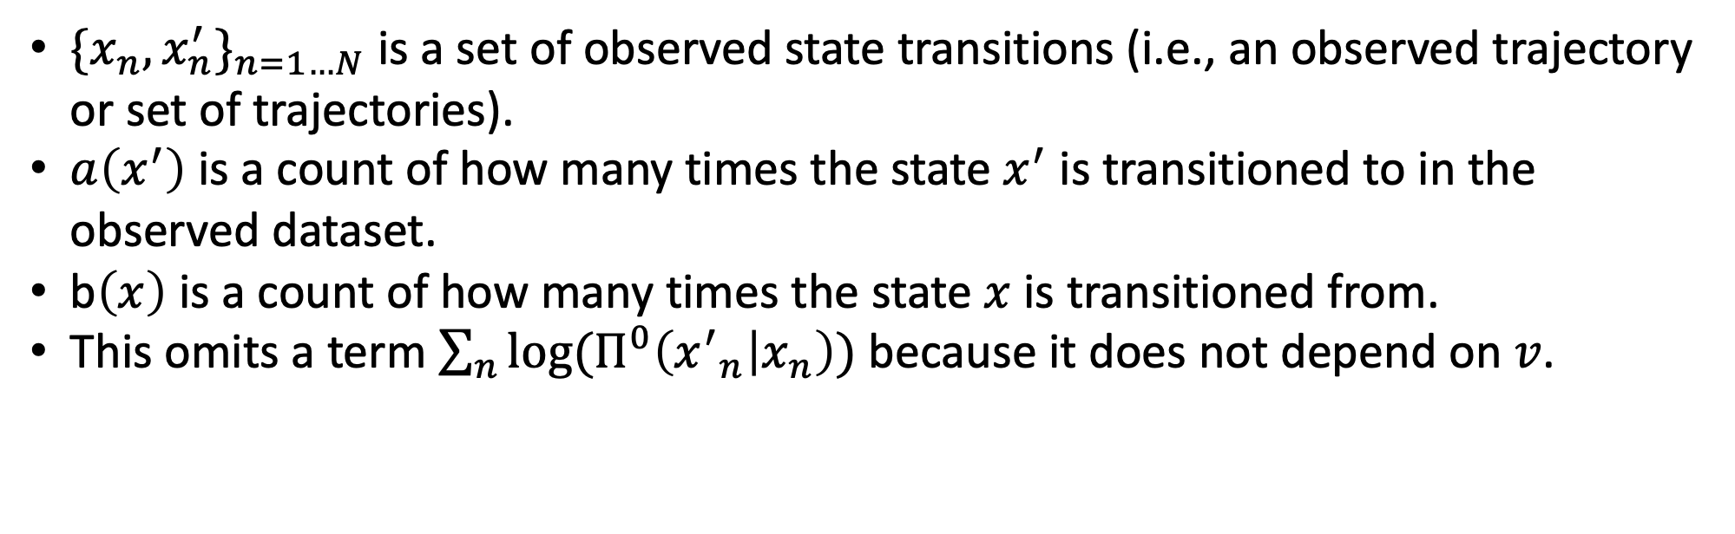
NLL for an LMDP trajectory (or set of trajectories) in terms of the optimal value function
${\{x_{n},x_{n}^{′}\}}_{n=1…N}$ is a set of observed state transitions (i.e., an observed trajectory or set of trajectories).
$a\left(x^{′}\right)$ is a count of how many times the state $x^{′}$ is transitioned to in the observed dataset.
b$\left(x\right)$ is a count of how many times the state $x$ is transitioned from.
This omits a term $\sum_{n}{log⁡(Π^{0}\left({x^{′}}_{n} | x_{n}\right))}$ because it does not depend on $v$.

Slide 38
NLL for an LMDP trajectory (or set of trajectories) in terms of the optimal value function
For a given player, we want to infer $θ$.

Slide 39
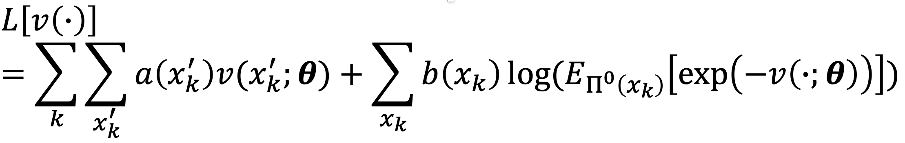
NLL for LMDP sequence model (when partitions are known)

Slide 40
NLL for LMDP sequence model (when partitions are known)
We modified the equation to reflect our inference algorithm's need to periodically update the controller’s planning space (i.e., their belief state about the wasps’ current locations and a projection of their possible future locations).

Slide 41
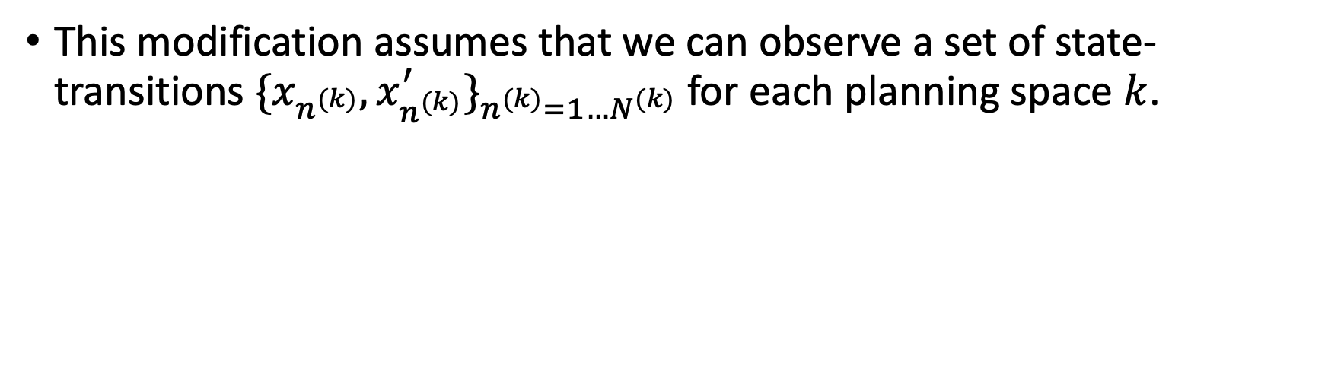
NLL for LMDP sequence model (when partitions are known)
This modification assumes that we can observe a set of state-transitions ${\{x_{n^{(k)}},x_{n^{(k)}}^{′}\}}_{n^{(k)}=1…N^{(k)}}$ for each planning space $k$.

Slide 42
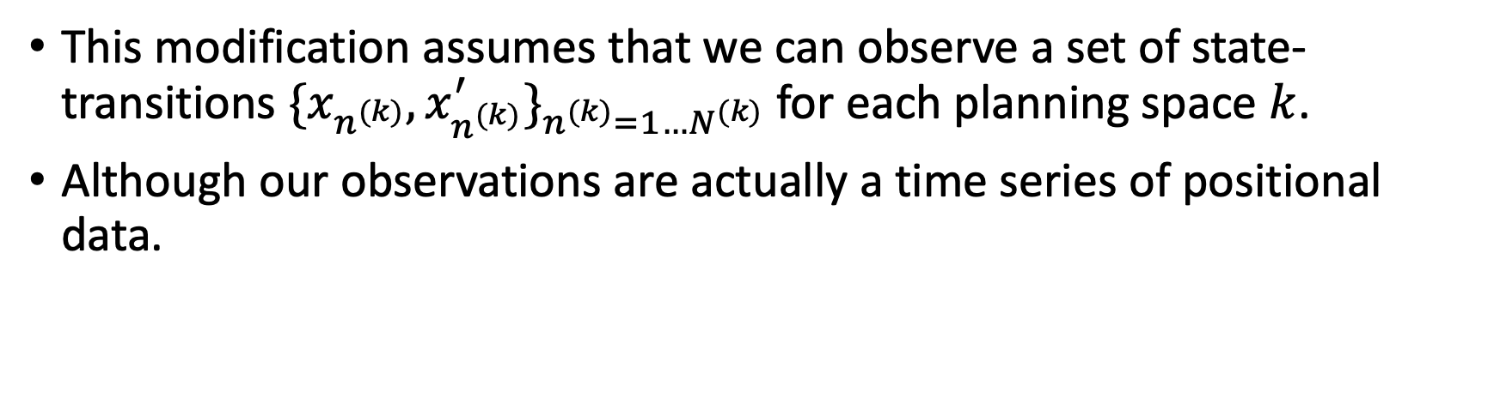
NLL for LMDP sequence model (when partitions are known)
This modification assumes that we can observe a set of state-transitions ${\{x_{n^{(k)}},x_{n^{(k)}}^{′}\}}_{n^{(k)}=1…N^{(k)}}$ for each planning space $k$.
Although our observations are actually a time series of positional data.

Slide 43
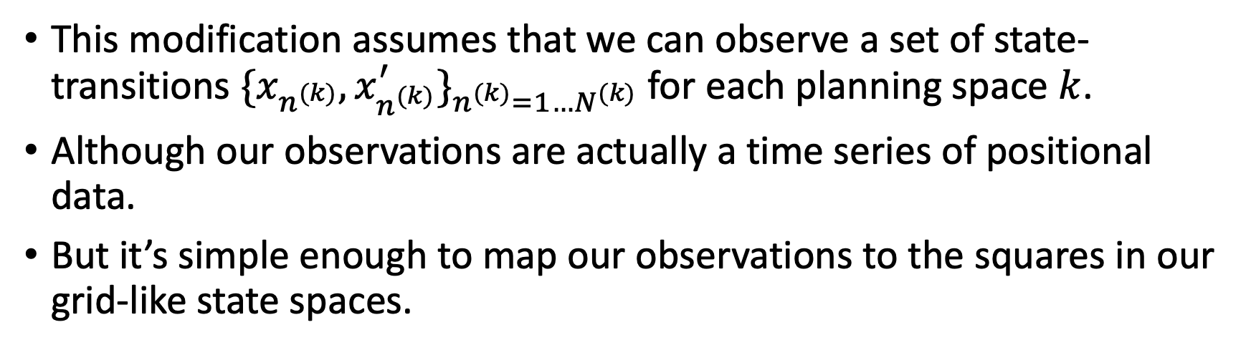
NLL for LMDP sequence model (when partitions are known)
This modification assumes that we can observe a set of state-transitions ${\{x_{n^{(k)}},x_{n^{(k)}}^{′}\}}_{n^{(k)}=1…N^{(k)}}$ for each planning space $k$.
Although our observations are actually a time series of positional data.
But it’s simple enough to map our observations to the squares in our grid-like state spaces.

Slide 44
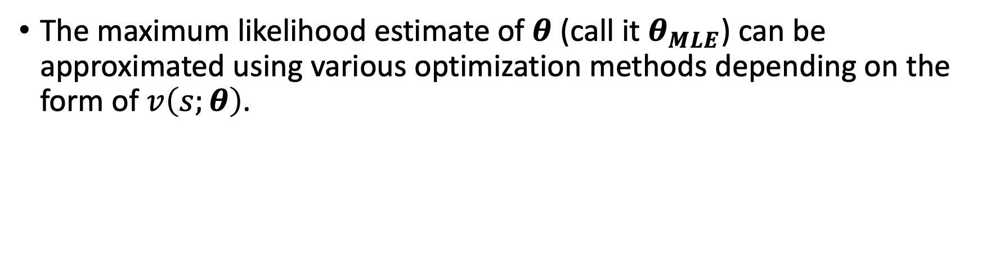
NLL for LMDP sequence model (when partitions are known)
The maximum likelihood estimate of $θ$ (call it $θ_{MLE}$) can be approximated using various optimization methods depending on the form of $v\left(s;θ\right)$.

Slide 45
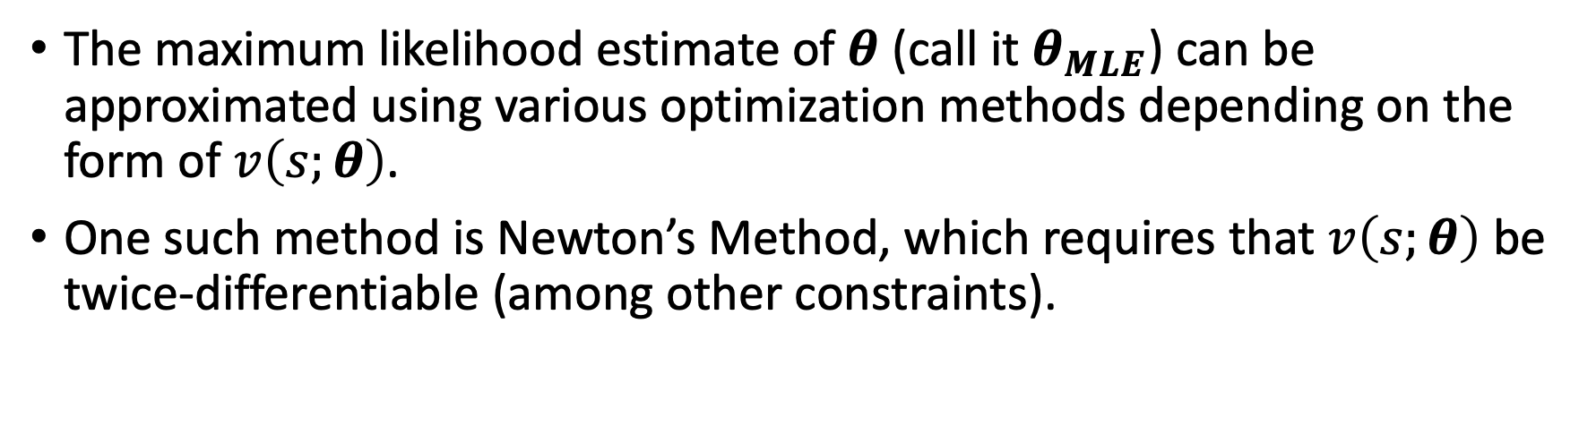
NLL for LMDP sequence model (when partitions are known)
The maximum likelihood estimate of $θ$ (call it $θ_{MLE}$) can be approximated using various optimization methods depending on the form of $v\left(s;θ\right)$.
One such method is Newton’s Method, which requires that $v\left(s;θ\right)$ be twice-differentiable (among other constraints).

Slide 46
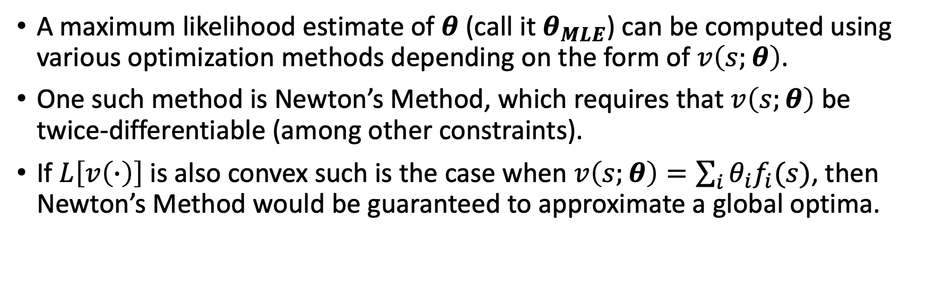
NLL for LMDP sequence model (when partitions are known)
A maximum likelihood estimate of $θ$ (call it $θ_{MLE}$) can be computed using various optimization methods depending on the form of $v\left(s;θ\right)$.
One such method is Newton’s Method, which requires that $v\left(s;θ\right)$ be twice-differentiable (among other constraints).
If $L\left[v\left(∙\right)\right]$ is also convex such is the case when $v\left(s;θ\right)=\sum_{i}{{θ_{i}f}_{i}(s)}$, then Newton’s Method would be guaranteed to approximate a global optima.

Slide 47
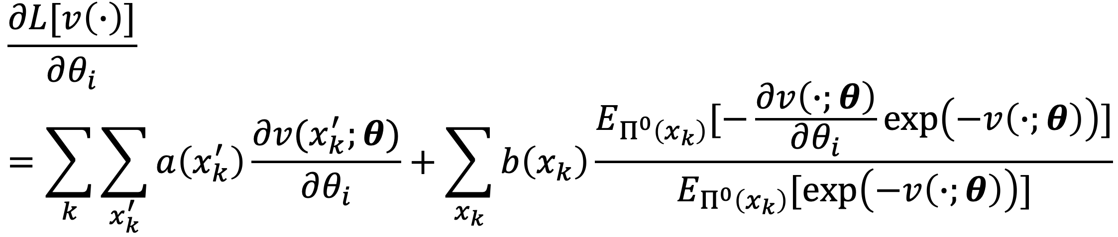
Gradient for NLL

Slide 48
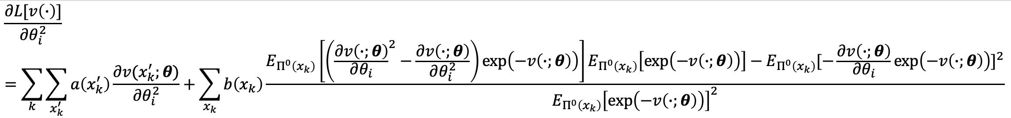
Hessian for NLL (diagonal)

Slide 49
Hessian for NLL (off-diagonal)

Slide 50
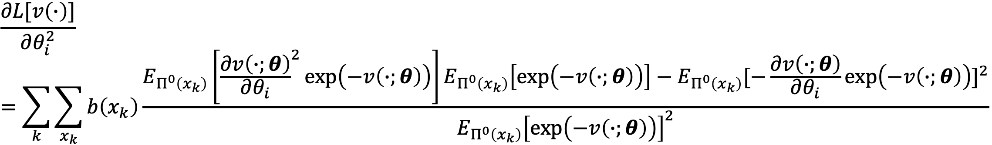
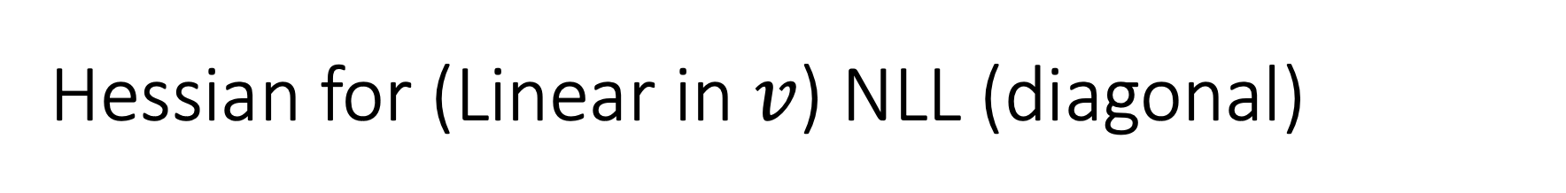
Hessian for (Linear in $v$) NLL (diagonal)

Slide 51
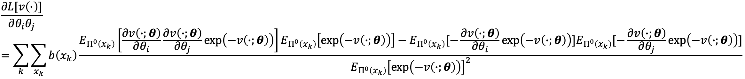
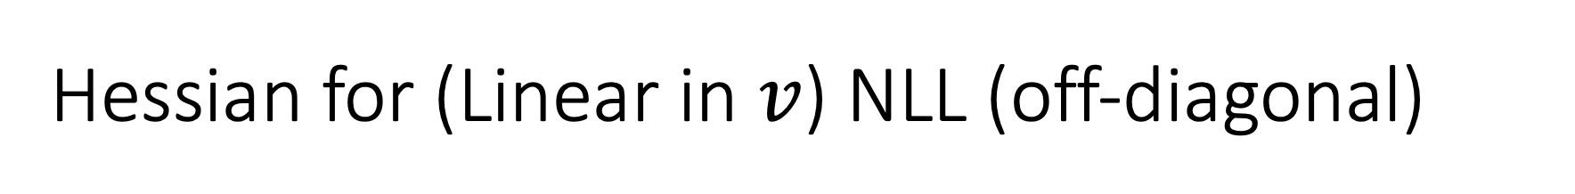
Hessian for (Linear in $v$) NLL (off-diagonal)

Slide 52
NLL for LMDP sequence model (when partitions are unknown)
In reality, we cannot directly observe when the controller updates their planning space.

Slide 53
NLL for LMDP sequence model (when partitions are unknown)
In reality, we cannot directly observe when the controller updates their planning space.
However, we can assume that they generate a new planning space at the start of an attempt and after reaching a goal, thus justifying separating attempts into runs.

Slide 54
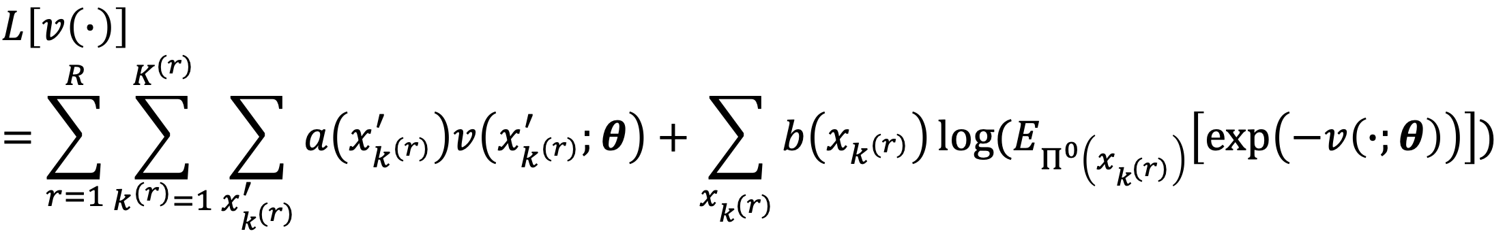
NLL for LMDP sequence model (when partitions are unknown)

Slide 55
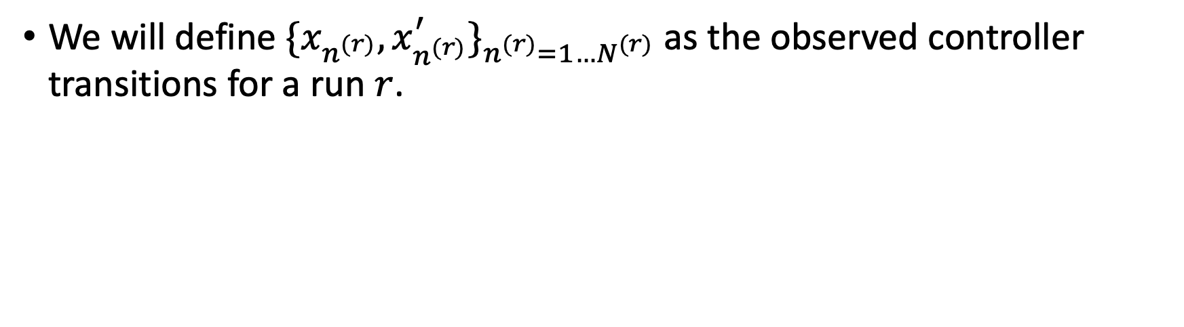
NLL for LMDP sequence model (when partitions are unknown)
We will define ${\{x_{n^{(r)}},x_{n^{(r)}}^{′}\}}_{n^{(r)}=1…N^{(r)}}$ as the observed controller transitions for a run $r$.

Slide 56
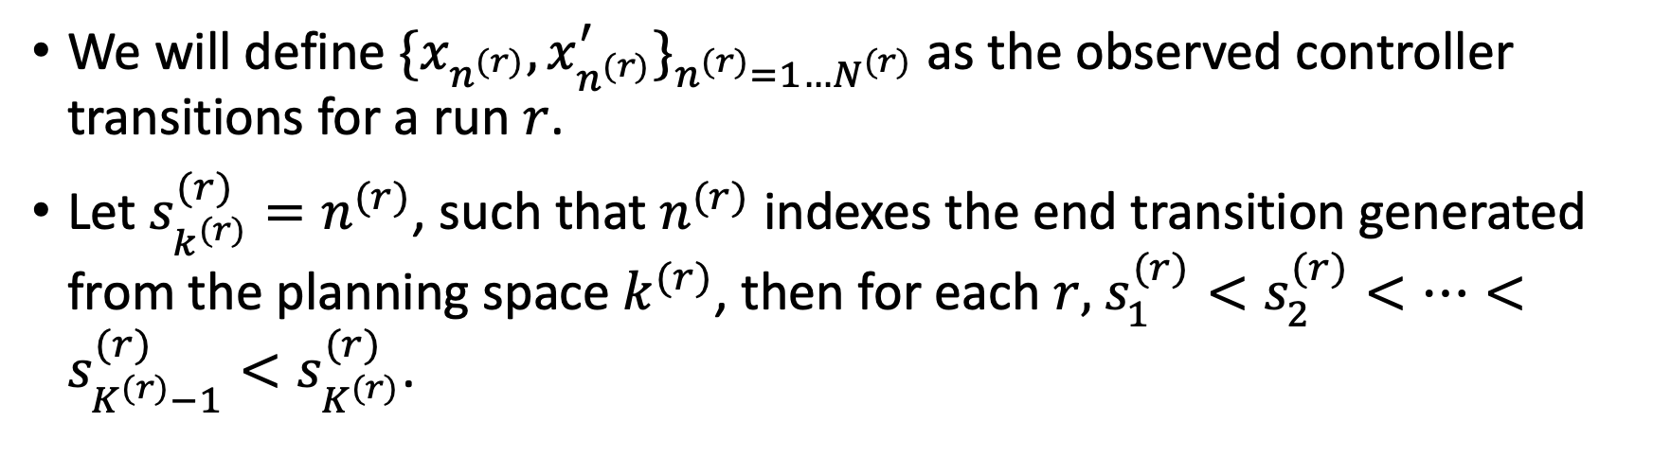
NLL for LMDP sequence model (when partitions are unknown)
We will define ${\{x_{n^{(r)}},x_{n^{(r)}}^{′}\}}_{n^{(r)}=1…N^{(r)}}$ as the observed controller transitions for a run $r$.
Let $s_{k^{(r)}}^{(r)}=n^{(r)}$, such that $n^{(r)}$ indexes the end transition generated from the planning space $k^{(r)}$, then for each $r,$ $s_{1}^{(r)}<s_{2}^{(r)}<…<s_{K^{(r)}−1}^{(r)}<s_{K^{(r)}}^{(r)}$.

Slide 57
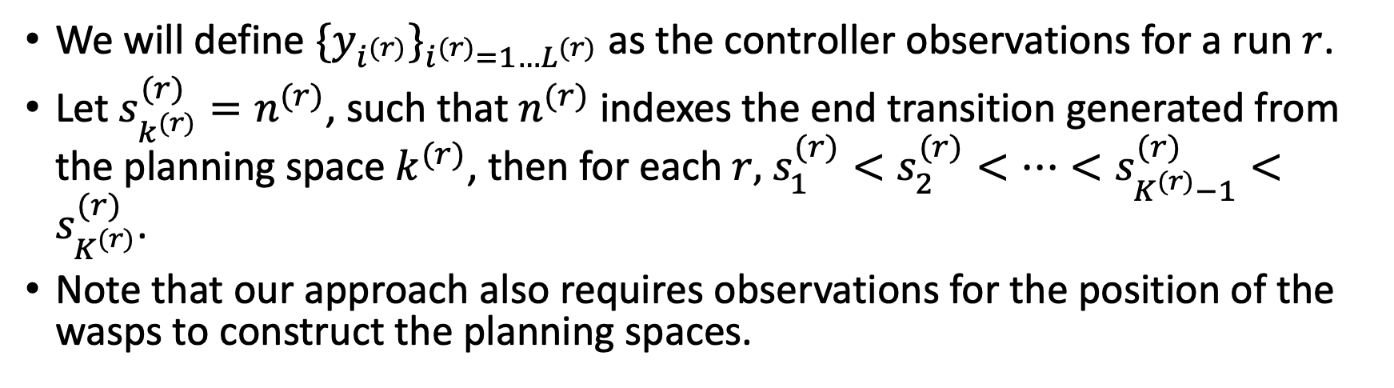
NLL for LMDP sequence model (when partitions are unknown)
We will define ${\{y_{i^{(r)}}\}}_{i^{(r)}=1…L^{(r)}}$ as the controller observations for a run $r$.
Let $s_{k^{(r)}}^{(r)}=n^{(r)}$, such that $n^{(r)}$ indexes the end transition generated from the planning space $k^{(r)}$, then for each $r,$ $s_{1}^{(r)}<s_{2}^{(r)}<…<s_{K^{(r)}−1}^{(r)}<s_{K^{(r)}}^{(r)}$.
Note that our approach also requires observations for the position of the wasps to construct the planning spaces.

Slide 58
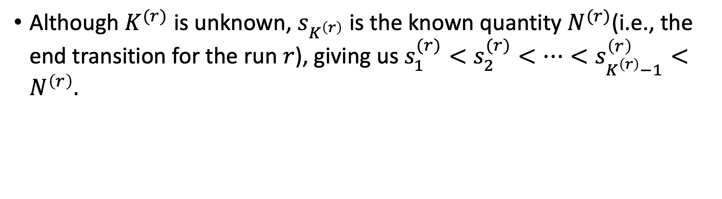
NLL for LMDP sequence model (when partitions are unknown)
Although $K^{(r)}$ is unknown, $s_{K^{\left(r\right)}}$ is the known quantity $N^{(r)}$(i.e., the end transition for the run $r$), giving us $s_{1}^{(r)}<s_{2}^{(r)}<…<s_{K^{\left(r\right)}−1}^{\left(r\right)}<N^{\left(r\right)}.$

Slide 59
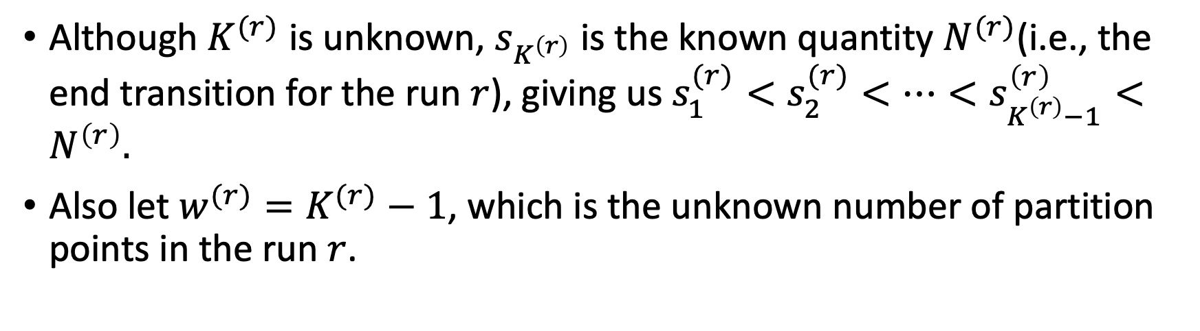
NLL for LMDP sequence model (when partitions are unknown)
Although $K^{(r)}$ is unknown, $s_{K^{\left(r\right)}}$ is the known quantity $N^{(r)}$(i.e., the end transition for the run $r$), giving us $s_{1}^{(r)}<s_{2}^{(r)}<…<s_{K^{\left(r\right)}−1}^{\left(r\right)}<N^{\left(r\right)}.$
Also let $w^{(r)}=K^{(r)}−1$, which is the unknown number of partition points in the run $r$.

Slide 60
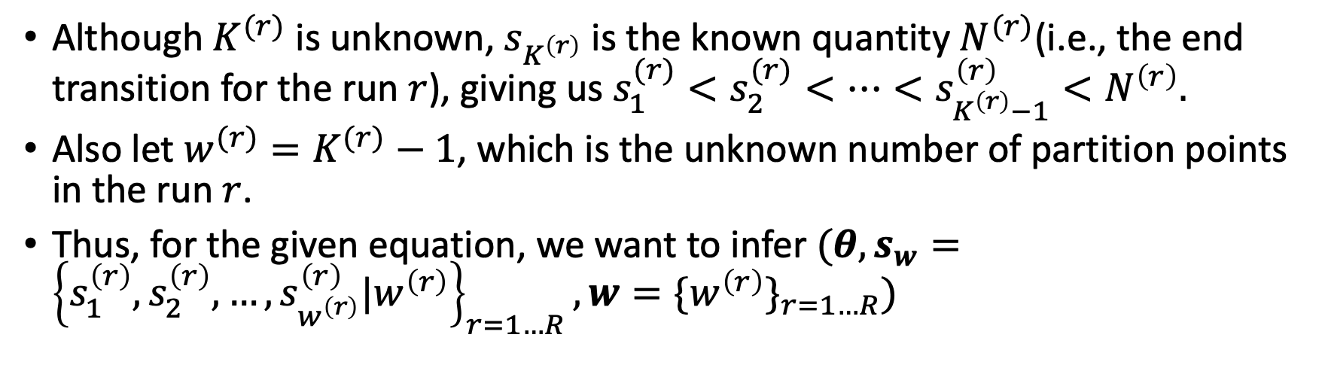
NLL for LMDP sequence model (when partitions are unknown)
Although $K^{(r)}$ is unknown, $s_{K^{\left(r\right)}}$ is the known quantity $N^{(r)}$(i.e., the end transition for the run $r$), giving us $s_{1}^{(r)}<s_{2}^{(r)}<…<s_{K^{\left(r\right)}−1}^{\left(r\right)}<N^{\left(r\right)}.$
Also let $w^{(r)}=K^{(r)}−1$, which is the unknown number of partition points in the run $r$.
Thus, for the given equation, we want to infer $(θ,s_{w}={\left\{s_{1}^{\left(r\right)},s_{2}^{\left(r\right)},…,s_{w^{\left(r\right)}}^{\left(r\right)}|w^{\left(r\right)}\right\}}_{r=1…R},w={\{w^{\left(r\right)}\}}_{r=1…R})$

Slide 61
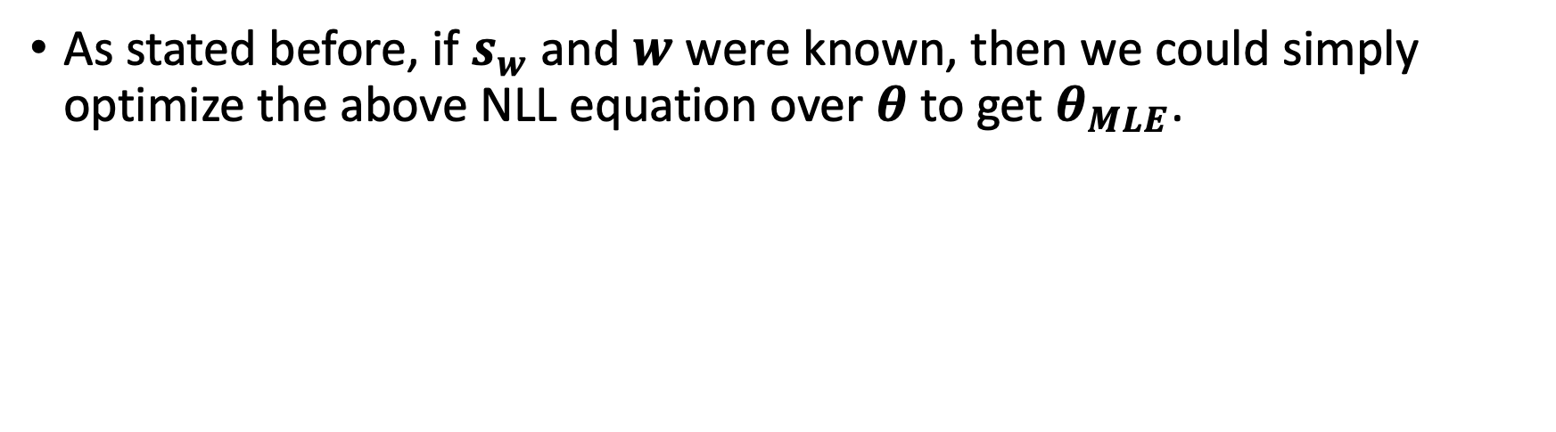
NLL for LMDP sequence model (when partitions are unknown)
As stated before, if $s_{w}$ and $w$ were known, then we could simply optimize the above NLL equation over $θ$ to get $θ_{MLE}$.

Slide 62
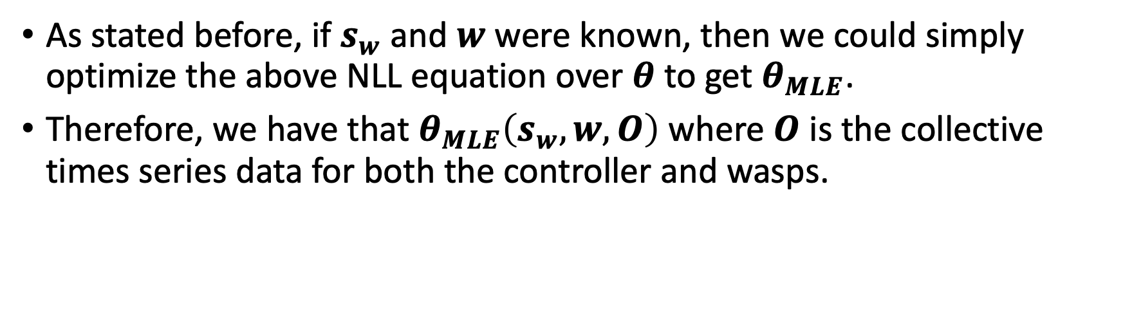
NLL for LMDP sequence model (when partitions are unknown)
As stated before, if $s_{w}$ and $w$ were known, then we could simply optimize the above NLL equation over $θ$ to get $θ_{MLE}$.
Therefore, we have that $θ_{MLE}\left(s_{w},w,O\right)$ where $O$ is the collective times series data for both the controller and wasps.

Slide 63
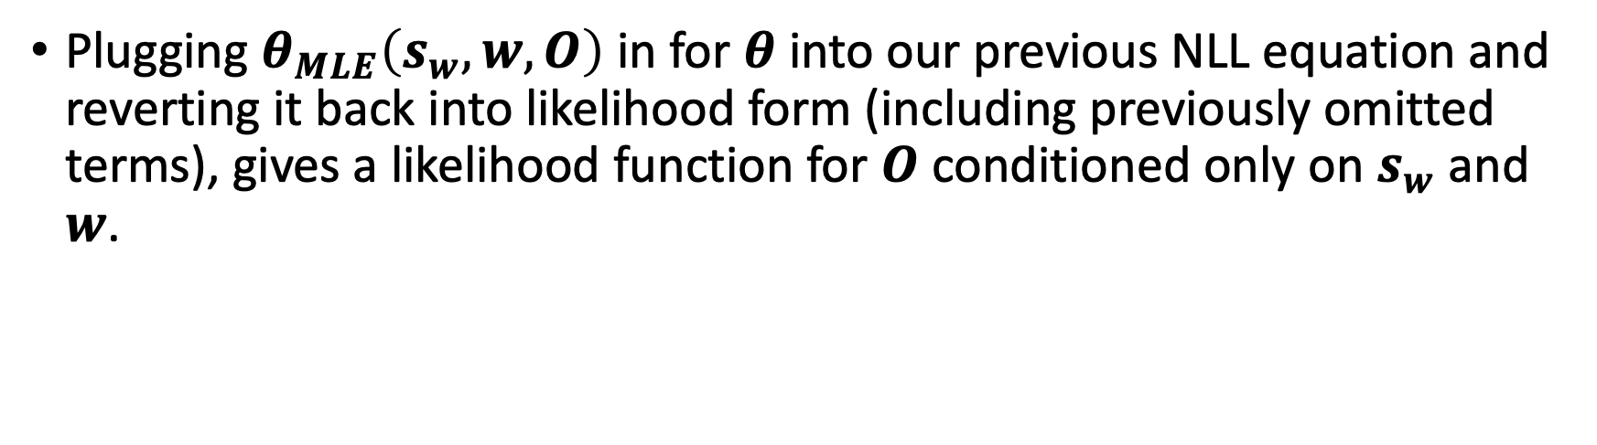
Likelihood function of unknown partitions for LMDP Sequence Model
Plugging $θ_{MLE}\left(s_{w},w,O\right)$ in for $θ$ into our previous NLL equation and reverting it back into likelihood form (including previously omitted terms), gives a likelihood function for $O$ conditioned only on $s_{w}$ and $w$.

Slide 64
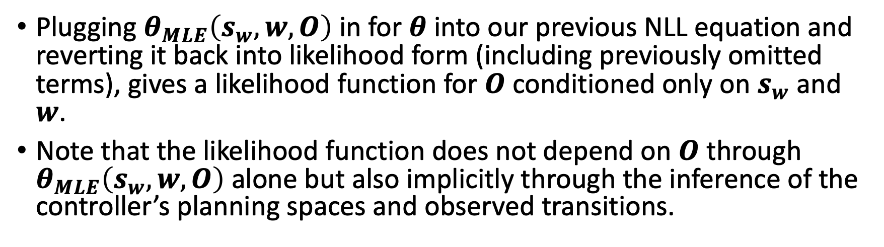
Likelihood function of unknown partitions for LMDP Sequence Model
Plugging $θ_{MLE}\left(s_{w},w,O\right)$ in for $θ$ into our previous NLL equation and reverting it back into likelihood form (including previously omitted terms), gives a likelihood function for $O$ conditioned only on $s_{w}$ and $w$.
Note that the likelihood function does not depend on $O$ through $θ_{MLE}\left(s_{w},w,O\right)$ alone but also implicitly through the inference of the controller’s planning spaces and observed transitions.

Slide 65
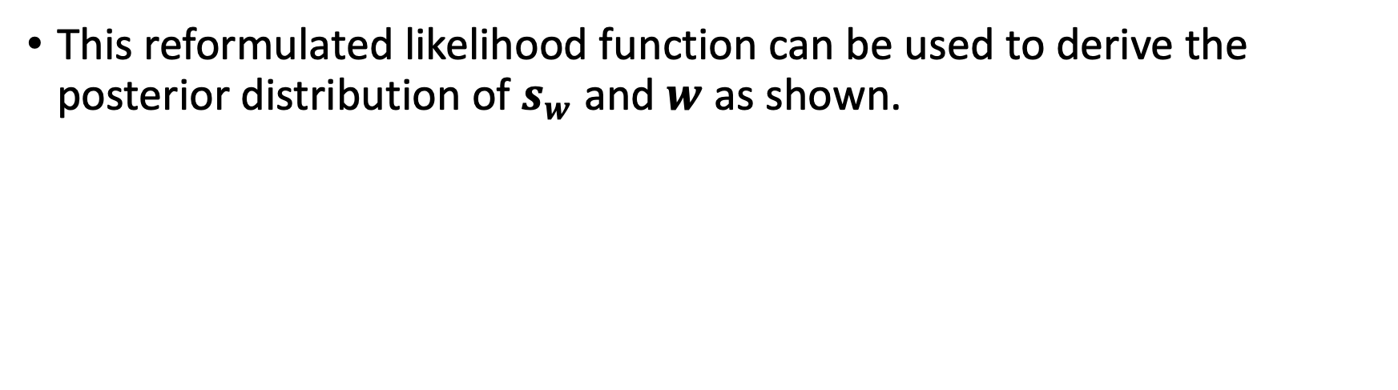

Posterior Distribution of $s_{w}$ and $w$
This reformulated likelihood function can be used to derive the posterior distribution of $s_{w}$ and $w$ as shown.

Slide 66
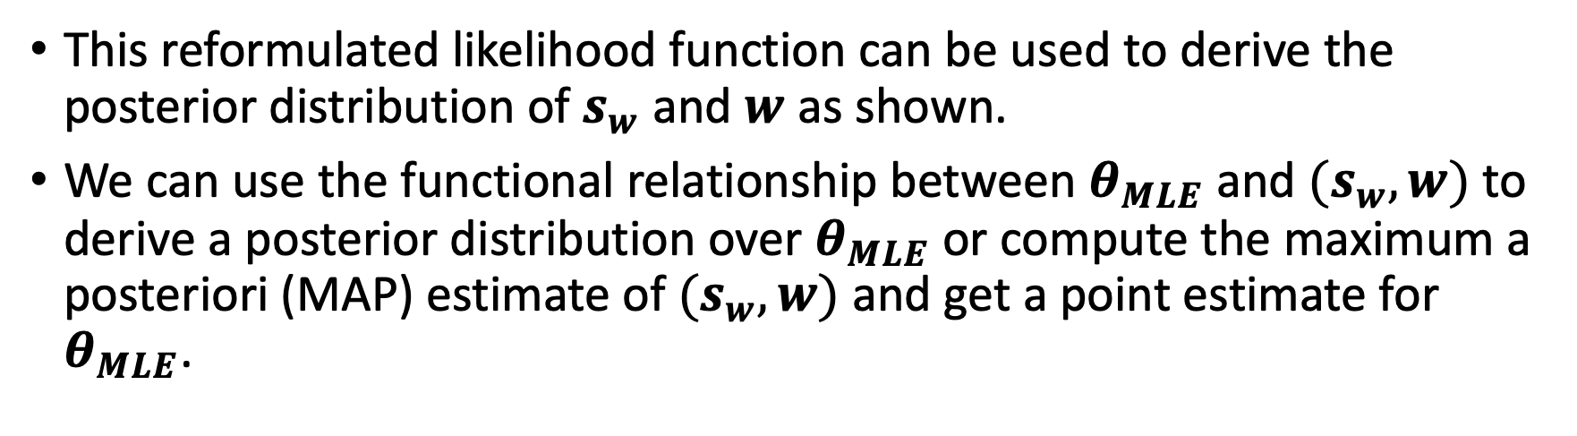
Posterior Distribution of $s_{w}$ and $w$
This reformulated likelihood function can be used to derive the posterior distribution of $s_{w}$ and $w$ as shown.
We can use the functional relationship between $θ_{MLE}$ and ${(s}_{w},w)$ to derive a posterior distribution over $θ_{MLE}$ or compute the maximum a posteriori (MAP) estimate of ${(s}_{w},w)$ and get a point estimate for $θ_{MLE}$.

Slide 67
Posterior Distribution of $s_{w}$ and $w$
This reformulated likelihood function can be used to derive the posterior distribution of $s_{w}$ and $w$ as shown.
We can use the functional relationship between $θ_{MLE}$ and ${(s}_{w},w)$ to derive a posterior distribution over $θ_{MLE}$ or compute the maximum a posteriori (MAP) estimate of ${(s}_{w},w)$ and get a point estimate for $θ_{MLE}$.

Slide 68
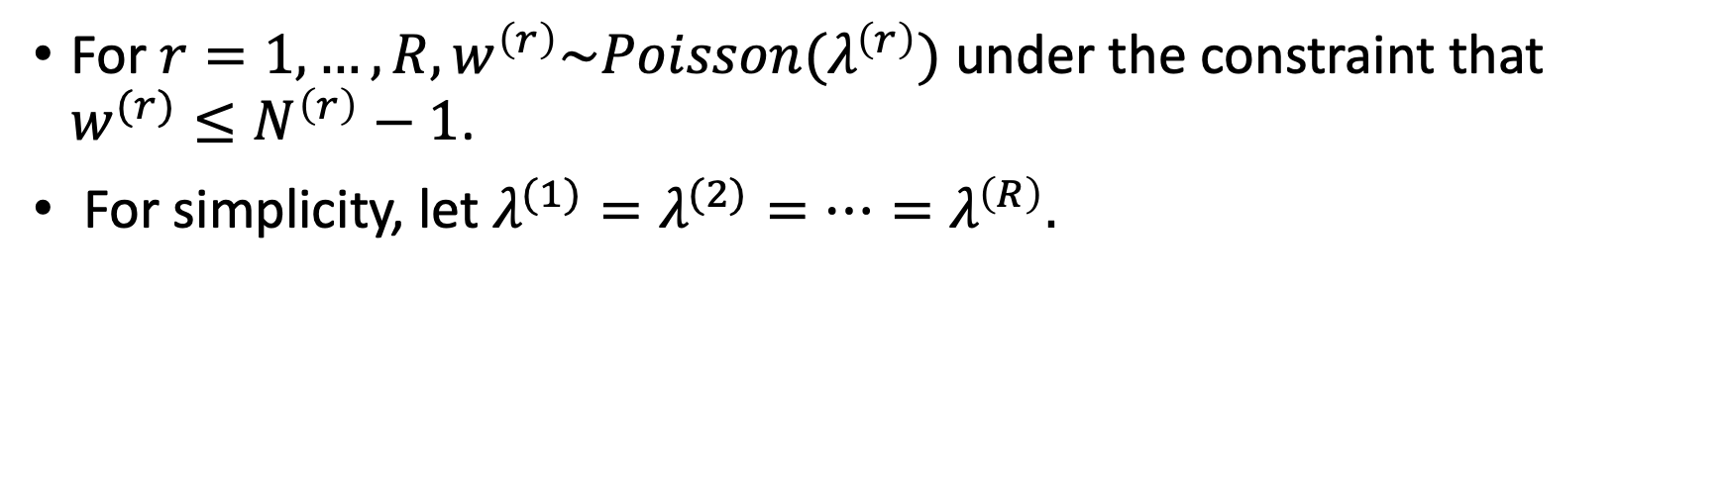

Prior of $w$
For $r=1,…,R, w^{\left(r\right)}\sim Poisson(λ^{\left(r\right)})$ under the constraint that $w^{(r)}≤N^{\left(r\right)}−1$.
For simplicity, let $λ^{(1)}=λ^{(2)}=…=λ^{\left(R\right)}.$

Slide 69
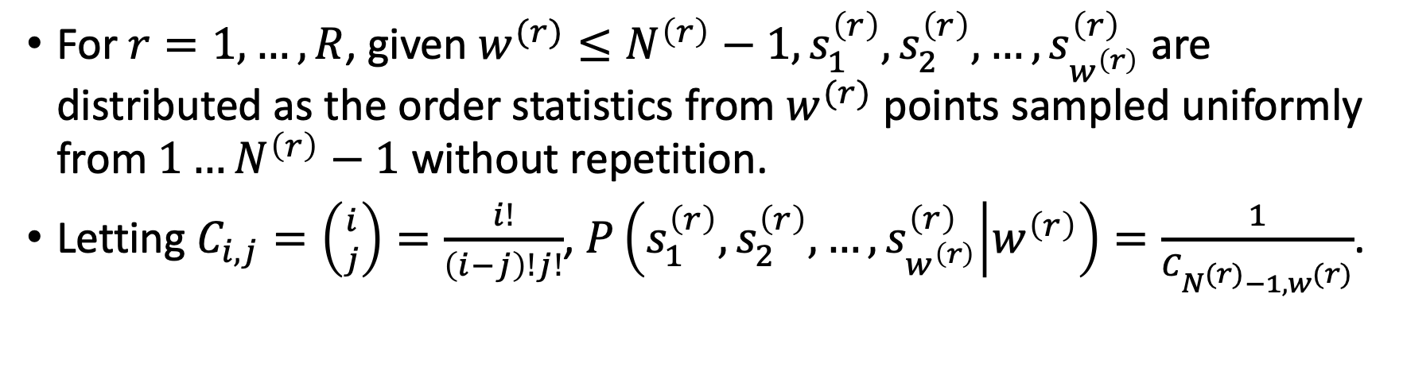

Prior of $s_{w}|w$
For $r=1,…,R$, given $w^{(r)}≤N^{\left(r\right)}−1,s_{1}^{\left(r\right)},s_{2}^{\left(r\right)},…,s_{w^{\left(r\right)}}^{\left(r\right)}$ are distributed as the order statistics from $w^{(r)}$ points sampled uniformly from $1…N^{\left(r\right)}−1$ without repetition.
Letting $C_{i,j}=\left({i \atop j}\right)=\frac{i!}{\left(i−j\right)!j!}$, $P\left(s_{1}^{\left(r\right)},s_{2}^{\left(r\right)},…,s_{w^{\left(r\right)}}^{\left(r\right)} | w^{\left(r\right)}\right)=\frac{1}{C_{N^{(r)}−1,w^{(r)}}}$.

Slide 70
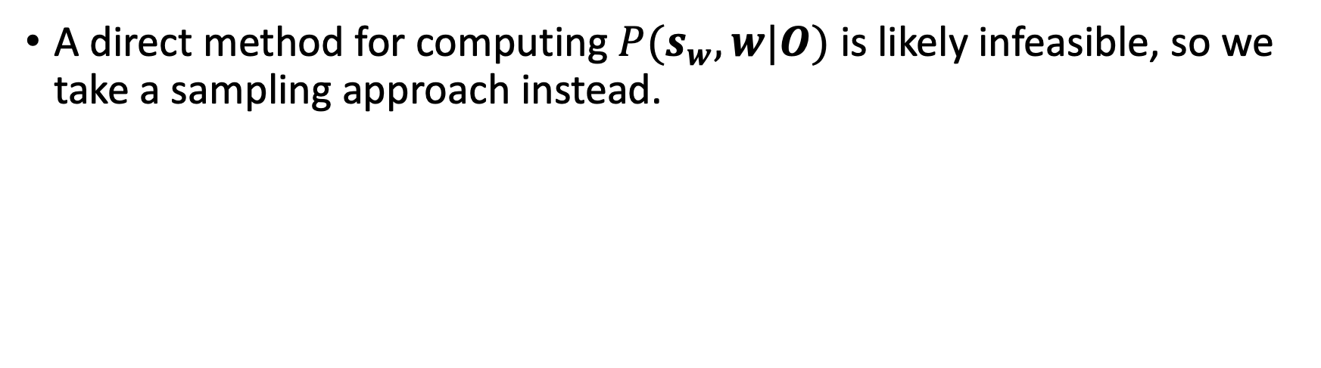
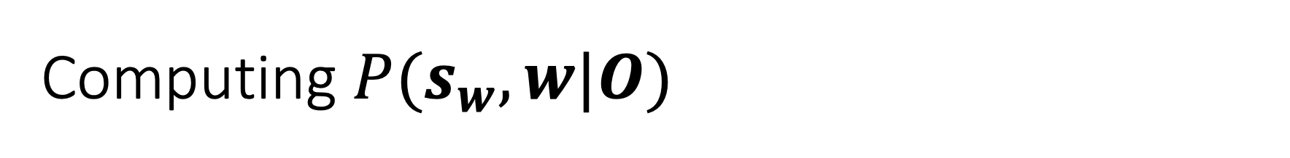
Computing $P(s_{w},w|O)$
A direct method for computing $P(s_{w},w|O)$ is likely infeasible, so we take a sampling approach instead.

Slide 71
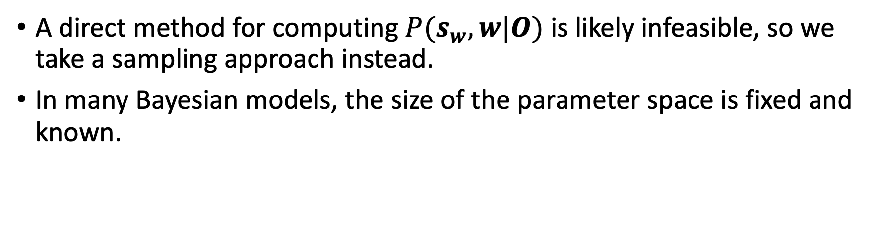
Computing $P(s_{w},w|O)$
A direct method for computing $P(s_{w},w|O)$ is likely infeasible, so we take a sampling approach instead.
In many Bayesian models, the size of the parameter space is fixed and known.

Slide 72
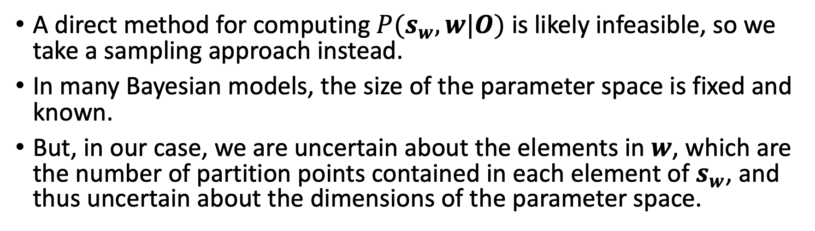
Computing $P(s_{w},w|O)$
A direct method for computing $P(s_{w},w|O)$ is likely infeasible, so we take a sampling approach instead.
In many Bayesian models, the size of the parameter space is fixed and known.
But, in our case, we are uncertain about the elements in $w$, which are the number of partition points contained in each element of $s_{w}$, and thus uncertain about the dimensions of the parameter space.

Slide 73
Reversible Jump Markov Chain Monte Carlo
No standard sampling approach (e.g., Metropolis-Hastings, importance sampling, etc.) can apply in such a case.

Slide 74
Reversible Jump Markov Chain Monte Carlo
No standard sampling approach (e.g., Metropolis-Hastings, importance sampling, etc.) can apply in such a case.
Instead, we employ a Markov Chain Monte Carlo (MCMC) algorithm called Reversible Jump Markov Chain Monte Carlo (RJMCMC).

Slide 75
Reversible Jump Markov Chain Monte Carlo
No standard sampling approach (e.g., Metropolis-Hastings, importance sampling, etc.) can apply in such a case.
Instead, we employ a Markov Chain Monte Carlo (MCMC) algorithm called Reversible Jump Markov Chain Monte Carlo (RJMCMC).
RJMCMC is devised explicitly for inference problems where the number of parameters is unknown.

Slide 76

RJMCMC Proposal Distribution
$r\sim unif\left\{1,R\right\}$, where $R$ is the number of runs.

Slide 77
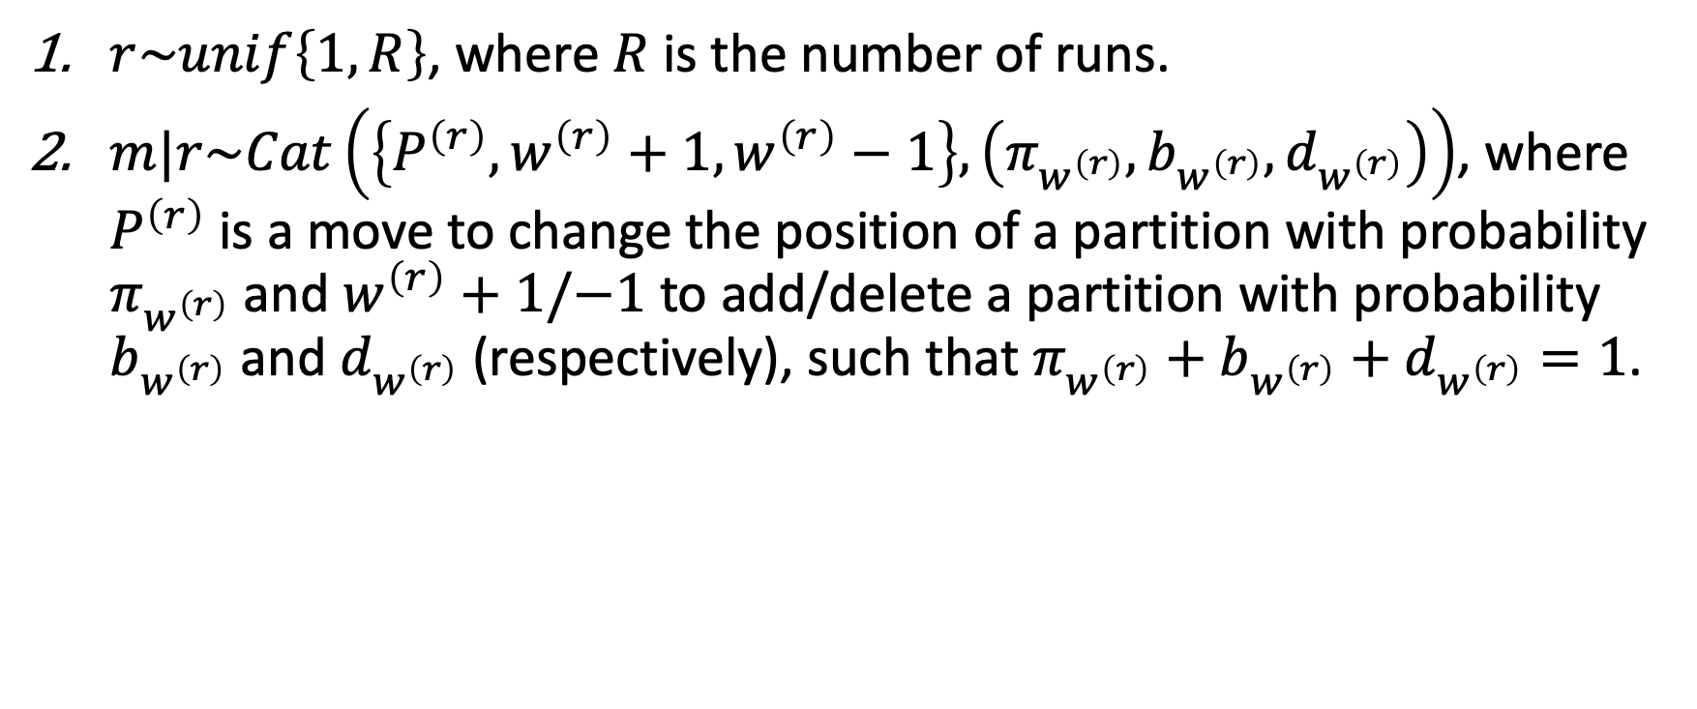
RJMCMC Proposal Distribution
$r\sim unif\left\{1,R\right\}$, where $R$ is the number of runs.
$m|r\sim Cat\left(\left\{P^{\left(r\right)},w^{\left(r\right)}+1,w^{\left(r\right)}−1\right\},\left(π_{w^{\left(r\right)}},b_{w^{\left(r\right)}},d_{w^{\left(r\right)}}\right)\right)$, where $P^{\left(r\right)}$ is a move to change the position of a partition with probability $π_{w^{\left(r\right)}}$ and $w^{\left(r\right)}+1/−1$ to add/delete a partition with probability $b_{w^{\left(r\right)}}$ and $d_{w^{\left(r\right)}}$ (respectively), such that $π_{w^{\left(r\right)}}+b_{w^{\left(r\right)}}+d_{w^{\left(r\right)}}=1$.

Slide 78
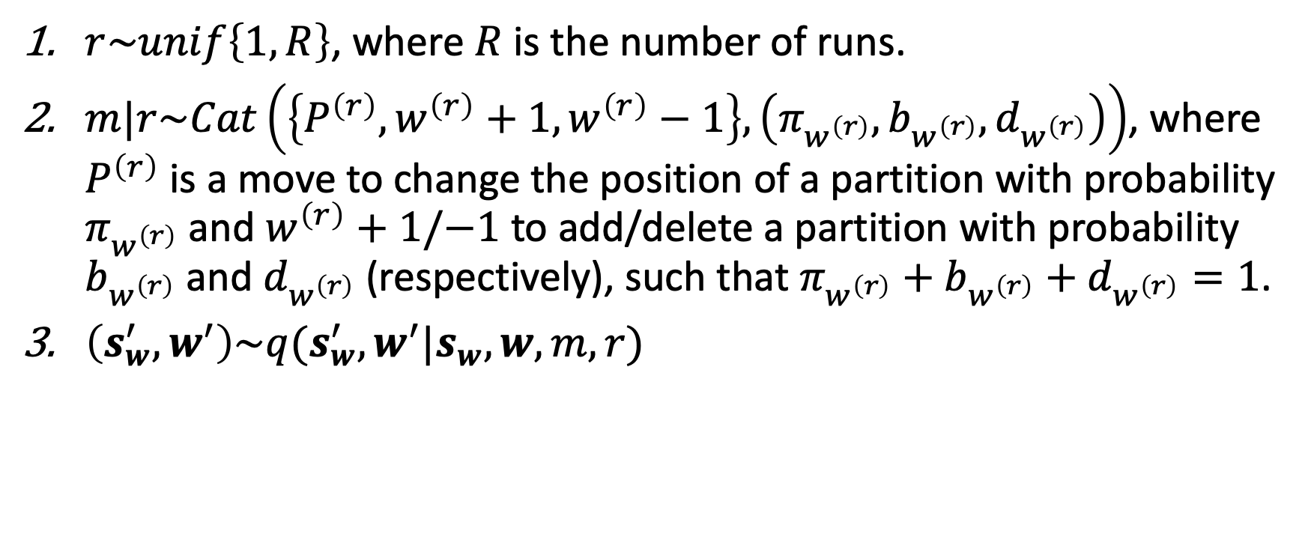
RJMCMC Proposal Distribution
$r\sim unif\left\{1,R\right\}$, where $R$ is the number of runs.
$m|r\sim Cat\left(\left\{P^{\left(r\right)},w^{\left(r\right)}+1,w^{\left(r\right)}−1\right\},\left(π_{w^{\left(r\right)}},b_{w^{\left(r\right)}},d_{w^{\left(r\right)}}\right)\right)$, where $P^{\left(r\right)}$ is a move to change the position of a partition with probability $π_{w^{\left(r\right)}}$ and $w^{\left(r\right)}+1/−1$ to add/delete a partition with probability $b_{w^{\left(r\right)}}$ and $d_{w^{\left(r\right)}}$ (respectively), such that $π_{w^{\left(r\right)}}+b_{w^{\left(r\right)}}+d_{w^{\left(r\right)}}=1$.
$\left(s_{w}^{′},w^{′}\right)\sim q(s_{w}^{′},w^{′}|s_{w},w,m,r)$

Slide 79
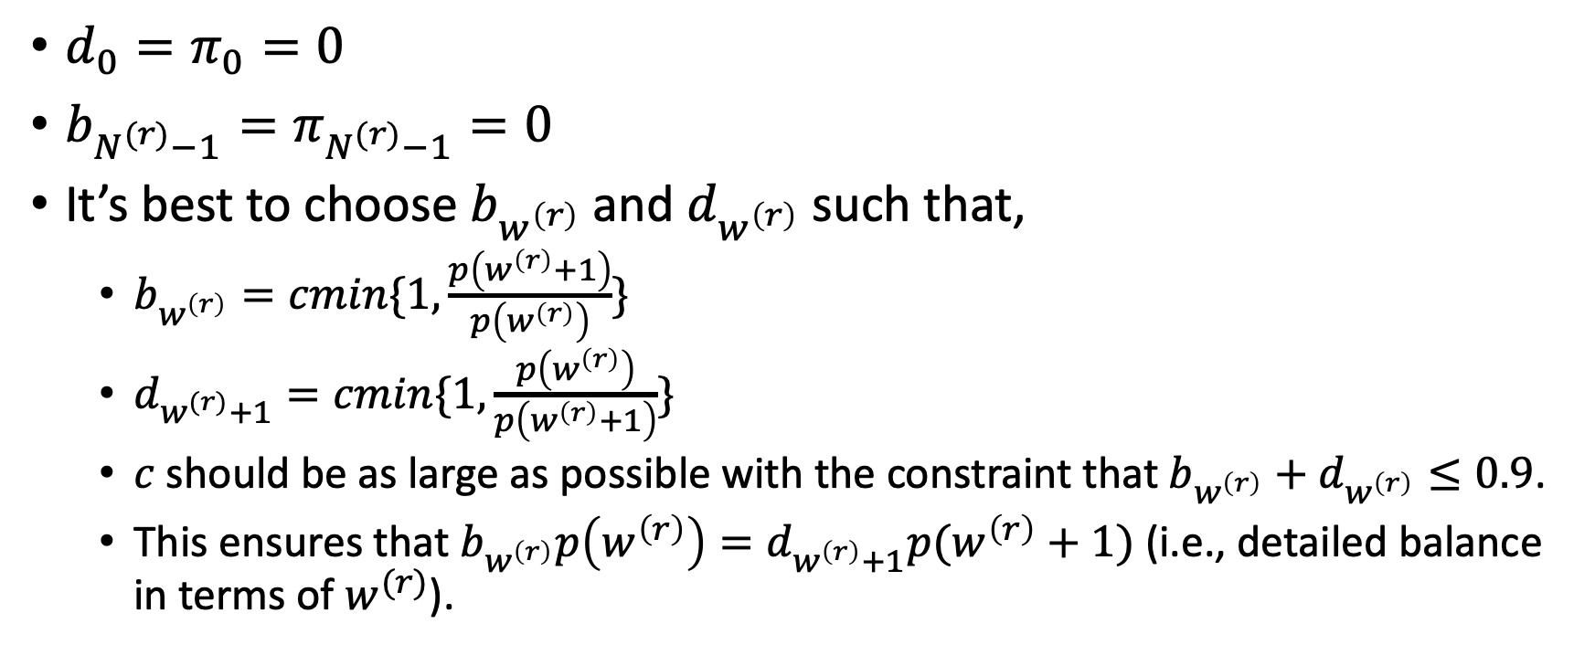
Other Assumptions and Constraints on the Proposal Distribution
$d_{0}=π_{0}=0$
$b_{N^{(r)}−1}=π_{N^{(r)}−1}=0$
It’s best to choose $b_{w^{\left(r\right)}}$ and $d_{w^{\left(r\right)}}$ such that,
$b_{w^{\left(r\right)}}=cmin\{1,\frac{p\left(w^{\left(r\right)}+1\right)}{p\left(w^{\left(r\right)}\right)}\}$
$d_{w^{(r)}+1}=cmin\{1,\frac{p\left(w^{\left(r\right)}\right)}{p\left(w^{\left(r\right)}+1\right)}\}$
$c$ should be as large as possible with the constraint that $b_{w^{\left(r\right)}}+d_{w^{\left(r\right)}}≤0.9$.
This ensures that $b_{w^{\left(r\right)}}p\left(w^{\left(r\right)}\right)=d_{w^{\left(r\right)}+1}p(w^{\left(r\right)}+1)$ (i.e., detailed balance in terms of $w^{(r)}$).

Slide 80

RJMCMC Position Change
$s_{j}^{(r)}\sim Cat(\left\{s_{1}^{\left(r\right)},s_{2}^{\left(r\right)},…,s_{w^{\left(r\right)}}^{\left(r\right)}\right\},\frac{1}{w^{\left(r\right)}})$

