Slide 1
Inverse Optimal Control of Linearly-Solvable Markov Decision Processes with Delayed Observations
By Loren Rieffer-Champlin

Slide 2
Busy Beeway
A research project funded by the Army Research Lab (ARL).

Slide 3
Busy Beeway
A research project funded by the Army Research Lab (ARL).
The main objectives are,
Modeling and inferring behavioral characteristics of humans carrying out simulated defense navigation tasks within a human-AI team
Transfer Learning between related simulated defense navigation tasks.

Slide 4
Busy Beeway
A research project funded by the Army Research Lab (ARL).
The main objectives are,
Modeling and inferring behavioral characteristics of humans carrying out simulated defense navigation tasks within a human-AI team
Transfer Learning between related simulated defense navigation tasks.

Slide 5
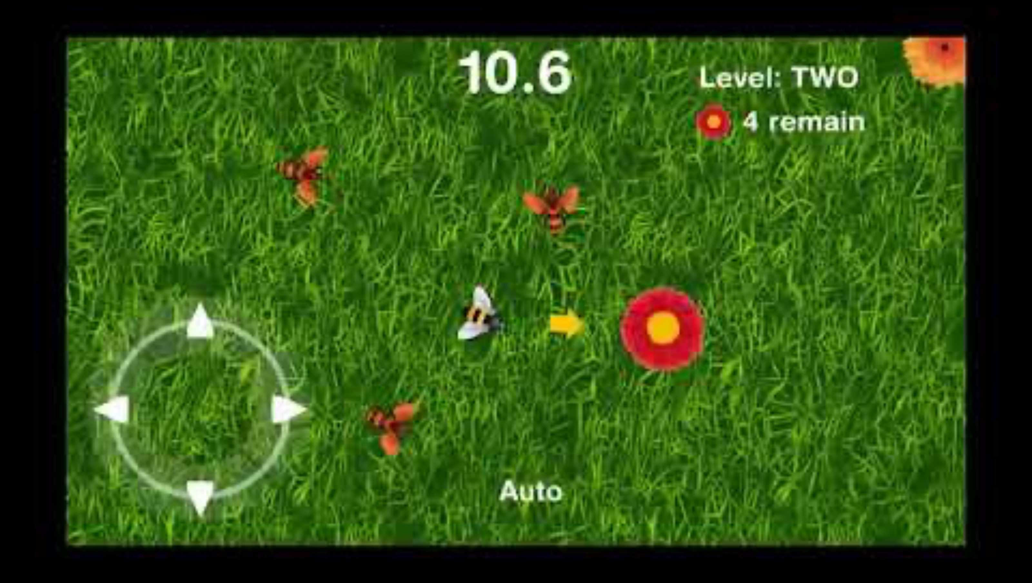
Busy Beeway

Slide 6
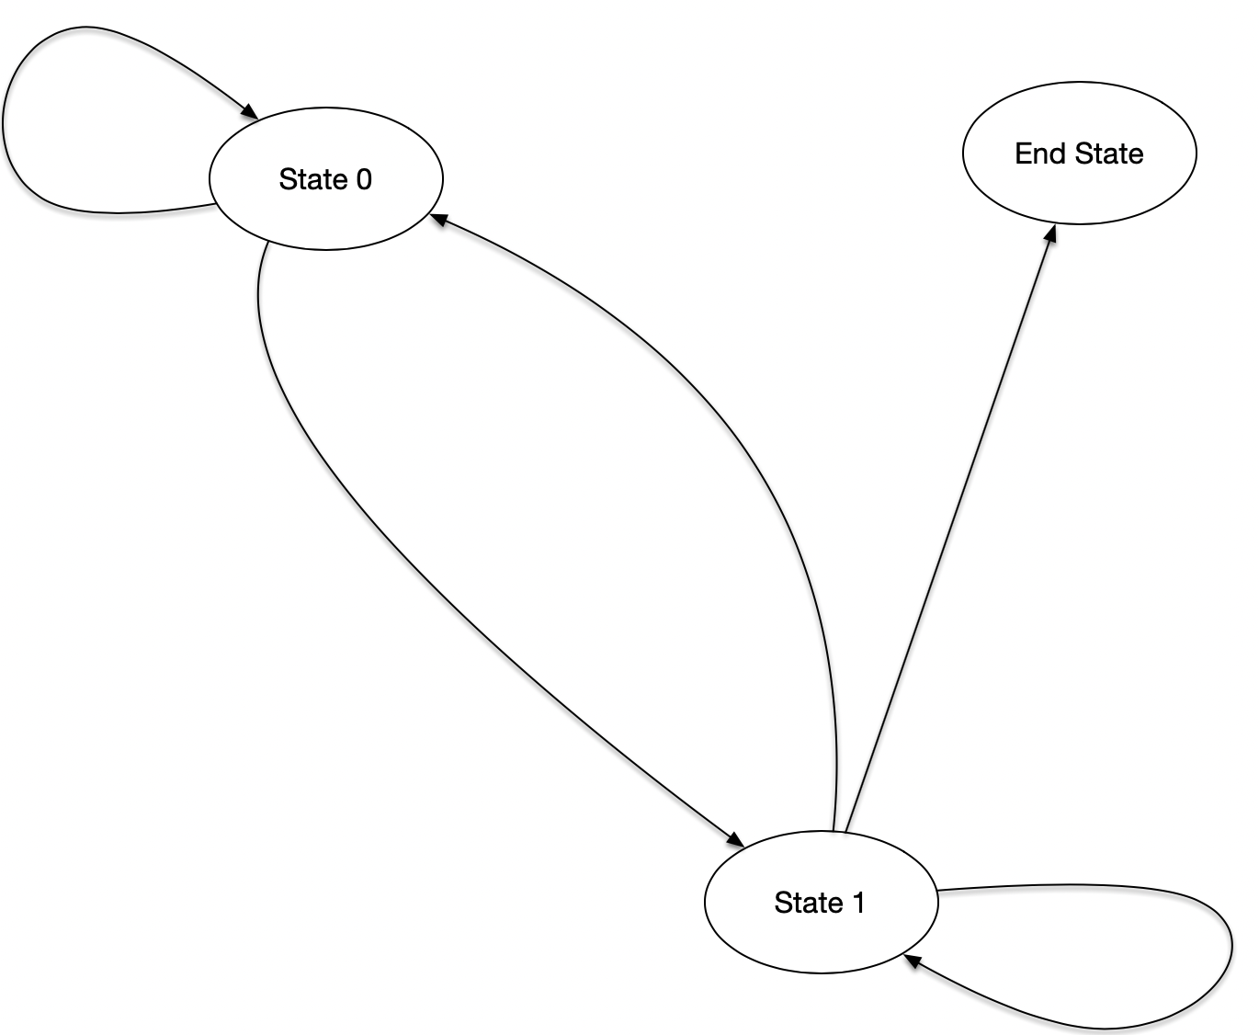
Linearly-Solvable Markov Decision Process (LMDP)

Slide 7
Linearly-Solvable Markov Decision Process (LMDP)
Yep…the model does not include actions, only state transitions.

Slide 8
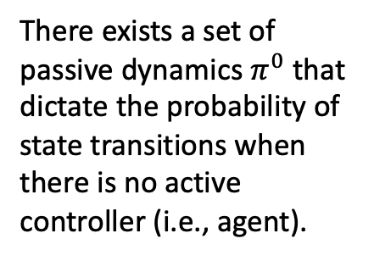
LMDP
There exists a set of passive dynamics $π^{0}$ that dictate the probability of state transitions when there is no active controller (i.e., agent).

Slide 9





LMDP
$$0.5$$
There exists a set of passive dynamics $π^{0}$ that dictate the probability of state transitions when there is no active controller (i.e., agent).
$$0.\overline{3}$$
$$0.5$$
$$0.\overline{3}$$
$$0.\overline{3}$$

Slide 10
LMDP
When there is an active controller, we assume they will attempt to impose their own dynamics onto the state space.

Slide 11





LMDP
$$0.1$$
The controller’s dynamics attempt to shift state transition probabilities such that the most likely trajectory (i.e., sequence of transitions) aligns with the controller's goal.
$$0.05$$
$$0.9$$
$$0.9$$
$$0.05$$

Slide 12
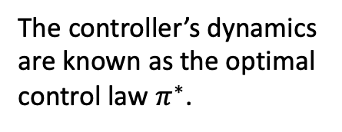
LMDP
The controller’s dynamics are known as the optimal control law $π^{∗}$.

Slide 13
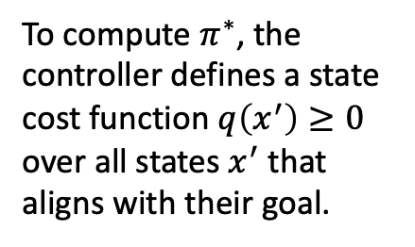



LMDP
$$q=1$$
$$q=0$$
To compute $π^{∗}$, the controller defines a state cost function $q\left(x^{′}\right)≥0$ over all states $x^{′}$ that aligns with their goal.
$$q=1$$

Slide 14
LMDP
$$q=1$$
$$q=0$$
Likewise, there is a control cost (not illustrated here), the price for pushing the system away from its passive dynamics.
$$q=1$$

Slide 15
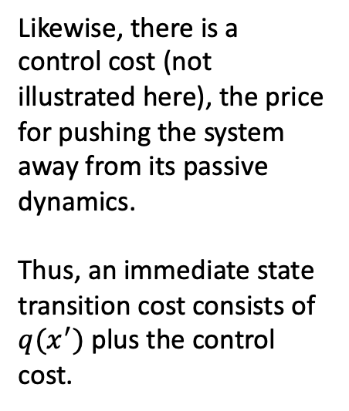
LMDP
$$q=1$$
$$q=0$$
Likewise, there is a control cost (not illustrated here), the price for pushing the system away from its passive dynamics.
Thus, an immediate state transition cost consists of $q(x^{′})$ plus the control cost.
$$q=1$$

Slide 16
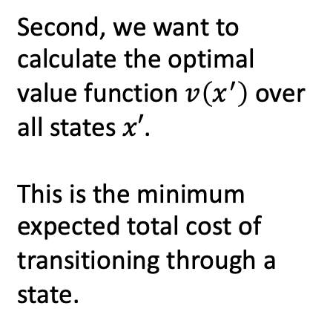



LMDP
$$v=1$$
$$v=0$$
Second, we want to calculate the optimal value function $v\left(x^{′}\right)$ over all states $x′$.
This is the minimum expected total cost of transitioning through a state.
$$v=0.5$$

Slide 17
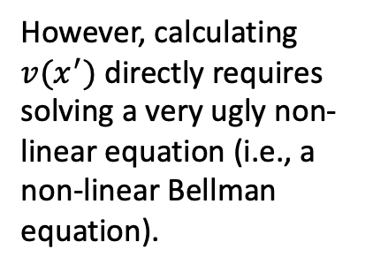
LMDP
$$v=1$$
$$v=0$$
However, calculating $v(x^{′})$ directly requires solving a very ugly non-linear equation (i.e., a non-linear Bellman equation).
$$v=0.5$$

Slide 18
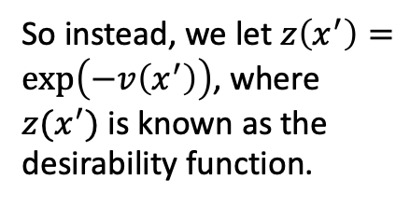



LMDP
$$z=0.3679$$
$$z=1$$
So instead, we let $z\left(x^{′}\right)=\exp\left(−v\left(x^{′}\right)\right)$, where $z(x^{′})$ is known as the desirability function.
$$z=0.6065$$

Slide 19
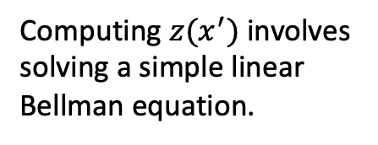
LMDP
$$z=0.3679$$
$$z=1$$
Computing $z(x^{′})$ involves solving a simple linear Bellman equation.
$$z=0.6065$$

Slide 20
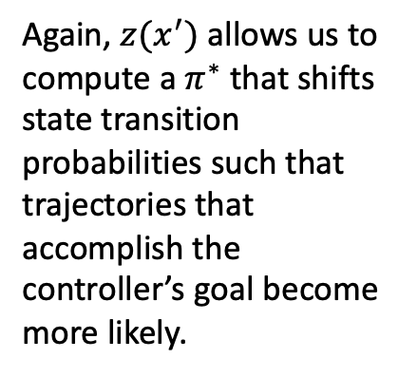
LMDP
$$0.1$$
Again, $z(x^{′})$ allows us to compute a $π^{∗}$ that shifts state transition probabilities such that trajectories that accomplish the controller’s goal become more likely.
$$0.05$$
$$0.9$$
$$0.9$$
$$0.05$$

Slide 21
Inverse Optimal Control (IOC)
$$q=1$$
$$q=0$$
IOC is a type of inverse reinforcement learning with the goal of recovering a controller’s cost function, optimal value function, and/or desirability function given observed trajectories through the state space.
$$q=1$$

Slide 22
IOC
$$v=1$$
$$v=0$$
IOC is a type of inverse reinforcement learning with the goal of recovering a controller’s cost function, optimal value function, and/or desirability function given observed trajectories through the state space.
$$v=0.5$$

Slide 23
IOC
$$z=0.3679$$
$$z=1$$
IOC is a type of inverse reinforcement learning with the goal of recovering a controller’s cost function, optimal value function, and/or desirability function given observed trajectories through the state space.
$$z=0.6065$$

Slide 24



IOC
IOC is a type of inverse reinforcement learning with the goal of recovering a controller’s cost function, optimal value function, and/or desirability function given observed trajectories through the state space.
$$2$$
$$0$$
$$1$$

Slide 25
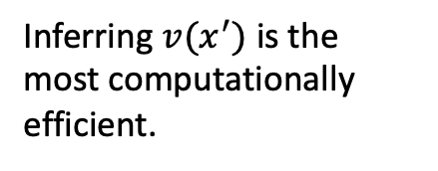
IOC
$$v=1$$
$$v=0$$
Inferring $v(x^{′})$ is the most computationally efficient.
$$v=0.5$$

Slide 26
IOC
$$v=1$$
$$v=0$$
These values on their own don’t tell us much about the controller other than they like certain states more than others...
$$v=0.5$$

Slide 27
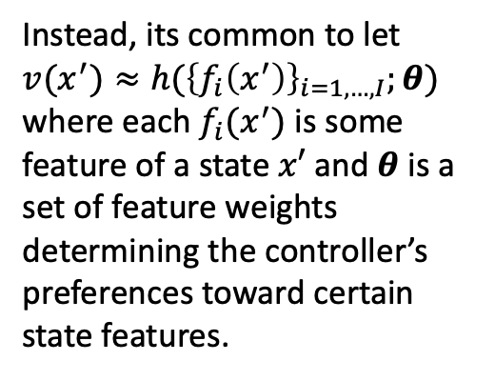
IOC
Instead, its common to let $v(x^{′})≈h({\left\{f_{i}\left(x^{′}\right)\right\}}_{i=1,…,I};θ)$ where each $f_{i}(x^{′})$ is some feature of a state $x′$ and $θ$ is a set of feature weights determining the controller’s preferences toward certain state features.

Slide 28
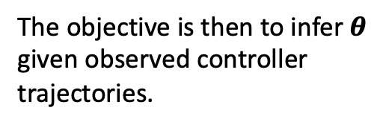
IOC
The objective is then to infer $θ$ given observed controller trajectories.

Slide 29
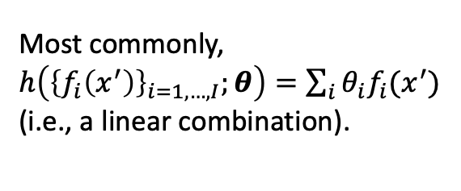
IOC
Most commonly, $h\left({\left\{f_{i}\left(x^{′}\right)\right\}}_{i=1,…,I};θ\right)=\sum_{i}{θ_{i}f_{i}(x^{′})}$ (i.e., a linear combination).

Slide 30
IOC
Example state features could be the distance to a goal or the distance to the closest obstacle.

Slide 31



Busy Beeway Trajectories
$$t=0$$
$$t=0$$
$$t=0$$

Slide 32



Busy Beeway Trajectories
$$t=1$$
$$t=0$$
$$t=0$$
$$t=1$$
$$t=1$$
$$t=0$$

Slide 33



Busy Beeway Trajectories
$$t=2$$
$$t=1$$
$$t=0$$
$$t=2$$
$$t=0$$
$$t=1$$
$$t=2$$
$$t=1$$
$$t=0$$

Slide 34

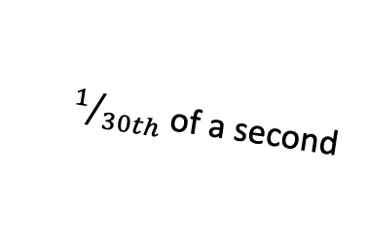
Busy Beeway Trajectories
$$t=2$$
$$t=1$$
$$t=0$$
$$t=2$$
$1/{30th}$ of a second
$$t=0$$
$$t=1$$
$$t=2$$
$$t=1$$
Data is being recorded at $30 Hz$.
$$t=0$$

Slide 35
Busy Beeway Trajectories
$$t=2$$
$$t=1$$
$$t=0$$
$$t=2$$
$1/{30th}$ of a second
$$t=0$$
$$t=1$$
$$t=2$$
$$t=1$$
It’s unlikely that humans observe and process their environment at this same rate…
$$t=0$$

Slide 36
Delayed Observations
E,g., delay of 2 time steps
$$t=0$$

Slide 37
Delayed Observations
E,g., delay of 2 time steps
$$t=1$$
$$t=0$$

Slide 38
Delayed Observations
E,g., delay of 2 time steps
$$t=2$$
$$t=1$$
$$t=0$$
$$t=0$$
$$t=0$$

Slide 39

Delayed Observations
E,g., delay of 2 time steps
$$t=2$$
$$t=1$$
$$t=0$$
$$t=3$$
$$t=0$$
$$t=1$$
$$t=1$$
$$t=0$$

Slide 40

Delayed Observations
E,g., delay of 2 time steps
$$t=2$$
$$t=1$$
$$t=0$$
$$t=2$$
$$t=3$$
$$t=0$$
$$t=1$$
$$t=2$$
$$t=1$$
$$t=4$$
$$t=0$$

Slide 41



LMDP with Delayed Observations
$$t$$
$$t−ΔT$$
$$t−ΔT$$

Slide 42
LMDP with Delayed Observations
$$t$$
$$t−ΔT$$
$$t−ΔT$$

Slide 43

LMDP with Delayed Observations
$$t$$
$$g_{t+1}(x^{′})$$
$$t−ΔT$$
$$t−ΔT$$

Slide 44

LMDP with Delayed Observations
$$t$$
$$g_{t+1}(x^{′})$$
$$t−ΔT$$
$g_{t+1}(x^{′})$ is a random variable…
$$t−ΔT$$

Slide 45

LMDP with Delayed Observations
$$t$$
$$t−ΔT$$
$$E_{p(g_{t+1}(x^{′})|o_{t−ΔT})}[g_{t+1}(x^{′})|o_{t−ΔT}]$$
$$t−ΔT$$

Slide 46
Main Reference
Dvijotham, K., & Todorov, E. (2010). Inverse Optimal Control with Linearly-Solvable MDPs. International Conference on Machine Learning.

Slide 47
Thanks For Listening
Questions?

