Slide 1
JobFit
Which entry-level jobs should I apply to?
Transparent, repeatable requirement-coverage ranking of 8,000 LinkedIn postings
[Group members] · Generative AI final project · November 2026
Notes:
Hi, we're presenting JobFit. The one-line pitch: you upload your resume, and JobFit ranks thousands of open entry-level postings by how well your resume covers what each posting actually asks for — with a score you can trust and evidence you can check.

Slide 2
Mass-applying wastes time; chatbots don't fix it
Students send one generic resume everywhere and get no feedback. The common shortcut — paste resume + JD into ChatGPT — has three gaps:
1
2
3
One at a time
Not repeatable
Opaque
A chat handles one posting; there are thousands of open roles
Ask twice, get two different scores
No evidence for what the number is based on
JobFit answers one question well: given my resume, which postings are a realistic fit?
Notes:
The entry-level market is competitive, so most of us mass-apply. Pasting a resume and a JD into ChatGPT is the common shortcut, but it has three structural problems: it works one posting at a time, its scores change between runs, and it doesn't show its evidence. JobFit is designed around exactly these three gaps. Important: our score measures requirement coverage, not the probability of getting an interview.

Slide 3
Data: 8,000 entry-level postings, 586 resumes
Jobs Kaggle LinkedIn Job Postings. Kept all non-IT postings, filled with IT (seed 42): 5,079 entry · 2,596 associate · 325 intern.
Resumes Kaggle Resume Dataset, 5 categories: Accountant, Finance, Banking, IT, Consultant — evaluation only, nothing trained on them.
Pre-built index ships in the repo (19 MB)
Notes:
Jobs come from the Kaggle LinkedIn postings dataset. We filtered 124k postings to 48k entry, associate and internship roles, then to Finance, Accounting, IT, Consulting and Analyst functions, and sampled 8,000, keeping every non-IT posting so IT doesn't dominate. Resumes come from the Kaggle resume dataset — 586 in our five categories — used only for evaluation.

Slide 4
Pipeline: extract once, match per request
1
2
3
4
Structured extraction
Semantic matching
Transparent score
Rank + explain
›
›
›
LLM with a fixed JSON schema (T=0, cached) — or offline rule-based taxonomy of 115 skills
Exact skill hit = 1; else calibrated sentence-embedding similarity to resume bullets
Explicit formula over required / preferred coverage, experience, education, role
Vectorised over all 8,000 postings; explanation built only from the match output
Served by FastAPI (/rank, /rank/upload, /match, /extract, /jobs) in a Docker image that runs fully offline; Gemini key optional.
Notes:
Four stages. One: structured extraction — every JD becomes a fixed schema of requirements, each marked required or preferred, plus minimum years and degree. We use an LLM with a JSON schema at temperature zero and cache it, so each JD is extracted once; there's also a rule-based extractor so everything runs offline. Two: each requirement is linked to the closest resume evidence. Three: an explicit formula turns that into a score. Four: we rank all postings and explain the top ones.

Slide 5
Matching sees past wording; the score is a formula
Requirement
overall = 100 · Σ W·sub / Σ W
Required coverage 0.45 · Role alignment 0.20 · Experience 0.15 · Preferred 0.10 · Education 0.10
Related evidence worth ≤ 85% of direct evidence
Certifications (CPA, CFA, Series 7) are exact-only
Soft skills count half; smoothing stops 1-requirement postings scoring 100
Every requirement shows status, method and the quoted resume line
Power BI
Resume evidence
“Built interactive Tableau dashboards to track portfolio performance”
cos 0.15 → 0.55
when the requirement is embedded with a descriptor: “Power BI (business intelligence dashboards…)”. Calibration AUC 0.920 → 0.947.
Notes:
This is the semantic part. A keyword matcher would say this resume has no Power BI. We embed requirements and resume bullets with a sentence-embedding model — an upgrade of the word vectors from Module 2. A trick that mattered: a bare tool name means little to the encoder, so we embed each requirement with a short descriptor; similarity jumps from 0.15 to 0.55. The score itself is an explicit weighted formula, not a model, so every number is traceable. Related evidence gets at most 85 percent credit, and licences like CPA must match exactly.

Slide 6
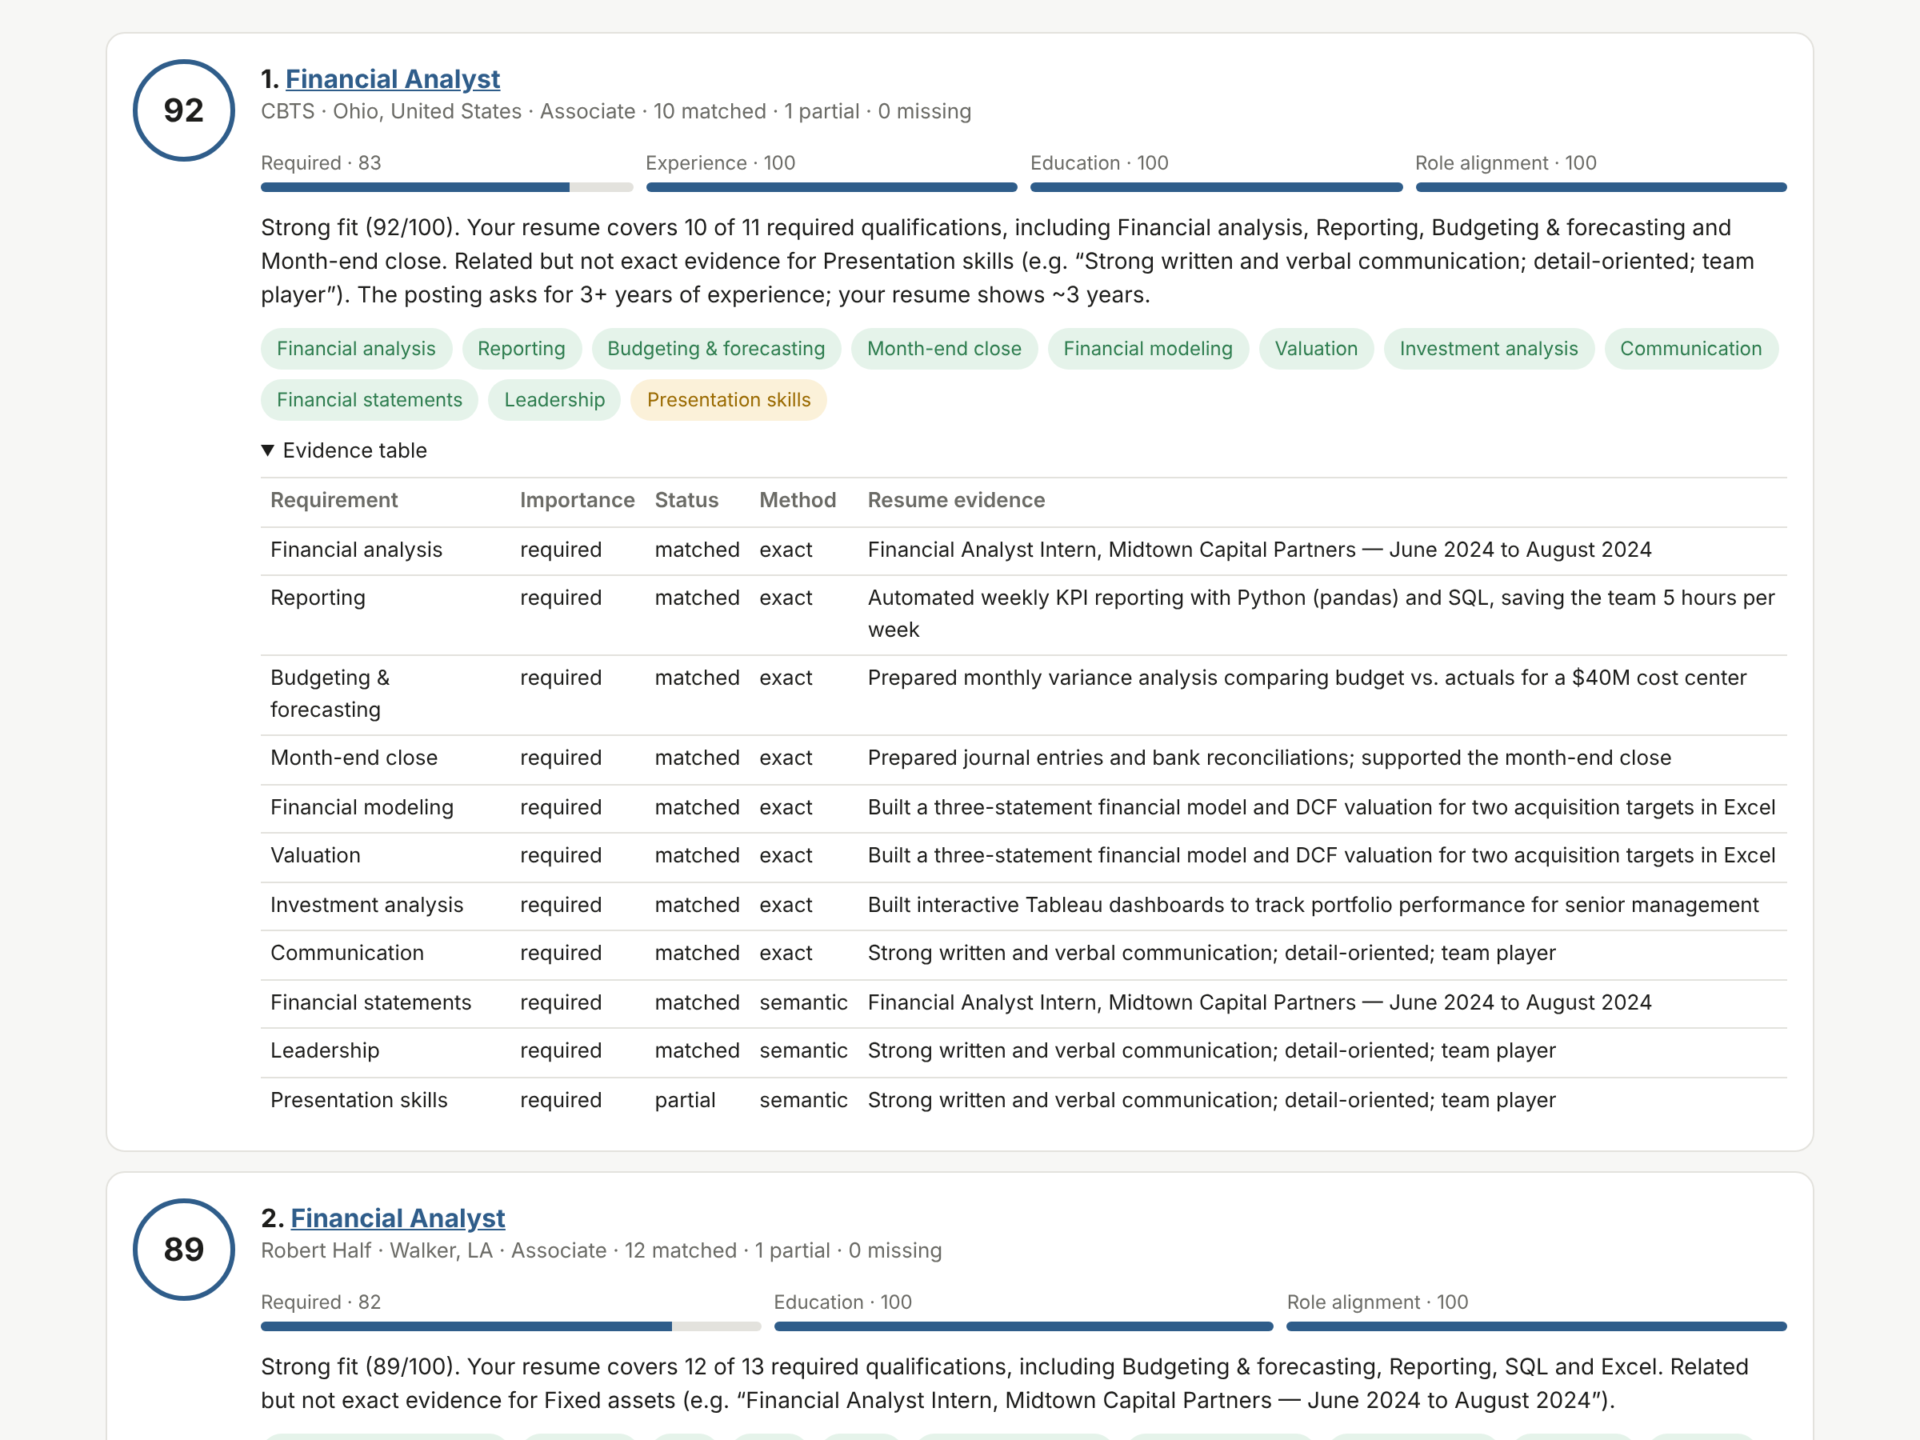
Demo: ranked postings with evidence
146 ms
median to score all 8,000 postings (CPU)
Upload PDF / DOCX / TXT or paste text
Filter by level, function, location
Green = matched, amber = related, red = missing
docker compose up → localhost:8000
Notes:
[Switch to live demo or narrate the screenshot.] Here our sample student resume is ranked against all 8,000 postings in about 150 milliseconds. Each card shows the score, the sub-scores, an explanation, and every requirement colour-coded — click the evidence table and you see the exact resume line behind each match. Everything here runs in one Docker container.

Slide 7
Ranking: beats keyword overlap, not doc-embeddings
Weak labels
Relevant = posting function matches resume category. They reward topic, not fit.
Takeaways
+0.03 over exact skill overlap; ≈ TF-IDF
Doc-embedding is a strong topic ranker — we report it plainly
Role alignment matters most (−0.109 if removed)
Notes:
We scored all 8,000 postings for each of 586 resumes. With no public ground truth, we used weak labels: a posting is relevant if its LinkedIn function matches the resume's category. JobFit gets nDCG@10 of 0.701, beating exact skill overlap and matching TF-IDF — but plain whole-document embedding similarity scores 0.742. We want to be upfront: these labels measure topic, and a document embedding is a great topic ranker. Doc-cosine can't tell you what's missing though. Combining the two gets 0.739 while keeping our evidence — that's our recommended next step. In ablations, role alignment was the biggest contributor.

Slide 8
The matcher behaves as a transparent score should
38% → 69%
100%
100%
recall on paraphrased evidence (keywords → JobFit), 0% false positives
of scores drop when evidence for a matched required skill is deleted
identical rankings on repeated runs — zero score variance
42 hand-written cases
n = 98, mean -6.7 pts
30 resumes × 3 runs
Adding a missing required skill raised the score in 100% of 17 cases.
Notes:
Because the category labels can't test requirement matching, we built targeted tests. A paraphrase benchmark: 42 requirement/evidence pairs written without shared keywords, each with a hard negative. Keywords find 38 percent; JobFit finds 69 with zero false positives. Counterfactuals: delete the evidence for a matched required skill and the score drops every time; add a missing skill and it rises every time. And repeated runs give identical rankings.

Slide 9
Value added over a plain LLM chat
 | Plain LLM chat | JobFit
Scale | One posting per chat | All 8,000 per request, filterable
Repeatability | Score varies by run | Identical output (tested)
Transparency | Opaque number | Per-requirement evidence + formula
Explanations | Can say anything | Only from the match output
Cost | 1 LLM call per pair | JDs extracted once; ranking needs no LLM
Measured plain-LLM variance & latency: eval/llm_baseline.py [insert results once the Gemini key is active]
Notes:
This is our value-add over off-the-shelf functionality. Scale: one request ranks everything. Repeatability: identical output for identical input. Transparency: every score decomposes into requirements and quoted evidence. Explanations are generated only from the structured match, so they can't invent qualifications. And cost: we call the LLM once per job description, not once per resume–job pair. [If you ran llm_baseline.py, add: the plain LLM's score varied by X points across five runs.]

Slide 10
Limitations & next steps
Limitations
Next steps
Weak labels measure topic, not fit
Kaggle resumes are mostly experienced
Rule extractor limited to its taxonomy
Weights set by hand, not learned
Human-labelled fit set → fit the weights
Two-stage: doc-similarity retrieval + JobFit
LLM-extracted index + measured LLM baseline
Resume suggestions from missing requirements
Thank you — questions? · github: [repository URL]
Notes:
To wrap up: the main limitation is evaluation — our labels measure topic, and the resumes skew experienced — so the most valuable next step is a small human-labelled set of resume–job pairs, which would let us fit the weights instead of setting them. We'd also add document-similarity retrieval in front of JobFit, run the LLM-extracted index, and turn missing requirements into resume suggestions. Thanks — happy to take questions.

