Slide 1
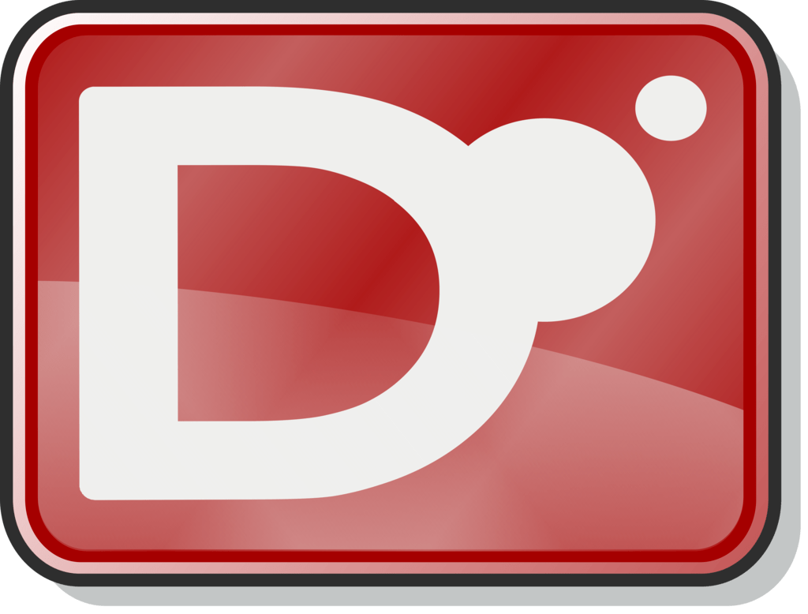
D
Michael Li

Slide 2

Overview
History
Pro/Cons
Language

Slide 3
History of D (Dlang)
Up-and-coming language
Walter Bright and Andrei Alexandrescu
Design goals – attempt to combine performance and safety of compiled languages with expressive abilities of modern dynamic languages.
Imagine C++ and Python
Add in some Java, C#, and Eiffel for good measure

Slide 4
Pros vs C++
Cons vs C++
Syntax easier to read
Provides garbage collection
Array implementation better
Less community support
IDEs and libraries not as developed
Slower and uses more memory due to overhead
Slow garbage collector

Slide 5
Pros vs Python
Cons vs Python
Faster – compiled language
Type inference
Provides encapsulation
Privacy matters!
Less community support
IDEs and libraries not as developed
Slower garbage collector

Slide 6
Language

Slide 7
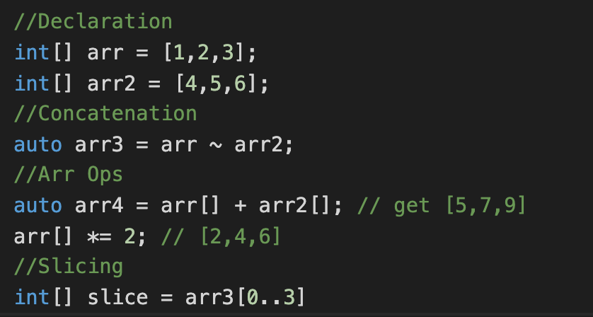
Arrays
Declaration
Concatenation ~
Array operations
Slicing : arr[0..4]

Slide 8
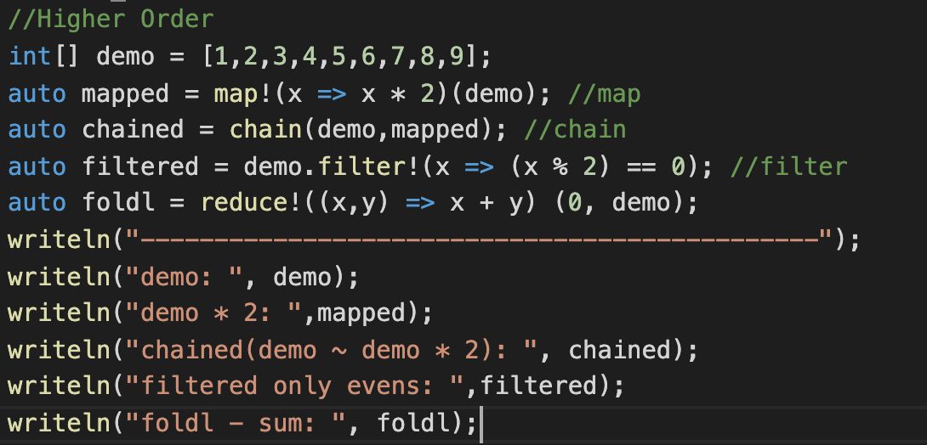
Higher Order Functions

Slide 9
Quick Practice

Slide 10
Classes
Similar to C++, Java syntax
No multiple inheritance
this
super(…)
override
abstract
public, protected, private

Slide 11
Memory Safety
@system – default normal functions
@safe – disallow function calls that may lead memory corruption
@trusted - functions guaranteed not to exhibit undefined behavior
Think of it as the const modifier in C++

Slide 12
In depth
Tutorial can be found at
https://tour.dlang.org/
https://www.youtube.com/watch?v=rwZFTnf9bDU

Slide 13
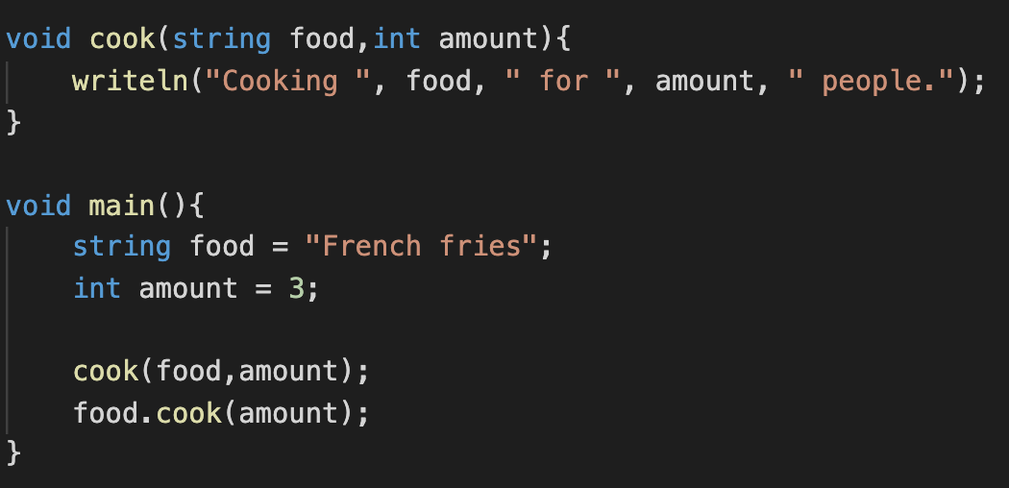
One Final Thing
Universal Function Call Syntax (UFCS), is a syntactic sugar in D that allows the call of regular functions, like member functions of an object.

Slide 14

References
https://www.slant.co/versus/110/118/~python_vs_d
https://digitalmars.com/d/2.0/comparison.html
https://www.quora.com/Did-D-fail-to-become-the-better-C-If-so-why-If-not-how-is-it-better-Whats-the-experience-of-people-replacing-C-with-D
http://bearcave.com/software/dlang/Cplus_plus_and_d.html

