Slide 1
Predicting Tomorrow’s Gold Price: Do we have a market advantage?
79 Coins Inc.
Bhanu Yerra
Data Scientist

Slide 2
Why Gold?
Historical Reasons, Contemporary Relevance

Slide 3



Gold Investments
Central
Banks
Finance Companies
Jewelry

Slide 4
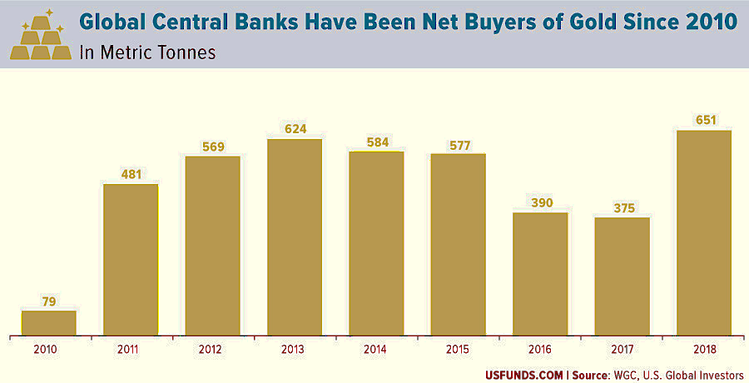
Gold Investments (continued)

Slide 5
Countries with Highest Gold Reserves

Slide 6
Reason for Investments in Gold
Gold Reserves: a guarantee to depositors and currency holders
Country’s financial strength
Hedge against inflation

Slide 7
How to Forecast?
The oracle is not answering my call

Slide 8
Methodology
Collect
Data
Model
Building
Model Selection

Slide 9
Methodology: Collect Data
Commodity prices
Gold, Gold Futures, Silver, Platinum, Palladium
Crude Oil
Economic & Financial Market Indicators
S&P 500, DJI, FTSE
Interest Rates, US Dollar Index, Treasury Bills

Slide 10
Methodology: Collect Data
Daily Closing Prices
2000 to 2018
Excludes US Holidays & Market Closures

Slide 11
Methodology: Models
Linear Regression
Time Series Forecasting
Costs with & without log transformation
Autoregressive models:
1, 3, 5, 10 & 30

Slide 12
Methodology: Metrics
Naïve Solution:
Don’t need a model
Next value is assumed to be equal to the last value

Slide 13
Methodology: Metrics
Metrics:
R-Squared Statistic
Mean Absolute Error

Slide 14
How good are the forecasts?
$$$???

Slide 15
Results
Detailed forecasts for 2016
High-level forecasts for 2006 to 2018

Slide 16
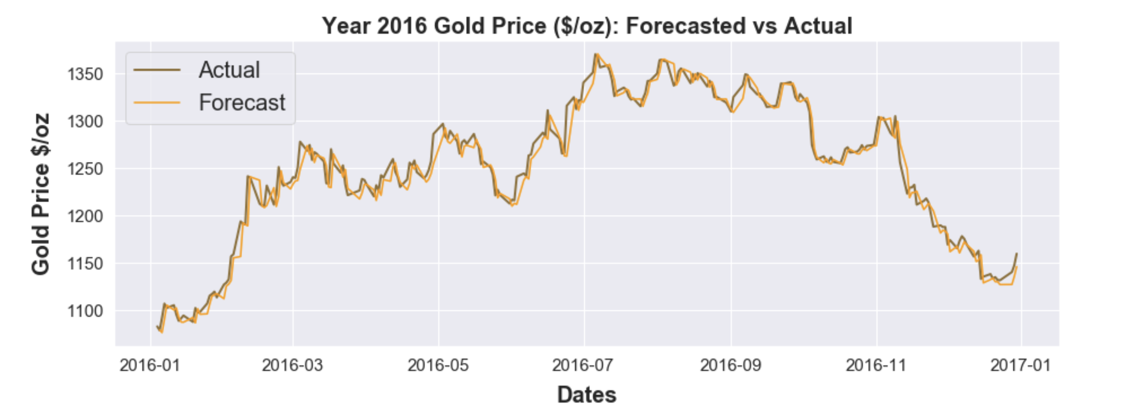
2016 Forecasts

Slide 17
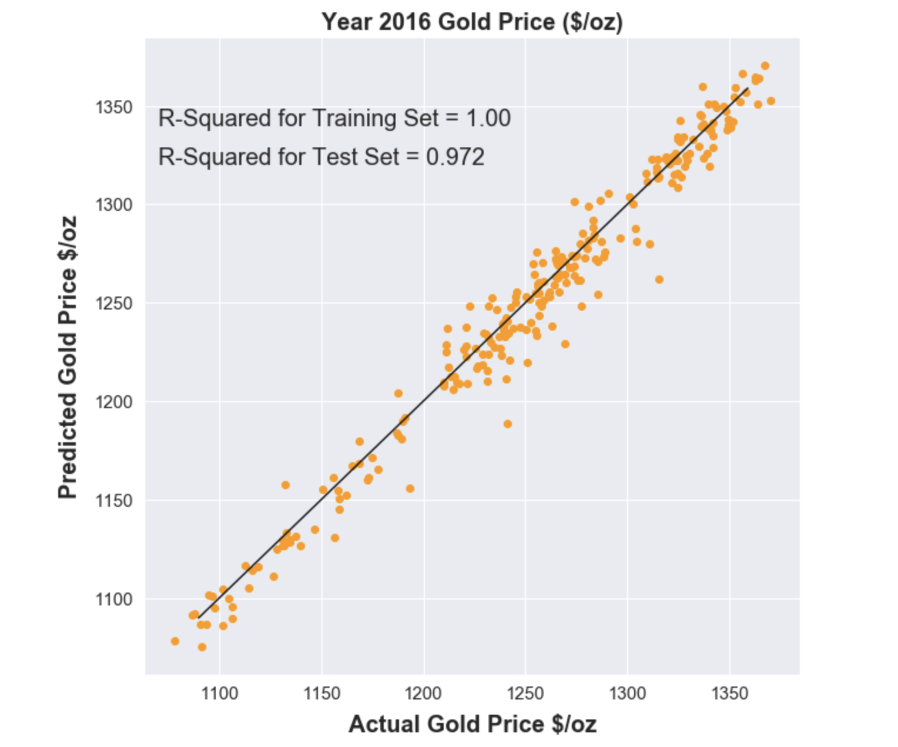
2016 Forecasts (continued)

Slide 18
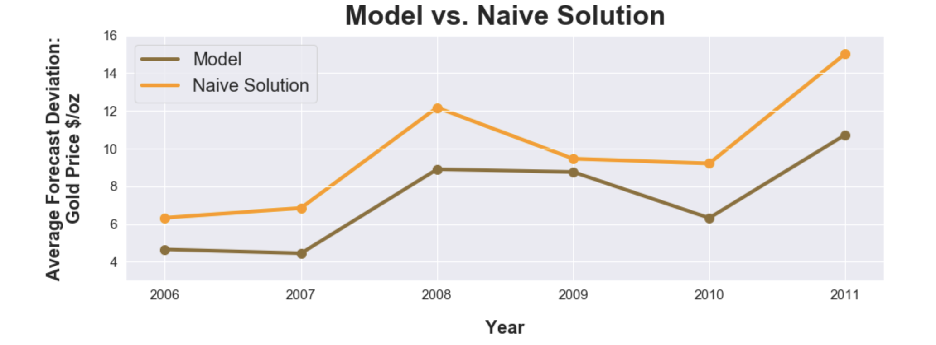
2006 to 2011 Forecasts

Slide 19
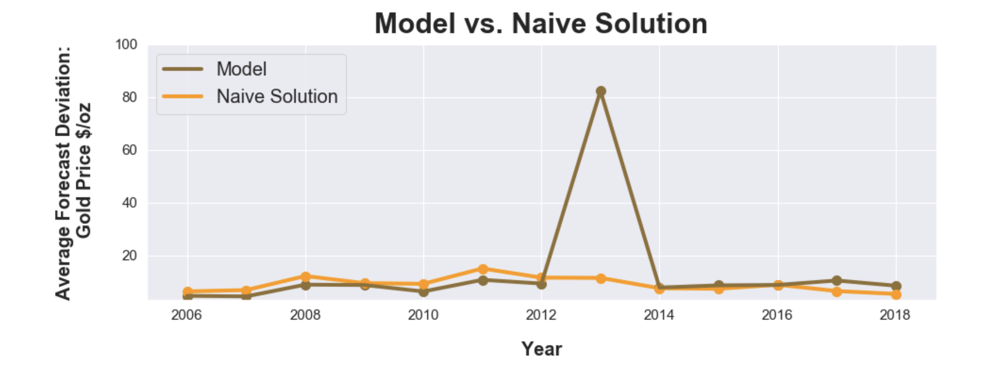
2006 to 2018 Forecasts

Slide 20
Conclusions
Short-term forecasts:
6 months into the future vs. one to three years
Multiple models and frequent updates

Slide 21
Conclusions
Long-term economic cycles
Short-term trends
Year 2013 is a short-term trend

Slide 22
Conclusions (continued)
Time Series
Forecasting
The past holds the key to the future.
Efficient-Market Hypothesis
Markets react only to new information.
vs.

Slide 23
Next Steps
More machine learning methods over classical statistical methods
Quantile Regression Forest/Support Vector Regression/Recurrent Neural Networks
Notes:
When underlying mechanism or physics of the problem is know, classical statistical methods tend to do well. When the underlying mechanism is complicated and interpretability is not a requirement, black-box type of machine learning models becomes an option

Slide 24
All the gold in the world is not enough to give in exchange for virtue.
Plato

Slide 25
Thanks!
Questions?

Slide 26
Appendix

Slide 27
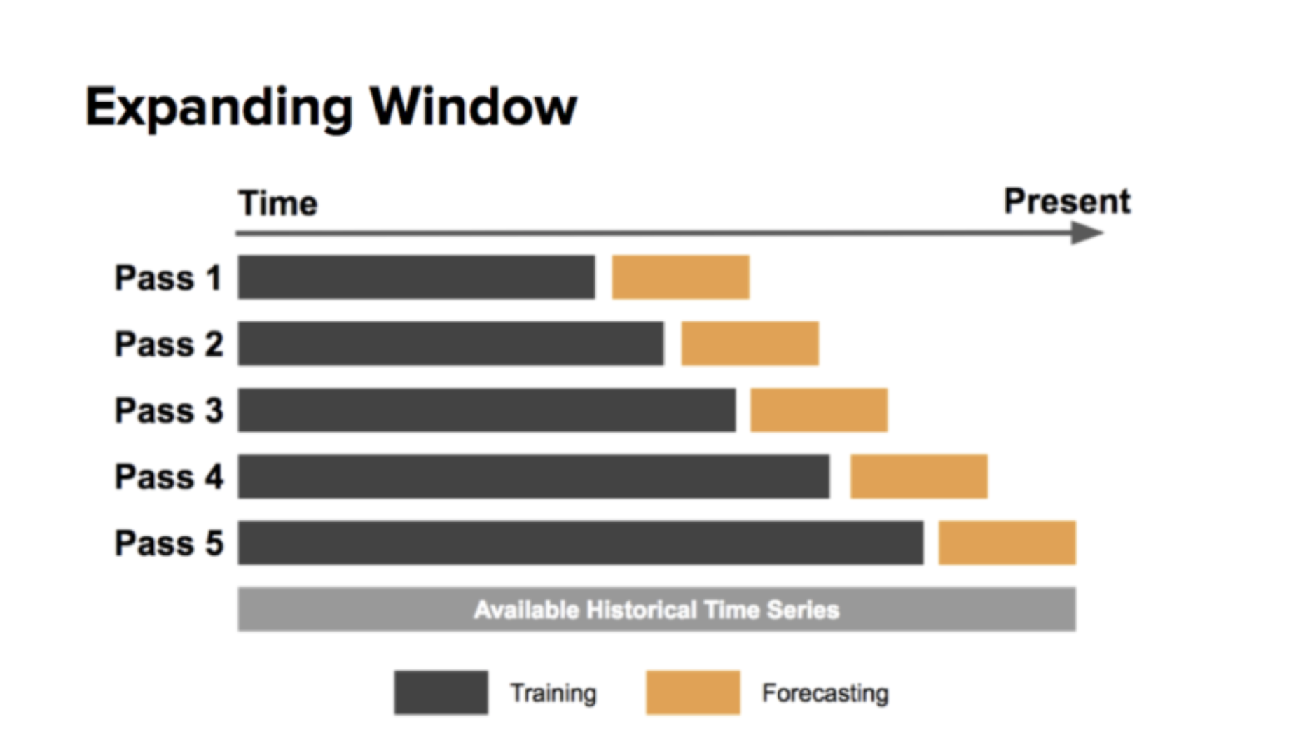
Methodology: Training/Testing

Slide 28
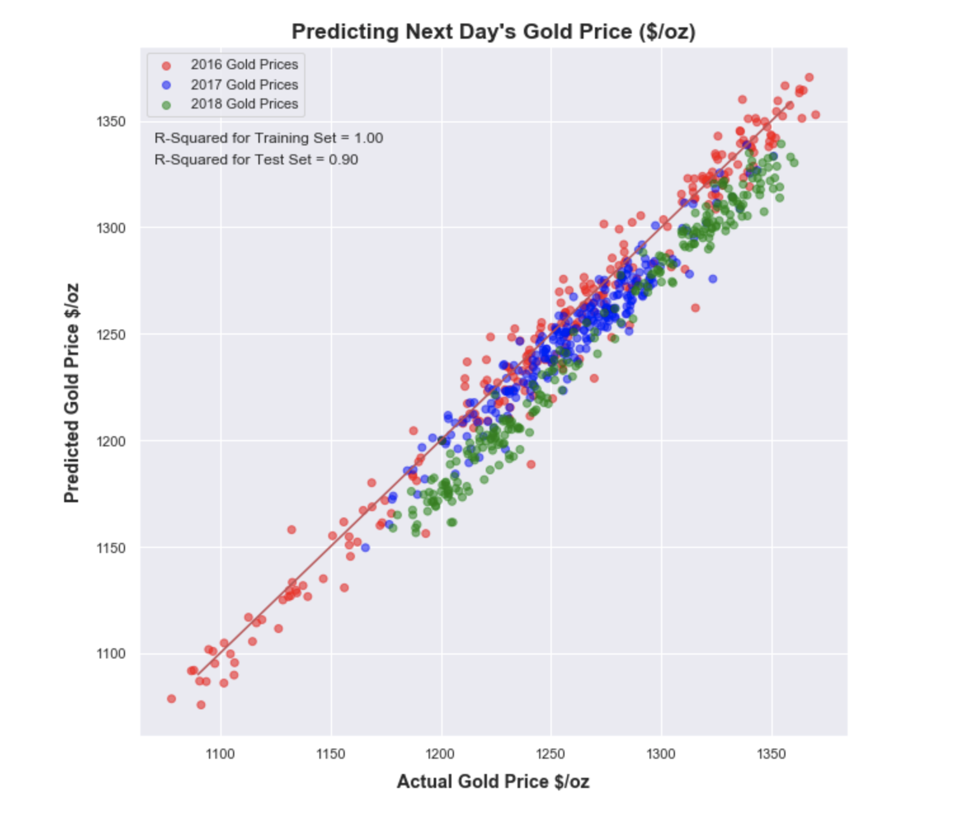
Results

Slide 29
They don’t give you gold medals for beating anybody. They give you gold medals for beating everybody.
Michael Johnson

