Slide 1
DIPS PRÆSENTATION

Slide 2
1. Synchronization

Slide 3

Motivation
Distributed System challenges
Common notion

Slide 4
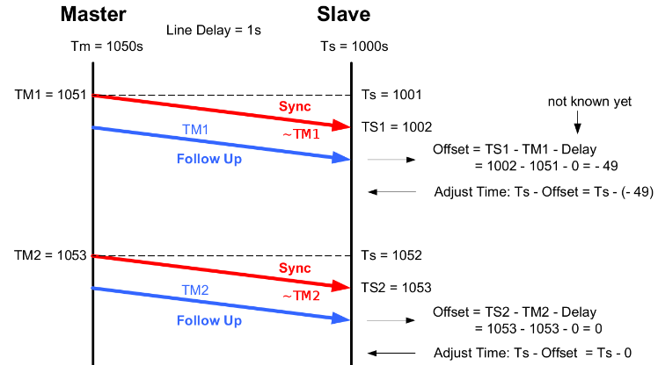
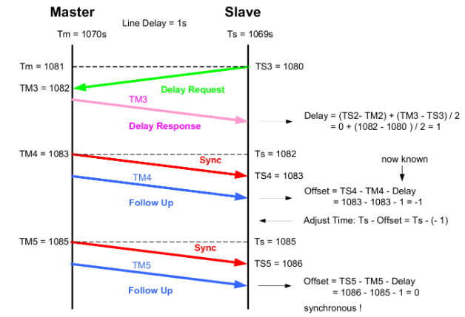
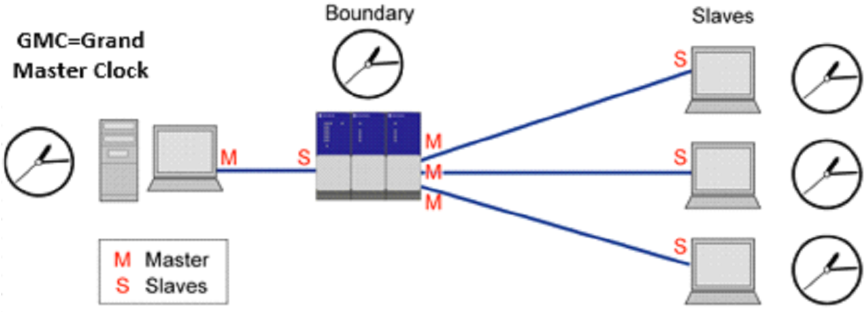
Techniques (Real)
Challenges
Precision Time Protocol
Timestamp

Slide 5

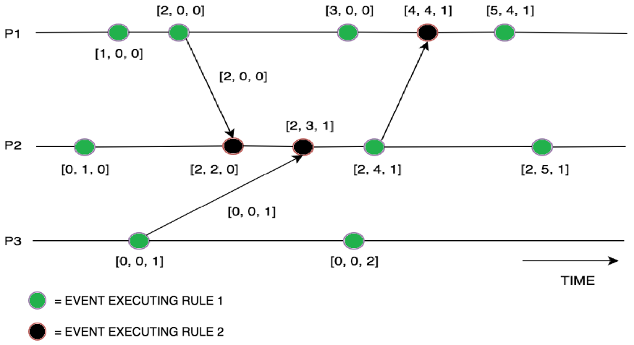
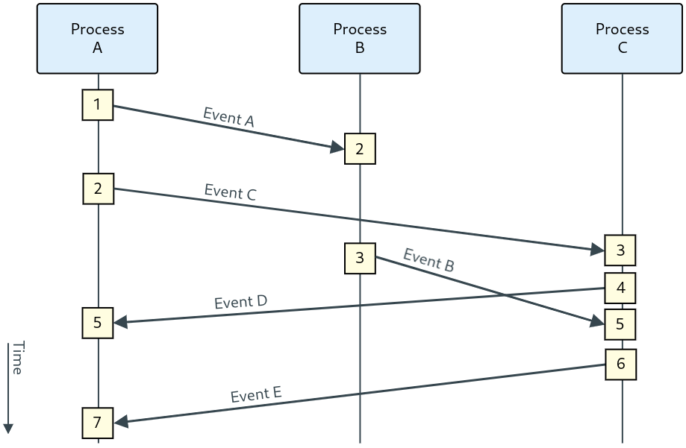
Techniques (Logical)
Challenges
Lamport time-stamps
Vector Clocks

Slide 6
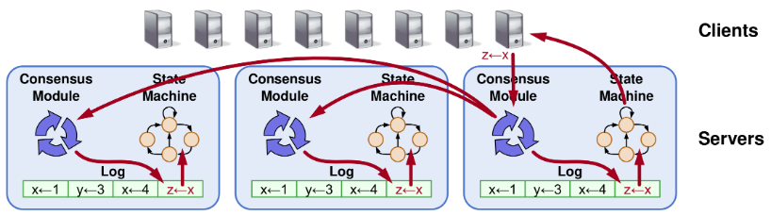
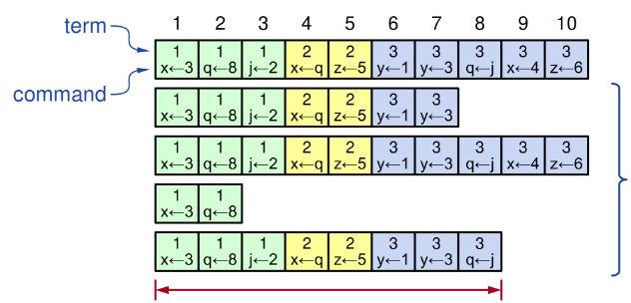
Perspectivation
RAFT

Slide 7
2. Leader Election and consistency

Slide 8
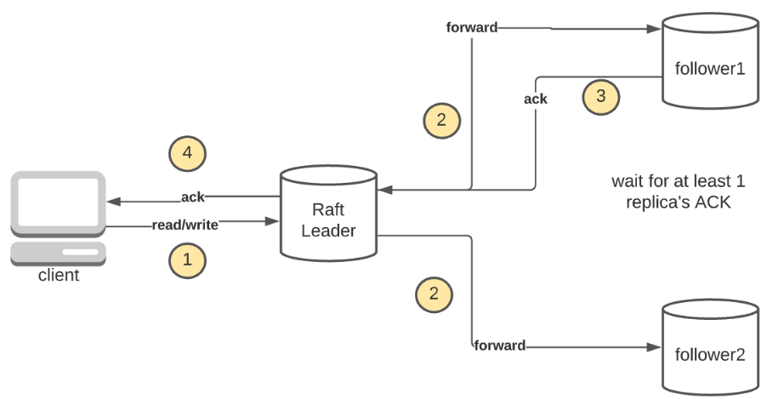
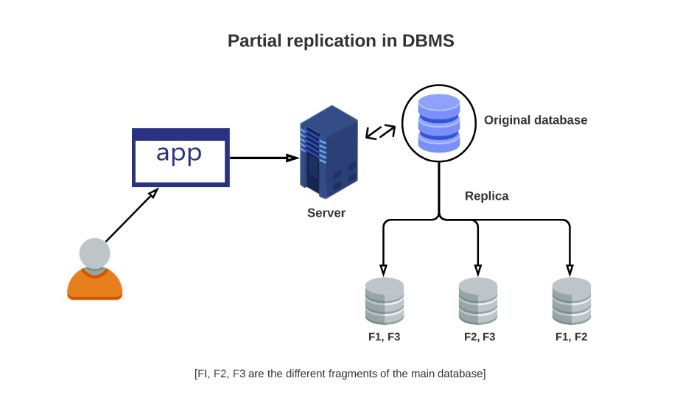
Motivation
Leader Election
Data & Div./Conq.
Consistency
Replication → Troubles

Slide 9
Leader Election
Prerequisites
When?
Approach
Technique Comparison

Slide 10
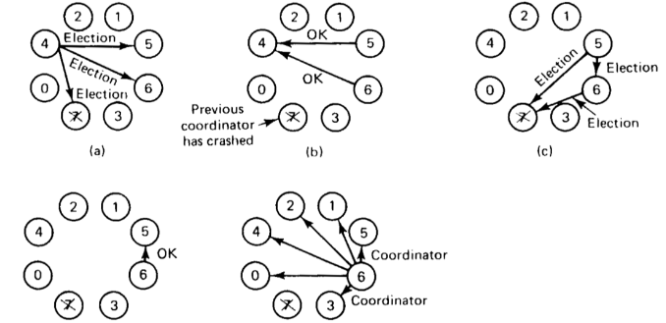
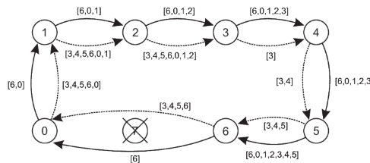
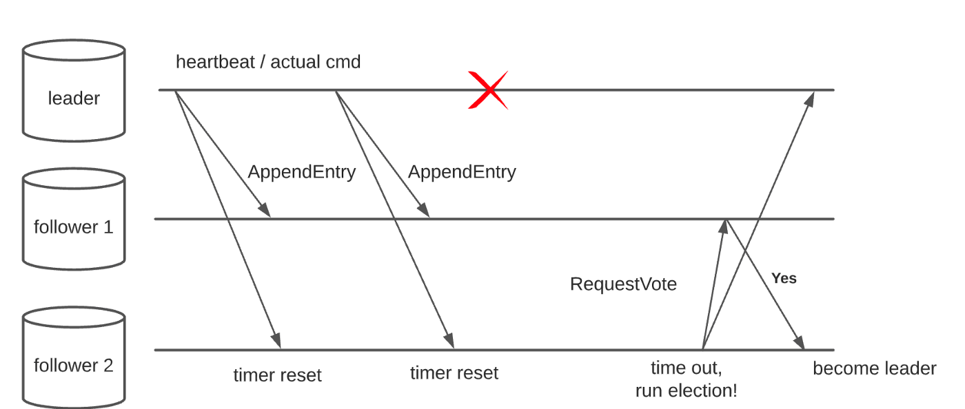
Techniques
Bully
Ring-based: Chang and Roberts
RAFT

Slide 11
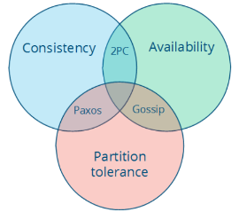
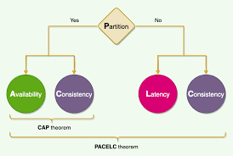
Consistency
CAP

Slide 12
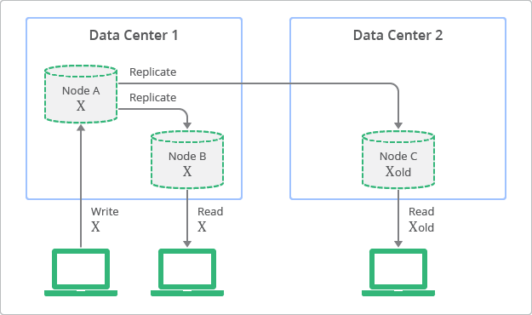
Consistency models
Strong Consistency
Weak Consistency
Eventual Consistency
Casual/read-writes….

Slide 13
3. Fault tolerance and consensus

Slide 14
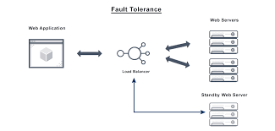
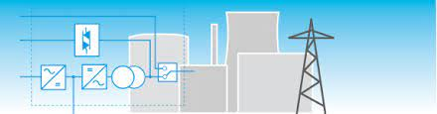
Motivation
Fault Tolerance
Failures?
Consensus
Coherency

Slide 15
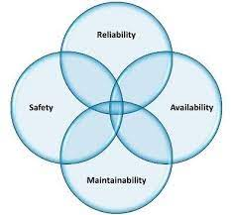
Terminology
Failures:
Crash, Arbitrary...
Fault consequences

Slide 16
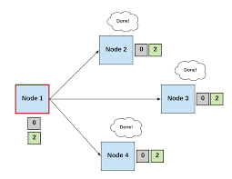
Consensus
What?
Fault consequences
Approaches
State machine replication
Limited processes
Paxos, Zoo Keeper, RAFT

Slide 17
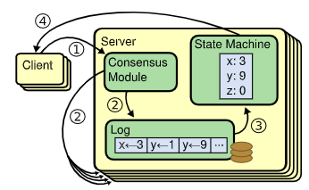
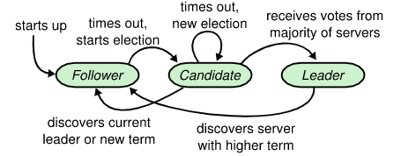
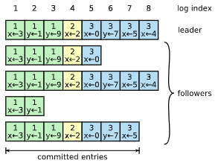
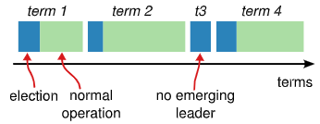
RAFT
Basics
Leader Election

Slide 18
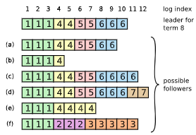
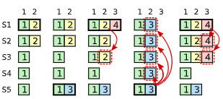
RAFT
Log Replication
Election Restriction (Safety)

Slide 19
4. Positioning and location awareness

Slide 20

Motivation
Navigation
Tracking/locating
Firefighters

Slide 21
Challenges
Technologies
Privacy
Interoperability

Slide 22
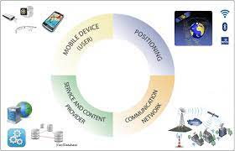
Concepts
Position
Absolute/Relative
Location
Location Service
Location Based Service

Slide 23
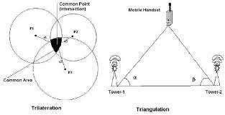
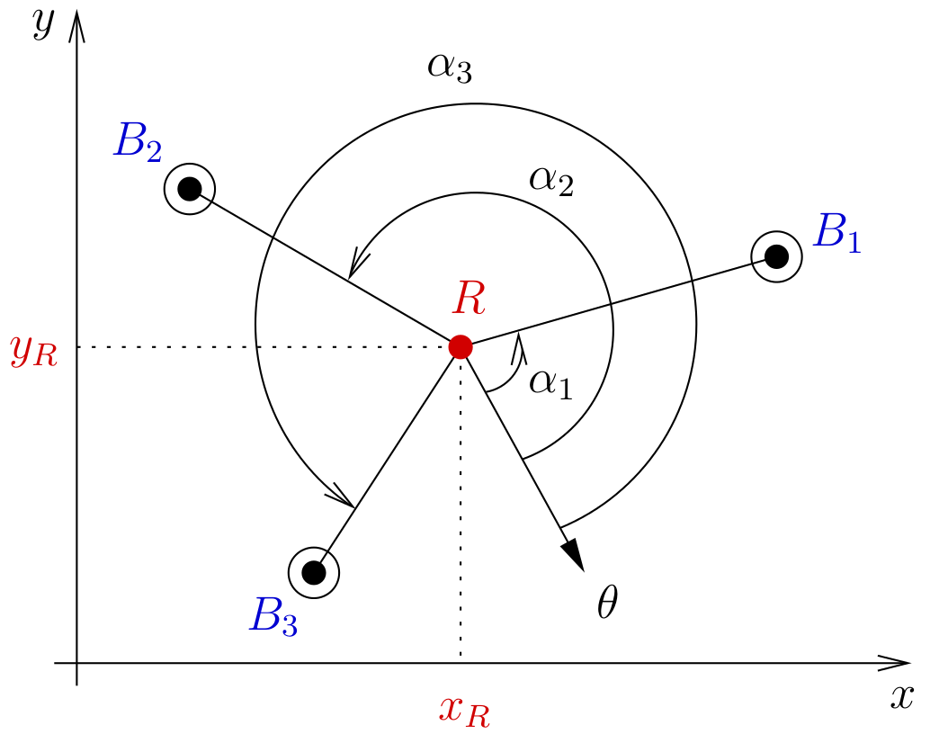
Absolute Positioning
Triangulation (ToTal)
Trilateration

Slide 24
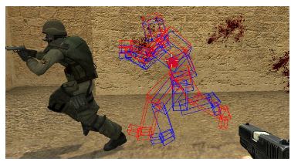
Relative Positioning
Dead Reckoning

Slide 25
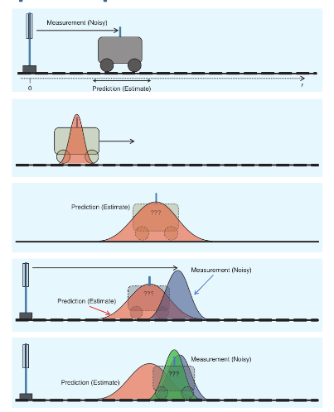
Hybrid Positioning
Sensor Fusion
Kalman filters
Guassian multiplication
Predict and correct

Slide 26
Perspectivation
Pervasive systems

Slide 27
5. Pervasive computing (background, methods, enabling tech.)

Slide 28
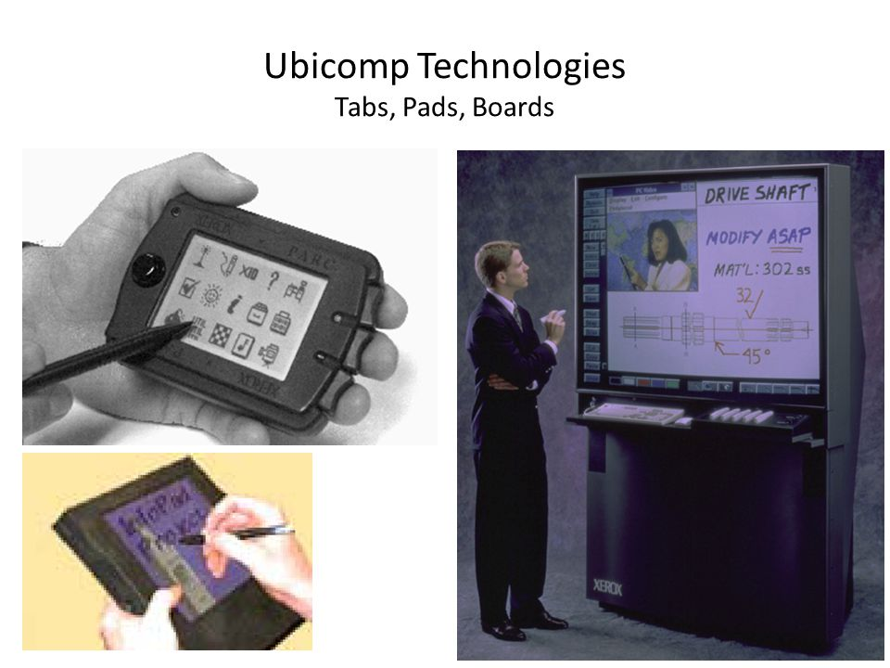
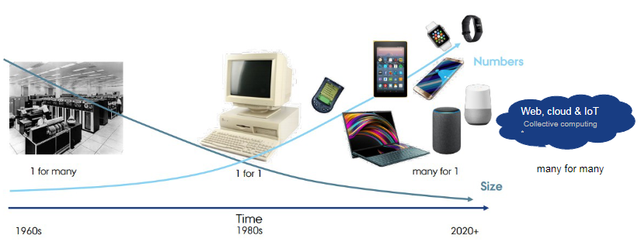
Background
Weiser – XEROC PARC
Generations

Slide 29
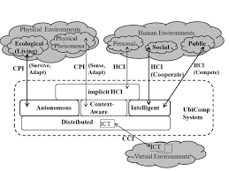
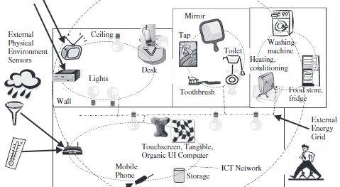
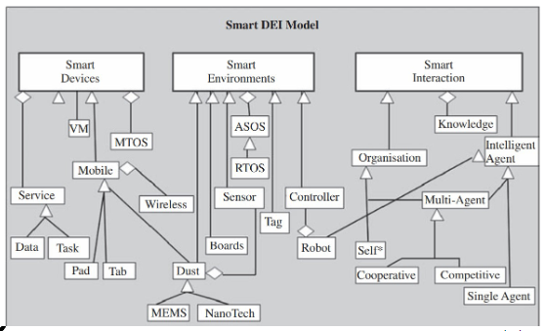
Pervasive Computing Concepts
Awareness
Interaction
Smart X

Slide 30
Methods

Slide 31
Enabling Technologies
Network
Middleware

