Slide 1
1. Synchronization

Slide 2

Motivation
Distributed System challenges
Common notion

Slide 3
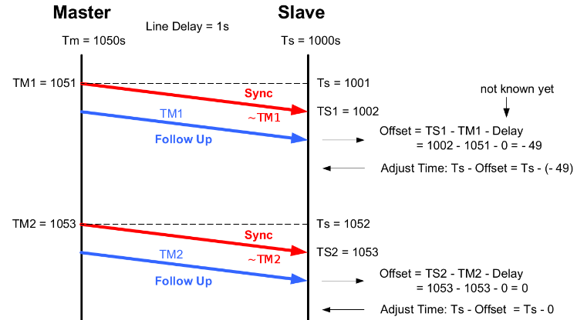
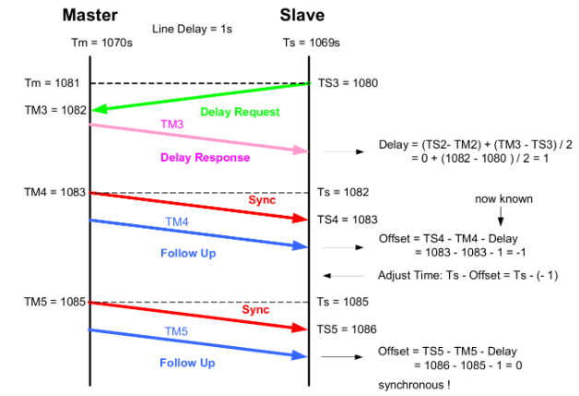
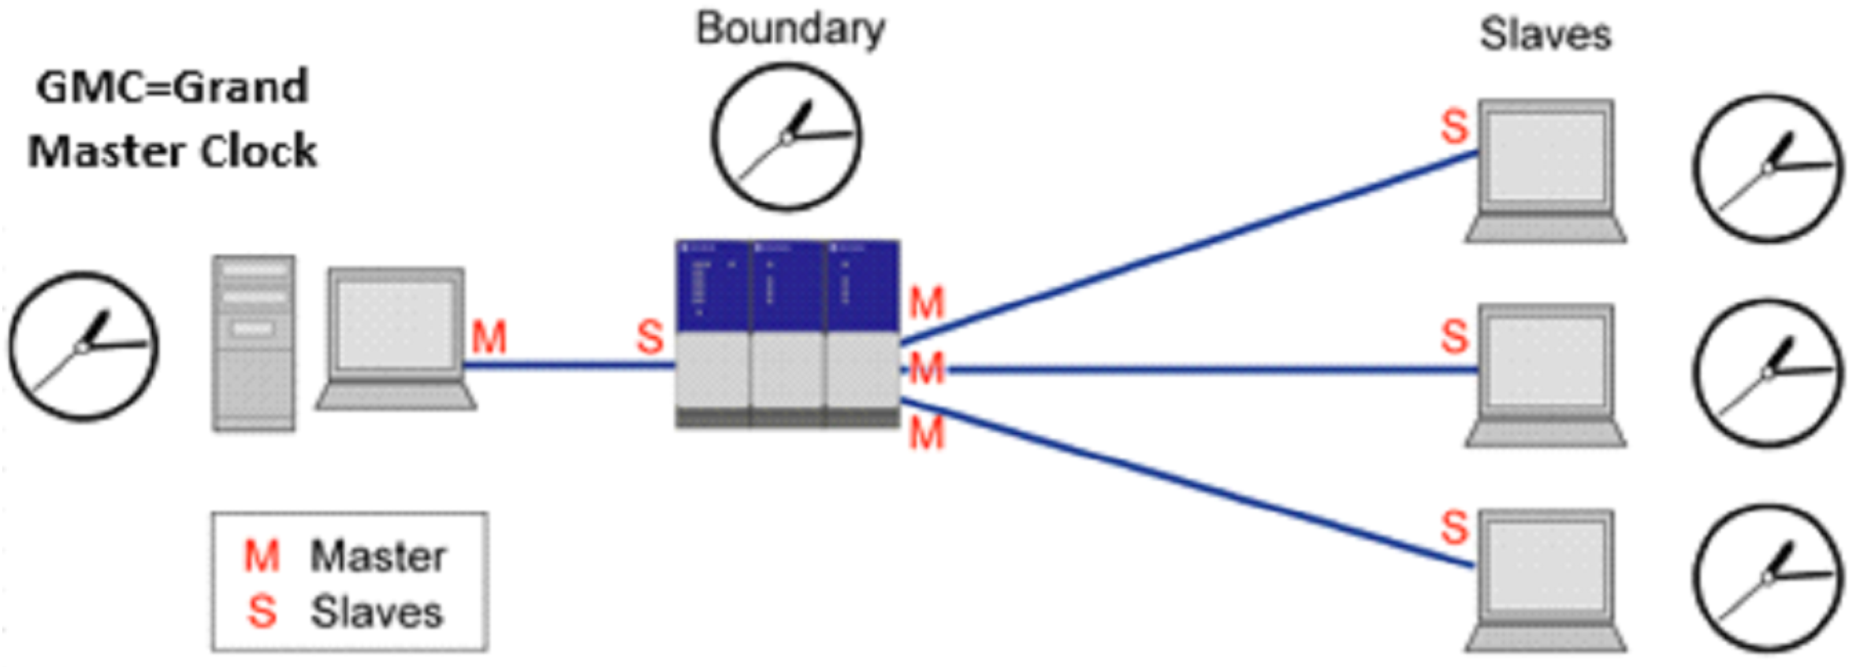
Techniques (Real)
Challenges
Precision Time Protocol
Timestamp

Slide 4

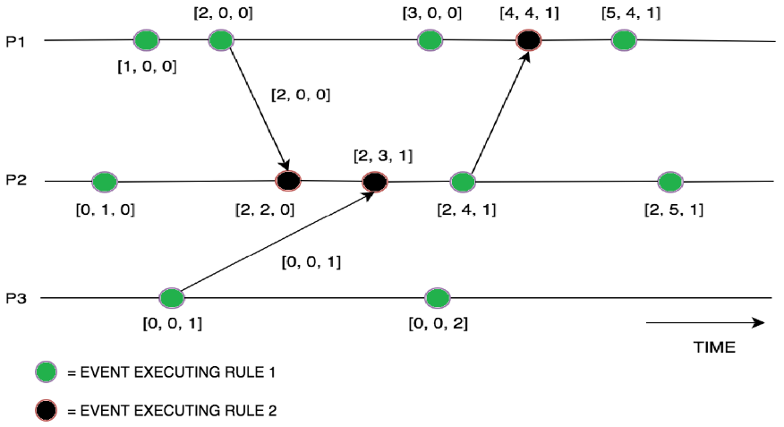
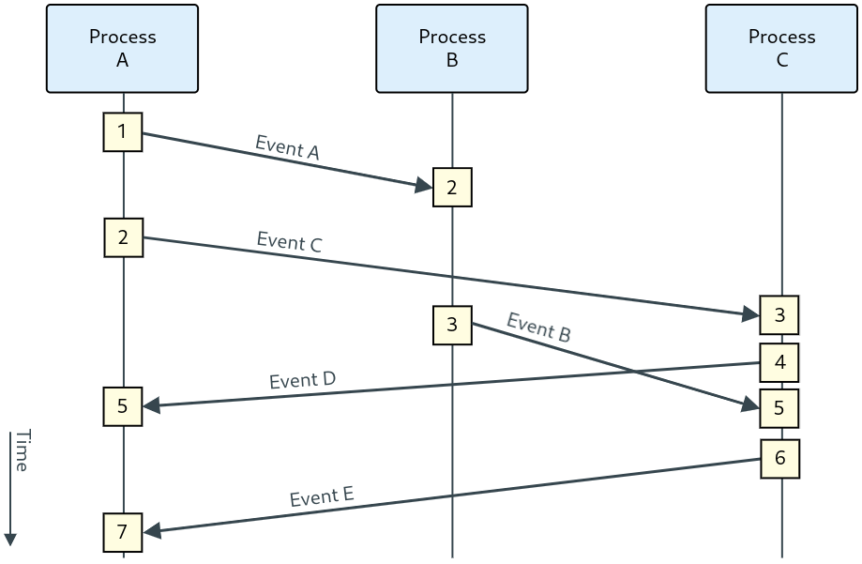
Techniques (Logical)
Challenges
Lamport time-stamps
Vector Clocks

Slide 5
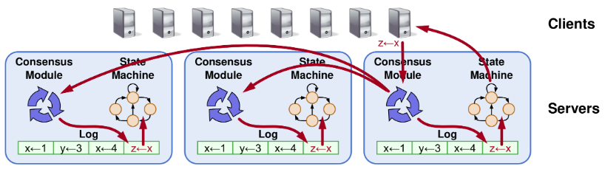
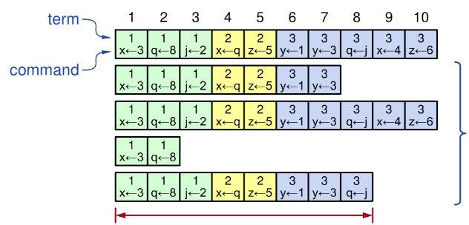
Perspectivation
RAFT

Slide 6
2. Leader Election and Consistency

Slide 7
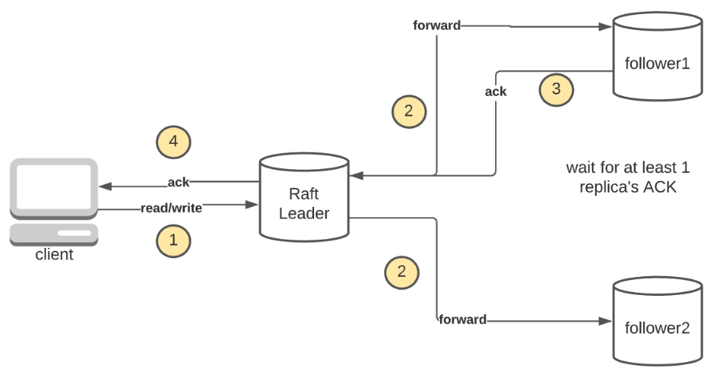
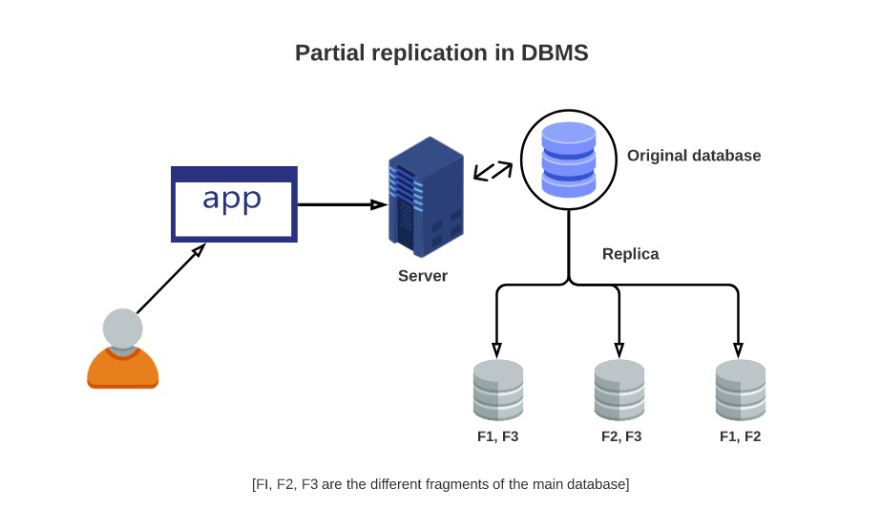
Motivation
Leader Election
Data & Div./Conq.
Consistency
Replication → Troubles

Slide 8
Leader Election
Prerequisites
When?
Approach
Technique Comparison

Slide 9
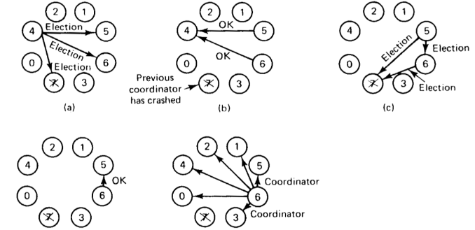
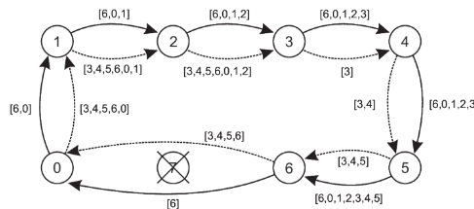
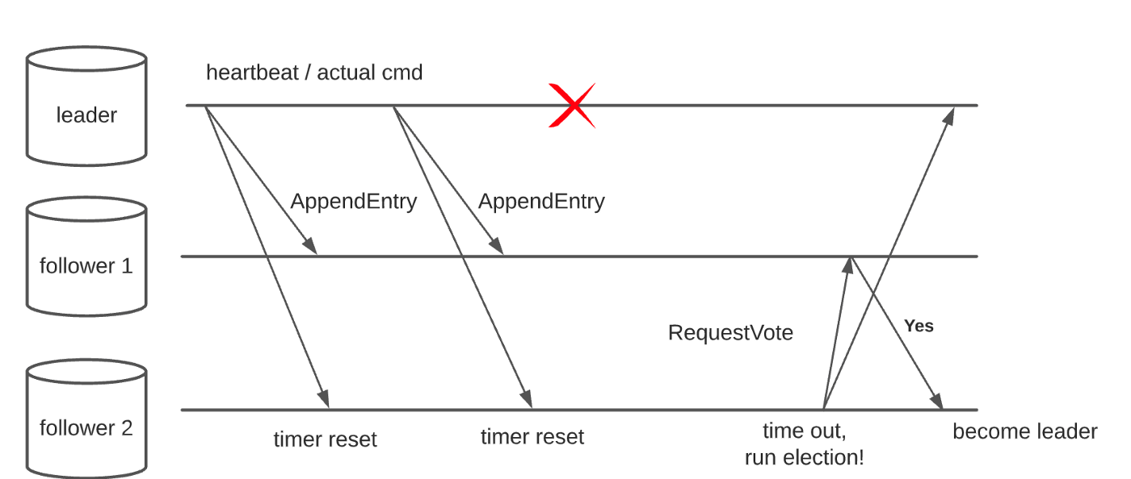
Techniques
Bully
Ring-based: Chang and Roberts
RAFT

Slide 10
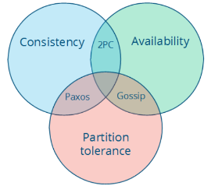
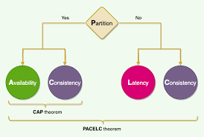
Consistency
CAP
PACELC

Slide 11
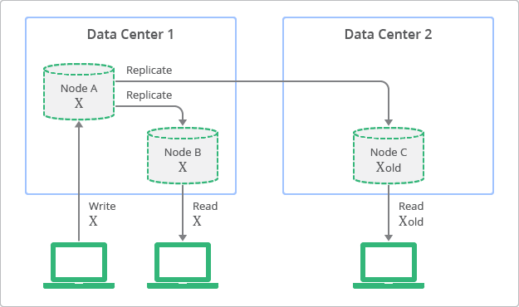
Consistency models
Strong Consistency
Weak Consistency
Eventual Consistency
Casual/read-writes….

Slide 12
3. Fault tolerance and consensus

Slide 13
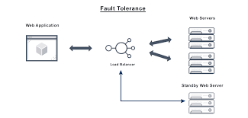

Motivation
Fault Tolerance
Failures?
Consensus
Coherency

Slide 14
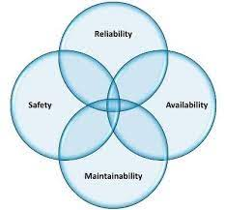
Terminology
Failures:
Crash, Arbitrary...
Fault consequences

Slide 15
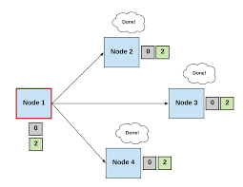
Consensus
What?
Fault consequences
Approaches
State machine replication
Limited processes
Paxos, Zoo Keeper, RAFT

Slide 16
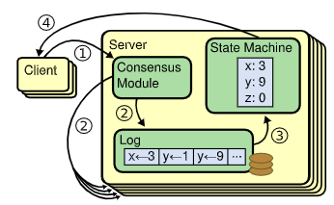
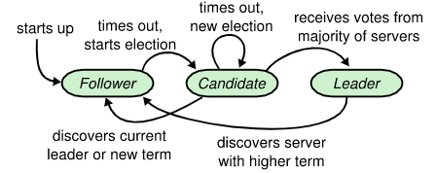
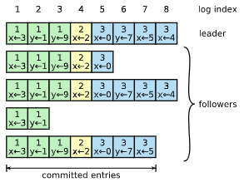
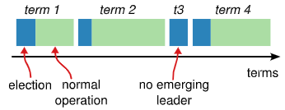
RAFT
Basics
Leader Election

Slide 17
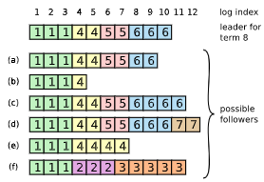
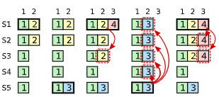
RAFT
Log Replication
Election Restriction (Safety)

Slide 18
4. Positioning and location awareness

Slide 19
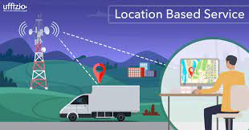
Motivation
Navigation
Tracking/locating
Firefighters

Slide 20
Challenges
Technologies
Privacy
Interoperability

Slide 21
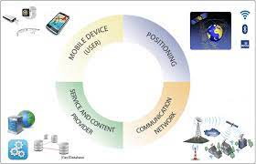
Concepts
Position
Absolute/Relative
Location
Location Service
Location Based Service

Slide 22
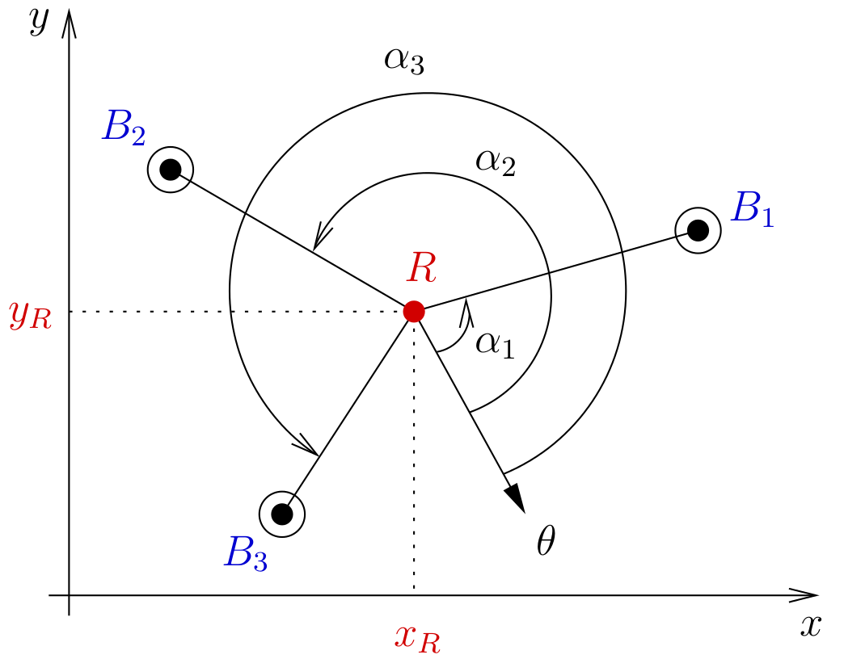
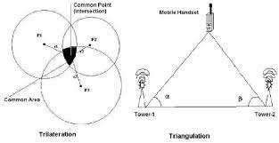
Absolute Positioning
Triangulation (ToTal)
Trilateration

Slide 23
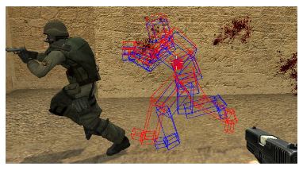
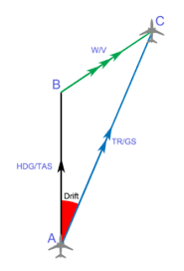
Relative Positioning
Dead Reckoning

Slide 24
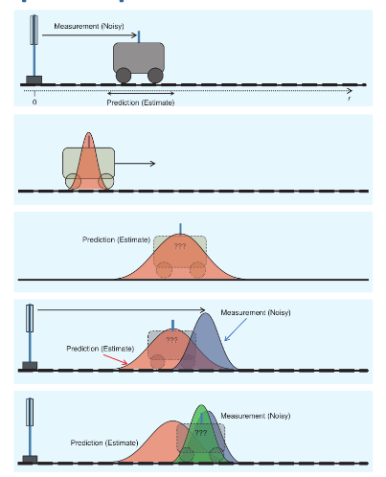
Hybrid Positioning
Sensor Fusion
Kalman filters
Guassian multiplication
Predict and correct

Slide 25
Perspectivation
Pervasive systems

Slide 26
5. Pervasive Computing (Background, Methods and Enabling tech.)

Slide 27
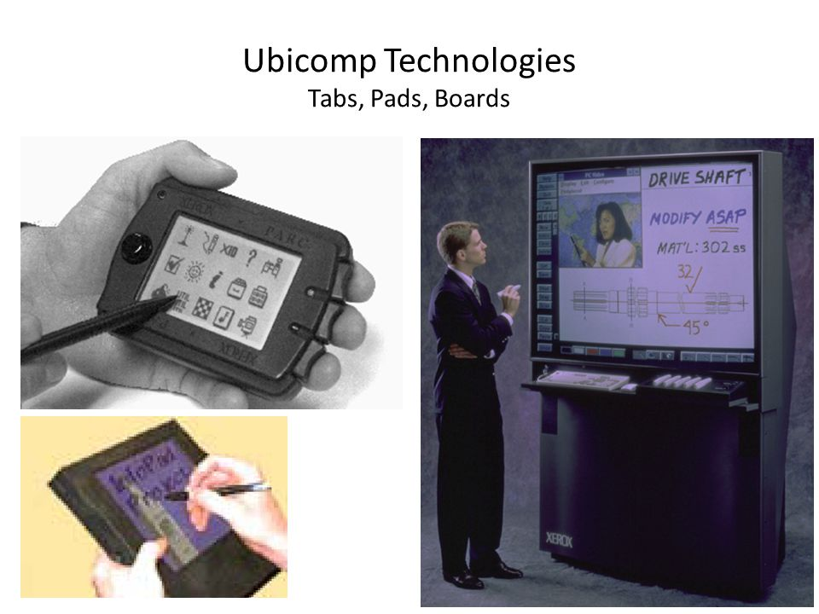
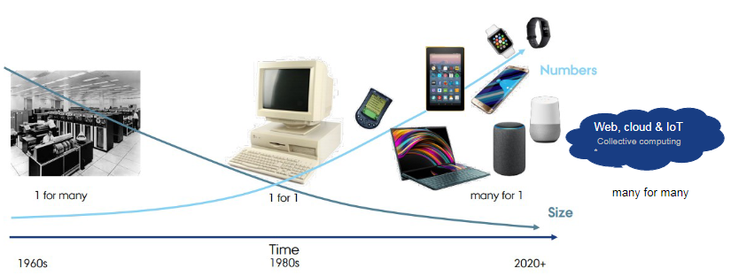
Background
Weiser – XEROC PARC
→ Cloud, Crowd and Shroud

Slide 28
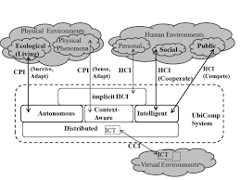
Properties
Ubiquitous
Transparent
Openness

Slide 29
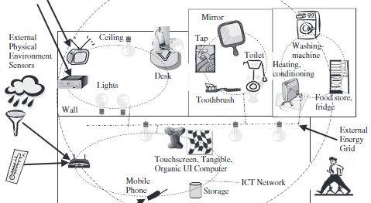
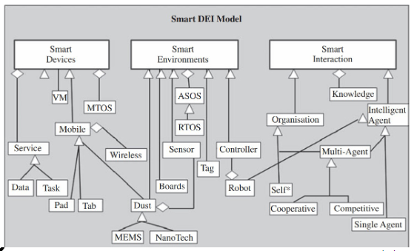
Concepts
Awareness
Interaction
Smart X
Calm Tech.

Slide 30
Methods
???

Slide 31
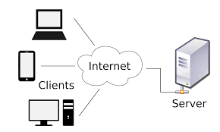
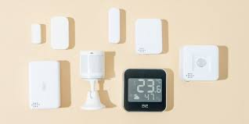
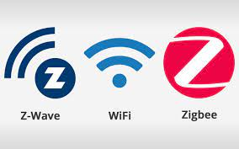
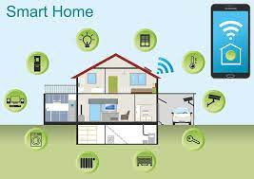
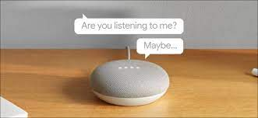

Enabling Technologies

Slide 32
6. Context awareness using smart X (towards intelligent environments)

Slide 33

Context Aware System
Situation
What, Where, When, How, Who and Why
Sensor Fusion

Slide 34
Challenges
User Context
Environment Context
Privacy
Accuracy vs. Cost

Slide 35
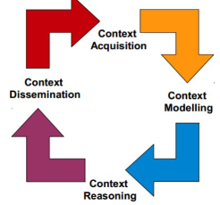
Lifecycle
Data Sources
Management - Querying
KB/KBG - Ontology Based
Ontology Based → Adaption (passive/active)

Slide 36
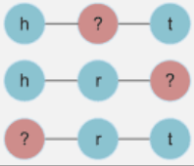
Example
Fact
Subject
Relation
Object

Slide 37
Smart X
Combination → Intelligent Environment

Slide 38
Intelligent Env. Example
Distributed
Smart Environment
Smart Interaction
Zero Conf.

