Slide 1
1. Synchronization

Slide 2

Motivation
Distributed System challenges
Common notion

Slide 3
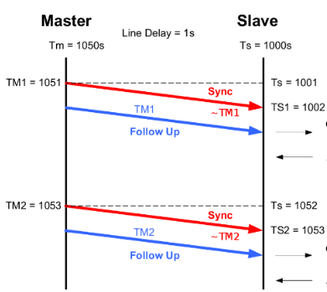
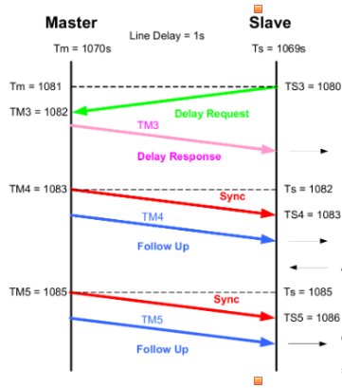
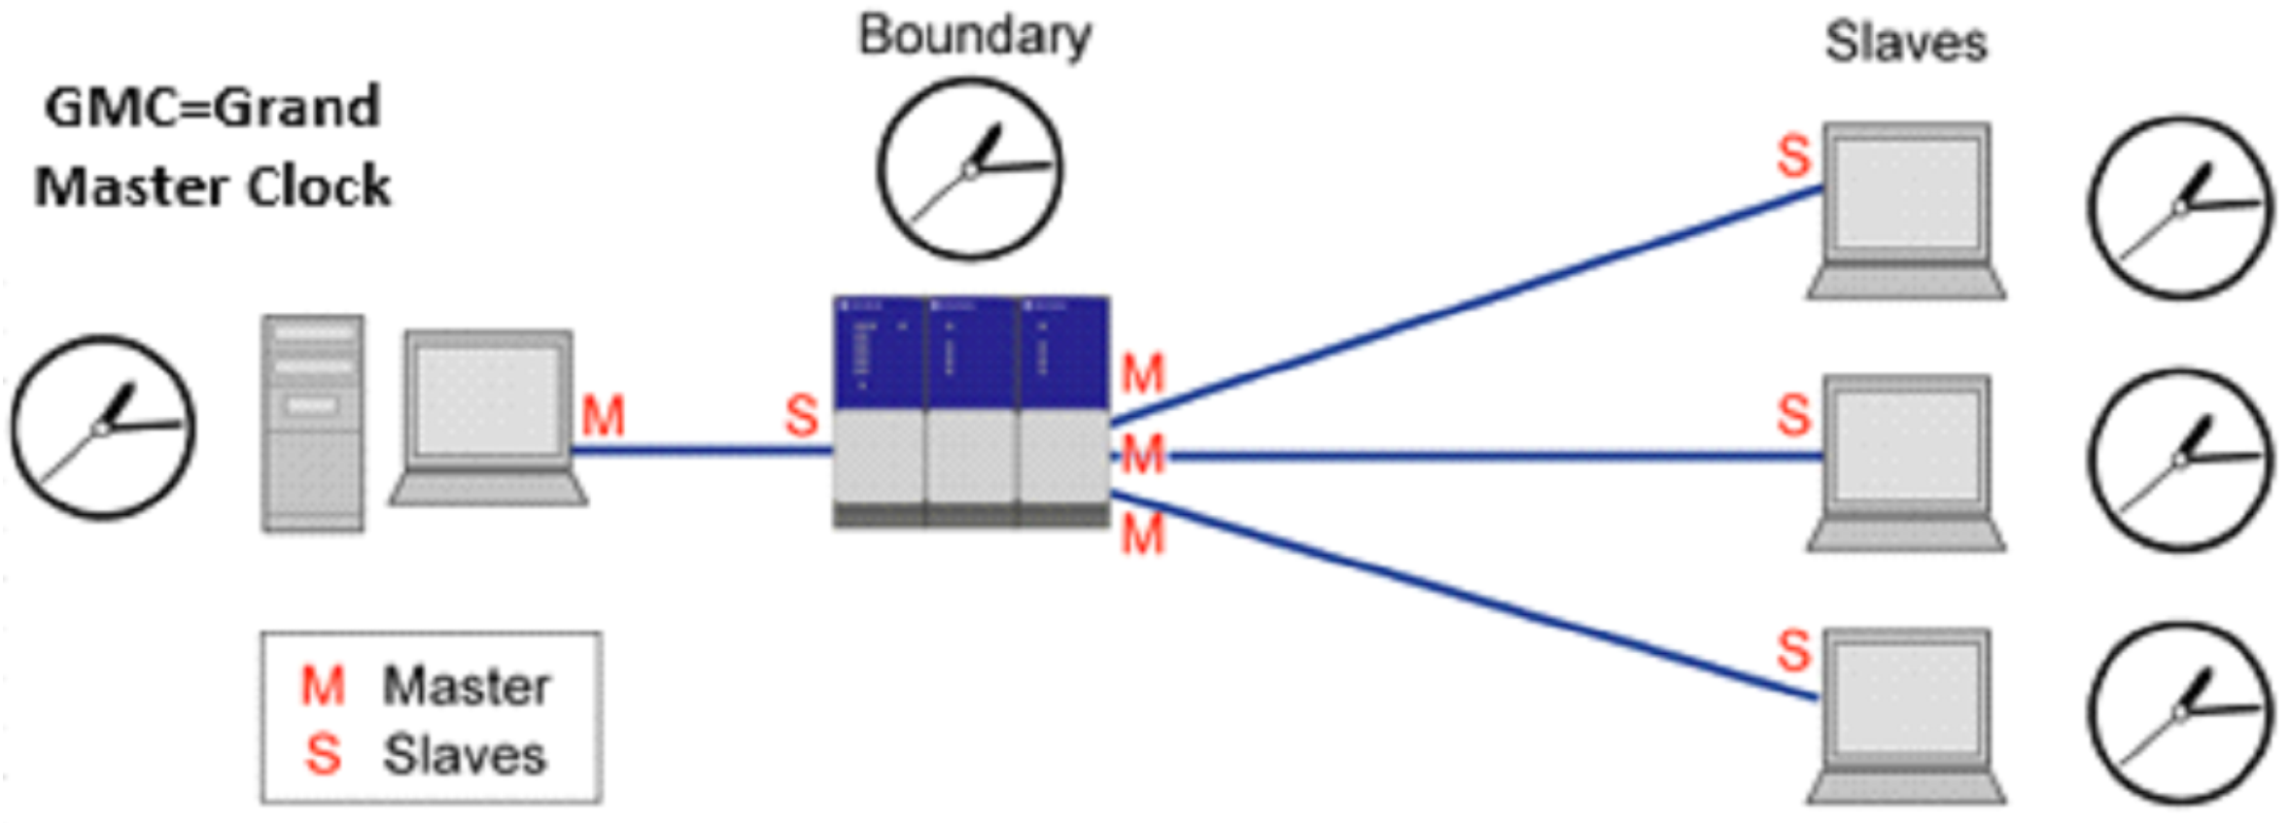
Techniques (Real)
Challenges
Precision Time Protocol
Timestamp

Slide 4

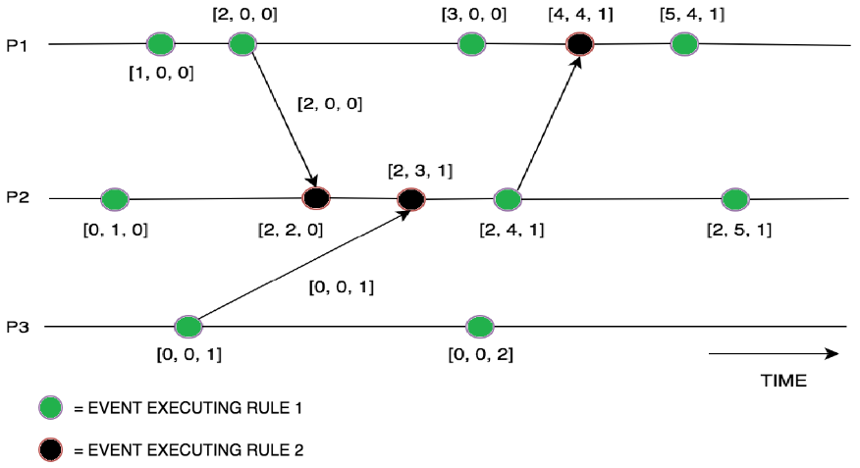
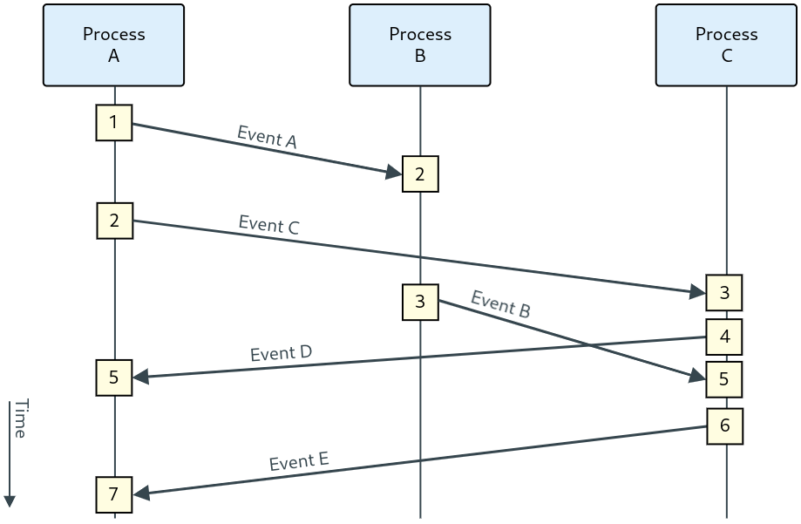
Techniques (Logical)
Challenges
Lamport time-stamps
Vector Clocks

Slide 5
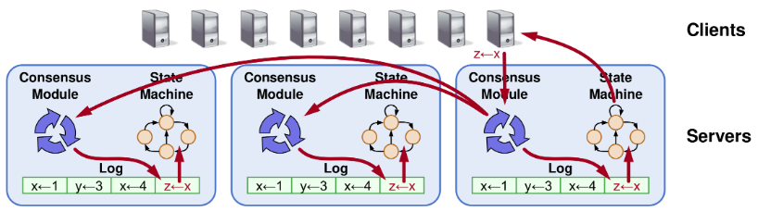
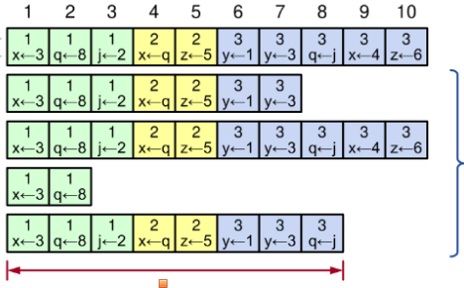
Perspectivation
RAFT

Slide 6
2. Leader Election and Consistency

Slide 7
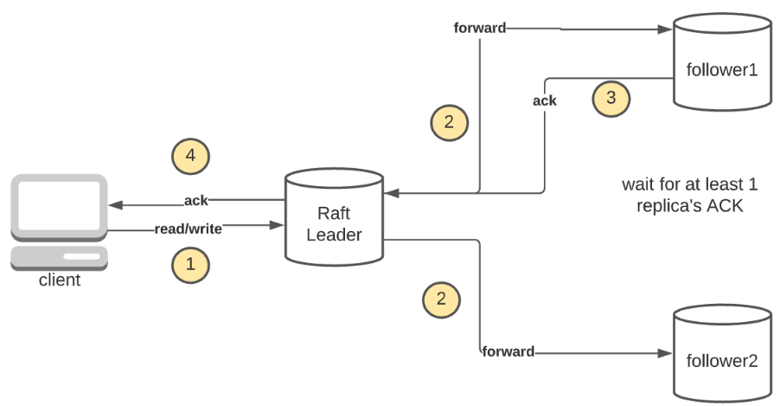
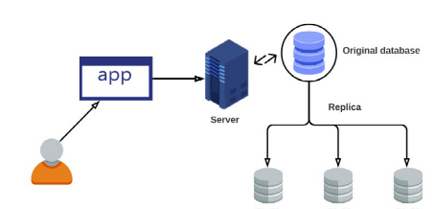
Motivation
Leader Election
Data & Div./Conq.
Consistency
Replication → Troubles

Slide 8
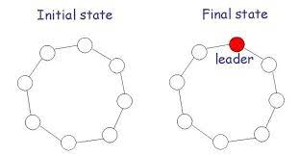
Leader Election
Prerequisites
General Approach
When?
Technique Comparison

Slide 9
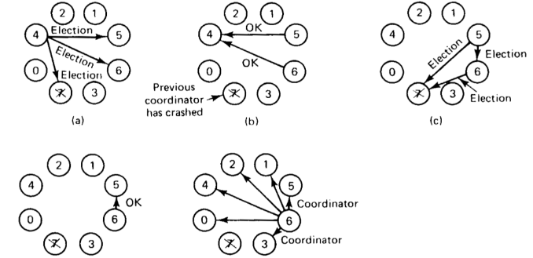
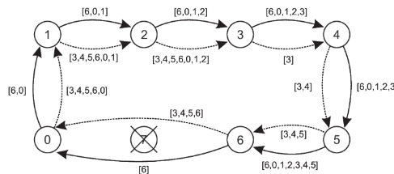
Techniques
Bully
Ring-based: Chang and Roberts
Message Complexicity

Slide 10
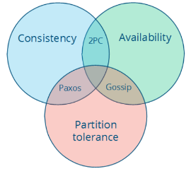
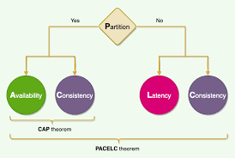
Consistency
!
CAP
PACELC

Slide 11
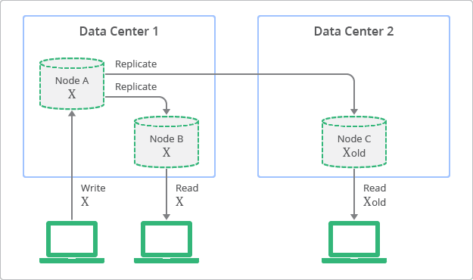
Consistency models
Strong Consistency
Weak Consistency
Eventual Consistency
….

Slide 12
3. Fault tolerance and consensus

Slide 13
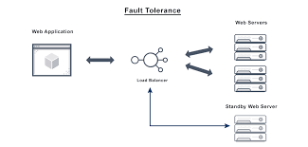

Motivation
Fault Tolerance
Failures?
Consensus
Coherent group

Slide 14
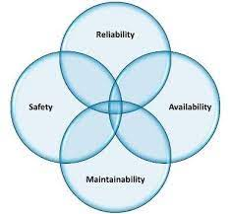
Terminology
Failures:
Crash, Arbitrary...
Fault consequences

Slide 15
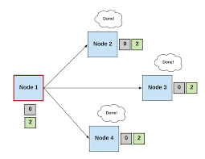
Consensus
What?
Fault consequences
Approaches
State machine replication
X Process fails
Paxos, Zoo Keeper, RAFT

Slide 16
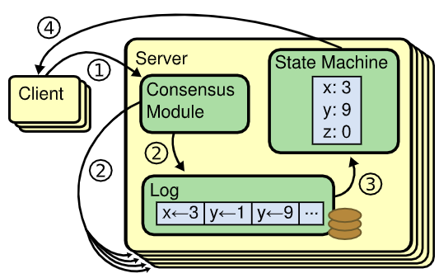
RAFT
!
Basics
Leader Election
Log Replication
Election Restriction (Safety)

Slide 17
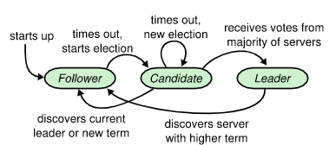
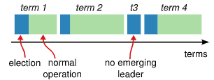
RAFT
!
Basics
Leader Election
Log Replication
Election Restriction (Safety)

Slide 18
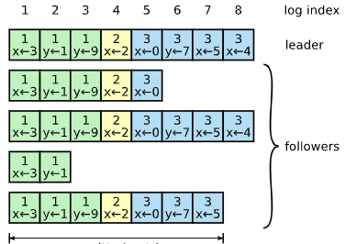
RAFT
!
Basics
Leader Election
Log Replication
Election Restriction (Safety)

Slide 19
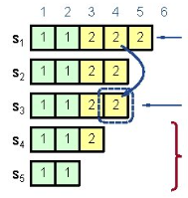
RAFT
!
Basics
Leader Election
Log Replication
Election Restriction (Safety)

Slide 20
4. Positioning and location awareness

Slide 21
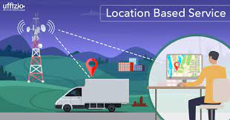
Motivation
Navigation
Firefighters

Slide 22

Challenges
Level
Privacy

Slide 23
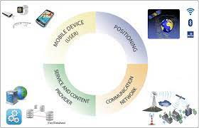
Concepts
Position
Absolute/Relative/Hybrid
Location
Location Service
Location Based Service

Slide 24
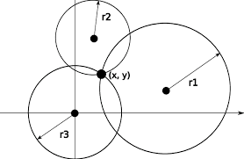
Absolute Positioning
Trilateration
Triangulation (ToTal)

Slide 25
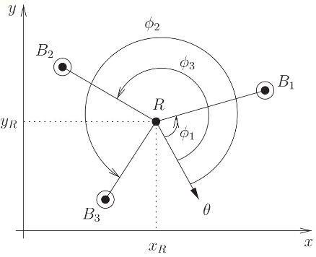
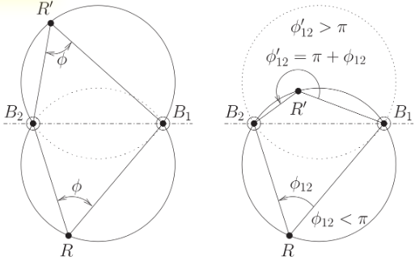
Absolute Positioning
Trilateration
Triangulation (ToTal)

Slide 26
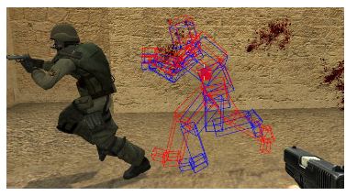
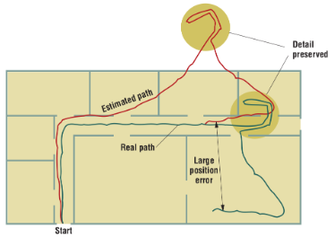
Relative Positioning
Dead Reckoning

Slide 27
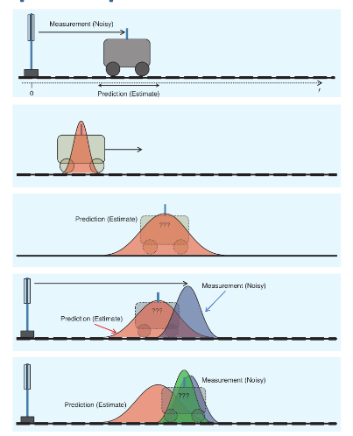

Hybrid Positioning
Sensor Fusion
Kalman filters

Slide 28
Perspective
Pervasive systems
Article - Privacy

Slide 29
5. Pervasive Computing (Background, Methods and Enabling tech.)

Slide 30
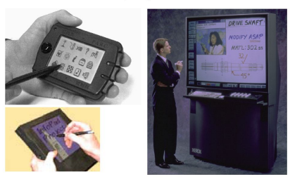
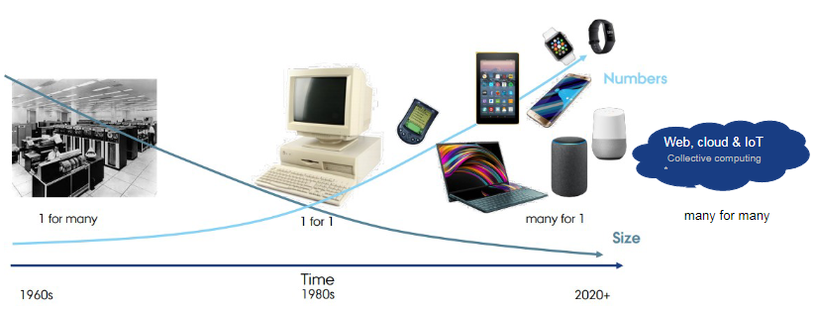
Background
Weiser – XEROC PARC
→ Cloud, Crowd and Shroud

Slide 31
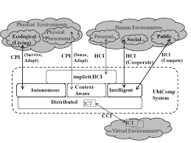
Properties
Ubiquitous
Transparent
Openness
Autonomous

Slide 32
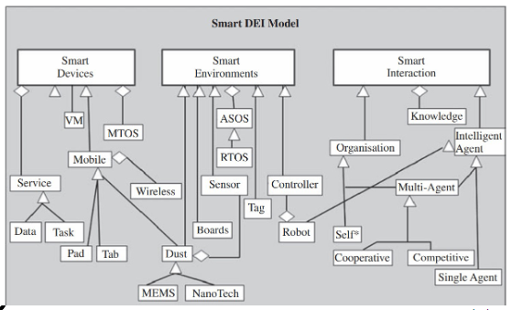
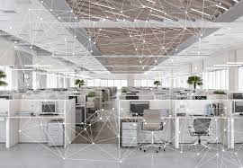
Concepts/Methods
!
Awareness
Interaction
Smart X
Calm Tech.

Slide 33
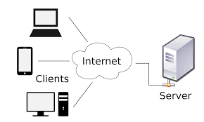
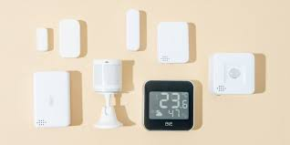
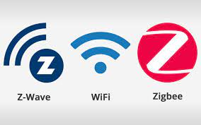
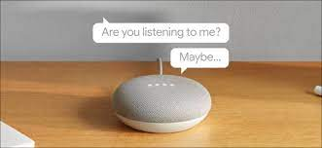
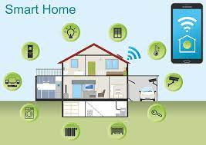

Enabling Technologies
!

Slide 34
6. Context awareness using smart X (towards intelligent environments)

Slide 35
Context Aware System
Situation
What, Where, When,
How
and Why
Sensor Fusion

Slide 36
Challenges
User Context
Environment Context
Privacy

Slide 37
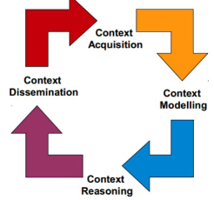
Lifecycle
Data Sources
Management - Querying
KB/KBG - Ontology Based
Ontology Based → Adaption (passive/active)

Slide 38
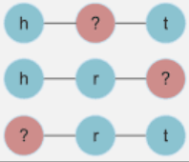
Example
Fact
Subject
Relation
Object

Slide 39
Smart X
Combination → Intelligent Environment

Slide 40
Intelligent System
Distributed
Environment
Interaction
Context
Zero Conf.

