Slide 1
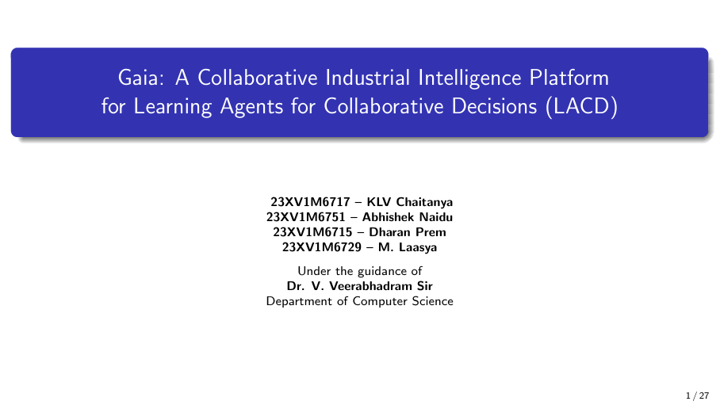
1 / 44

Slide 2
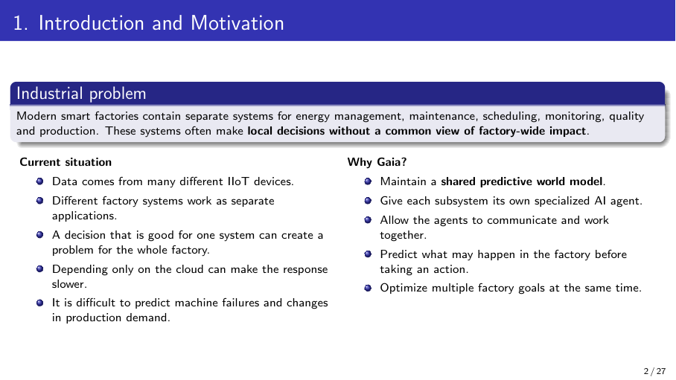
2 / 44

Slide 3
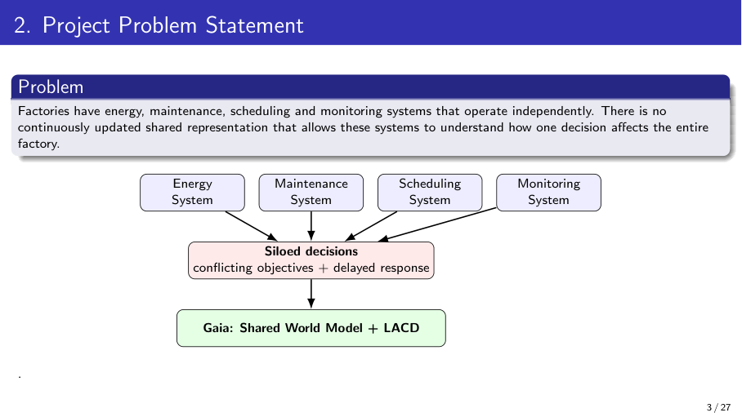
3 / 44

Slide 4
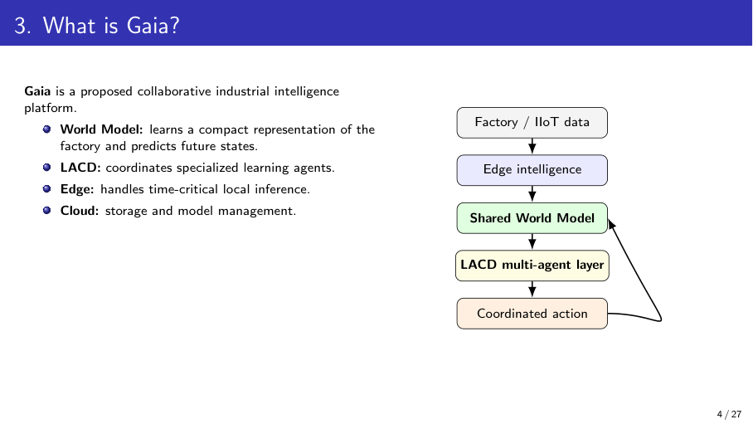
4 / 44

Slide 5
Review 1 Feedback and Actions Taken
Review 1 Suggestion | Action Taken
[Add faculty suggestion 1] | [Add action taken]
[Add faculty suggestion 2] | [Add action taken]
[Add faculty suggestion 3] | [Add action taken]
Methodology only at block-diagram level | Detailed What / Why / How methodology prepared
Compare existing work | Comparative table of 8 papers prepared
Problem statement too broad | Refined problem statement and 5 objectives written
Red rows are placeholders: replace with the actual Review 1 comments before presenting.
5 / 44

Slide 6
Refined Problem Statement
Existing situation
Smart factories run energy, maintenance, scheduling and monitoring as separate systems fed by many IIoT devices.
Problem
Each system optimizes locally; a good decision for one can hurt the whole factory.
Limitation
Existing work studies world models, MARL, digital twins, maintenance and carbon scheduling in isolation, mostly on single objectives or simulated data.
Need
A shared predictive view of the factory so every subsystem can see the factory-wide impact of an action before acting.
Proposed direction
Gaia: a shared world model + LACD multi-agent coordination, split across edge and cloud, optimizing several factory goals together.
6 / 44

Slide 7
Objectives
1
Data
Identify factory subsystems and IIoT variables; collect or generate the dataset.
2
World model
Build a shared world model that learns factory state and predicts future states.
3
Agents + LACD
Develop energy, maintenance, scheduling and monitoring agents with LACD coordination.
4
Optimization
Optimize energy, carbon, latency, machine health and throughput together across edge and cloud.
5
Evaluation
Compare Gaia with centralized and independent-agent baselines, with ablation studies.
7 / 44

Slide 8
Comparative Analysis of Literature
Paper | Year | Method | Dataset / Setting | Reported result | Limitation
World Models (Ha & Schmidhuber) | 2018 | VAE + MDN-RNN + controller | CarRacing, VizDoom | CarRacing score 906 ± 21 | Imperfect model can be exploited
MARL demand response | — | POMDP + MAPPO + attention critic | Steel powder plant (sim.) | Better coordination at α = 0.8 | Energy only; no maintenance link
ML2MAS | — | GAN + BNN + MARL | ZeMA hydraulic data | F1 = 0.95–0.99 | Not tied to energy / scheduling
Carbon-aware scheduling (Asadov et al.) | 2025 | Spatial + temporal shifting | Review of 28 studies | Only 2 combine both | No unified optimization
Digital twin + edge + FL (Padmavathi et al.) | 2025 | Edge AI + FMI co-simulation + FL | Simulated smart factory | 42 ms latency; 94.2% fault acc. | No shared world model
Hybrid DT + meta-learning (Harshinni) | 2025 | FFNN + MAML + Q-learning | Synthetic wafer data | MAE 2.15; 92% accuracy | Synthetic data only
CausalPulse (Shyalika et al.) | 2026 | Neurosymbolic multi-agent RCA | Future Factories, PSE | 98.0% success | Diagnosis; no future prediction
MARL in smart factories (Bahrpeyma & Reichelt) | 2022 | Review | — | — | Credit assignment, scalability
Gaia (proposed) | 2026 | Shared world model + LACD | To be finalized | To be evaluated | Targets the gaps above
8 / 44

Slide 9
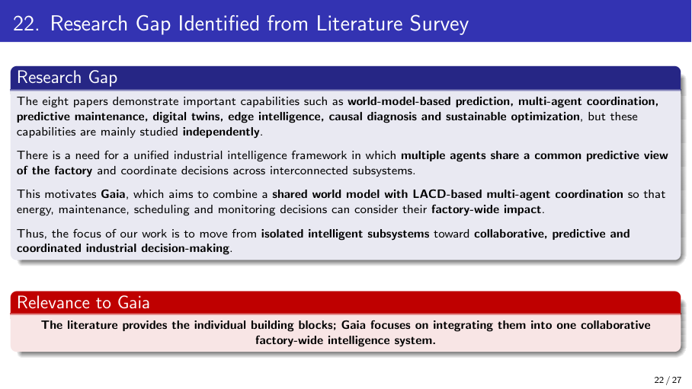
9 / 44

Slide 10
Final Research Gap: From Literature to Methodology
Literature
Limitations
Research Gap
Methodology
• World models predict states
• MARL coordinates agents
• Edge + digital twins cut latency
• Maintenance and causal diagnosis work
• Each studied independently
• Maintenance not linked to energy / scheduling
• Learned models are imperfect
• Mostly simulated, single-objective
• No framework where agents share one predictive factory state
• No joint, factory-wide, multi-objective decisions
• Shared world model
• LACD multi-agent coordination
• Edge–cloud execution
• Multi-objective J(a)
Why it matters
Local decisions without a common view cause conflicting actions, delayed response and missed failures. Gaia addresses this by connecting prediction, coordination and action.
10 / 44

Slide 11
Proposed Contribution
What is new?
A single shared predictive world model that connects energy, maintenance, scheduling and monitoring agents, so decisions are coordinated and optimized factory-wide.
Contribution points
Shared world model as the common state for all agents
LACD: coordinated learning agents with conflict resolution
Joint multi-objective cost J(a): energy, carbon, latency, health, throughput
Edge–cloud split: fast local decisions, global coordination
Why not just a combination?
Existing papers cover each block alone; none links them through one predictive state
Uncertainty-aware: actions are validated against factory constraints before execution
Ablation (without world model / LACD) will show the value of each part
11 / 44

Slide 12
Detailed Methodology (1/2): Data, World Model, Agents
Component | What? | Why? | How?
1. Data and state representation | Builds one common factory-state vector from IIoT, PLC, log and sensor data. | Subsystems use different formats, so they cannot share a view. | Define shared schema; clean, normalize and window time-series data.
2. Shared world model | Learns a compact factory state and predicts the next states. | Lets agents see the effect of an action before acting. | Encoder + recurrent dynamics model (as in World Models) with uncertainty estimates.
3. Specialized agents | Energy, maintenance, scheduling and monitoring agents, each with its own goal. | Each subsystem needs its own expertise and fast decisions. | RL policies (PPO-style) trained on world-model states; validated one by one.
12 / 44

Slide 13
Detailed Methodology (2/2): LACD, Edge–Cloud, Optimization
Component | What? | Why? | How?
4. LACD coordination | Agents exchange state and resolve conflicting objectives. | Independent agents give locally good but globally poor actions. | Centralized training, decentralized execution (MAPPO-style) with attention critic.
5. Edge–cloud integration | Edge runs time-critical inference; cloud trains and manages models. | Cloud-only control is slow; edge-only lacks global view. | Lightweight models at the edge; periodic model sync from cloud.
6. Multi-objective optimization and safety | Scores each action by J(a) and checks it against factory limits. | Factory goals conflict; model errors can cause unsafe actions. | Weighted sum of E, C, L, H, P; reject actions that violate constraints.
13 / 44

Slide 14
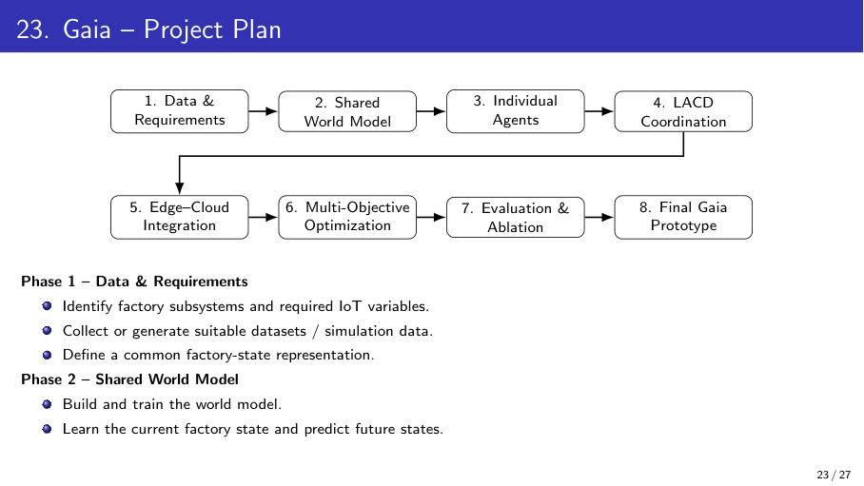
14 / 44

Slide 15
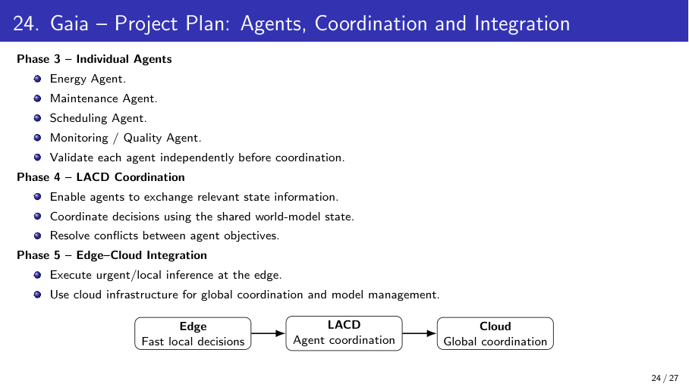
15 / 44

Slide 16
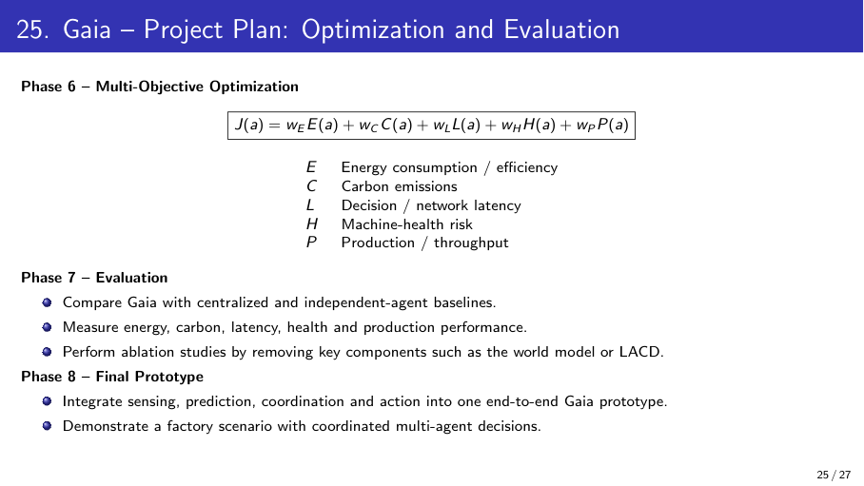
16 / 44

Slide 17
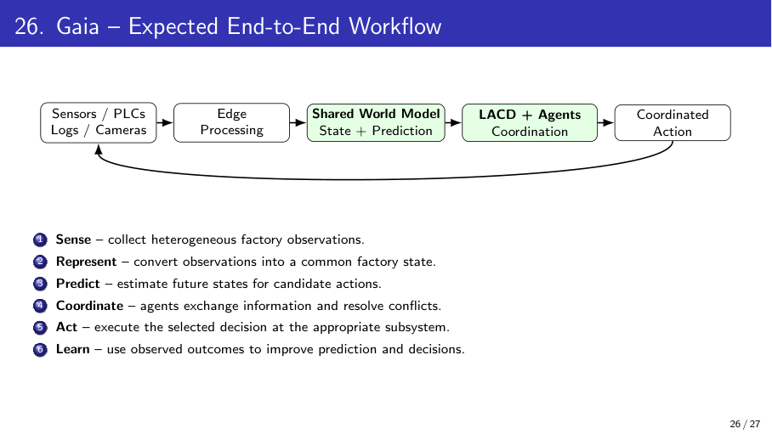
17 / 44

Slide 18
Dataset / Data Collection
Field | Dataset 1 | Dataset 2 | Dataset 3
Dataset name | [name] | [name] | [name]
Source / link | [https://link-to-dataset-1] | [https://link-to-dataset-2] | [https://link-to-dataset-3]
Samples / variables | [ ] | [ ] | [ ]
Input format | [sensor / time-series, dimensions] | [ ] | [ ]
Train / val / test split | [ ] | [ ] | [ ]
Preprocessing | [cleaning, normalization, windowing] | [ ] | [ ]
Template: team to fill in. If data is self-collected, add: collection method, sample size, labeling process and privacy notes.
18 / 44

Slide 19
Tools and Technologies
Category | Tool | Role in Gaia
Language | Python | All modeling, simulation and agent code
Deep learning | PyTorch | World model and agent policy networks
Multi-agent RL | Gymnasium / PettingZoo, RLlib | Factory environment and MAPPO-style training
Data handling | Pandas, NumPy, scikit-learn | Preprocessing, windowing, baseline metrics
Edge–cloud | Docker, MQTT | Edge deployment and IIoT message passing
Environment | Google Colab, VS Code, GitHub | Training, development and version control
Proposed stack: confirm or change before the review.
19 / 44

Slide 20
Baseline Approaches
Model | Description | Purpose
B1: Centralized | One controller optimizes all subsystems | Tests speed at scale
B2: Independent agents | Agents act on local data, no sharing | Tests value of coordination
B3: Gaia without world model | Agents + LACD, no shared prediction | Ablation
B4: Gaia without LACD | World model, agents act independently | Ablation
Proposed: full Gaia | World model + LACD + edge–cloud | Main system
Results table (to be filled after experiments)
Model | E | C | L | H | P
Baselines (B1–B4) | — | — | — | — | —
Gaia | — | — | — | — | —
20 / 44

Slide 21
Initial Implementation Progress
Status
Implementation is in progress. No results are claimed yet.
Item | Status | Evidence
Literature study (8 papers) and comparison | Completed | Slides: Literature and Comparative Analysis
Problem, objectives and methodology refined | Completed | Slides: Problem, Objectives, Methodology
Environment and tools set up | [Update] | [screenshot / repo link]
Dataset downloaded / simulator built | [Update] | [sample data]
Initial code (preprocessing, baseline) | [Update] | [code / plot]
21 / 44

Slide 22
Evaluation Strategy
What will we measure?
What will we compare?
• E Energy consumption
• C Carbon emissions
• L Decision / network latency
• H Machine-health risk
• P Production throughput
• World-model prediction error
• Gaia vs centralized baseline (B1)
• Gaia vs independent agents (B2)
• Gaia vs ablations (B3, B4)
• Overall cost J(a) = wE·E + wC·C + wL·L + wH·H + wP·P
What shows success?
• Gaia achieves a lower J(a) than every baseline.
• Latency stays within the edge limit; production is not reduced.
• Exact target improvement to be fixed after baseline runs.
22 / 44

Slide 23
Current Status
Activity | Status
Problem identification | Completed
Literature review | Completed
Research gap | Completed
Methodology design | In Progress
Dataset identification | In Progress
Data preprocessing | Yet to Start
Baseline implementation | Yet to Start
Proposed model (world model + LACD) | Yet to Start
Evaluation | Yet to Start
Draft statuses: update to match actual progress.
23 / 44

Slide 24
Work Completed After Review 1
Studied 8 papers and prepared a comparative analysis
Refined the problem statement and wrote 5 objectives
Sharpened the research gap and stated the proposed contribution
Detailed the methodology (What / Why / How) and defined 4 baselines
Defined evaluation metrics and the multi-objective cost J(a)
[Add: environment setup, code written, experiments run]
[Add: faculty feedback incorporated]
24 / 44

Slide 25
Remaining Work and Timeline
Phase | Activity | Draft timeline | Status
1 | Data and requirements | Weeks 1–3 | In Progress
2 | Shared world model | Weeks 3–7 | Yet to Start
3 | Individual agents | Weeks 6–10 | Yet to Start
4 | LACD coordination | Weeks 9–13 | Yet to Start
5 | Edge–cloud integration | Weeks 12–15 | Yet to Start
6 | Multi-objective optimization | Weeks 14–17 | Yet to Start
7 | Evaluation and ablation | Weeks 16–19 | Yet to Start
8 | Final Gaia prototype | Weeks 19–22 | Yet to Start
Draft timeline in weeks: adjust to the project schedule.
25 / 44

Slide 26
References
[1] D. Ha and J. Schmidhuber, "World Models," 2018.
[2] "Multi-agent deep reinforcement learning based demand response and energy management for heavy industries with discrete manufacturing systems."
[3] "ML2MAS: a multi-agent reinforcement learning and BNNs-GAN integration framework for smart manufacturing optimization."
[4] Asadov et al., "Carbon-Aware Spatio-Temporal Workload Shifting in Edge–Cloud Environments: A Review and Novel Algorithm," 2025.
[5] Padmavathi, Kanimozhi and Saminathan, "Digital twin driven smart factories: real time physics based co-simulation using edge A.I. and federated learning," 2025.
[6] Harshinni B., "Hybrid Digital Twin Framework with Meta-Learning and Reinforcement Learning for Nonlinear Manufacturing Systems," 2025.
[7] Shyalika et al., "CausalPulse: An Industrial-Grade Neurosymbolic Multi-Agent Copilot for Causal Diagnostics in Smart Manufacturing," 2026.
[8] Bahrpeyma and Reichelt, "A review of the applications of multi-agent reinforcement learning in smart factories," 2022.
[Add authors / venue / DOI for [2] and [3]]
26 / 44

Slide 27
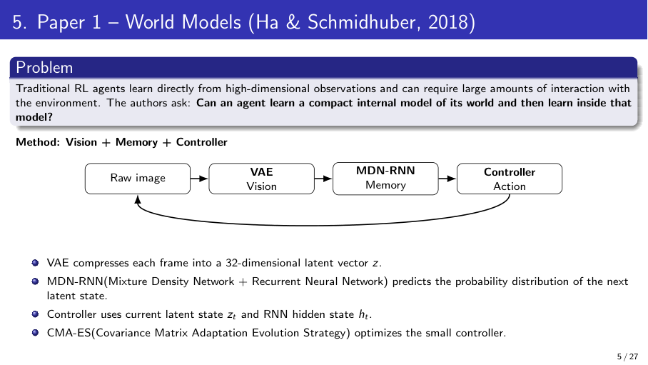
27 / 44

Slide 28
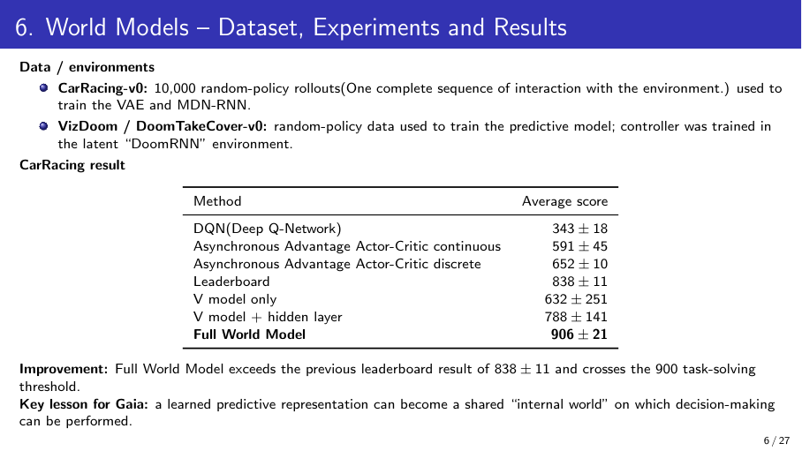
28 / 44

Slide 29
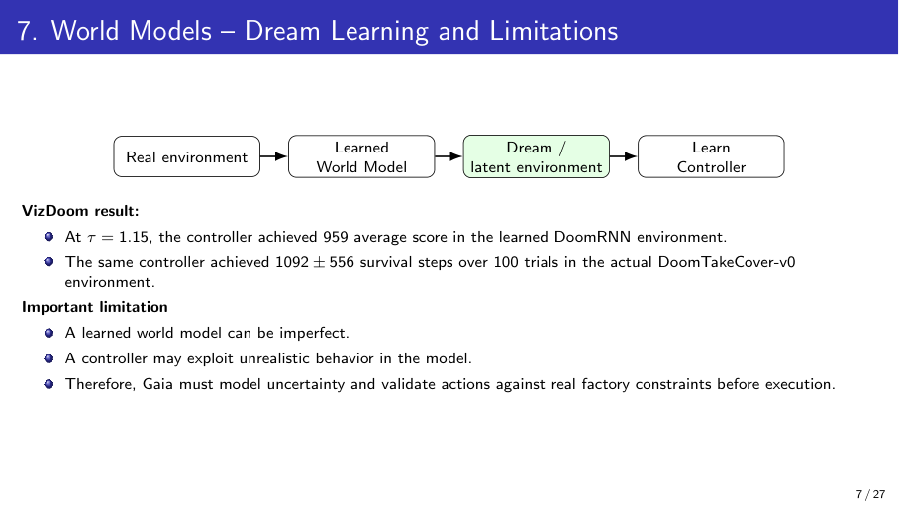
29 / 44

Slide 30
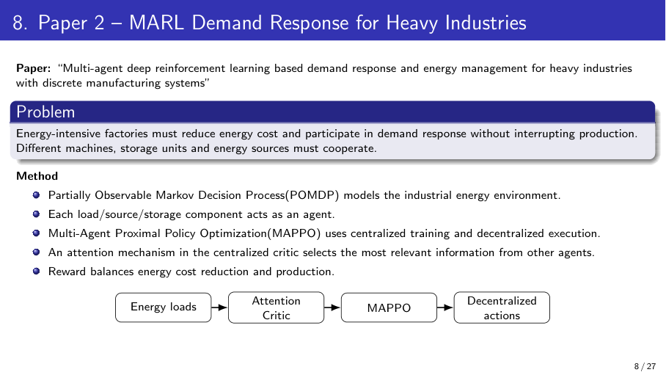
30 / 44

Slide 31
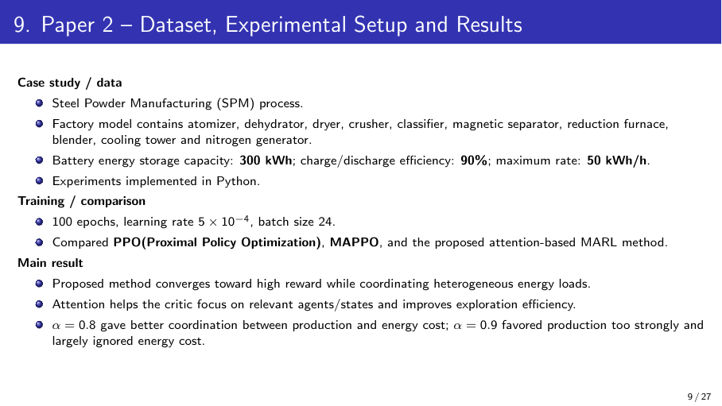
31 / 44

Slide 32
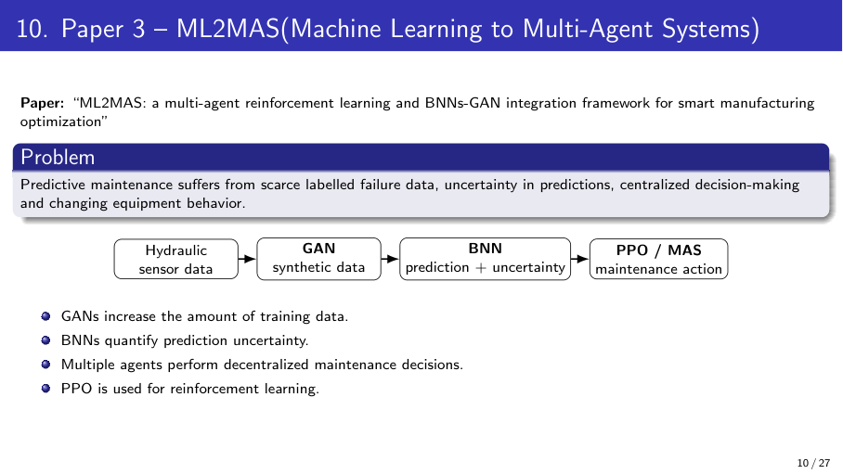
32 / 44

Slide 33
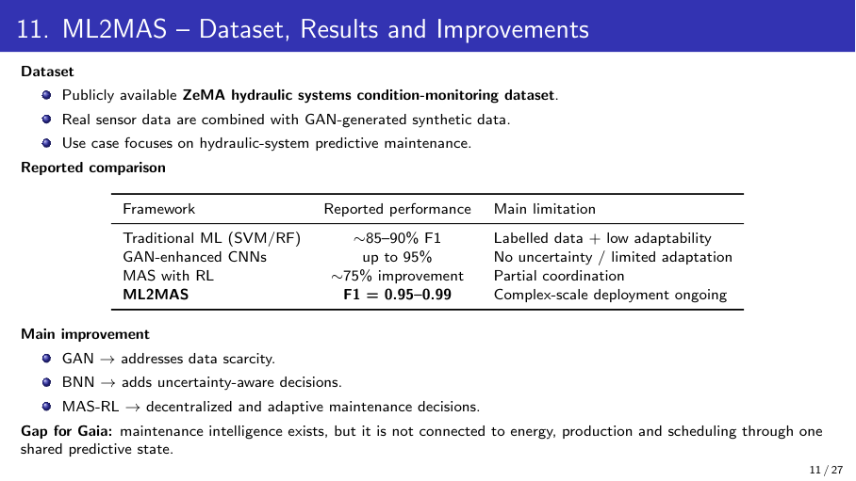
33 / 44

Slide 34
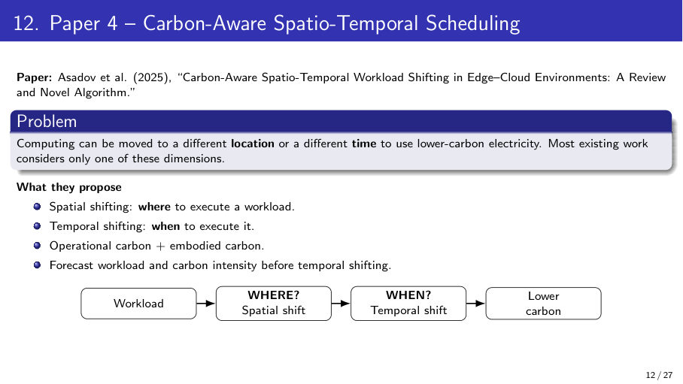
34 / 44

Slide 35
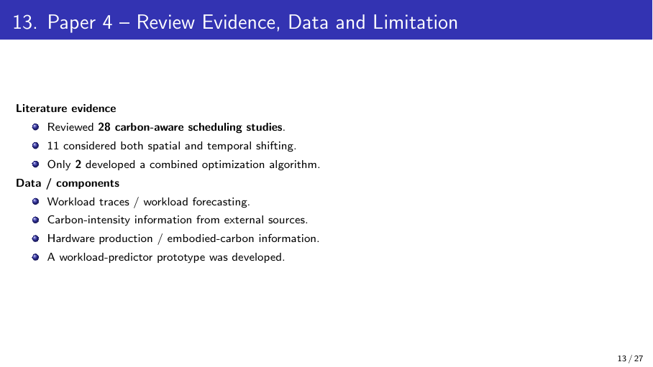
35 / 44

Slide 36
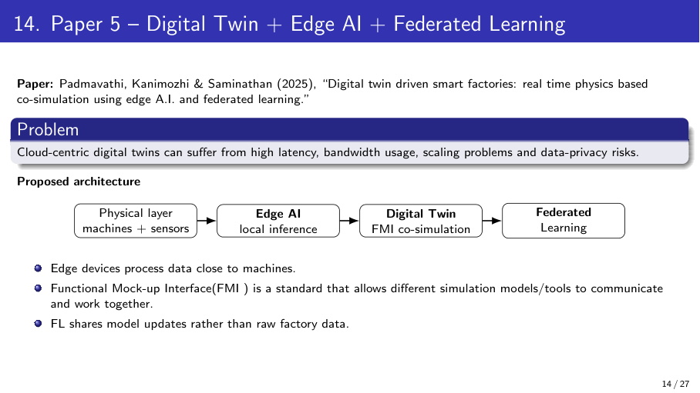
36 / 44

Slide 37
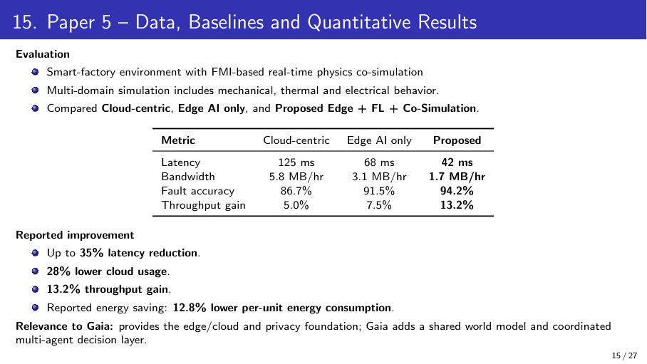
37 / 44

Slide 38
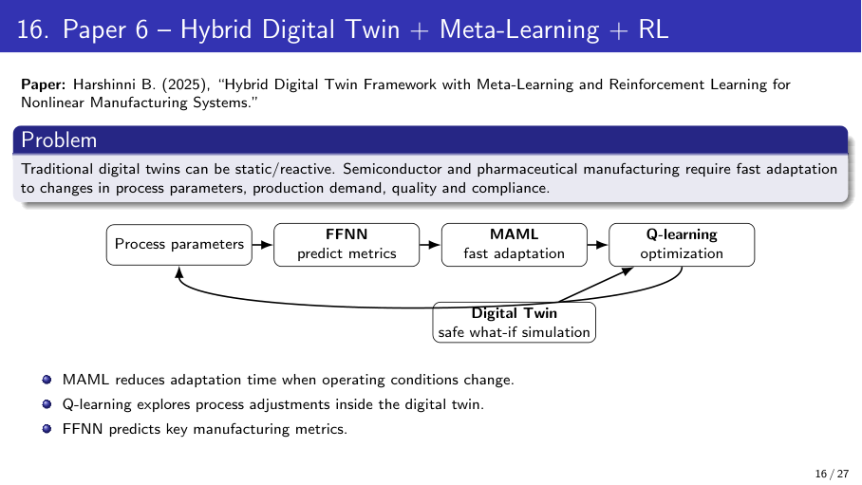
38 / 44

Slide 39
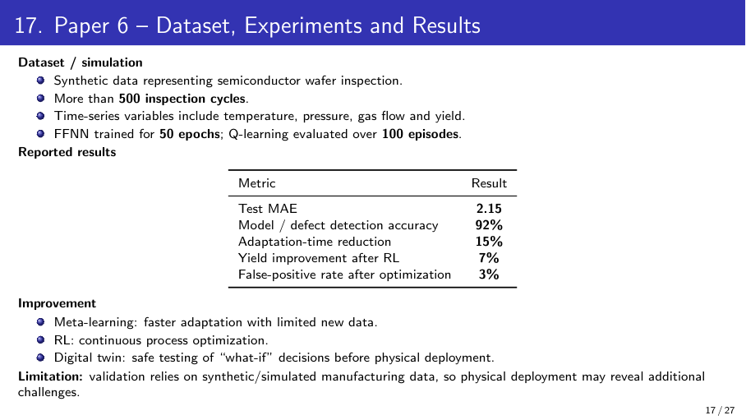
39 / 44

Slide 40
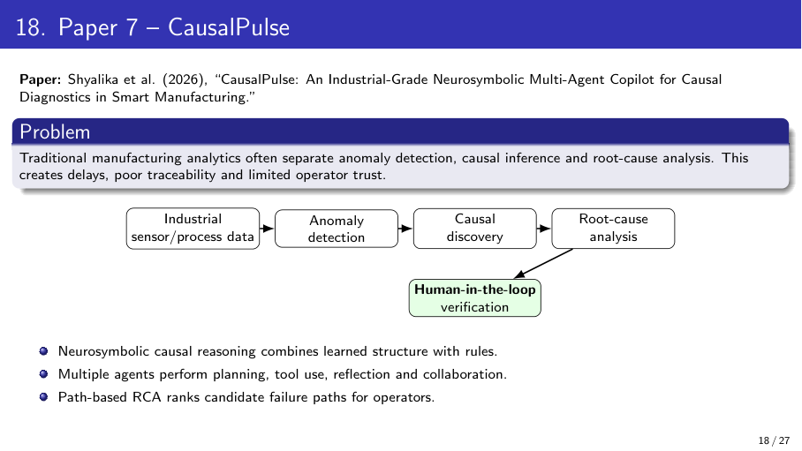
40 / 44

Slide 41
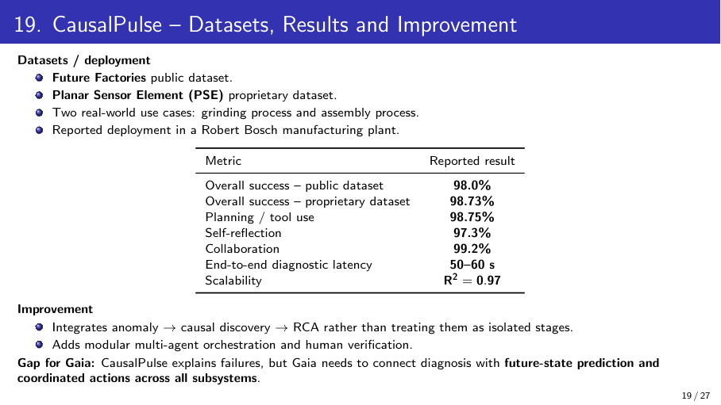
41 / 44

Slide 42
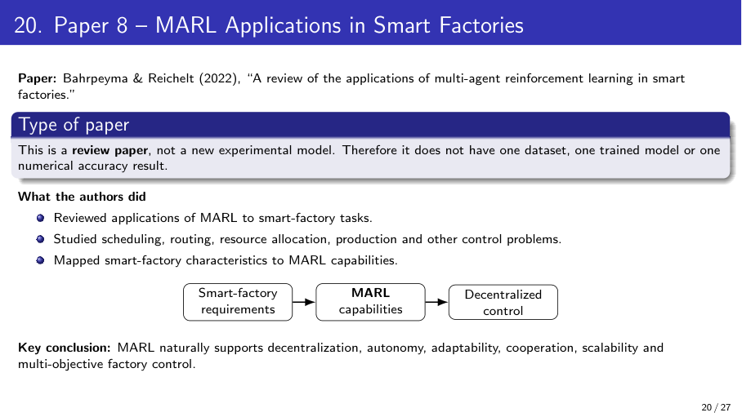
42 / 44

Slide 43
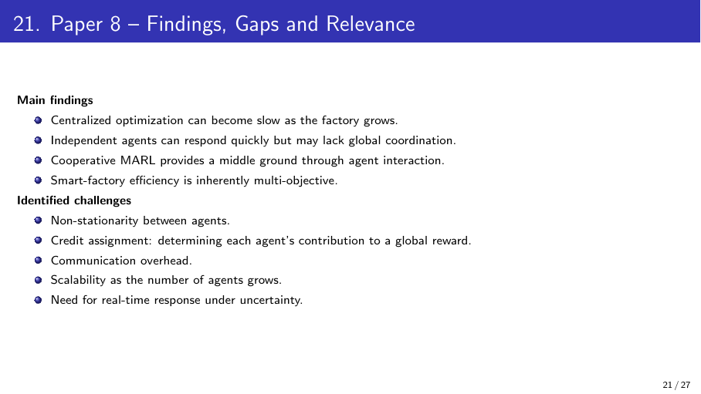
43 / 44

Slide 44
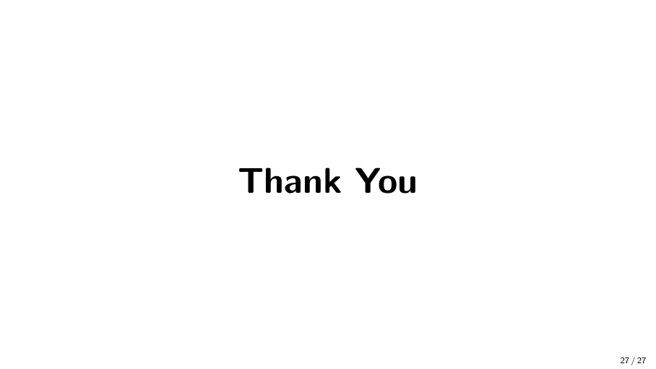
44 / 44

