Slide 1
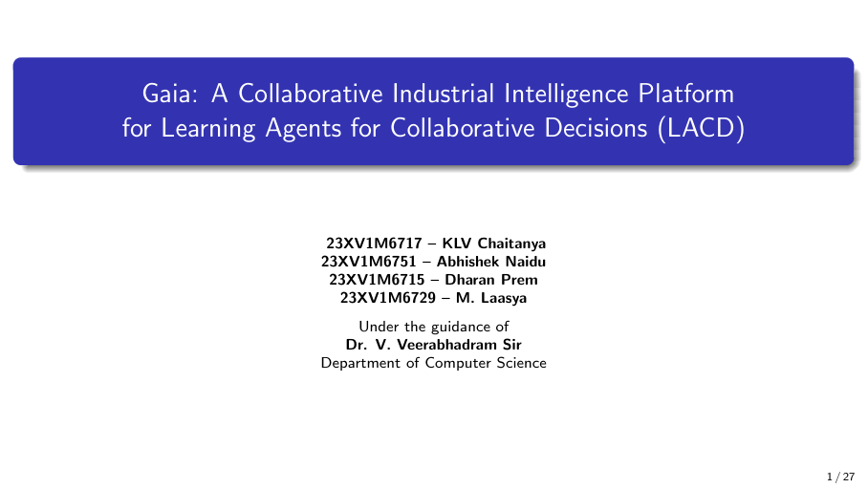
1 / 44

Slide 2
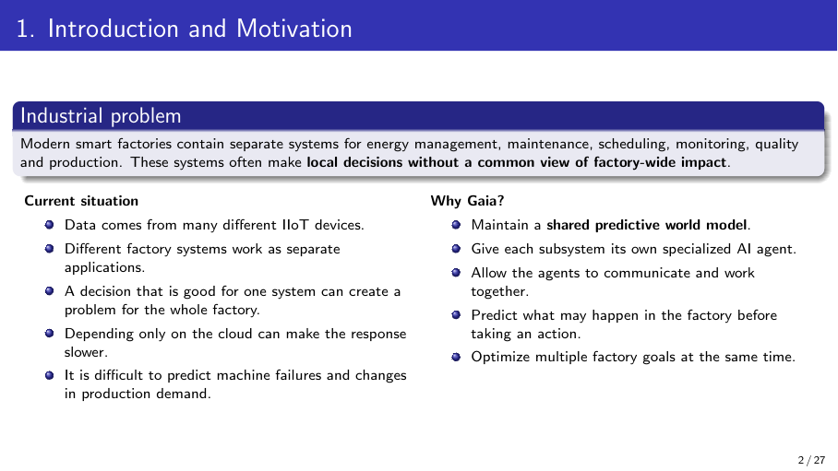
2 / 44

Slide 3
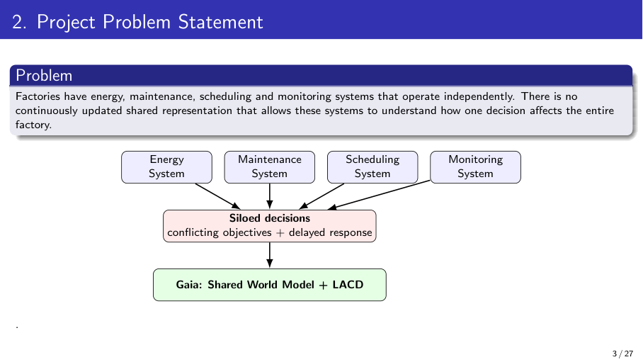
3 / 44

Slide 4
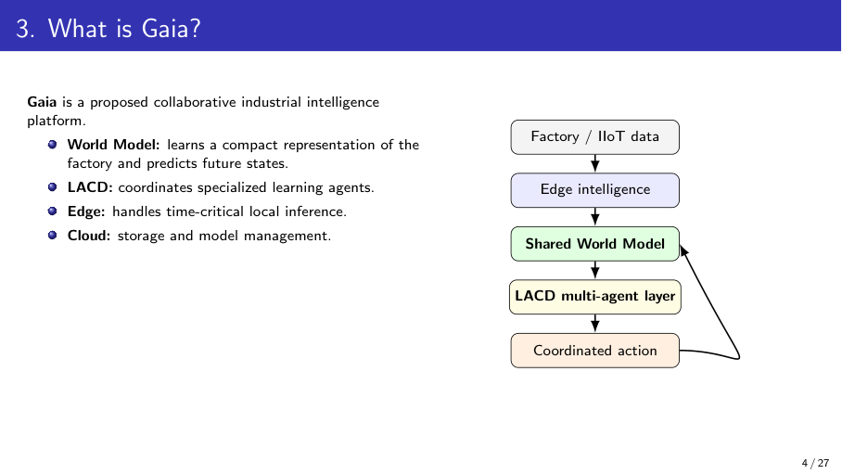
4 / 44

Slide 5
Review 1 Feedback and Actions Taken
Review 1 Suggestion | Action Taken
[Add faculty suggestion 1] | [Add action taken]
[Add faculty suggestion 2] | [Add action taken]
[Add faculty suggestion 3] | [Add action taken]
Methodology only at block-diagram level | Detailed What / Why / How methodology prepared
Compare existing work | Comparative table of 8 papers prepared
Problem statement too broad | Refined problem statement and 5 objectives written
Red rows are placeholders: replace with the actual Review 1 comments before presenting.
5 / 44

Slide 6
Refined Problem Statement
Existing situation
Smart factories run energy, maintenance, scheduling and monitoring as separate systems fed by many IIoT devices.
Problem
Each system optimizes locally; a good decision for one can hurt the whole factory.
Limitation
Existing work studies world models, MARL, digital twins, maintenance and carbon scheduling in isolation, mostly on single objectives or simulated data.
Need
A shared predictive view of the factory so every subsystem can see the factory-wide impact of an action before acting.
Proposed direction
Gaia: a shared world model + LACD multi-agent coordination, split across edge and cloud, optimizing several factory goals together.
6 / 44

Slide 7
Objectives
1
Data
Identify factory subsystems and IIoT variables; collect or generate the dataset.
2
World model
Build a shared world model that learns factory state and predicts future states.
3
Agents + LACD
Develop energy, maintenance, scheduling and monitoring agents with LACD coordination.
4
Optimization
Optimize energy, carbon, latency, machine health and throughput together across edge and cloud.
5
Evaluation
Compare Gaia with centralized and independent-agent baselines, with ablation studies.
7 / 44

Slide 8
Comparative Analysis of Literature
Paper | Year | Method | Dataset / Setting | Reported result | Limitation
World Models (Ha & Schmidhuber) | 2018 | VAE + MDN-RNN + controller | CarRacing, VizDoom | CarRacing score 906 ± 21 | Imperfect model can be exploited
MARL demand response | — | POMDP + MAPPO + attention critic | Steel powder plant (sim.) | Better coordination at α = 0.8 | Energy only; no maintenance link
ML2MAS | — | GAN + BNN + MARL | ZeMA hydraulic data | F1 = 0.95–0.99 | Not tied to energy / scheduling
Carbon-aware scheduling (Asadov et al.) | 2025 | Spatial + temporal shifting | Review of 28 studies | Only 2 combine both | No unified optimization
Digital twin + edge + FL (Padmavathi et al.) | 2025 | Edge AI + FMI co-simulation + FL | Simulated smart factory | 42 ms latency; 94.2% fault acc. | No shared world model
Hybrid DT + meta-learning (Harshinni) | 2025 | FFNN + MAML + Q-learning | Synthetic wafer data | MAE 2.15; 92% accuracy | Synthetic data only
CausalPulse (Shyalika et al.) | 2026 | Neurosymbolic multi-agent RCA | Future Factories, PSE | 98.0% success | Diagnosis; no future prediction
MARL in smart factories (Bahrpeyma & Reichelt) | 2022 | Review | — | — | Credit assignment, scalability
Gaia (proposed) | 2026 | Shared world model + LACD | To be finalized | To be evaluated | Targets the gaps above
8 / 44

Slide 9
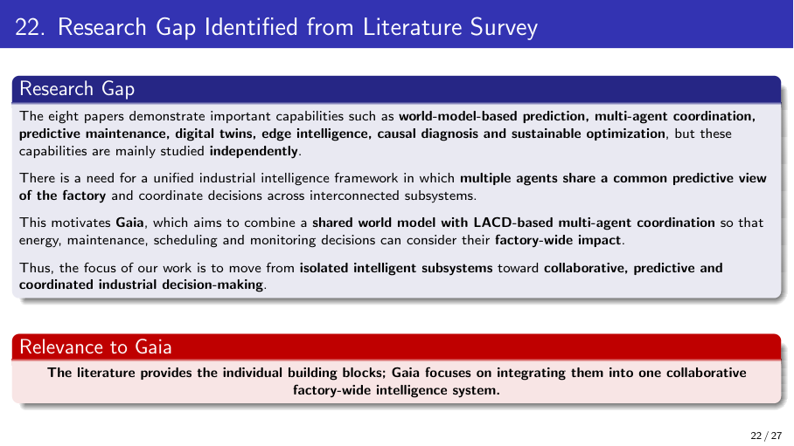
9 / 44

Slide 10
Final Research Gap: From Literature to Methodology
Literature
Limitations
Research Gap
Methodology
• World models predict states
• MARL coordinates agents
• Edge + digital twins cut latency
• Maintenance and causal diagnosis work
• Each studied independently
• Maintenance not linked to energy / scheduling
• Learned models are imperfect
• Mostly simulated, single-objective
• No framework where agents share one predictive factory state
• No joint, factory-wide, multi-objective decisions
• Shared world model
• LACD multi-agent coordination
• Edge–cloud execution
• Multi-objective J(a)
Why it matters
Local decisions without a common view cause conflicting actions, delayed response and missed failures. Gaia addresses this by connecting prediction, coordination and action.
10 / 44

Slide 11
Proposed Contribution
What is new?
A single shared predictive world model that connects energy, maintenance, scheduling and monitoring agents, so decisions are coordinated and optimized factory-wide.
Contribution points
Shared world model as the common state for all agents
LACD: coordinated learning agents with conflict resolution
Joint multi-objective cost J(a): energy, carbon, latency, health, throughput
Edge–cloud split: fast local decisions, global coordination
Why not just a combination?
Existing papers cover each block alone; none links them through one predictive state
Uncertainty-aware: actions are validated against factory constraints before execution
Ablation (without world model / LACD) will show the value of each part
11 / 44

Slide 12
Detailed Methodology (1/2): Data, World Model, Agents
Component | What? | Why? | How?
1. Data and state representation | Builds one common factory-state vector from IIoT, PLC, log and sensor data. | Subsystems use different formats, so they cannot share a view. | Define shared schema; clean, normalize and window time-series data.
2. Shared world model | Learns a compact factory state and predicts the next states. | Lets agents see the effect of an action before acting. | Encoder + recurrent dynamics model (as in World Models) with uncertainty estimates.
3. Specialized agents | Energy, maintenance, scheduling and monitoring agents, each with its own goal. | Each subsystem needs its own expertise and fast decisions. | RL policies (PPO-style) trained on world-model states; validated one by one.
12 / 44

Slide 13
Detailed Methodology (2/2): LACD, Edge–Cloud, Optimization
Component | What? | Why? | How?
4. LACD coordination | Agents exchange state and resolve conflicting objectives. | Independent agents give locally good but globally poor actions. | Centralized training, decentralized execution (MAPPO-style) with attention critic.
5. Edge–cloud integration | Edge runs time-critical inference; cloud trains and manages models. | Cloud-only control is slow; edge-only lacks global view. | Lightweight models at the edge; periodic model sync from cloud.
6. Multi-objective optimization and safety | Scores each action by J(a) and checks it against factory limits. | Factory goals conflict; model errors can cause unsafe actions. | Weighted sum of E, C, L, H, P; reject actions that violate constraints.
13 / 44

Slide 14
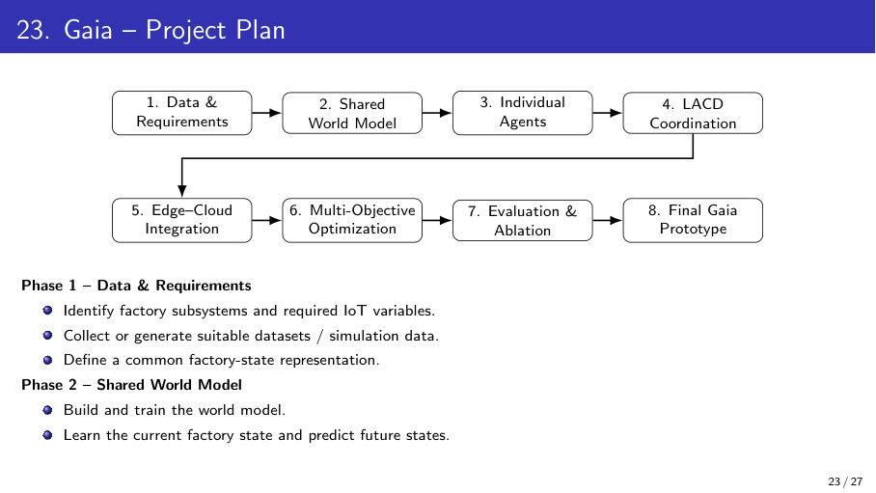
14 / 44

Slide 15
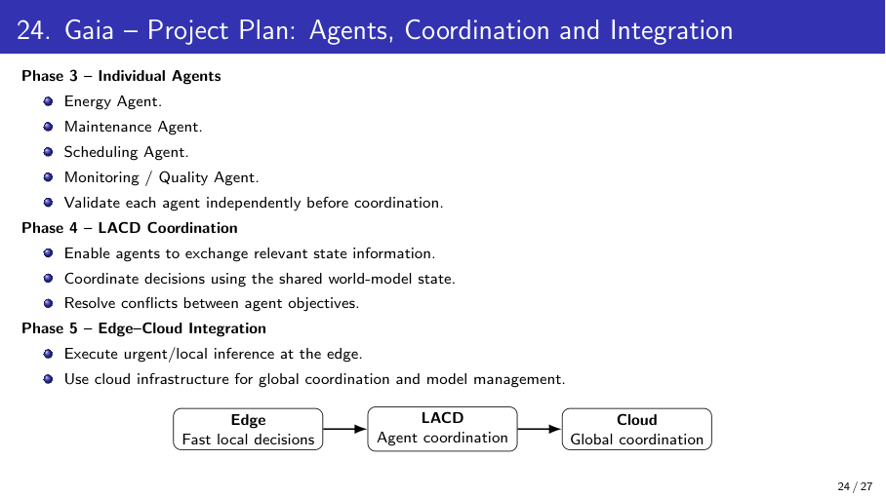
15 / 44

Slide 16
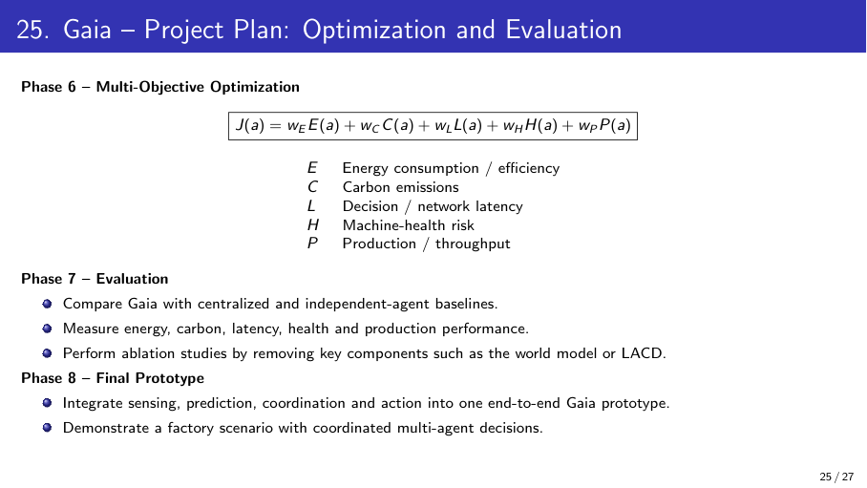
16 / 44

Slide 17
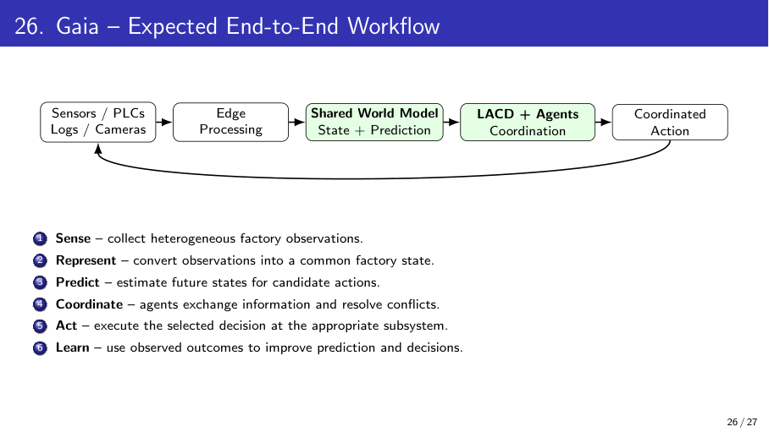
17 / 44

Slide 18
Dataset / Data Collection
Field | ZeMA hydraulic rig | Future Factories analog | HIPE electrical telemetry
Dataset name | ZeMA condition monitoring | Future Factories 2023 analog | HIPE cleaned 2017-10-23 to 2017-10-30
Source / file | Gaia-Code/Dataset/data.zip | Gaia-Code/Dataset/archive (15).zip | Gaia-Code/Dataset/hipe_cleaned_...zip
Samples / variables | 2,205 cycles; 17 sensor matrices | 974,836 timestamps; 7 synchronized CSVs | 1,239,845 raw rows; 11 machines
Input format | Tab-separated sensor matrices + profile labels | Seven timestamp-aligned analog CSV channels | Wide electrical telemetry CSVs
Train / val / test | 64-cycle grouped, disjoint splits | 80 / 10 / 10 grouped blocks; 10k labeled rows | 70 / 15 / 15 chronological; 78,056 / 16,731 / 16,731
Preprocessing | Per-cycle statistics; train-only impute/scale | Five-timestep windows; blank labels excluded | Per-machine minute aggregation; exact lags; train-only scaling
Also processed Smart Manufacturing: 12,757,920 communications, 832,930 positions and 213,056 state events; no anomaly labels. The semiconductor archive contains 100 machines and 40 process steps (metadata only). Full archive inventory: Gaia_Paper_Aligned/docs/DATASETS.md.
18 / 44

Slide 19
Tools and Technologies
Category | Tool | Role in Gaia
Language | Python | All modeling, simulation and agent code
Deep learning | PyTorch | World model and agent policy networks
Multi-agent RL | Gymnasium / PettingZoo, RLlib | Factory environment and MAPPO-style training
Data handling | Pandas, NumPy, scikit-learn | Preprocessing, windowing, baseline metrics
Edge–cloud | Docker, MQTT | Edge deployment and IIoT message passing
Environment | Google Colab, VS Code, GitHub | Training, development and version control
Proposed stack: confirm or change before the review.
19 / 44

Slide 20
Baseline Approaches
Model | Description | Purpose
B1: Centralized baseline | One heuristic controller sees the shared simulator state. | Reference baseline
B2: Independent agents | Subsystem heuristics act without proposal exchange. | Coordination baseline
B3: Without world model | Decentralized monitoring, scheduling, maintenance, energy and edge agents; no prediction. | LACD-inspired rule baseline
B4: Without LACD | Independent proposals with GRU-based candidate-action scoring. | World-model ablation
Full Gaia prototype | Bounded peer proposals + shared GRU prediction + safety penalties. | Prototype; not trained MAPPO/LACD
Measured simulator means per step; 30 paired evaluation seeds x 96 steps. E/C/L/H are proxies (lower is better); P is throughput (higher is better).
Policy | E | C | L | H | P
B1 central | 0.7124 | 0.4053 | 0.1264 | 0.2788 | 0.5798
B2 independent | 0.7126 | 0.4186 | 0.1201 | 0.3090 | 0.5709
B3 no WM | 0.7081 | 0.4040 | 0.1257 | 0.2805 | 0.5766
B4 no LACD | 0.7616 | 0.4276 | 0.1309 | 0.3241 | 0.6085
Full Gaia | 0.7554 | 0.4192 | 0.1328 | 0.3256 | 0.6026
20 / 44

Slide 21
Initial Implementation Progress
Status
Initial implementation and baseline runs are complete. Results below are measured from supplied datasets or the synthetic simulator; they are not paper-reported scores.
Item | Status | Evidence
Literature study (8 papers) and comparison | Completed | Comparative analysis slides
Problem, objectives and methodology refined | Completed | Review 2 methodology slides
Environment and tools set up | Completed | Python 3.12, PyTorch, scikit-learn, Streamlit
Five supplied archives inspected | Completed | Schema, timestamps, labels and sizes documented
Preprocessing and subsystem baselines | Completed | ZeMA, Future Factories, HIPE and monitoring outputs
Five-policy simulator evaluation | Completed | 30 paired seeds; 96 steps; saved episode metrics
21 / 44

Slide 22
Evaluation Strategy
What will we measure?
What will we compare?
• E: energy consumption and price-weighted cost proxies
• C: simulated carbon proxy
• L: simulated decision latency
• H: simulator health-risk proxy
• P: simulated throughput
• Shared GRU next-state MAE: 0.0750 on held-out simulator episodes
• B1 centralized heuristic
• B2 independent agents
• B3 decentralized agents without world model
• B4 world-model scoring without LACD coordination
• Full Gaia prototype
• Same 30 evaluation seeds and 96-step horizon for every policy
Observed result and interpretation
• Mean reward: full Gaia 0.2579 ± 0.0392; B1 0.2539 ± 0.0219; B4 0.2599 ± 0.0350.
• Full Gaia did not beat B4. It traded higher throughput than B1 (0.6026 vs 0.5798) for higher energy cost (0.7020 vs 0.6607) and carbon proxy (0.4192 vs 0.4053).
• Descriptive simulator results only; no significance test or weighted J(a) is claimed because objective weights are unspecified.
22 / 44

Slide 23
Current Status
Activity | Status
Problem identification | Completed
Literature review | Completed
Research gap | Completed
Methodology design | Implemented as prototype
Dataset identification | Completed: five sources inspected
Data preprocessing | Completed: task-specific pipelines
Baseline implementation | Completed: ZeMA / FF / HIPE / monitoring
Proposed model (world model + decentralized agents) | Prototype; not trained MAPPO/LACD
Evaluation | Completed: 30 paired seeds + held-out dataset tests
Status reflects code and experiment artifacts generated on 2026-10-27.
23 / 44

Slide 24
Work Completed After Review 1
Studied 8 papers and prepared a comparative analysis
Refined the problem statement and wrote 5 objectives
Sharpened the research gap and stated the proposed contribution
Detailed the methodology (What / Why / How) and defined 4 baselines
Defined evaluation metrics and the multi-objective cost J(a)
Implemented five dataset-specific inspection / preprocessing paths
Trained ZeMA, Future Factories and HIPE baselines; ran unlabeled Smart Manufacturing screening
Ran 30 paired simulator seeds and saved model, metrics and split metadata
Faculty feedback: not supplied in the project files; update after supervisor review.
24 / 44

Slide 25
Remaining Work and Timeline
Phase | Activity | Next checkpoint | Status
1 | Confirm provenance and cite each supplied dataset | Source pages / dataset papers | In progress
2 | Repeat dataset evaluation with robust temporal/block splits | Multiple seeds and full labeled data | Next
3 | Specify LACD equations, message schema and safety constraints | Approved algorithm definition | Not started
4 | Train MAPPO-style agents after LACD is specified | Compare against rule prototype | Not started
5 | Validate edge/cloud latency on real devices or traces | Measured network and compute delay | Not started
6 | Set objective weights and hard safety limits | Define E/C/L/H/P weights | Not started
7 | Run larger paired-seed tests and statistical analysis | 100+ seeds; uncertainty estimates | Not started
8 | Integrate factory data and write final limitations | External validation and reproducibility pack | Not started
Next work depends on data access and a formal LACD specification.
25 / 44

Slide 26
References
[1] D. Ha and J. Schmidhuber, "World Models," 2018.
[2] "Multi-agent deep reinforcement learning based demand response and energy management for heavy industries with discrete manufacturing systems."
[3] "ML2MAS: a multi-agent reinforcement learning and BNNs-GAN integration framework for smart manufacturing optimization."
[4] Asadov et al., "Carbon-Aware Spatio-Temporal Workload Shifting in Edge–Cloud Environments: A Review and Novel Algorithm," 2025.
[5] Padmavathi, Kanimozhi and Saminathan, "Digital twin driven smart factories: real time physics based co-simulation using edge A.I. and federated learning," 2025.
[6] Harshinni B., "Hybrid Digital Twin Framework with Meta-Learning and Reinforcement Learning for Nonlinear Manufacturing Systems," 2025.
[7] Shyalika et al., "CausalPulse: An Industrial-Grade Neurosymbolic Multi-Agent Copilot for Causal Diagnostics in Smart Manufacturing," 2026.
[8] Bahrpeyma and Reichelt, "A review of the applications of multi-agent reinforcement learning in smart factories," 2022.
[Add authors / venue / DOI for [2] and [3]]
26 / 44

Slide 27
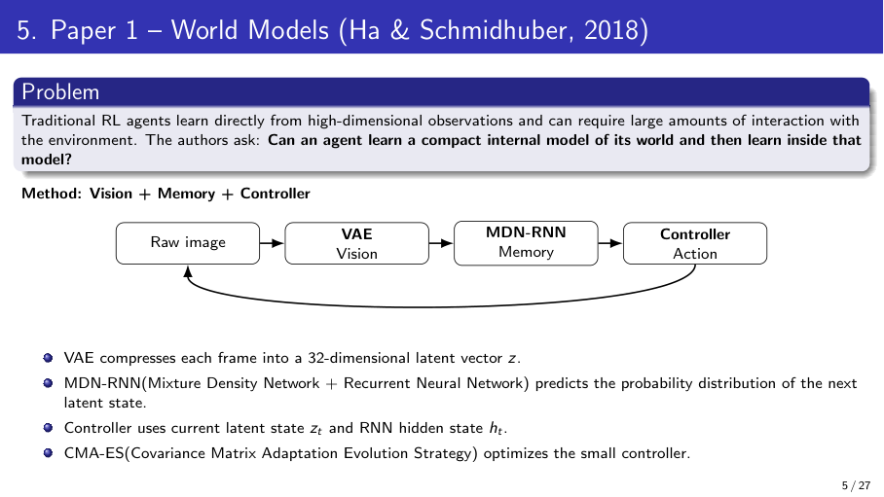
27 / 44

Slide 28
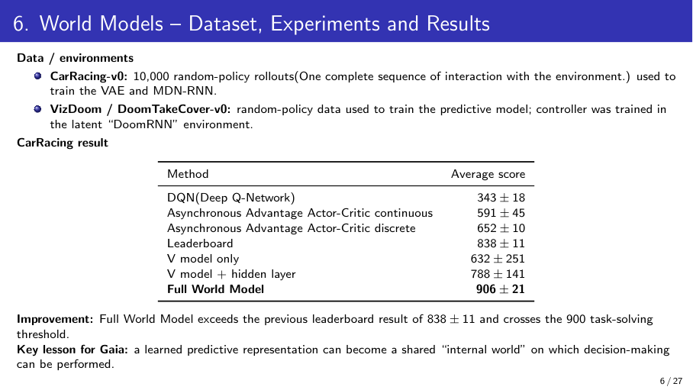
28 / 44

Slide 29
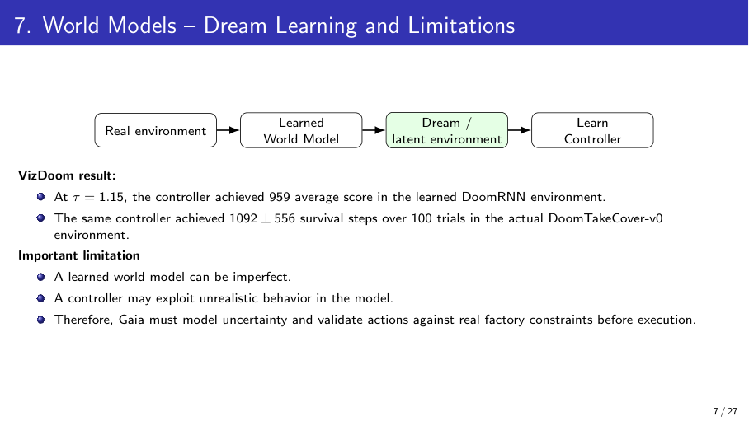
29 / 44

Slide 30
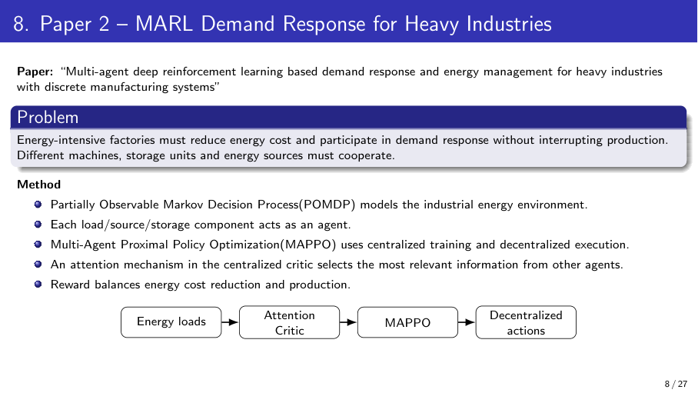
30 / 44

Slide 31
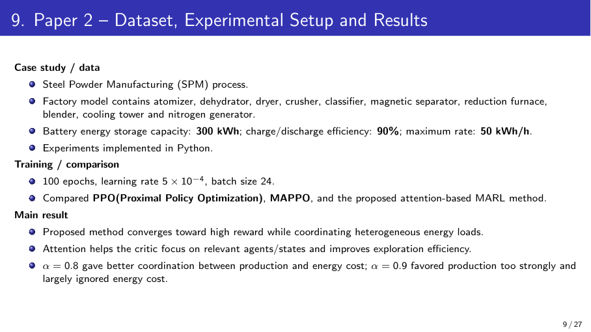
31 / 44

Slide 32
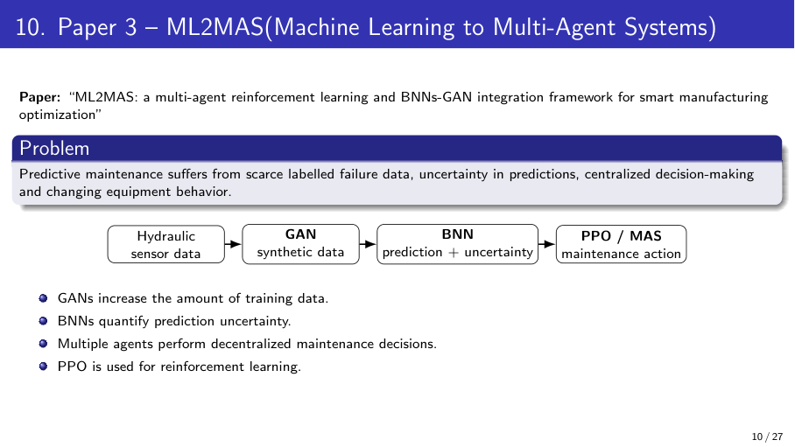
32 / 44

Slide 33
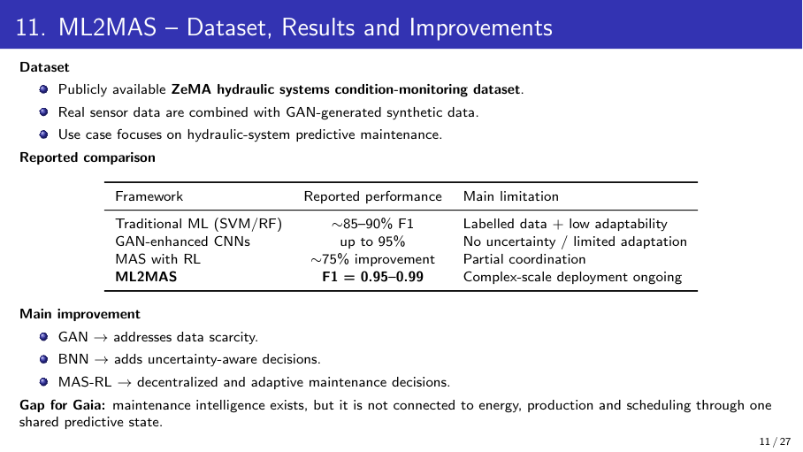
33 / 44

Slide 34
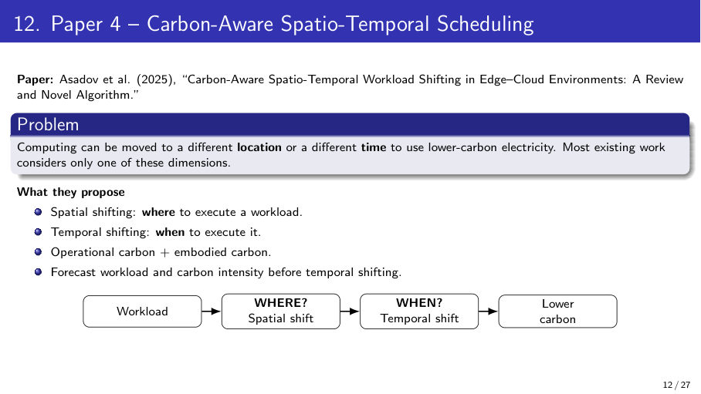
34 / 44

Slide 35
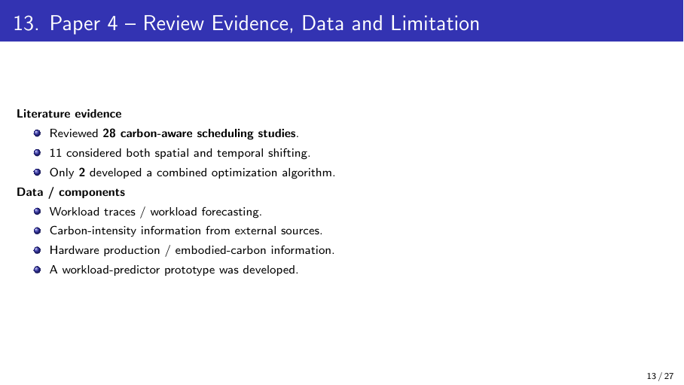
35 / 44

Slide 36
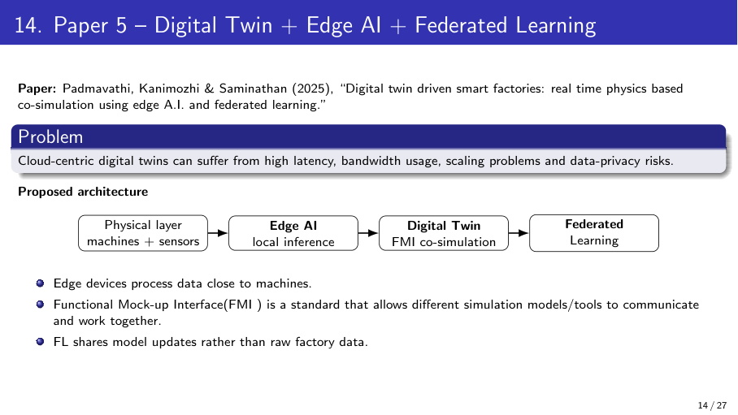
36 / 44

Slide 37
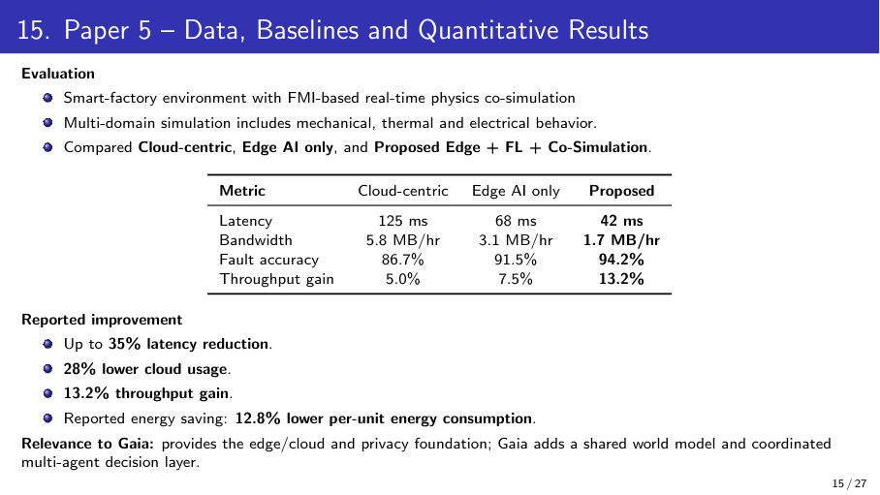
37 / 44

Slide 38
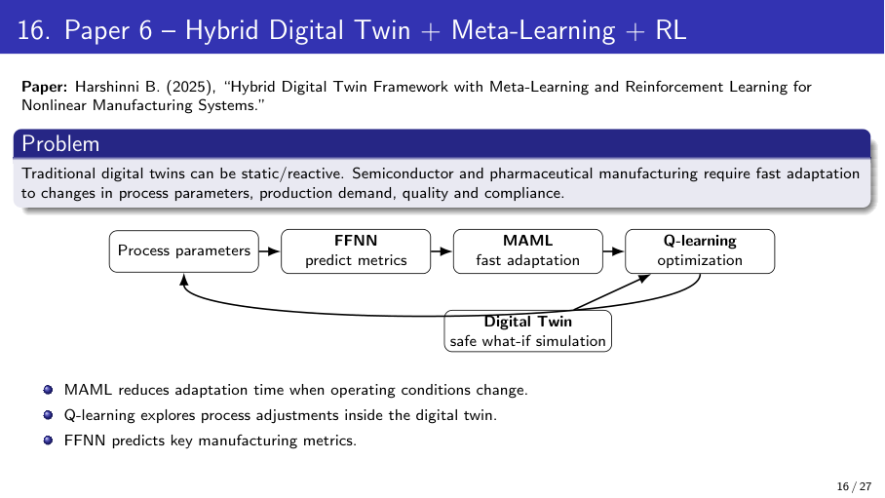
38 / 44

Slide 39
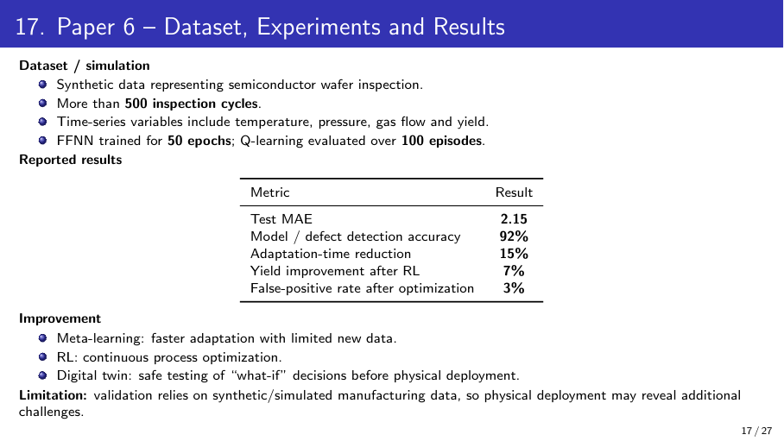
39 / 44

Slide 40
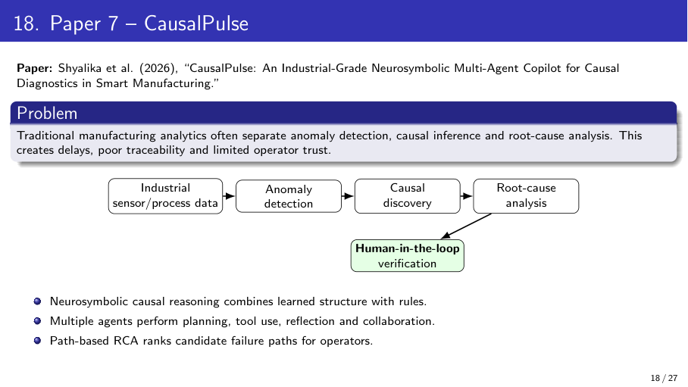
40 / 44

Slide 41
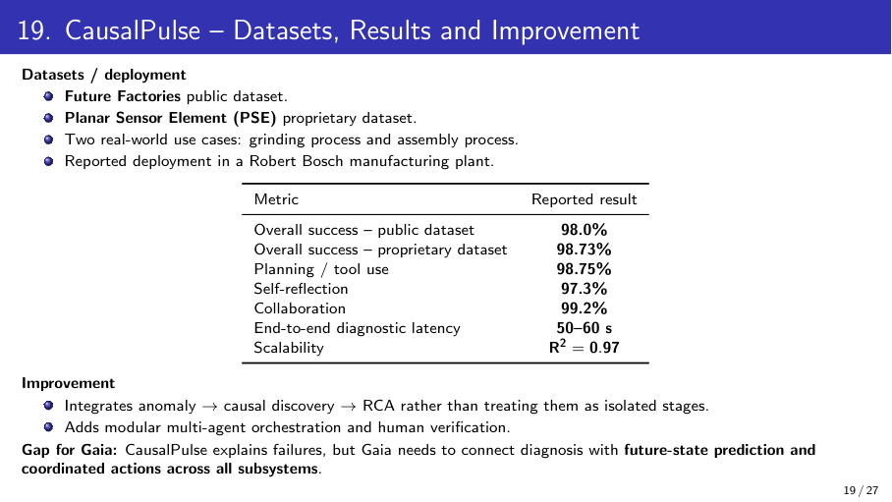
41 / 44

Slide 42
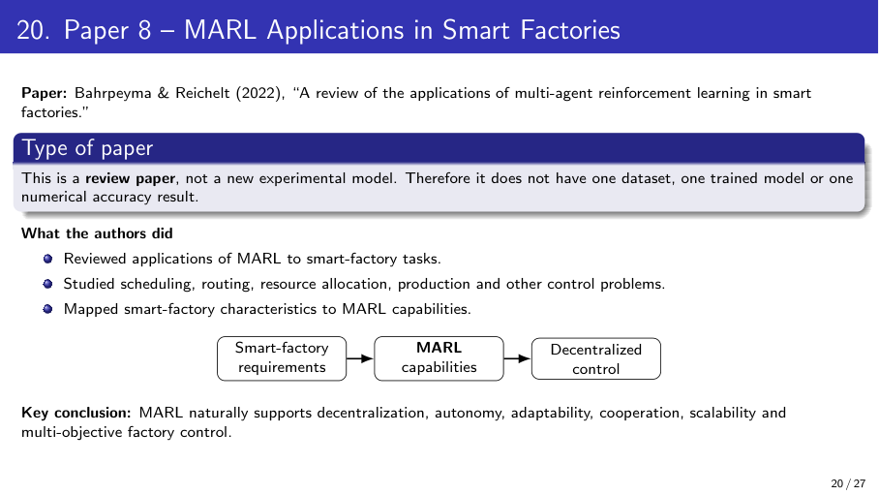
42 / 44

Slide 43
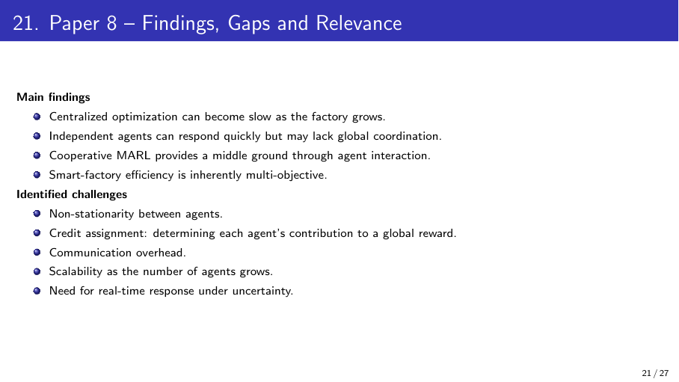
43 / 44

Slide 44
Results and conclusion
Paired simulator study
30 evaluation seeds x 96 steps; same seeds for all policies.
Full Gaia reward: 0.2579 ± 0.0392
B1: 0.2539 ± 0.0219 | B4: 0.2599 ± 0.0350
Dataset baselines
Future Factories: test macro-F1 0.692 (10k labeled windows).
HIPE: next-minute power MAE 0.0617 kW.
ZeMA test macro-F1: cooler 0.997; valve 0.604; pump 1.000; accumulator 0.837.
Interpretation
Full Gaia did not outperform B4. Throughput rose versus B1, with higher energy and carbon proxies.
Smart Manufacturing screening is unlabeled (5/172 test minutes flagged); it is not fault accuracy.
Conclusion
The implementation demonstrates end-to-end feasibility for separate industrial data tasks, a shared GRU state-prediction prototype, and decentralized proposal exchange between subsystem agents. Current evidence does not establish that Gaia is superior, production-ready, safer, or privacy-preserving. LACD remains a rule-based prototype because its exact learned algorithm is not specified in the supplied materials. No weighted overall J(a) is reported because the objective weights have not been defined.
Next: validate with real factory observations, formalize and train LACD/MAPPO, test edge/cloud performance, define objective weights, and repeat evaluations with larger seed counts and statistical uncertainty.
Team 15 · Gaia research prototype · 2026
44 / 44

