Slide 1
Introduction – types of analytics, applications of predictive analytics, overview of predictive analytics. Setting up the problem - processing steps, business understanding, objectives, data for predictive modeling, columns as measures, target variables, measures of success for prediction
book: Applied Predictive Analytics by Dean Abbott

Slide 2
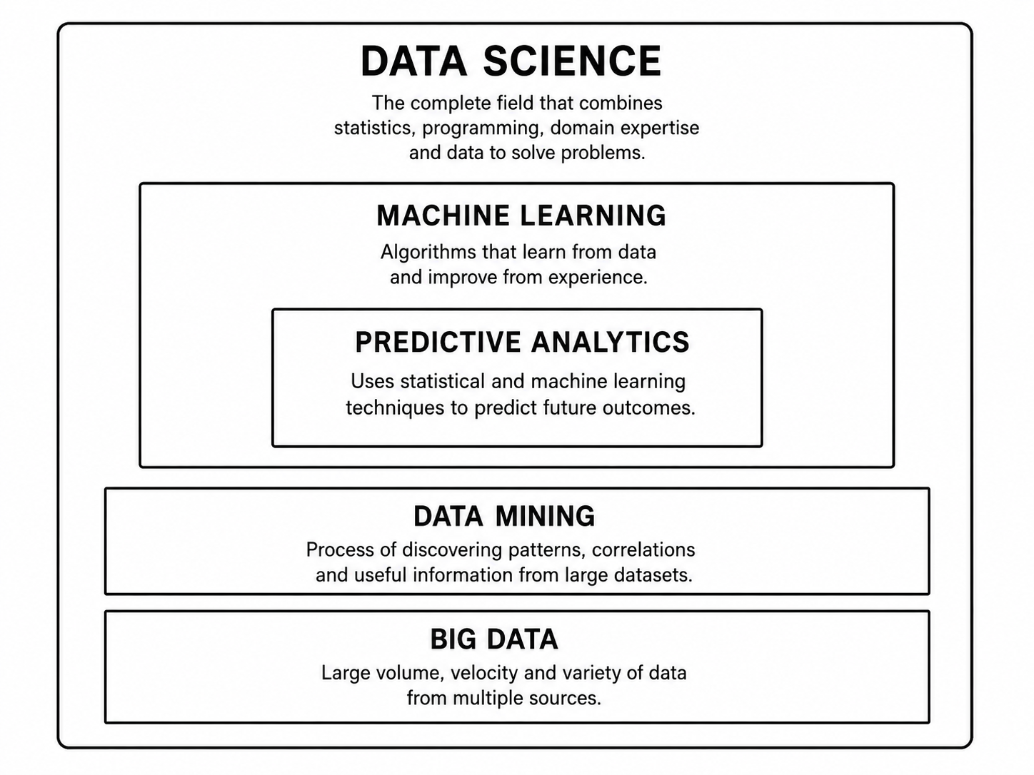
combines all these methods to solve real-world problems
Learns from patterns to
Build models
Predict future events/outcome
Find useful/hidden patterns
Provides huge data and complex data
ie Logs from mobile, Sensors, Social Media, Transactions, Images, videos, etc.
Notes:
Velocity speed at which data is generated, collected, and processed. Example:
Users watch, pause, search, and rate movies every second. Netflix updates recommendations quickly.

Slide 3
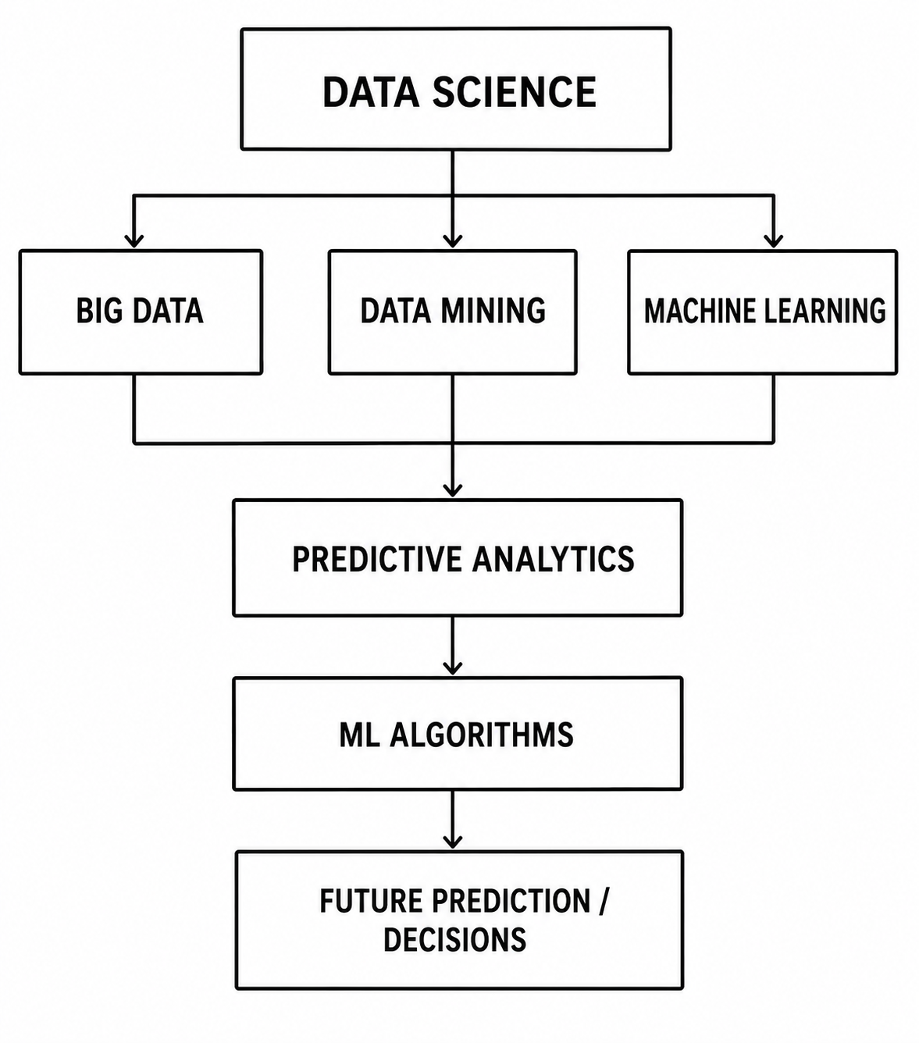

Slide 4
Uber ride-pricing (how uber uses predictive analytics to predict the best fare before the ride starts.) Big Data → Data Mining → Machine Learning → Predictive Analytics → Price Decision
Big Data (Collect Huge Data) : Uber collects millions of records using Ride Data like Pickup location , Drop location , Distance , Traffic condition , Time of day , Weather , Number of drivers nearby , Customer demand, Past ride prices
Eg: (Distance, Time, Traffic, Demand, Price) – (5 km,10 AM,Low,Normal,₹120) (5 km,6 PM, High, High,₹250) will become training data
2. Data Mining (Discover Patterns): Uber finds hidden relationships.
Eg: Pattern 1: Office time (6 PM) + Heavy traffic+ More customers →Higher price Pattern 2: Rainy weather ->More ride requests ->Price increases
Machine Learning model learns: ML algorithm learns from historical data.
Input: Distance = 10 km , Time = 8 PM, Traffic = Heavy, Demand = High, Drivers = Few
ML models: Regression models/ Decision Trees/ Random Forest/ Neural Networks Model will learned from the past data trained using features then input given to ML model will predicts expected fare

Slide 5
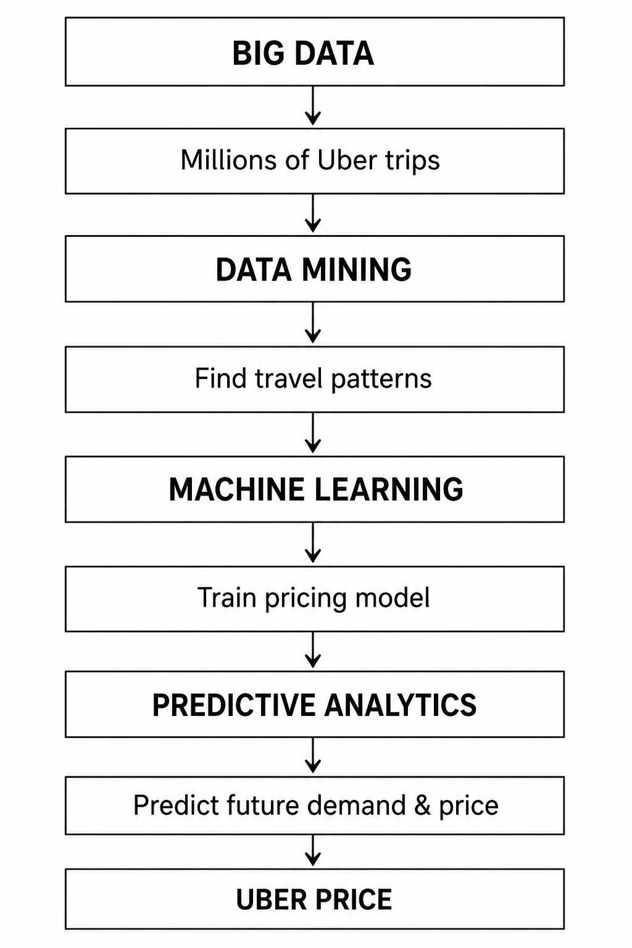
4: Predictive Analytics: asks What will the ride price be now?
Current situation: Customer opens Uber App gives
Location = Airport, Time = 7 PM
Traffic = Heavy, Drivers = Few → Predictive Model → Predicted Price = ₹850
5: Dynamic Pricing Decision : Final price will be Base Fare + Distance Cost + Time Cost + Demand Prediction + Traffic Prediction → Final Uber Fare

Slide 6
Netflix Movie Recommendation
Big Data : Millions of users, Movie ratings, Watch time, Search history, Likes/dislikes
Data Mining to finds hidden patterns : User A likes action movies, Similar users watched Movie X
Machine Learning will Builds recommendation model using: Collaborative filtering, Neural networks
Predictive analytics will predicts this user has a 90% chance of liking this movie
Decision will recommend movies on the home page.

Slide 7
Introduction
Analytics is a term that includes a wide variety of analyses that can be done with data to gain insight. The purpose of analytics is to discover, interpret, and communicate findings to improve the performance ( affect decisions ) of an organization.
Predictive analytics collection of techniques (statistical or ML) that uses historical data to estimate unknown future outcomes so that humans or machines can make better decisions.

Slide 8
Eg: Smart Bomb Guidance Problem : A bomb must reach a target accurately. The ideal path depends on: Current position, Speed, Distance to target, Direction, Control fin movements, earlier scientists used variational calculus to calculate the best path.
Bomb position +Speed +Target location -> Mathematical Optimization ->Best fin movements ->Hit the target accurately. The simulation worked well. But problem is the calculation was too complex. The small computer inside the bomb could not calculate the best path quickly during flight.
Complex calculation -> Needs powerful computer ->Bomb computer too small ->Cannot run in real time
Solution is using Predictive Model Instead of calculating the perfect answer every time Train a model using thousands of previous simulations. The model learns: Situation during flight when (position, speed, distance) given to Predictive Model ->Best control command
Now the bomb can quickly estimate the best movement. This is called Optimal Path-to-Go guidance
Eg 2: Marketing Prediction: A company wants to know "Will a customer buy/respond? "Historical data: Customer age, Previous purchases, Interest level, Website activity → Predictive Model →Will customer respond?YES / NO . The company can send offers to the right customers.
What is common between both examples?
Although One predicts human behavior and another One predicts physical movement both follow the same process: Historical Data ->Learn Patterns ->Create Predictive Model ->Predict Unknown Future Value ->Make Better Decision .
Main Idea is Predictive analytics helps when We have past examples , Future value is unknown, A decision must be made

Slide 9
Business intelligence and how it differs from predictive analysis
BI analyzes existing data to understand business performance. It converts raw data into useful information through reports, summaries, and dashboards.BI provides Key Performance Indicators (KPIs) to support decision-making.
BI mainly answers questions about the past and present (“What happened?”). It helps managers monitor trends, identify problems, and improve business operations. Examples: customer activity like Which product had the highest sales, fraud statistics like How many fraudulent transactions occurred last month?
BI is retrospective analysis. It analyzes historical data. It explains what happened in the past. Output is usually Reports, Dashboards KPIs
Example: How many customers purchased last month? What was last year's sales performance?
Predictive analytics is prospective analysis. It uses historical data to predict future behavior. It finds patterns in past data and applies them to future situations.
Example: Which customer is likely to buy next month? Will a customer respond to an email campaign?

Slide 10
Types of analytics
Data analytics techniques are commonly described as part of four distinct categories: descriptive→diagnostic→predictive→ prescriptive
Descriptive: is basic of analytic like cleaning, relating, summarising visualizing your data. questions about what is happening in business
Diagnostic : getting down to why things are happening. What's causing revenue to decline or to increase? How are things related?
Predictive what’s is going to happen in the future. If you are a business professional and want to make effective business decisions, having an understanding of what might happen in the future can help you ask better questions and make more accurate decisions.
Prescriptive what is our course of action
Notes:
After understanding what happened (descriptive analytics) and why it happened (diagnostic analytics), predictive analytics helps answer what may happen next. Businesses can use these future predictions to make smarter decisions and improve their strategies.

Slide 11
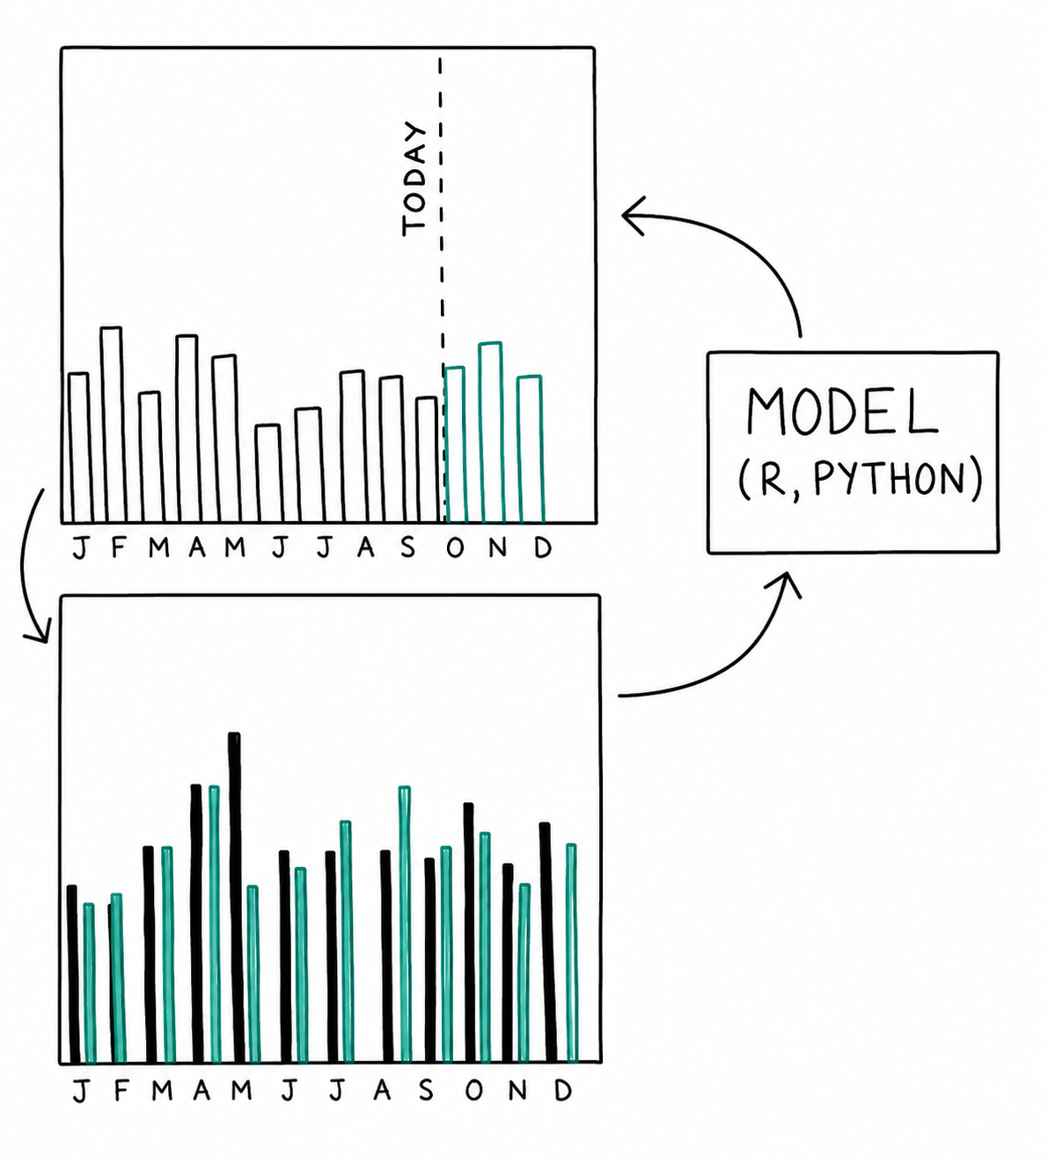
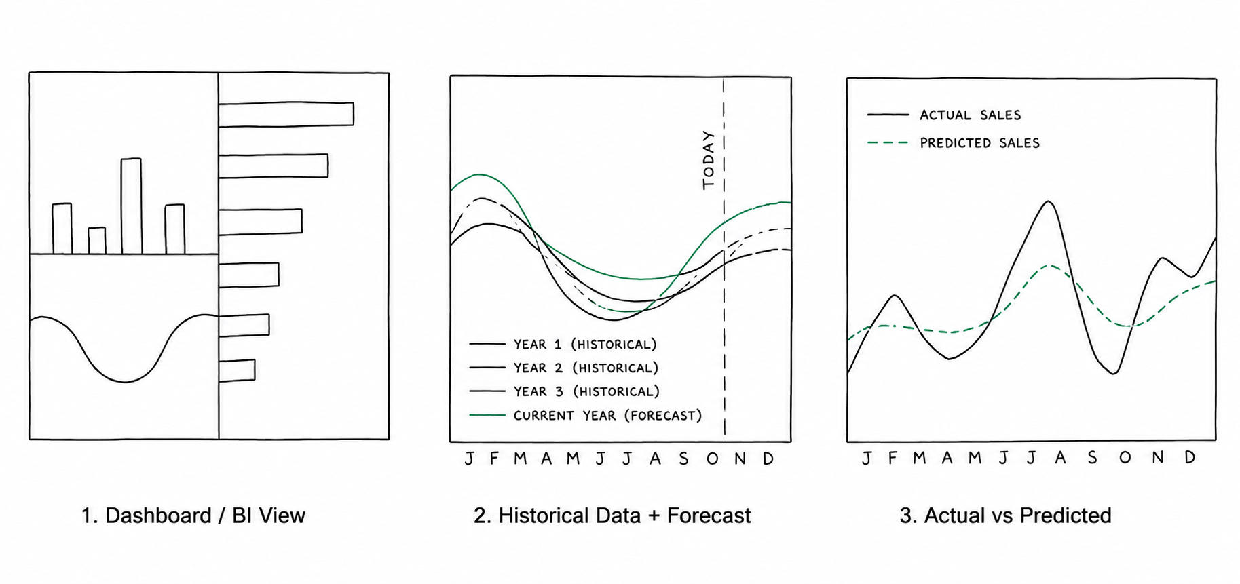
Predictive Analytics Example – Grocery Store owners
A grocery store uses descriptive analytics to understand current business performance using dashboards and reports for Sales by department (vegetables, fruits, bakery items) [what is happening], to see Revenue trends and Product performance (product sells more or less) [Why did it happen?]
The store wants to know or predict what will happen in the future? like How many units of each product will each store sell? Which helps in Inventory planning , supply chain management, Profit management
Building the Predictive Model by Collecting historical sales data from previous years. Analyze past sales patterns and Combine clean data with Mathematical models and Machine learning algorithms
Using Prediction Results the business can decide whether to increase product stock if demand will rise, plan resources better, Improve profit strategies. [What action should be taken?]
Model Evaluation : After using the model Compare Predicted Sales (green) vs Actual Sales (black) . If predictions are wrong Identify missing factors, Improve the data/model and Retrain and redeploy. If difference is high add more data and retrain model
Conclusion: A business person can analyze the prediction chart and make better decisions. ie, if the model predicts that sales will increase, the store can add more products to meet future customer demand. If the prediction shows higher profit than expected, the company can invest in new programs or expand services. Hence predictive analytics helps businesses make smarter and more innovative decisions.

Slide 12
eg 2: Visiting doctor for annual check up
DESCRIPTIVE :Your cholesterol level is 215
DIAGNOSTIC: Your cholesterol level is 215. This is on the high end and likely due to lack of exercise and too much saturated fat in your diet.
PREDICTIVE: If you maintain your current diet and lifestyle, your cholesterol level will continue to rise and increase your risk of cardiovascular disease.
PRESCRIPTIVE: Based on your test results, prescribed statins and recommended a new diet to lower your cholesterol and reduce the risk of heart disease.

Slide 13
Challenges in using Predictive analytics
Predictive analytics can greatly improve efficiency, decision-making, and return on investment, but many predictive models fail to be successfully implemented in real-world operations
The main reasons for failure include
1. Obstacles in management: Here problems are related to people, planning, and business support. ie: Management does not clearly define the problem, No support from decision-makers, Predictions are not used in business decisions.
Eg: Suppose an organisation is building a fraud detection model. A fraud detection model can identify 1,000 suspicious transactions every month that further require investigation. For the model to succeed, organizations need proper processes, investigator trust, and management support; otherwise, the predictions may not be used effectively.

Slide 14
2. Obstacles with data : Predictive models require data in a structured format with rows and columns (single table or flat file). Data is often stored in multiple transactional databases such as customer, sales, and payment tables. A common key/identifier is needed to combine data from different sources into one table. If proper keys are missing, data cannot be joined and the predictive modeling project may fail. Even after combining data, the information must be Complete , Accurate , Consistent
Missing or incorrectly stored input/output values make the data unreliable. Poor-quality data leads to inaccurate predictions.
Eg: data problem in predictive model building for a customer acquisition model. A company wants to predict: Which potential customer (lead) will become an actual customer?
For training, the model needs both examples to learn patterns
(1) People contacted and became customers and (2) People contacted but did not respond
Lead ID | Age | Income | Campaign | Response
101 | 25 | ₹50,000 | Email offer | Yes
102 | 40 | ₹70,000 | Email offer | No
103 | 30 | ₹60,000 | SMS offer | Yes

Slide 15
Problem 1: Data stored in different tables
Companies may store data separately.
Marketing Leads Table
Customer Table
Issues : If the customer table does not store which campaign created that customer, we cannot know:
Which leads responded?
Which leads ignored?
So training data cannot be created.
Lead ID | Campaign | Contacted
101 | Email Offer | Yes
102 | Email Offer | Yes
Customer ID | Name
101 | Ravi

Slide 16
Problem 2: Updating old data removes history
During campaign:
Later after becoming customer:
The original information is lost. The model should learn from Data available before prediction is during the campaign, not after.
Lead | Age | Income | Phone
A | 25 | 40000 | No phone
Customer | Age | Income | Phone
A | 26 | 60000 | 9876543210
Problem 2: Data leakage means: Using future information that was not available at prediction time. The company gets phone numbers only after someone becomes a customer. Training data will become
Lead Phone Number Became Customer
A Yes Yes
B No No
The model learns: Has phone number -> Will become customer
But this is wrong because the phone number came after conversion.

Slide 17
Reason for obstacles in data which will lead to wrong prediction
Different Tables : Data is stored separately and cannot be linked.
History Removed: Old values are overwritten with new ones.
Data Leakage : Future information is mistakenly used during training

Slide 18
Predictive models fail when: Old campaign data cannot be reconstructed, Important relationships between tables are missing. Updated data replaces historical values, Future information accidentally enters training data (data leakage).
Obstacles with modelling : first challenges in building predictive models is overfitting. Overfitting occurs when a model becomes too complex and memorizes the training data instead of learning general patterns.
An overfitted model gives very good results on training data but performs poorly on new/unseen data. The model’s predictions and interpretations become unreliable. If proper testing and validation are not performed during model development, overfitting may only be discovered after deployment. This can cause the predictive model to fail in real-world applications.
second challenge in predictive modeling is trying to build a model that is too complex or ambitious. Analysts may attempt to create an advanced model without considering Available data, Project requirements , Time limitations
If the complex model cannot be completed on time, the project may fail and no model will be deployed. A better approach is to first develop a simple working model that provides useful predictions. The model can be improved later by adding More data , Better features , Advanced algorithms

Slide 19
Eg: Customer Retention Model Example
Predict which customers may leave the company so actions can be taken to retain them.
A model developer may collect thousands of possible factors like Customer age ,Purchase history , Website visits ,Number of complaints ,Time spent on app ,Payment history ,Discounts used product ratings etc
The problem Processing thousands of variables takes more time, Choosing the best combination becomes difficult, The model development may be delayed.
Better Approach is an experienced analyst already knows some important predictors so used important variables only.
Variable | Why useful
Number of complaints | More complaints → higher chance of leaving
Last login date | Inactive users may leave
Purchase frequency | Less buying → risk of leaving
Customer satisfaction score | Low score → churn risk

Slide 20
Obstacles with deployment : Predictive models can fail during the deployment stage, even if the model works well during development. The model must be integrated with the organization’s operational systems to generate real-time predictions. Models need to be converted into a format or programming language supported by the system.
Eg: SQL , Java , C++ , Other high-level languages
If the model is not translated correctly, it cannot be used in real-world applications.
Data Preparation Issues During Deployment :
The same data preparation steps used during model building must be repeated during deployment.
Data from multiple tables must be Collected , Joined , Converted into the required format
Complex data processing can delay real-time predictions.
Eg: Website Content Recommendation
A model predicts: Which content should be shown to a website visitor?
Required data: Previous browsing history , User preferences , Past interactions
When User visits website →Collect user data →Apply predictive model→ Recommend content→ Display webpage
Challenge:
The page must load within seconds.
Data collection + processing + prediction must happen quickly

Slide 21
Applications of predictive analytics
1. Forecasting
Predicts future values using historical data.
Example: Stock price prediction, sales prediction, weather prediction.
2. Classification
Predicts a category/class.
Example: Customer will buy loan → Yes/No, spam detection.
3. Optimization
Finds the best possible decision.
Example: Best investment allocation, route planning.
4. Unsupervised Learning
Finds hidden patterns without predefined labels.
Example: Customer segmentation, patient grouping.

Slide 22
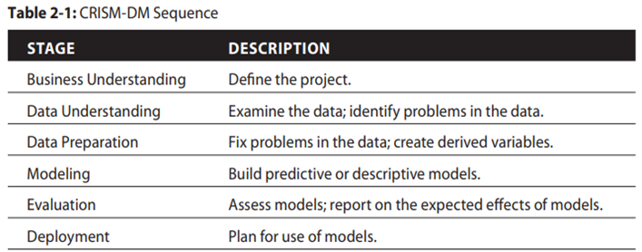
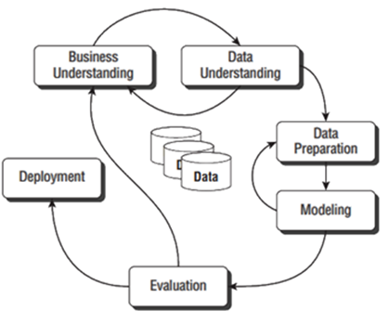
Setting up the problem using CRISP-DM process model
The Cross-Industry Standard Process Model for Data Mining (CRISP-DM) describes the six steps need to be completed in the process of building models.
1
2
3
Feedback loops show how the predictive analytics process can be modified and improved during a project.
After defining business objectives, the available data is analyzed during the data understanding phase.
If the data has problems such as Insufficient quantity and Poor data quality, the business objectives may need to be redefined based on available data. The project may move back to earlier stages instead of continuing with poor data.
4
3. If a developed model gives low accuracy, the data preparation step is revisited. New features or derived variables can be created to improve model performance.
4. Predictive modeling is an iterative process where steps are repeated until better results are achieved.

Slide 23
Business Understanding
Successful predictive modeling depends on below three important groups of experts (three legged stool) and If any one is missing, the project may fail.
Domain Experts Understand the business area and problem. Define the correct business objectives. Ensure the predictive model provides value to the organization.
eg: A banking manager defines the problem how to Predict customers who are likely to fail to repay their loans in the future. Agricultural expert (plant diseases, pest attacks, best harvesting time), Dr (Early disease detection), insurance officer (Predict whether a customer is likely to file an insurance claim, commit insurance fraud, or determine the insurance premium.)
2. Data / Database Experts Identify the data required for building the model. Collect, access, clean, and organize data from different sources. Prepare data in a suitable format for analysis. People who know the databases.
Eg: Collect customer details, transaction history, and loan records.
3. Predictive Modeling Experts develop and test predictive models. Select suitable algorithms and techniques and build models that solve business problems. Machine Learning specialists.
Eg :Use machine learning algorithms to predict loan risk.

Slide 24
Case 1. If Domain Experts Are Missing :
The business problem may not be defined correctly.
Modelers may build highly accurate models that do not solve the real business need.
The model may not provide value to the organization.
Wrong evaluation measures may be selected, leading to choosing the wrong model.
Eg: Model predicts customer behavior accurately. But prediction does not help improve sales or customer retention then Business does not use the model.
Case 2. If Data/Database Experts Are Missing
Required data may not be identified or accessed properly.
Analysts may not understand Database structure, Tables and relationships, Meaning of fields
Problems may occur due to Missing data dictionary, Confusing field names, Lack of data access permissions, Difficulty joining data from multiple tables
Deployment may fail if the database system cannot support the model requirements.
Eg: Model needs customer purchase history. Analyst cannot locate or combine the correct database tables.

Slide 25
3. If Predictive Modeling Experts Are Missing
Business teams may define unrealistic modeling goals.
They may expect models that cannot actually be developed.
Target variables may be not defined, Poorly defined.
Required modeling data structure may not be planned correctly.
Important fields needed for prediction may be missing.
Eg: Predict customer leaving. But no proper "customer left/not left" target variable exists.

Slide 26
Business Objectives
Identify the core business problem Decide what problem the predictive model should solve. Eg :Predict customers likely to leave. Detect fraudulent transactions.
Measure the business objective Convert the goal into measurable values. Eg: Reduce customer loss by 20%. Increase sales by 10%.
Identify available data Check whether required data exists to support the objective. Eg: Customer history, Transactions, Purchase records
Select suitable modeling methods Decide which predictive techniques can solve the problem. Eg: Classification, Regression, Forecasting
Define model evaluation criteria Decide how model success will be measured. Eg: Accuracy, Profit improvement, Error reduction
Plan model deployment Decide how the model will be used in real business operations. Eg: Fraud alerts in banking systems, Product recommendations on websites
Challenges
Required data may not be available.
Target variable may be difficult to define.
Computing resources may be limited.
Time and budget constraints may exist

Slide 27
Defining data for predictive modeling
Predictive modeling requires data in a two-dimensional format with Rows , Columns
Each row represents one unit of analysis (the object/event being studied).
Data can be loaded from different file formats:
1. Delimited Flat Files: Values are separated using delimiters, Common format: CSV files (.csv) , Tab-separated files
2. Fixed-Width Flat Files: Each field has a fixed number of characters. No separator is used and the structure must be known before reading data.
3. Customized Flat Files
Special file formats created based on organizational needs.
4. Binary Files Software-specific data formats. Like: SPSS files (.sav) , SAS files (.sas7bdat), MATLAB files (.mat)
Accessing Data from Databases : Predictive modeling software can directly connect to databases using Native database connections and ODBC drivers, Analysts can write queries to extract required data.
Advantages of Direct Database Connection
Avoids saving and loading large files manually.
Data remains stored and managed inside the database.
Reduces problems with maintaining multiple file versions.
Provides analysts more flexibility to select and prepare required data.

Slide 28
Defining columns as measures
Columns / Attributes in Data
Columns in predictive modeling are also called: Attributes , Variables , Fields , Features ,Descriptors
Each column describes some information about the unit of analysis.
Eg: Customer Analytics
Customer ID | Age | Address | Income
10001 | 35 | Hyderabad | 50000
Rectangular Data Format : Predictive models require data in row-column format.
Every record should have consistent columns
Same number of columns
Same order of columns
Same meaning for each column
Eg :storing Customers who have visited hotel multiple Visits
Different customers may have different numbers of visits.
Eg: Customer 1: Visited once 5/2/12
Customer 2: Visited three times 6/9/12, 9/29/12, 10/13/12

Slide 29
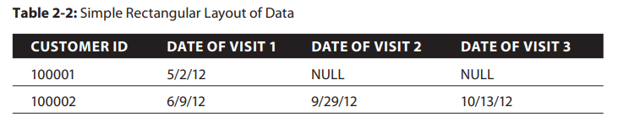
Method 1: Store Visits as Separate Columns
Problem:
Creates missing values (NULL).
Customers with fewer visits have empty fields.
Some algorithms cannot handle missing values well.
Method 2: Store Most Recent Visit First
Customer ID | Recent Visit | Previous Visit
100001 | 5/2/12 | NULL
100002 |10/13/12 |9/29/12
Advantage:
Recent customer behavior is captured better.
Useful because latest actions often predict future behavior.

Slide 30
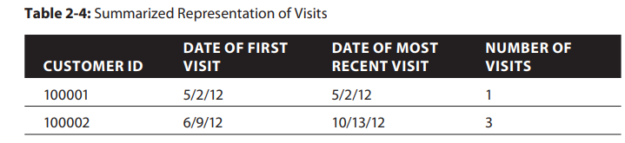
Method 3: Summarize Visit Information
Instead of storing every visit:
Create useful features.
Advantages:
Removes missing values.
Maintains rectangular format.
Easier for predictive models.

Slide 31
Defining the unit of analysis
unit analysis defines what each row/record represents, and predictive algorithms assume that every record is an independent observation.
If records are connected or influenced by each other, the model may learn biased patterns instead of true behavior.
For eg, Hotel customer data model - built only from employees of one company may learn that company's travel rules rather than general customer travel behavior, making predictions less accurate for other customers.
It is one of the first decisions made before building a predictive model.

Slide 32
Suppose a hotel wants to build a predictive model to predict:
“Which customer is likely to book a room again?”
Here the unit of analysis = one customer
Each row represents one customer:
The model assumes:
Customer 101 behavior is independent
Customer 102 behavior is independent
Customer 103 behavior is independent
It learns general patterns:
Frequent visits → higher chance of returning
Long stays → loyal customer
Customer ID | Visits | Purpose | Book Again
101 | 5 | Vacation | Yes
102 | 1 | Business | No
103 | 3 | Family Trip | Yes

Slide 33
Problem: Records Are Connected
Now assume all customers are employees of the same company.
These customers are connected because:
Same company books hotels
Same travel policy
Same location preference
The model may learn:
ABC company travel rules->Not real individual customer behavior
After Deployment Problem
A new normal customer comes:
Family vacation customer-> Model prediction wrong
because the model learned company travel patterns, not general hotel customer patterns.
Customer | Company | Visits | Reason
A | ABC Ltd | 10 | Business meeting
B | ABC Ltd | 8 | Training
C | ABC Ltd | 12 | Conference
Each row should represent independent behavior. If records are related, the model may become biased and fail on new data.

Slide 34
Choosing which Unit of Analysis in Predictive Modeling
Selecting the correct unit of analysis depends on the business objective and how predictions will be used.
1. Customer as Unit of Analysis
Each row represents one customer.
Example:
Customer information is summarized into one record.
Features may include: Customer demographics, Number of visits ,Recent visit details, Spending behavior
Advantages:
Gives a complete summary of each customer.
Each customer record is independent.
Limitation:
Details of individual visits may be lost.
Extra derived variables are needed to capture trends.
Like ---Increasing spending over visits , Decreasing interest
Customer | Visits | Average Spend | Recent Visit
A | 5 | ₹5000 | Jan
B | 2 | ₹2000 | Mar

Slide 35
2. Visit as Unit of Analysis
Each row represents one hotel visit.
Example: A customer with 10 visits will have 10 records.
Advantages: Captures detailed information about each visit.
Limitation:
Model may treat repeated visits as separate customers.
Frequent customers may have more influence on the model.
Customer | Visit | Amount Spent
A | Visit 1 | ₹2000
A | Visit 2 | ₹5000
A | Visit 3 | ₹7000
Using Derived Variables
Derived variables help connect customer history with individual visits.
Eg below details can also be added:
Total number of previous visits
Average spending in last 3 visits
Days since last visit
Important: Use only past information. Do not include future data (avoid data leakage).

Slide 36
Choosing the Right Unit
Depends on the prediction goal:
Goal | Unit of Analysis
Predict customer behavior | Customer
Predict next hotel stay | Visit
Predict fraud | Transaction

Slide 37
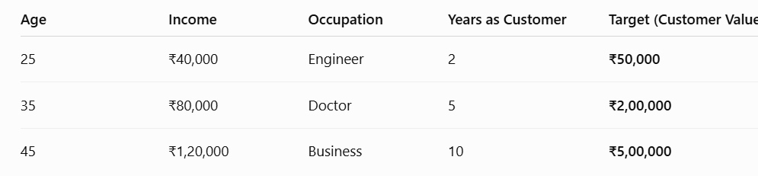
Defining target variables in Predictive Modeling
A target variable is the value that a predictive model tries to predict or estimate.
It is a column in the modeling dataset that represents the business objective.
Target variables can be: Numeric (continuous) ,Categorical , Binary
Types of Target Variables
Binary Target Variable
Has only two possible outcomes. (Use: Classification problems)
Example: Customer Acquisition (1 → Customer acquired , 0 → Customer not acquired)
Continuous Target Variable
Predicts a numerical value.
Example: How much money will each customer spend with us in the future?
Categorical Target Variable Predicts one category among multiple classes.
Eg: Fraud Detection-- Instead of: Fraud = Yes / No
Predict: Fraud Type 1,Fraud Type 2,Fraud Type 3,Fraud Type 4,No Fraud
Advantage: Gives more detailed information for decision-making.

Slide 38
Temporal Considerations for Target Variables : consider the time relationship between input data and the target variable while building a predictive model.
1. Timeline Arrangement
A time gap is the time kept between the data used for prediction and the event we want to predict.
This gap allows a business to take action before the event happens.
Eg: Customer Churn Prediction
Goal: Predict which customers may stop using a service. (A customer stops using Airtel/Jio SIM. A Netflix subscriber cancels the subscription. A customer closes a bank account.)
Without time gap: Customer behavior data ->Model predicts: "Customer leaves today" -> Too late to take action
The company cannot stop the customer because the customer has already left.
With time gap: Customer activity history (Jan - March) -> Predictive Model ->Prediction: Customer may leave after 30 days -> (Time gap) Company takes action: - Give discount - Provide special offers - Improve service -> Customer continues using service

Slide 39
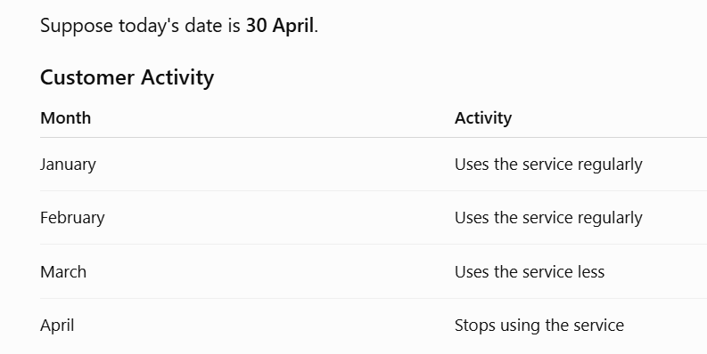
Now the company builds a model.
What happens?
By the time the model predicts,
the customer has already left.
The company cannot do anything.

Slide 40
Input Variable Timeframe - Defines how much historical information is used for prediction.
Example: Use: Last 6 months purchases , Last 1 year transactions, Recent activities ,Very old data may not be useful.
Additional Data for Testing
Future unseen data is kept aside to test the model.
Purpose: Check model accuracy, Identify bias, Verify real-world performance.

Slide 41
measures of success for prediction
Success Criteria for Classification
metrics to assess model accuracy is Percent Correct Classification (PCC). PCC measures overall accuracy without regard to what kind of errors are made; every error has the same weight.
Another measure of classification accuracy is the confusion matrix, which enumerates different ways errors are made, like false alarms and false dismissals. PCC and the confusion matrix metrics are good for an entire population in dataset.
For eg, if customers who visit a website are to be served customized content on the site based on their browsing behavior, every visitor will need a model score and a treatment based on that score.
If you are treating a subset of the population, a selected population, sorting the population by model score and acting on only a portion of those entities in the selected group can be accomplished through metrics such as Lift, Gain, ROC, and Area under the Curve (AUC).
Success Criteria for Estimation
For continuous-valued estimation problems, metrics often used for assessing models are R2, average error, Mean Squared Error (MSE), median error, aver age absolute error, and median absolute error.
Average errors can be useful in determining whether the models are biased toward positive or negative errors. Average absolute errors are useful in estimating the magnitude of the errors (whether positive or negative).

