Slide 1
Decision trees
Terminologies related to Decision Trees
Different splitting criterion in Decision Trees
Optimizing performance of DT

Slide 2
DT used for classification and regression. Ensemble algorithm like random forest and XGBoost uses multiple DT
How to select best split can be decided y using techniques like gini impurity , CHAID , reduce in variance , CART

Slide 3
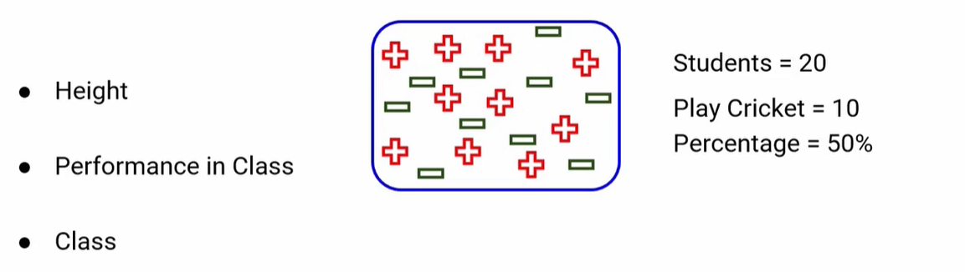
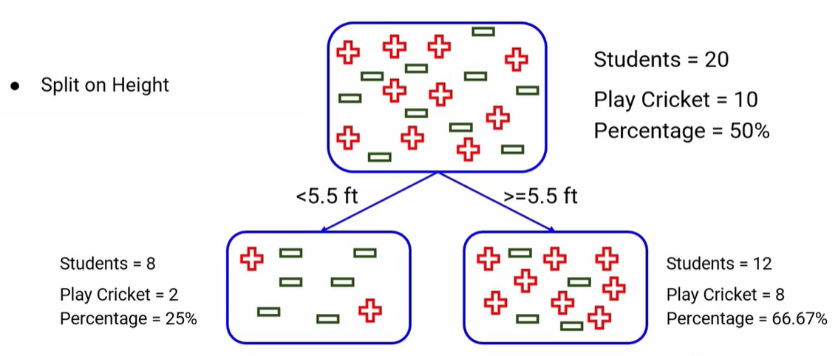

Slide 4
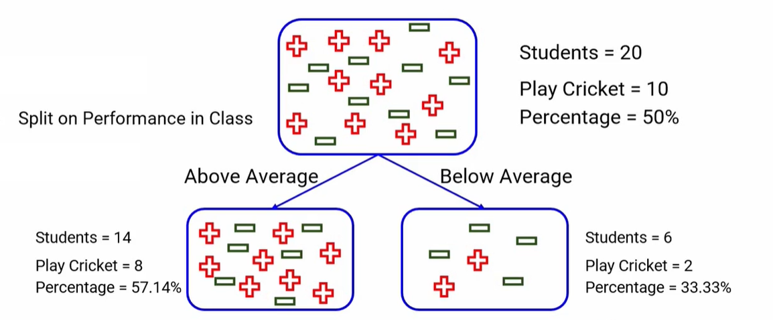
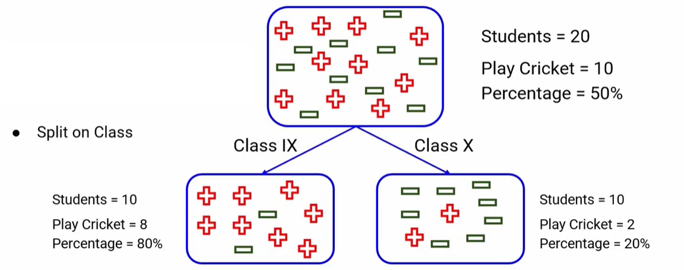

Slide 5
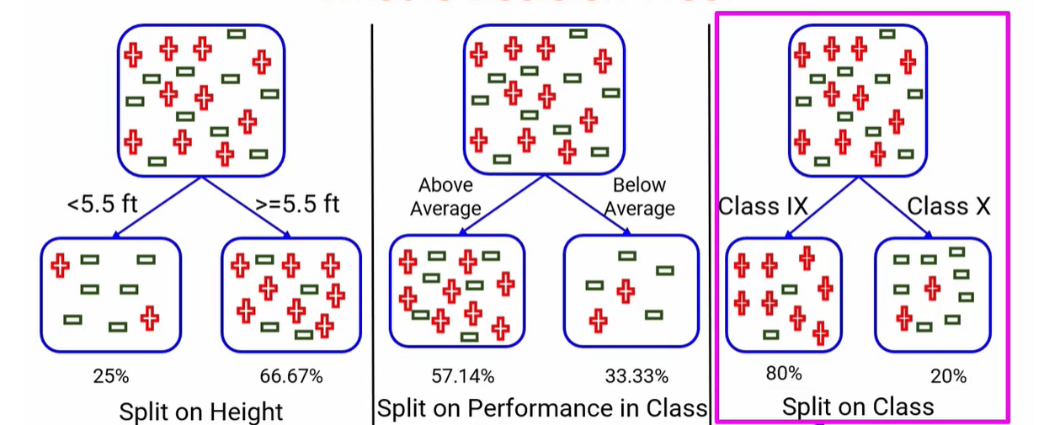
Pure nodes
Which is better split, DT should be able to separate the classes , last one
Split is pure nodes

Slide 6
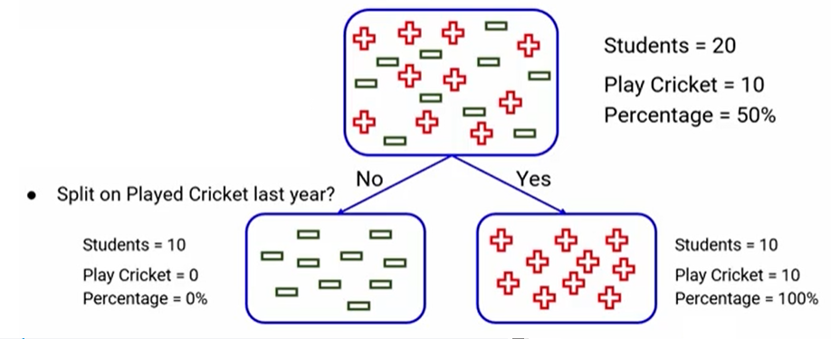
purity in DT
Very rare that completely different class can be obtained from pure nodes after the split, Ideal case is where features gives completely pure nodes,
Objective of DT is to have pure nodes

Slide 7
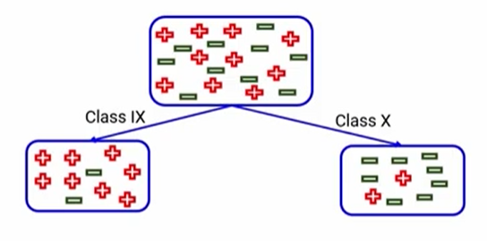
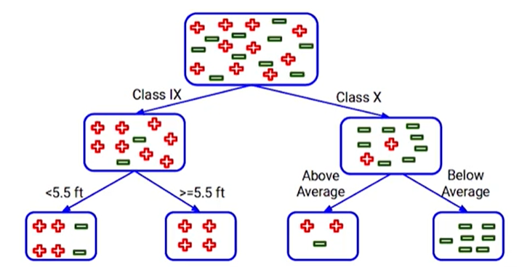
DT don’t stop at first split, can have more split
We can have multiple split, multiple decisions in DT, so how to decide which split is better or what should be the first split and second split etc
What should be sequence split made.
Techniques are there to decide purity of nodes based on which feature can decide best splitting point, also how to select 5.5 or 6 in height feature
How to select best split point in DT
Decision tree split the nodes on all available variables
select the split which results in most homogenous sub nodes

Slide 8
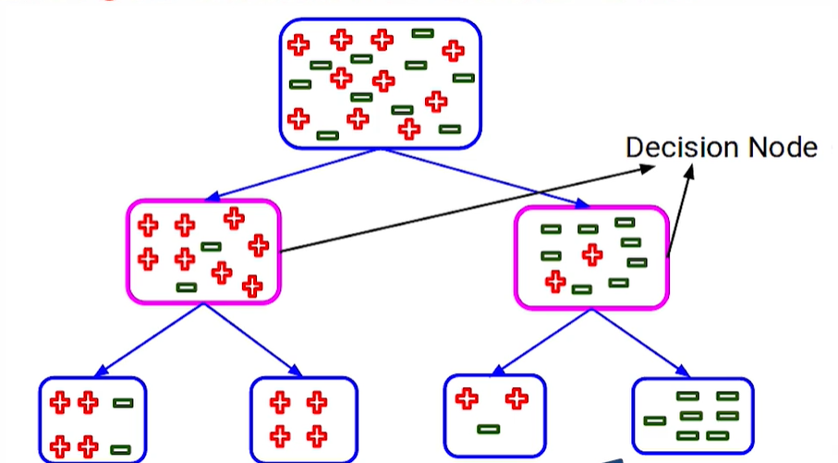
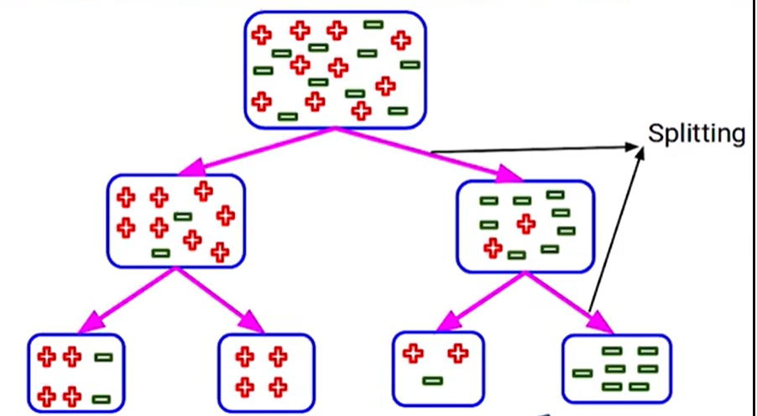
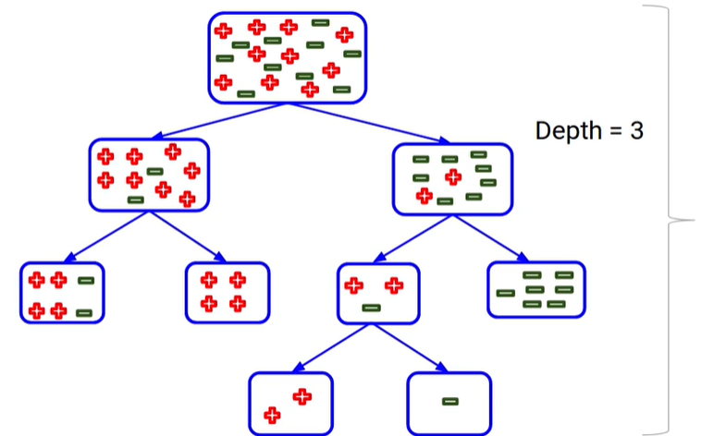
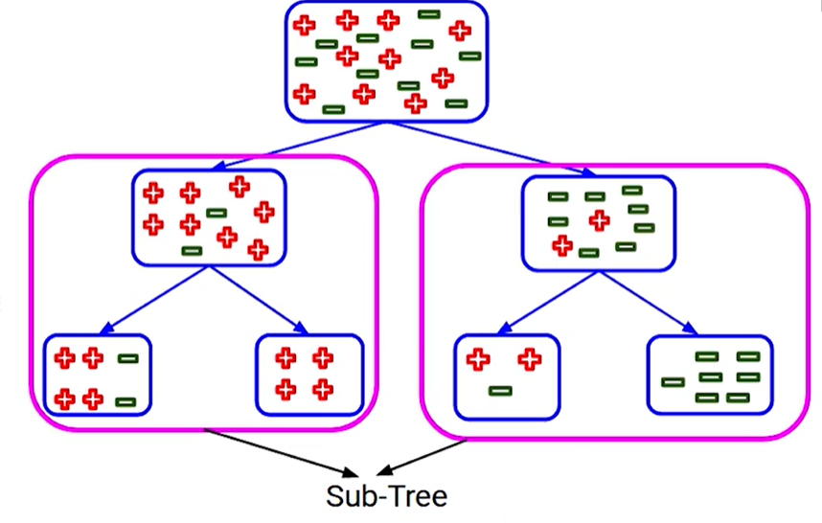

Slide 9
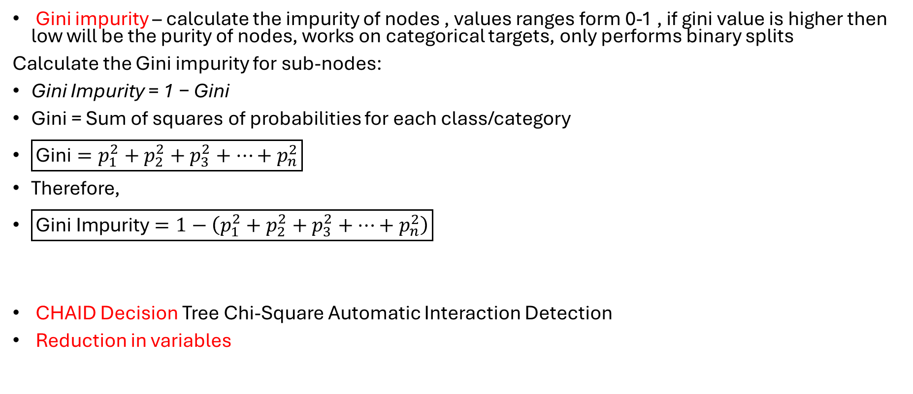
Techniques used to select which is best split
Gini impurity – calculate the impurity of nodes , values ranges form 0-1 , if gini value is higher then low will be the purity of nodes, works on categorical targets, only performs binary splits
Calculate the Gini impurity for sub-nodes:
Gini Impurity = 1 − Gini
Gini = Sum of squares of probabilities for each class/category
$\boxed{\text{Gini}=p_{1}^{2}+p_{2}^{2}+p_{3}^{2}+⋯+p_{n}^{2}}$
Therefore,
$\boxed{\text{Gini Impurity}=1−\left(p_{1}^{2}+p_{2}^{2}+p_{3}^{2}+⋯+p_{n}^{2}\right)}$
CHAID Decision Tree Chi-Square Automatic Interaction Detection
Reduction in variables

Slide 10
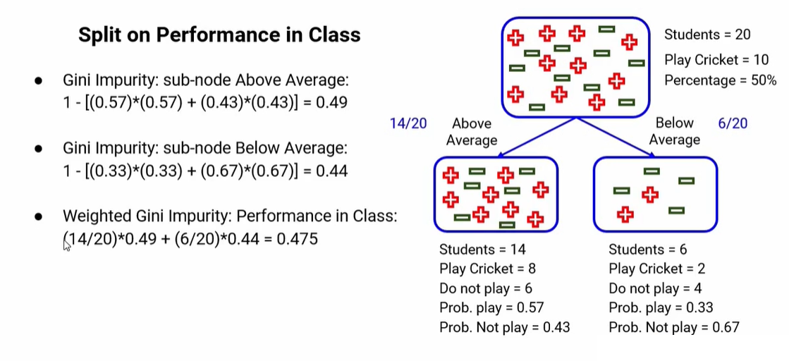

Slide 11
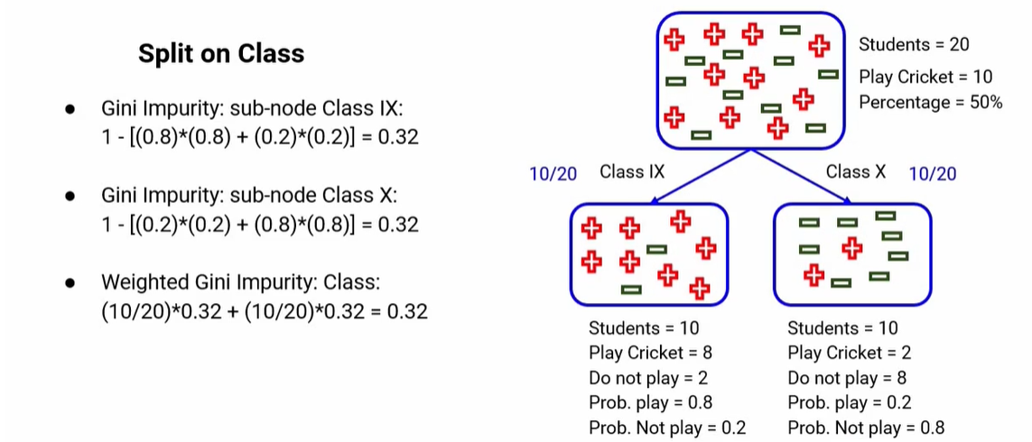
Split | Weighted Gini Impurity
Performance in Class | 0.475
Class | 0.32

Slide 12
CHAID (Chi-Square Automatic Interaction Detection) is a decision tree algorithm used mainly for classification. It builds the tree by selecting the feature that has the strongest statistical association with the target variable using the Chi-square test.

Slide 13
Play Tennis dataset
Day | Outlook | Temp. | Humidity | Wind | Decision
1 | Sunny | Hot | High | Weak | No
2 | Sunny | Hot | High | Strong | No
3 | Overcast | Hot | High | Weak | Yes
4 | Rain | Mild | High | Weak | Yes
5 | Rain | Cool | Normal | Weak | Yes
6 | Rain | Cool | Normal | Strong | No
7 | Overcast | Cool | Normal | Strong | Yes
8 | Sunny | Mild | High | Weak | No
9 | Sunny | Cool | Normal | Weak | Yes
10 | Rain | Mild | Normal | Weak | Yes
11 | Sunny | Mild | Normal | Strong | Yes
12 | Overcast | Mild | High | Strong | Yes
13 | Overcast | Hot | Normal | Weak | Yes
14 | Rain | Mild | High | Strong | No

Slide 14
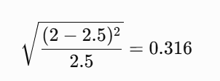

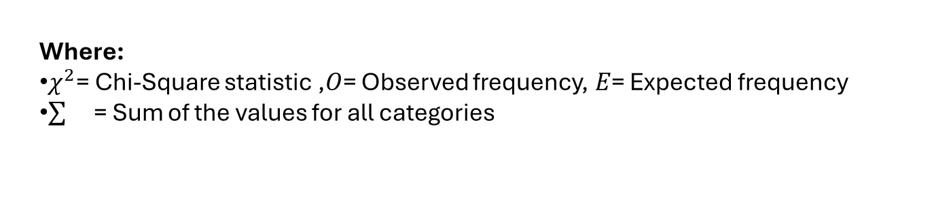
We need to find the most dominant feature in the data set.
Outlook feature
Outlook feature has 3 classes: Sunny, Rain, and Overcast. There are 2 decisions: Yes and No.
We first find the number of Yes decisions and No decisions for each class.
Outlook | Yes | No | Total | Expected | Chi-square (Yes) | Chi-square (No)
Sunny | 2 | 3 | 5 | 2.5 | 0.316 | 0.316
Overcast | 4 | 0 | 4 | 2.0 | 1.414 | 1.414
Rain | 3 | 2 | 5 | 2.5 | 0.316 | 0.316
Expected = total/2
Chi-Square(Outlook)=0.316+1.414+0.316+0.316+1.414+0.316 =4.092
Where:
$χ^{2}$= Chi-Square statistic ,$O$= Observed frequency,$E$= Expected frequency
= Sum of the values for all categories
S= sunny given Y=yes

Slide 15
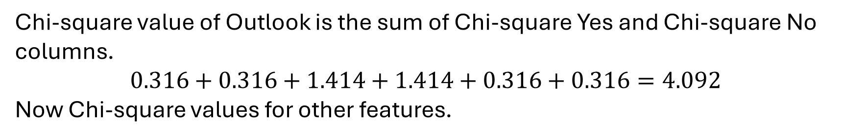
Chi-square value of Outlook is the sum of Chi-square Yes and Chi-square No columns.
$$0.316+0.316+1.414+1.414+0.316+0.316=4.092$$
Now Chi-square values for other features.
Temperature Feature
This feature has 3 classes: Hot, Mild, and Cool. The following table summarizes the Chi-square values for these classes.
Temperature | Yes | No | Total | Expected | Chi-square (Yes) | Chi-square (No)
Hot | 2 | 2 | 4 | 2 | 0 | 0
Mild | 4 | 2 | 6 | 3 | 0.577 | 0.577
Cool | 3 | 1 | 4 | 2 | 0.707 | 0.707
Chi-square Value of Temperature Feature
$$0+0+0.577+0.577+0.707+0.707=2.569$$

Slide 16
Humidity Feature
Humidity has 2 classes: High and Normal. The following table summarizes the Chi-square values.
Humidity | Yes | No | Total | Expected | Chi-square (Yes) | Chi-square (No)
High | 3 | 4 | 7 | 3.5 | 0.267 | 0.267
Normal | 6 | 1 | 7 | 3.5 | 1.336 | 1.336
Chi-square Value of Humidity Feature
$$0.267+0.267+1.336+1.336=3.207$$
Feature | Chi-square Value
Outlook | 4.092
Temperature | 2.569
Humidity | 3.207
Wind | 1.604
Since Outlook has the highest Chi-square value (4.092), the CHAID Decision Tree selects Outlook as the root node (most dominant feature) for the first split.

Slide 17
Steps for Developing a CHAID Tree
Start with complete training data in the root node.
Check the statistical significance of each independent variable.
The variable with the least p-value, based on the statistical tests described in Step 2, is used for splitting the data set, thereby creating subsets.
Using the independent variables, repeat Step 3 for each of the subsets of the data until:
a) All the dependent variables are exhausted or they are not statistically significant at α (alpha).
b) The stopping criteria are met.
Generate business rules for the terminal (leaf) nodes of the tree.

Slide 18
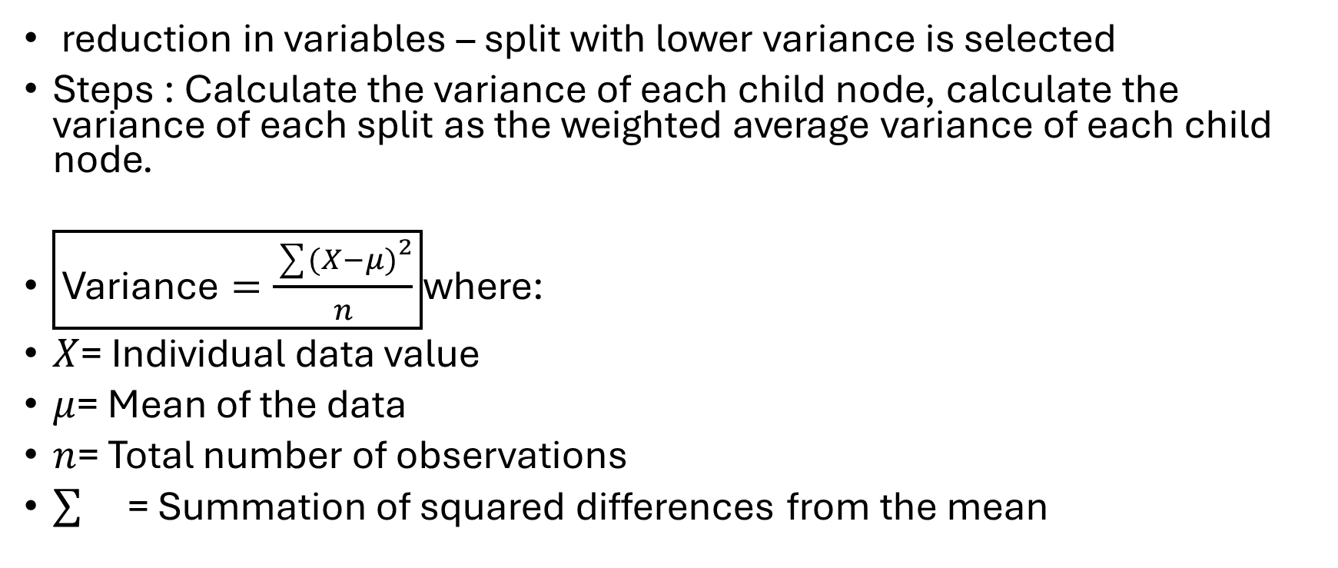
Algorithm which decide best fit for when dealing with continuous target variables like taxi fare, sales etc
reduction in variables – split with lower variance is selected
Steps : Calculate the variance of each child node, calculate the variance of each split as the weighted average variance of each child node.
$\boxed{\text{Variance}=\frac{\sum{(}\left.X−μ{\left.)\right.}^{2}\right.}{n}}$where:
$X$= Individual data value
$μ$= Mean of the data
$n$= Total number of observations
= Summation of squared differences from the mean

Slide 19
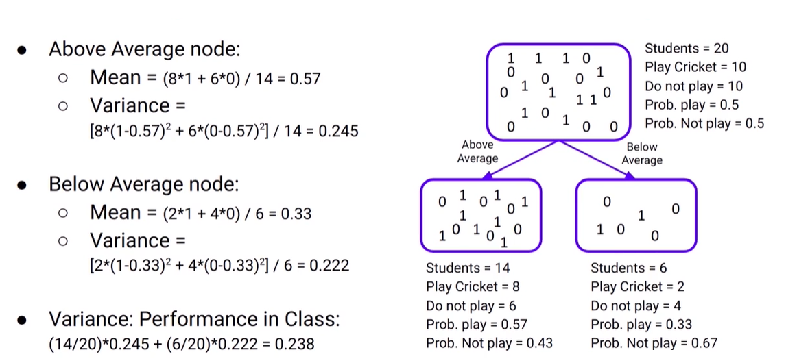
Plays Cricket = 1 Do not play Cricket = 0

Slide 20
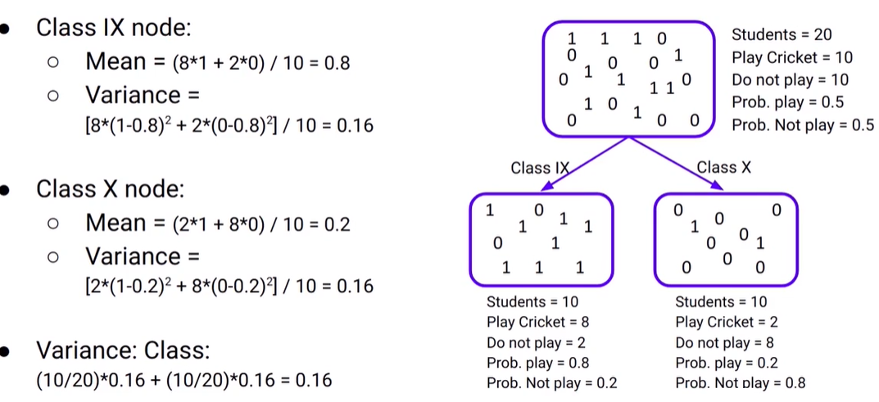
Split | Variance
Performance in Class | 0.238
Class | 0.16

Slide 21
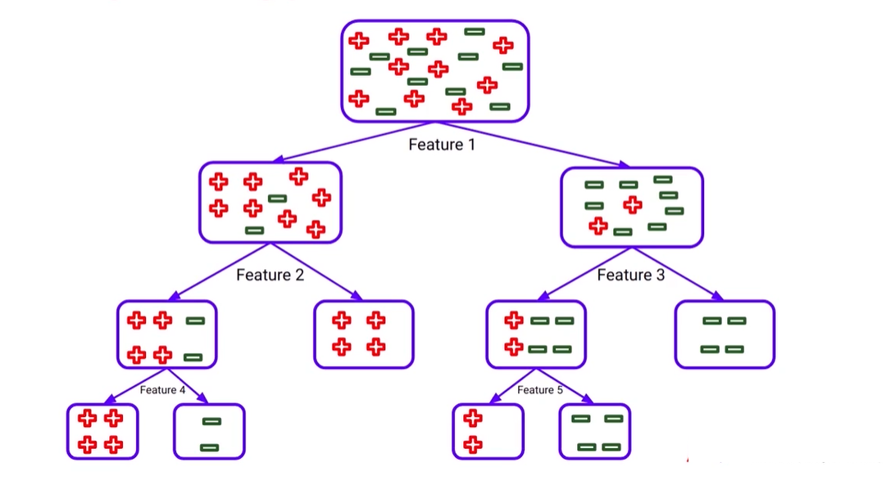
Optimizing performance of DT
If no constraint is kept on tree it grows until it complete all pure nodes , model fits on the training observation and get 100 % accuracy in training .
So if we train unseen data model leads to overfitting

Slide 22
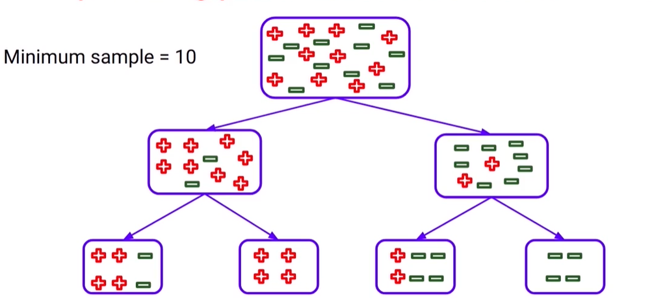
sol: set a threshold on growth of tree. Depth=1 in such cases training data also won't be good enough for accuracy checking and leads to underfitting
So both overfitting and underfitting need to be solved for DT
1. Set minimum samples for a node split
a. Higher values control overfitting.
b. Too high values can lead to underfitting. Model don’t learn anything

Slide 23
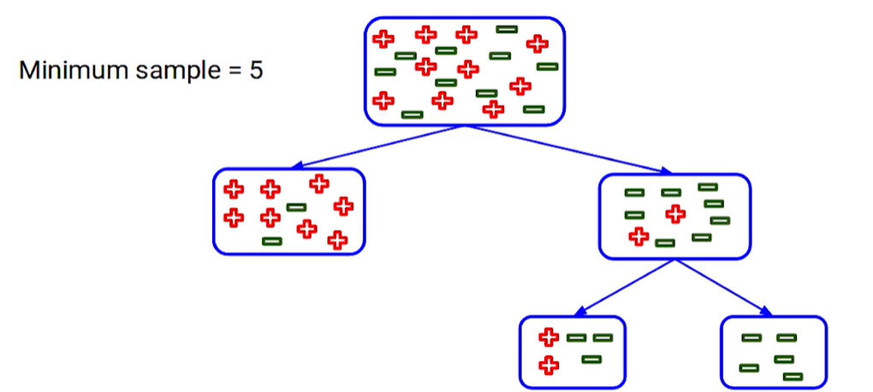
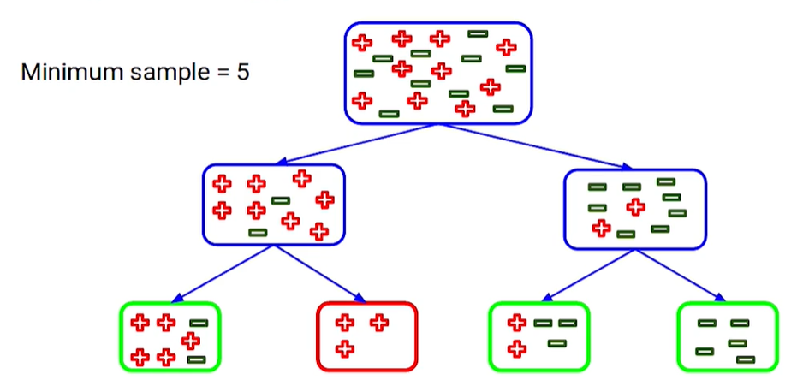
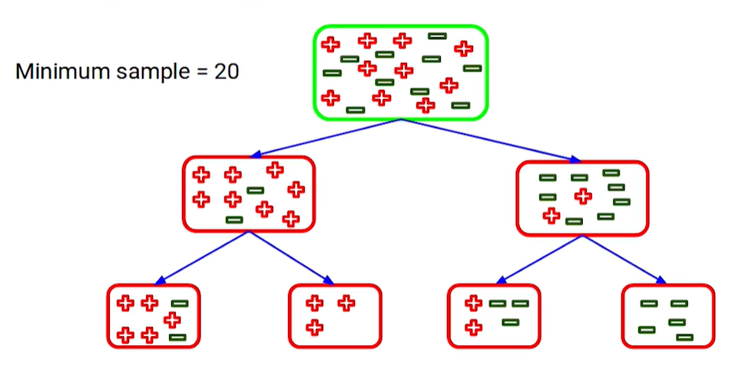
2. set minimum sample for terminal nodes
So parent node become leaf node
a. Higher value controls overfitting.
b. Too high values can lead to underfitting.
Here we cant split further form root node itself cause model to not learn anything so choose value which is not too low and not too high

Slide 24
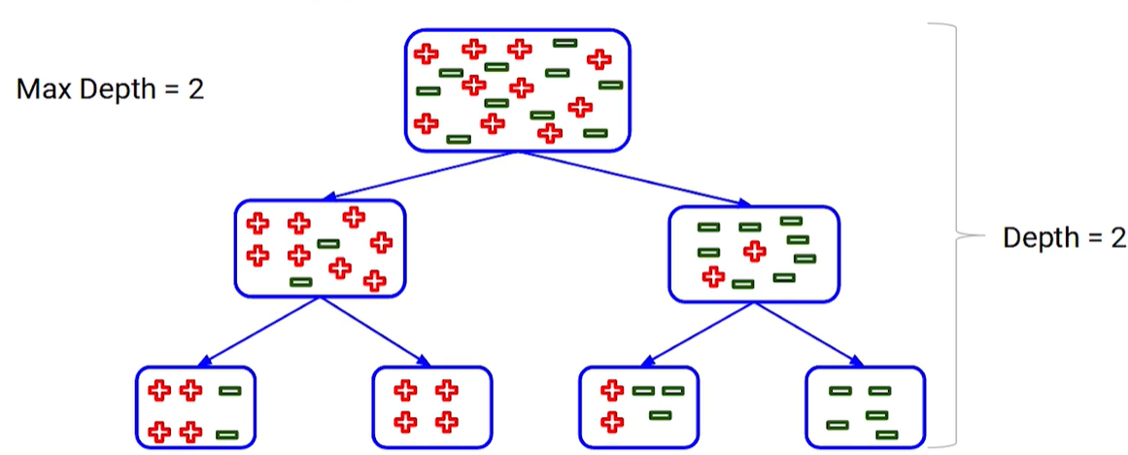
3. Set maximum depth of tree
a. Higher depth can lead to overfitting.
b. Lower depth can lead to underfitting.
So depending on problem set the max depth

Slide 25
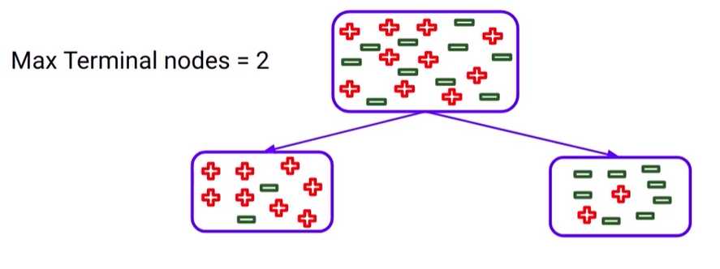
4. Maximum number of terminal nodes

Slide 26
Consider the dataset below.
ID | Age | Income | Student | Buy Laptop
1 | Young | High | No | No
2 | Young | Low | Yes | Yes
3 | Middle | High | Yes | Yes
4 | Senior | Low | Yes | Yes
5 | Senior | High | No | No
6 | Middle | Low | No | Yes
Answer the following:
Calculate the Gini Impurity of the root node.
Compute the weighted Gini Impurity for all three features.
Which feature will GINI select as the first split? Explain your reasoning.
Which feature is likely to be selected by CHAID? Explain your reasoning using the Chi-square criterion.

