Slide 1
Logistic regression
Linear Regression predicts the numerical response but is not suitable for predicting categorical variables.
When categorical variables are involved, it is called a Classification Problem.
Logistic Regression is suitable for binary classification problems.
Examples:
1. Is the mail spam or not spam? The answer is Yes or No. This categorical dependent variable is a binary response (Yes or No).
2. If the student should be admitted or not is based on entrance examination marks. Here categorical response is admitted or not.
3. The student being pass or fail is based on marks secured.

Slide 2
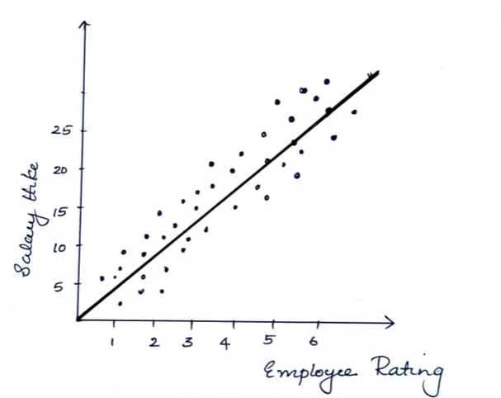
Working of Logistic Regression Algorithm
Consider the following example. An organisation wants to determine an employee's salary increase based on their performance.
For this purpose, a linear regression algorithm will help them decide.
Plotting a regression line by considering the employee's performance as the independent variable and the salary increase as the dependent variable will make their task easier.

Slide 3
Now, if the organisation wants to know whether an employee would get a promotion or not, based on their performance, then the above linear graph (or linear regression) won't be suitable in this case.
As such, we convert the linear output into a sigmoid curve (S-curve), which produces values between 0 and 1.
Based on the threshold value, the organisation can decide whether an employee will get a salary increase or not.
The example above mixes two different problems:
Linear Regression: Predicts the numerical salary increase based on employee performance.
Logistic Regression: Predicts a categorical outcome, such as whether an employee will receive a promotion (Yes/No).
In logistic regression, the sigmoid function converts the linear predictor into a probability between 0 and 1.
For example:This is the correct distinction between linear regression and logistic regression.
Predicted probability | Decision (threshold = 0.5)
0.85 | Promotion – Yes
0.70 | Promotion – Yes
0.40 | Promotion – No
0.15 | Promotion – No

Slide 4
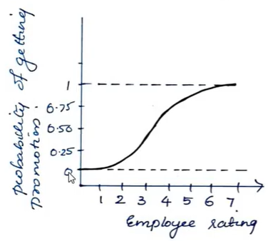
Graph explanation: Based on the probability of promotion, salary hike is given.
If probability of promotion = 0, No promotion.
If probability of promotion = 1, Promotion.
But what if the probability of promotion is 0.30 or 0.75?
So, we set a threshold value.
For example: Threshold = 0.5
Then, 0.30 → No promotion.
And, 0.75 → Will get a promotion.
Logistic regression predicts the probability of an event occurring. The threshold converts that probability into a categorical decision (Yes/No).

Slide 5
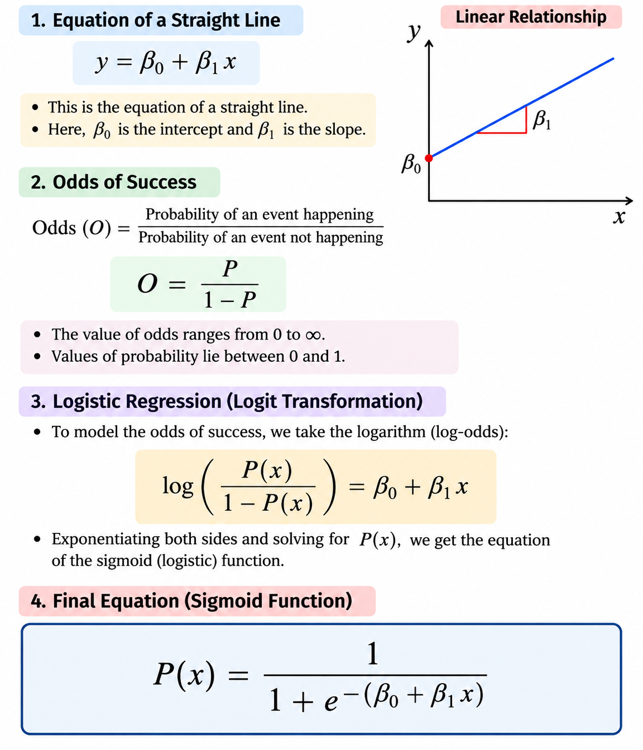

Numerical example

Slide 6
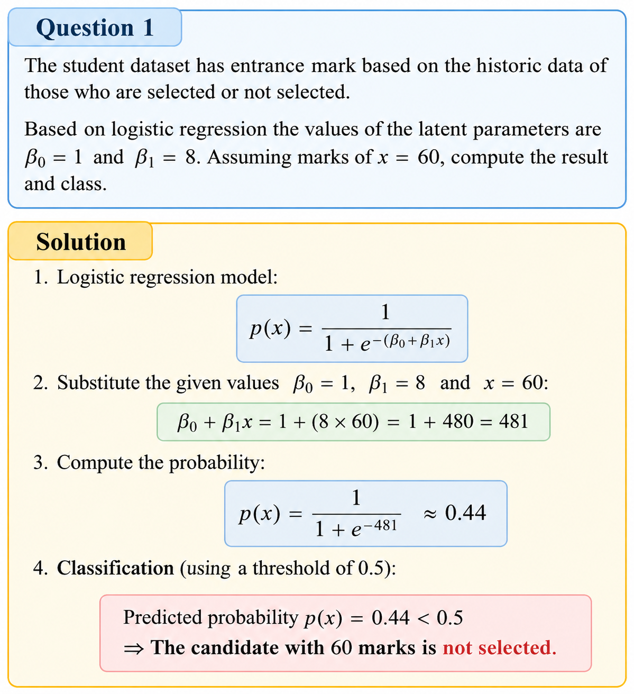

Slide 7
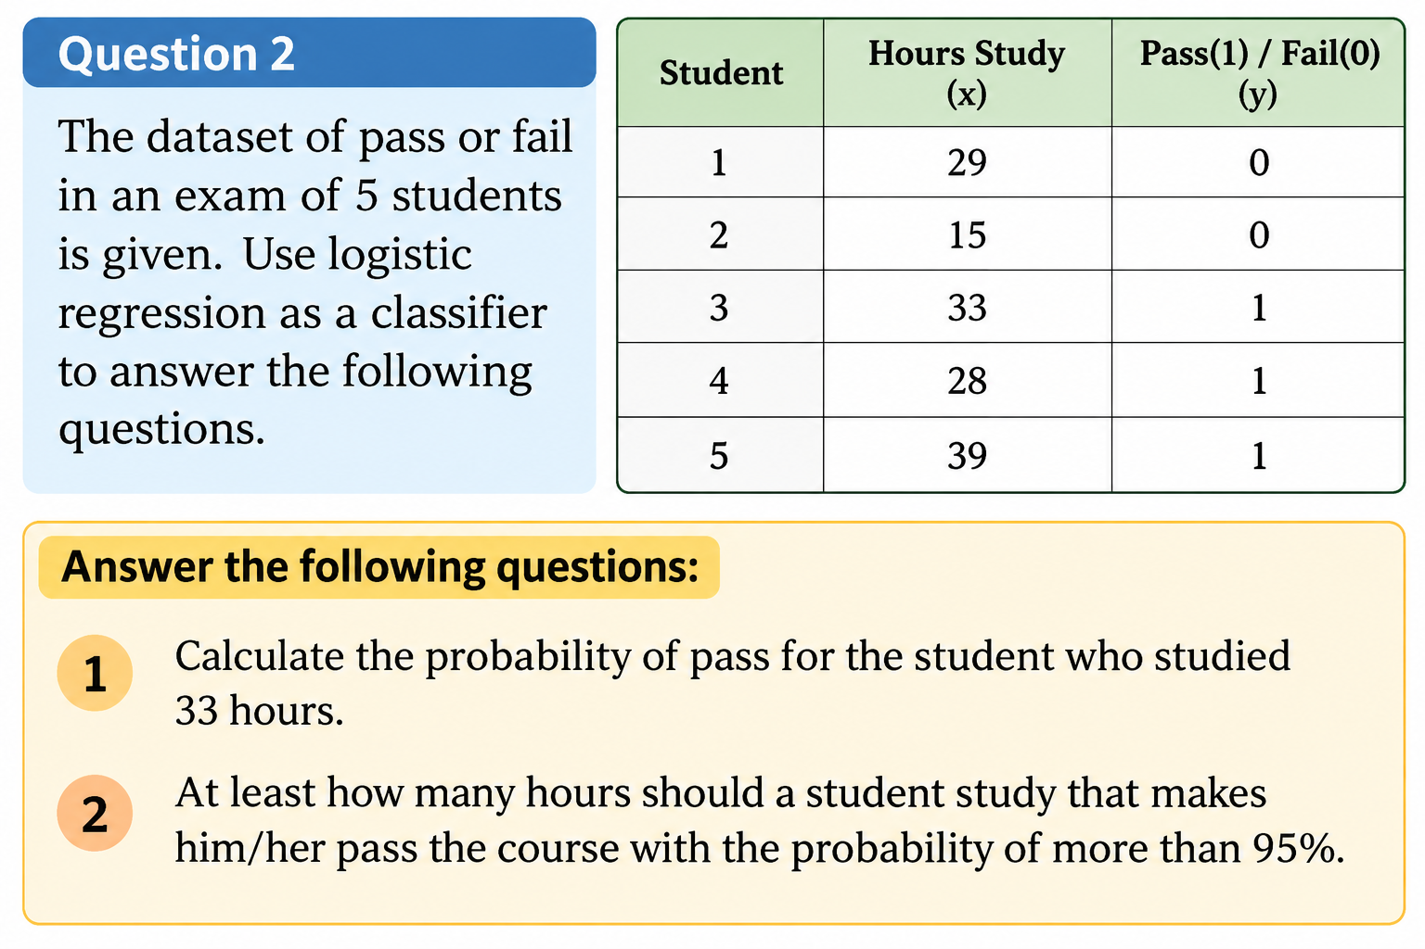

Slide 8
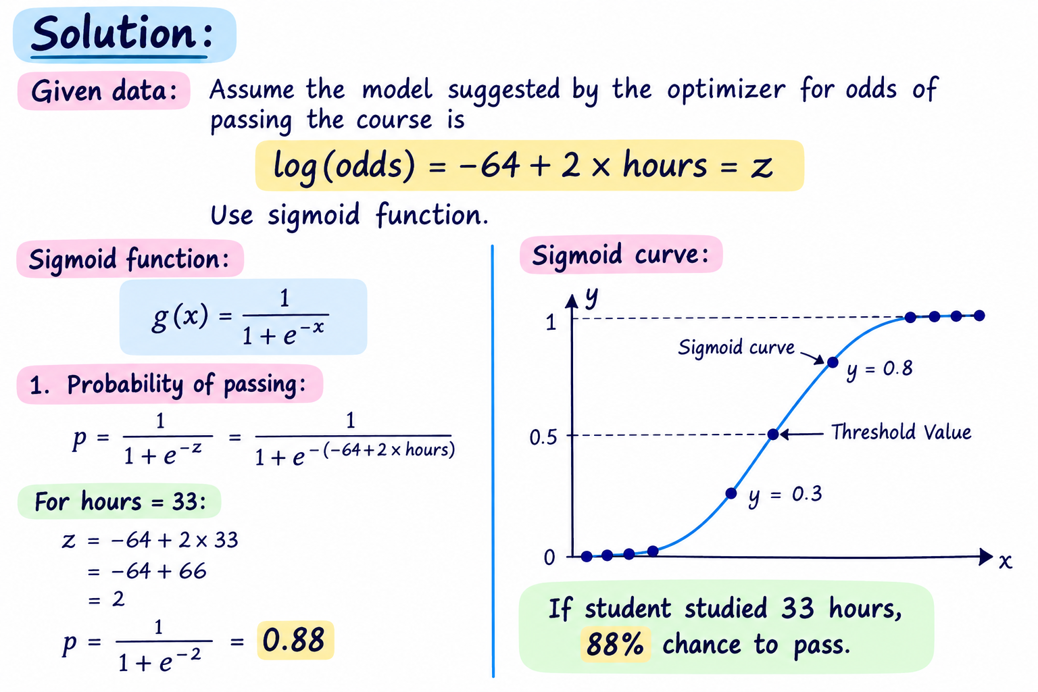
β0 and β1 will be given . In this example since its not given took by assumption

Slide 9
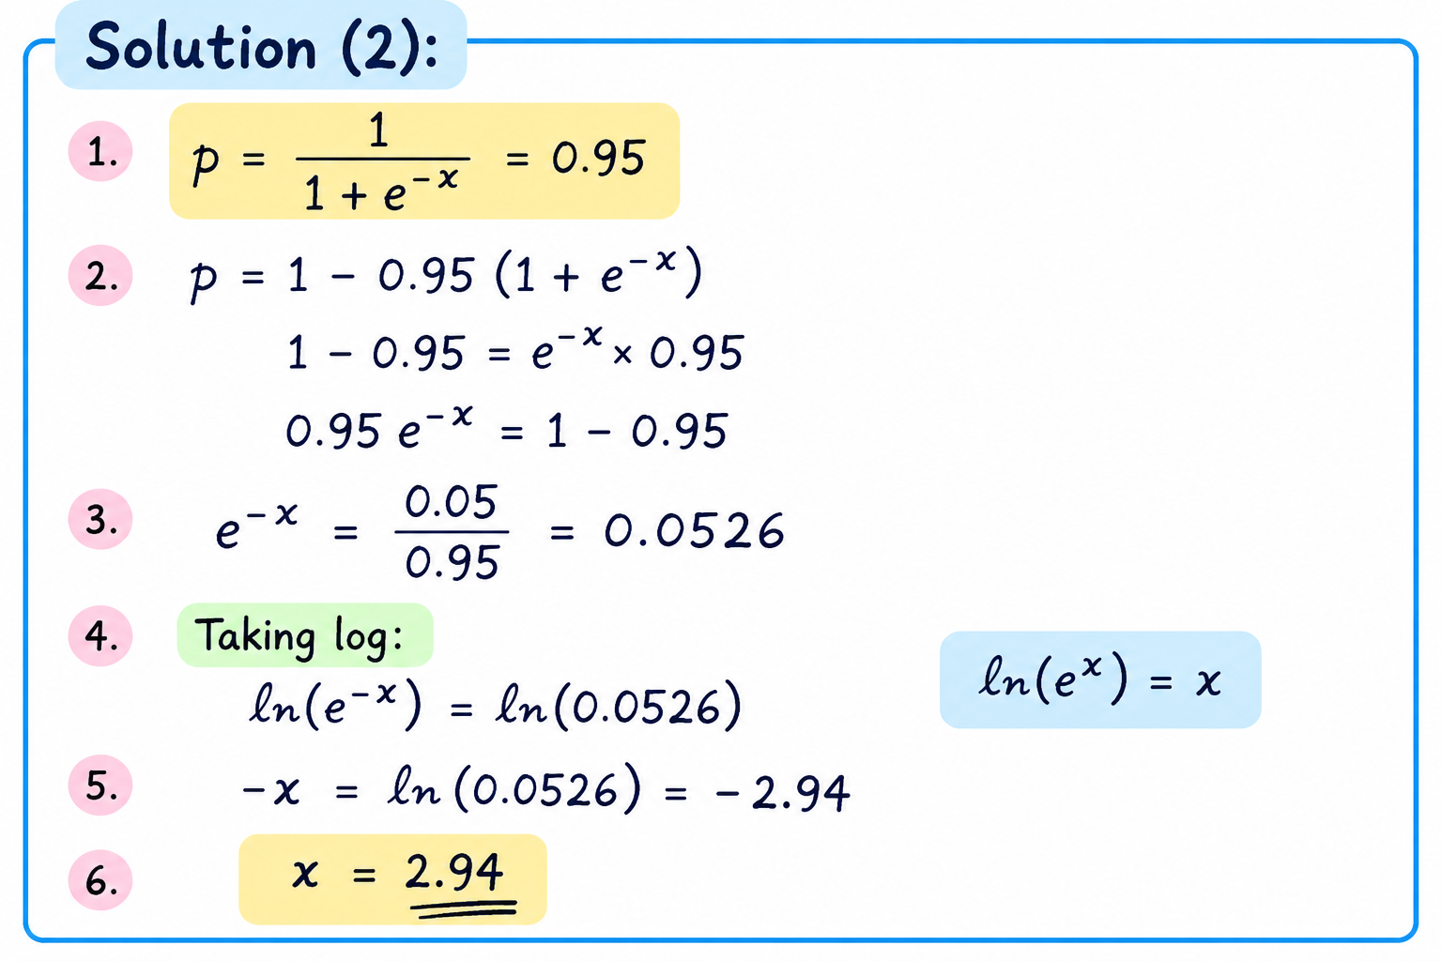
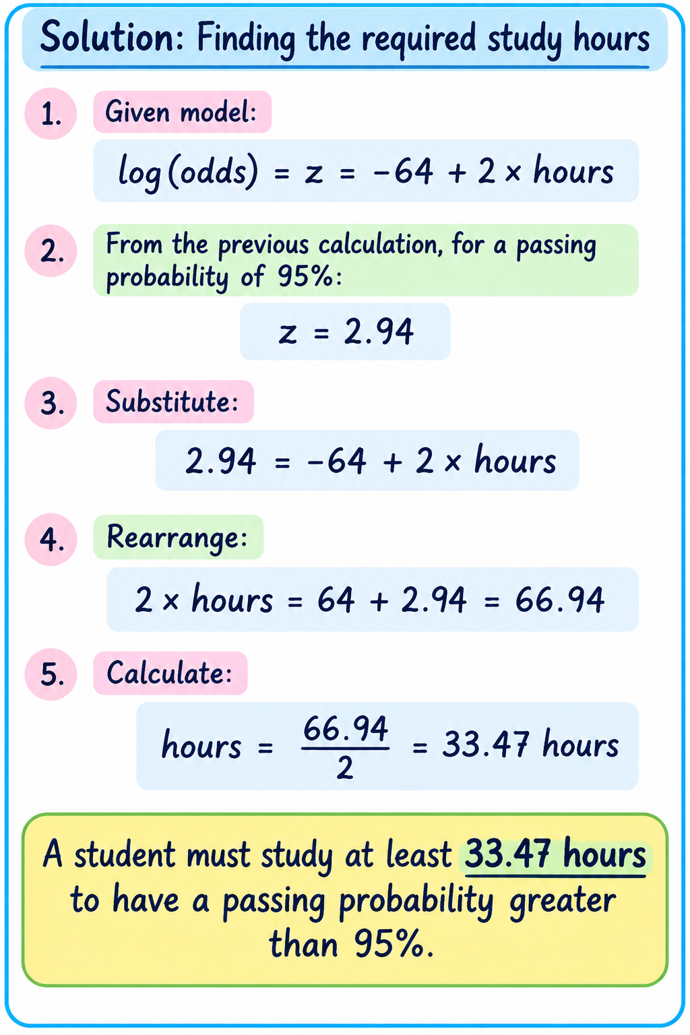
Here x as z are same so use x value to find the hours

Slide 10
Previous slides is also explained in below link
https://www.youtube.com/watch?v=r8OjlgWpAI0
https://www.youtube.com/watch?v=UCOm-LFKX9E

Slide 11
kNN Classification
hear below video similar type numerical example will come
https://www.youtube.com/watch?v=O1nWXTXcCwI

Slide 12
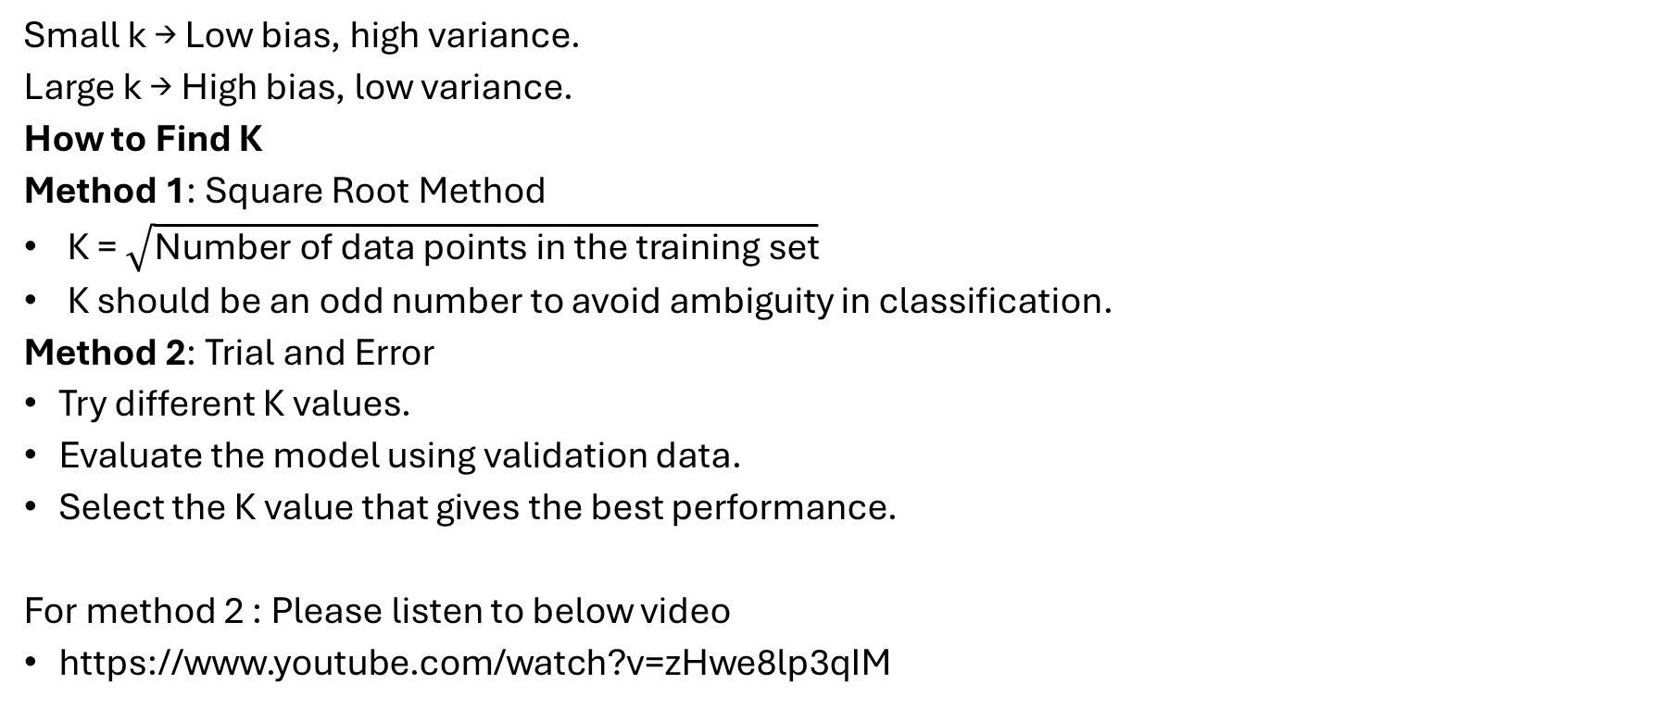
How to choose k value
Small k → Low bias, high variance.
Large k → High bias, low variance.
How to Find K
Method 1: Square Root Method
K = $\sqrt{\text{Number of data points in the training set}}$
K should be an odd number to avoid ambiguity in classification.
Method 2: Trial and Error
Try different K values.
Evaluate the model using validation data.
Select the K value that gives the best performance.
For method 2 : Please listen to below video
https://www.youtube.com/watch?v=zHwe8lp3qIM

