Slide 1
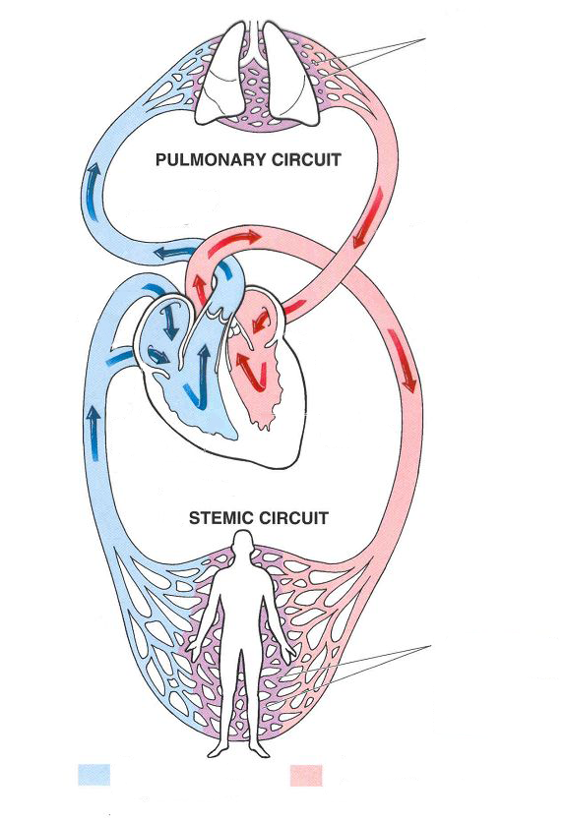
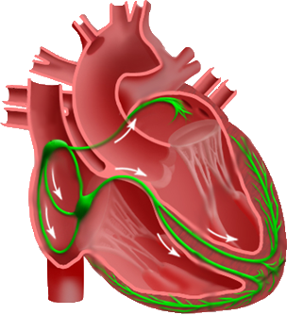
SA Node
AV Node
His-Purkinje System
(a) Circulation System
(b) Electrical Conduction System

