Slide 1
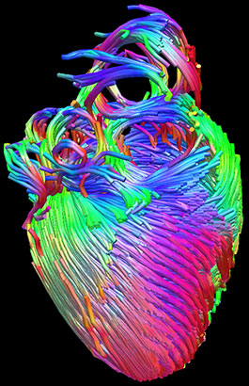
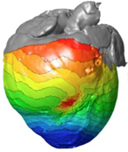
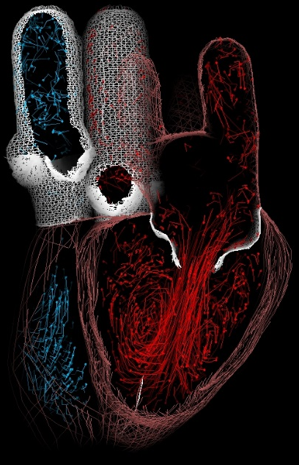
(a) Anatomy Model
(c) Electrophysiology Model
(d) Electro-mechanical Model
(b) Blood Flow Model

