Slide 1
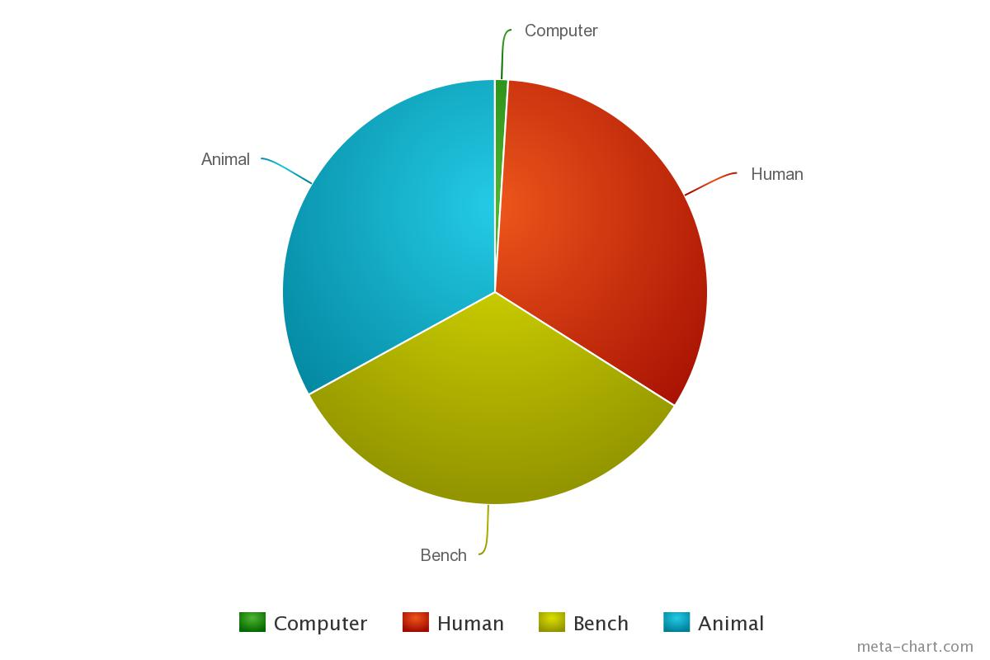
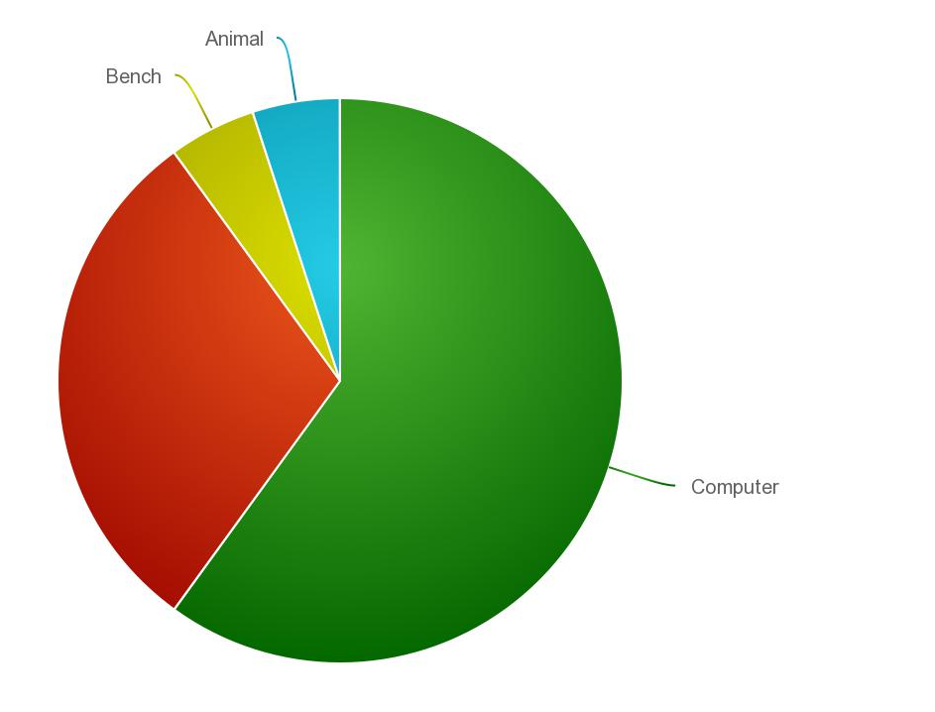
Computer
Animal
Bench
Animal
Human
Human
Computer
Bench
Now
Future

