Slide 1
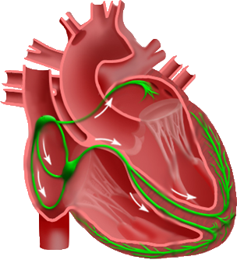
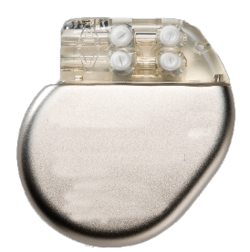
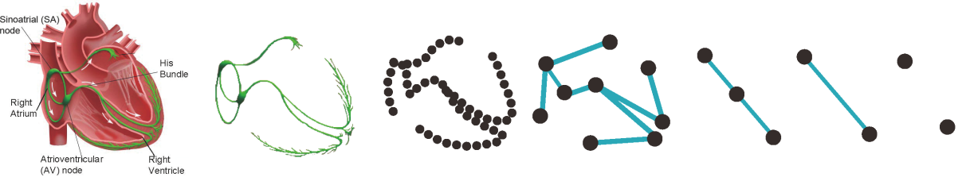
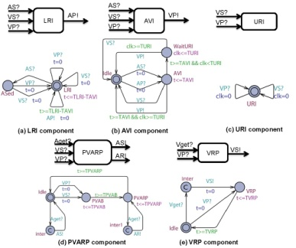
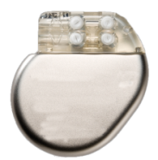


Abstraction
Refinement
Heart
Pacemaker
Heart
H₀
H₁
H₂
H₃
H₄
Non-deterministic
UPPAAL Model
Verification
No
Yes
UPP2SF
Model Translation
Model Checker
Valid?
Yes
Interpolation
Ambiguous?
Deterministic
Stateflow
Chart
Simulation
Pacemaker
Timed automata model
Counter-
examples
No
HDL Coder
Simulink Coder
Safe?
No
TCTL
FPGA
implementation
C Code
implementation
Yes
Implementation
Physiological
requirements
System Safe
Bug found
Physician
Notes:
On the pacemaker side, we developed a model based design tool chain for pacemaker. The closed-loop system including the pacemaker and the heart are first modeled in model checker UPPAAL and some safety properties are checked.
Using the tool UPP2SF, which is a matlab script developed by us, the UPPAAL model of the pacemaker can be rigorously translated into stateflow chart
Using the realtime workshop in simulink, the stateflow chart can be translated into C code and implemented on any embedded platform.
Using this automated tool chain, we can rule out discrepancies introduced by manual translations between layers. Together with our heart model implementation, we can ensure all properties satisfied at verification level still holds after implementation.

