Slide 1
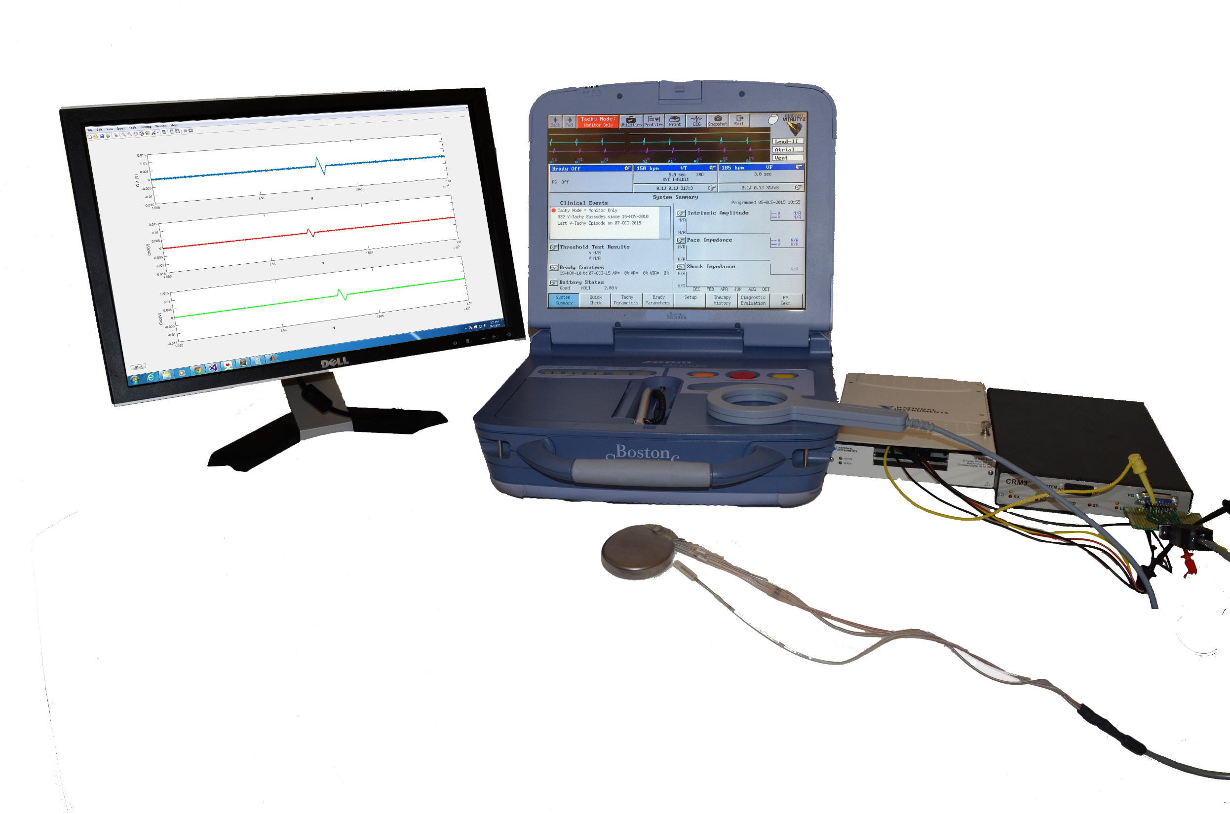
PRM
DAQ
PC USER
INTERFACE
ICD
POD

