Slide 1
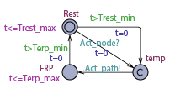
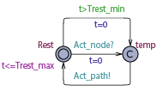
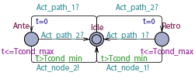
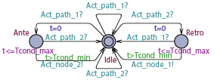












$$N_{1}^{1}$$
$$N_{2}^{1}$$
$$P_{1}^{1}$$
$$N_{1}^{3}$$
$$P_{2}^{1}$$
$$P_{1}^{2}$$
$$N_{1}^{2}$$
$$N_{2}^{2}$$
$$N_{1}^{}$$
$$N_{2}^{}$$
$$P_{1}^{}$$
$$P_{2}^{}$$

