Slide 1


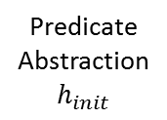


(a)
Initial
Abstraction
Abstraction Tree of Environment Models
Abstraction
Abstraction 2.1
Refinement
Spurious
Counter-example 1
Closed-loop
Model Checking
Refinement 1
$$h_{1}$$
Abstraction 1.2
Abstraction 1.1
Predicate
Abstraction
$$h_{init}$$
Device
Spurious
Counter-example 2
$$h_{2}$$
$$h_{1}$$
Refinement 2
Heart
Condition x
Heart
Condition 1
Heart
Condition 2
Heart
Condition 3
Bugs
Device
(b)
Concrete counter-examples with
Physiological context
Bugs
Physician

