Slide 1
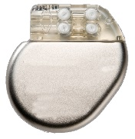


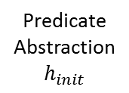


Initial
Abstraction
Abstraction Tree of Environment Models
Abstraction
Abstraction 2.1
Refinement
Spurious
Counter-example 1
$$h_{1}$$
Closed-loop
Model Checking
Refinement 1
Abstraction 1.1
1
Abstraction 1.2
Predicate
Abstraction
$$h_{init}$$
3
Spurious
Counter-example N
$$h_{2}$$
2
$$h_{1}$$
Refinement N
Heart
Condition 1
Heart
Condition 2
Heart
Condition 3
Heart
Condition x
Pacemaker
Bugs
(a)
Device
(b)
Concretized counter-examples with
Physiological context
Physician
Bugs

