Slide 1
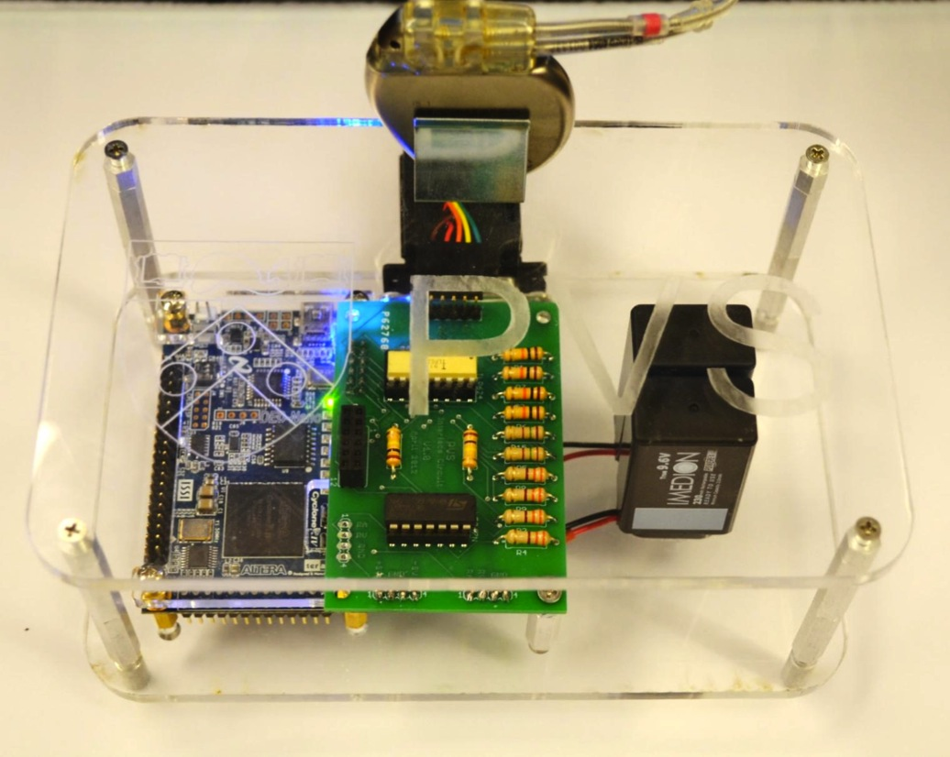
Pacemaker
Microcontroller

