Slide 1
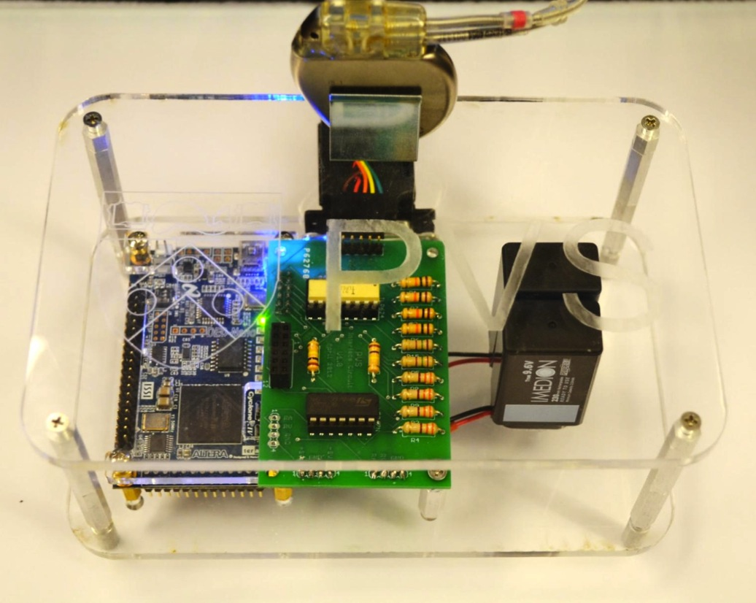
Pacemaker
Heart Model Implementation
Analog
Interface

