Slide 1
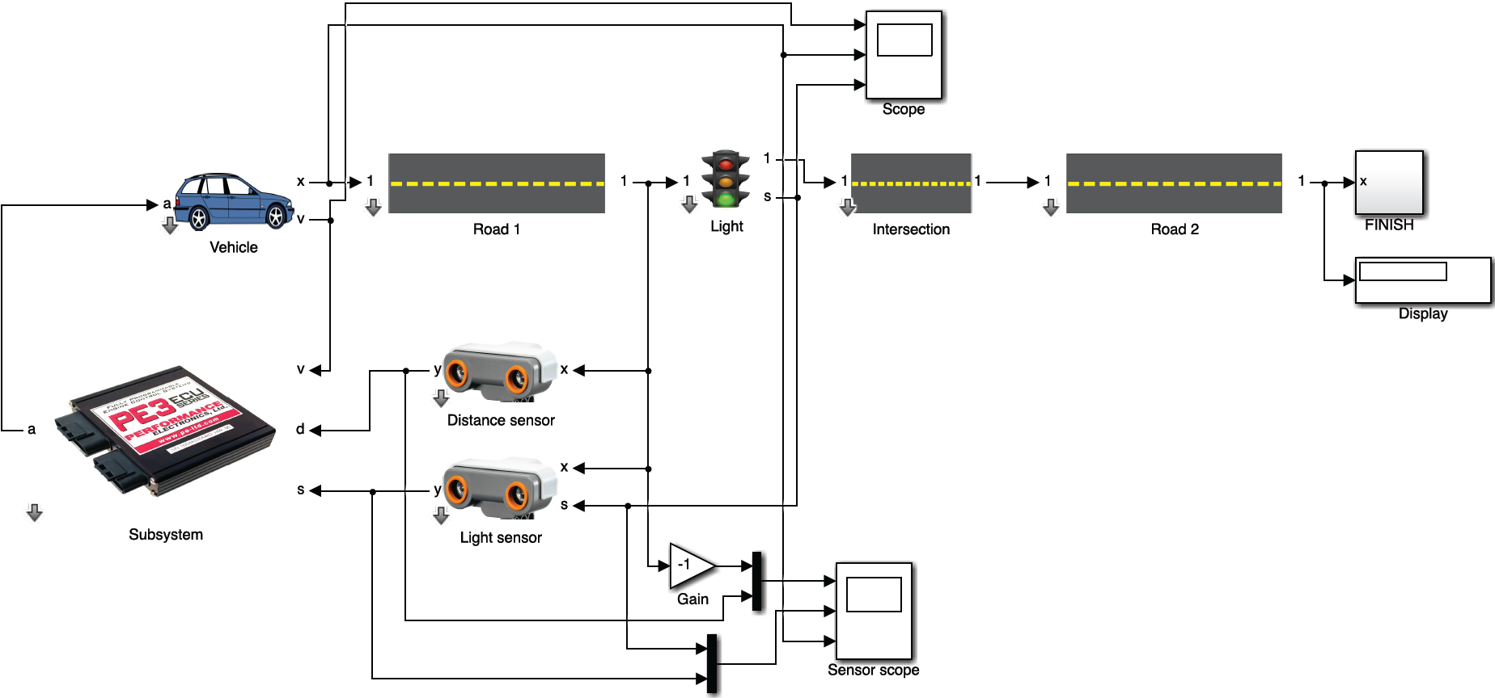
Notes:
use Simulink to model a driving scenario, run some simulations, then translate it into APEX IR, then from the APEX IR to the tool bus for formal verification.

