Slide 1

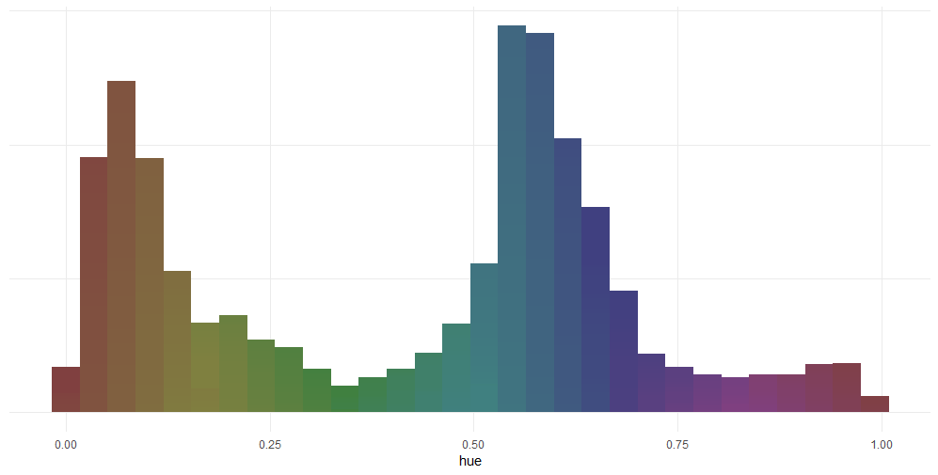
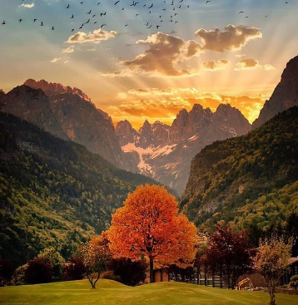
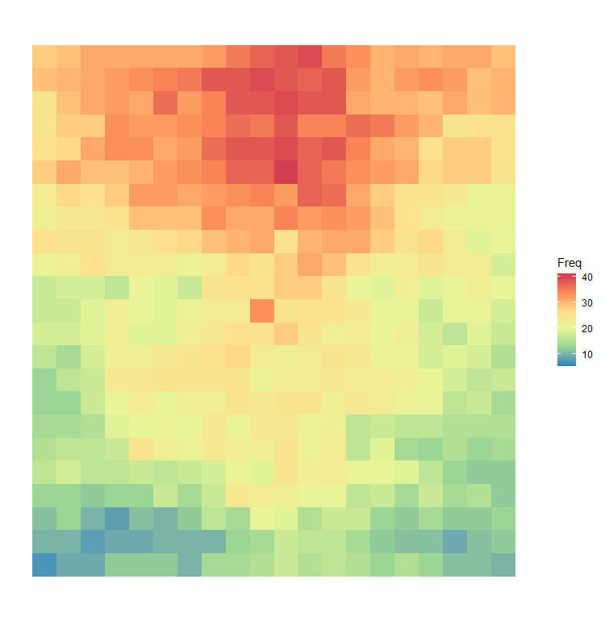
LANDSCAPE PHOTOGRAPHY
Aspect Ratio
most popular colours
5:4
Saturation
Lightness distribution
Bright tones
Dark tones

