Slide 1
Concurrent systems Case study: FreeBSD kernel concurrency
Dr Robert N. M. Watson
University of Cambridge
Notes:
Detailed concurrent system case study - FreeBSD kernel
Exercises many key concurrency principles: sources of concurrency, race conditions, primitives to manage it.
deadlocks, livelock, priority inversion, transactions…

Slide 2
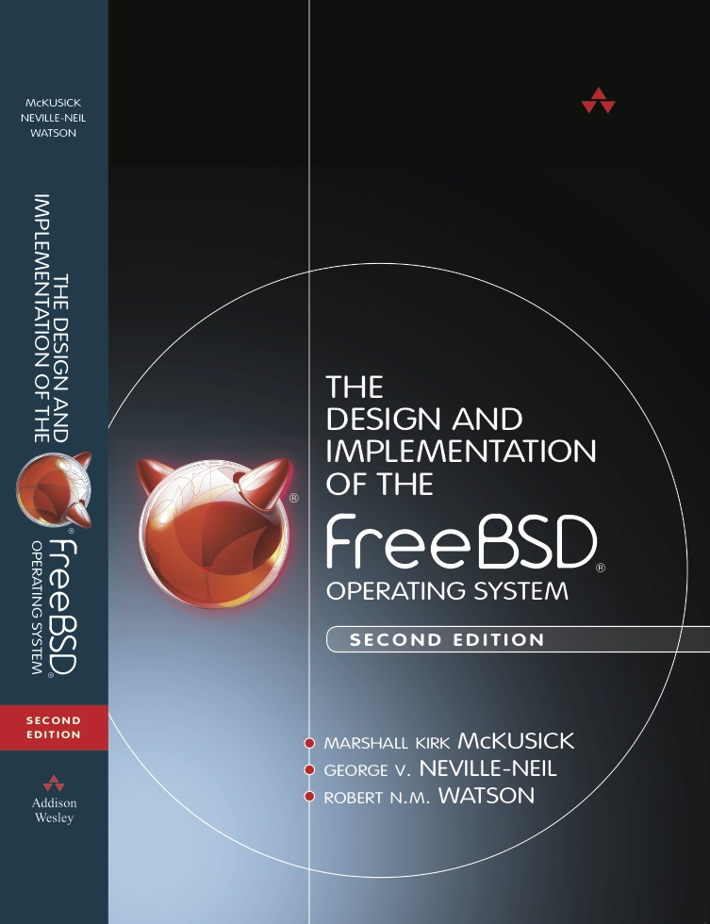
FreeBSD kernel
Open-source OS kernel
Large: millions of LoC
Complex: thousands of subsystems, drivers, ...
Very concurrent: dozens or hundreds of CPU cores/threads
Widely used: NetApp, EMC, Dell, Apple, Juniper, Netflix, Sony, Cisco, Yahoo!, … + in research
Why a case study?
Employs critical concurrency design principles
Concurrency performance and composability at scale
Marshall Kirk McKusick, George V. Neville-Neil, and Robert N. M. Watson. The Design and Implementation of the FreeBSD Operating System (2nd Edition), Pearson Education, 2014.
Notes:
Many components by many authors all interacting … raises concerns with composability.
Why doesn’t concurrency compose cleanly, unlike other properties – e.g., serial correctness based on API contracts?

Slide 3
BSD + FreeBSD: a brief history
1980s Berkeley Standard Distribution (BSD)
‘BSD’-style open-source license (MIT, ISC, CMU, …)
UNIX Fast File System (UFS/FFS), sockets API, DNS, used TCP/IP stack, FTP, sendmail, BIND, cron, vi, …
Open-source FreeBSD operating system
1993: FreeBSD 1.0 without support for multiprocessing
1998: FreeBSD 3.0 with giant-lock multiprocessing
2003: FreeBSD 5.0 with fine-grained locking
2005: FreeBSD 6.0 with mature fine-grained locking
2012: FreeBSD 9.0 with TCP scalability beyond 32 cores

Slide 4
FreeBSD: before multiprocessing (1)
Concurrency model inherited from UNIX
Userspace
Preemptive multitasking between processes
Later, preemptive multithreading within processes
Kernel
‘Just’ a C program running ‘bare metal’
Internally multithreaded
User threads ‘in kernel’ (e.g., in system calls)
Kernel services (e.g., async. work for VM, etc.)
Notes:
Userspace threading really hits the scene in the mid-1990s
Kernels and research systems using threading much earlier
User threads also enter the kernel for page faults, signal delivery

Slide 5
FreeBSD: before multiprocessing (2)
Cooperative multitasking within kernel
Except for interrupt handlers, non-preemptive kernel
Mutual exclusion as long as you don’t sleep()
Implied global lock means local locks rarely required
Wait channels: implied condition variable for every address
sleep(&x, …); // Wait for event on &x
wakeup(&x); // Signal an event on &x
Must leave global state consistent when calling sleep()
Must reload any cached local state after sleep() returns
Primitive to build more complex synchronization tools
E.g., lockmgr() reader-writer lock can be held over I/O (sleep)
Critical sections limit interrupt-handler execution
Notes:
Explain ‘&’ if needed
Lock released invisibly: sleep() … or call something that calls sleep()!
Simplicity of model means much less overhead: aren’t constantly locking!

Slide 6
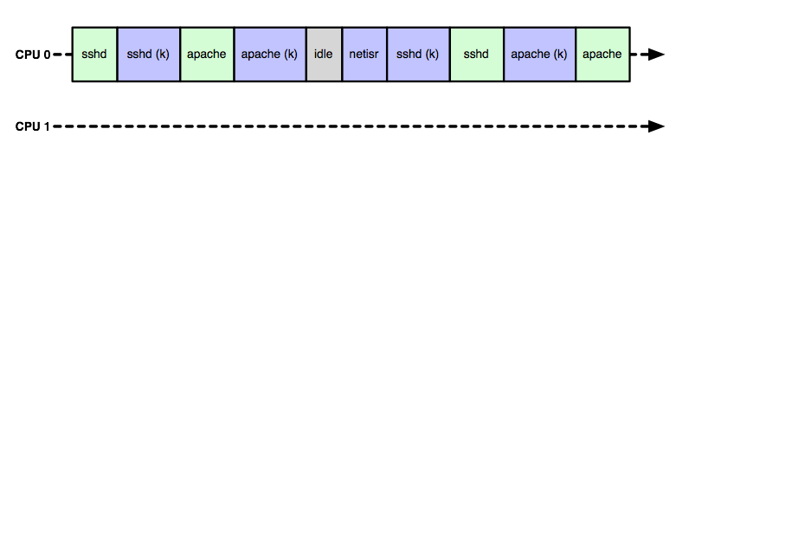
Pre-multiprocessor scheduling
Lots of unexploited parallelism!
Notes:
No kernel or user code on the second processor!

Slide 7
Hardware parallelism, synchronization
Late 1990s: multi-CPU begins to move down market
In 2000s: 2-processor a big deal
In 2010s: 64-core increasingly common
Coherent, symmetric, shared memory systems
Instructions for atomic memory access
Compare-and-swap, test-and-set, load linked/store conditional
Signaling via Inter-Processor Interrupts (IPIs)
CPUs can trigger an interrupt handler on each another
Vendor extensions for performance, programmability
MIPS inter-thread message passing
Intel TM support: TSX (Whoops: HSW136!)
Notes:
Low-end: i.e., not a super computer
Which instruction? Doesn’t really matter: we can build the higher-level primitives such as ‘atomic add’ with any.
My phone has fourcores; my notebook has more

Slide 8
Giant locking the kernel
FreeBSD follows footsteps of Cray, Sun, …
First, allow user programs to run in parallel
One instance of kernel code/data shared by all CPUs
Different user processes/threads on different CPUs
No affinity model: schedule work on first available CPU
Giant spinlock around kernel
Acquire on syscall/trap to kernel; drop on return
In effect: kernel ‘migrates’ between CPUs on demand
Interrupts
If interrupt delivered on CPU X while kernel is on CPU Y, forward interrupt to Y using an IPI
Notes:
Target is parallel application programs
Keep the same kernel concurrency model
Inter-processor interrupts (IPIs) forward interrupts to the right CPU via a trampoline

Slide 9
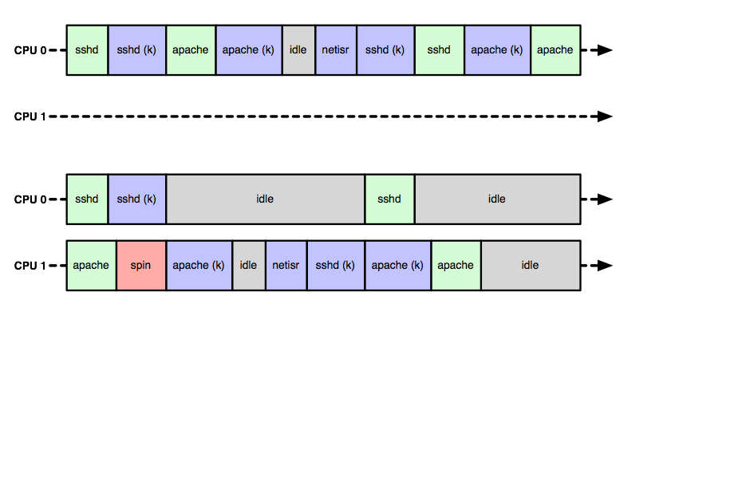
Giant-locked scheduling
User-user parallelism
Kernel-user parallelism
Kernel giant-lock contention
Serial kernel execution; parallelism opportunity missed

Slide 10
Fine-grained locking
Giant locking is fine for user-program parallelism
Kernel-centered workloads trigger Giant contention
Scheduler, IPC-intensive workloads
TCP/buffer cache on high-load web servers
Process-model contention with multithreading (VM, …)
Motivates migration to fine-grained locking
Greater granularity (may) afford greater parallelism
Mutexes/condition variables rather than semaphores
Why this approach?
Increasing consensus on pthreads-like synchronization
Unlike semaphores, access to priority inheritance
Notes:
Why might filesystems now experience more contention than before?
Low-latency I/O means kernel work becomes more dominant
Why do semaphores make priority inheritance hard?

Slide 11
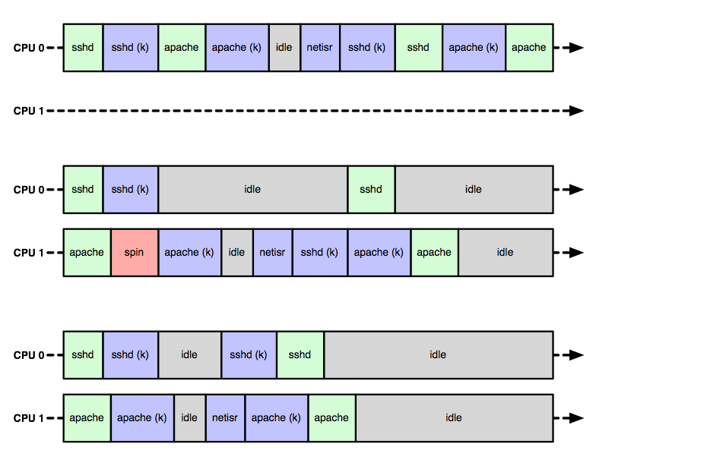
Fine-grained scheduling
True kernel parallelism

Slide 12
Kernel synchronization primitives
Spin locks – scheduler, interrupt synchronization
Mutexes, reader-writer, read-mostly locks
Most heavily used – different optimization tradeoffs
Sleep for only a bounded period of time – mutex holds
Shared-eXclusive (SX) locks, condition variables
May sleep for an unbounded period of time – e.g., I/O
Implied lock order: unbounded before bounded; why?
Condition variables usable with any lock type
Adaptive: sleeping is expensive, spin for a bit first
Most primitives support priority propagation
Notes:
Why? Mutex are only ever held for ‘short’ waits, whereas SX locks can be held over long waits – e.g., disk I/O. Holders of the former should not try to acquire the latter or they risk cascading ‘long’ waits.
How long should an adaptive mutex spin? As long as necessary … unless the other thread is itself sleeping

Slide 13
WITNESS lock-order checker
Kernel relies on partial lock order to prevent deadlock (recall dining philosophers)
WITNESS is a lock-order debugging tool
Warns when lock cycles (could) arise by tracking edges
Only in debugging kernels due to overhead (15%+)
Tracks both statically declared, dynamic lock orders
Static orders most commonly intra-module (why?)
Dynamic orders most commonly inter-module (why?)
In-field lock-related deadlocks are (very) rare
Unbounded sleep (e.g., I/O) deadlocks harder to debug
What thread should have woken up a CV being waited on?

Slide 14
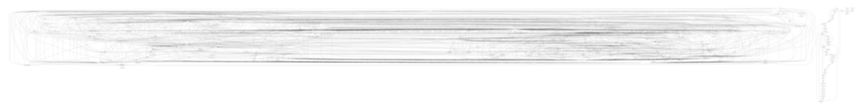
WITNESS: global lock-order graph*
* Turns out that the global lock-order graph is pretty complicated.

Slide 15

* Commentary on WITNESS full-system lock-order graph complexity; courtesy Scott Long, Netflix

Slide 16
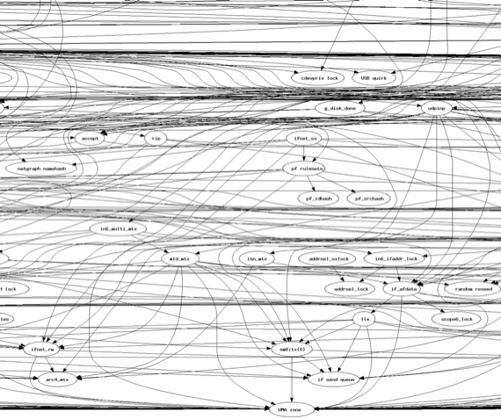
Excerpt from global lock-order graph*
This bit mostly has to do with networking
Local clusters: e.g., related locks from the firewall: two leaf nodes; one is held over calls to other subsystems
Network interface locks: “transmit” tends to occur at the bottom of call stacks via many layers holding locks
UMA zone lock implicitly or explicitly follows most other locks, since most kernel components depend on memory allocation
* The local lock-order graph is also complicated.

Slide 17
WITNESS debug output
1st 0xffffff80025207f0 run0_node_lock (run0_node_lock) @ /usr/src/sys/net80211/ieee80211_ioctl.c:1341
2nd 0xffffff80025142a8 run0 (network driver) @ /usr/src/sys/modules/usb/run/../../../dev/usb/wlan/if_run.c:3368
KDB: stack backtrace:
db_trace_self_wrapper() at db_trace_self_wrapper+0x2a
kdb_backtrace() at kdb_backtrace+0x37
_witness_debugger() at _witness_debugger+0x2c
witness_checkorder() at witness_checkorder+0x853
_mtx_lock_flags() at _mtx_lock_flags+0x85
run_raw_xmit() at run_raw_xmit+0x58
ieee80211_send_mgmt() at ieee80211_send_mgmt+0x4d5
domlme() at domlme+0x95
setmlme_common() at setmlme_common+0x2f0
ieee80211_ioctl_setmlme() at ieee80211_ioctl_setmlme+0x7e
ieee80211_ioctl_set80211() at ieee80211_ioctl_set80211+0x46f
in_control() at in_control+0xad
ifioctl() at ifioctl+0xece
kern_ioctl() at kern_ioctl+0xcd
sys_ioctl() at sys_ioctl+0xf0
amd64_syscall() at amd64_syscall+0x380
Xfast_syscall() at Xfast_syscall+0xf7
--- syscall (54, FreeBSD ELF64, sys_ioctl), rip = 0x800de7aec, rsp = 0x7fffffffd848, rbp = 0x2a ---
Lock names and source code locations of acquisitions adding the offending graph edge
Stack trace to acquisition that triggered cycle
Notes:
What is a graph edge?
Lock A is held
Lock B is acquired
Cycles in the graph can be direct or implied – e.g., implied by a larger cycle
Can inspect the full graph using the kernel debugger

Slide 18
How does this work in practice?
Kernel is heavily multi-threaded
Each user thread has a corresponding kernel thread
Represents user thread when in syscall, page fault, etc.
Kernels services often execute asynchrously in threads
Interrupts, timers, I/O, networking, etc.
Therefore extensive synchronization
Locking model is almost always data-oriented
Think ‘monitors’ rather than ‘critical sections’
Reference counting or reader-writer locks used for stability
Higher-level patterns (producer-consumer, active objects, etc.) used frequently

Slide 19
Kernel threads in action
Vast hoards of threads represent concurrent kernel activities
robert@lemongrass-freebsd64:~> procstat –at
PID TID COMM TDNAME CPU PRI STATE WCHAN
0 100000 kernel swapper 1 84 sleep sched
0 100009 kernel firmware taskq 0 108 sleep -
0 100014 kernel kqueue taskq 0 108 sleep -
0 100016 kernel thread taskq 0 108 sleep -
0 100020 kernel acpi_task_0 1 108 sleep -
0 100021 kernel acpi_task_1 1 108 sleep -
0 100022 kernel acpi_task_2 1 108 sleep -
0 100023 kernel ffs_trim taskq 1 108 sleep -
0 100033 kernel em0 taskq 1 8 sleep -
1 100002 init - 0 152 sleep wait
2 100027 mpt_recovery0 - 0 84 sleep idle
3 100039 fdc0 - 1 84 sleep -
4 100040 ctl_thrd - 0 84 sleep ctl_work
5 100041 sctp_iterator - 0 84 sleep waiting_
6 100042 xpt_thrd - 0 84 sleep ccb_scan
7 100043 pagedaemon - 1 84 sleep psleep
8 100044 vmdaemon - 1 84 sleep psleep
9 100045 pagezero - 1 255 sleep pgzero
10 100001 audit - 0 84 sleep audit_wo
11 100003 idle idle: cpu0 0 255 run -
11 100004 idle idle: cpu1 1 255 run -
12 100005 intr swi4: clock 1 40 wait -
12 100006 intr swi4: clock 0 40 wait -
12 100007 intr swi3: vm 0 36 wait -
12 100008 intr swi1: netisr 0 1 28 wait -
12 100015 intr swi5: + 0 44 wait -
12 100017 intr swi6: Giant task 0 48 wait -
12 100018 intr swi6: task queue 0 48 wait -
12 100019 intr swi2: cambio 1 32 wait -
12 100024 intr irq14: ata0 0 12 wait -
12 100025 intr irq15: ata1 1 12 wait -
12 100026 intr irq17: mpt0 1 12 wait -
12 100028 intr irq18: uhci0 0 12 wait -
12 100034 intr irq16: pcm0 0 4 wait -
12 100035 intr irq1: atkbd0 1 16 wait -
12 100036 intr irq12: psm0 0 16 wait -
12 100037 intr irq7: ppc0 0 16 wait -
12 100038 intr swi0: uart uart 0 24 wait -
13 100010 geom g_event 0 92 sleep -
13 100011 geom g_up 1 92 sleep -
13 100012 geom g_down 1 92 sleep -
14 100013 yarrow - 1 84 sleep -
15 100029 usb usbus0 0 32 sleep -
15 100030 usb usbus0 0 28 sleep -
15 100031 usb usbus0 0 32 sleep USBWAIT
15 100032 usb usbus0 0 32 sleep -
16 100046 bufdaemon - 0 84 sleep psleep
17 100047 syncer - 1 116 sleep syncer
18 100048 vnlru - 1 84 sleep vlruwt
19 100049 softdepflush - 1 84 sleep sdflush
104 100055 adjkerntz - 1 152 sleep pause
615 100056 dhclient - 0 139 sleep select
667 100075 dhclient - 1 120 sleep select
685 100068 devd - 1 120 sleep wait
798 100065 syslogd - 0 120 sleep select
895 100076 sshd - 0 120 sleep select
934 100052 login - 1 120 sleep wait
935 100070 getty - 0 152 sleep ttyin
936 100060 getty - 0 152 sleep ttyin
937 100064 getty - 0 152 sleep ttyin
938 100077 getty - 1 152 sleep ttyin
939 100067 getty - 1 152 sleep ttyin
940 100072 getty - 1 152 sleep ttyin
941 100073 getty - 0 152 sleep ttyin
9074 100138 csh - 0 120 sleep ttyin
3023 100207 ssh-agent - 1 120 sleep select
3556 100231 sh - 0 123 sleep piperd
3558 100216 sh - 1 124 sleep wait
3559 100145 sh - 0 122 sleep vmo_de
3560 100058 sh - 0 123 sleep piperd
3588 100176 sshd - 0 122 sleep select
3590 101853 sshd - 1 122 run -
3591 100069 tcsh - 0 152 sleep pause
3596 100172 procstat - 0 172 run -
Idle CPUs are occupied by an idle thread … why?
PID TID COMM TDNAME CPU PRI STATE WCHAN
11 100003 idle idle: cpu0 0 255 run -
12 100024 intr irq14: ata0 0 12 wait -
12 100025 intr irq15: ata1 1 12 wait -
12 100008 intr swi1: netisr 0 1 28 wait -
3588 100176 sshd - 0 122 sleep select
Device-driver interrupts execute in kernel interrupt threads (ithreads) within kernel-only ‘intr’ process
Asynchronous packet processing occurs in a netisr ‘soft’ ithread
Familiar userspace thread: sshd, blocked in network I/O (‘in kernel’)
Kernel-internal concurrency is represented using a familiar shared memory threading model

Slide 20
Case study: the network stack (1)
What is a network stack?
Kernel-resident library of networking routines
Sockets, TCP/IP, UDP/IP, Ethernet, …
Implements user abstractions, network-interface abstraction, sockets, protocol state machines, etc.
System calls: socket(), connect(), send(), recv(), listen(), …
Highly complex and concurrent subsystem
Composed from many (pluggable) elements
Socket layer, network device drivers, protocols, …
Paths: ‘up’ and ‘down’ – packets come in, go out
Notes:
Sometimes packets go in *and* out.

Slide 21
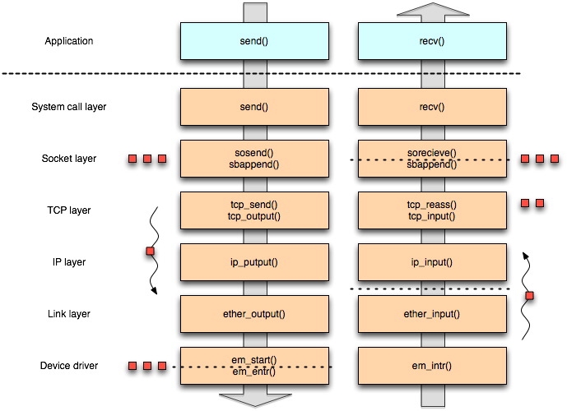
Network-stack work flows
Applications send, receive, await data on sockets
Data/packets processed; enqueued at various dispatch or buffering points
Packets go in and out of network interfaces
The work: adding/removing headers, calculating checksums, fragmentation/defragmentation, segment reassembly, ensuring order, flow control, congestion, etc.
Notes:
Multiprocessing doesn’t really change the work done, just when and where it is done
Summary: packets go in, packets go out
Dotted lines: historic dispatch points
Software router path: ip_input() calls ip_output()
XXX: Next year, explicitly point out that the handoffs are producer-consumer relationships

Slide 22
Case study: the network stack (2)
First, make it safe without the Giant lock
Lots of data structures require locks
Condition signaling already exists but added to
Establish key work flows, lock orders
Then, optimize
Especially locking primitives themselves
As hardware becomes more parallel, identify and exploit further concurrency opportunities
Add more threads, distribute more work
Notes:
The most parallelism a threaded system can ever implement is the number of defined threads
Simply having threads doesn’t help: you must deliver work to threads

Slide 23
What to lock and how?
Lock overhead vs. lock contention
Fine-grained locking: avoid contention at greater overhead
Coarse-grained locking: less overhead, at risk of contention
Some contention is inevitable: reflects need for communication
Other contention is false sharing: side effect of memory layout
Principle: lock data, not code (i.e., not critical sections)
Key structures: network interfaces, sockets, work queues
Independent instances should be parallelizable
Horizontal parallelism vs. vertical parallelism
H: Different locks for different connections (e.g., TCP1 vs. TCP2)
H: Different locks within a layer (e.g., receive vs. send buffers)
V: Different locks at different layers (e.g., socket vs. TCP state)
Things not to lock: packets in flight - mbufs (‘work’)
Notes:
Goal: don’t change core functionality, just representation
Check: do students know what ‘false sharing’ is?

Slide 24
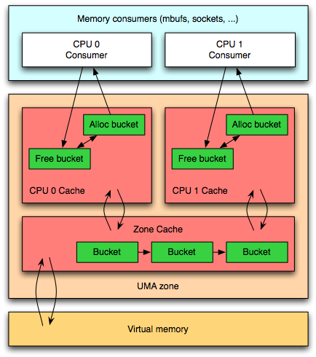
Example: Kernel Memory Allocation
Universal Memory Allocator (UMA)
Slab allocator
(Bonwick 1994)
Object-oriented model
init/destroy, alloc/free
Per-CPU caches
Accessed in critical sections
Encourage cache locality by allocating memory where last freed
Avoid contention on global UMA zone lock
Notes:
Historically, critical sections were cheaper than locks, so used for per-CPU variables.
Nowadays, mutexes are quite cheap -- so a design choice that might change.

Slide 25
Work distribution
Packets (mbufs) are units of work
Parallel work requires distribution to threads
Must keep packets ordered – or TCP gets cranky!
Implication: strong per-flow serialization
I.e., no generalized producer-consumer/round robin
Various strategies to keep work ordered; e.g.:
Process in a single thread
Multiple threads in a ‘pipeline’ linked by a queue
Establish flow-CPU affinity can both order processing and utilize caches well
Notes:
Why does TCP get cranky?
Same structure as Linux, only ‘skbufs’

Slide 26
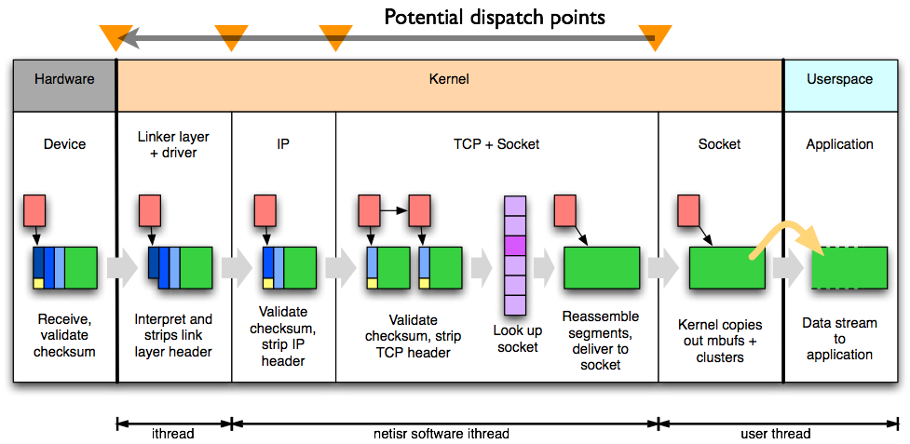
TCP input path
Notes:
A recent change:
Directly dispatch “stack” from ithread, rather than netisr
Why? hardware work distribution.

Slide 27
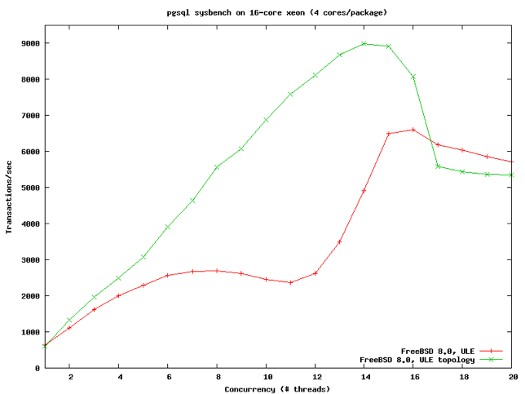
Scalability
Key idea:
speedup
As we add more parallelism, we would like the system to get faster.
Another key idea:
performance collapse
Sometimes parallelism hurts performance more than it helps due to work-distribution overheads, contention.
What might we expect if we didn’t hit contention?
?
Notes:
Idea: contention is expensive; if one CPU holds a lock and two more spin waiting for it, we get (at best) 1/3 efficiency
Other fundamental bottlenecks exist -- e.g., memory bandwidth which remains (perhaps) constant as CPUs grow

Slide 28
Changing hardware impacts software
Changes in measurement and optimization:
Counting instructions ➞ cache misses
Lock contention ➞ cache-line contention
Locking ➞ find parallelism opportunities
Work ordering, classification, distribution
NIC offload of even more protocol layers
Vertically integrate distribution/affinity
DMA/cache interactions
But: core principles for concurrency control (synchronization) remain the same

Slide 29
Longer-term strategies
Optimize for inevitable contention
Lockless primitives
E.g., statistics, queues
Tune primitives for workloads
E.g., rmlocks, read-copy-update (RCU)
Replicate data structures; with weak consistency?
E.g., per-CPU statistics, per-CPU memory caches
Distribution/affinity to minimize contention
From parallelism to NUMA + I/O affinity
Notes:
Why is contention inevitable?
Because communication is inevitable.

Slide 30
Conclusions
FreeBSD employs many of concurrency principles
Mutual exclusion, condition synchronization
Producer-consumer
Lockless primitives
Real-world systems are really complicated
Hopefully, you will mostly consume, rather than produce, concurrency primitives like these
Composition is not straightforward
Debugging requires specialized approaches and tools
Parallelism performance wins are a lot of work
Hardware continues to evolve

