Slide 1
Introduction to Operating Systems
THrough tracing, analysis and experimentation
gnn@freebsd.org

Slide 2
Objectives
A grounding in systems principles
A grand tour of the Operating System
Practical insights into how the OS works

Slide 3
Course Outline
Day 1
Day 2
High Level Definitions
History
Introduction to Tracing
Lab 1: System Setup and First Traces
Quiz
Processes
Locking
Scheduling
Virtual Memory
Lab 2: Tracking Processes

Slide 4
Course Outline
Day 3: Communication
Day 4: storing data
I/O
Inter Process Communication
Sockets and Network Communication
Lab 3: TCP Connection Setup
Storage Overview
Naming and Location
Virtual Filesystem Layer
Storing and Retrieving Data
Lab 4: Reading a file from disk

Slide 5
Course Outline
day 5: Whole system view
Serving Web Content
NGINX
Review
Final Exam

Slide 6
Lab Work
Tracing Systems Setup, Begin using DTrace
Processes Tracing the Process Life Cycle
Communication Networking and TCP
Storage Storing and Retrieving Data

Slide 7
What do computers do?
Processing Converting information from one form to another.
Communication Moving information between one or more systems.
Storage Maintaining information over time.

Slide 8
What is an Operating System?

Slide 9
What is an Operating System?
[An OS is] the low-level software that supports a computer’s basic functions, such as scheduling tasks and controlling peripherals. - Google hive mind

Slide 10
General purpose operating systems
... are for general-purpose computers
• Servers, workstations, mobile devices
• Run ‘applications’ – i.e., software unknown at design time
• Abstract the hardware, provide ‘class libraries’
• E.g., Windows, Mac OS X, Android, iOS, Linux, FreeBSD,
...

Slide 11
General-purpose operating systems
User space
Kernel
Local and remote shells
management tools
daemons
Run-time linker
system libraries
tracing facilities
System calls
hypercalls
remote procedure call (RPC)
Processes
filesystems
IPC
sockets
System Call Interface

Slide 12
What does an operating system do?
Key hardware-software surface (cf. compilers)
System management: bootstrap, shutdown, watchdogs
Low-level abstractions and services
Programming: processes, threads, IPC, program model
Resource sharing: scheduling, multiplexing, virtualisation
I/O: device drivers, local/distributed filesystems, network stack
Security: authentication, encryption, permissions, labels, audit
Local or remote access: console, window system, SSH
Libraries: math, protocols, RPC, cryptography, UI, multimedia
Other stuff: system log, debugging, profiling, tracing

Slide 13
Key Functions of an Operating System
Provides the Programming Model
Protects Programs from each other
Controls access to hardware
Ensures fair sharing of resources
Does all these things efficiently

Slide 14
What an Operating System is
A single large program
Written in the C language
Built with make
More than 20, 000 files
12, 000, 000 lines of code

Slide 15
Why study operating systems?
Key interface between hardware and software
Strong influence on whole-system performance
Critical foundation for computer security
Exciting programming techniques, algorithms, problems
Virtual memory; network stacks; filesystems; runtime linkers; ...
Co-evolves with platforms, applications, users
Multiple active research communities
Reusable techniques for building complex systems
Boatloads of fun (best text adventure ever)

Slide 16
FreeBSD
Open Source
Unix
Posix
Complete System
20 years of history
Used in real systems around the world

Slide 17
Computer History from the Operating System Perspective
The Hardware Environment
Defines what is possible.
Requirements
What are we asking the system to do?
Services
What can the OS provide.

Slide 18
In the beginning: early computers
Wired programs
Highly specialized to only one problem
Armies of programmers tend a single machine

Slide 19
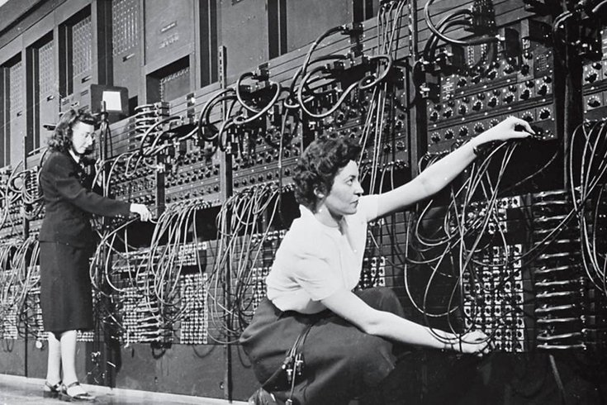
The First Programmers

Slide 20
Early Computers
Processing measured in hundres of Hz
Tiny memories
Limited to no input/output devices
Not much for an Operating System to do or provide

Slide 21
Mainframes and Batch Processing
Standardized input/output with cards
One program at a time (batch processing) • No interactive programming
Early disks and printers
What is a byte?
The rise of computer languages.
Earliest operating systems (monitors)

Slide 22
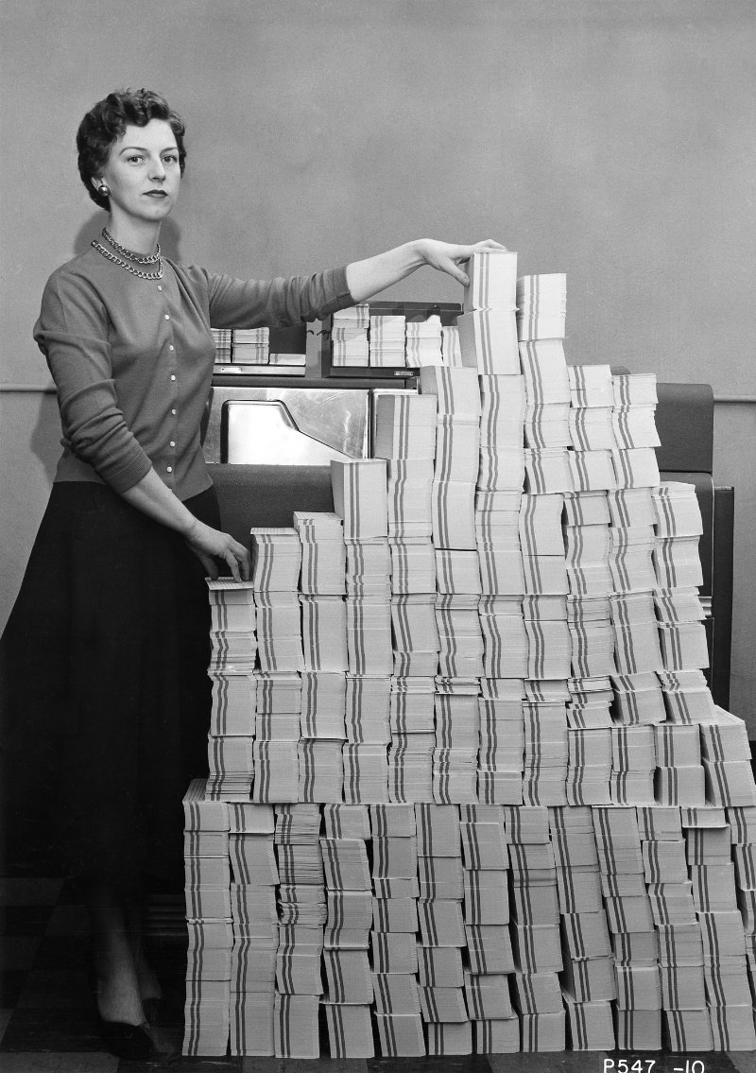
5Mb of Source Code

Slide 23
Mini-computers and Time Sharing Systems
Shrinking hardware and affordable computing resources
CTSS
MULTICS
C, the portable assembler
UNIX
(D)ARPANet

Slide 24
The Unix Kernel
Everything Else
System Calls
Kernel

Slide 25
The Rise of the Microcomputer
LSI shrinks hardware onto the first chip based processors • Moore’s Law
Less powerful than mini-computers
8-bitting
Single user
No networking
Operating System is a monitor and convience routines

Slide 26
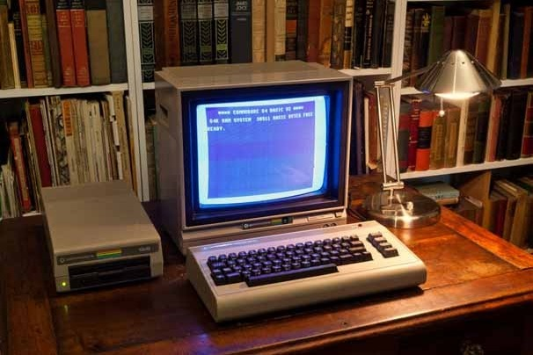
A typical microcomputer 1982

Slide 27
Workstations and Networking
VLSI provides faster and more powerful CPUs
Graphical Displays (X10 and X11)
Ethernet
TCP/IP
UNIX is the de-facto standard, sort of

Slide 28
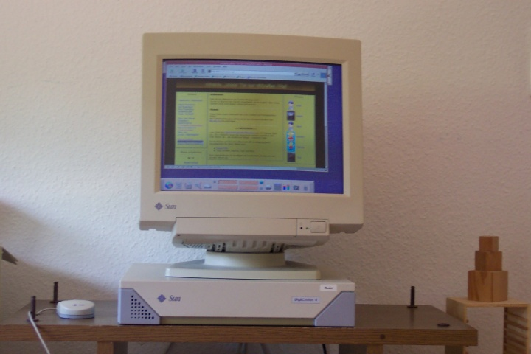
Workstation from the 1990s

Slide 29
Embedded and Real Time Systems
Applied kernel programming
Tasks have deadlines
Failure is not an option
Often forgo more expensive UNIX like features

Slide 30
Mobile Devices and the Ubiquitous Internet
Sensors
Always connected
A return to single user, but with a multi-user OS
Programming for power rather than speed

Slide 31
Today
Multi-user Unix like systems everywhere
Continued use of C for OS development
Heterogeneous environments

Slide 32
Our Challenge
How does data move in a real world system?
Serving Data from Storage to Clients
Program Web Server
Stored Data Filesystem
Communication Network Stack

Slide 33
UNIX Philosophies
Everything is a byte stream
Do a small number of things well
Build complex systems out of simple building blocks
Swiss Army Knife vs. Toolbox

Slide 34
Some Special Considerations
An OS kernel is one, large program.
More than 50, 000 functions.
5677 files
5, 131, 552 lines of C code just for the kernel
A unique programming environment

Slide 35
Design and Implementation Requirements
Fast Low overhead, high performaance
Safe Secure, tractable
Flexible Can be used by many applications

Slide 36
User vs. Kernel Space
User space
Kernel
Local and remote shells
management tools
daemons
Run-time linker
system libraries
tracing facilities
System calls
hypercalls
remote procedure call (RPC)
Processes
filesystems
IPC
sockets
System Call Interface

Slide 37
System Calls: The Operating System’s API
Border between User and Kernel Space
Everything that can be done with the OS
open(), read(), write(), close()
Over 1000 separate interfaces
Section 2 of the manual set
> man 2 open

Slide 38
OS Programming
C is the programming language
Simple data structures
Lists
Hash Tables
Hand crafted classes and objects
Programming without a net

Slide 39
Competing Kernel Architectures
Micro-Kernel
Monolithic
Kernel is Only a Scheduler
Services Model
in-kernel IPC
POSIX as a service
Mach, Barrelfish, L4
One big program
Function Calls
System Call API
FreeBSD, Linux, Windows

Slide 40
Review: What an Operating System Does

Slide 41
A Brief History of Debugging Methods
Blinking lights
Radio Frequency Interference (AM Radio)
print statements
Trace Instructions

Slide 42
What is DTrace?
A dynamic tracing framework for software
Low impact on overall system performance
Does not incur costs when not in use

Slide 43
What can DTrace show me?
When a function is being called
A function’s arguments
The frequency of function calls
A whole lot more...

Slide 44
A Simple Example
1 dtrace −n syscall :::
2 dtrace : description ’ syscall : : : ’ matched 2148 probes
3 CPU
4 1
5 1
6 1
7 1
8 1
9 1
10 1
11 1
ID 51079 51078 51079 51078 51079 51632 51633 51784
FUNCTION : NAME ioctl :return ioctl : entry ioctl :return ioctl : entry ioctl :return sigprocmask : entry sigprocmask : return sigaction : entry
• Look at all system calls

Slide 45
How does DTrace Work?
Various probes are added to the system
The probes are activated using the dtrace program
A small number of assembly instructions are modified at run-time to get the system to run in the probe

Slide 46
A more complex example
dtrace −n ’syscall::write:entry /arg2 != 0/ { printf("write size % d\n", arg2); } ’ dtrace: description ’syscall::write:entry ’ matched 2 probes
CPU 50978
write : entry write : entry write : entry
write write write
size 1 size 55 size 2

Slide 47
DTrace Glossary
Probe - A way of specifying what to trace
Provider - DTrace defined module that provides information about something in the system
Module - A software module, such as kernel
Function - A function in a module, such as ether_input
Predicate - A way of filtering DTrace probes
Action – The set of D language statements carried out when a probe is matched

Slide 48
Providers
fbt Function Boundary Tracing (50413)
syscall System Calls (2148)
profile Timing source
proc Process Operations
sched Scheduler
io I/O calls
ip Internet Protocol
udp UDP
tcp TCP
vfs Filesystem Routines

Slide 49
Disecting a Probe
syscall::write:entry
Provider syscall
Module None
Function write
Name entry
fbt:kernel:ether_input:entry
Provider fbt
Module kernel
Function ether_input
Name entry

Slide 50
DTrace Requirements
A kernel with DTrace support built in
Default on FreeBSD 10 or later
The ability to sudo or be root
The complete command syntax is covered in the dtrace manual page

Slide 51
Finding Probes
Listing all the probes gets you 50000 to choose from
Judicious use of providers, modules and grep
e.g. dtrace -l -P syscall

Slide 52
Probe Arguments
• Use verbose (-v) mode to find probe arguments
• sudo dtrace -lv -f syscall:freebsd:read
ID PROVIDER
57177 syscall
Argument Types
args[0]: int
args[1]: void *
args[2]: size_t
MODULE
freebsd

Slide 53
The D Language
A powerful subset of C
Includes features specific to DTrace, such as aggregations
Anything beyond some simple debugging usually required a D script

Slide 54
DTrace One-Liners
• A set of useful single line scripts
# Trace f i l e opens with process and filename :
dtrace −n ’syscall ::open∗:entry { printf("%s %s", execname, copyinstr(arg0)); } ’ # Count system calls by program name:
dtrace−n ’syscall:::entry {@[execname] = count(); }’
# Count system calls by syscall :
dtrace −n ’syscall ::: entry { @[probefunc] = count(); } ’

Slide 55
Count System Calls
dtrace −n ’syscall ::: entry { @[probefunc] = count(); } ’
dtrace : description ^C
fstat setitimer getpid read sigreturn write getsockopt select sigaction _umtx_op __sysctl
munmap
mmap sigprocmask
clock_gettime ioctl
’ syscall : : : entry
’
matched
1072
probes
1 1 2 2 2 3 4 6 6 7 8
18 19 23 42 45

Slide 56
Aggregations
syscall:::entry { @[probefunc] = count(); }
The @[probefunc] syntax
Aggregates data during a run for later output
Extremely powerful feature of D language

Slide 57
Quantization
# Summarize requested write() sizes by program name, as power−of−2 distributions (bytes): dtrace−n ’syscall::write:entry {@[execname] = quantize(arg2); }’
dtrace: description ’syscall::write:entry ’ matched 2 probes
^C
1
2
3
4
5
6 71|0 82|1 94| 17
10 11 12 13 14
8 |@@ 841 16 |@@@@@@@@@@@@@ 6940 32 |@@@@@@@@@@@@@@@@@@@@@@@@@ 13666 64 | 59
128 | 0

Slide 58
Probing the stack
Find out how we got where we are
The stack() routine

Slide 59
Who called malloc()?
29371 malloc : entry
kernel ‘ cloneuio+0x2c
kernel ‘ vn_io_fault1+0x3b
kernel ‘ vn_io_fault+0x18b
kernel ‘ dofileread+0x95
kernel ‘ kern_readv+0x68
kernel ‘ sys_read+0x63
kernel ‘ amd64_syscall+0x351
kernel ‘0 xffffffff80d0aa6b
• Read upwards from the bottom

Slide 60
DTrace Toolkit
An open source set of tools written to use D scripts
Originally specific to Solaris
Now a part of OpenDTrace
Exists as a FreeBSD port and package
Currently being updated with new scripts

Slide 61
An example script: hotkernel
1 ./ hotkernel
2 Sampling... Hit Ctrl−C to end.
3 ^C
4 FUNCTION
5 kernel ‘ lookup
6 kernel ‘ unlock_mtx
7 kernel ‘ _vm_page_deactivate
8 ...
9 kernel ‘ amd64_syscall
10 k e r n e l ‘ pmap_remove_pages
11 kernel ‘ hpet_get_timecount
12 kernel ‘ pagezero
13 kernel ‘0 xffffffff80
14 kernel ‘ spinlock_exit
15 kernel ‘ acpi_cpu_c1
COUNT PCNT 1 0.1% 1 0.1% 1 0.1%
9 0.5%
9 0.5% 13 0.7% 15 0.8% 34 1.9%
486 27.0% 965 53.6%

Slide 62
Predicates
Filtering probes based on relevant data
Useful for excluding common conditions
/arg0 != 0/ Ignore a normal return value

Slide 63
Tracing a Specific Process
pid is used to track a Process ID
Used in predicates
/pid == 1234/

Slide 64
Running a Program Under DTrace
DTrace is most often used on running systems
DTrace can be attached at runtime to a program
dtrace -p pid ...
Run a program completely under the control of DTrace
dtrace -c cmd ...

Slide 65
Going too far
Overly broad probes slow down the system
Watching everything in the kernel
Registering a probe on a module

Slide 66
The Probe Effect
Each probe point has a cost
Every action has a reaction
Any action code requires time to run
Impacts system performance

Slide 67
Into the Laboratory
Time to begin Lab 1

